Slide 1
The Lex Scanner Generator
NTHU SSLAB

Slide 2
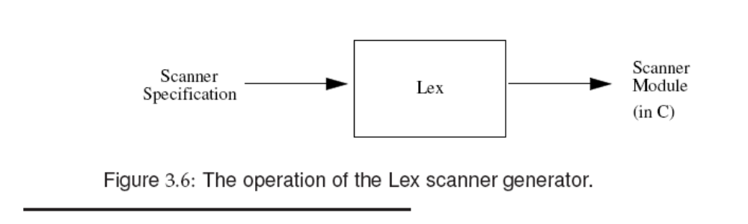
Lex
A scanner generator.
Flex: fast lexical analyzer generator = faster lex

Slide 3
Lex Operation
Lex source lex.l
Lex
Lex.yy.c
Lex.yy.c
C/C++ compiler
a.out
Input stream
a.out
tokens

Slide 4
Using Lex

Slide 5
The Structure of a Lex Program
(Declarations)
%%
(Regular expression rules)
%%
(Subroutines definitions)

Slide 6
Declarations
Lex copies the material between “%{“ and “%}” directly to the generated C file, so you may write any valid C codes here
E.g.
%{
#define A 100
%}
WS [ \t]+
letter [A-Za-z]
digit [0-9]
op_plus "+"
(Declarations)
%%
(Regular expression rules)
%%
(Subroutines definitions)

Slide 7
Regular expression rules
Each rule is made up of two parts
  A pattern (regular expression)
  An action
E.g.
[\t ]+ /* ignore white space */ ;
{op_plus} return OP_PLUS;
(Declarations)
%%
(Regular expression rules)
%%
(Subroutines definitions)

Slide 8
Regular expression rules(Cont’d)
E.g.
[a-zA-Z]+ { printf("%s: is alpha\n", yytext); }
.|\n { ECHO; /* normal default anyway */ }
Lex had a set of simple disambiguating rules:
  Lex patterns only match a given input character or string once
  Lex executes the action for the longest possible match for the current input

Slide 9
Subroutines definitions
It can consists of any legal C code
Lex copies it to the C file after the end of the Lex generated code
%%
main()
{
yylex();
}
(Declarations)
%%
(Regular expression rules)
%%
(Subroutines definitions)

Slide 10
Special Variables/Procedures
yytext where token text is stores
yyleng length of the token text
yylineno the current line number
yylex() name of procedure for the lex generated scanner
yywrap A user supplied function. It returns 1 when no more input to process, otherwise, return 0
yyin, yyout input and output files
  (yyin初始預設為stdin)

Slide 11
Example
%{
#define A 100
%}
WS [ \t]+
letter [A-Za-z]
digit [0-9]
op_plus "+"
%%
[\t ]+ /* ignore white space */ ;
{op_plus} return OP_PLUS;
%%
main()
{
yylex();
}

Slide 12
Example 1-1: Word recognizer ch1-02.l
%{
/*
* this sample demonstrates (very) simple recognition:
* a verb/not a verb.
*/
%}
%%
[\t ]+ /* ignore white space */ ;
is |
am |
are |
were |
was |
be |
being |
been |
do |
does |
did |
will |
would |
should |
can |
could |
has |
have |
had |
go { printf("%s: is a verb\n", yytext); }
[a-zA-Z]+ { printf("%s: is not a verb\n", yytext); }
.|\n { ECHO; /* normal default anyway */ }
%%
main()
{
yylex();
}

Slide 13
A Word Counting Program
The definition section
%{
unsigned charCount = 0, wordCount = 0, lineCount = 0;
%}
word [^ \t\n]+
eol \n

Slide 14
A Word Counting Program (Cont’d)
The rules section
{word} { wordCount++; charCount += yyleng; }
{eol} { charCount++; lineCount++; }
. charCount++;

Slide 15
A Word Counting Program (Cont’d)
The user subroutines section
main(argc,argv)
int argc;
char **argv;
{
if (argc > 1) {
FILE *file;
file = fopen(argv[1], "r");
if (!file) {
fprintf(stderr,"could not open %s\n",argv[1]);
exit(1);
}
yyin = file;
}
yylex();
printf("%d %d %d\n",charCount, wordCount, lineCount);
return 0;
}

Slide 16
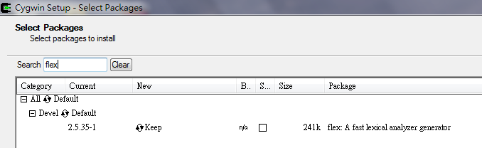
Getting started
Installation:
  % sudo apt-get install flex (in ubuntu)
  Download and install cygwin (in windows)
  Install gcc, make, gdb, flex … package

Slide 17
Getting started (cont’d)
Compilation:
  % flex example.l (output file：lex.yy.c)
  % gcc lex.yy.c -lfl (-lfl : to link flex library )
  or
  %gcc lex.yy.c -ll (-lfl : to link lex library )

Slide 18
Getting started (cont’d)
Execution:
% cat input | ./a.out (in linux)
$ cat input | ./a.exe (in windows)
You can also use:
yyin=fopen(“input”,”r”);

