Slide 1
Chapter 2 A Simple Compiler
Prof Chung.

Slide 2
Outlines
2.1 The Structure of a Micro Compiler
2.2 A Micro Scanner
2.3 The Syntax of Micro
2.4 Recursive Descent Parsing
2.5 Translating Micro

Slide 3
Outlines
2.1 The Structure of a Micro Compiler
2.2 A Micro Scanner
2.3 The Syntax of Micro
2.4 Recursive Descent Parsing
2.5 Translating Micro

Slide 4
The Structure of a Micro compiler(1)
Micro : a very simple language
  Only integers
  No declarations
  Variables consist of A..Z, 0..9
  At most 32 characters long
  Comments begin with “--” and end with end-of-line.
  Three kinds of statements:
    assignments, e.g., a := b + c
    read(list of ids), e.g., read(a, b)
    write(list of exps), e.g., write(a+b)
  Begin, end, read, and write are reserved words.
  Tokens may not extend to the following line.

Slide 5
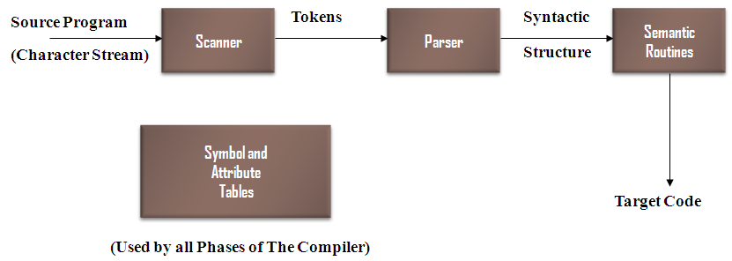
The Structure of a Micro compiler(2)
One-pass type,
no explicit intermediate representations used
The interface
  Parser is the main routine.
  Parser calls scanner to get the next token.
  Parser calls semantic routines at appropriate times.
  Semantic routines produce output in assembly language.
  A simple symbol table is used by the semantic routines.

Slide 6
Outlines
2.1 The Structure of a Micro Compiler
2.2 A Micro Scanner
2.3 The Syntax of Micro
2.4 Recursive Descent Parsing
2.5 Translating Micro

Slide 7
A Micro Scanner (1)
The Micro Scanner
  will be a function of no arguments that returns token values
  There are 14 tokens.
typedef enum token_types {
BEGIN, END, READ, WRITE, ID, INTLITERAL,
LPAREN, RPAREN, SEMICOLON, COMMA,
ASSIGNOP,PLUOP, MINUSOP, SCANEOF
} token;
Extern token scanner(void);

Slide 8
A Micro Scanner (2)
The Micro Scanner
  Returns the longest string that constitutes a token,
  e.g., in
    abcdef
  ab, abc, abcdef are all valid tokens.
  The scanner will return the longest one
  e.g.,
    abcdef

Slide 9
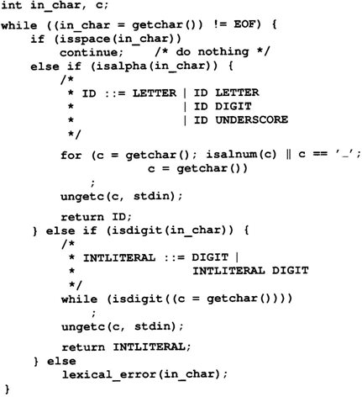
A Micro Scanner (3)
The Micro Scanner
  Continue:
    skip one iteration
    getchar() , isspace(),
    isalpha(), isalnum(),
    isdigital()
  ungetc():
    push back one character

Slide 10
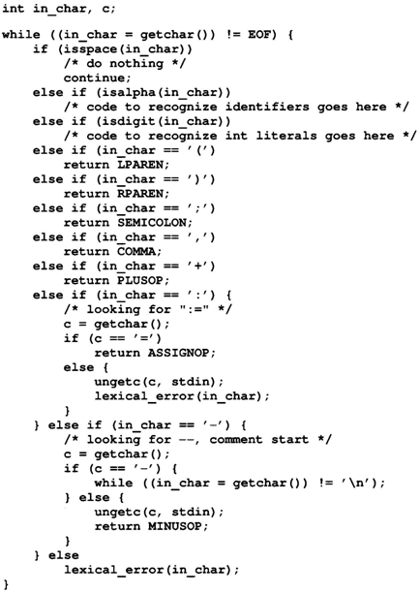
A Micro Scanner (4)
The Micro Scanner
  Continue:
    skip one iteration
    getchar() , isspace(),
    isalpha(), isalnum(),
    isdigital()
  ungetc():
    push back one character

Slide 11
A Micro Scanner (5)
The Micro Scanner
  How to handle RESERVED words?
    Reserved words are similar to identifiers.
  Two approaches:
    Use a separate table of reserved words
    Put all reserved words into symbol table initially.

Slide 12
A Micro Scanner (6)
The Micro Scanner
  Provision for saving the characters of a token as they are scanned
    token_buffer
    buffer_char()
    clear_buffer()
    check_reserved()
  Handle end of file
    feof(stdin)

Slide 13
Outlines
2.1 The Structure of a Micro Compiler
2.2 A Micro Scanner
2.3 The Syntax of Micro
2.4 Recursive Descent Parsing
2.5 Translating Micro

Slide 14
The Syntax of Micro (1)
The Syntax of Micro
  Micro's syntax is defined by a context-free grammar (CFG)
    CFG is also called BNF (Backus-Naur Form) grammar
  CFG consists of a set of production rules,
A→B C D… Z
LHS
must be a single nonterminal
RHS
consists 0 or more terminals or nonterminals

Slide 15
The Syntax of Micro (2)
Two kinds of symbols
  Nonterminals
    Delimited by “<“ and “>”
    Represent syntactic structures
  Terminals
    Represent tokens
  E.g.
    <program> → begin <statement list> end
Start or goal symbol
  λ : empty or null string
  E.g.
    <statement list> → <statement><statement tail>
    <statement tail> → λ
    <statement tail> → <statement><statement tail>

Slide 16
The Syntax of Micro (3)
Extended BNF: some abbreviations
  optional: [ ] 0 or 1
    <stmt> → if <exp> then <stmt>
    <stmt> → if <exp> then <stmt> else <stmt>
    <stmt> → if <exp> then <stmt> [ else <stmt> ]
  repetition: { } 0 or more
    <stmt list> → <stmt> <tail>
    <tail> → λ
    <tail> → <stmt> <tail>
    <stmt list> → <stmt> { <stmt> }

Slide 17
The Syntax of Micro (4)
Extended BNF: some abbreviations
  alternative: | or
    <stmt> → <assign>
    <stmt> → <if stmt>
    <stmt> → <assign> | <if stmt>
Extended BNF == BNF
  Either can be transformed to the other.
  Extended BNF is more compact and readable

Slide 18
The Syntax of Micro (5)
Extended CFG Defining Micro
<program> → begin <statement list> end
<statement list> → <statement> { <statement> }
<statement> → ID := <expression> ;
<statement> → read ( <id list> ) ;
<statement> → write ( <expr list> ) ;
<id list> → ID { , ID }
<expr list> → <expression> { , <expression> }
<expression> → <primary> { <add op> <primary> }
<primary> → ( <expression> )
<primary> → ID
<primary> → INTLITERAL
<add op> → +
<add op> → -
<system goal> → <program> SCANEOF

Slide 19
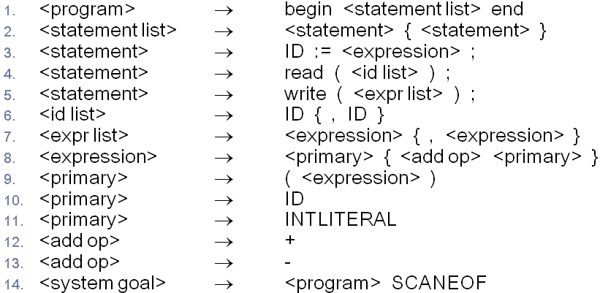
The Syntax of Micro (5)
begin ID := ID + ( INTLITERAL - ID ) ; end
<program> (Apply rule 1)
begin <statement list> end (Apply rule 2)
begin <statement> { <statement> } end
(Choose 0 repetitions)
begin <statement> end (Apply rule 3)
begin ID := <expression> ; end (Apply rule 8)
begin ID := <primary> { <add op> <primary> }; end
(Choose 1 repetitions)
begin ID := <primary> <add op> <primary> ; end (Apply rule 12)
begin ID := <primary> + <primary> ; end (Apply rule 10)
begin ID := ID + <primary> ; end (Apply rule 9)
begin ID := ID + ( <expression> ) ; end (Apply rule 8)
begin ID := ID + ( <primary> { <add op> <primary> } ) ; end (Choose 1 repetitions)
begin ID := ID + ( <primary> <add op> <primary> ) ; end (Apply rule 13)
begin ID := ID + ( <primary> - <primary> ) ; end (Apply rule 11)
begin ID := ID + ( INTLITERAL - <primary> ) ; end (Apply rule 10)
begin ID := ID + ( INTLITERAL - ID ) ; end

Slide 20
The Syntax of Micro (6)
A CFG
  defines a language, which is a set of sequences of tokens
Syntax errors & semantic errors
  A:=‘X’+True;
Associativity
  A-B-C
Operator precedence
  A+B*C

Slide 21
The Syntax of Micro (7)
A grammar fragment
  defines such a precedence relationship
    <expression> → <factor> {<add op><factor>}
    <factor>→ <primary> {<mult op><primary>}
    <primary>→(< expression >)
    <primary>→ID
    <primary>→INTLITERAL
<expression>
<factor>
<primary>
<mult op>
<primary>
(
<expression>
)
*
ID
<expression>
<factor>
<add op>
<factor>
<factor>
<add op>
<factor>
<primary>
<primary>
<mult op>
<primary>
<primary>
+
<primary>
+
ID
ID
*
ID
ID
ID
Derivation Tree for A+B*C
Derivation Tree for (A+B)*C

Slide 22
Outlines
2.1 The Structure of a Micro Compiler
2.2 A Micro Scanner
2.3 The Syntax of Micro
2.4 Recursive Descent Parsing
2.5 Translating Micro

Slide 23
Recursive Descent Parsing (1)
There are many parsing techniques.
  Recursive descent is one of the simplest parsing techniques
Basic idea (1)
  Each nonterminal has a parsing procedure
  For symbol on the RHS : a sequence of matching
    To Match a nonterminal A
      Call the parsing procedure of A
    To match a terminal symbol t
      Call match(t)
        match(t) calls the scanner to get the next token. If is it t, everything is correct. If it is not t, we have found a syntax error.

Slide 24
Recursive Descent Parsing (2)
Basic idea (2)
  If a nonterminal has several productions,
    choose an appropriate one based on the next input token.
  Parser is started by invoking system_goal().
void system_goal(void)
{
/* <system goal> ::=
<program> SCANEOF */
program();
match(SCANEOF);
}

Slide 25
Recursive Descent Parsing (3)
void program(void)
void program(void)
{
/* <program> ::=
BEGIN <statement list> END */
match(BEGIN)
statement_list();
match(END);
}

Slide 26
Recursive Descent Parsing (4)
void statement_list(void)
void statement_list(void)
{
/* <statement list> ::=
<statement> { <statement> } */
statement();
while (TRUE) {
switch (next_token()) {
case ID:
case READ:
case WRITE:
statement();
break;
default:
return;
}
}
}
處理{<statement>}不出現的情形
next_token()
  a function that returns the next token. It does not call scanner(void).

Slide 27
Recursive Descent Parsing (5)
void statement(void) {
token tok = next_token();
switch (tok) {
case ID:
/* <statement> ::= ID := <expression> ; */
match(ID); match(ASSIGNOP);
expression(); match(SEMICOLON);
break;
case READ:
/* <statement> ::= READ ( <id list> ) ; */
match(READ); match(LPAREN);
id_list(); match(RPAREN); match(SEMICOLON);
break;
case WRITE:
/* <statement> ::= WRITE (<expr list>) ; */
match(WRITE); match(LPAREN);
expr_list(); match(RPAREN);
match(SEMICOLON);
break;
default:
syntax_error(tok);
break;
}
}
void statement(void)
<statement>
必出現一次

Slide 28
Recursive Descent Parsing (6)
void id_list(void)
void id_list(void)
{
/* <id list> ::= ID { , ID } */
match(ID);
while (next_token() == COMMA) {
match(COMMA);
match(ID);
}
}

Slide 29
Recursive Descent Parsing (7)
void expression(void)
void expression(void)
{
/* <expression> ::=
<primary> { <add op> <primary> } */
token t;
primary();
for (t = next_token(); t == PLUSOP || t == MINUSOP; t = next_token()) {
add_op();
primary();
}
}

Slide 30
Recursive Descent Parsing (8)
void expr_list(void)
{
/* <expr list> ::=
<expression> { , <expression> } */
expression();
while (next_token() == COMMA) {
match(COMMA);
expression();
}
}

Slide 31
Recursive Descent Parsing (9)
void add_op(void)
{
/* <addop> ::= PLUSOP I MINUSOP */
token tok = next_token();
if (tok == PLUSOP || tok ==MINUSOP)
match(tok);
else
syntax_error(tok);
}

Slide 32
Recursive Descent Parsing (10)
void primary(void)
void primary(void)
{
token tok = next_token();
switch (tok) {
case LPAREN:
/* <primary> ::= ( <expression> ) */
match(LPAREN); expression();
match(RPAREN);
break;
case ID:
/* <primary> ::= ID */
match(ID);
break;
case INTLITERAL:
/* <primary> ::= INTLITERAL */
match(INTLITERAL);
break;
default:
syntax_error(tok);
break;
}
}

Slide 33
Outlines
2.1 The Structure of a Micro Compiler
2.2 A Micro Scanner
2.3 The Syntax of Micro
2.4 Recursive Descent Parsing
2.5 Translating Micro

Slide 34
Translating Micro (1)
Target language: 3-addr code (quadruple)
  OP A, B, C
Note that we did not worry about registers at this time.
  temporaries: Sometimes we need to hold temporary values.
    E.g. A+B+C
      ADD A,B,TEMP&1
      ADD TEMP&1,C,TEMP&2

Slide 35
Translating Micro (2)
Action Symbols
  The bulk of a translation is done by semantic routines
  Action symbols can be added to a grammar to specify
  when semantic processing should take place
    Be placed anywhere in the RHS of a production
  translated into procedure call in the parsing procedures
    #add corresponds to a semantic routine named add()
  No impact on the languages recognized
  by a parser driven by a CFG

Slide 36
Translating Micro (3)
Grammar for Mirco with Action Symbols
  <program> → #start begin <statement list> end
  <statement list> → <statement> { <statement> }
  <statement> → <ident> := <expression> #assign ;
  <statement> → read ( <id list> ) ;
  <statement> → write ( <expr list> ) ;
  <id list> → <ident> #read_id { , <ident> #read_id }
  <expr list> → <expression> #write_expr { , <expression> #write_expr }
  <expression> → <primary> { <add op> <primary> #gen_infix }
  <primary> → ( <expression> )
  <primary> → <ident>
  <primary> → INTLITERAL #process_literal
  <add op> → + #process_op
  <add op> → - #process_op
  <ident> → ID #process_id
  <system goal> → <program> SCANEOF #finish

Slide 37
Semantic Information (1)
Semantic routines need certain information to do their work.
  These information is stored in semantic records.
  Each kind of grammar symbol has a semantic record
#define MAXIDLEN 33
typedef char string[MAXIDLEN];
/* for operators */
typedef struct operator {
enum op { PLUS, MINUS } operator;
} op_rec;
/* for <primary> and <expression> */
enum expr { IDEXPR, LITERALEXPR, TEMPEXPR };
typedef struct expression {
enum expr kind;
  union {
  string name; /* for IDEXPR, TEMPEXPR */
  int val; /* for LITERALEXPR */
  };
} expr_rec;
semantic records for Micro Symbols

Slide 38
Semantic Information (2)
Parsing procedure
<expression> →
<primary> {<add op> <primary> #gen_infix}
void expression (expr_rec *result)
{
expr_rec left_operand, right_operand;
op_rec op;
/* <expression> ::= <primary>
{ <add op> <primary> #gen_infix }*/
primary( &left_operand)
while (next_token() == PLUSOP || next_token() == MINUSOP) {
add_op( &op);
primary( &right_operand);
left_operand
=gen_infix(left_operand,
op, right_operand);
}
*result = left_operand;
}
void expression(void)
{
token t;
/* <expression> ::= <primary>
{ <add op> <primary> } */
primary();
for (t = next_token(); t == PLUSOP ||
t == MINUSOP; t = next_token()) {
add_op();
primary();
}
}
Old parsing procedure ( P. 37 )
New parsing procedure which involved semantic routines

Slide 39
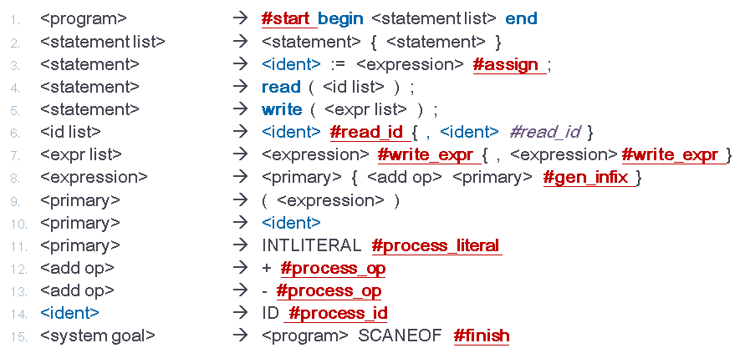
Semantic Information (3)
Subroutines for symbol table
Symbol table
  Is s in the symbol ?
extern int lookup(string s);
/* Put s unconditionally into symbol table. */
extern void enter(string s);
void check_id(string s)
{
if (! lookup(s)) {
enter(s);
generate("Declare", s, "Integer“," ");
}
}

Slide 40
Semantic Information (4)
Subroutines for temporaries
Temporaries
char *get_temp(void) {
/* max temporary allocated so far*/
static int max_temp = 0;
static char tempname[MAXIDLEN];
max_temp++;
sprintf(tempname, "Temp&%d",
max_temp);
check_id(tempname);
return tempname;
}

Slide 41
Semantic Information (5)
Subroutines
start
void start(void)
{
/* Semantic initializations, none needed. */
}

Slide 42
Semantic Information (6)
Subroutines
assign
void assign(expr_rec target, expr_rec source)
{
/* Generate code for assignment. */
generate("Store", extract(source), target.name, "");
}

Slide 43
Semantic Information (7)
Subroutines
read_id
void read_id(expr_rec in_var)
{
/* Generate code for read. */
generate("Read", in_var.name,"Integer", "");
}

Slide 44
Semantic Information (8)
Subroutines
write_expr
void write_expr(expr_rec out_expr)
{
/* Generate code for write. */
generate("Write", extract(out_expr),"Integer", "");
}

Slide 45
Semantic Information (9)
Subroutines
gen_infix
expr_rec gen_infix(expr_rec e1, op_rec op, expr_rec e2)
{
/* Generate code for infix operation.
* Get result temp and set up semantic
* record for result. */
expr_rec e_rec;
/* An expr_rec with temp variant set. */
e_rec.kind = TEMPEXPR;
strcpy(e_rec.name, get_temp());
generate(extract(op), extract(e1),extract(e2), e_rec.name);
return e_rec;
}

Slide 46
Semantic Information (10)
Subroutines
process_literal
expr_rec process_literal(void)
{
/* Convert literal to a numeric representation
and build semantic record. */
expr_rec t;
t.kind = LITERALEXPR;
(void) sscanf(token_buffer, “%d",&t.val);
return t;
}

Slide 47
Semantic Information (11)
Subroutines
process_op
op_rec process_op(void)
{
/* Produce operator descriptor. */
op_rec o;
if (current_token == PLUSOP)
o.operator = PLUS;
else
o.operator = MINUS;
return o;
}

Slide 48
Semantic Information (12)
Subroutines
process_id
expr_rec process_id(void)
{
/* Declare ID and build a corresponding semantic record. */
expr_rec t;
check_id(token_buffer);
t.kind = IDEXPR;
strcpy(t.name, token_buffer);
return t;
}

Slide 49
Semantic Information (13)
Subroutines
finish
void finish(void)
{
/* Generate code to finish program. */
generate("Halt", "", "");
}

Slide 50
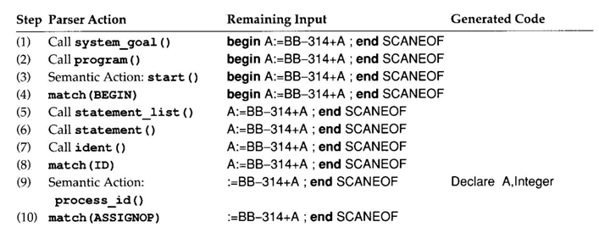
Tracing Example (1)

Slide 51
Tracing Example (2)

Slide 52
Tracing Example (3)

Slide 53
Tracing Example (4)

Slide 54
Tracing Example (5)

Slide 55
Tracing Example (6)

Slide 56
Tracing Example (7)

Slide 57
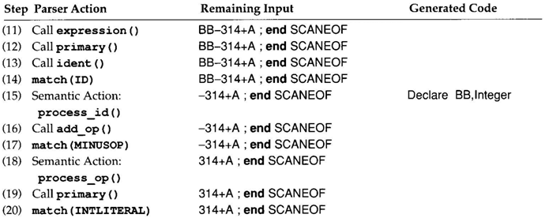
Tracing Example (8)

Slide 58
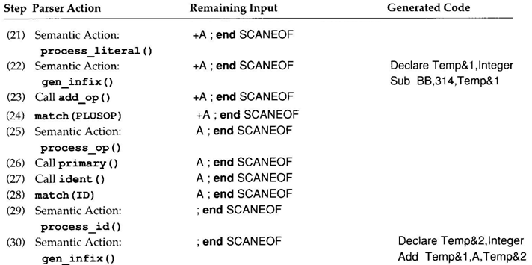
Tracing Example (9)

Slide 59
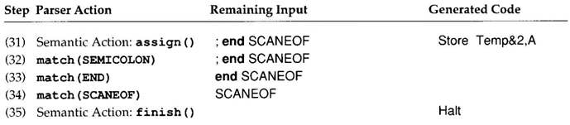
Tracing Example (10)

Slide 60
Chapter 2 End
Any Question?

