Slide 1
Chapter 3
Scanning - Theory and Practice
Prof Chung.

Slide 2
Outlines
3.1 Overview
3.2 Regular Expression
3.3 Finite Automata and Scanners
3.4 Using a Scanner Generator
  LEX --- Introduce in TA course: LEX introduction
3.5 Practical Considerations
3.6 Translating Regular Expressions into Finite Automata
3.7 Tracing Example
  Modify form http://www.cs.ualberta.ca/~amaral/courses/680/

Slide 3
Outlines
3.1 Overview
3.2 Regular Expression
3.3 Finite Automata and Scanners
3.4 Using a Scanner Generator
3.5 Practical Considerations
3.6 Translating Regular Expressions into Finite Automata
3.7 Tracing Example
  Modify form http://www.cs.ualberta.ca/~amaral/courses/680/

Slide 4
Overview(1)
Formal notations
  For specifying the precise structure of tokens are necessary
  Quoted string in Pascal
  Can a string split across a line?
  Is a null string allowed?
  Is .1 or 10. ok?
  The 1..10 problem
Scanner generators
  Tables, Programs
What formal notations to use?
Notes:
Quoted string in Pascal ➔ “ ” ’ “ String ” ’ ” ” , “ ” ” ” String “ ” ” ” ”
Can a string split across a line? ➔ “Hello \n
world “
Is a null string allowed? ➔ “ (我是空白)“
Is .1 or 10. ok?
the 1..10 problem ➔ 1. .10 (錯誤) ➔ 1 .. 10 (正確)

Slide 5
Overview(2)
Lexical analyzer (scanner) role
  Produce a sequence of (tokens) for parser
  Stripe out comments and whitespaces
  Associate a line number with each error message
  Expand macros
source
program
Lexical
Analyzer
token
Parser
to semantic
analysis
getNextToken
Symbol
Table

Slide 6
Outlines
3.1 Over View
3.2 Regular Expression
3.3 Finite Automata and Scanners
3.5 Practical Considerations
3.4 Using a Scanner Generator
3.6 Translating Regular Expressions into Finite Automata
3.7 Tracing Example
  Modify form http://www.cs.ualberta.ca/~amaral/courses/680/

Slide 7
Regular Expression (1)
Tokens
  built from symbols of a finite vocabulary.
Structures of tokens
  use regular expressions to define
Set Definition
  The sets of strings defined by regular expressions are termed
  ∅ is a regular expression denoting the empty set
  λ is a regular expression
  denoting the set that contains only the empty string
  A string s is a regular expression denoting a set containing only s

Slide 8
Regular Expression (2)
if A and B are regular expressions, so are
  A | B (alternation)
    A regular expression formed by A or B
    (a)|(b) = {a, b}
  AB or A•B (concatenation)
    A regular expression formed by A followed by B
    (a)(b) = {ab}
  A* (Kleene closure)
    A regular expression formed by zero or more repetitions of A
    a* = {λ, a, aa, aaa, …}
More Complex Example
(a|b|c)* = {λ, a, b, c, aa, ab, ac, ba, bb, bc, ca, cb, cc …}
Notes:
(a|b|c)* = (a|b,c)*

Slide 9
Regular Expression (3)
Some notational convenience
  P⁺
    PP* (at least one)
  Not(A)
    V - A
  Not(S)
    V* - S
  A^{K}
    AA …A (k copies)
  A?
    Optional, zero or one occurrence of A
More Complex Example
Let D = (0 | 1 | 2 | 3 | 4 | ... | 9 )
Let L = (A | B | ... | Z | a | b |... | z)
comment = -- not(EOL)* EOL
  ex: --hello12_34 \n
decimal = D⁺ · D⁺
  ex: 123.456
ident = L (L | D | _)*
  ex: A1a5_6
comments = ((#| λ ) not(#))*
  ex:#A435#3
Notes:
Comment = c language 的 // 註解

Slide 10
Regular Expression (4)
  Is regular expression as power as CFG?
  { [^{i} ]^{i} | i≥1}
Regular grammar
A→a
A→a
or
A→aB
A→Ba
Notes:
Answer : NO
aB : right grammar
Ba : left grammar

Slide 11
Outlines
3.1 Over View
3.2 Regular Expression
3.3 Finite Automata and Scanners
3.4 Using a Scanner Generator
3.5 Practical Considerations
3.6 Translating Regular Expressions into Finite Automata
3.7 Tracing Example
  Modify form http://www.cs.ualberta.ca/~amaral/courses/680/

Slide 12
Finite Automata and Scanners (1)
Finite automaton (FA)
  can be used to recognize the tokens specified by a regular expression
A FA consists of
  A finite set of states S
  A set of input symbols Σ (the input symbol alphabet)
  A set of transitions (or moves) from one state to another,
  labeled with characters in V
  A special start state s₀ (only one)
  A set of final, or accepting, states F
FA = {S, Σ, s₀, F, move }
Notes:
Finite automation = Finite State Machine

Slide 13
Finite Automata and Scanners (2)
is a state
is a transition
is the start state
is a final state
Example at next page….

Slide 14
Finite Automata and Scanners (3)
Example
  A transition diagram
    This machine accepts (abc⁺)⁺
(
a
b
c
)
⁺
⁺
a
a
b
c
c

Slide 15
Finite Automata and Scanners (4)
Other Example
  (0|1)*0(0|1)(0|1)
0
0,1
0,1
1
2
3
4
0,1
0
5
0,1
(0|1)
*
0
(0|1)
(0|1)
Notes:
對一個state 有兩個input 兩個move 就叫做NFA

Slide 16


Finite Automata and Scanners (5)
Other Example
  ID = L(L|D)*(_(L|D)⁺)*
  A data structure can be translated for many REs or FAs
Final for two * symbol
L
(L|D)*
(_(L|D)⁺)*
L | D
L
-
What difference?
Answer : “_” by times
item 2 = item 3
L | D
Notes:
兩個不一樣的地方 在於 identify 的定義
ID = L(L|D)*(_(L|D)⁺)* to L(L|D)*(_(L|D)⁺)*
A data structure can be translated for many REs or FAs

Slide 17
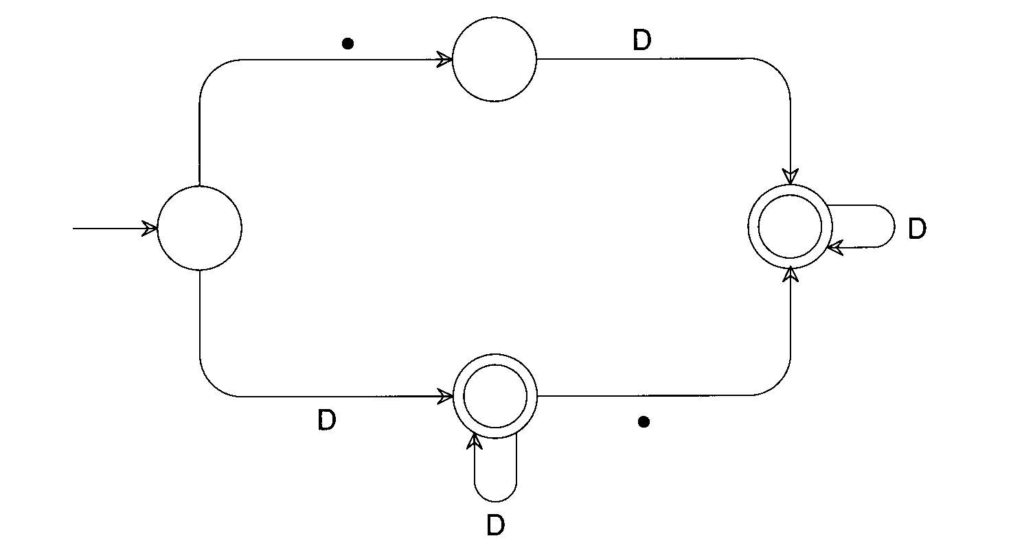
Finite Automata and Scanners (6)
Other Example
  RealLit = (D⁺(λ|.))|(D*.D⁺)

Slide 18
Finite Automata and Scanners (7)
Two kinds of FA:
  Deterministic: next transition is unique
  Non-deterministic: otherwise
a
...
a
...
Which path we should select?

Slide 19
Finite Automata and Scanners (8)
A transition diagram
A transition table
Not(Eol)
-
-
Eol
1
2
3
4
State | Character
 | - | Eol | a | b | …
2
1
2
3
3
3
4
3
3
3
4

Slide 20
Finite Automata and Scanners (9)
Any regular expression
  can be translated into a DFA
  that accepts the set of strings denoted by the regular expression
The transition can be done
  Automatically by a scanner generator : LEX (TA course)
  Manually by a programmer : Your homework #1 (3/19 publishes)

Slide 21
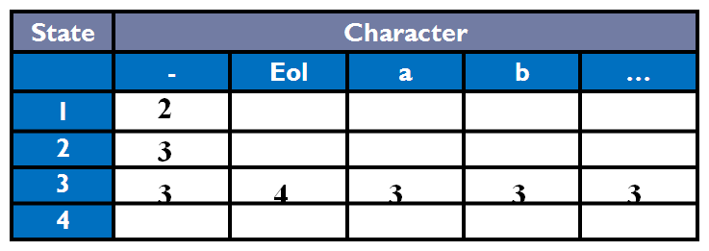
Finite Automata and Scanners (10)
Scanner Driver Interpreting a Transition Table
/* Note: current_char is already set to the current input character. */
state = initial_state;
while (TRUE) {
next_state = T[state][current_char];
if (next_state == ERROR)
break;
state = next_state;
if (current_char == EOF)
break;
current_char = getchar();
}
If(is_final_state(state))
/* Return or process valid token. */
else
lexical_error(current_char);
Notes:
非有值則錯

Slide 22
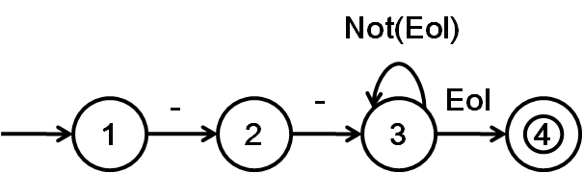
Finite Automata and Scanners (11)
Scanner with Fixed Token Definition
if (current_char == '-') {
current_char = getchar();
if (current_char == '-') {
do {
current_char = getchar();
} while (current_char != '\n');
} else {
ungetc(current_char, stdin);
lexical_error(current_char);
}
}
else
lexical_error(current_char);
/* Return or process valid token. */
Notes:
缺點 沒彈性 一改就全改了

Slide 23
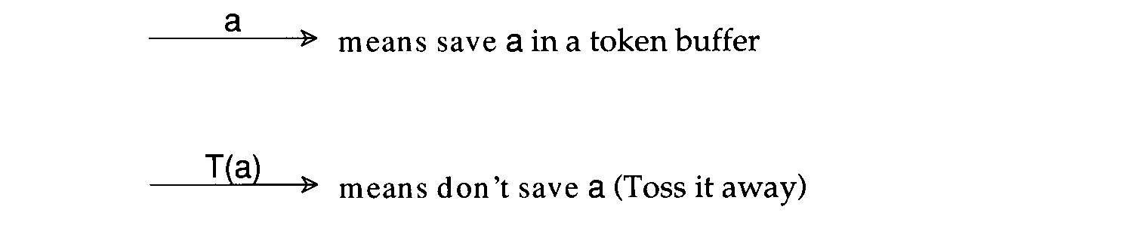
Finite Automata and Scanners (12)
Transducer
  We may perform some actions during state transition.

Slide 24
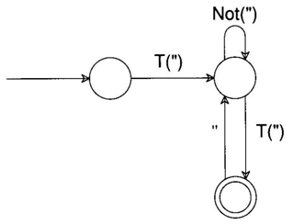
Finite Automata and Scanners (13)
Other Example
  be given by quoted strings,
  according to the regular expression ("(Not(")|"")*")
  A corresponding transducer might be
  The input “”“Hi“”” would produce output “Hi”

Slide 25
Outlines
3.1 Over View
3.2 Regular Expression
3.3 Finite Automata and Scanners
3.4 Using a Scanner Generator
3.5 Practical Considerations
3.6 Translating Regular Expressions into Finite Automata
3.7 Tracing Example
  Modify form http://www.cs.ualberta.ca/~amaral/courses/680/

Slide 26
Using a Scanner Generator
By Ta….

Slide 27
Outlines
3.1 Over View
3.2 Regular Expression
3.3 Finite Automata and Scanners
3.4 Using a Scanner Generator
3.5 Practical Considerations
3.6 Translating Regular Expressions into Finite Automata
3.7 Tracing Example
  Modify form http://www.cs.ualberta.ca/~amaral/courses/680/

Slide 28
Practical Considerations (1)
Reserved Words
    Usually, all keywords are reserved in order to simplify parsing.
    In Pascal, we could even write
    begin
    begin; end; end; begin;
    end
    if else then if = else;
    The problem
    with reserved words is that they are too numerous.
    COBOL has several hundreds of reserved words!
      ZEROS
      ZERO
      ZEROES
Notes:
ZEROS
ZERO
ZERO1S

Slide 29
Practical Considerations (2)
Compiler Directives and Listing Source Lines
  Compiler options e.g. optimization, profiling, etc.
    handled by scanner or semantic routines
    Complex pragmas are treated like other statements.
  Source inclusion
    e.g. #include in C
    handled by preprocessor or scanner
  Conditional compilation
    e.g. #if, #endif in C
    useful for creating program versions
Notes:
Directives : 不屬於語法的一部分 為了輔助compiler處理的動作

Slide 30
Practical Considerations (3)
Entry of Identifiers into the Symbol Table
    Who is responsible for entering symbols into symbol table?
  Scanner?
  Consider this example:
    { int abc;
    …
    { int abc; }
    }
Notes:
用誰來做?
Parser去做
複雜的給semical routine (parser)
我們要決定要給parser哪些事情做 哪些功能

Slide 31
Practical Considerations (4)
How to handle end-of-file?
    Create a special EOF token.
    EOF token is useful in a CFG
Multicharacter Lookahead
    Blanks are not significant in Fortran
    DO 10 I= 1,100
      Beginning of a loop
    DO 10 I = 1.100
      An assignment statement DO 10I=1.100
    A Fortran Scanner
      can determine whether the O is the last character of a DO token only after reading as far as the comma

Slide 32
Practical Considerations (5)
Multicharacter Lookahead (Cont’d)
    In Ada and Pascal
  To scan 10..100
    There are three token
      10
      ..
      100
    Two-character (..) lookahead after the 10
  It is easy to build a scanner that can perform general backup.
  If we reach a situation
    in which we are not in final state and
    cannot scan any more characters, backup is invoked.
      Until we reach a prefix of the scanned characters flagged as a valid token
Example at next page

Slide 33
Practical Considerations (6)
An FA That Scans Integer and Real Literals and the Subrange Operator
D
D
D
●
D
Buffered Token | Token Flag
1 | Integer Literal
12 | Integer Literal
12. | Invalid
12.3 | Real Literal
12.3e | Invalid
12.3e+ | Invalid
●
●
Detail Operation of each case at next page

Slide 34
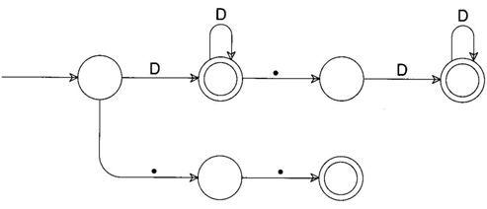
Practical Considerations (7)
An FA That Scans Integer and Real Literals and the Subrange Operator
D
Input Token
Buffered Token
Token Flag
1
1
Integer Literal

Slide 35
Practical Considerations (8)
An FA That Scans Integer and Real Literals and the Subrange Operator
D
D
Input Token
Buffered Token
Token Flag
1
2
1
2
Integer Literal

Slide 36
Practical Considerations (9)
An FA That Scans Integer and Real Literals and the Subrange Operator
D
D
●
Input Token
Buffered Token
Token Flag
1
2
.
1
2
.
Invalid

Slide 37
Practical Considerations (10)
An FA That Scans Integer and Real Literals and the Subrange Operator
D
D
●
D
Input Token
Buffered Token
Token Flag
1
2
.
3
1
2
.
3
Real Literal

Slide 38
Practical Considerations (11)
An FA That Scans Integer and Real Literals and the Subrange Operator
D
?
D
●
D
Input Token
Buffered Token
Token Flag
1
2
.
3
e
1
2
.
3
e
Invalid

Slide 39
Practical Considerations (12)
An FA That Scans Integer and Real Literals and the Subrange Operator
D
?
?
D
●
D
Input Token
Buffered Token
Token Flag
1
2
.
3
e
⁺
1
2
.
3
e
⁺
Invalid

Slide 40
Outlines
3.1 Over View
3.2 Regular Expression
3.3 Finite Automata and Scanners
3.4 Using a Scanner Generator
3.5 Practical Considerations
3.6 Translating Regular Expressions into Finite Automata
3.7 Tracing Example
  Modify form http://www.cs.ualberta.ca/~amaral/courses/680/

Slide 41
Translating Regular Expressions into Finite Automata(1)
Regular expressions are equivalent to FAs
The main job of a scanner generator
  To transform a regular expression definition into an equivalent FA
Importance in NFA->DFA
A regular expression
Nondeterministic FA
Deterministic FA
minimize # of states
Optimized Deterministic FA

Slide 42
Translating Regular Expressions into Finite Automata(2)
We can transform any regular expression
into an NFA with the following properties:
  There is an unique final state
  The final state has no successors
  Every other state has at least one successors
  Example : A Nondeterministic Finite Automaton (NFA)
    Input : babb
    Regular Expressions : (a|b)*abb
a
a
b
b
0
1
2
3
b
either one or two successors
Unique final state
Final S has no successor

Slide 43
Translating Regular Expressions into Finite Automata(3)
We need to review the definition of regular expression
  Item 1: λ
    It is null string
  Item 2: a
    It is a char of the vocabulary
  Item 3 : |
    It is “or” operation.
    Example : A|B
  Item 4 : ●
    It is the operation of catenation
    Example : AB
  Item 4 : *
    It is the operation of repetition
    Example : A*
More Example at Next Page

Slide 44
Translating Regular Expressions into Finite Automata(4)
NFA : λ (null string)
NFA : a (1string)
    A char of the vocabulary
Processing Token
λ
λ
a
Processing Token
a

Slide 45
Translating Regular Expressions into Finite Automata(5)
NFA : Α|Β
Α
Processing Token
|
Β
NFA
For A
λ
λ
λ
NFA
For B
λ
Notes:
先A 在B

Slide 46
Translating Regular Expressions into Finite Automata(6)
NFA : Α●Β
Processing Token
Α
Β
●
λ
NFA
For A
λ
NFA
For B
Notes:
以課本為主 不對 扣分

Slide 47
Translating Regular Expressions into Finite Automata(7)
NFA : Α∗
Processing Token
Α
∗
λ
> 1 times
λ
NFA
For A
λ
λ
= 0 times

Slide 48
Translating Regular Expressions into Finite Automata(8)
Construct an NFA for Regular Expression 1∗
  01* | 1 ⇒ (0(1*)) |1
λ
λ
1
λ
Start
λ
1
*
Processing Token

Slide 49
Translating Regular Expressions into Finite Automata(9)
Construct an NFA for Regular Expression 01∗
  01*|1 ⇒ (0(1*)) |1
λ
Start
For Connection
λ
0
λ
λ
1
λ
λ
0
1
*
Processing Token

Slide 50
Translating Regular Expressions into Finite Automata(10)
Construct an NFA for Regular Expression 01∗|1
  01*+1 ⇒ (0(1*))+1
λ
λ
0
λ
λ
1
λ
λ
λ
λ
λ
1
λ
Start
0
1
*
|
1
Processing Token

Slide 51
Translating Regular Expressions into Finite Automata(11)
What’s problem about NFA?
  Ans: It may be ambiguous that difficult to program!!!
  A Nondeterministic Finite Automaton (NFA):(a|b)*abb
a
a
b
b
0
1
2
3
Start
b
Ambiguous!!!
Which one should we select?
Input : babb
Processing Token
b
a

Slide 52
Translating Regular Expressions into Finite Automata(12)
What’s problem about NFA?
  Ans: It may be ambiguous that difficult to program!!!
  A deterministic Finite Automaton (NFA): b*abb
a
b
b
0
1
2
3
Start
b
No Ambiguous!!!
It have unique path!
Input : babb
Processing Token
b
a
b
b

Slide 53
Creating Deterministic Automata(1)
The transformation
  from an NFA N to an equivalent DFA M works
  by what is sometimes called the subset construction
  An Example for each step…
    Initial NFA : 01*|1 ⇒ (0(1*)) |1
λ
1
λ
Start
1
8
9
10
λ
λ
λ
0
λ
λ
1
λ
2
3
4
5
6
7
λ
More Detail operation at next page…

Slide 54
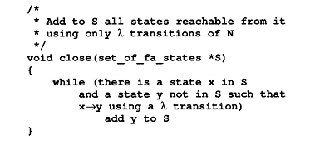
Creating Deterministic Automata(2)
Step 1:
1
λ
8
1
9
λ
10
Start
λ
λ
λ
0
λ
λ
λ
2
3
4
5
1
6
7
λ
1. λ-closure(1) ={1, 2, 8}
2. λ-closure(2) ={2}
3. λ-closure(3) ={3 ,4 ,5 ,7 ,10}
4. λ-closure(4) ={4 ,5 ,7 ,10}
5. λ-closure(5) ={5}
6. λ-closure(6) ={5 ,6 ,7 ,10}
7. λ-closure(7) ={5, 7, 10}
8. λ-closure(8) ={8}
9. λ-closure(9) ={9 ,10}
10. λ-closure(10) ={10}
More Detail operation at next page…

Slide 55
Creating Deterministic Automata(2)
Step 1:
1
λ
8
1
9
λ
10
Start
λ
λ
λ
0
λ
λ
λ
2
3
4
5
1
6
7
λ
1. λ-closure(1) ={1, 2, 8}
2. λ-closure(2) ={2}
3. λ-closure(3) ={3 ,4 ,5 ,7 ,10}
4. λ-closure(4) ={4 ,5 ,7 ,10}
5. λ-closure(5) ={5}
6. λ-closure(6) ={5 ,6 ,7 ,10}
7. λ-closure(7) ={5, 7 ,10}
8. λ-closure(8) ={8}
9. λ-closure(9) ={9 ,10}
10. λ-closure(10) ={10}

Slide 56
Creating Deterministic Automata(2)
Step 1:
1
λ
8
1
λ
0
2
1. λ-closure(1) ={1, 2, 8}

Slide 57
Creating Deterministic Automata(2)
Step 1:
1
λ
8
1
9
λ
10
Start
λ
λ
λ
0
λ
λ
λ
2
3
4
5
1
6
7
λ
1. λ-closure(1) ={1, 2, 8}
2. λ-closure(2) ={2}
3. λ-closure(3) ={3 ,4 ,5 ,7 ,10}
4. λ-closure(4) ={4 ,5 ,7 ,10}
5. λ-closure(5) ={5}
6. λ-closure(6) ={5 ,6 ,7 ,10}
7. λ-closure(7) ={5, 7 ,10}
8. λ-closure(8) ={8}
9. λ-closure(9) ={9 ,10}
10. λ-closure(10) ={10}

Slide 58
Creating Deterministic Automata(2)
Step 1:
0
2
2. λ-closure(2) ={2}

Slide 59
Creating Deterministic Automata(2)
Step 1:
1
λ
8
1
9
λ
10
Start
λ
λ
λ
0
λ
λ
λ
2
3
4
5
1
6
7
λ
1. λ-closure(1) ={1, 2, 8}
2. λ-closure(2) ={2}
3. λ-closure(3) ={3 ,4 ,5 ,7 ,10}
4. λ-closure(4) ={4 ,5 ,7 ,10}
5. λ-closure(5) ={5}
6. λ-closure(6) ={5 ,6 ,7 ,10}
7. λ-closure(7) ={5, 7 ,10}
8. λ-closure(8) ={8}
9. λ-closure(9) ={9 ,10}
10. λ-closure(10) ={10}

Slide 60
Creating Deterministic Automata(2)
Step 1:
10
λ
λ
λ
3
4
5
1
7
λ
3. λ-closure(3) ={3 ,4 ,5 ,7 ,10}

Slide 61
Creating Deterministic Automata(2)
Step 1:
1
λ
8
1
9
λ
10
Start
λ
λ
λ
0
λ
λ
λ
2
3
4
5
1
6
7
λ
1. λ-closure(1) ={1, 2, 8}
2. λ-closure(2) ={2}
3. λ-closure(3) ={3 ,4 ,5 ,7 ,10}
4. λ-closure(4) ={4 ,5 ,7 ,10}
5. λ-closure(5) ={5}
6. λ-closure(6) ={5 ,6 ,7 ,10}
7. λ-closure(7) ={5, 7 ,10}
8. λ-closure(8) ={8}
9. λ-closure(9) ={9 ,10}
10. λ-closure(10) ={10}

Slide 62
Creating Deterministic Automata(2)
Step 1:
10
λ
λ
4
5
1
7
λ
4. λ-closure(4) ={4 ,5 ,7 ,10}

Slide 63
Creating Deterministic Automata(2)
Step 1:
1
λ
8
1
9
λ
10
Start
λ
λ
λ
0
λ
λ
λ
2
3
4
5
1
6
7
λ
1. λ-closure(1) ={1, 2, 8}
2. λ-closure(2) ={2}
3. λ-closure(3) ={3 ,4 ,5 ,7 ,10}
4. λ-closure(4) ={4 ,5 ,7 ,10}
5. λ-closure(5) ={5}
6. λ-closure(6) ={5 ,6 ,7 ,10}
7. λ-closure(7) ={5, 7 ,10}
8. λ-closure(8) ={8}
9. λ-closure(9) ={9 ,10}
10. λ-closure(10) ={10}

Slide 64
Creating Deterministic Automata(2)
Step 1:
5
1
5. λ-closure(5) ={5}

Slide 65
Creating Deterministic Automata(2)
Step 1:
1
λ
8
1
9
λ
10
Start
λ
λ
λ
0
λ
λ
λ
2
3
4
5
1
6
7
λ
1. λ-closure(1) ={1, 2, 8}
2. λ-closure(2) ={2}
3. λ-closure(3) ={3 ,4 ,5 ,7 ,10}
4. λ-closure(4) ={4 ,5 ,7 ,10}
5. λ-closure(5) ={5}
6. λ-closure(6) ={5 ,6 ,7 ,10}
7. λ-closure(7) ={5, 7 ,10}
8. λ-closure(8) ={8}
9. λ-closure(9) ={9 ,10}
10. λ-closure(10) ={10}

Slide 66
Creating Deterministic Automata(2)
Step 1:
10
λ
λ
5
6
λ
7
1
This point line not be computed!!
6. λ-closure(6) ={5 ,6 ,7 ,10}

Slide 67
Creating Deterministic Automata(2)
Step 1:
1
λ
8
1
9
λ
10
Start
λ
λ
λ
0
λ
λ
λ
2
3
4
5
1
6
7
λ
1. λ-closure(1) ={1, 2, 8}
2. λ-closure(2) ={2}
3. λ-closure(3) ={3 ,4 ,5 ,7 ,10}
4. λ-closure(4) ={4 ,5 ,7 ,10}
5. λ-closure(5) ={5}
6. λ-closure(6) ={5 ,6 ,7 ,10}
7. λ-closure(7) ={5, 7 ,10}
8. λ-closure(8) ={8}
9. λ-closure(9) ={9 ,10}
10. λ-closure(10) ={10}

Slide 68
Creating Deterministic Automata(2)
Step 1:
10
λ
λ
5
1
7
7. λ-closure(7) ={5, 7 ,10}

Slide 69
Creating Deterministic Automata(2)
Step 1:
1
λ
8
1
9
λ
10
Start
λ
λ
λ
0
λ
λ
λ
2
3
4
5
1
6
7
λ
1. λ-closure(1) ={1, 2, 8}
2. λ-closure(2) ={2}
3. λ-closure(3) ={3 ,4 ,5 ,7 ,10}
4. λ-closure(4) ={4 ,5 ,7 ,10}
5. λ-closure(5) ={5}
6. λ-closure(6) ={5 ,6 ,7 ,10}
7. λ-closure(7) ={5, 7 ,10}
8. λ-closure(8) ={8}
9. λ-closure(9) ={9 ,10}
10. λ-closure(10) ={10}

Slide 70
Creating Deterministic Automata(2)
Step 1:
8
1
8. λ-closure(8) ={8}

Slide 71
Creating Deterministic Automata(2)
Step 1:
1
λ
8
1
9
λ
10
Start
λ
λ
λ
0
λ
λ
λ
2
3
4
5
1
6
7
λ
1. λ-closure(1) ={1, 2, 8}
2. λ-closure(2) ={2}
3. λ-closure(3) ={3 ,4 ,5 ,7 ,10}
4. λ-closure(4) ={4 ,5 ,7 ,10}
5. λ-closure(5) ={5}
6. λ-closure(6) ={5 ,6 ,7 ,10}
7. λ-closure(7) ={5, 7 ,10}
8. λ-closure(8) ={8}
9. λ-closure(9) ={9 ,10}
10. λ-closure(10) ={10}

Slide 72
Creating Deterministic Automata(2)
Step 1:
9
λ
10
9. λ-closure(9) ={9 ,10}

Slide 73
Creating Deterministic Automata(2)
Step 1:
1
λ
8
1
9
λ
10
Start
λ
λ
λ
0
λ
λ
λ
2
3
4
5
1
6
7
λ
1. λ-closure(1) ={1, 2, 8}
2. λ-closure(2) ={2}
3. λ-closure(3) ={3 ,4 ,5 ,7 ,10}
4. λ-closure(4) ={4 ,5 ,7 ,10}
5. λ-closure(5) ={5}
6. λ-closure(6) ={5 ,6 ,7 ,10}
7. λ-closure(7) ={5, 7 ,10}
8. λ-closure(8) ={8}
9. λ-closure(9) ={9 ,10}
10. λ-closure(10) ={10}

Slide 74
Creating Deterministic Automata(2)
Step 1:
10
10. λ-closure(10) ={10}

Slide 75
Creating Deterministic Automata(2)
Step 1:
1
λ
8
1
9
λ
10
Start
λ
λ
λ
0
λ
λ
λ
2
3
4
5
1
6
7
λ
1. λ-closure(1) ={1, 2, 8}
2. λ-closure(2) ={2}
3. λ-closure(3) ={3 ,4 ,5 ,7 ,10}
4. λ-closure(4) ={4 ,5 ,7 ,10}
5. λ-closure(5) ={5}
6. λ-closure(6) ={5 ,6 ,7 ,10}
7. λ-closure(7) ={5, 7 ,10}
8. λ-closure(8) ={8}
9. λ-closure(9) ={9 ,10}
10. λ-closure(10) ={10}
Total closures, but…..

Slide 76
Creating Deterministic Automata(2)
Step 1:
1
λ
8
1
9
λ
10
Start
λ
λ
λ
0
λ
λ
λ
2
3
4
5
1
6
7
λ
1. λ-closure(1) ={1, 2, 8}
2. λ-closure(2) ={2}
3. λ-closure(3) ={3 ,4 ,5 ,7 ,10}
4. λ-closure(4) ={4 ,5 ,7 ,10}
5. λ-closure(5) ={5}
6. λ-closure(6) ={5 ,6 ,7 ,10}
7. λ-closure(7) ={5, 7 ,10}
8. λ-closure(8) ={8}
9. λ-closure(9) ={9 ,10}
10. λ-closure(10) ={10}
Delete Sub Set ...

Slide 77
Creating Deterministic Automata(2)
Step 1:
1
λ
8
1
9
λ
10
State 3
λ⁰ state 3
λ¹ state 4
λ² state 5,7
λ³ state 10
λ⁴ empty
Start
λ
λ
λ
0
λ
λ
λ
2
3
4
5
1
6
7
λ
1. λ-closure(1) ={1, 2, 8}
2. λ-closure(2) ={2}
3. λ-closure(3) ={3 ,4 ,5 ,7 ,10}
4. λ-closure(4) ={4 ,5 ,7 ,10}
5. λ-closure(5) ={5}
6. λ-closure(6) ={5 ,6 ,7 ,10}
7. λ-closure(7) ={7 ,10}
8. λ-closure(8) ={8}
9. λ-closure(9) ={9 ,10}
10. λ-closure(10) ={10}
Now Closures, No Sub Set ...

Slide 78
Creating Deterministic Automata(3)
Step 1:
  The initial state of M is the set of states reachable
  from the initial state of N by λ-transitions
  Usually called l-closure or ε-closure
Algorithm for example at upside

Slide 79
Creating Deterministic Automata(4)
Step 2:
  To create the successor states
    Take any state S of M and any character c, and compute S’s successor under c
      S is identified with some set of N’s states, {n₁, n₂,…}
      Find all possible successor states to {n₁, n₂,…} under c
        Obtain a set {m₁, m₂,…}
      T=close({m₁, m₂,…})
S
T
{n₁, n₂,…}
close({m₁, m₂,…})

Slide 80
Creating Deterministic Automata(7)
Step 2:
  void make_deterministic( nondeterministic_fa N , deterministic *M)
  {
  set_of_fa_states T;
  M->initial_state = SET_OF(N.initial_state) ;
  close (& M->initial_state );
  Add M-> initial_state to M->states;
  while( states or transitions can be added)
  {
  choose S in M->states and c in Alphabet;
  T=SET_OF (y in N . states SUCH THAT x->y under c for some x in S);
  close(& T);
  if(T not in M->states)
  add T to M->states;
  Add the transition to M->transitions:
  S->T under c;
  }
  M->final_states = SET_OF(S in M->states
  SUCH_THAT N.final_state in S);
  }
Example at next page…

Slide 81
Creating Deterministic Automata(5)
Step 2:
  First Re-Number for simplifying the work flow
    1. λ-closure(1) ={1, 2, 8} ➔ A = {1, 2, 8}
    3. λ-closure(3) ={3 ,4 ,5 ,7 ,10} ➔ B = {3 ,4 ,5 ,7 ,10}
    6. λ-closure(6) ={5 ,6 ,7 ,10} ➔ C = {5 ,6 ,7 ,10}
    9. λ-closure(9) ={9 ,10} ➔ D = {9, 10}
1
λ
8
1
9
λ
10
Start
λ
λ
λ
0
λ
λ
λ
2
3
4
5
1
6
7
λ
More Operation at next page ……

Slide 82
Creating Deterministic Automata(6)
1
λ
8
1
9
λ
10
Start
A : {1, 2, 8}
B : {3 ,4 ,5 ,7 ,10}
C : {5 ,6 ,7 ,10}
D : {9, 10}
λ
λ
λ
2
0
λ
λ
λ
3
4
5
1
6
7
λ
A
D
{1,2,8}
1
{9, 10}
Start
No
Out-Degree
0
1
B
C
{3 ,4 ,5 ,7 ,10}
1
{5 ,6 ,7 ,10}
Final
Notes:
dFinal many
Nfa many
DFA no empty

Slide 83
Creating Deterministic Automata(7)
Step 2:
  void make_deterministic( nondeterministic_fa N , deterministic *M)
  {
  set_of_fa_states T;
  M->initial_state = SET_OF(N.initial_state) ;
  close (& M->initial_state );
  Add M-> initial_state to M->states;
  while( states or transitions can be added)
  {
  choose S in M->states and c in Alphabet;
  T=SET_OF (y in N . states SUCH THAT x->y under c for some x in S);
  close(& T);
  if(T not in M->states)
  add T to M->states;
  Add the transition to M->transitions:
  S->T under c;
  }
  M->final_states = SET_OF(S in M->states
  SUCH_THAT N.final_state in S);
  }
Example at next page…

Slide 84
Optimizing Finite Automata(1)
Minimize number of states
  Every DFA has a unique smallest equivalent DFA
  Given a DFA M
  we use Transition Table to construct the equivalent minimal DFA.
  Initially, we draw a transition table from DFA diagram.
State | Character
 | 0 | 1
A | B | D
B |  | C
C |  | C
D
DFA
A
1
D
Start
0
1
B
1
C
Table
A: Start State
B,C,D: Final State

Slide 85
Optimizing Finite Automata(2)
Minimize number of states
DFA
New DFA
A
1
D
Start
1
A
1
D
0
Start
B
1
C
0
1
B,C
State | Character
 | 0 | 1
A | B | D
B |  | C
C |  | C
D
State | Character
 | 0 | 1
A | {B, C} | D
{B, C} |  | {B, C}
D
Optimize
B is equal C
A: Start State
B,C,D: Final State
Special :
B can merge into C, Because the B and C are final state.
Notes:
A . B* | C
先

Slide 86
Additional
Simplifying rules (removing parentheses)
  “*” has highest precedence and is left associative
  Concatenation has 2nd highest precedence and is left associative
  “| “has lowest precedence and is left associative
  E.g., (a)|((b)*(c)) == a|b*c

Slide 87
Outlines
3.1 Over View
3.2 Regular Expression
3.3 Finite Automata and Scanners
3.4 Using a Scanner Generator
3.5 Practical Considerations
3.6 Translating Regular Expressions into Finite Automata
3.7 Tracing Example
  Modify form http://www.cs.ualberta.ca/~amaral/courses/680/

Slide 88
Tracing Example(1)
Review Steps of Scanner Generator
Importance in NFA->DFA
A regular expression
Nondeterministic FA
Deterministic FA
minimize # of states
Optimized Deterministic FA

Slide 89
Tracing Example(2)
Regular Expression
IF and IFA
if {return IF;}
[a - z] [a - z0 - 9 ] * {return ID;}
[0 - 9] + {return NUM;}
. {error ();}
Notes:
先個別化
再用線連接起來

Slide 90
Tracing Example(3)
Translate from RE to NFA
A regular
expression
Nondeterministic
FA
Deterministic
FA
minimize # of states
Optimized
Deterministic
FA

Slide 91
Tracing Example(4)
if {return IF;}
The NFA for a symbol i is:
start
i
1
2
The NFA for a symbol f is:
start
f
1
2
The NFA for the regular expression if is:
start
i
f
1
2
3
IF

Slide 92
Tracing Example(5)
[a-z] [a-z0-9 ] * {return ID;}
λ
a-z
λ
start
a-z
2
3
4
1
0-9
λ
ID

Slide 93
Tracing Example(6)
[0 - 9] + {return NUM;}
λ
start
0-9
0-9
1
2
3
4
5
λ
λ
NUM

Slide 94
Tracing Example(9)
λ
i
f
a-z
a-z
λ
1
2
3
1
2
3
4
0-9
ID
λ
IF
λ
1
0-9
0-9
2
3
4
5
1
2
λ
any but \n
λ
NUM
error

Slide 95
Tracing Example(10)
Translate from NFA to DFA
A regular
expression
Nondeterministic
FA
Deterministic
FA
minimize # of states
Optimized
Deterministic
FA

Slide 96
Tracing Example(11)
Full NFA Diagram
a-z
f
IF
λ
ID
2
3
4
a-z
λ
5
6
7
8
i
λ
0-9
λ
1
λ
λ
NUM
λ
9
0-9
0-9
14
any
character
15
10
11
12
λ
13
error
λ
Special case :Handle in Final

Slide 97
Tracing Example(12)
λ
a-z
f
IF
ID
2
3
4
a-z
λ
5
6
7
8
i
λ
0-9
λ
1
λ
λ
NUM
λ
9
0-9
0-9
14
any
character
15
10
11
12
13
λ
error
λ
1. λ-closure(1) ={ 1, 4, 9, 14}
6. λ-closure(8) ={ 6, 8}
2. λ-closure(2) ={ 2}
7. λ-closure(10) ={ 10, 11, 13}
3. λ-closure(3) ={ 3}
8. λ-closure(12) ={12, 13}
4. λ-closure(5) ={ 5, 6, 8}
9. λ-closure(13) ={11, 13}
5. λ-closure(7) ={ 7, 8}
10. λ-closure(15) ={15}

Slide 98
Tracing Example(13)
λ
a-z
f
IF
ID
2
3
4
a-z
λ
5
6
7
8
i
λ
0-9
λ
1
λ
λ
NUM
λ
9
0-9
0-9
14
any
character
15
10
11
12
13
λ
error
λ
DFA States = {1-4-9-14}
Now we need to compute:
a-h
5-6-8-15
move(1-4-9-14,a-h) =
{5,15}
1-4-9-14
λ-closure({5,15}) =
{5,6,8,15}

Slide 99
Tracing Example(16)
λ
a-z
f
IF
2
3
4
a-z
λ
5
6
7
8
i
λ
0-9
λ
1
λ
λ
λ
9
0-9
0-9
14
any
character
15
10
11
12
13
λ
error
DFA States = {1-4-9-14}
move(1-4-9-14, i) =
{2,5,15}
a-h
5-6-8-15
λ-closure({2,5,15}) =
{2,5,6,8,15}
1-4-9-14
i
2-5-6-8-15

Slide 100
Tracing Example(21)
λ
a-z
f
IF
ID
2
3
4
a-z
λ
5
6
7
8
i
λ
0-9
λ
1
λ
λ
NUM
λ
9
0-9
0-9
14
any
character
15
10
11
12
13
λ
error
DFA States = {1-4-9-14}
move(1-4-9-14, j-z) =
{5,15}
a-h
5-6-8-15
j-z
λ-closure({5,15}) =
{5,6,8,15}
1-4-9-14
i
2-5-6-8-15

Slide 101
Tracing Example(22)
λ
a-z
f
IF
ID
2
3
4
a-z
λ
5
6
7
8
i
λ
0-9
λ
1
λ
λ
NUM
λ
9
0-9
0-9
14
any
character
15
10
11
12
13
λ
error
λ
DFA States = {1-4-9-14}
move(1-4-9-14, 0-9) =
{10,15}
10-11-13-15
a-h
5-6-8-15
j-z
λ-closure({10,15}) =
{10,11,13,15}
0-9
1-4-9-14
i
2-5-6-8-15

Slide 102
Tracing Example(23)
λ
a-z
f
IF
ID
2
3
4
a-z
λ
5
6
7
8
i
λ
0-9
λ
1
λ
λ
NUM
λ
9
0-9
0-9
14
any
character
15
10
11
12
13
λ
error
λ
DFA States = {1-4-9-14}
move(1-4-9-14, other) =
{15}
10-11-13-15
a-h
5-6-8-15
j-z
λ-closure({15}) =
{15}
0-9
1-4-9-14
i
2-5-6-8-15
other
15

Slide 103
Tracing Example(24)
a-z
f
IF
λ
ID
2
3
4
a-z
λ
5
6
7
8
i
λ
0-9
λ
1
λ
λ
NUM
λ
9
0-9
0-9
14
any
character
15
10
11
12
λ
13
error
DFA states = {1-4-9-14}
λ
10-11-13-15
a-h
The analysis for 1-4-9-14
is complete. We mark it and
pick another state in the DFA
to analysis. (Practice)
5-6-8-15
j-z
0-9
1-4-9-14
i
2-5-6-8-15
other
15

Slide 104
Tracing Example(25)
ID
a-e, g-z, 0-9
2-5-6-8-15
f
IF
i
3-6-7-8
ID
a-z,0-9
ID
a-h
5-6-8-15
1-4-9-14
a-z,0-9
6-7-8
j-z
0-9
NUM
NUM
a-z,0-9
0-9
11-12-13
10-11-13-15
other
error
0-9
15
See pp. 118 of Aho-Sethi-Ullman
and pp. 29 of Appel.

Slide 105
Tracing Example(26)
Minimize DFA
A regular
expression
Nondeterministic
FA
Deterministic
FA
minimize # of states
Optimized
Deterministic
FA

Slide 106
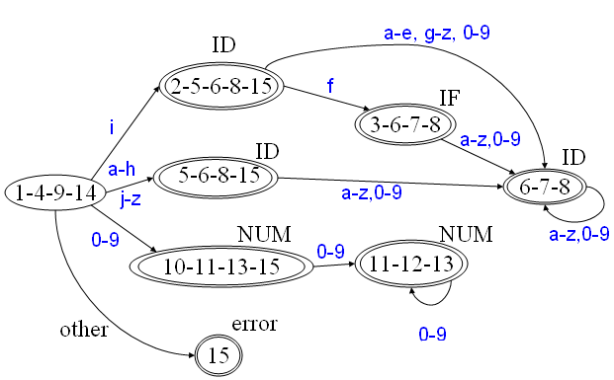
Tracing Example(27)
DFA
B
F
C
A
G
Transition Table
H
D
State | character
 | 0-9 | a-e | f | g-h | i | j-z | other
A | D | C | C | C | B | C | E
B | G | G | F | G | G | G | -
C | G | G | G | G | G | G | -
D | H | - | - | - | - | - | -
E | - | - | - | - | - | - | -
F | G | G | G | G | G | G | -
G | G | G | G | G | G | G | -
H | H | - | - | - | - | - | -
E

Slide 107
Tracing Example(28)
DFA
B
F
C
A
G
Transition Table
H
D
State | character
 | 0-9 | a-e | f | g-h | i | j-z | other
A | D | C | C | C | B | C | E
B | G | G | F | G | G | G | -
C | G | G | G | G | G | G | -
D | H | - | - | - | - | - | -
E | - | - | - | - | - | - | -
F | G | G | G | G | G | G | -
G | G | G | G | G | G | G | -
H | H | - | - | - | - | - | -
E
New Transition Table-1
State | character
 | 0-9 | a-e | f | g-h | i | j-z | other
A | D | C | C | C | B | C | E
B | C | C | C | C | C | C | -
C | C | C | C | C | C | C | -
D | D | - | - | - | - | - | -
E | - | - | - | - | - | - | -

Slide 108
Tracing Example(29)
DFA
B
F
C
A
G
New Transition Table-1
D
H
E
State | character
 | 0-9 | a-e | f | g-h | i | j-z | other
A | D | C | C | C | B | C | E
B | C | C | C | C | C | C | -
C | C | C | C | C | C | C | -
D | D | - | - | - | - | - | -
E | - | - | - | - | - | - | -
New Transition Table-2
State | character
 | 0-9 | a-e | f | g-h | i | j-z | other
A | D | B | B | B | B | B | E
B | B | B | B | B | B | B | -
D | D | - | - | - | - | - | -
E | - | - | - | - | - | - | -

Slide 109
Tracing Example(30)
New Transition Table-2
IF can be handled by look-ahead programming
State | character
 | 0-9 | a-e | f | g-h | i | j-z | other
A | D | B | B | B | B | B | E
B | B | B | B | B | B | B | -
D | D | - | - | - | - | - | -
E | - | - | - | - | - | - | -
New DFA
f
IF
i
B
a-z
a-z,0-9
ID
A
DFA
B
0-9
NUM
F
D
C
A
G
0-9
H
other
error
D
B=C=F=G
D=H
E
E

Slide 110
Chapter 3 End
隨堂考試(1⁺)
What is the optimized DFA for 1⁺?
Any Question?

Slide 111
1*
= 1 . 1⁺ (Can use this method)
λ
1
A
B
{1,2}
1
{3,4,2}
1
λ
2
1
3
λ
4
Start
1. λ-closure(1) ={1, 2}
2. λ-closure(2) ={2}
3. λ-closure(3) ={3 ,4 ,2}
4. λ-closure(4) ={4 ,2}
State | Character
 | 0 | 1
A |  | B
B |  | B
1. λ-closure(1) ={1, 2} ➔ A
3. λ-closure(3) ={3 ,4 ,2} ➔ B
1
Can Not Optimized, (Merge)
For A is Start State, B is Final State!
A
1
B

