Slide 1
Chapter 6 LR Parsing Techniques
Prof Chung.

Slide 2
Outline
6.0 Introduction
6.1 Shift-Reduce Parsers
6.2 LR Parsers
6.3 LR(1) Parsing
6.4 SLR(1)Parsing
6.5 LALR(1)
6.6 Calling Semantic Routines in Shift-Reduce Parsers
6.7 Using a Parser Generator (TA course)
6.8 Optimizing Parse Tables
6.9 Practical LR(1) Parsers
6.10 Properties of LR Parsing
6.11 LL(1) or LAlR(1) , That is the question
6.12 Other Shift-Reduce Technique

Slide 3
Introduction(1)
Overview
  Top-down parsers
    starts constructing the parse tree at the top (root) of the tree and move down towards the leaves.
    Easy to implement by hand, but work with restricted grammars.
    example: predictive parsers
In Chapter 6
  Bottom-up parsers
    build the nodes on the bottom of the parse tree first.
    Suitable for automatic parser generation, handle a larger class of grammars.
    examples: shift-reduce parser (or LR (k) parsers)

Slide 4
Introduction(2)
In Chapter 6
  Bottom-up parsers
    A bottom-up parser, or a shift-reduce parser,
    begins at the leaves and works up to the top of the tree.
    The reduction steps trace a rightmost derivation on reverse.
More Example at Next Page to explain it.
Grammar
parse
S → aABe
A → Abc | b
B → d
The input string : abbcde.
115/11/07

Slide 5
Introduction(3)
Bottom-Up Parser Example
Shift a
INPUT:
a
b
b
c
d
e
$
OUTPUT:
Production
S → aABe
Bottom-Up Parsing
Program
A → Abc
A → b
B → d

Slide 6
Introduction(4)
Bottom-Up Parser Example
Shift b
Reduce from b to A
INPUT:
a
b
b
c
d
e
$
OUTPUT:
Production
S → aABe
Bottom-Up Parsing
Program
A → Abc
A
A → b
B → d
b

Slide 7
Introduction(5)
Bottom-Up Parser Example
Shift A
INPUT:
a
A
b
c
d
e
$
OUTPUT:
Production
S → aABe
Bottom-Up Parsing
Program
A → Abc
A
A → b
B → d
b

Slide 8
Introduction(6)
Bottom-Up Parser Example
Shift b
INPUT:
a
A
b
c
d
e
$
OUTPUT:
Production
S → aABe
Bottom-Up Parsing
Program
A → Abc
A
A → b
B → d
b

Slide 9
Introduction(7)
Bottom-Up Parser Example
Shift c
Reduce from Abc to A
INPUT:
a
A
b
c
d
e
$
OUTPUT:
Production
A
S → aABe
Bottom-Up Parsing
Program
A → Abc
A
b
c
A → b
B → d
b

Slide 10
Introduction(8)
Bottom-Up Parser Example
Shift A
INPUT:
a
A
d
e
$
OUTPUT:
Production
A
S → aABe
Bottom-Up Parsing
Program
A → Abc
A
b
c
A → b
B → d
b

Slide 11
Introduction(9)
Bottom-Up Parser Example
Shift d
Reduce from d to B
INPUT:
a
A
d
e
$
OUTPUT:
Production
A
B
S → aABe
Bottom-Up Parsing
Program
A → Abc
A
b
c
d
A → b
B → d
b

Slide 12
Introduction(10)
Bottom-Up Parser Example
Shift B
INPUT:
a
A
B
e
$
OUTPUT:
Production
A
B
S → aABe
Bottom-Up Parsing
Program
A → Abc
A
b
c
d
A → b
B → d
b

Slide 13
Introduction(11)
Bottom-Up Parser Example
Shift e
Reduce from aABe to S
INPUT:
a
A
B
e
$
OUTPUT:
S
Production
a
A
B
e
S → aABe
Bottom-Up Parsing
Program
A → Abc
A
b
c
d
A → b
B → d
b

Slide 14
Introduction(12)
Bottom-Up Parser Example
Shift S
Hit the target $
INPUT:
S
$
OUTPUT:
S
Production
a
A
B
e
S → aABe
Bottom-Up Parsing
Program
A → Abc
A
b
c
d
A → b
B → d
b
This parser is known as an LR Parser because
it scans the input from Left to right, and it constructs
a Rightmost derivation in reverse order.

Slide 15
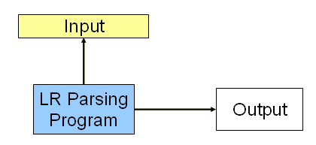
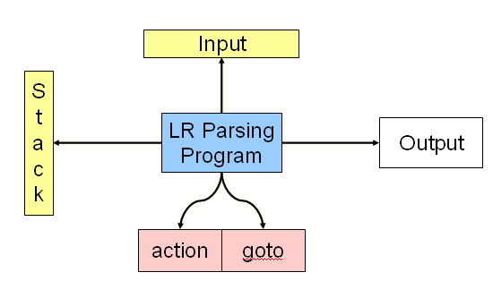
Introduction(13)
Conclusion
  The scanning of productions for matching with handles in the input string
  Backtracking makes the method used in the previous example very inefficient.
Can we do better? Discuss in later!!!
Previous Architecture
Renew Architecture

Slide 16
Outline
6.0 Introduction
6.1 Shift-Reduce Parsers
6.2 LR Parsers
6.3 LR(1) Parsing
6.4 SLR(1)Parsing
6.5 LALR(1)
6.6 Calling Semantic Routines in Shift-Reduce Parsers
6.7 Using a Parser Generator (TA course)
6.8 Optimizing Parse Tables
6.9 Practical LR(1) Parsers
6.10 Properties of LR Parsing
6.11 LL(1) or LAlR(1) , That is the question
6.12 Other Shift-Reduce Technique

Slide 17
Shift-Reduce Parsers(1)
Shift-Reduce (bottom-up) parser is known as an LR Parser
    It scans the input from Left to right
    Rightmost derivation in reverse order
  Kinds of LR
    LR(k)
      most powerful deterministic bottom-up parsing using k lookaheads
    SLR(k)
    LALR(k)
  mechanism to perform
  bottom-up parsing
    finite state machine
    to manipulate “handle”
  Components
    Parse stack
    Shift-reduce driver
    Action table
    Goto table

Slide 18
Shift-Reduce Parsers(2)
Parse stack
  Initially empty, contains symbols already parsed
    Elements in the stack are not terminal or non-terminal symbols
  The parse stack catenated with the remaining input always represents a right sentential form

Slide 19
Shift-Reduce Parsers(3)
Shift-Reduce driver
  Shift -- when top of stack doesn't contain a handle of the sentential form
    push input token (with contextual information) into stack
  Reduce -- when top of stack contains a handle
    pop the handle
    push reduced non-terminal (with contextual information)

Slide 20
Shift-Reduce Parsers(4)
Two questions
  Have we reached the end of handles and how long is the handle?
  Which non-terminal does the handle reduce to?
We use tables to answer the questions
  ACTION table
  GOTO table

Slide 21
Shift-Reduce Parsers(5)
LR parsers are driven by two tables:
  Action table, which specifies that actions to take
    Shift, reduce, accept or error
  Goto table, which specifies state transition
    To indicate transition of finite state machine
  We push states, rather than symbols onto the stack
  Each state represents the possible sub-trees of the parse tree

Slide 22
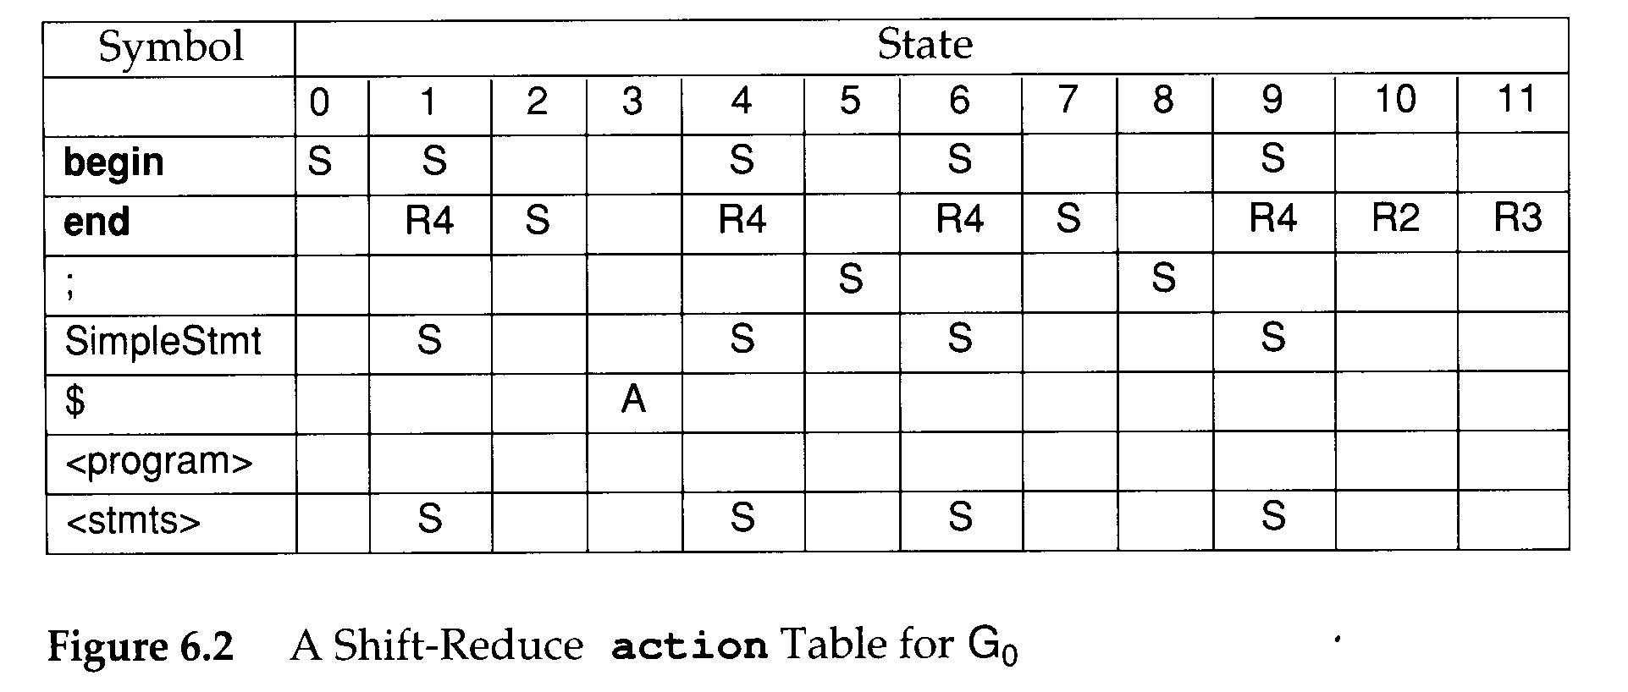
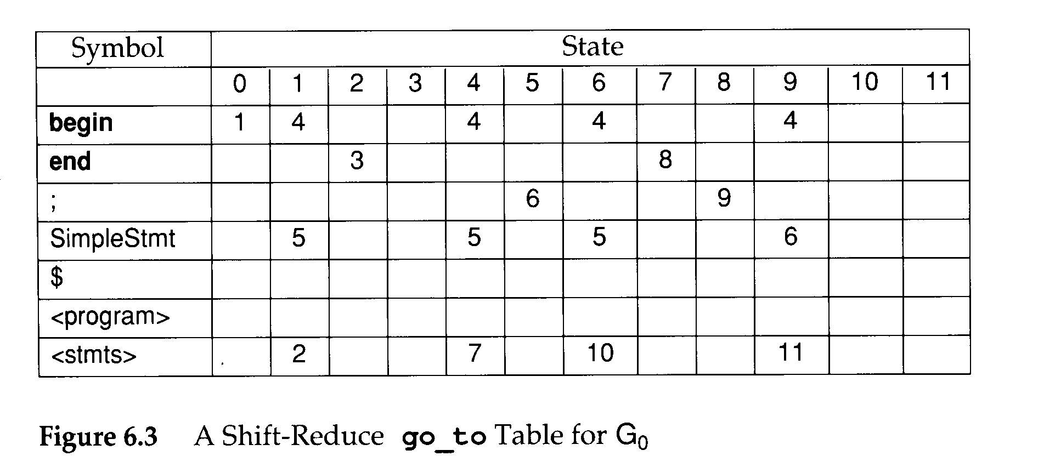
Shift-Reduce Parsers(6)
grammar G₀
  1. <program> → begin <stmts> end $
  2. <stmts> → SimpleStmt ; <stmts>
  3. <stmts> → begin <stmts> end ; <stmts>
  4. <stmts> → λ
Goto Table
Action Table
blank -- ERROR

Slide 23
Shift-Reduce Parsers(7)
void shift_reduce_driver(void)
{
/* Push the Start State, S₀,
* onto an empty parse stack. */
push(S₀);
while (TRUE) { /* forever */
/* Let S be the top parse stack state;
* let T be the current input token.*/
switch (action[S][T]) {
case ERROR:
announce_syntax_error();
break;
case ACCEPT:
/* The input has been correctly * parsed. */
clean_up_and_finish();
return;
case SHIFT:
push(go_to[S][T]);
scanner(&T);
/* Get next token. */
break;
case REDUCE_{i}:
/* Assume i-th production is
* X → Y₁ ⋅ ⋅ ⋅ Y_{m}.
* Remove states corresponding to
* the RHS of the production. */
pop(m);
/* S' is the new stack top. */
push(go_to[S'][X]);
break;
}
}
}

Slide 24
Shift-Reduce
Parsers(8)
grammar G₀
  1. <program>→begin<stmts>end$
  2. <stmts> →SimpleStmt;<stmts>
  3. <stmts> →begin<stmts>end;<stmts>
  4. <stmts> →λ
tracing steps
Step Parse Stack Remaining Input Action
(1) 0 begin SimpleStmt ; SimpleStmt ; end $ Shift 1
action
table
Symbol
State
0
1
2
3
4
5
6
7
8
9
10
11
begin
S
S
S
S
S
end
R4
S
R4
R4
S
R4
R2
R3
;
S
S
SimpleStmt
S
S
S
S
$
A

Slide 25
Shift-Reduce
Parsers(9)
grammar G₀
  1. <program>→begin<stmts>end$
  2. <stmts> →SimpleStmt;<stmts>
  3. <stmts> →begin<stmts>end;<stmts>
  4. <stmts> →λ
tracing steps
Step Parse Stack Remaining Input Action
(2) 0,1 SimpleStmt ; SimpleStmt ; end $ Shift 5
action
table
Symbol
State
0
1
2
3
4
5
6
7
8
9
10
11
begin
S
S
S
S
S
end
R4
S
R4
R4
S
R4
R2
R3
;
S
S
SimpleStmt
S
S
S
S
$
A

Slide 26
Shift-Reduce
Parsers(10)
grammar G₀
  1. <program>→begin<stmts>end$
  2. <stmts> →SimpleStmt;<stmts>
  3. <stmts> →begin<stmts>end;<stmts>
  4. <stmts> →λ
tracing steps
Step Parse Stack Remaining Input Action
(3) 0,1,5 ; SimpleStmt ; end $ Shift 6
action
table
Symbol
State
0
1
2
3
4
5
6
7
8
9
10
11
begin
S
S
S
S
S
end
R4
S
R4
R4
S
R4
R2
R3
;
S
S
SimpleStmt
S
S
S
S
$
A

Slide 27
Shift-Reduce
Parsers(11)
grammar G₀
  1. <program>→begin<stmts>end$
  2. <stmts> →SimpleStmt;<stmts>
  3. <stmts> →begin<stmts>end;<stmts>
  4. <stmts> →λ
tracing steps
Step Parse Stack Remaining Input Action
(4) 0,1,5,6 SimpleStmt ; end $ Shift 5
action
table
Symbol
State
0
1
2
3
4
5
6
7
8
9
10
11
begin
S
S
S
S
S
end
R4
S
R4
R4
S
R4
R2
R3
;
S
S
SimpleStmt
S
S
S
S
$
A

Slide 28
Shift-Reduce
Parsers(12)
grammar G₀
  1. <program>→begin<stmts>end$
  2. <stmts> →SimpleStmt;<stmts>
  3. <stmts> →begin<stmts>end;<stmts>
  4. <stmts> →λ
tracing steps
Step Parse Stack Remaining Input Action
(5) 0,1,5,6,5 ; end $ Shift 6
action
table
Symbol
State
0
1
2
3
4
5
6
7
8
9
10
11
begin
S
S
S
S
S
end
R4
S
R4
R4
S
R4
R2
R3
;
S
S
SimpleStmt
S
S
S
S
$
A

Slide 29

Shift-Reduce
Parsers(13)
grammar G₀
  1. <program>→begin<stmts>end$
  2. <stmts> →SimpleStmt;<stmts>
  3. <stmts> →begin<stmts>end;<stmts>
  4. <stmts> →λ
tracing steps
Step Parse Stack Remaining Input Action
(6) 0,1,5,6,5,6,λ end $ /* goto(6,<stmts>) = 10 */ Reduce 4
action
table
Symbol
State
0
1
2
3
4
5
6
7
8
9
10
11
begin
S
S
S
S
S
end
R4
S
R4
R4
S
R4
R2
R3
;
S
S
SimpleStmt
S
S
S
S
$
A
goto
table

Slide 30
Shift-Reduce
Parsers(14)
grammar G₀
  1. <program>→begin<stmts>end$
  2. <stmts> →SimpleStmt;<stmts>
  3. <stmts> →begin<stmts>end;<stmts>
  4. <stmts> →λ
tracing steps
Step Parse Stack Remaining Input Action
(7) 0,1,5,6,5,6,10 end $ /* goto(6,<stmts>) = 10 */ Reduce 2
action
table
Symbol
State
0
1
2
3
4
5
6
7
8
9
10
11
begin
S
S
S
S
S
end
R4
S
R4
R4
S
R4
R2
R3
;
S
S
SimpleStmt
S
S
S
S
$
A
goto
table

Slide 31
Shift-Reduce
Parsers(15)
grammar G₀
  1. <program>→begin<stmts>end$
  2. <stmts> →SimpleStmt;<stmts>
  3. <stmts> →begin<stmts>end;<stmts>
  4. <stmts> →λ
tracing steps
Step Parse Stack Remaining Input Action
(8) 0,1,5,6,10 end $ /* goto(1,<stmts>) = 2 */ Reduce 2
action
table
Symbol
State
0
1
2
3
4
5
6
7
8
9
10
11
begin
S
S
S
S
S
end
R4
S
R4
R4
S
R4
R2
R3
;
S
S
SimpleStmt
S
S
S
S
$
A
goto
table

Slide 32
Shift-Reduce
Parsers(16)
grammar G₀
  1. <program>→begin<stmts>end$
  2. <stmts> →SimpleStmt;<stmts>
  3. <stmts> →begin<stmts>end;<stmts>
  4. <stmts> →λ
tracing steps
Step Parse Stack Remaining Input Action
(9) 0,1,2 end $ Shift 3
action
table
Symbol
State
0
1
2
3
4
5
6
7
8
9
10
11
begin
S
S
S
S
S
end
R4
S
R4
R4
S
R4
R2
R3
;
S
S
SimpleStmt
S
S
S
S
$
A

Slide 33
Shift-Reduce
Parsers(17)
grammar G₀
  1. <program>→begin<stmts>end$
  2. <stmts> →SimpleStmt;<stmts>
  3. <stmts> →begin<stmts>end;<stmts>
  4. <stmts> →λ
tracing steps
Step Parse Stack Remaining Input Action
(10) 0,1,2,3 $ Accept
action
table
Symbol
State
0
1
2
3
4
5
6
7
8
9
10
11
begin
S
S
S
S
S
end
R4
S
R4
R4
S
R4
R2
R3
;
S
S
SimpleStmt
S
S
S
S
$
A

Slide 34
Shift-Reduce Parsers(18)
tracing steps
Step Parse Stack Remaining Input Action
(1) 0 begin SimpleStmt ; SimpleStmt ; end $ Shift 1
(2) 0,1 SimpleStmt ; SimpleStmt ; end $ Shift 5
(3) 0,1,5 ; SimpleStmt ; end $ Shift 6
(4) 0,1,5,6 SimpleStmt ; end $ Shift 5
(5) 0,1,5,6,5 ; end $ Shift 6
(6) 0,1,5,6,5,6,λ end $ /* goto(6,<stmts>) = 10 */ Reduce 4
(7) 0,1,5,6,5,6,10 end $ /* goto(6,<stmts>) = 10 */ Reduce 2
(8) 0,1,5,6,10 end $ /* goto(1,<stmts>) = 2 */ Reduce 2
(9) 0,1,2 end $ Shift 3
(10) 0,1,2,3 $ Accept
<program>
begin(1)
<stmts>
end(9)
$(10)
R2(8)
SimpleStmt(2)
;(3)
<stmts>
R2(7)
grammar G₀
  1. <program>→ begin <stmts> end $
  2. <stmts> → SimpleStmt ; <stmts>
  3. <stmts> → begin <stmts> end ; <stmts>
  4. <stmts> → λ
SimpleStmt(4)
;(5)
<stmts>
R4(6)
λ(6)

Slide 35
Outline
6.0 Introduction
6.1 Shift-Reduce Parsers
6.2 LR Parsers
6.3 LR(1) Parsing
6.4 SLR(1)Parsing
6.5 LALR(1)
6.6 Calling Semantic Routines in Shift-Reduce Parsers
6.7 Using a Parser Generator (TA course)
6.8 Optimizing Parse Tables
6.9 Practical LR(1) Parsers
6.10 Properties of LR Parsing
6.11 LL(1) or LAlR(1) , That is the question
6.12 Other Shift-Reduce Technique

Slide 36
LR Parsers
LR(n) n=0~k
  Read from Left, Right-most derivation, n look-ahead
LR parsers are deterministic
  No backup or retry parsing actions
LR(0):
  Without prediction read from Left, Right-most derivation, 0 look-ahead
LR(1):
  1-token look-ahead
  General
LR(k) parsers
  Decide the next action by examining the tokens already shifted and at most k look-ahead tokens
  The most powerful of deterministic
  Difficult to implement

Slide 37
LR(0) Table Construction(1)
A production has the form
  A→X₁X₂…X_{j}
By adding a dot, we get a configuration (or an item)
  A→•X₁X₂…X_{j}
  A→X₁X₂…X_{i} • X_{i+1} … X_{j}
  A→X₁X₂…X_{j} •
The • indicates how much of a RHS has been shifted into the stack.
An item with the • at the end of the RHS
  A→X₁X₂…X_{j} •
  indicates (or recognized) that RHS should be reduced to LHS
An item with the • at the beginning of RHS
  A→•X₁X₂…X_{j}
  predicts that RHS will be shifted into the stack

Slide 38
LR(0) Table Construction(2)
An LR(0) state is a set of configurations
  This means that the actual state of LR(0) parsers is denoted by one of the items.
The closure0 operation:
  if there is an configuration B→δ • A ρ in the set then add all configurations of the form A→ • γ to the set.
The initial configuration
  s0 = closure0({S→ • α $})
Configuration_set closure (configuration_set s)
{
configuration_set s’ = s ;
do
{
if( B →δ • A ρ ∈ s’ for A ∈ V_{n} )
{
/*
* Predict productions with A
* as the left-hand side
*/
Add all configurations of the form
A → • γ to s’
}
} while (more new configurations can be added) ;
return 0;
}
EX: for grammar G₁ :
1. S'→S$
2.S→ID|λ
closure0( { S → • E $ } ) =
{ S' → • S$,
S → • ID,
S → λ • }
special case: λ

Slide 39
LR(0) Table Construction(3)
Q1: Why the grammar use S'→S$ ?
  Ans: Easy to check the ending of parser!
  EX: If S’ is not exist~
  S→ID$
  S→ λ$
  When we button up to reduce
  the original symbol S, there are
  two paths to achieve it.
  Multipath is a problem that if we
  have complex grammars like C.
  A lot of paths we need to check
  the ending symbol $.
EX: for grammar G₁ :
1. S'→S$
2.S→ID|λ
closure0( { S → • E $ } ) =
{ S' → • S$,
S → • ID,
S → λ • }

Slide 40
LR(0) Table Construction(4)
Given a configuration set s, we can compute its successor, s’ , under a symbol X
  Denoted go_to0(s,X)=s’
Configuration_set goto (configuration_set s , symbol x)
{
S_{b} = Ø ;
for (each configuration c ∈ s)
if( each configuration c ∈ s)
Add A → βx • γ to s_{b} ;
/*
* That is, we advance the • past the symbol X,
* if possible. Configurations not having a
* dot preceding an X are not included in s_{b .}
*/
/* Add new predictions to s_{b} via closure0. */
return closure0(s_{b}) ;
}

Slide 41
LR(0) Table Construction(5)
Characteristic finite state machine (CFSM)
  It is a finite automaton
  Identifying configuration sets and successor operation with CFSM states and transitions
EX: for grammar G₁ :
1. S'→S$
2.S→ID|λ
void_build_CFSM(void)
{
S = SET_OF(S₀);
while (S is nonempty) {
Remove a configuration set s from S;
/* Consider both terminals and non-terminals */
for ( X in Symbols) {
if(go_to0(s,X) does not label a CFSM state) {
Create a new CFSM state and label it
with go_to0(s , X) into S;
}
Create a transition under X from the state s
labels to the state go_to0(s , X)
}
}
}
state 0
S' → • S$,
S → • ID,
S → λ •
ID
state 1
S → ID •
S
state 2
S' → S • $
$
state 3
S' → S $ •

Slide 42
LR(0) Table Construction(6)
CFSM is the goto table of LR(0) parsers.
state 0
S' → • S$,
S → • ID,
S → λ •
ID
state 1
S → ID •
Int ** build_go_to_table(finite_automation CFSM)
{
const int N = num_states (CFSM);
int **tab;
Dynamically allocate a table of dimension
N × num_symbols (CFSM) to represent
the go_to table and assign it to tab;
Number the states of CFSM from 0 to N-1,
with the Start State labeled 0;
for( S = 0 ; S<=N-1 ; S++) {
/* Consider both terminals and non-terminals. */
for ( X in Symbols) {
if ( State S has a transition under X to some state T)
tab [S][X] = T ;
else
tab [S][X] = EMPTY;
}
}
return tab;
}
S
state 2
S' → S • $
$
state 3
S' → S $ •
goto table
State | Symbol
 | ID | $ | S
0 | 1 | 4 | 2
1 | 4 | 4 | 4
2 | 4 | 3 | 4
3 | 4 | 4 | 4
4

Slide 43
LR(0) Table Construction(7)
Because LR(0) uses no look-ahead, we must extract the action function directly from the configuration sets of CFSM
Let Q={Shift, Reduce₁, Reduce₂ , …, Reduce_{n}}
  There are n productions in the CFG
S₀ be the set of CFSM states
  P:S₀→2^{Q}
P(s)={Reduce_{i} | B→ρ • ∈ s and production i is B→ρ } ∪ (if A→ α• aβ ∈ s for a ∈V_{t} Then {Shift} Else ∅)

Slide 44
LR(0) Table Construction(8)
G is LR(0) if and only if ∀ s ∈ S₀ |P(s)|=1
If G is LR(0), the action table is trivially extracted from P
  P(s)={Shift} ⇒ action[s]=Shift
  P(s)={Reduce_{i}}, where production j is the augmenting production, ⇒ action[s]=Accept
  P(s)={Reduce_{i}}, i≠j, action[s]=Reduce_{i}
  P(s)=∅ ⇒ action[s]=Error

Slide 45
LR(0) Table Construction(9)
EX: for grammar G₁ :
1. S'→S$
2.S→ID|λ
state 0
S' → • S$,
S → • ID,
S → λ •
ID
state 1
S → ID •
S
state 2
S' → S • $
$
state 3
S' → S $ •
state | 0 | 1 | 2 | 3
action | S | R2 | S | Accept

Slide 46
LR(0) Table Construction(10)
EX: for grammar G₁ :
1. S'→S$
2.S→ID|λ
state 0
S' → • S$,
S → • ID,
S → λ •
ID
state 1
S → ID •
S
state 2
S' → S • $
$
state 3
S' → S $ •
state | 0 | 1 | 2 | 3
action | S | R2 | S | Accept

Slide 47
LR(0) Table Construction(11)
EX: for grammar G₁ :
1. S'→S$
2.S→ID|λ
state 0
S' → • S$,
S → • ID,
S → λ •
ID
state 1
S → ID •
S
state 2
S' → S • $
$
state 3
S' → S $ •
state | 0 | 1 | 2 | 3
action | S | R2 | S | Accept

Slide 48
LR(0) Table Construction(12)
EX: for grammar G₁ :
1. S'→S$
2.S→ID|λ
state 0
S' → • S$,
S → • ID,
S → λ •
ID
state 1
S → ID •
S
state 2
S' → S • $
$
state 3
S' → S $ •
state | 0 | 1 | 2 | 3
action | S | R2 | S | Accept

Slide 49
LR(0) Table Construction(13)
Any state s ∈ S₀ for which |P(s)|>1 is said to be inadequate
Two kinds of parser conflicts create inadequacies in configuration sets
  Shift-reduce conflicts
  Reduce-reduce conflicts
If is easy to introduce inadequacies in CFSM states
  Hence, few real grammars are LR(0). For example,
    Consider λ-productions
      The only possible configuration involving a λ-production is of the form A→ λ•
      However, is A can generate any terminal string other than λ, then a shift action must also be possible (First(A))
    LR(0) parser will have problems in handling operator precedence properly

Slide 50
LR(0) Tracing Example(0)
Before tracing , we will need to know the mind of CFSM
for grammar G₂ :
1. S→E$
2.E→E+T
3.E→T
4.T →id
5.T →(E)
When shift ( , some possible answers of tree:
T
T
(
E
)
(
E
)
E
+
T
T
closure0( { T →(• E ) }
= { T →(• E ) ,
E →• E + T ,
E →• T ,
T →• id ,
T →• ( E ) }
T
id
(
E
)
T
id

Slide 51
LR(0) Tracing Example(1)
state 0
S → • E$
E → • E+T
E → • T
T → • id
T → • (E)
T
(
id
E
closure0( { S → • E$ } ) =
{ S → • E$,
E → • E+T,
E → • T,
T → • id,
T → • (E) }

Slide 52
LR(0) Tracing Example(2)
state 0
S → • E$
E → • E+T
E → • T
T → • id
T → • (E)
T
(
id
E
state 1
S → E • $
E → E • +T
+
$
closure0({ S → E • $, E → E • +T } ) =itself

Slide 53
LR(0) Tracing Example(3)
state 0
S → • E$
E → • E+T
E → • T
T → • id
T → • (E)
T
(
id
E
state 1
S → E • $
E → E • +T
+
$
state 2
S → E $ •
closure0({ S → E $ •} ) =itself

Slide 54
LR(0) Tracing Example(4)
state 0
S → • E$
E → • E+T
E → • T
T → • id
T → • (E)
T
(
id
E
id
state 1
S → E • $
E → E • +T
+
state 3
E → E + •T
T → • id
T → • (E)
(
$
T
state 2
S → E $ •
closure0({E → E+ • T}) =
{E → E+ • T,
T → • id,
T → • (E) }

Slide 55
LR(0) Tracing Example(5)
state 0
S → • E$
E → • E+T
E → • T
T → • id
T → • (E)
T
(
id
E
id
state 1
S → E • $
E → E • +T
+
state 3
E → E + •T
T → • id
T → • (E)
(
$
T
state 2
S → E $ •
state 4
E → E +T•
closure0({E → E+ T • }) =itself

Slide 56
LR(0) Tracing Example(6)
T
state 0
S → • E$
E → • E+T
E → • T
T → • id
T → • (E)
(
id
state 5
T → id •
E
id
state 1
S → E • $
E → E • +T
+
state 3
E → E + •T
T → • id
T → • (E)
(
$
T
state 2
S → E $ •
state 4
E → E +T•
closure0({T → id • }) =itself

Slide 57
LR(0) Tracing Example(7)
T
T
state 0
S → • E$
E → • E+T
E → • T
T → • id
T → • (E)
(
(
state 6
T → (• E)
E → • E+T
E → • T
T → • id
T → • (E)
id
state 5
T → id •
id
E
id
E
state 1
S → E • $
E → E • +T
+
state 3
E → E + •T
T → • id
T → • (E)
(
$
T
state 2
S → E $ •
state 4
E → E +T•
closure0({T → (• E) }) =
{ T → (• E) ,
E → • E+T,
E → • T,
T → • id,
T → • (E) }

Slide 58
LR(0) Tracing Example(8)
T
state 0
S → • E$
E → • E+T
E → • T
T → • id
T → • (E)
T
(
(
state 6
T → (• E)
E → • E+T
E → • T
T → • id
T → • (E)
id
state 5
T → id •
id
E
id
E
state 1
S → E • $
E → E • +T
+
state 3
E → E + •T
T → • id
T → • (E)
(
state 7
T → (E•)
E → E • +T
$
+
)
T
state 2
S → E $ •
state 4
E → E +T•
closure0({T → (E• ) ,E → E • +T } ) =itself

Slide 59
LR(0) Tracing Example(9)
T
state 0
S → • E$
E → • E+T
E → • T
T → • id
T → • (E)
T
(
(
state 6
T → (• E)
E → • E+T
E → • T
T → • id
T → • (E)
id
state 5
T → id •
id
E
id
E
state 1
S → E • $
E → E • +T
+
state 3
E → E + •T
T → • id
T → • (E)
(
state 7
T → (E•)
E → E • +T
$
+
)
T
state 2
S → E $ •
state 8
T → (E) •
state 4
E → E +T•
closure0({T → (E ) •} ) =itself

Slide 60
LR(0) Tracing Example(10)
state 9
E → T•
T
state 0
S → • E$
E → • E+T
E → • T
T → • id
T → • (E)
T
(
(
state 6
T → (• E)
E → • E+T
E → • T
T → • id
T → • (E)
id
state 5
T → id •
id
E
id
E
state 1
S → E • $
E → E • +T
+
state 3
E → E + •T
T → • id
T → • (E)
(
state 7
T → (E•)
E → E • +T
$
+
)
T
state 2
S → E $ •
state 8
T → (E) •
state 4
E → E +T•
closure0({E → T •} ) =itself

Slide 61
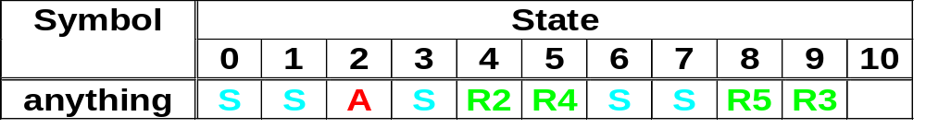
LR(0) Tracing Example(11)
state 9
E → T•
T
state 0
S → • E$
E → • E+T
E → • T
T → • id
T → • (E)
T
(
(
state 6
T → (• E)
E → • E+T
E → • T
T → • id
T → • (E)
id
state 5
T → id •
id
E
id
E
state 1
S → E • $
E → E • +T
+
state 3
E → E + •T
T → • id
T → • (E)
(
state 7
T → (E•)
E → E • +T
$
+
)
T
state 2
S → E $ •
state 8
T → (E) •
state 4
E → E +T•
any
error
state 10
Error
action
table

Slide 62
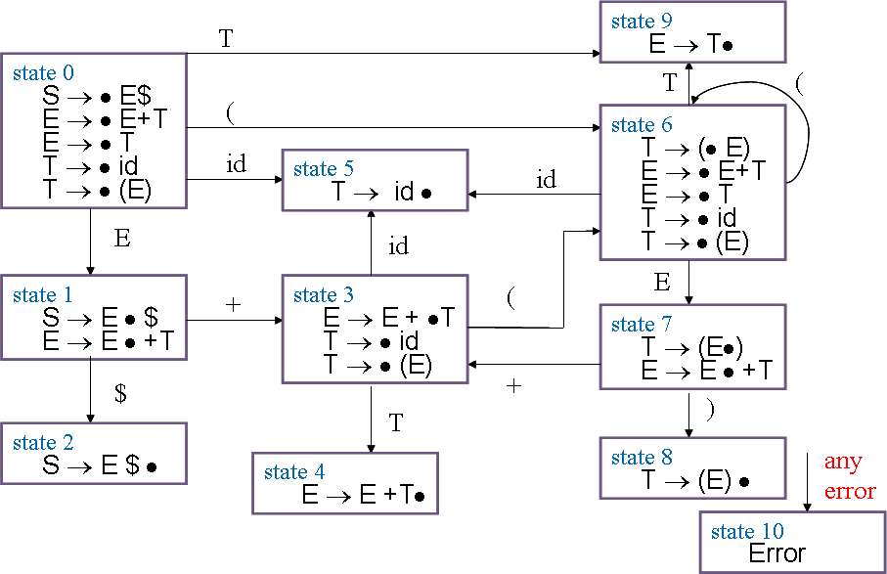
LR(0) Tracing
Example(12)
State | Symbol
 | S | E | T | + | id | ( | ) | $
0 |  | 1 | 9 |  | 5 | 6
1 |  |  |  | 3 |  |  |  | 2
2
3 |  |  | 4 |  | 5 | 6
4
5
6 |  | 7 | 9 |  | 5 | 6
7 |  |  |  | 3 |  |  | 8
8
9
10
goto table

Slide 63
State | Symbol
 | S | E | T | + | id | ( | ) | $
0 |  | 1 | 9 |  | 5 | 6
1 |  |  |  | 3 |  |  |  | 2
2
3 |  |  | 4 |  | 5 | 6
4
5
6 |  | 7 | 9 |  | 5 | 6
7 |  |  |  | 3 |  |  | 8
8
9
10
Program Example (1)
Initial :(id)$
step1:0 (id)$ shift (
Tree:
(
1

Slide 64
State | Symbol
 | S | E | T | + | id | ( | ) | $
0 |  | 1 | 9 |  | 5 | 6
1 |  |  |  | 3 |  |  |  | 2
2
3 |  |  | 4 |  | 5 | 6
4
5
6 |  | 7 | 9 |  | 5 | 6
7 |  |  |  | 3 |  |  | 8
8
9
10
Program Example (2)
Initial :(id)$
step2:06 id)$ shift id
Tree:
(
id
2

Slide 65
State | Symbol
 | S | E | T | + | id | ( | ) | $
0 |  | 1 | 9 |  | 5 | 6
1 |  |  |  | 3 |  |  |  | 2
2
3 |  |  | 4 |  | 5 | 6
4
5
6 |  | 7 | 9 |  | 5 | 6
7 |  |  |  | 3 |  |  | 8
8
9
10
Program Example (3)
Initial :(id)$
step3:065 )$ reduce 4
Tree:
(
T
id
3

Slide 66
State | Symbol
 | S | E | T | + | id | ( | ) | $
0 |  | 1 | 9 |  | 5 | 6
1 |  |  |  | 3 |  |  |  | 2
2
3 |  |  | 4 |  | 5 | 6
4
5
6 |  | 7 | 9 |  | 5 | 6
7 |  |  |  | 3 |  |  | 8
8
9
10
Program Example (4)
Initial :(id)$
step4:069 )$ reduce 3
Tree:
(
E
T
id
4

Slide 67
State | Symbol
 | S | E | T | + | id | ( | ) | $
0 |  | 1 | 9 |  | 5 | 6
1 |  |  |  | 3 |  |  |  | 2
2
3 |  |  | 4 |  | 5 | 6
4
5
6 |  | 7 | 9 |  | 5 | 6
7 |  |  |  | 3 |  |  | 8
8
9
10
Program Example (5)
Initial :(id)$
step5:067 )$ shift )
Tree:
(
E
)
T
id
5

Slide 68
State | Symbol
 | S | E | T | + | id | ( | ) | $
0 |  | 1 | 9 |  | 5 | 6
1 |  |  |  | 3 |  |  |  | 2
2
3 |  |  | 4 |  | 5 | 6
4
5
6 |  | 7 | 9 |  | 5 | 6
7 |  |  |  | 3 |  |  | 8
8
9
10
Program Example (6)
Initial :(id)$
step6:0678 $ reduce 5
T
Tree:
(
E
)
T
id
6

Slide 69
State | Symbol
 | S | E | T | + | id | ( | ) | $
0 |  | 1 | 9 |  | 5 | 6
1 |  |  |  | 3 |  |  |  | 2
2
3 |  |  | 4 |  | 5 | 6
4
5
6 |  | 7 | 9 |  | 5 | 6
7 |  |  |  | 3 |  |  | 8
8
9
10
Program Example (7)
Initial :(id)$
step7:09 $ reduce 3
E
Tree:
T
(
E
)
T
id
7

Slide 70
State | Symbol
 | S | E | T | + | id | ( | ) | $
0 |  | 1 | 9 |  | 5 | 6
1 |  |  |  | 3 |  |  |  | 2
2
3 |  |  | 4 |  | 5 | 6
4
5
6 |  | 7 | 9 |  | 5 | 6
7 |  |  |  | 3 |  |  | 8
8
9
10
Program Example (8)
Initial :(id)$
step8:01 $ shift $
E
$
T
Tree:
(
E
)
T
id
8

Slide 71
State | Symbol
 | S | E | T | + | id | ( | ) | $
0 |  | 1 | 9 |  | 5 | 6
1 |  |  |  | 3 |  |  |  | 2
2
3 |  |  | 4 |  | 5 | 6
4
5
6 |  | 7 | 9 |  | 5 | 6
7 |  |  |  | 3 |  |  | 8
8
9
10
Program Example (9)
Initial :(id)$
step9:012 Accept
S
E
$
Tree:
T
(
E
)
T
id
9 Accept

Slide 72
Practice
for grammar G₃ :
  1. S → E $
  2. E → E + T
  3. E → T
  4. T → T * P
  5. T → P
  6. P → id
  7. P → ( E )
Question2
What’s problem in LR(0) when you
finished G₃ LR(0) trace ???

