Slide 1
Outline
6.0 Introduction
6.1 Shift-Reduce Parsers
6.2 LR Parsers
6.3 LR(1) Parsing
6.4 SLR(1)Parsing
6.5 LALR(1)
6.6 Calling Semantic Routines in Shift-Reduce Parsers
6.7 Using a Parser Generator (TA course)
6.8 Optimizing Parse Tables
6.9 Practical LR(1) Parsers
6.10 Properties of LR Parsing
6.11 LL(1) or LAlR(1) , That is the question
6.12 Other Shift-Reduce Technique

Slide 2
SLR(1) Parsing (1)
LR(1) parsers are the most powerful case of shift-reduce parsers, using a single look-ahead
  LR(1) grammars exist for virtually all programming languages
  LR(1)’s problem is that the LR(1) machine contains so many states that the go_to and action tables become prohibitively large
In reaction to the space inefficiency of LR(1) tables, computer scientists have devised parsing techniques that are almost as powerful as LR(1) but that require far smaller tables
  One is to start with the CFSM, and then add look-ahead after the CFSM is build
    SLR(1)
  The other approach to reducing LR(1)’s space inefficiencies is to merger inessential LR(1) states
    LALR(1)

Slide 3
SLR(1) Parsing (2)
SLR(1) stands for Simple LR(1)
  One-symbol look-ahead
  Look-aheads are not built directly into configurations but rather are added after the LR(0) configuration sets are built
  An SLR(1) parser will perform a reduce action for configuration B→ ρ • if the look-ahead symbol is in the set Follow(B)
The SLR(1) projection function, from CFSM states,
  P : S₀×V_{t}→2^{Q}
  P(s,a)={Reduce_{i} | B→ρ •,a∈ Follow(B) and production i is B→ρ } ∪ (if A→ α• aβ ∈ s for a∈ V_{t} Then {Shift} Else ∅)

Slide 4
SLR(1) Parsing (3)
G is SLR(1) if and only if
  ∀s∈ S₀ ∀a∈ V_{t} |P(s,a)|≤1
If G is SLR(1), the action table is trivially extracted from P
  P(s,$)={Shift} ⇒ action[s][$]=Accept
  P(s,a)={Shift}, a≠$ ⇒ action[s][a]=Shift
  P(s,a)={Reduce_{i}}, ⇒ action[s][a]=Reduce_{i}
  P(s,a)=∅ ⇒ action[s][a]=Error
Clearly SLR(1) is a proper superset of LR(0)

Slide 5
SLR(1) Parsing (4)
Consider G₃
  It is LR(1) but not LR(0)
  What’re follow-sets in G₃?
Consider G₃ :
  1. S → E $
  2. E → E + T
  3. E → T
  4. T → T * P
  5. T → P
  6. P → id
  7. P → ( E )
Follow(S) = {λ},
Follow(E) = {+)$},
Follow(T) = {+*)$},
Follow(P) = {+*)$}

Slide 6
state 0
S → • E$
E → • E+T
E → • T
T → • T*P
T → • P
P → • id
P → • (E)
E
P
id
T
(
Follow(S) = {λ},
Follow(E) = {+)$},
Follow(T) = {+*)$},
Follow(P) = {+*)$}

Slide 7
state 0
S → • E$
E → • E+T
E → • T
T → • T*P
T → • P
P → • id
P → • (E)
state 1
S → E • $
E → E •+T
E
$
P
+
id
T
(
Follow(S) = {λ},
Follow(E) = {+)$},
Follow(T) = {+*)$},
Follow(P) = {+*)$}

Slide 8
state 0
S → • E$
E → • E+T
E → • T
T → • T*P
T → • P
P → • id
P → • (E)
state 1
S → E • $
E → E •+T
state 2 //Accept
S → E $ •
E
$
P
+
id
T
(
Follow(S) = {λ},
Follow(E) = {+)$},
Follow(T) = {+*)$},
Follow(P) = {+*)$}

Slide 9
state 0
S → • E$
E → • E+T
E → • T
T → • T*P
T → • P
P → • id
P → • (E)
state 1
S → E • $
E → E •+T
state 2 //Accept
S → E $ •
E
$
P
+
state 3
E → E+ • T
T → • T*P
T → • P
P → • id
P → • (E)
P
id
T
(
id
T
(
Follow(S) = {λ},
Follow(E) = {+)$},
Follow(T) = {+*)$},
Follow(P) = {+*)$}

Slide 10
state 0
S → • E$
E → • E+T
E → • T
T → • T*P
T → • P
P → • id
P → • (E)
state 1
S → E • $
E → E •+T
state 2 //Accept
S → E $ •
E
$
P
P
+
state 3
E → E+ • T
T → • T*P
T → • P
P → • id
P → • (E)
state 4
T → P •
P
id
T
(
id
T
(
Follow(S) = {λ},
Follow(E) = {+)$},
Follow(T) = {+*)$},
Follow(P) = {+*)$}

Slide 11
state 0
S → • E$
E → • E+T
E → • T
T → • T*P
T → • P
P → • id
P → • (E)
state 1
S → E • $
E → E •+T
state 2 //Accept
S → E $ •
E
$
P
P
+
state 3
E → E+ • T
T → • T*P
T → • P
P → • id
P → • (E)
state 4
T → P •
P
id
state 5
P → id •
T
(
id
T
(
Follow(S) = {λ},
Follow(E) = {+)$},
Follow(T) = {+*)$},
Follow(P) = {+*)$}

Slide 12
state 0
S → • E$
E → • E+T
E → • T
T → • T*P
T → • P
P → • id
P → • (E)
state 1
S → E • $
E → E •+T
state 2 //Accept
S → E $ •
E
$
P
P
+
state 3
E → E+ • T
T → • T*P
T → • P
P → • id
P → • (E)
state 4
T → P •
P
id
state 5
P → id •
T
(
id
T
id
(
state 6
P → (• E)
E → • E+T
E → • T
T → • T*P
T → • P
P → • id
P → • (E)
T
E
(
P
Follow(S) = {λ},
State 4
Follow(E) = {+)$},
Follow(T) = {+*)$},
Follow(P) = {+*)$}

Slide 13
state 0
S → • E$
E → • E+T
E → • T
T → • T*P
T → • P
P → • id
P → • (E)
state 1
S → E • $
E → E •+T
state 2 //Accept
S → E $ •
E
$
P
P
+
state 3
E → E+ • T
T → • T*P
T → • P
P → • id
P → • (E)
state 4
T → P •
P
id
state 5
P → id •
T
(
id
T
state 7
E → T •
T → T • *P
id
(
state 6
P → (• E)
E → • E+T
E → • T
T → • T*P
T → • P
P → • id
P → • (E)
*
T
E
(
P
Follow(S) = {λ},
State 4
Follow(E) = {+)$},
Follow(T) = {+*)$},
Follow(P) = {+*)$}

Slide 14
state 0
S → • E$
E → • E+T
E → • T
T → • T*P
T → • P
P → • id
P → • (E)
state 1
S → E • $
E → E •+T
state 2 //Accept
S → E $ •
E
$
P
P
+
state 3
E → E+ • T
T → • T*P
T → • P
P → • id
P → • (E)
state 4
T → P •
P
id
state 5
P → id •
T
(
id
T
state 7
E → T •
T → T • *P
id
id
(
state 6
P → (• E)
E → • E+T
E → • T
T → • T*P
T → • P
P → • id
P → • (E)
*
T
state 8
T → T* • P
P → • id
P → • (E)
(
E
P
(
P
Follow(S) = {λ},
State 4
Follow(E) = {+)$},
Follow(T) = {+*)$},
Follow(P) = {+*)$}

Slide 15
state 0
S → • E$
E → • E+T
E → • T
T → • T*P
T → • P
P → • id
P → • (E)
state 1
S → E • $
E → E •+T
state 2 //Accept
S → E $ •
E
$
P
P
+
state 3
E → E+ • T
T → • T*P
T → • P
P → • id
P → • (E)
state 4
T → P •
P
id
state 5
P → id •
T
(
id
T
state 7
E → T •
T → T • *P
id
id
(
state 6
P → (• E)
E → • E+T
E → • T
T → • T*P
T → • P
P → • id
P → • (E)
*
T
state 8
T → T* • P
P → • id
P → • (E)
(
E
P
(
P
state 9
T → T* P •
Follow(S) = {λ},
State 4
Follow(E) = {+)$},
Follow(T) = {+*)$},
Follow(P) = {+*)$}

Slide 16
state 0
S → • E$
E → • E+T
E → • T
T → • T*P
T → • P
P → • id
P → • (E)
state 1
S → E • $
E → E •+T
state 2 //Accept
S → E $ •
E
$
P
P
+
state 3
E → E+ • T
T → • T*P
T → • P
P → • id
P → • (E)
state 4
T → P •
P
id
state 5
P → id •
T
(
id
T
state 7
E → T •
T → T • *P
id
id
(
state 11
E → E+ T •
T → T • *P
state 6
P → (• E)
E → • E+T
E → • T
T → • T*P
T → • P
P → • id
P → • (E)
*
T
*
state 8
T → T* • P
P → • id
P → • (E)
State 8
(
E
P
(
P
state 9
T → T* P •
Follow(S) = {λ},
State 4
Follow(E) = {+)$},
Follow(T) = {+*)$},
Follow(P) = {+*)$}

Slide 17
state 0
S → • E$
E → • E+T
E → • T
T → • T*P
T → • P
P → • id
P → • (E)
state 1
S → E • $
E → E •+T
state 2 //Accept
S → E $ •
E
$
P
P
+
state 3
E → E+ • T
T → • T*P
T → • P
P → • id
P → • (E)
state 4
T → P •
P
id
state 5
P → id •
T
(
id
T
state 7
E → T •
T → T • *P
id
id
(
state 11
E → E+ T •
T → T • *P
state 6
P → (• E)
E → • E+T
E → • T
T → • T*P
T → • P
P → • id
P → • (E)
*
T
*
state 8
T → T* • P
P → • id
P → • (E)
State 8
(
E
state 12
P → (E •)
E → E • +T
P
(
)
+
P
state 9
T → T* P •
Follow(S) = {λ},
State 3
State 4
Follow(E) = {+)$},
Follow(T) = {+*)$},
Follow(P) = {+*)$}

Slide 18
state 0
S → • E$
E → • E+T
E → • T
T → • T*P
T → • P
P → • id
P → • (E)
state 1
S → E • $
E → E •+T
state 2 //Accept
S → E $ •
E
$
P
P
+
state 3
E → E+ • T
T → • T*P
T → • P
P → • id
P → • (E)
state 4
T → P •
P
id
state 5
P → id •
T
(
id
T
state 7
E → T •
T → T • *P
id
id
(
state 11
E → E+ T •
T → T • *P
state 6
P → (• E)
E → • E+T
E → • T
T → • T*P
T → • P
P → • id
P → • (E)
*
T
*
state 8
T → T* • P
P → • id
P → • (E)
State 8
(
E
state 12
P → (E •)
E → E • +T
P
(
)
+
P
state 9
T → T* P •
Follow(S) = {λ},
State 3
State 4
Follow(E) = {+)$},
Follow(T) = {+*)$},
state 10
P → (E) •
Follow(P) = {+*)$}

Slide 19
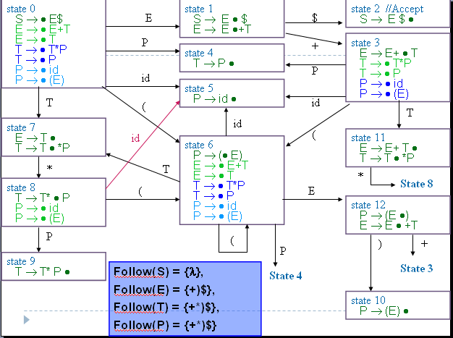
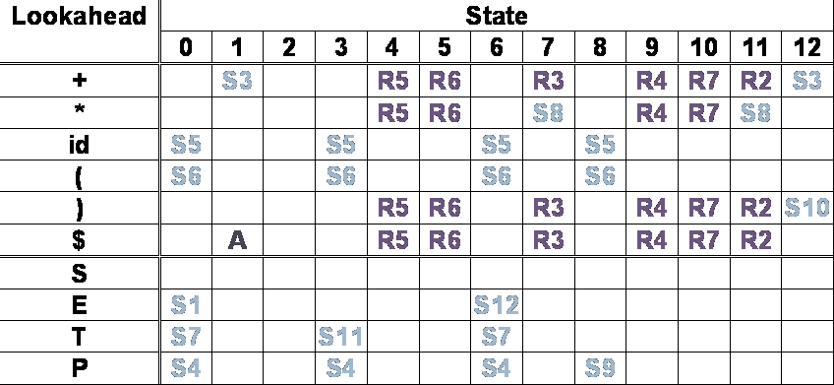
SLR(1) Parsing (5)
SLR(1) action table

Slide 20
SLR(1) Parsing (6)
Limitations of the SLR(1) Technique
  The use of Follow sets to estimate the look-aheads that predict reduce actions is less precise than using the exact look-aheads incorporated into LR(1) configurations
  Example in next page

Slide 21
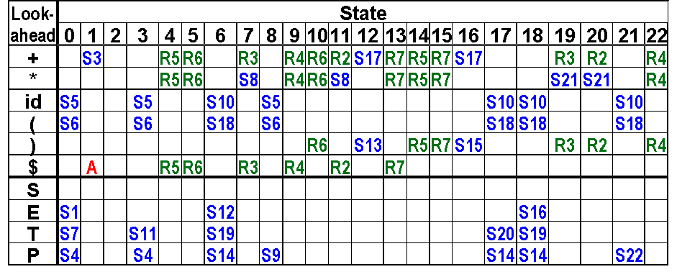
Compare
LR(1)&
SLR(1)
Consider G₃ :
  1. S → E $
  2. E → E + T
  3. E → T
  4. T → T * P
  5. T → P
  6. P → id
  7. P → ( E )
Consider Input: id )
LR(1)
LR(1)
Step1:0 id) shift 5
Step2:05 ) Error
The performance of detecting errors
SLR(1)
Step1:0 id) shift 5
Step2:05 ) Reduce 6
Step3:04 ) Reduce 5
Step4:07 ) Reduce 3
Step5:01 ) Error
SLR(1)

Slide 22
Outline
6.0 Introduction
6.1 Shift-Reduce Parsers
6.2 LR Parsers
6.3 LR(1) Parsing
6.4 SLR(1)Parsing
6.5 LALR(1)
6.6 Calling Semantic Routines in Shift-Reduce Parsers
6.7 Using a Parser Generator (TA course)
6.8 Optimizing Parse Tables
6.9 Practical LR(1) Parsers
6.10 Properties of LR Parsing
6.11 LL(1) or LAlR(1) , That is the question
6.12 Other Shift-Reduce Technique

Slide 23
LALR(1) (1)
LALR(1) parsers can be built by first constructing an LR(1) parser and then merging states
  An LALR(1) parser is an LR(1) parser in which all states that differ only in the look-ahead components of the configurations are merged
  LALR is an acronym for Look Ahead LR
The core of the above two configurations is the same. Example: LR(1)- stage3,stage17
state 3
E → E+ • T,{$+}
T → • T*P ,{$+*}
T → • P ,{$+*}
P → • id ,{$+*}
P → • (E) ,{$+*}
Cognate(s′)={c|c∈s, core(s)=s′}
state 3
E → E+ • T,{)$+}
T → • T*P ,{)$+*}
T → • P ,{)$+*}
P → • id ,{)$+*}
P → • (E) ,{)$+*}
Core s’
E → E+ • T
T → • T*P
T → • P
P → • id
P → • (E)
state 17
E → E +•T,{)+}
T → • T*P ,{)+*}
T → • P ,{)+*}
P → • id ,{)+*}
P → • (E) ,{)+*}

Slide 24
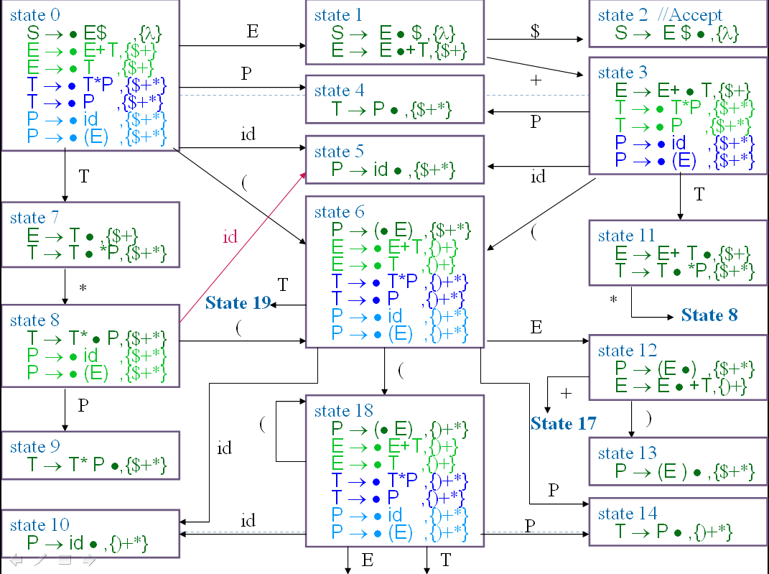
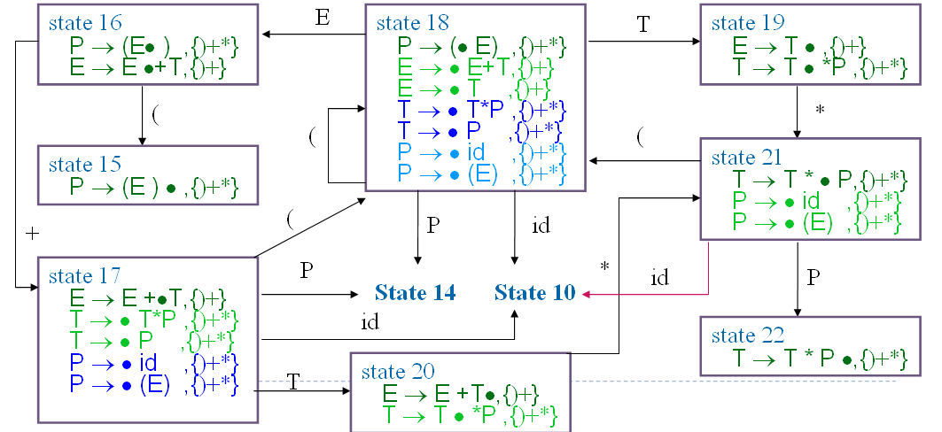
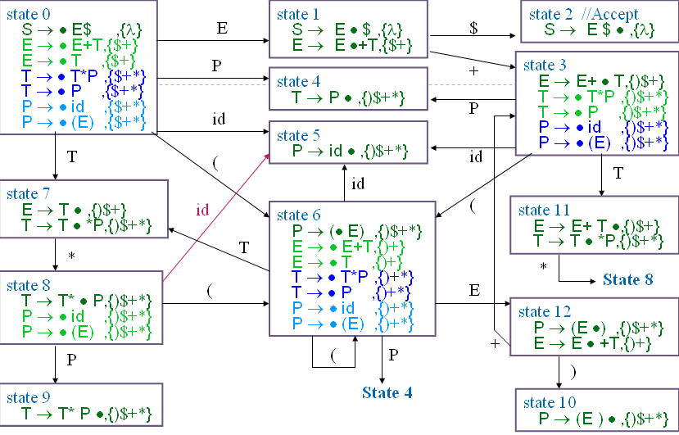
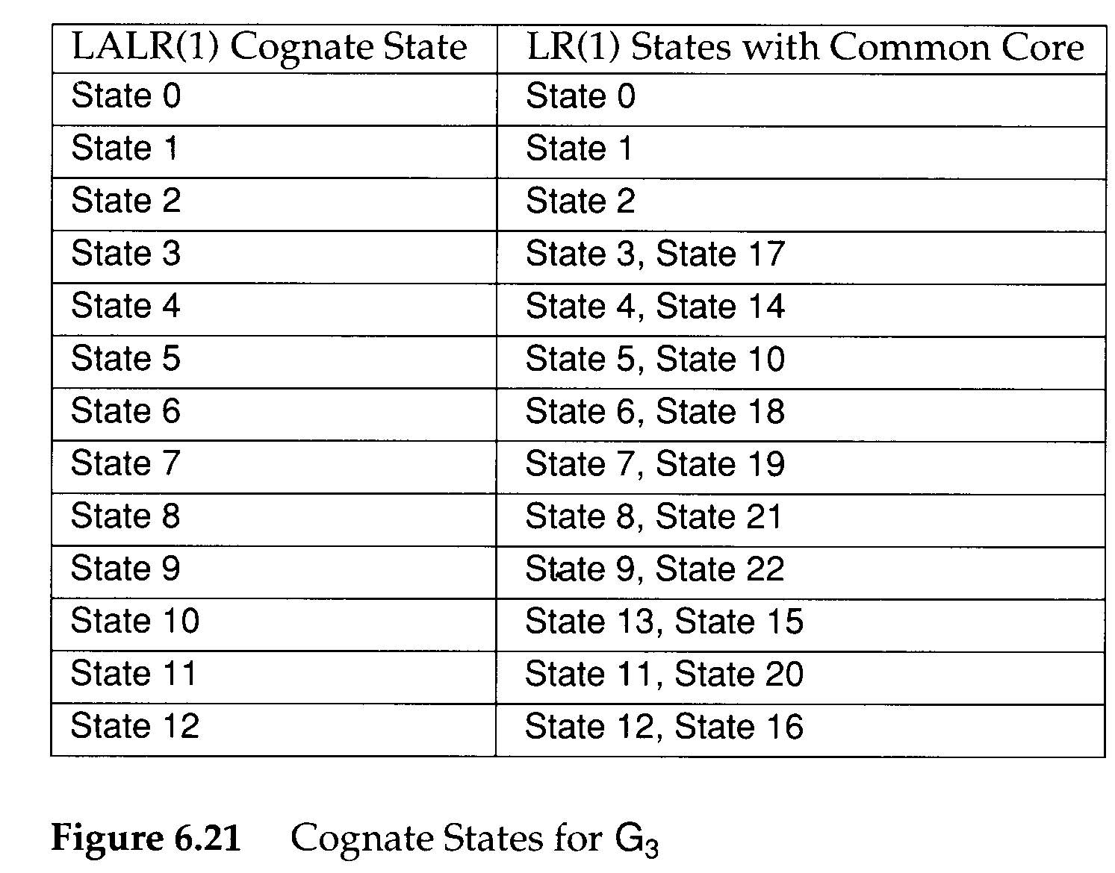
LR(1) G₃ diagram
LALR(1) G₃ diagram

Slide 25
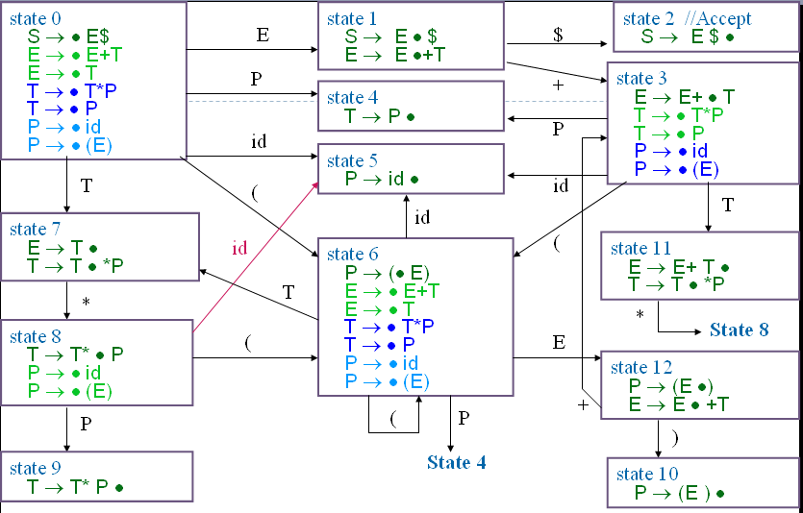
Follow(S) = {λ},
Follow(E) = {+)$},
Follow(T) = {+*)$},
SLR(1) G₃ diagram (CFSM)
Follow(P) = {+*)$}
Compare SLR(1) & LALR(1)
It’s same behavior whether action or goto using SLR(1) or LALR(1) in G₃
Example:
Compare state 7and state10
in SLR(1) andLALR(1).
Are they all same?
When’s different???
LALR(1) G₃ diagram

Slide 26
LALR(1) (4)
The CFSM state is transformed into its LALR(1) Cognate
  P : S₀×V_{t}→2^{Q}
  P(s,a)={Reduce_{i} | B→ρ •,a∈ Cognate(s) and production i is B→ρ } ∪ (if A→ α• aβ ∈ s Then {Shift} Else ∅)
G is LALR(1) if and only if
  ∀s∈ S₀ ∀a∈ V_{t} |P(s,a)|≤1
If G is LALR(1), the action table is trivially extracted from P
  P(s,$)={Shift} ⇒ action[s][$]=Accept
  P(s,a)={Shift}, a≠$ ⇒ action[s][a]=Shift
  P(s,a)={Reduce_{i}}, ⇒ action[s][a]=Reduce_{i}
  P(s,a)=∅ ⇒ action[s][a]=Error

Slide 27
LALR(1) (5)
grammar G₅ :
…..
<prog>→ <stmt>;{<stmt>;}
<stmt>→ID
<stmt>→<var>:=<expr>
<var> →ID
<var> →ID[<expr>]
<expr>→<var>
For Grammar 5:
Assume statements are separated by ;’s, the grammar is not SLR(1) because
  ; ∈ Follow(<stmt>) and
  ; ∈ Follow(<var>), since <expr>→<var>
state 0
……
<prog>→ •<stmt>;{<stmt>;}
<stmt>→ •ID
<stmt>→ •<var>:=<expr>
<var> → •ID
<var> → •ID[<expr>]
<expr>→ •<var>
id
state 1
<stmt>→ ID •
<var> → ID •
<var> → ID •[<expr>]
Reduce-reduce conflict

Slide 28
LALR(1) (6)
state 0
……
<prog>→ •<stmt>;{<stmt>;} ,{$ ;}
<stmt>→ •ID ,{$ ;}
<stmt>→ •<var>:=<expr> ,{$ ; :=}
<var> → •ID,{$ ; :=}
<var> → •ID[<expr>] ,{$ ; := [ }
<expr>→ •<var>
id
state 1
<stmt>→ ID • ,{$ ;}
<var> → ID • ,{$ ; :=}
<var> → ID •[<expr>] ,{$ ; := [ }
However, in LALR(1), if we use <var> → ID the next symbol must be :=
  so action[ 1, := ] = reduce(<var> → ID)
  action[ 1, ; ] = reduce(<stmt> → ID)
  action[ 1,[ ] = shift
There is no conflict.

Slide 29
LALR(1) (7)
A common technique to put an LALR(1) grammar into SLR(1) form is to introduce a new non-terminal whose global (I.e. SLR) look-aheads more nearly correspond to LALR’s exact look-aheads
  Follow(<lhs>) = {:=}
grammar G₅ :
……
<prog>→ <stmt>;{<stmt>;}
<stmt>→ ID
<stmt>→ <var>:=<expr>
<var> → ID
<var> → ID[<expr>]
<expr>→ <var>
grammar G₅ :
……
<prog>→ <stmt>;{<stmt>;}
<stmt>→ ID
<stmt>→ <lhs>:=<expr>
<lhs> → ID
<lhs> → ID[<expr>]
<var> → ID
<var> → ID[<expr>]
<expr>→ <var>

Slide 30
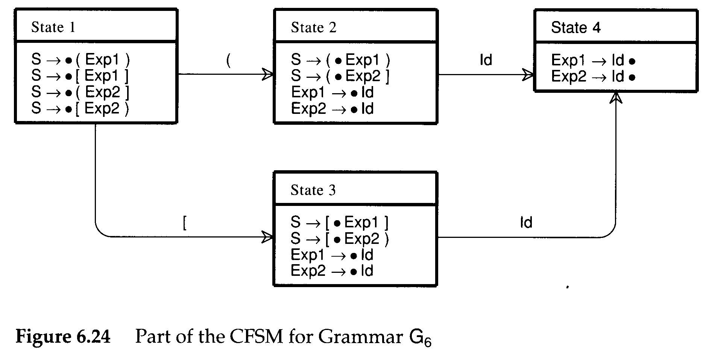
LALR(1) (8)
grammar G₆ :
S→ (Exp1)
S→ [Exp1]
S→ (Exp1]
S→ [Exp1)
<Exp1>→ID
<Exp2>→ID
Both SLR(1) and LALR(1) are both built CFSM
  Does the case ever occur in which action table
  can’t work?
At times, it is the CFSM itself that is at fault.
A different expression non-terminal is used to allow error or warning diagnostics
In state4 , we can’t reduce because we can’t make sure where state does it come from.
In LR(1) , state4 will split into two states and have a solution.

Slide 31
Building LALR(1) Parsers (1)
In the definition of LALR(1)
  An LR(1) machine is first built, and then its states are merged to form an automaton identical in structure to the CFSM
    May be quite inefficient
  An alternative is to build the CFSM first.
    Then LALR(1) look-aheads are “propagated” from configuration to configuration
Propagate links:
  Case 1: one configuration is created from another in a previous state via a shift operation
  Case 2: one configuration is created as the result of a closure or prediction operation on another configuration
A→ α•Xγ , L₁
A→ αX• γ , L₂
B→ β•Aγ , L₁
A→ •α , L₂
L₂={ x|x∈First(γt) and t ∈L₁ }

Slide 32
Building LALR(1) Parsers(2)
Step 1: After the CFSM is built, we can create all the necessary propagate links to transmit look-aheads from one configuration to another (case1)
Step 2: spontaneous look-aheads are determined (case2)
  By including in L₂, for configuration A→•α,L₂, all spontaneous look-aheads induced by configurations of the form B → β • Aγ,L₁
    These are simply the non-λ values of First(γ)
Step 3: Then, propagate look-aheads via the propagate links
While (stack is not empty)
{
pop top items , assign its components to (s,c,L)
if ( configuration c in state s has any propagate links)
{
Try, in turn, to add L to the look-ahead set of each
configuration so linked.
for (each configuration c’ in state s’ to which L is added)
Push(s’,c’,L) onto the stack
}
}

Slide 33
Building LALR(1) Parsers(3)
grammar G₆ :
S→ Opts $
Opts→ Opt Opt
Opt→ ID
state 1
S → • Opts$
Opts → • Opt Opt
Opt → • ID
state 2
Opts → Opt • Opt
Opt → • ID
Opt
ID
ID
state 3
Opt → ID •
Build CFSM
state 1
S → • Opts$ , {}
Opts → • Opt Opt ,{$}
Opt → • ID,{ID}
state 2
Opts → Opt • Opt
Opt → • ID
Opt
ID
ID
Stack:
(s1,c2,$)
(s1,c3,ID)
state 3
Opt → ID •
Build initial Lookahead

Slide 34
Building LALR(1) Parsers(3)
grammar G₆ :
S→ Opts $
Opts→ Opt Opt
Opt→ ID
state 1
S → • Opts$ , {}
Opts → • Opt Opt ,{$}
Opt → • ID,{ID}
state 2
Opts → Opt • Opt,{$}
Opt → • ID
Opt
ID
ID
Step1:
Pop(s1,c2,$)
Add $ to c1 in s2
Push(s2,c1,$)
Stack:
(s1,c2,$)
(s1,c3,ID)
state 3
Opt → ID •
state 1
S → • Opts$ , {}
Opts → • Opt Opt ,{$}
Opt → • ID,{ID}
state 2
Opts → Opt • Opt.{$}
Opt → • ID,{$}
Opt
ID
ID
Step2:
Pop(s2,c1,$)
Add $ to c2 in s2
Push(s2,c2,$)
Stack:
(s2,c1,$)
(s1,c3,ID)
state 3
Opt → ID •

Slide 35
Building LALR(1) Parsers(4)
grammar G₆ :
S→ Opts $
Opts→ Opt Opt
Opt→ ID
state 1
S → • Opts$ , {}
Opts → • Opt Opt ,{$}
Opt → • ID,{ID}
state 2
Opts → Opt • Opt.{$}
Opt → • ID,{$}
Opt
ID
ID
Step3:
Pop(s2,c2,$)
Add $ to c1 in s3
Push(s3,c1,$)
Stack:
(s2,c2,$)
(s1,c3,ID)
state 3
Opt → ID • ,{$}
state 1
S → • Opts$ , {}
Opts → • Opt Opt ,{$}
Opt → • ID,{ID}
state 2
Opts → Opt • Opt.{$}
Opt → • ID,{$}
Opt
ID
ID
Step4:
Pop(s3,c1,$)
Nothing to added
(no links)
Stack:
(s3,c1,$)
(s1,c3,ID)
state 3
Opt → ID • ,{$}

Slide 36
Building LALR(1) Parsers(4)
grammar G₆ :
S→ Opts $
Opts→ Opt Opt
Opt→ ID
state 1
S → • Opts$ , {}
Opts → • Opt Opt ,{$}
Opt → • ID,{ID}
state 2
Opts → Opt • Opt.{$}
Opt → • ID,{$}
Opt
ID
ID
Step5:
Pop(s1,c3,ID)
Add ID to c1 in s3
Push(s3,c1,ID)
Stack:
(s1,c3,ID)
state 3
Opt → ID • ,{$ ID}
state 1
S → • Opts$ , {}
Opts → • Opt Opt ,{$}
Opt → • ID,{ID}
state 2
Opts → Opt • Opt.{$}
Opt → • ID,{$}
Opt
ID
ID
Step6:
Pop(s3,c1,ID)
Nothing to added
(no links)
Stack:
(s3,c1,ID)
state 3
Opt → ID • ,{$ ID}

Slide 37
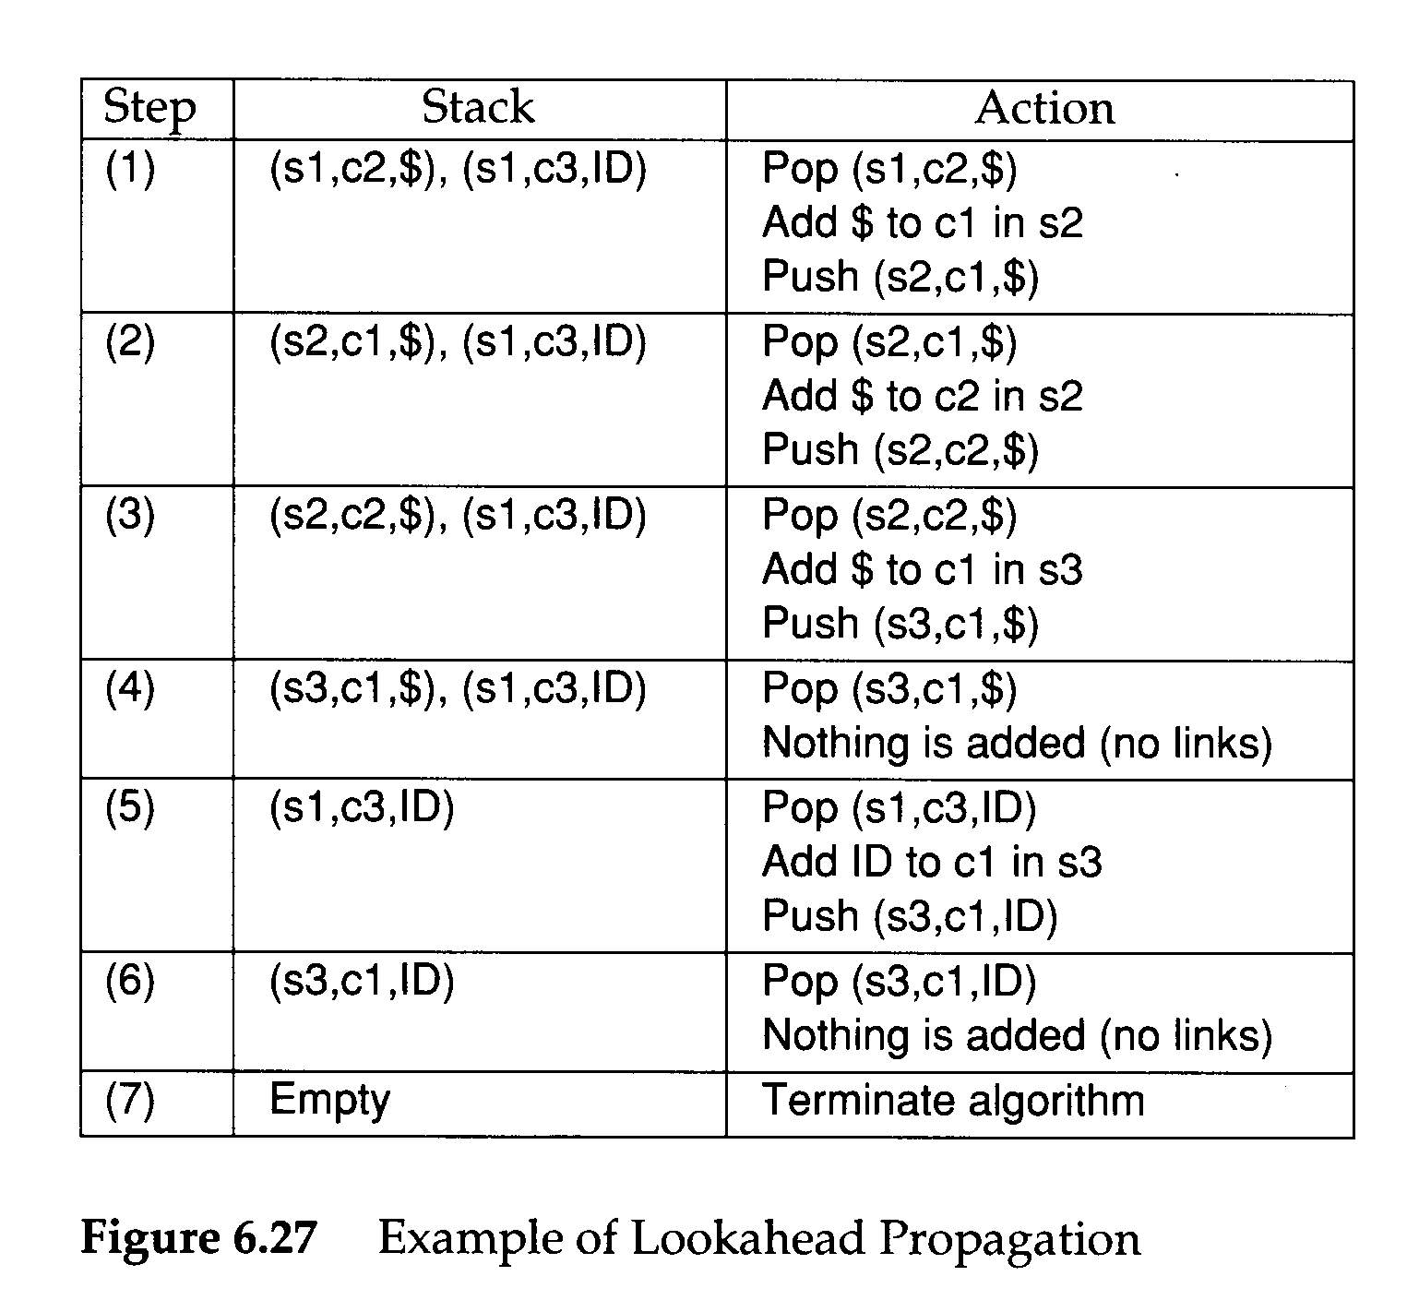
Building LALR(1) Parsers(5)
grammar G₆ :
S→ Opts $
Opts→ Opt Opt
Opt→ ID
state 1
S → • Opts$ , {}
Opts → • Opt Opt ,{$}
Opt → • ID,{ID}
state 2
Opts → Opt • Opt.{$}
Opt → • ID,{$}
Opt
ID
ID
Step7:
Terminate algorithm
Stack:
state 3
Opt → ID • ,{$ ID}
Stack:
high Index → low Index

Slide 38
Building LALR(1) Parsers (6)
A number of LALR(1) parser generators use look-ahead propagation to compute the parser action table
  LALR-Gen uses the propagation algorithm
  YACC examines each state repeatedly

Slide 39
Outline
6.0 Introduction
6.1 Shift-Reduce Parsers
6.2 LR Parsers
6.3 LR(1) Parsing
6.4 SLR(1)Parsing
6.5 LALR(1)
6.6 Calling Semantic Routines in Shift-Reduce Parsers
6.7 Using a Parser Generator (TA course)
6.8 Optimizing Parse Tables
6.9 Practical LR(1) Parsers
6.10 Properties of LR Parsing
6.11 LL(1) or LAlR(1) , That is the question
6.12 Other Shift-Reduce Technique

Slide 40
Calling Semantic Routines in Shift-Reduce Parsers (1)
Shift-reduce parsers can normally handle larger classes of grammars than LL(1) parsers, which is a major reason for their popularity
Shift-reduce parsers are not predictive, so we cannot always be sure what production is being recognized until its entire right-hand side has been matched
  The semantic routines can be invoked only after a production is recognized and reduced
    Action symbols only at the extreme right end of a right-hand side

Slide 41
Calling Semantic Routines in Shift-Reduce Parsers (2)
Two common tricks are known that allow more flexible placement of semantic routine calls
For example,
  <stmt>→if <expr> then <stmts> else <stmts> end if
We need to call semantic routines after the conditional expression else and end if are matched
  Solution: create new non-terminals that generate λ
  <stmt>→if <expr> <test cond>
  then <stmts> <process then part>
  else <stmts> end if
  <test cond>→λ
  <process than part>→λ

Slide 42
Calling Semantic Routines in Shift-Reduce Parsers (3)
If the right-hand sides differ in the semantic routines that are to be called, the parser will be unable to correctly determine which routines to invoke
  Ambiguity will manifest. For example,
  <stmt>→if <expr> <test cond1>
  then <stmts> <process then part>
  else <stmts> end if;
  <stmt>→if <expr> <test cond2>
  then <stmts> <process then part>
  else <stmts> end if;
  <test cond1>→λ
  <test cond2>→λ
  <process than part>→λ

Slide 43
Calling Semantic Routines in Shift-Reduce Parsers (4)
An alternative to the use of λ–generating non-terminals is to break a production into a number of pieces, with the breaks placed where semantic routines are required
  <stmt>→<if head><then part><else part>
  <if head>→if <expr>
  <then part>→then <stmts>
  <else part>→then <stmts> end if;
  This approach can make productions harder to read but has the advantage that no λ–generating are needed

Slide 44
Outline
6.0 Introduction
6.1 Shift-Reduce Parsers
6.2 LR Parsers
6.3 LR(1) Parsing
6.4 SLR(1)Parsing
6.5 LALR(1)
6.6 Calling Semantic Routines in Shift-Reduce Parsers
6.7 Using a Parser Generator (TA course)
6.8 Optimizing Parse Tables
6.9 Practical LR(1) Parsers
6.10 Properties of LR Parsing
6.11 LL(1) or LALR(1) , That is the question
6.12 Other Shift-Reduce Technique

Slide 45
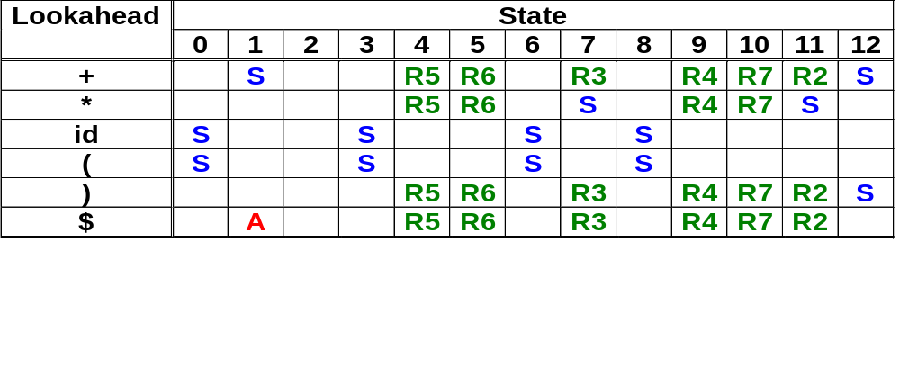
Optimizing
Parse tables (1)
Optimizing Parse Table
  Step1:Merge Action table
  and Go-to table
Action table

Slide 46
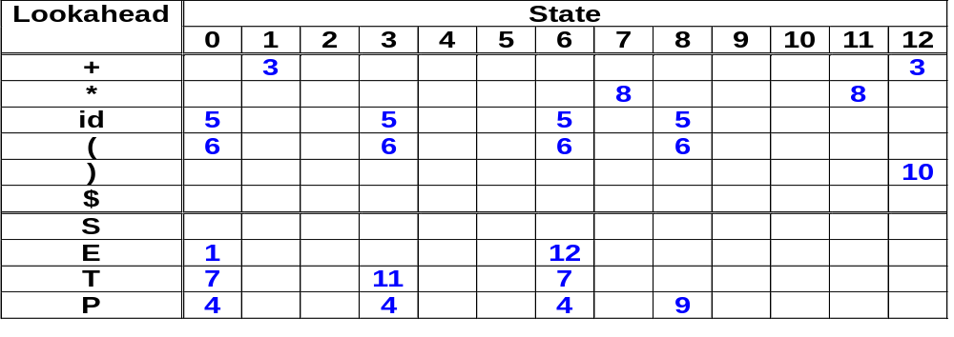
Optimizing
Parse tables (1)
Optimizing Parse Table
  Step1:Merge Action table
  and Go-to table
Goto table

Slide 47
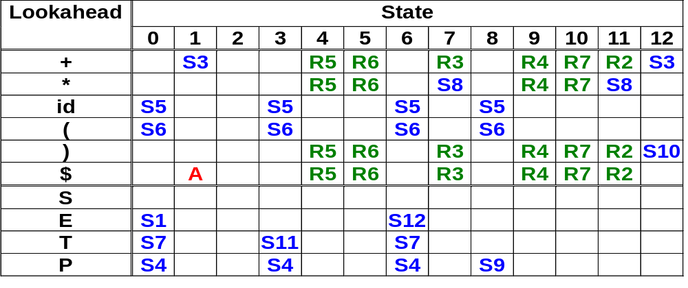
Optimizing Parse tables (3)
Action table
+
Goto table
Complete table

Slide 48
Optimizing Parse Tables (2)
Single Reduce State
  The state always simply reduce
  Because of always reducing , can we simplify using another display?

Slide 49
Optimizing Parse Tables (2)
  Step2:Eliminate all single reduce states.
    Replaced with a special marker--- L-prefix
    Example
      Shift to state4 would be replaced by the entry L5
    Make only one possible reduction in a state, we need not ever go to that state
Cancel this column
Replace S4 to L5
L5
L5
L5

Slide 50
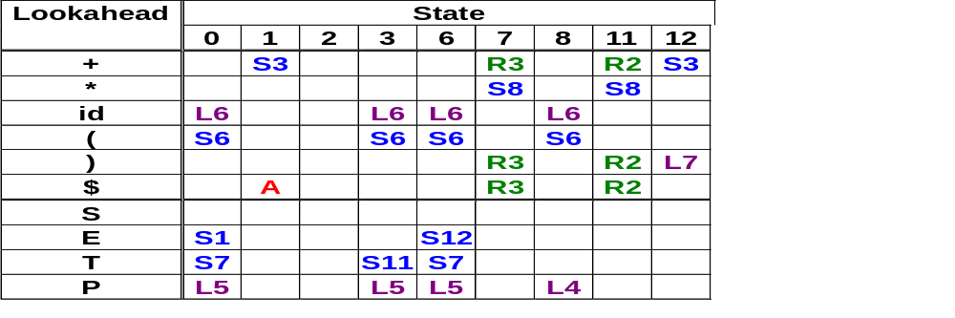
Optimizing Parse Tables (3)
Plz change in your slides

Slide 51
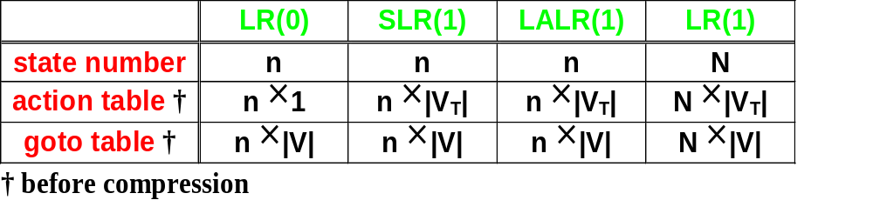
LL(1) or LALR(1) , That is the question(1)
--Modified by http://www.csie.ntu.edu.tw/~compiler/
power --
LR(1) grammar
LALR(1) grammar
SLR(1) grammar
LR(0) grammar
LALR(1) is the most commonly used bottom-up parsing method

Slide 52
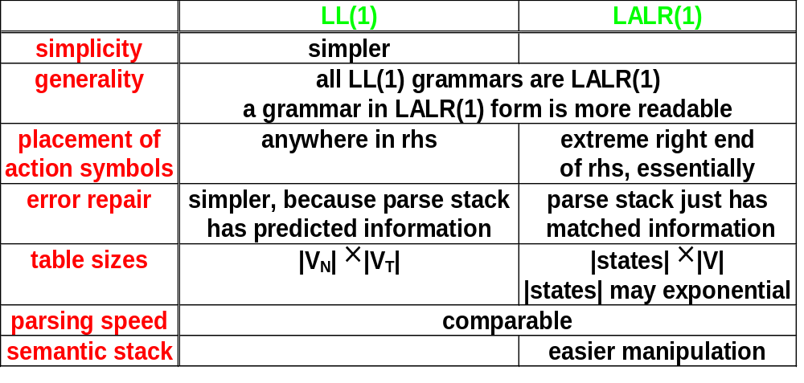
LL(1) or LALR(1) , That is the question(2)
--Modified by http://www.csie.ntu.edu.tw/~compiler/
Two most popular parsing methods

Slide 53
Assignment 2 Q&A
(id+id)$
Q1: How about Output??
  A syntax tree
  Not a table~!!!
  The data structure you can
  Use like
  Tree
  ---directed but diff to handle
  Binary Tree
  ---Left Chid Right Brother Tree
  Other(Linked Tree……)
Tree:
T
P
(
E
)
E
+
T
T
P
P
id
id

Slide 54
Assignment 2 Q&A (2)
Q2:How can remove about Expression’s ambiguous ???
Ans:
1. Rewrite the grammars(But difficult I Know)
2. Use LL(2) if needed.
example a<b vs. a=b+1
Q3:How can I display the tree???
  Use tree traverse You Learn in Data Structure.
  You can use some skill to help more readable.
  Ex: id+id
  You can display a+b
  Match grammars E
  Get token:+
  Match grammars E
  Match grammars T
  Match grammars P
  Get token id=a
  Match grammars T
  Match grammars P
  Get token id=b
Tree:
T
P
(
E
)
E
+
T
T
P
P
id
id

