Slide 1
CS235102
Data Structures
Chapter 10 Search Structures
(Selected Topics)

Slide 2
Search Structures: Outline
Optimal Binary Search Trees
AVL Trees
2-3 Trees

Slide 3
Optimal binary search trees (1/14)
In this section we look at the construction of binary search trees for a static set of identifiers
  Make no additions to or deletions from the
  Only perform searches
We examine the correspondence between a binary search tree and the binary search function

Slide 4
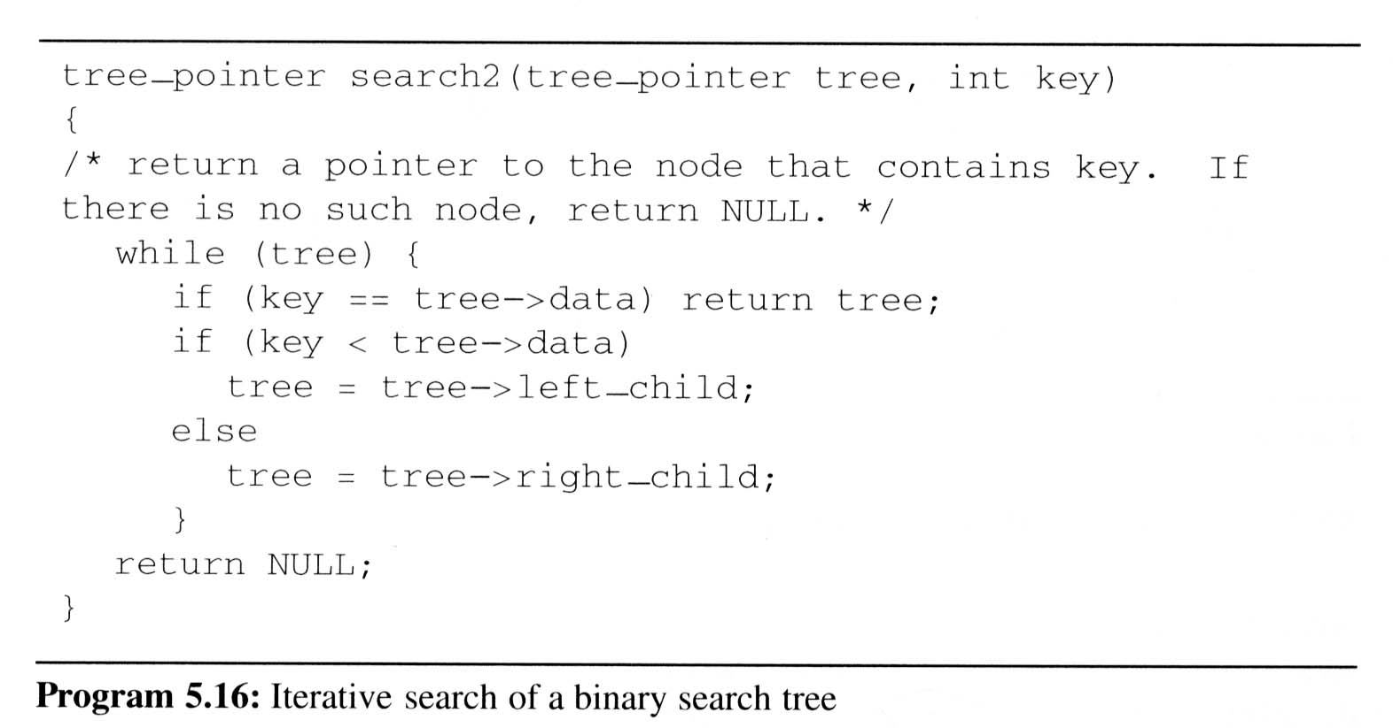
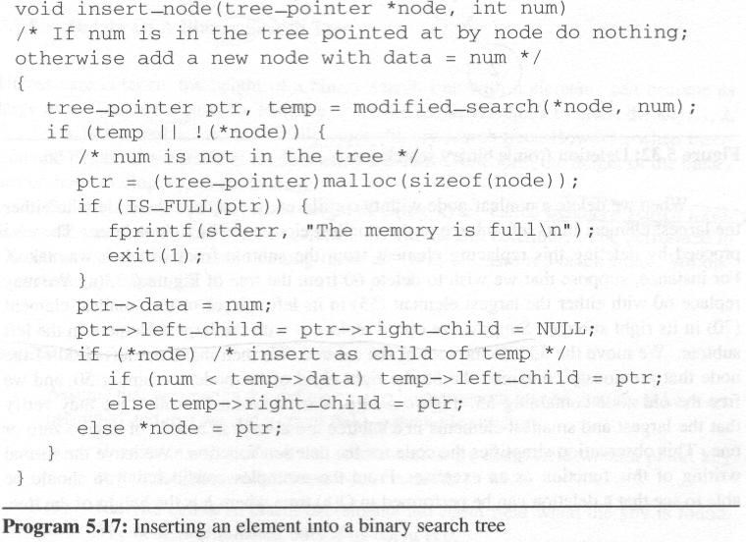
Optimal binary search trees (2/14)
Examine: A binary search on the list (do, if , while) is equivalent to
using the function
(search2) on the
binary search tree

Slide 5
Optimal binary search trees (3/14)
For a given static list, to decide a cost measure for search tree in order to find an optimal binary search tree
  Assume that we wish to search for an identifier at level k of a binary search tree.
  Generally, the number of iteration of binary search equals the level number of the identifier we seek.
  It is reasonable to use the level number of a node as its cost.

Slide 6
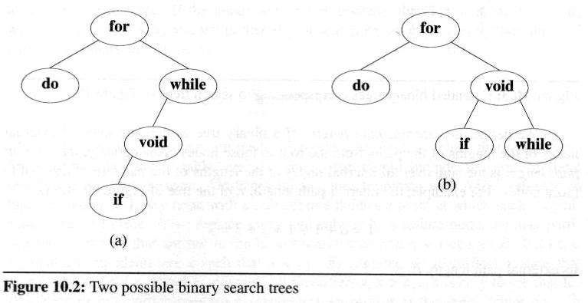
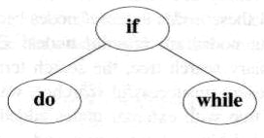
A full binary tree may not be an optimal binary search tree if the identifiers are
searched for with different frequency
Consider these
two search trees,
If we search for
each identifier with equal probability
  In first tree, the average number of
  comparisons for successful search is 2.4.
  Comparisons for second tree is 2.2.
The second tree has
  a better worst case search time than
  the first tree.
  a better average behavior.
1
2
2
3
4
(1+2+2+3+4)/5 = 2.4
1
2
2
(1+2+2+3+3)/5 = 2.2
3
3

Slide 7
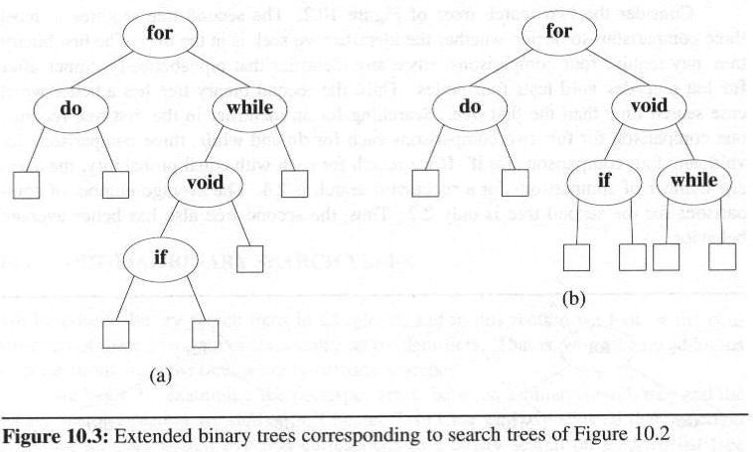
Optimal binary search trees (5/14)
In evaluating binary search trees,
it is useful to add a special
square node at every place
there is a null links.
  We call these nodes external nodes.
  We also refer to the external nodes
  as failure nodes.
  The remaining nodes are
  internal nodes.
  A binary tree with external nodes
  added is an extended binary tree

Slide 8
Optimal binary search trees (6/14)
external / internal path length
  the sum overall external / internal nodes of the lengths of the paths from the root to those nodes.
For example
  internal path length, I, is:
  I = 0 + 1 + 1 + 2 + 3 = 7
  external path length, E, is :
  E = 2 + 2 + 4 + 4 + 3 + 2 = 17
A binary tree with n internal
nodes are related by the formula
E = I + 2n
0
1
1
2
2
2
2
3
3
4
4

Slide 9


Optimal binary search trees (7/14)
The maximum and minimum possible values for I with n internal nodes
Maximum:
  The worst case occurs when the tree is skewed, that is, the tree has a depth of n.
Minimum:
  We must have as many internal nodes as close to the root as possible in order to obtain trees with minimal I
  One tree with minimal internal path length is the complete binary tree that the distance of node i from the root is ⎣log₂i⎦.

Slide 10

Optimal binary search trees (8/14)
In the binary search tree:
  the identifiers a₁, a₂, …, a_{n} with a₁ < a₂ < … < a_{n}
  the probability of searching for each a_{i} is p_{i}
  the total cost (when only successful searches are made) is:
If we replace the null subtree by a failure node, we may partition the identifiers that are not in the binary search tree into n+1 classes E_{i}, 0 ≤ i ≤ n
  E_{i} contains all identifiers x such that a_{i} < x < a_{i+1}
  for all identifiers in a particular class, E_{i}, the search terminates at the same failure node

Slide 11



Optimal binary search trees (9/14)
We number the failure nodes form 0 to n with i being for class E_{i}, 0 ≤ i ≤ n.
  If q_{i} is the probability that the identifier we are searching for is in E_{i}, then the cost of the failure node is:
Therefore, the total cost of a binary search tree is:
  An optimal binary search tree for the identifier set a₁, …, a_{n} is one that minimizes Eq. (10.1)
  Since all searches must terminate either successfully or unsuccessfully, we have
(10.1)

Slide 12
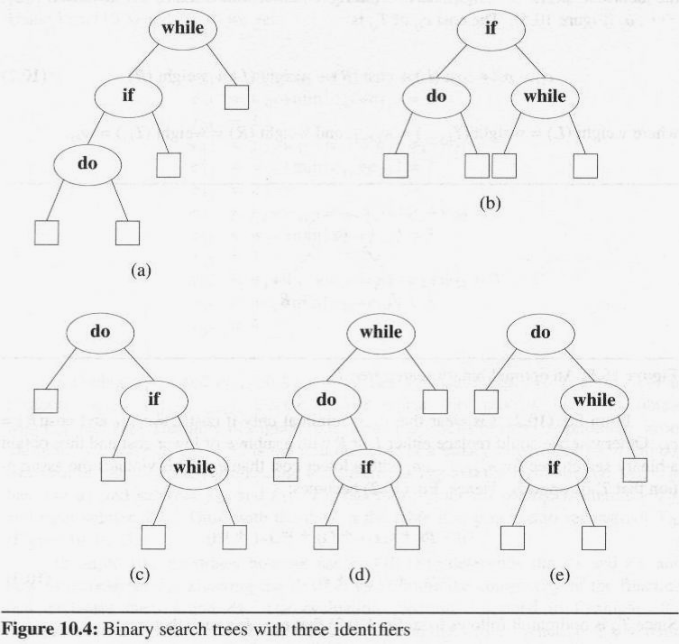
Optimal binary search trees (10/14)
1
E₃
2
1
The possible binary search trees for the
identifier set (a₁, a₂, a₃) = (do, if, while)
  the identifiers with equal probabilities,
  p_{i}=a_{j}=1/7 for all i, j,
    cost(tree a) = 15/7; cost(tree b) = 13/7 (optimal);
    cost(tree c) = 15/7; cost(tree d) = 15/7;
    cost(tree e) = 15/7;
  p₁ = 0.5, p₂ = 0.1, p₃ = 0.05,
  q₀ = 0.15, q₁= 0.1, q₂ = 0.05, q₃ = 0.05
    cost(tree a) = 2.65;
    cost(tree b) = 1.9;
    cost(tree c) = 1.5;
    (optimal)
    cost(tree d) = 2.05;
    cost(tree e) = 1.6;
E₂
3
2
E₀
E₁
3
3

Slide 13
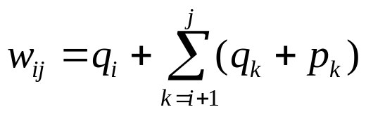
Optimal binary search trees (11/14)
How do we determine the optimal binary search tree for a given set of identifiers?
  We can make some observations about the properties of optimal binary search trees
  T_{ij} : an optimal binary search tree for a_{i+1}, …, a_{j}, i < j.
    T_{ii} is an empty tree for 0 ≤ i ≤ n and T_{ij} is not defined for i > j.
  c_{ij} : the cost of the search tree T_{ij}.
    By definition c_{ii} is 0.
  r_{ij} : the root of T_{ij}
  w_{ij} : the weight of T_{ij} ,
    By definition, r_{ii} = 0 and w_{ii} = q_{i} , 0 ≤ i ≤ n .
  T_{0n} is an optimal binary search for a₁, …, a_{n}. Its cost is c_{0n}, its weight is w_{0n}, and its root is r_{0n}

Slide 14
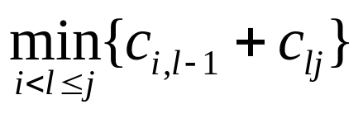
Optimal binary search trees (12/14)
If T_{ij} is an optimal binary search tree for a_{i+1}, …, a_{j} and r_{ij} = k, then k satisfies the inequality
i < k ≤ j.
T has two subtrees L and R.
  L is the left subtree and the identifiers a_{i+1}, …, a_{k-1}
  R is the right subtree and the identifiers a_{k+1}, …, a_{j}
The cost c_{ij} of T_{ij} is (w_{ij} = p_{k} + w_{i,k-1} + w_{kj})
  p_{k} + cost(L) + cost(R) + weight(L) + weight(R) =
  p_{k} + C_{i,k-1} + C_{kj} + w_{i,k-1} + w_{kj} = w_{ij} + C_{i,k-1} + C_{kj} =
  w_{ij} +
  It shows us how to obtain T_{0n} and C_{0n}, starting from knowledge that T_{ii} = φ and c_{ii} = 0
a_{k}
L
R

Slide 15
Optimal binary search trees (13/14)
Example
  Let n = 4, (a₁, a₂, a₃, a₄) = (do, for, void, while).
  Let (p₁, p₂, p₃, p₄) = (3, 3, 1, 1)
  and (q₀, q₁, q₂, q₃, q₄) = (2, 3, 1, 1, 1).
  Initially w_{ii} = q_{i} , c_{ii} = 0, and r_{ii} = 0, 0 ≤ i ≤ 4
w₀₁ = p₁ + w₀₀ + w₁₁ = p₁ + q₁ + w₀₀ = 8
c₀₁ = w₀₁ + min{c₀₀ +c₁₁} = 8, r₀₁ = 1
w₁₂ = p₂ + w₁₁ + w₂₂ = p₂ +q₂ +w₁₁ = 7
c₁₂ = w₁₂ + min{c₁₁ +c₂₂} = 7, r₁₂ = 2
w₂₃ = p₃ + w₂₂ + w₃₃ = p₃ +q₃ +w₂₂ = 3
c₂₃ = w₂₃ + min{c₂₂ +c₃₃} = 3, r₂₃ = 3
w₃₄ = p₄ + w₃₃ + w₄₄ = p₄ +q₄ +w₃₃ = 3
c₃₄ = w₃₄ + min{c₃₃ +c₄₄} = 3, r₃₄ = 4

Slide 16
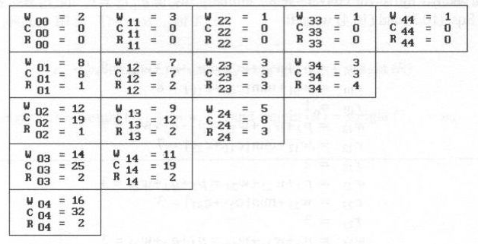
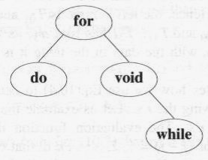
Optimal binary search trees (14/14)
w_{ii} = q_{i}
w_{ij} = p_{k} + w_{i,k-1} + w_{kj}
c_{ij} = w_{ij} +
c_{ii} = 0
r_{ii} = 0
r_{ij} = l
(p1, p2, p3, p4) = (3, 3, 1, 1)
(q0, q1, q2, q3, q4) = (2, 3, 1, 1, 1)
2
1
3
Computation is carried out row-wise from row 0 to row 4
4
The optimal search tree as the result

Slide 17
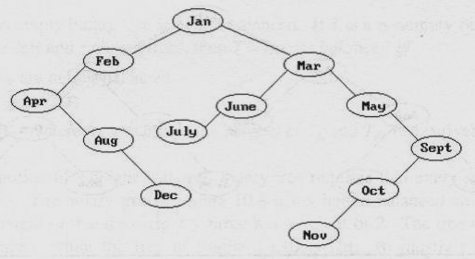
AVL Trees (1/17)
We also may maintain dynamic tables as binary search trees.
  Figure 10.8 shows the binary search tree obtained by entering the months January to December, in that order, into an initially empty binary search tree
  The maximum number of comparisons needed to search for any identifier in the tree of Figure 10.8 is six
  (for November).
  Average number of
  comparisons is
  42/12 = 3.5

Slide 18
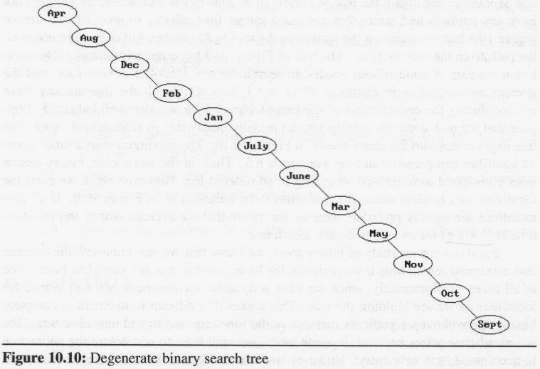
AVL Trees (2/17)
Suppose that we now enter the months into an initially empty tree in alphabetical order
  The tree degenerates into the chain
  number of comparisons:
  maximum: 12, and average: 6.5
  in the worst
  case, binary
  search trees
  correspond to
  sequential
  searching in an
  ordered list

Slide 19
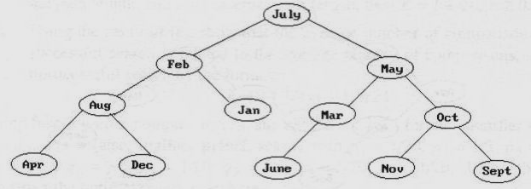
Another insert sequence
  In the order Jul, Feb, May, Aug, Jan, Mar, Oct, Apr, Dec, Jun, Nov, and Sep, by Figure 10.9.
  Well balanced and does not have any paths to leaf nodes that are much longer than others.
  number of comparisons:
  maximum: 4, and average: 37/12 ≈ 3.1.
  all intermediate trees created during the construction of
  Figure 10.9 are also well balanced
  If all permutations are equally probable, then we can prove that the average
  search and
  insertion time is
  O(logn) for n
  node binary
  search tree

Slide 20
AVL Trees (4/17)
Since we have a dynamic environment, it is hard to achieve:
  Required to add new elements and maintain a complete binary tree without a significant increasing time
Adelson-Velskii and Landis introduced a binary tree structure (AVL trees):
  balanced with respect to the heights of the subtrees.
  we can perform dynamic retrievals in O(logn) time for a tree with n nodes.
  we can enter an element into the tree, or delete an element form it, in O(logn) time. The resulting tree remain height balanced.
  As with binary trees, we may define AVL tree recursively

Slide 21
AVL Trees (5/17)
Definition:
  An empty binary tree is height balanced. If T is a nonempty binary tree with T_{L} and T_{R} as its left and right subtrees, then T is height balanced iff
    T_{L} and T_{R} are height balanced, and
    |h_{L} - h_{R}| ≤ 1 where h_{L} and h_{R} are the heights of T_{L} and T_{R}, respectively.
The definition of a height balanced binary tree requires that
every subtree
also be height
balanced

Slide 22
AVL Trees (6/17)
This time we will insert the months into the tree in the order
  Mar, May, Nov, Aug, Apr, Jan, Dec, Jul, Feb, Jun, Oct, Sep
It shows the tree as it grows, and the restructuring involved in keeping it balanced.
The numbers by each node represent the difference in heights between the left and right subtrees of that node
We refer to this as the balance factor of the node
Definition:
  The balance factor, BF(T), of a node, T, in a binary tree is defined as h_{L} - h_{R}, where h_{L}(h_{R}) are the heights of the left(right) subtrees of T.
  For any node T in an AVL tree BF(T) = -1, 0, or 1.

Slide 23
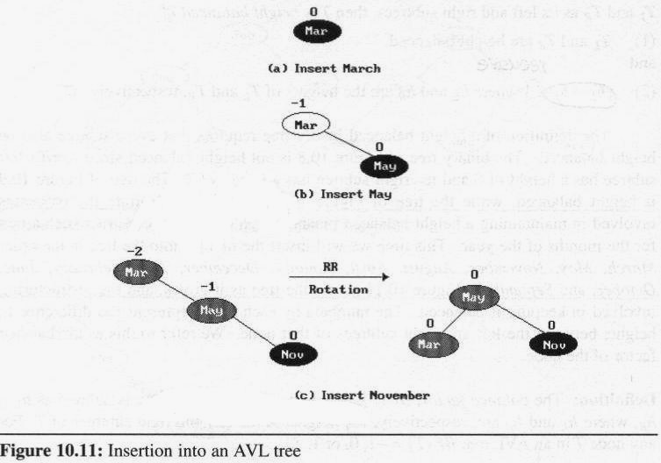
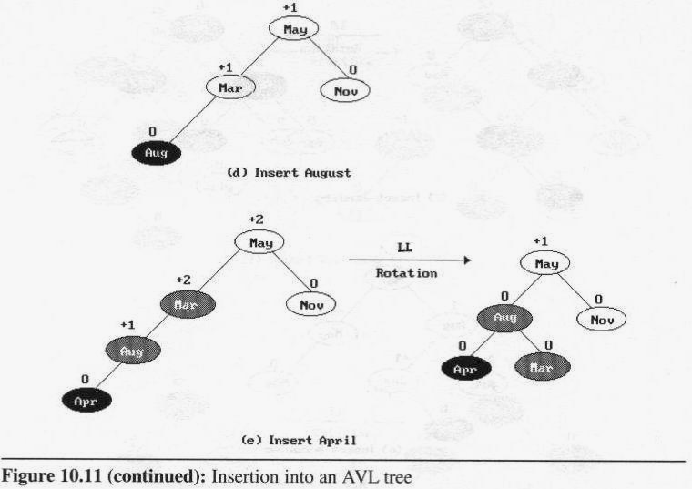
AVL Trees (7/17)
Insertion into an AVL tree

Slide 24
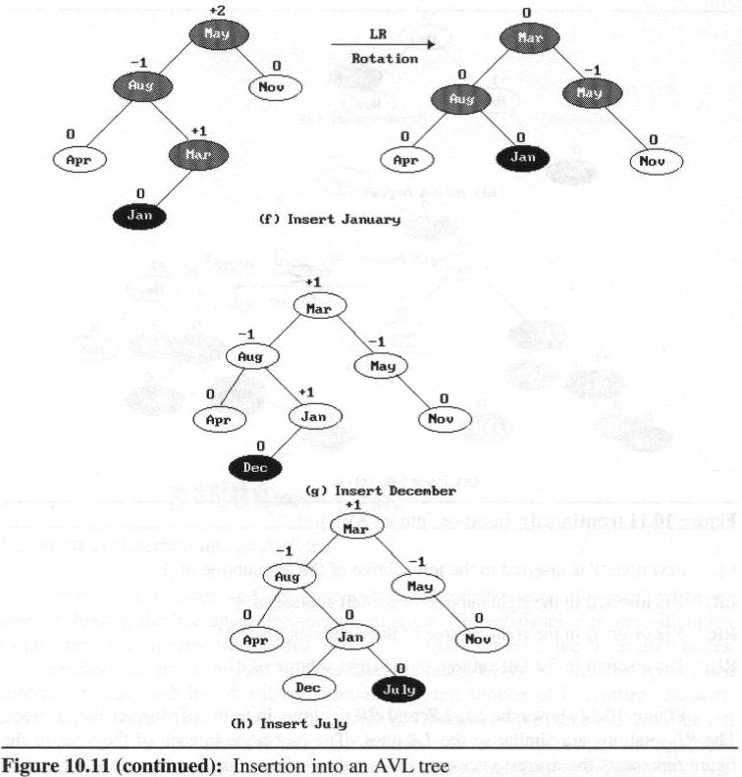
AVL Trees (8/17)
Insertion into an AVL tree (cont’d)

Slide 25
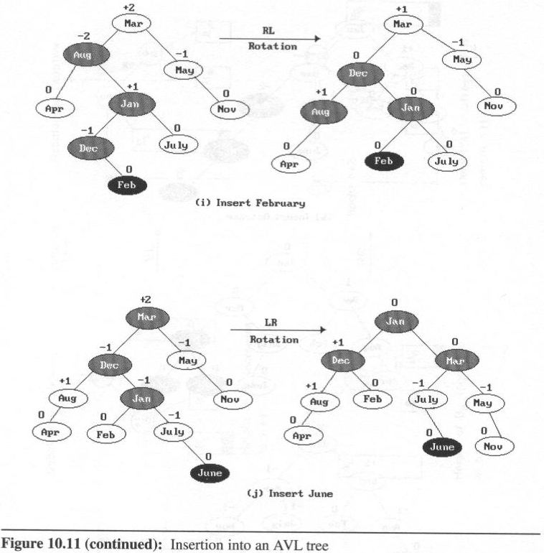
Insertion into an AVL tree (cont’d)

Slide 26
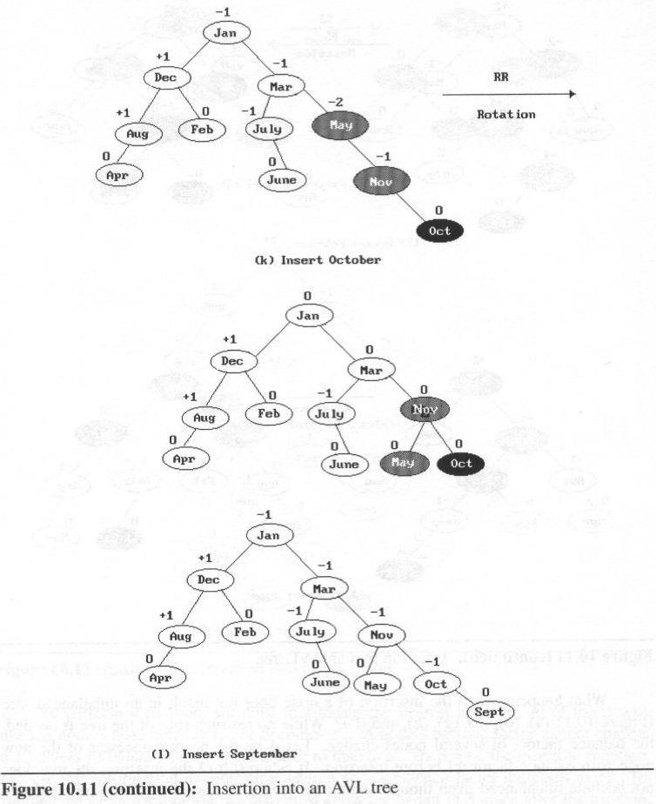
Insertion into an AVL tree (cont’d)

Slide 27
AVL Trees (11/17)
We carried out the rebalancing using four different kinds of rotations:
LL, RR, LR, and RL
  LL and RR are symmetric as are LR and RL
  These rotations are characterized by the nearest ancestor, A, of the inserted node, Y, whose balance factor becomes ±2.
    LL: Y is inserted in the left subtree of the left subtree of A.
    LR: Y is inserted in the right subtree of the left subtree of A
    RR: Y is inserted in the right subtree of the right subtree of A
    RL: Y is inserted in the left subtree of the right subtree of A

Slide 28
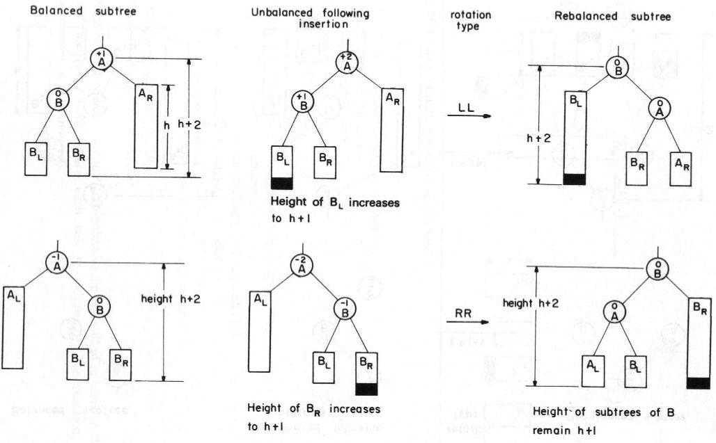
AVL Trees (12/17)
Rebalancing rotations

Slide 29
AVL Trees (13/17)
Rebalancing rotations

Slide 30
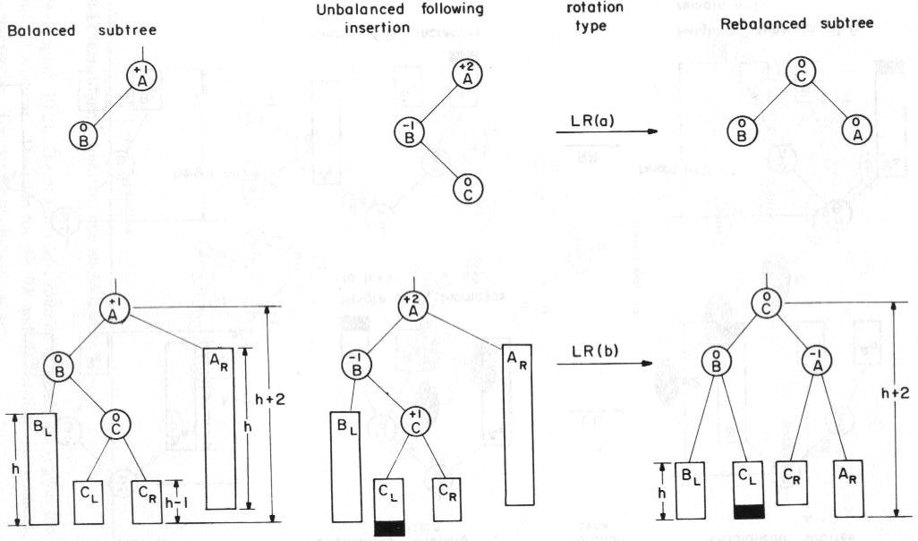
AVL Trees (14/17)
Rebalancing rotations (cont’d)

Slide 31
AVL Trees (15/17)
Rebalancing rotations (cont’d)

Slide 32
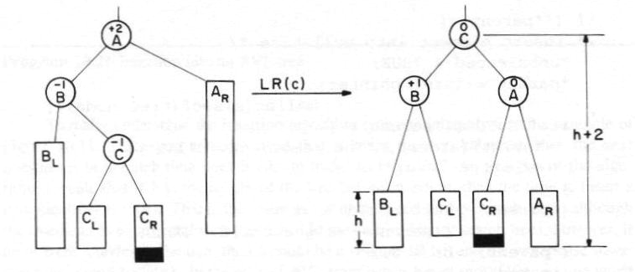
Rebalancing rotations (cont’d)

Slide 33
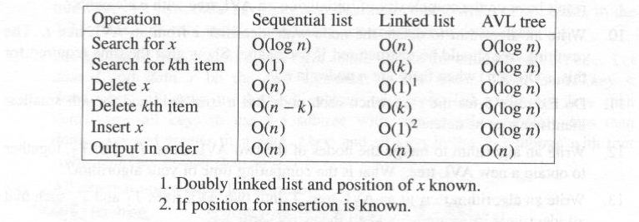
AVL Trees (17/17)
Complexity:
  In the case of binary search trees, if there were n nodes in the tree, then h (the height of tree) could be be n and the worst case insertion time would be O(n).
  In the case of AVL trees, since h is at most (log n), the worst case insertion time is O(log n).
  Figure 10.13 compares the worst case times of certain operations

Slide 34
2-3 Trees (1/11)
By considering search tree of degree greater than 2, we can arrive at tree structures for which the insertion and deletion algorithms are simpler than that for AVL trees.
  These algorithms have O(logn) complexity
Definition:
  A 2-3 tree is a search tree that is either empty or satisfies the following properties:
    Each internal node is either a 2-node or a 3-node. A 2-node has one element while a 3-node has two elements.

Slide 35
2-3 Trees (2/11)
2-node
  children of a 2-node: left_child and middle_child.
  data_l be the element in this node and data_l.key is its key.
  All elements in the 2-3 subtree with the root left_child (middle_child) have key less (greater) than data_l.key
3-node
  children of a 3-node: left_child, middle_child, right_child
  data_l and data_r be the two elements in this node. Then, data_l.key < data_r.key
  all keys in the 2-3 subtree with root left_child (right_child) are less than data_l.key (data_r.key)
  all keys in the 2-3 subtree with root middle_child are less than data_r.key and greater than data_l.key
All external nodes are at the same level

Slide 36
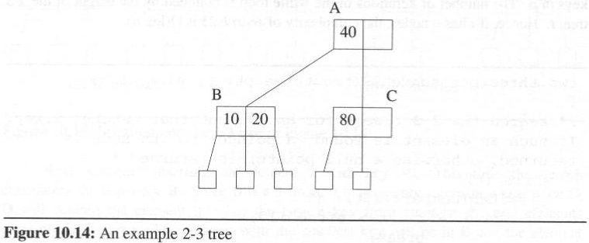
2-3 Trees (3/11)
The number of elements in a 2-3 tree with height h is between 2^{h} -1 and 3^{h} -1.
The height of a 2-3 tree with n elements is between ⎡log₃(n+1)⎤ and ⎡log₂(n+1)⎤

Slide 37
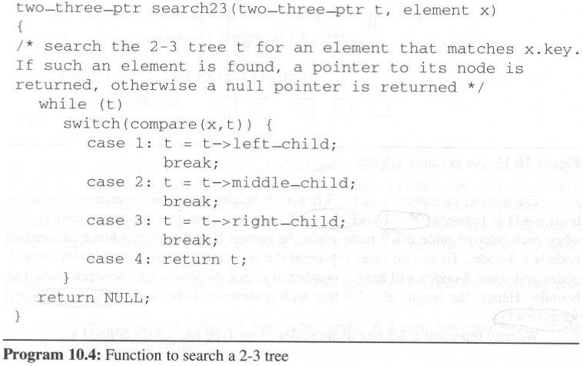
2-3 Trees (4/11)
Searching a 2-3 tree
  Searching a 2-3 tree, t, for a node that contains an element with key x.
  If such an element is found, a pointer to its node is returned, otherwise a null pointer
    compare functions: a key, x, with the keys in a given node p.
    The complexity of search23 is O(logn).
x is less than the first key
x is between the
first and second keys
x is greater than the second key
x is equal to one of keys in p

Slide 38
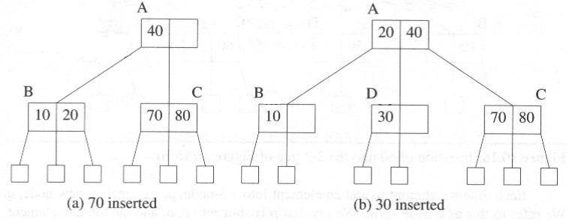
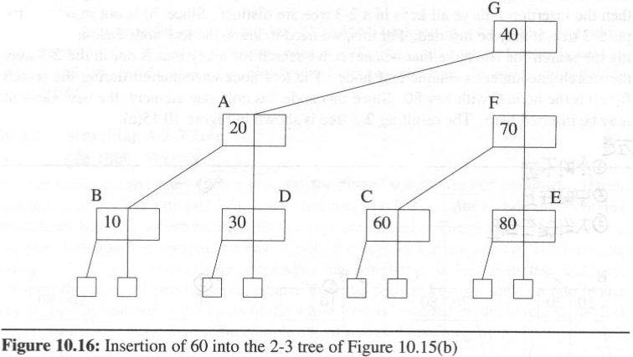
2-3 Trees (5/11)
Insertion into a 2-3 tree
(c) 60 inserted

Slide 39
2-3 Trees (6/11)
Deletion from a 2-3 tree
  In case we are deleting an element that is not in a leaf node
  we transform this into a deletion from a leaf node by replacing the deleted element by a suitable element that is in a leaf
  in a general situation we may use either the element
    with largest key in the subtree on the left or
    with smallest key in the subtree on the right
  Henceforth, we consider only the case of deletion from a leaf node.

Slide 40
2-3 Trees (7/11)
Steps in deleting from a leaf node, p of a 2-3 tree
  Step 1: Modify p as necessary to reflect its status after the desired element in p has been deleted
  Step 2: while (p has zero elements && p is not the root) {
  let r be the parent of p;
  let q be the left or right sibling of p (as appropriate);
  if (q is a 3-node)
  rotate;
  else
  combine;
  p = r;
  }
  Step 3: If p has zero elements, then p must be the root. The left child of p becomes the new root and p is deleted.

Slide 41
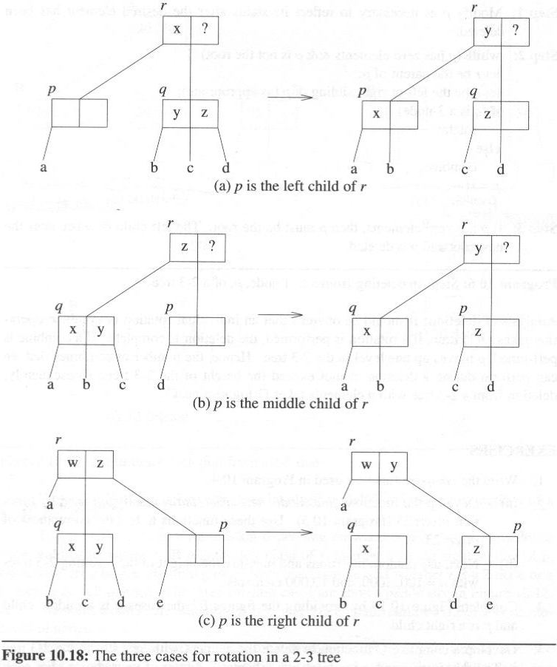
2-3 Trees (8/11)
Rotation
  If p is the left
  child of r, then let q be the right sibling of p. Otherwise, let q be the left sibling of p.
  Whether r is a 2-node or
  3-node, q is well defined
  A “?” denotes a don’t
  care situation. a, b, c,
  and d denote the
  children of nodes

Slide 42
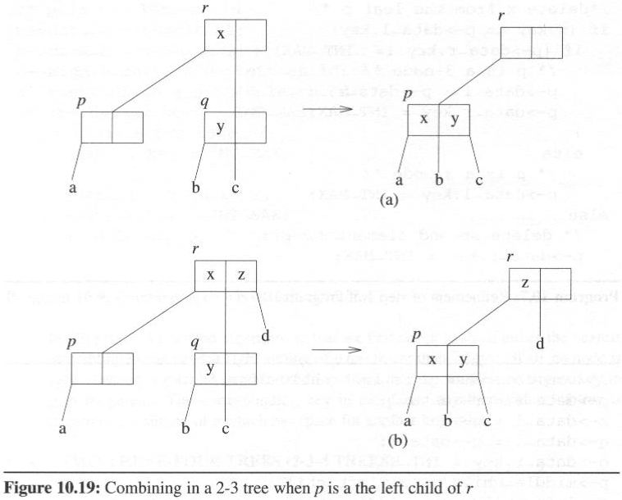
2-3 Trees (9/11)
Combine

Slide 43
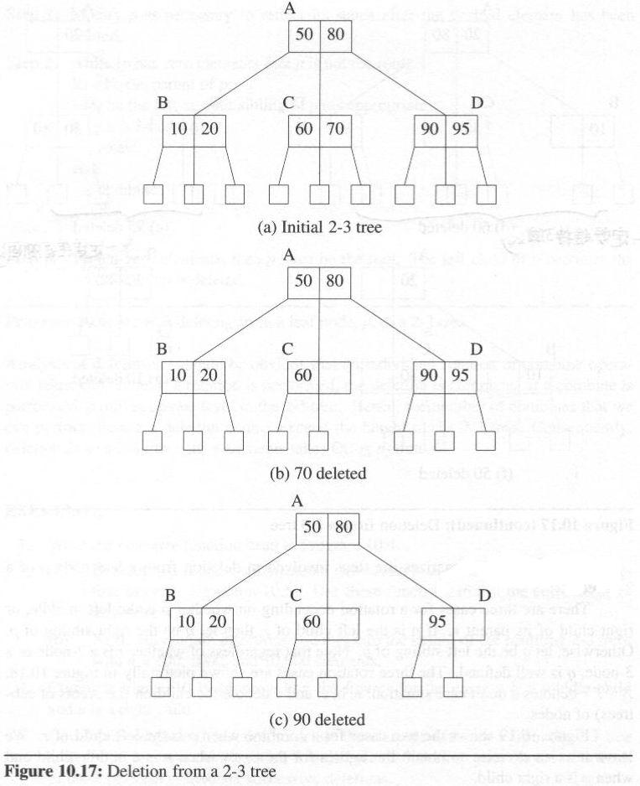
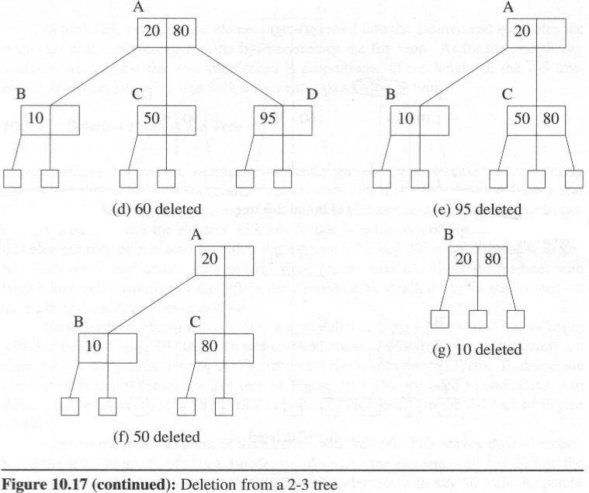
Deletion from a 2-3 tree, example

Slide 44
2-3 Trees (11/11)
Deletion from a 2-3 tree, example (cont’d)

