Slide 1
CS235102
Data Structures
Chapter 2 Arrays and Structures

Slide 2
Chapter 2 Arrays and Structures
The array as an abstract data type
Structures and Unions
The polynomial Abstract Data Type
The Sparse Matrix Abstract Data Type
The Representation of Multidimensional Arrays

Slide 3
2.1 The array as an ADT (1/6)
Arrays
  Array: a set of pairs, <index, value>
  data structure
    For each index, there is a value associated with that index.
  representation (possible)
    Implemented by using consecutive memory.
    In mathematical terms, we call this a correspondence or a mapping.

Slide 4
2.1 The array as an ADT (2/6)
When considering an ADT we are more concerned with the operations that can be performed on an array.
  Aside from creating a new array, most languages provide only two standard operations for arrays, one that retrieves a value, and a second that stores a value.
  Structure 2.1 shows a definition of the array ADT
  The advantage of this ADT definition is that it clearly points out the fact that the array is a more general structure than “a consecutive set of memory locations.”

Slide 5
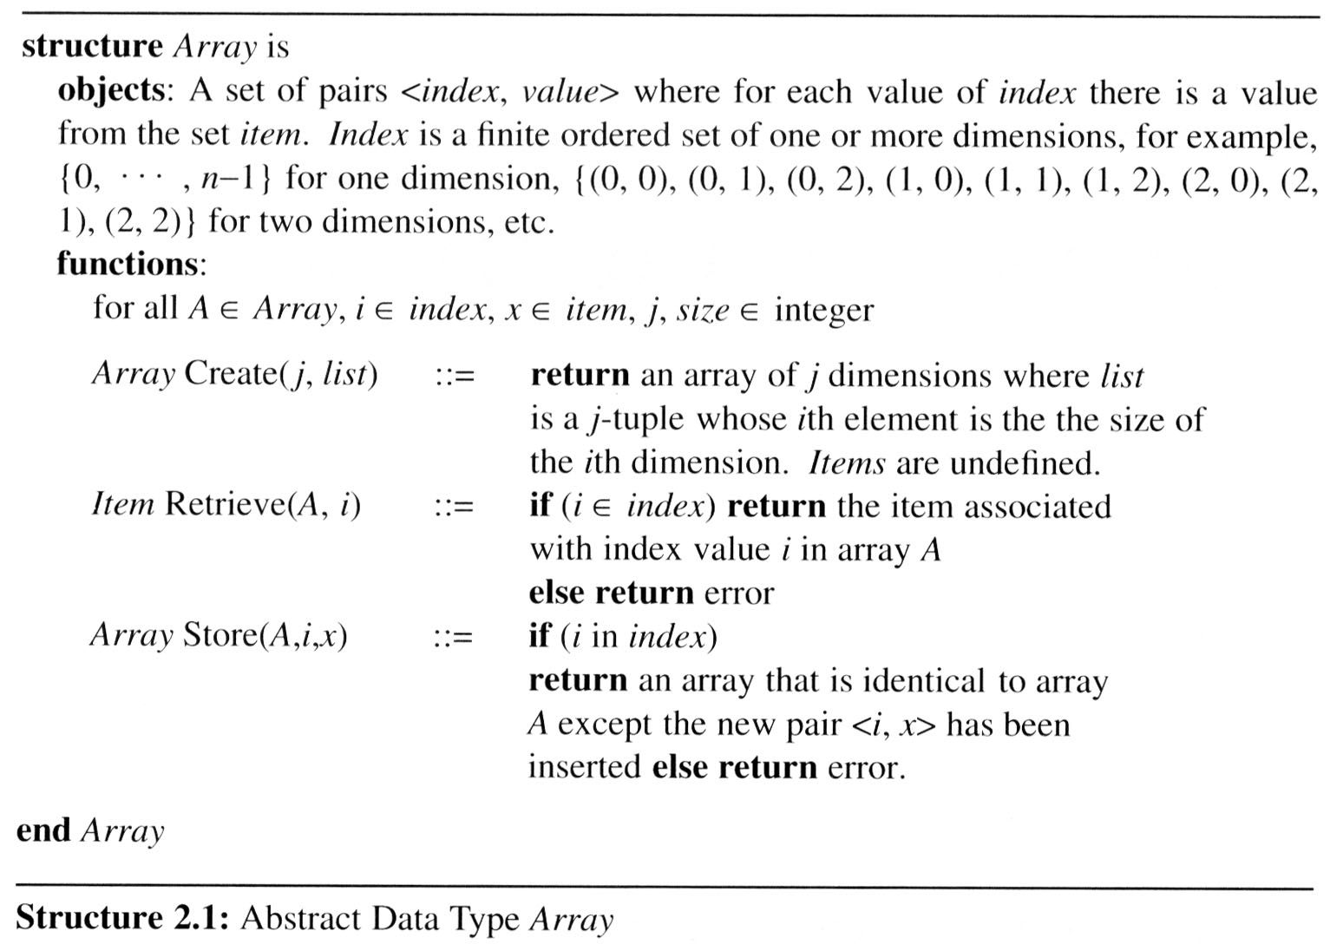
2.1 The array as an ADT (3/6)

Slide 6
2.1 The array as an ADT (4/6)
Arrays in C
  int list[5], *plist[5];
  list[5]: (five integers) list[0], list[1], list[2], list[3], list[4]
  *plist[5]: (five pointers to integers)
    plist[0], plist[1], plist[2], plist[3], plist[4]
  implementation of 1-D array
  list[0] base address = α
  list[1] α + sizeof(int)
  list[2] α + 2*sizeof(int)
  list[3] α + 3*sizeof(int)
  list[4] α + 4*sizeof(int)

Slide 7
2.1 The array as an ADT (5/6)
Arrays in C (cont’d)
  Compare int *list1 and int list2[5] in C.
  Same: list1 and list2 are pointers.
  Difference: list2 reserves five locations.
  Notations:
  list2 － a pointer to list2[0]
  (list2 + i) － a pointer to list2[i] (&list2[i])
  *(list2 + i) － list2[i]

Slide 8
2.1 The array (6/6)
Example:
1-dimension array addressing
  int one[] = {0, 1, 2, 3, 4};
  Goal: print out address and value
    void print1(int *ptr, int rows){
    /* print out a one-dimensional array using a pointer */
    int i;
    printf(“Address Contents\n”);
    for (i=0; i < rows; i++)
    printf(“%8u%5d\n”, ptr+i, *(ptr+i));
    printf(“\n”);
    }

Slide 9
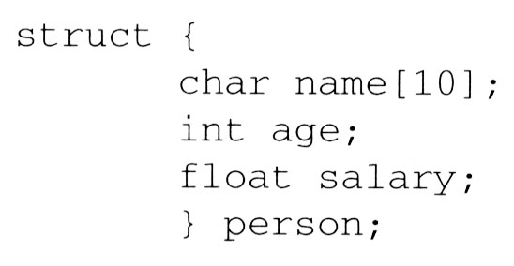
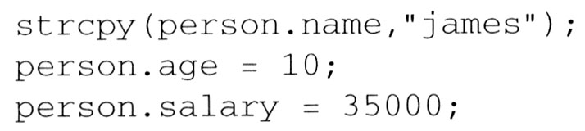
2.2 Structures and Unions (1/6)
2.2.1 Structures (records)
  Arrays are collections of data of the same type. In C there is an alternate way of grouping data that permit the data to vary in type.
    This mechanism is called the struct, short for structure.
  A structure is a collection of data items, where each item is identified as to its type and name.

Slide 10
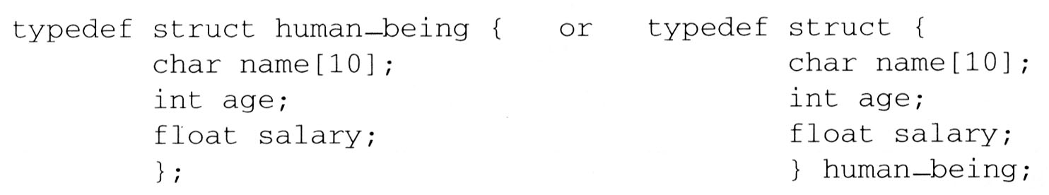
2.2 Structures and Unions (2/6)
Create structure data type
  We can create our own structure data types by using the typedef statement as below:
    This says that human_being is the name of the type defined by the structure definition, and we may follow this definition with declarations of variables such as:
    human_being person1, person2;

Slide 11
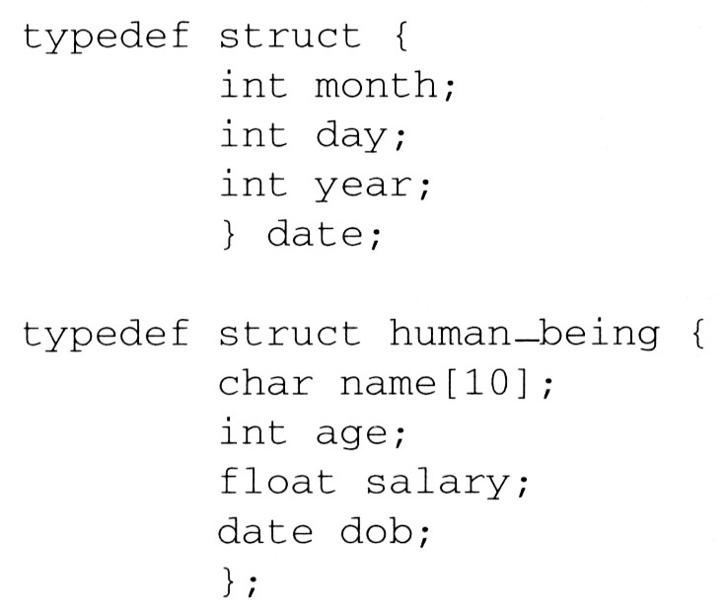
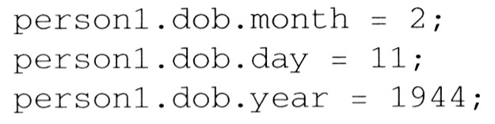
2.2 Structures and Unions (3/6)
  We can also embed a structure within a structure.
    A person born on February 11, 1994, would have have values for the date struct set as

Slide 12
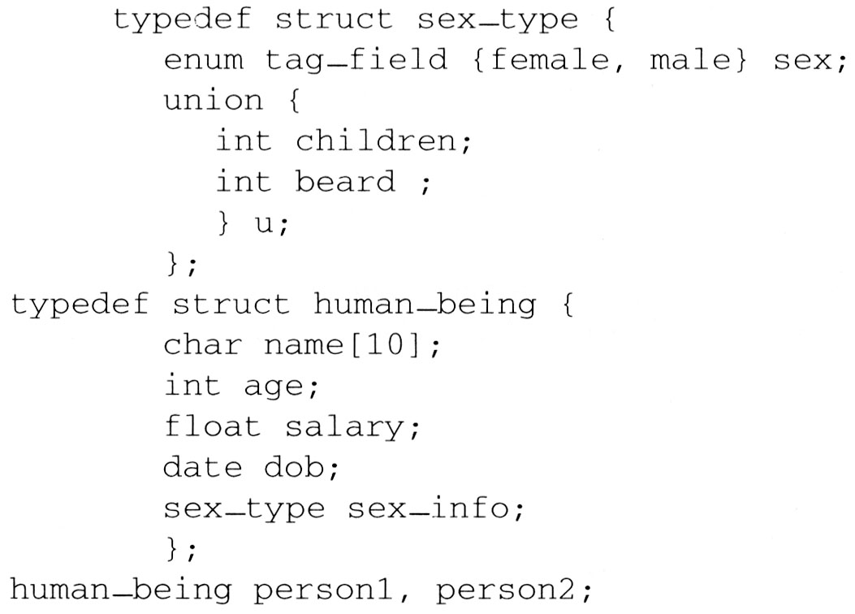
2.2 Structures and Unions (4/6)
2.2.2 Unions
  A union declaration is similar to a structure.
  The fields of a union must share their memory space.
  Only one field of the union is “active” at any given time
    Example: Add fields for male and female.
person1.sex_info.sex = male;
person1.sex_info.u.beard = FALSE;
and
person2.sex_info.sex = female;
person2.sex_info.u.children = 4;

Slide 13
2.2 Structures and Unions (5/6)
2.2.3 Internal implementation of structures
  The fields of a structure in memory will be stored in the same way using increasing address locations in the order specified in the structure definition.
  Holes or padding may actually occur
    Within a structure to permit two consecutive components to be properly aligned within memory
  The size of an object of a struct or union type is the amount of storage necessary to represent the largest component, including any padding that may be required.

Slide 14
2.2 Structures and Unions (6/6)
2.2.4 Self-Referential Structures
  One or more of its components is a pointer to itself.
  typedef struct list {
  char data;
  list *link;
  }
  list item1, item2, item3;
  item1.data=‘a’;
  item2.data=‘b’;
  item3.data=‘c’;
  item1.link=item2.link=item3.link=NULL;
Construct a list with three nodes
item1.link=&item2;
item2.link=&item3;
malloc: obtain a node (memory)
free: release memory
a
b
c

Slide 15
2.3 The polynomial ADT (1/10)
Ordered or Linear List Examples
  ordered (linear) list: (item1, item2, item3, …, itemn)
    (Sunday, Monday, Tuesday, Wednesday, Thursday, Friday, Saturday)
    (Ace, 2, 3, 4, 5, 6, 7, 8, 9, 10, Jack, Queen, King)
    (basement, lobby, mezzanine, first, second)
    (1941, 1942, 1943, 1944, 1945)
    (a1, a2, a3, …, an-1, an)

Slide 16
2.3 The polynomial ADT (2/10)
Operations on Ordered List
  Finding the length, n , of the list.
  Reading the items from left to right (or right to left).
  Retrieving the i’th element.
  Storing a new value into the i’th position.
  Inserting a new element at the position i , causing elements numbered i, i+1, …, n to become numbered i+1, i+2, …, n+1
  Deleting the element at position i , causing elements numbered i+1, …, n to become numbered i, i+1, …, n-1
Implementation
  sequential mapping (1)~(4)
  non-sequential mapping (5)~(6)

Slide 17
2.3 The polynomial ADT (3/10)
Polynomial examples:
  Two example polynomials are:
    A(x) = 3x²⁰+2x⁵+4 and B(x) = x⁴+10x³+3x²+1
  Assume that we have two polynomials,
  A(x) = Σa_{i}x^{i} and B(x) = Σb_{i}x^{i} where x is the variable, a_{i} is the coefficient, and i is the exponent, then:
    A(x) + B(x) = Σ(a^{i} + b^{i})x^{i}
    A(x) · B(x) = Σ(a^{i}x^{i} · Σ(b^{j}x^{j}))
    Similarly, we can define subtraction and division on polynomials, as well as many other operations.

Slide 18
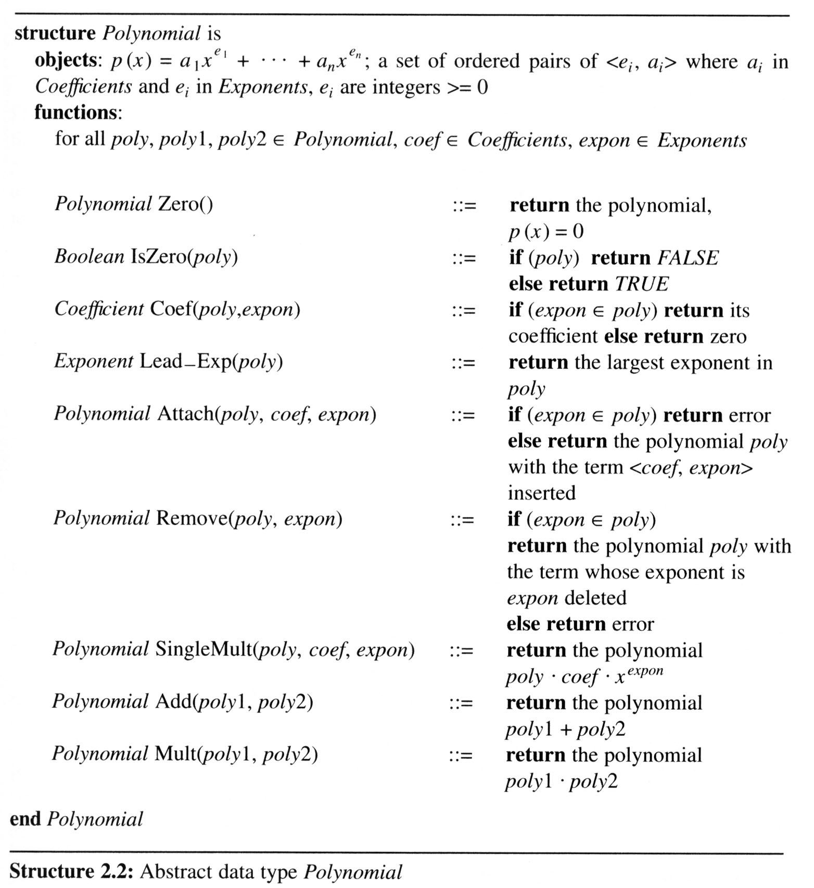
2.3 The polynomial ADT (4/10)
An ADT definition
of a polynomial

Slide 19
2.3 The polynomial ADT (5/10)
There are two ways to create the type
polynomial in C
Representation I
  define MAX_degree 101 /*MAX degree of polynomial+1*/
  typedef struct{
  int degree;
  float coef [MAX_degree];
  }polynomial;
drawback: the first
representation may
waste space.

Slide 20
2.3 (6/10)
Polynomial Addition
  /* d =a + b, where a, b, and d are polynomials */
  d = Zero( )
  while (! IsZero(a) && ! IsZero(b)) do {
  switch COMPARE (Lead_Exp(a), Lead_Exp(b)) {
  case -1: d =
  Attach(d, Coef (b, Lead_Exp(b)), Lead_Exp(b));
  b = Remove(b, Lead_Exp(b));
  break;
  case 0: sum = Coef (a, Lead_Exp (a)) + Coef ( b, Lead_Exp(b));
  if (sum) {
  Attach (d, sum, Lead_Exp(a));
  a = Remove(a , Lead_Exp(a));
  b = Remove(b , Lead_Exp(b));
  }
  break;
  case 1: d =
  Attach(d, Coef (a, Lead_Exp(a)), Lead_Exp(a));
  a = Remove(a, Lead_Exp(a));
  }
  }
  insert any remaining terms of a or b into d
  *Program 2.4 :Initial version of padd function(p.62)
advantage: easy implementation
disadvantage: waste space when sparse

Slide 21
2.3 The polynomial ADT (7/10)
Representation II
  MAX_TERMS 100 /*size of terms array*/
  typedef struct{
  float coef;
  int expon;
  }polynomial;
  polynomial terms [MAX_TERMS];
  int avail = 0;

Slide 22
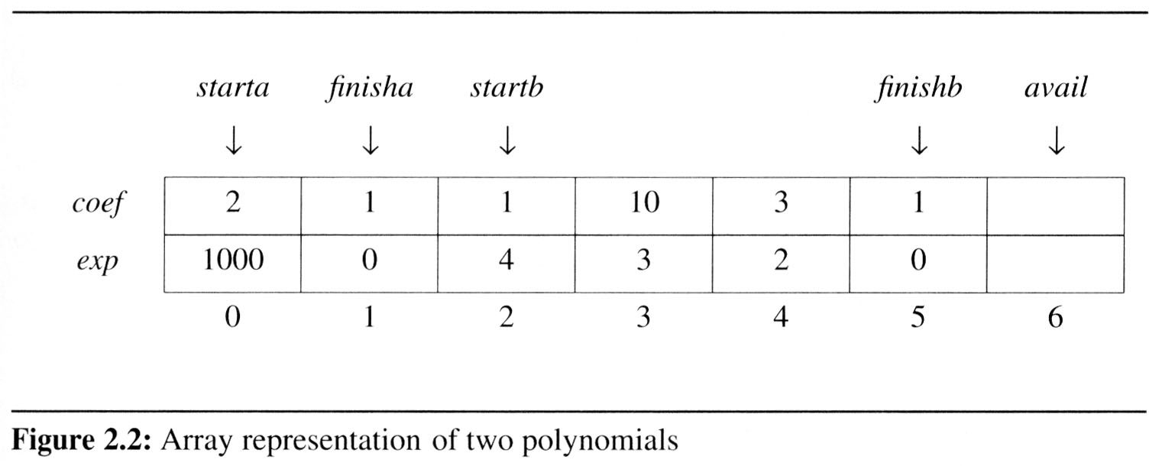
2.3 The polynomial ADT (8/10)
Use one global array to store all polynomials
  Figure 2.2 shows how these polynomials are stored in the array terms.
specification representation
poly <start, finish>
A <0,1>
B <2,5>
A(x) = 2x¹⁰⁰⁰+1
B(x) = x⁴+10x³+3x²+1
storage requirements: start, finish, 2*(finish-start+1)
non-sparse: twice as much as Representation I when all the items are nonzero

Slide 23
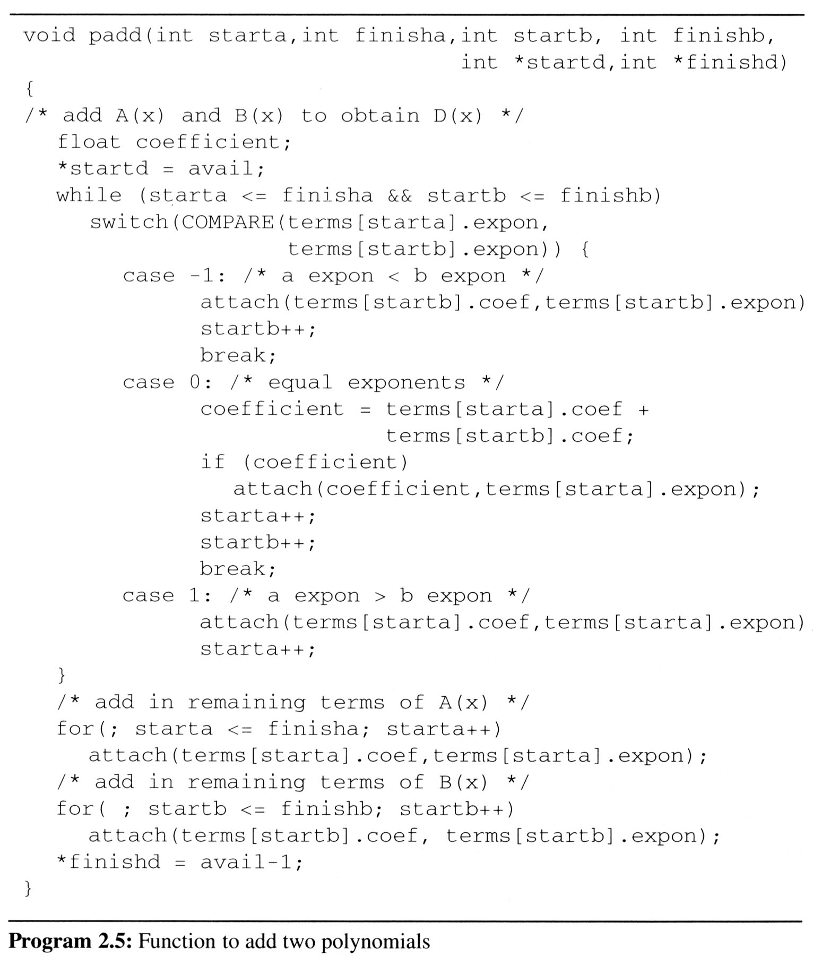
2.3 The polynomial ADT (9/10)
We would now like to write a C function that adds two polynomials,
A and B, represented as above to obtain D = A + B.
  To produce D(x), padd (Program 2.5) adds A(x) and B(x) term by term.
Analysis: O(n+m)
where n (m) is the number
of nonzeros in A (B).

Slide 24
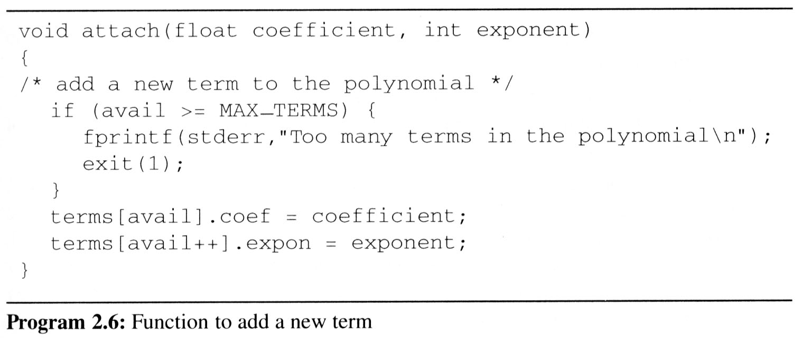
2.3 The polynomial ADT (10/10)
Problem: Compaction is required
when polynomials that are no longer needed.
(data movement takes time.)

Slide 25
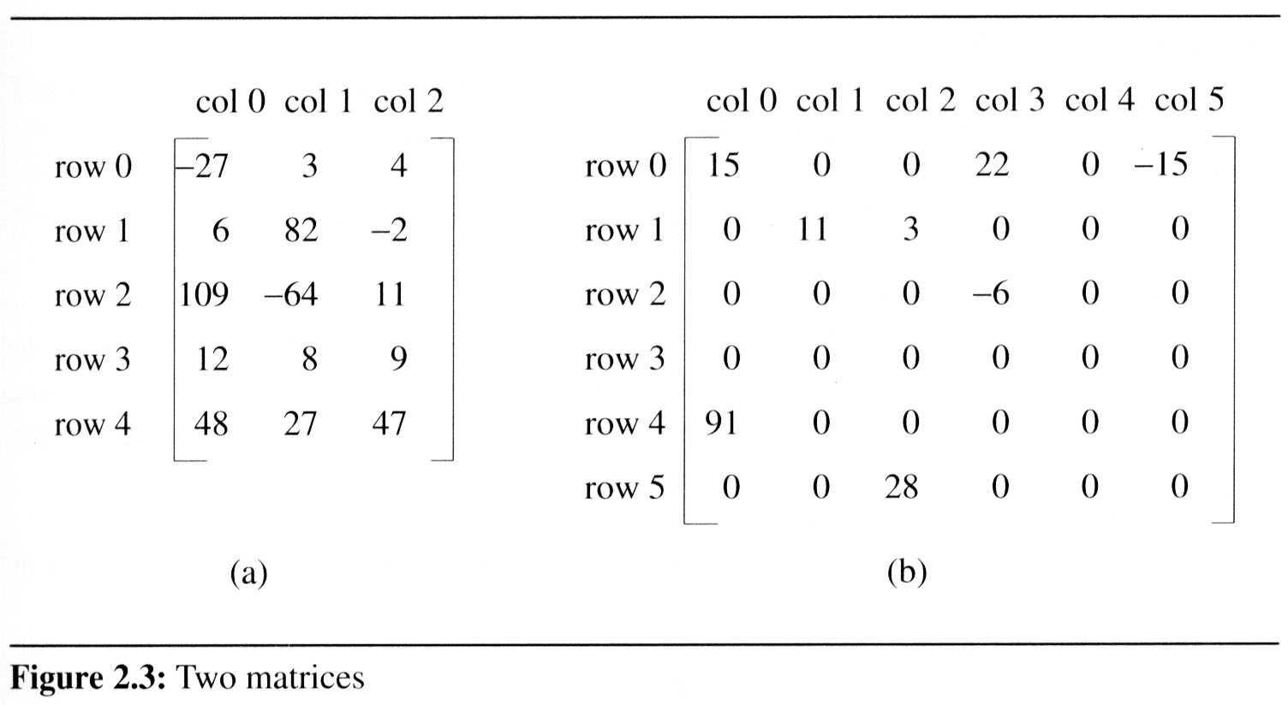
2.4 The sparse matrix ADT (1/18)
2.4.1 Introduction
  In mathematics, a matrix contains m rows and n columns of elements, we write m×n to designate a matrix with m rows and n columns.
sparse matrix
data structure?
5*3
15/15
8/36
6*6

Slide 26
2.4 The sparse matrix ADT (2/18)
The standard representation of a matrix is a two dimensional array defined as a[MAX_ROWS][MAX_COLS].
  We can locate quickly any element by writing a[i ][ j ]
Sparse matrix wastes space
  We must consider alternate forms of representation.
  Our representation of sparse matrices should store only nonzero elements.
  Each element is characterized by <row, col, value>.

Slide 27
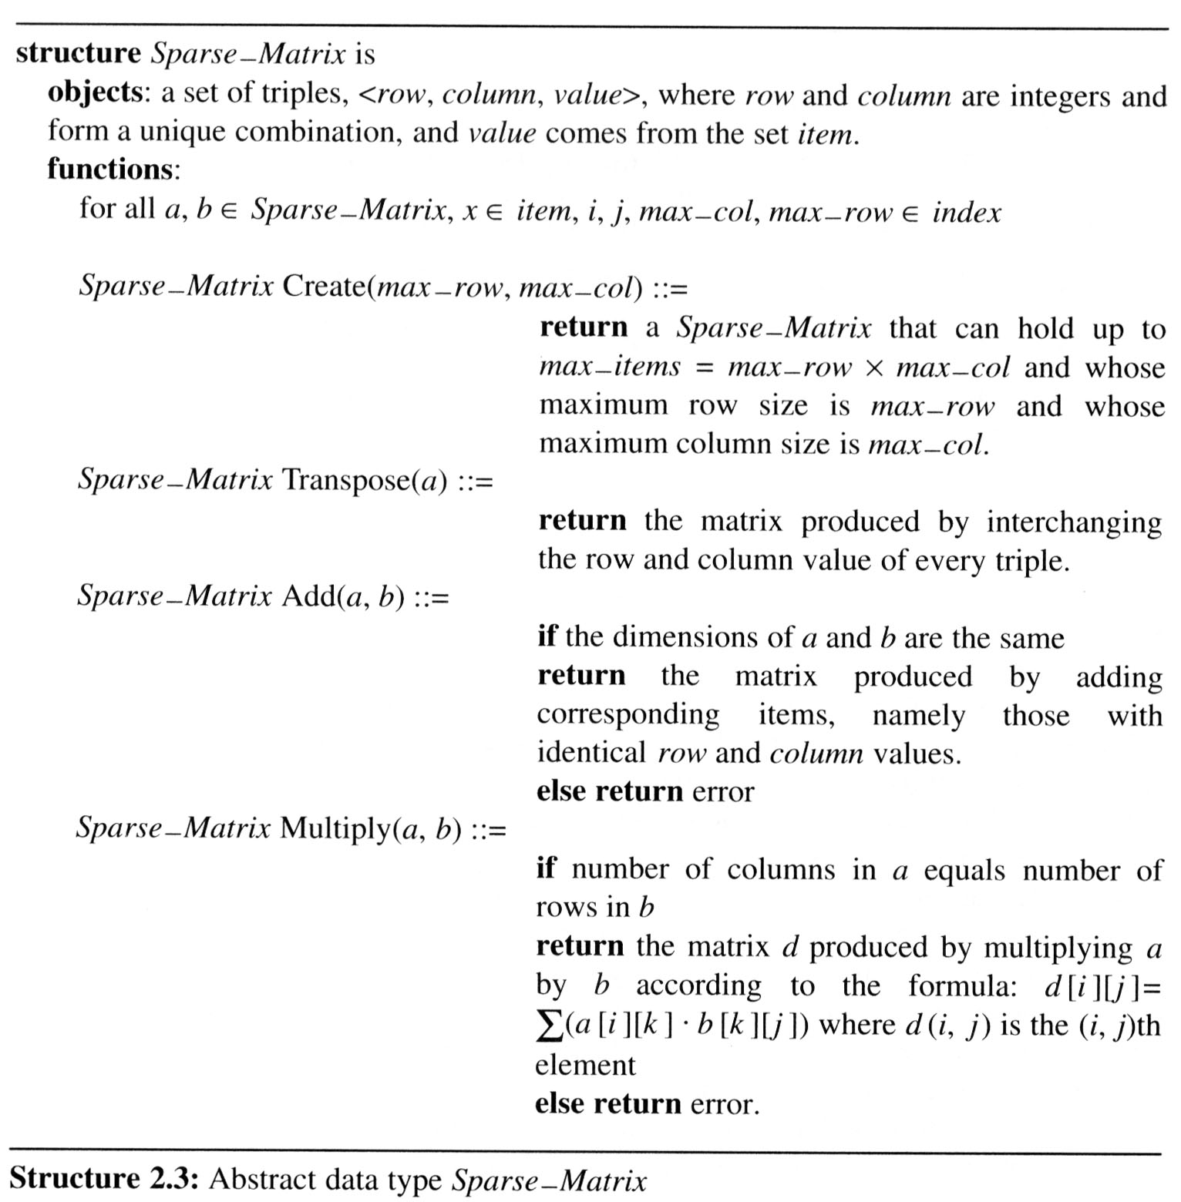
2.4 The sparse matrix ADT (3/18)
Structure 2.3 contains our specification of the matrix ADT.
  A minimal set of operations includes matrix creation, addition, multiplication, and transpose.

Slide 28
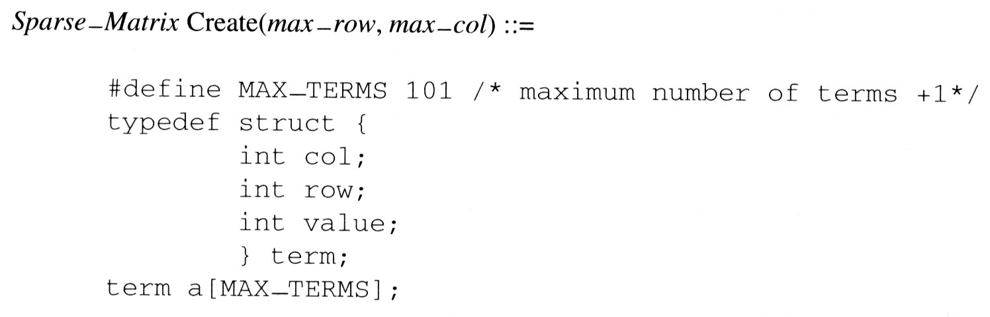
2.4 The sparse matrix ADT (4/18)
We implement the Create operation as below:

Slide 29
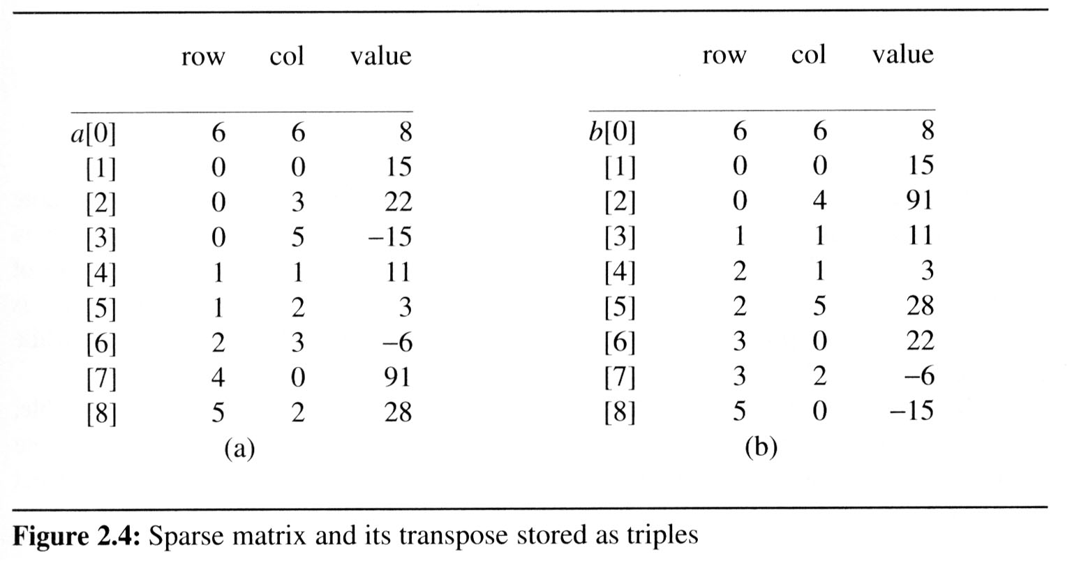
2.4 The sparse matrix ADT (5/18)
Figure 2.4(a) shows how the sparse matrix of Figure 2.3(b) is represented in the array a.
  Represented by a two-dimensional array.
  Each element is characterized by <row, col, value>.
# of rows (columns)
# of nonzero terms
transpose
row, column in
ascending order

Slide 30
2.4 The sparse matrix ADT (6/18)
2.4.2 Transpose a Matrix
  For each row i
    take element <i, j, value> and store it in element <j, i, value> of the transpose.
    difficulty: where to put <j, i, value>
    (0, 0, 15) ====> (0, 0, 15)
    (0, 3, 22) ====> (3, 0, 22)
    (0, 5, -15) ====> (5, 0, -15)
    (1, 1, 11) ====> (1, 1, 11)
    Move elements down very often.
  For all elements in column j,
  place element <i, j, value> in element <j, i, value>

Slide 31
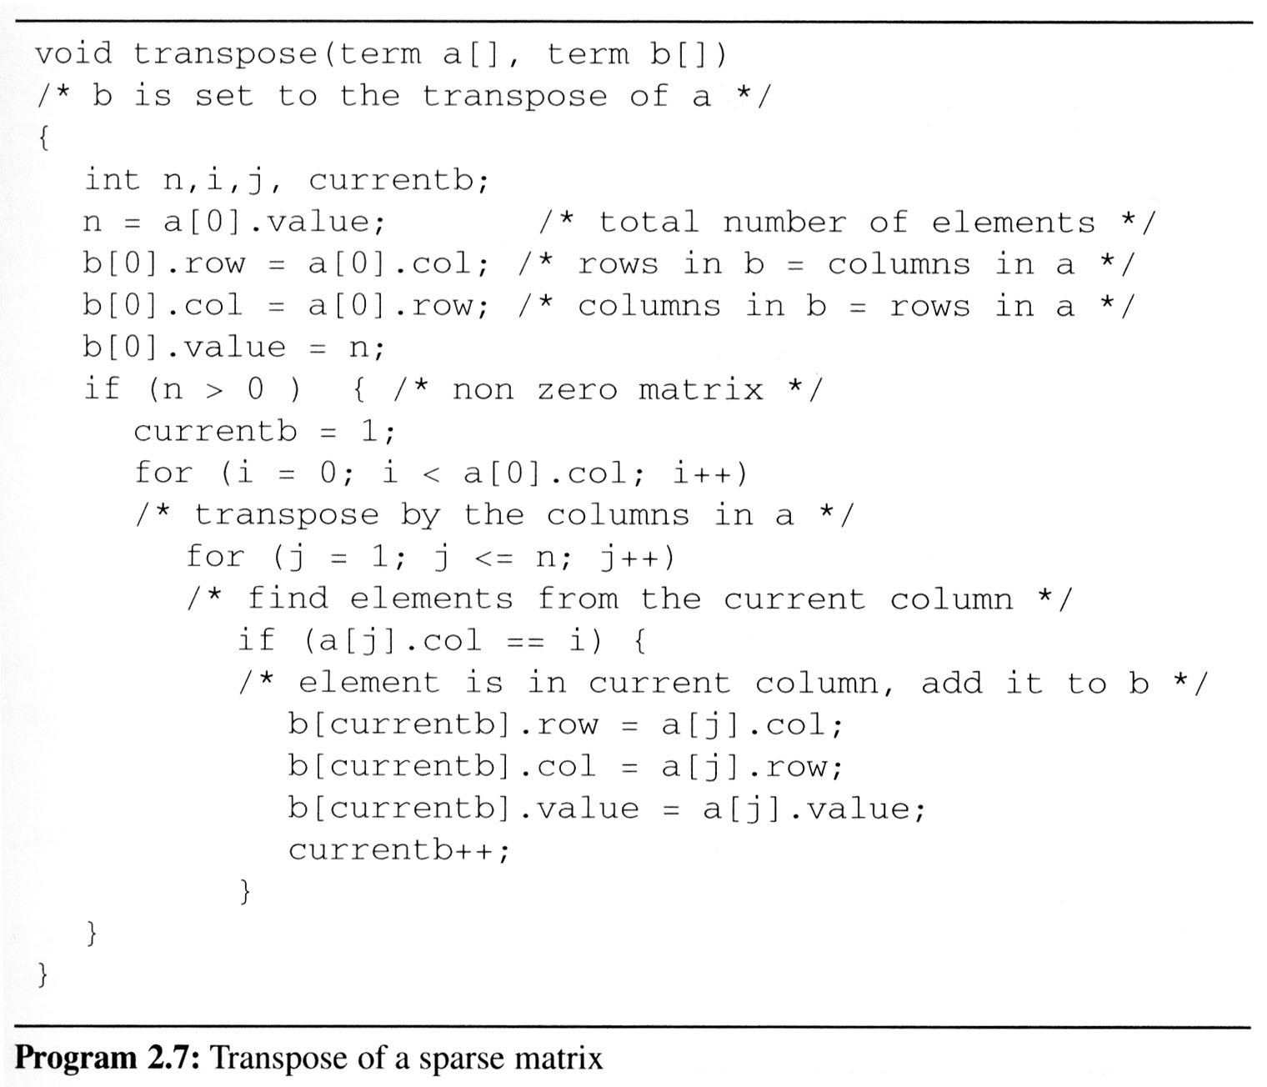
2.4 The sparse matrix ADT (7/18)
This algorithm is incorporated in transpose (Program 2.7).
columns
elements
Scan the array
“columns” times.
The array has
“elements” elements.
==> O(columns*elements)

Slide 32
2.4 The sparse matrix ADT (8/18)
Discussion: compared with 2-D array representation
  O(columns*elements) vs. O(columns*rows)
  elements --> columns * rows when non-sparse,
  O(columns²*rows)
Problem: Scan the array “columns” times.
  In fact, we can transpose a matrix represented as a sequence of triples in O(columns + elements) time.
Solution:
  First, determine the number of elements
  in each column of the original matrix.
  Second, determine the starting positions of each row
  in the transpose matrix.

Slide 33
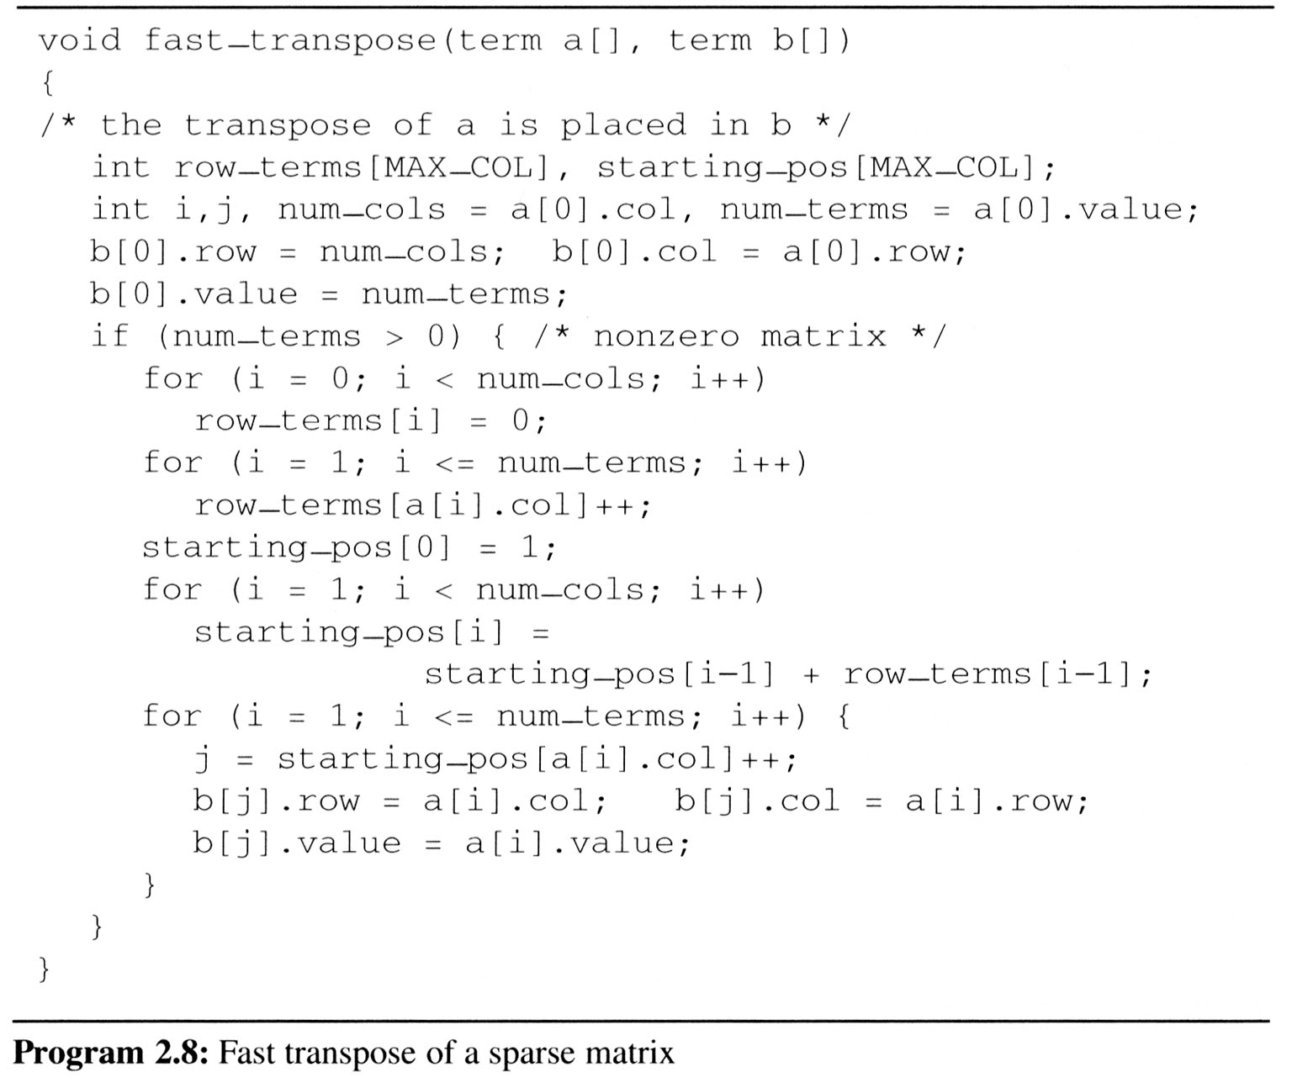
2.4 The sparse matrix ADT (9/18)
Compared with 2-D array representation:
O(columns+elements) vs. O(columns*rows)
elements --> columns * rows O(columns*rows)
Cost:
Additional row_terms and starting_pos arrays are required.
Let the two arrays row_terms and starting_pos be shared.
columns
elements
columns
columns
elements

Slide 34
2.4 The sparse matrix ADT (10/18)
After the execution of the third for loop, the values of row_terms and starting_pos are:
[0] [1] [2] [3] [4] [5]
row_terms = 1 2 2 2 0 1
starting_pos = 1 2 4 6 8 8
transpose

Slide 35
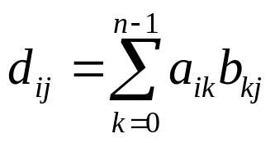
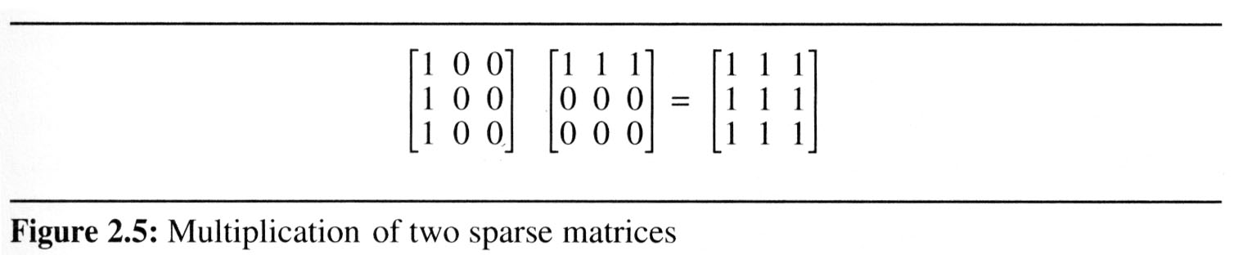
2.4 The sparse matrix ADT (11/18)
2.4.3 Matrix multiplication
  Definition:
    Given A and B where A is m×n and B is n×p, the product matrix D has dimension m×p. Its <i, j> element is
    for 0 ≤ i < m and 0 ≤ j < p.
  Example:

Slide 36
2.4 The sparse matrix ADT (12/18)
Sparse Matrix Multiplication
  Definition: [D]_{m*p}=[A]_{m*n}* [B]_{n*p}
  Procedure: Fix a row of A and find all elements
  in column j of B for j=0, 1, …, p-1.
  Alternative 1.
  Scan all of B to find all elements in j.
  Alternative 2.
  Compute the transpose of B.
  (Put all column elements consecutively)
    Once we have located the elements of row i of A and column j of B we just do a merge operation similar to that used in the polynomial addition of 2.2

Slide 37
2.4 The sparse matrix ADT (13/18)
General case:
d_{ij}=a_{i0}*b_{0j}+a_{i1}*b_{1j}+…+a_{i(n-1)}*b_{(n-1)j}
  Array A is grouped by i, and after transpose,
  array B is also grouped by j
a Sa d Sd
b Sb e Se
c Sc f Sf
g Sg
The generation at most:
entries ad, ae, af, ag, bd, be, bf, bg, cd, ce, cf, cg

Slide 38
The sparse matrix ADT (14/18)
An Example
A = 1 0 2 B^{T} = 3 -1 0 B = 3 0 2
-1 4 6 0 0 0 -1 0 0
2 0 5 0 0 5
a[0] 2 3 5 b_{t}[0] 3 3 4 b[0] 3 3 4
[1] 0 0 1 b_{t}[1] 0 0 3 b[1] 0 0 3
[2] 0 2 2 b_{t}[2] 0 1 -1 b[2] 0 2 2
[3] 1 0 -1 b_{t}[3] 2 0 2 b[3] 1 0 -1
[4] 1 1 4 b_{t}[4] 2 2 5 b[4] 2 2 5
[5] 1 2 6
row
col
value
row
col
value
row
col
value

Slide 39
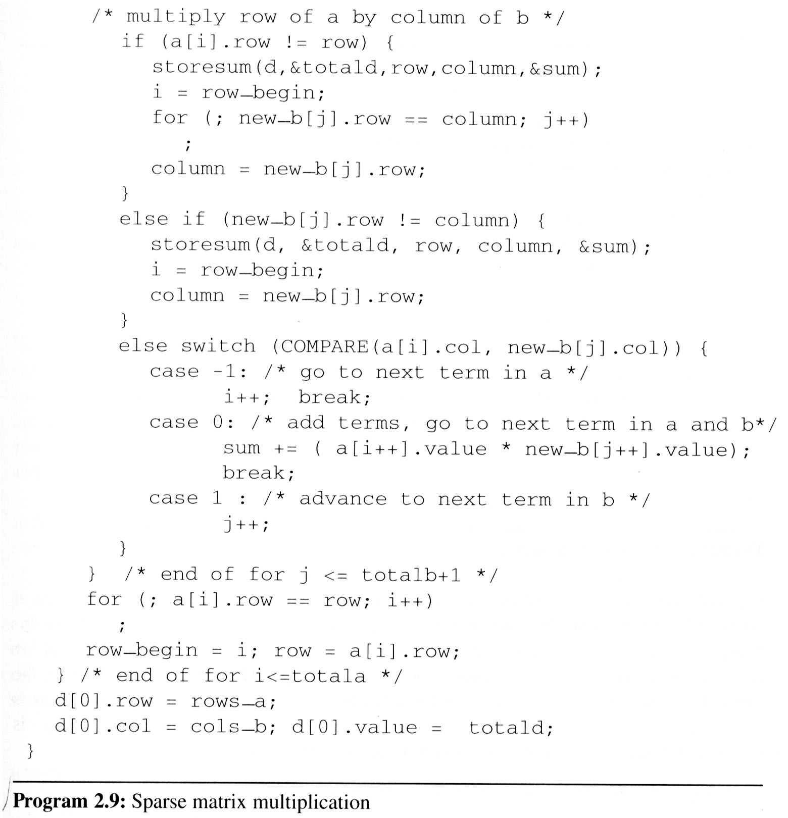
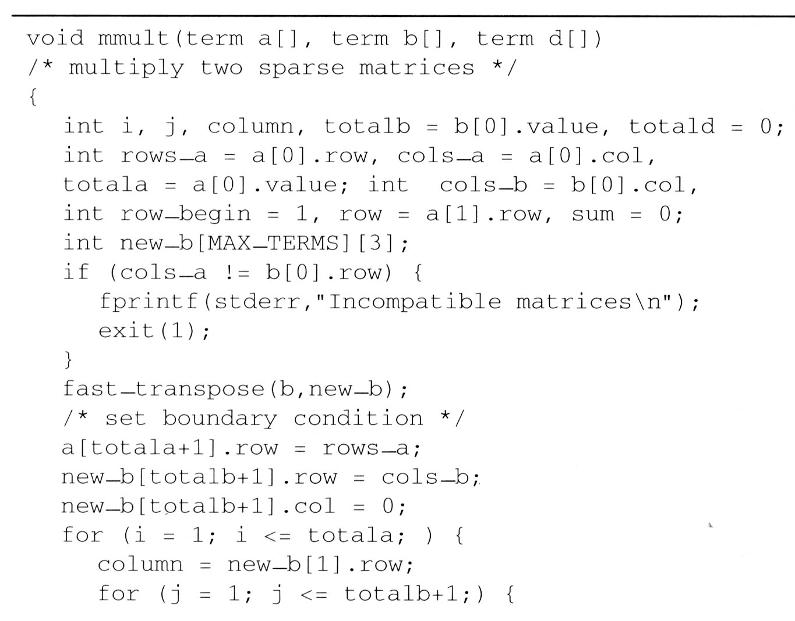
2.4 The sparse matrix ADT (15/18)
The programs 2.9 and 2.10 can obtain the product matrix D which multiplies matrices A and B.
a × b

Slide 40
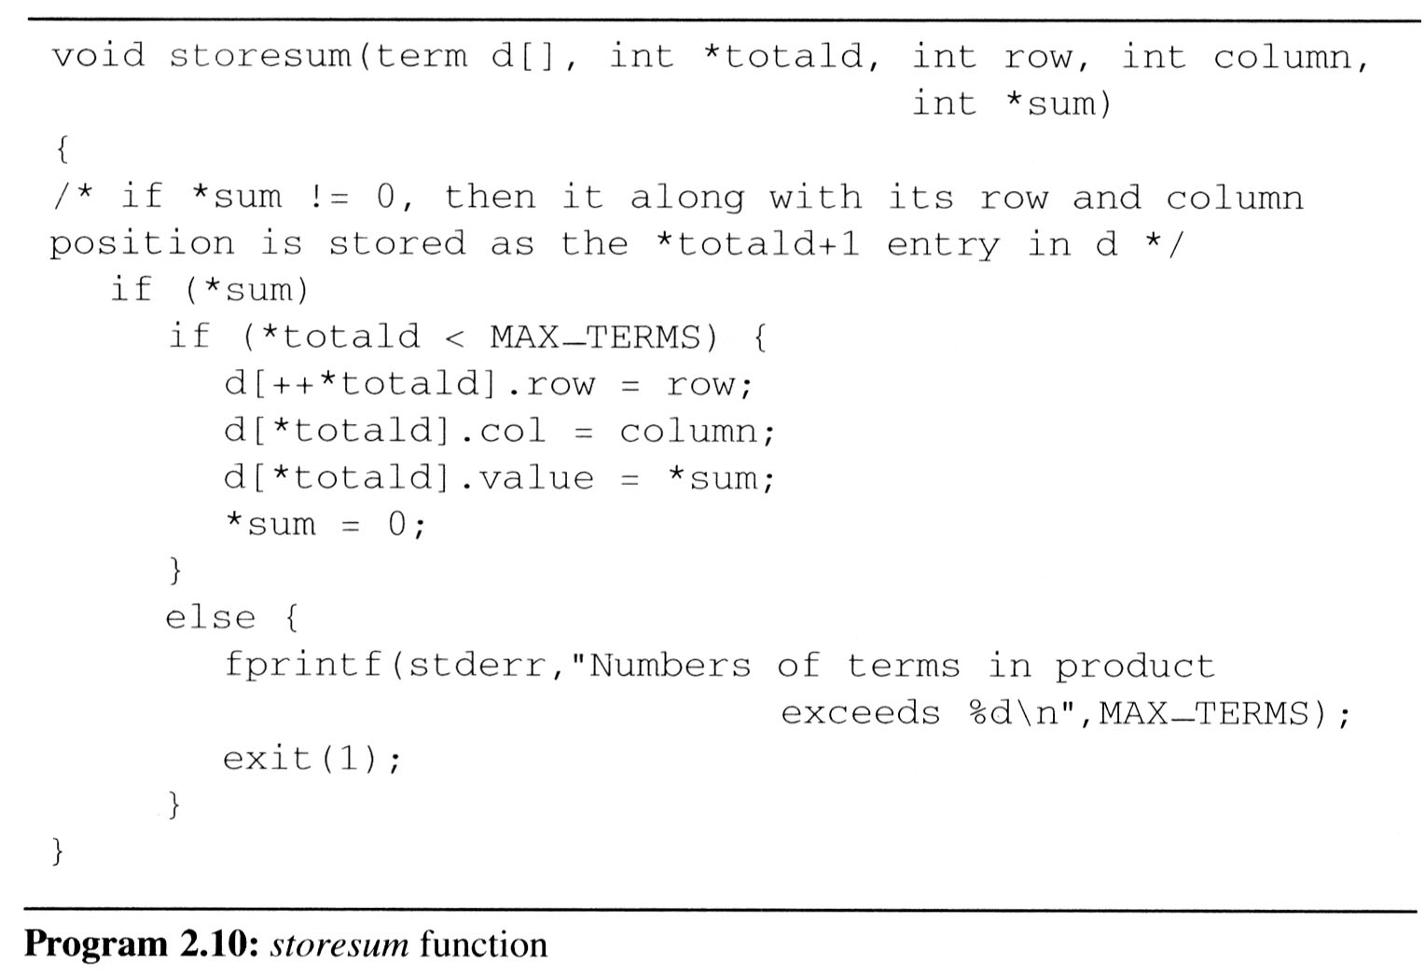
2.4 The sparse matrix ADT (16/18)

Slide 41
2.4 The sparse matrix ADT (17/18)
Analyzing the algorithm
  cols_b * termsrow1 + totalb +
  cols_b * termsrow2 + totalb +
  … +
  cols_b * termsrowp + totalb
  = cols_b * (termsrow1 + termsrow2 + … + termsrowp)+
  rows_a * totalb
  = cols_b * totala + row_a * totalb
  O(cols_b * totala + rows_a * totalb)

Slide 42
2.4 The sparse matrix ADT (18/18)
Compared with matrix multiplication using array
  for (i =0; i < rows_a; i++)
  for (j=0; j < cols_b; j++) {
  sum =0;
  for (k=0; k < cols_a; k++)
  sum += (a[i][k] *b[k][j]);
  d[i][j] =sum;
  }
  O(rows_a * cols_a * cols_b) vs.
  O(cols_b * total_a + rows_a * total_b)
  optimal case:
  total_a < rows_a * cols_a total_b < cols_a * cols_b
  worse case:
  total_a --> rows_a * cols_a, or
  total_b --> cols_a * cols_b

Slide 43
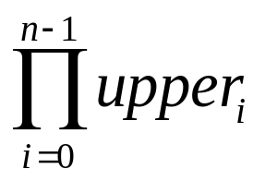
2.5 Representation of multidimensional array (1/5)
The internal representation of multidimensional arrays requires more complex addressing formula.
  If an array is declared a[upper₀][upper₁]…[upper_{n}], then it is easy to see that the number of elements in the array is:
  Where Π is the product of the upper_{i}’s.
  Example:
    If we declare a as a[10][10][10], then we require 10*10*10 = 1000 units of storage to hold the array.

Slide 44
2.5 Representation of multidimensional array (2/5)
Represent multidimensional arrays:
row major order and column major order.
  Row major order stores multidimensional arrays by rows.
    A[upper₀][upper₁] as
    upper₀ rows, row₀, row₁, …, row_{upper0-1},
    each row containing upper1 elements.

Slide 45
2.5 Representation of multidimensional array (3/5)
Row major order: A[i][j] : α + i*upper₁ + j
Column major order: A[i][j] : α + j*upper₀ + i
  col₀ col₁ col_{u1-1}
  row₀ A[0][0] A[0][1] . . . A[0][u1-1]
  α α + u₀ α+(u₁-1)* u₀
  row₁ A[1][0] A[1][1] . . . A[1][u1-1]
  α + u₁
  . . .
  row_{u0-1} A[u0-1][0] A[u0-1][1] . . . A[u0-1][u1-1]
  α+(u₀-1)*u₁

Slide 46
2.5 Representation of multidimensional array (4/5)
To represent a three-dimensional array, A[upper₀][upper₁][upper₂], we interpret the array as upper₀ two-dimensional arrays of dimension upper₁×upper₂.
  To locate a[i][j][k], we first obtain α + i*upper₁*upper₂ as the address of a[i][0][0] because there are i two dimensional arrays of size upper₁*upper₂ preceding this element.
  α + i*upper₁*upper₂+j *upper₂+k
  as the address of a[i][j][k].

Slide 47
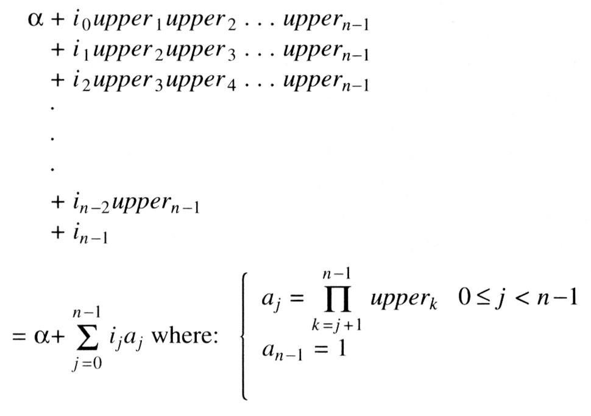
2.5 Representation of multidimensional array (5/5)
Generalizing on the preceding discussion, we can obtain the addressing formula for any element A[i₀][i₁]…[i_{n-1}] in an n-dimensional array declared as: A[upper₀][upper₁]…[upper_{n-1}]
  The address for A[i₀][i₁]…[i_{n-1}] is:

