Slide 1
CS235102
Data Structures
Chapter 3 Stacks and Queues

Slide 2
Chapter 3 Stacks and Queues
The Stack Abstract Data Type
The Queue Abstract Data Type
A Mazing Problem
Evaluation of Expressions

Slide 3
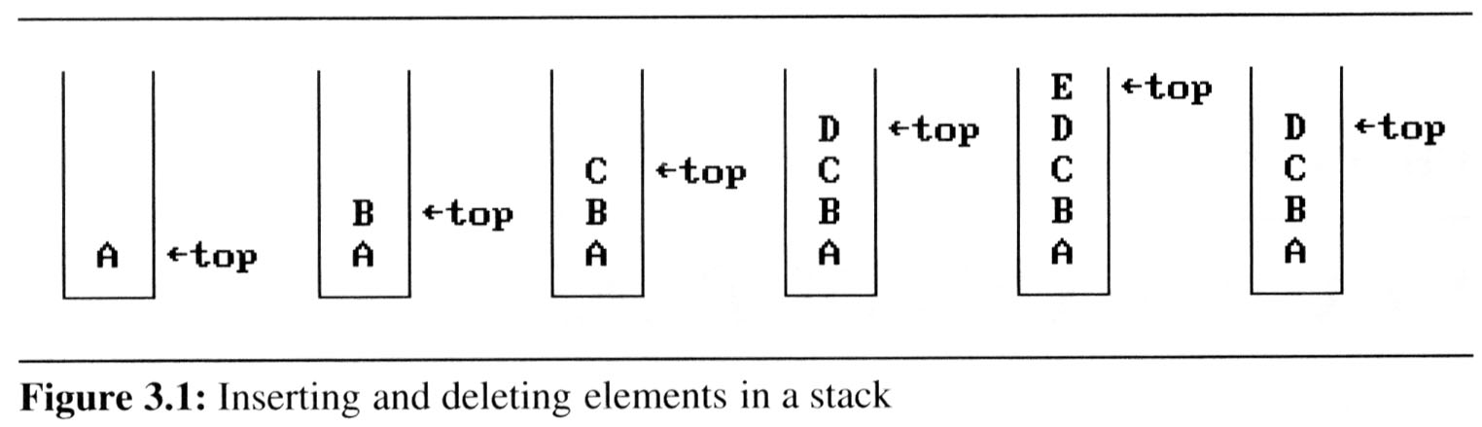
3.1 The stack ADT (1/5)
A stack is an ordered list in which insertions and deletions are made at one end called the top.
If we add the elements A, B, C, D, E to the stack, in that order, then E is the first element we delete from the stack
A stack is also known as a Last-In-First-Out (LIFO) list.

Slide 4
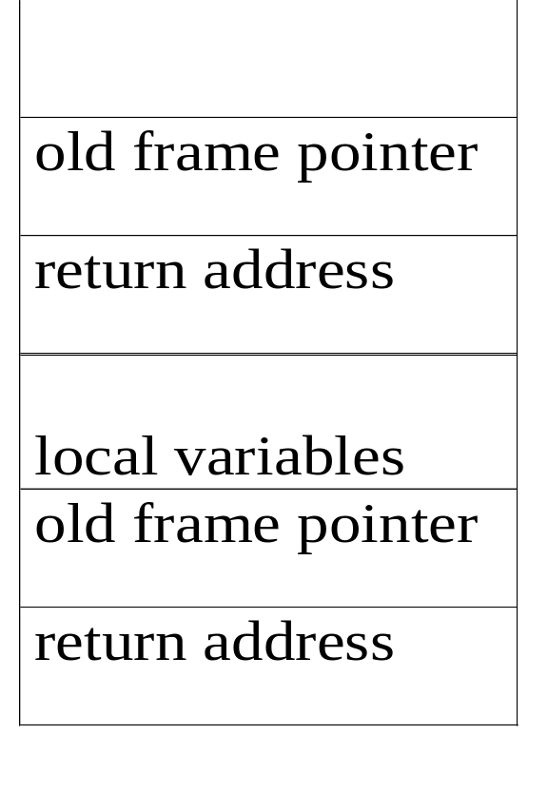
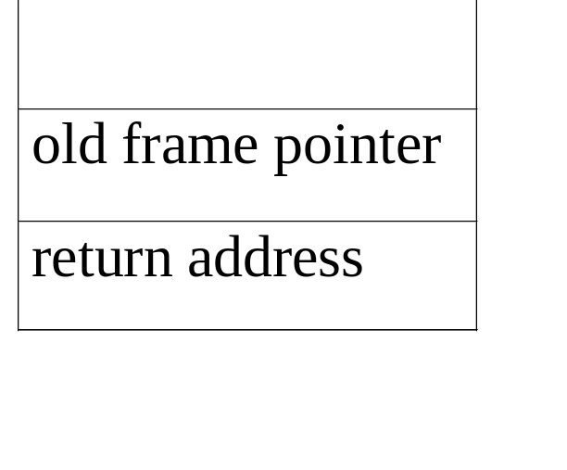
3.1 The stack ADT (2/5)
An application of stack: stack frame of function call
fp
al
(activation record)
fp: a pointer to current stack frame
fp
main
stack frame of invoking function
system stack before a1 is invoked
system stack after a1 is invoked
(a) (b)
*Figure 3.2: System stack after function call a1 (p.103)

Slide 5
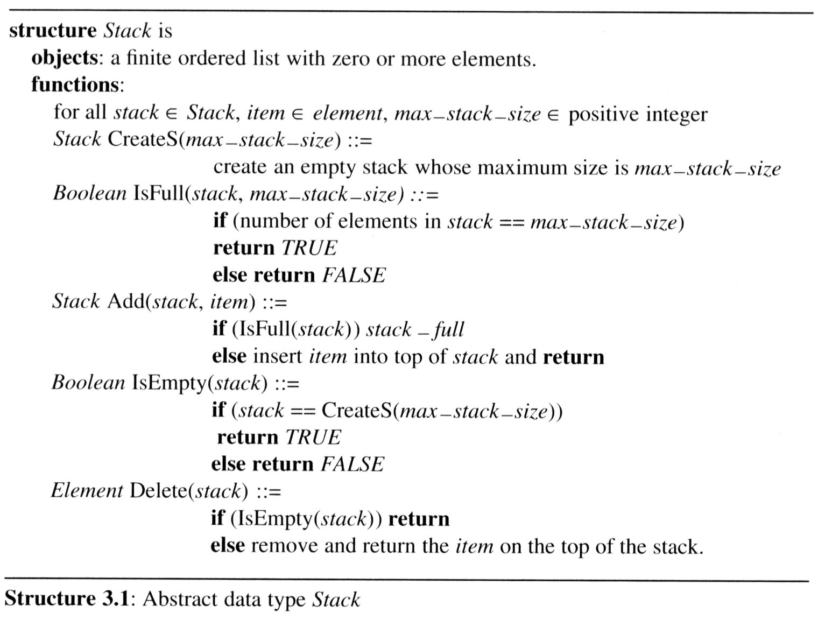
3.1 The stack ADT (3/5)
The ADT specification of the stack is shown in Structure 3.1

Slide 6
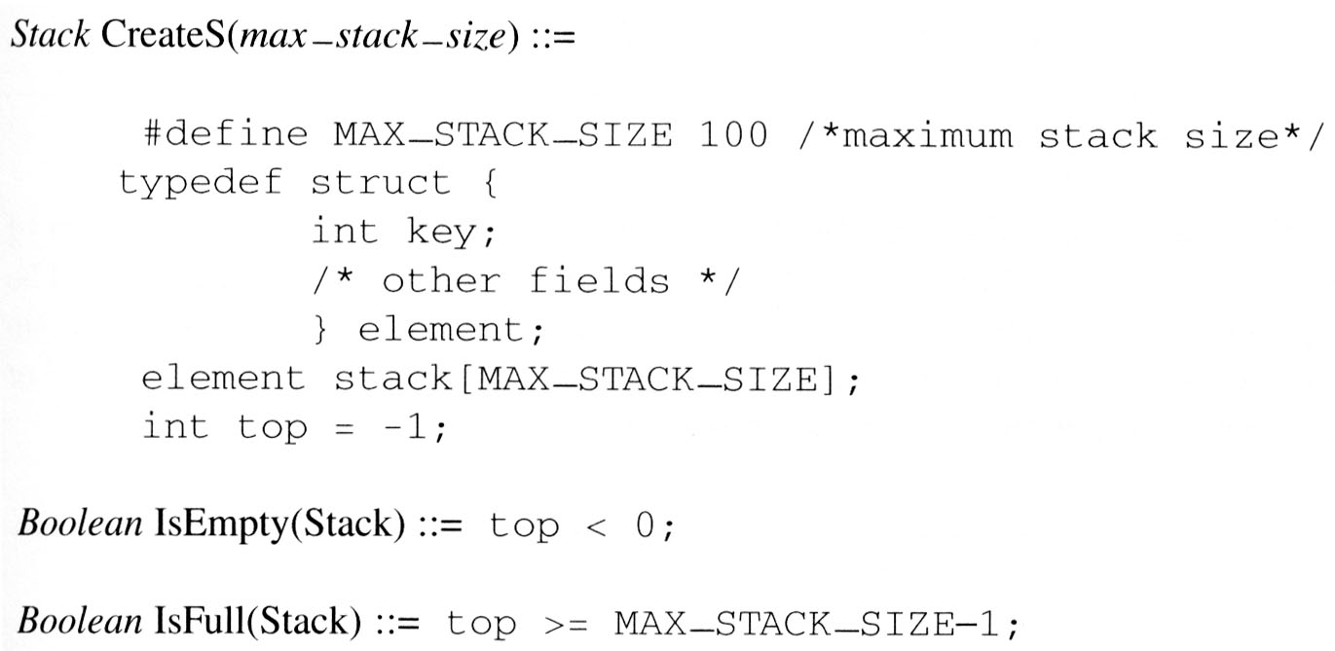
3.1 The stack ADT (4/5)
Implementation: using array

Slide 7
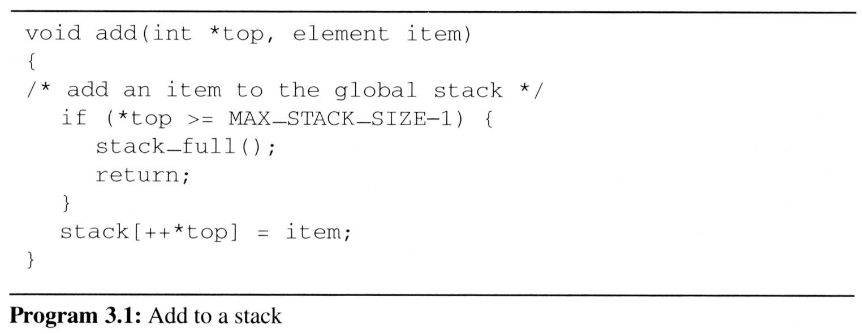
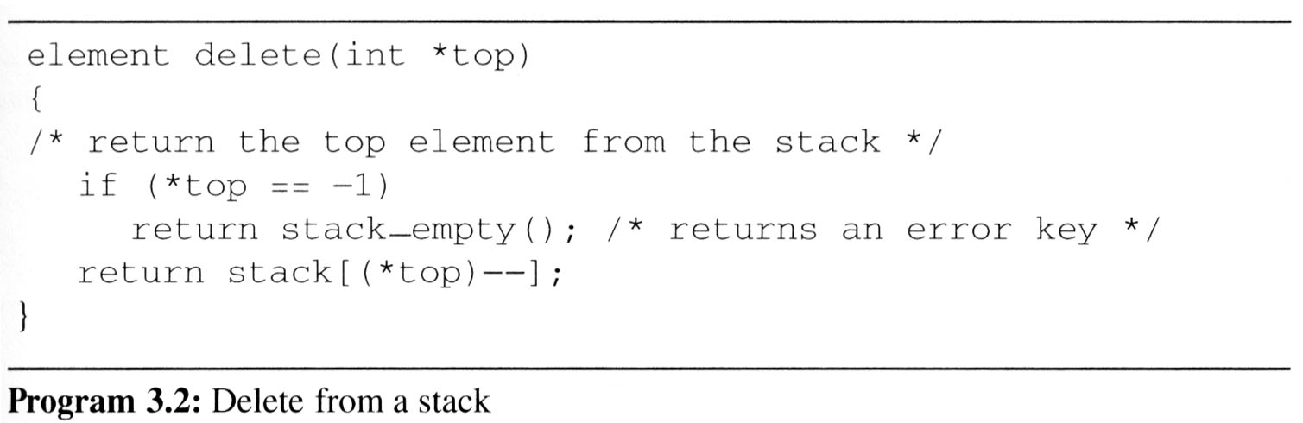
3.1 The stack ADT (5/5)

Slide 8
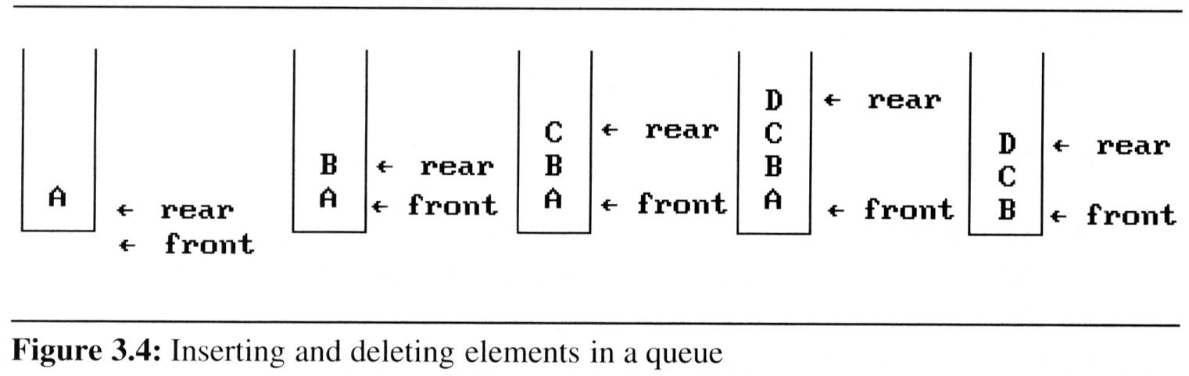
3.2 The queue ADT (1/7)
A queue is an ordered list in which all insertion take place one end, called the rear and all deletions take place at the opposite end, called the front
If we insert the elements A, B, C, D, E, in that order, then A is the first element we delete from the queue
A stack is also known as a First-In-First-Out (FIFO) list

Slide 9
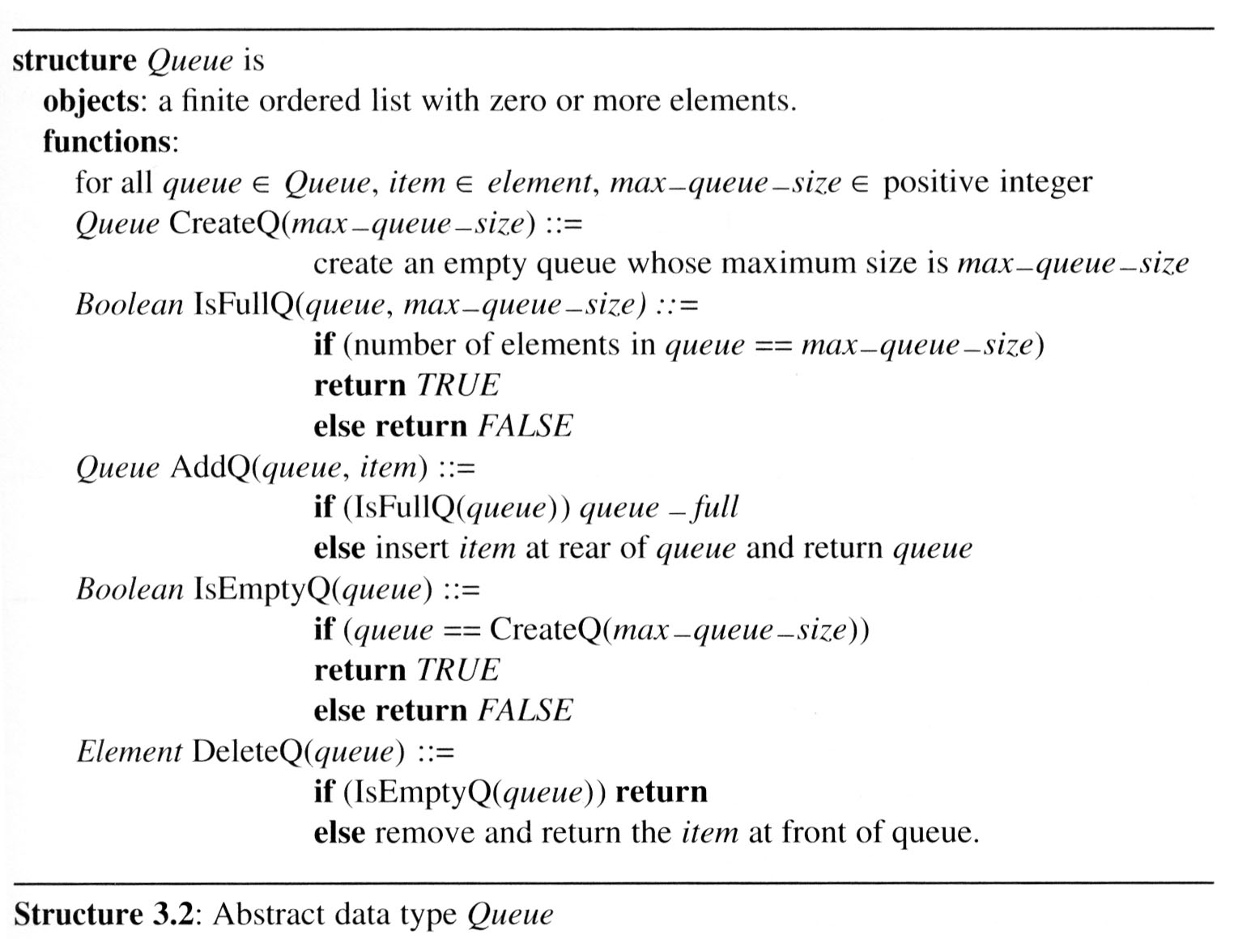
3.2 The queue ADT (2/7)
The ADT specification of the queue appears in Structure 3.2

Slide 10
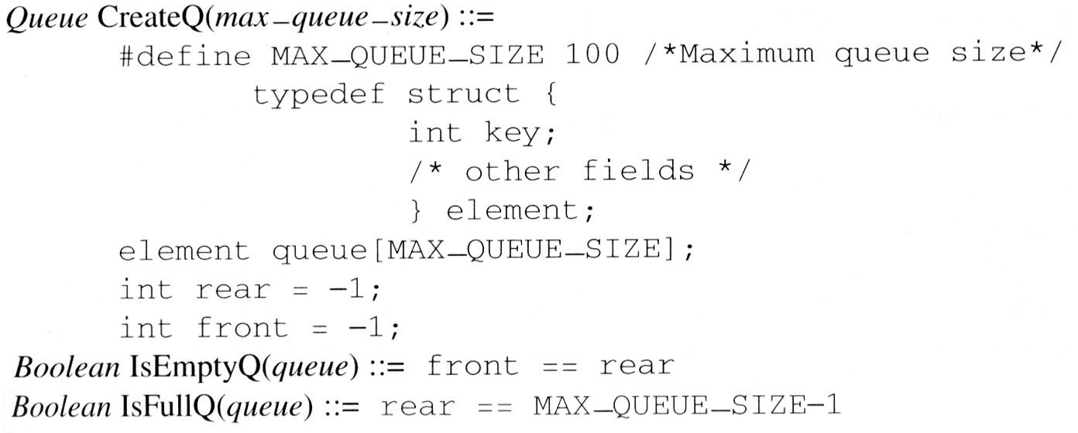
3.2 The queue ADT (3/7)
Implementation 1:
using a one dimensional array and
two variables, front and rear

Slide 11
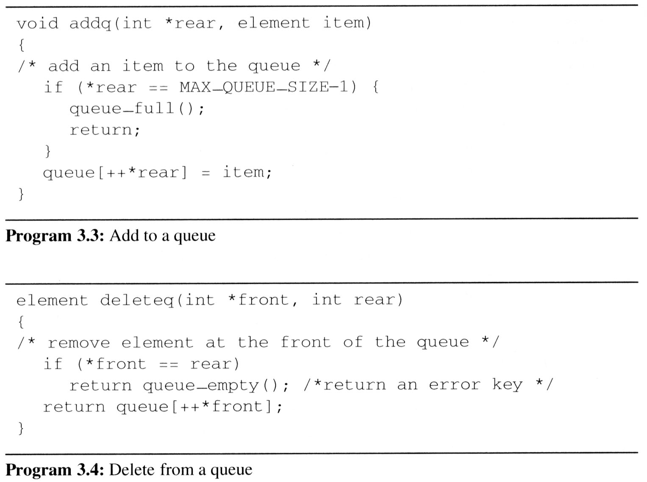
3.2 The queue ADT (4/7)
problem: there may be available space when IsFullQ is true i.e. movement is required.

Slide 12
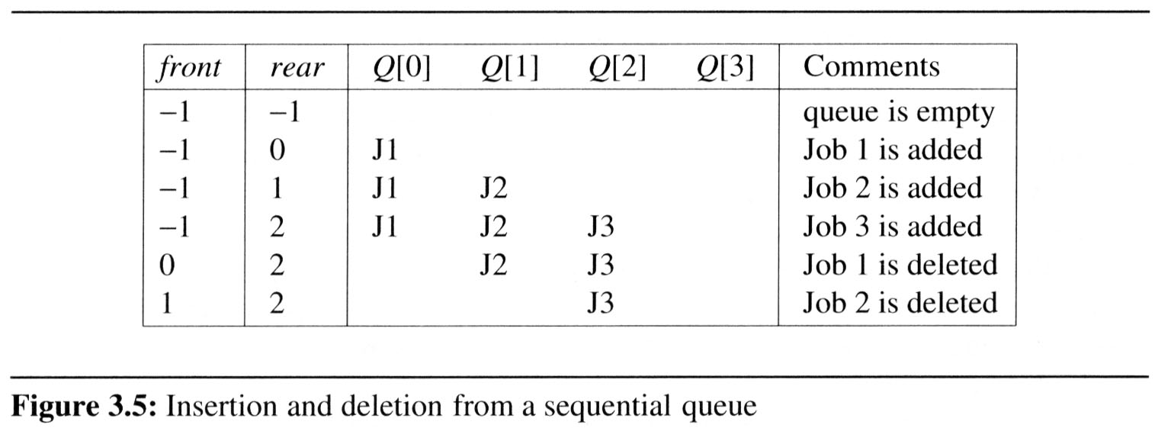
3.2 The queue ADT (5/7)
Example 3.2 [Job scheduling]:
  Figure 3.5 illustrates how an operating system might process jobs if it used a sequential representation for its queue.
    As jobs enter and leave the system, the queue gradually shift to right.
    In this case, queue_full should move the entire queue to the left so that the first element is again at queue[0], front is at -1, and rear is correctly positioned.
      Shifting an array is very time-consuming, queue_full has a worst case complexity of O(MAX_QUEUE_SIZE).

Slide 13
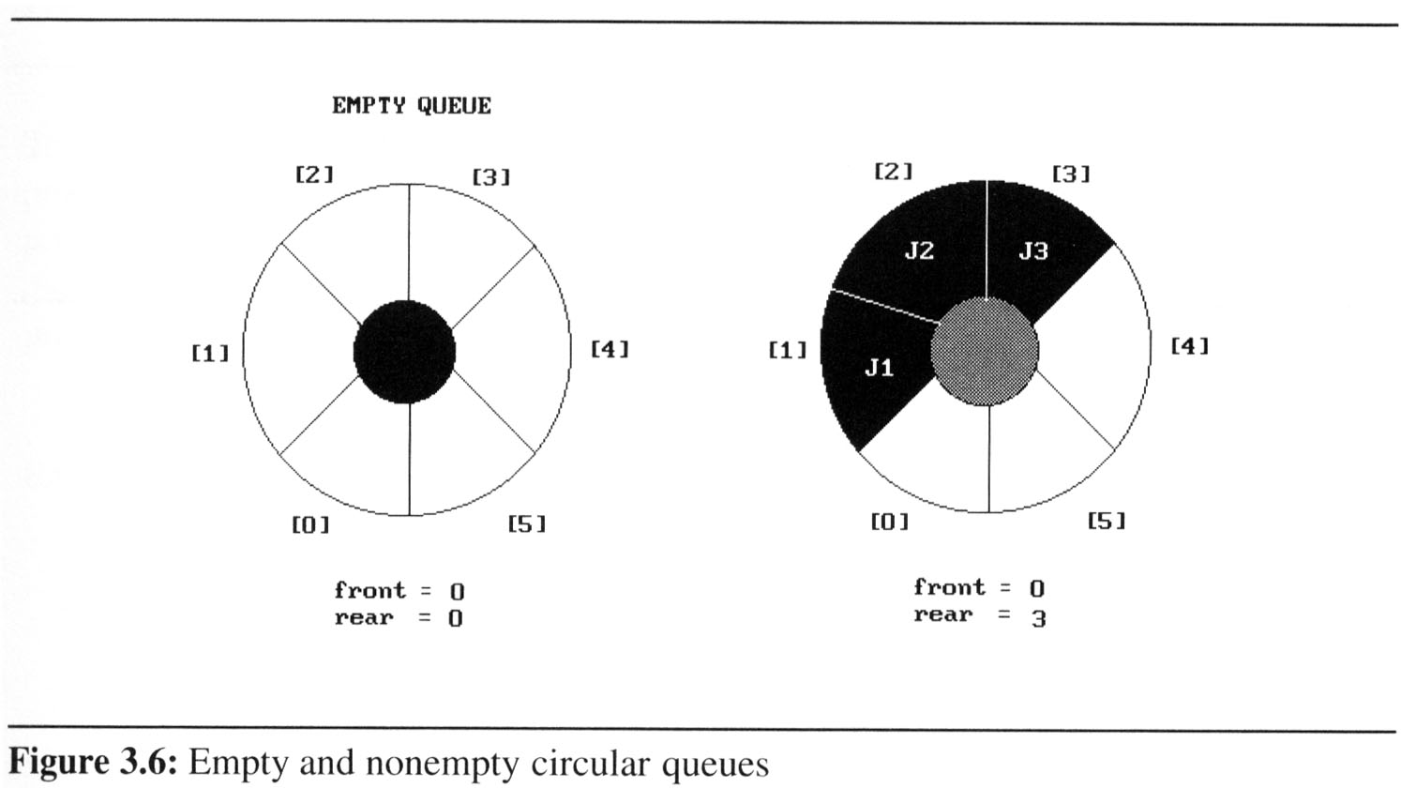
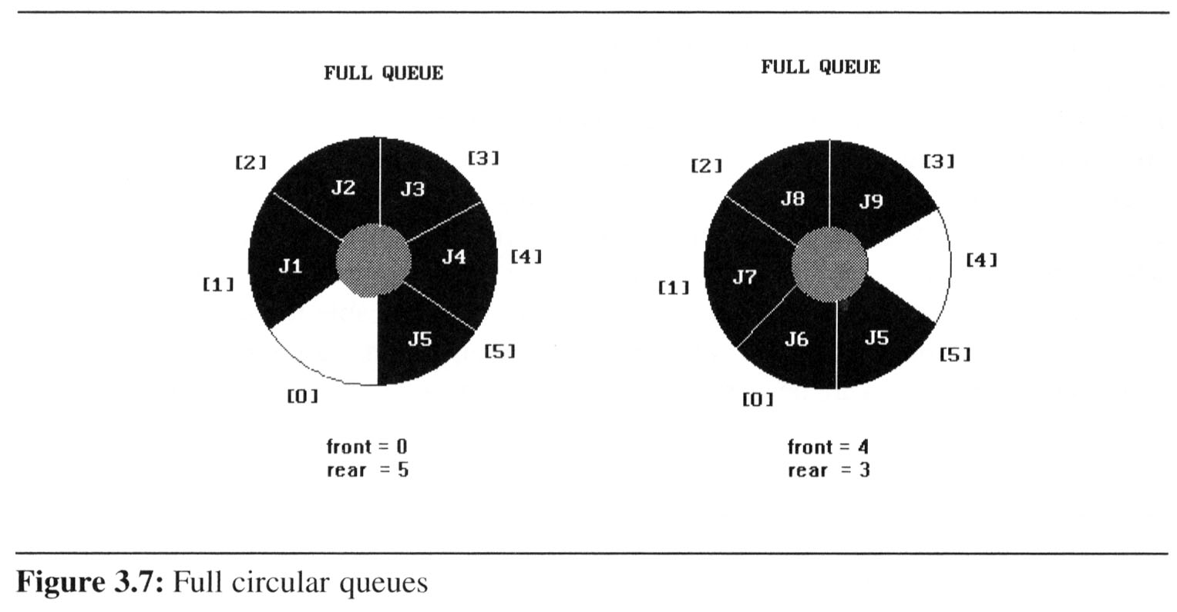
3.2 (6/7)
We can obtain a more efficient representation if we regard the array queue[MAX_QUEUE_SIZE] as circular.
Implementation 2:
regard an array as a circular
queue
front: one position
counterclockwise from the
first element
rear: current end
Problem: one space is left when queue is full.

Slide 14
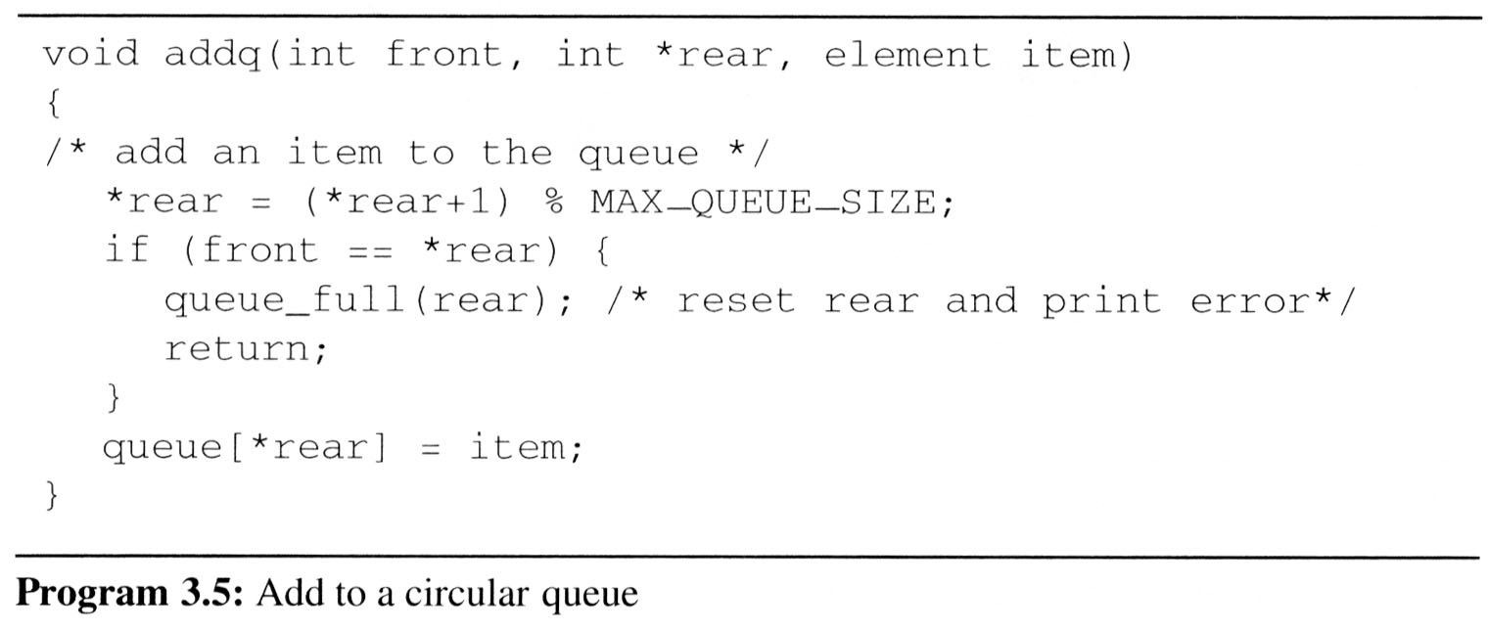
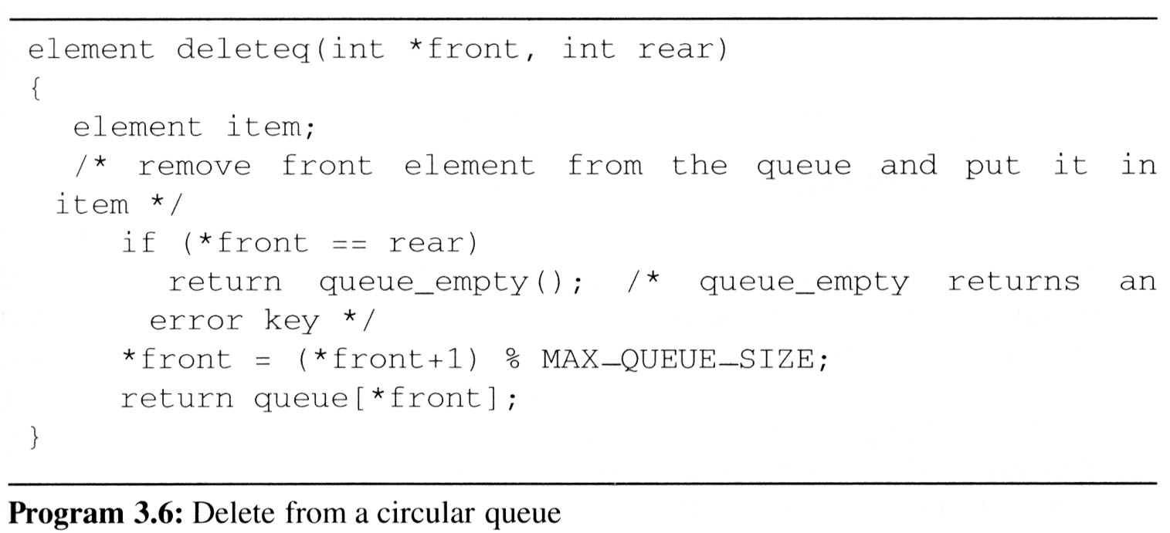
3.2 (7/7)
Implementing addq and deleteq for a circular queue is slightly more difficult since we must assure that a circular rotation occurs.

Slide 15
3.3 A Mazing Problem (1/8)
Representation of the maze
  The most obvious choice is a two dimensional array
    0s the open paths and 1s the barriers
  Notice that not every position has eight neighbors.
    To avoid checking for these border
    conditions we can surround the maze
    by a border of ones. Thus an m×p
    maze will require an (m+2) × (p+2)
    array
    The entrance is at
    position [1][1] and the exit at [m][p]
entrance
1 1 1 1 1 1 1 1 1 1 1 1 1 1 1 1 1
1 0 1 0 0 0 1 1 0 0 0 1 1 1 1 1 1
1 1 0 0 0 1 1 0 1 1 1 0 0 1 1 1 1
1 0 1 1 0 0 0 0 1 1 1 1 0 0 1 1 1
1 1 1 0 1 1 1 1 0 1 1 0 1 1 0 0 1
1 1 1 0 1 0 0 1 0 1 1 1 1 1 1 1 1
1 0 0 1 1 0 1 1 1 0 1 0 0 1 0 1 1
1 0 1 1 1 1 0 0 1 1 1 1 1 1 1 1 1
1 0 0 1 1 0 1 1 0 1 1 1 1 1 0 1 1
1 1 1 0 0 0 1 1 0 1 1 0 0 0 0 0 1
1 0 0 1 1 1 1 1 0 0 0 1 1 1 1 0 1
1 0 1 0 0 1 1 1 1 1 0 1 1 1 1 0 1
1 1 1 1 1 1 1 1 1 1 1 1 1 1 1 1 1
exit

Slide 16
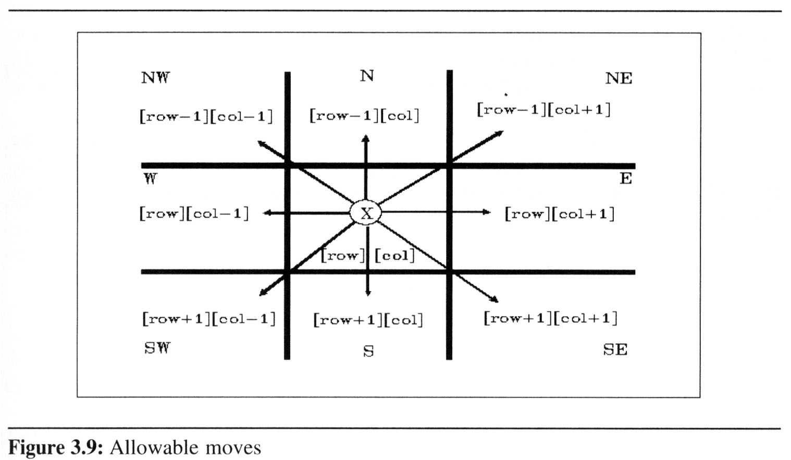
3.3 A Mazing Problem (2/8)
If X marks the spot of our current location, maze[row][col], then Figure 3.9 shows the possible moves from this position

Slide 17
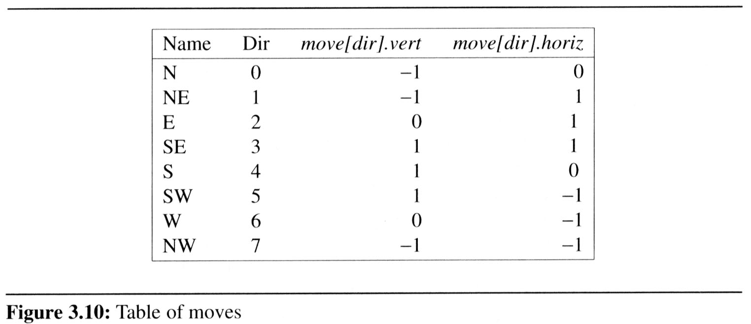
3.3 A Mazing Problem (3/8)
A possible implementation:
  Predefinition: the possible directions to move in an array, move, as in Figure 3.10.
    Obtained from Figure 3.9
    typedef struct {
    short int vert;
    short int horiz;
    } offsets;
    offsets move[8]; /*array of moves for each direction*/
  If we are at position, maze[row][col], and we wish to find the position of the next move, maze[row][col], we set:
    next_row = row + move[dir].vert;
    next_col = col + move[dir].horiz;

Slide 18
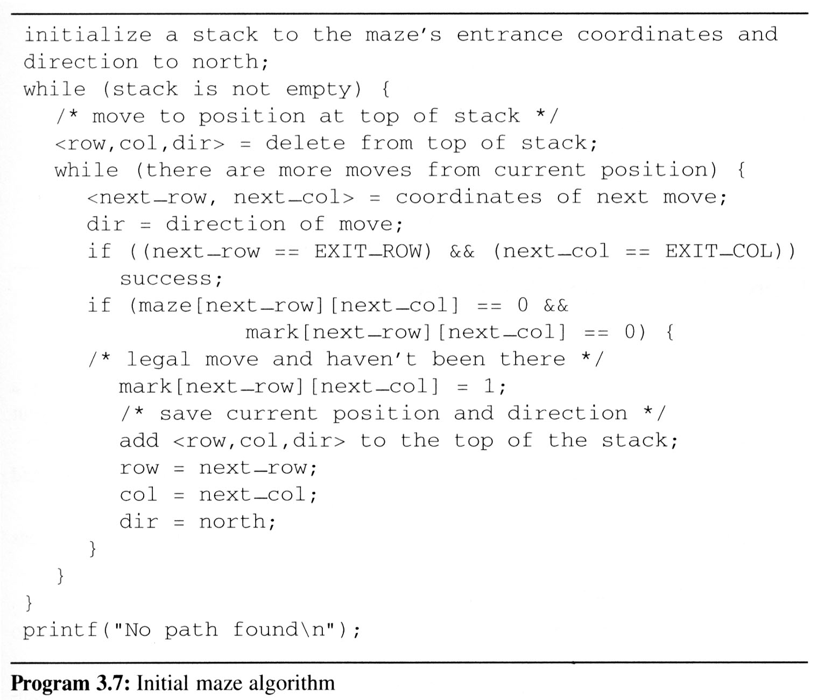
3.3 A Mazing Problem (4/8)
Initial attempt at a maze traversal algorithm
  maintain a second two-dimensional array, mark, to record
  the maze positions
  already checked
  use stack to keep
  pass history
  #define MAX_STACK_SIZE 100 /*maximum stack size*/
  typedef struct {
  short int row;
  short int col;
  short int dir;
  } element;
  element stack[MAX_STACK_SIZE];

Slide 19
R: row
C: col
D: dir
R 1 C 1 D 1
R4 C14 D 2
R3 C12 D 5
R3 C13 D 3
R3 C13 D 6
Pop out
R2 C12 D 3
R2 C11 D 2
maze[1][1]: entrance
Initially set mark[1][1]=1
R1 C10 D 3
R 1 C 9 D 2
1 1 1 1 1 1 1 1 1 1 1 1 1 1 1 1 1
1 0 1 0 0 0 1 1 0 0 0 1 1 1 1 1 1
1 1 0 0 0 1 1 0 1 1 1 0 0 1 1 1 1
1 0 1 1 0 0 0 0 1 1 1 1 0 0 1 1 1
1 1 1 0 1 1 1 1 0 1 1 0 1 1 0 0 1
1 1 1 0 1 0 0 1 0 1 1 1 1 1 1 1 1
1 0 0 1 1 0 1 1 1 0 1 0 0 1 0 1 1
1 0 1 1 1 1 0 0 1 1 1 1 1 1 1 1 1
1 0 0 1 1 0 1 1 0 1 1 1 1 1 0 1 1
1 1 1 0 0 0 1 1 0 1 1 0 0 0 0 0 1
1 0 0 1 1 1 1 1 0 0 0 1 1 1 1 0 1
1 0 1 0 0 1 1 1 1 1 0 1 1 1 1 0 1
1 1 1 1 1 1 1 1 1 1 1 1 1 1 1 1 1
█ █ █ █ █ █ █ █ █ █ █ █ █ █ █ █ █
█ █ █ █ █ █ █ █ █ █ █ █ █ █ █ █ █
█ █ █ █ █ █ █ █ █ █ █ █ █ █ █ █ █
█ █ █ █ █ █ █ █ █ █ █ █ █ █ █ █ █
█ █ █ █ █ █ █ █ █ █ █ █ █ █ █ █ █
█ █ █ █ █ █ █ █ █ █ █ █ █ █ █ █ █
█ █ █ █ █ █ █ █ █ █ █ █ █ █ █ █ █
█ █ █ █ █ █ █ █ █ █ █ █ █ █ █ █ █
█ █ █ █ █ █ █ █ █ █ █ █ █ █ █ █ █
█ █ █ █ █ █ █ █ █ █ █ █ █ █ █ █ █
█ █ █ █ █ █ █ █ █ █ █ █ █ █ █ █ █
█ █ █ █ █ █ █ █ █ █ █ █ █ █ █ █ █
█ █ █ █ █ █ █ █ █ █ █ █ █ █ █ █ █
❒
❒
❒
❒
❒
❒
❒
R 1 C 8 D 2
❒
❒
❒
❒
❒
R 2 C 7 D 1
❒
❒
❒
❒
R 3 C 6 D 1
❒
❒
❒
R 3 C 5 D 2
R 2 C 4 D 3
R 1 C 5 D 5
R 1 C 4 D 2
R 1 C 3 D 2
R 2 C 2 D 1
R 1 C 1 D 1
maze[15][11]: exit
R 1 C 1 D 3

Slide 20
3.3 A Mazing Problem (6/8)
Review of add and delete to a stack

Slide 21
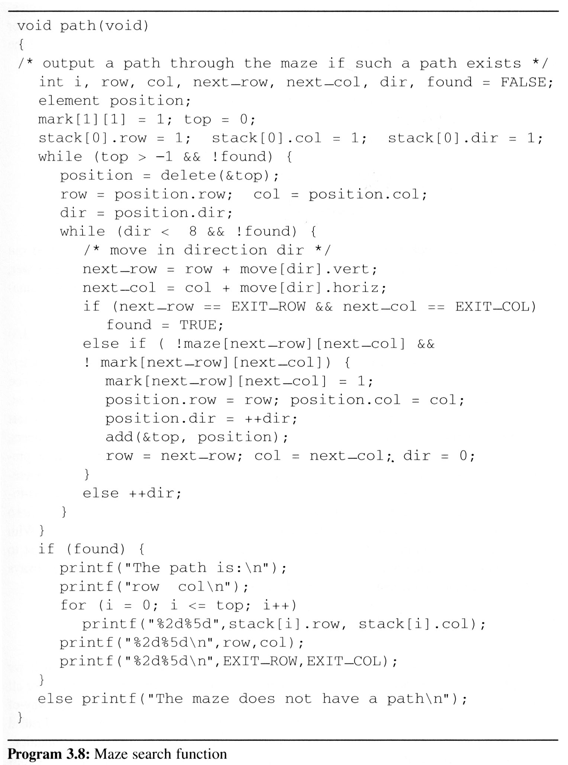
3.3 A Mazing Problem (7/7)
Analysis:
  The worst case of computing time of path is O(mp), where m and p are the number of rows and columns of the maze
  respectively
0
7 N 1
6 W E 2
5 S 3
4
(1,1)
(m,p)
(m+2)*(p+2)

Slide 22

3.3 A Mazing Problem (8/8)
The size of a stack
  0 0 0 0 0 1
  1 1 1 1 1 0
  1 0 0 0 0 1
  0 1 1 1 1 1
  1 0 0 0 0 1
  1 1 1 1 1 0
  1 0 0 0 0 1
  0 1 1 1 1 1
  1 0 0 0 0 0
  *Figure 3.11: Simple maze with a long path (p.116)
m*p

Slide 23
3.4 Evaluation of Expressions (1/14)
3.4.1 Introduction
  The representation and evaluation of expressions is of great interest to computer scientists.
    ((rear+1==front) || ((rear==MAX_QUEUE_SIZE-1) && !front)) (3.1)
    x = a/b - c+d*e - a*c (3.2)
  If we examine expressions (3.1),
  we notice that they contains:
    operators: ==, +, -, ||, &&, !
    operands: rear, front, MAX_QUEUE_SIZE
    parentheses: ( )

Slide 24
3.4 Evaluation of Expressions (2/14)
Understanding the meaning of these or any other expressions and statements
  assume a = 4, b = c = 2, d = e = 3 in the statement (3.2), finding out the value of x = a/b – c + d*e - a*c
    Interpretation 1: ((4/2)-2)+(3*3)-(4*2) = 0+8+9 = 1
    Interpretation 2: (4/(2-2+3))*(3-4)*2 = (4/3)*(-1)*2 = -2.66666…
  we would have written (3.2) differently by using parentheses to change the order of evaluation:
    x = ((a/(b - c+d))*(e - a)*c (3.3)
How to generate the machine instructions corresponding to a given expression?
precedence rule + associative rule

Slide 25
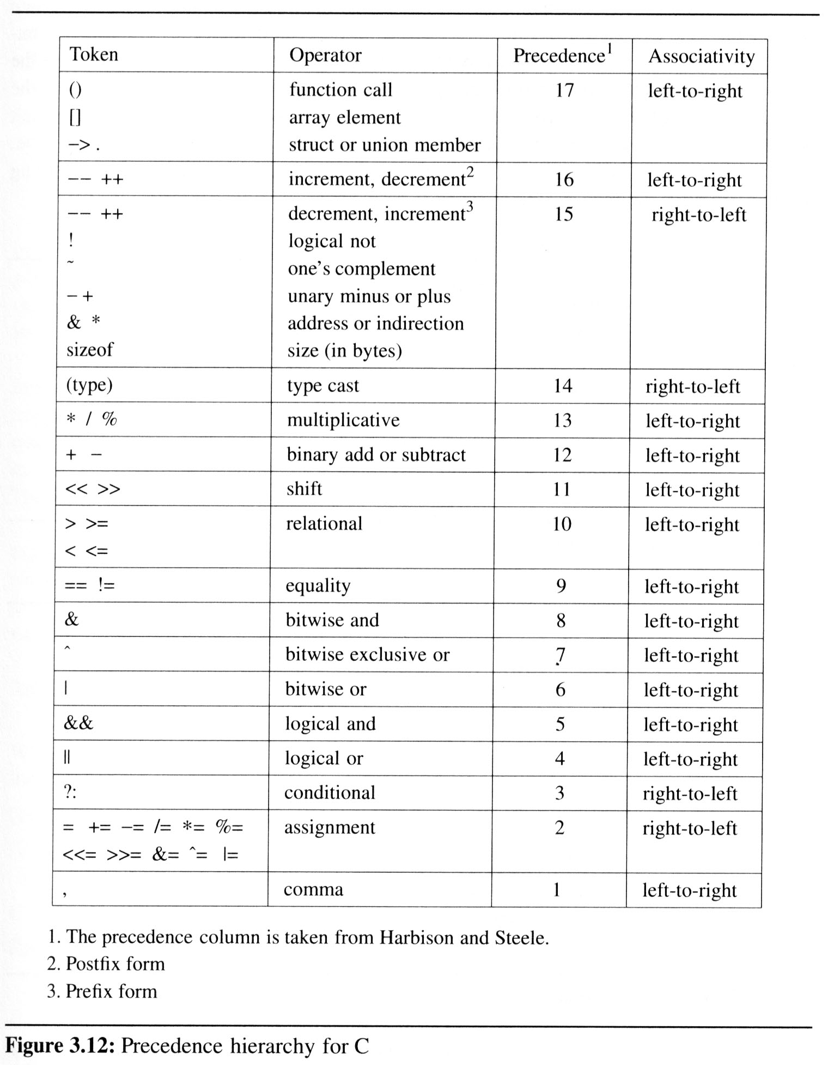
3.4 (3/14)
Precedence hierarchy and associative for C

Slide 26
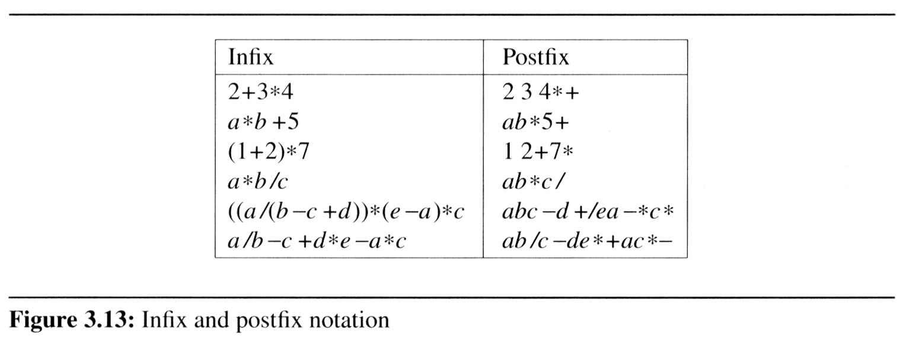
3.4 Evaluation of Expressions (4/14)
Evaluating postfix expressions
  The standard way of writing expressions is known as infix notation
    binary operator in-between its two operands
  Infix notation is not the one used by compilers to evaluate expressions
  Instead compilers typically use a parenthesis-free notation referred to as postfix
Postfix:
no parentheses,
no precedence

Slide 27
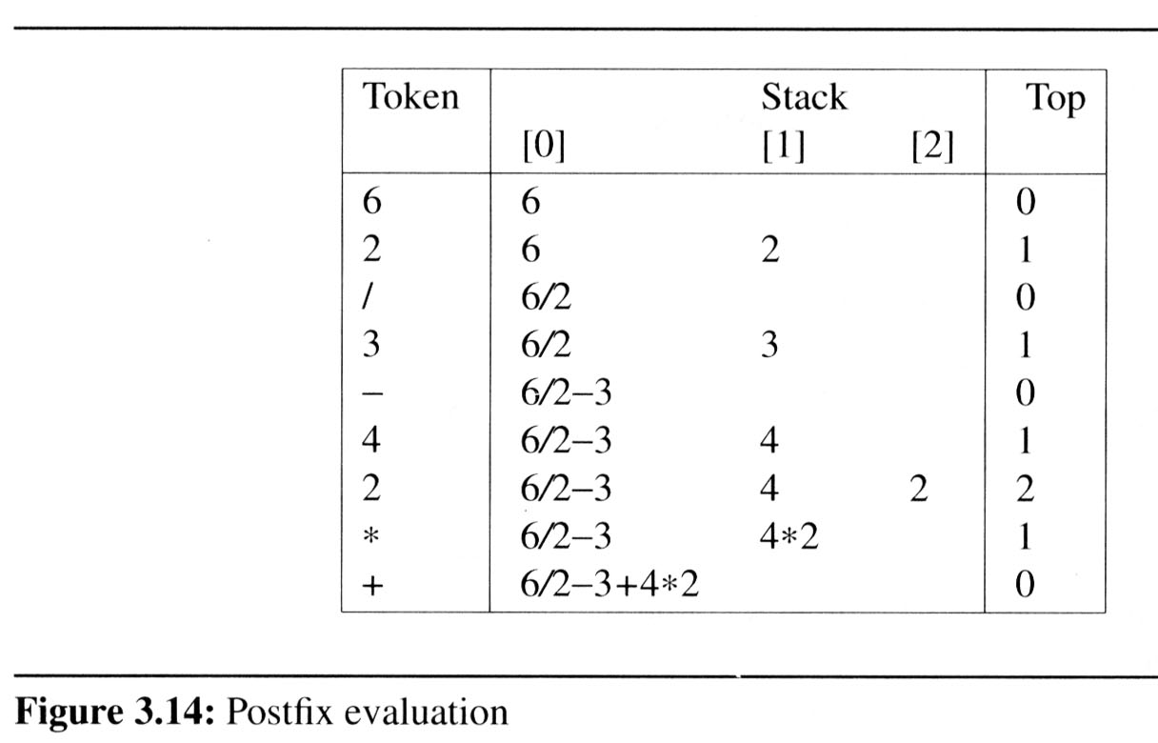
3.4 Evaluation of Expressions (5/14)
Evaluating postfix expressions is much simpler than the evaluation of infix expressions:
  There are no parentheses to consider.
  To evaluate an expression we make a single left-to-right scan of it.
  We can evaluate
  an expression
  easily by using
  a stack
Figure 3.14 shows this processing when the input is nine character string 6 2/3-4 2*+

Slide 28
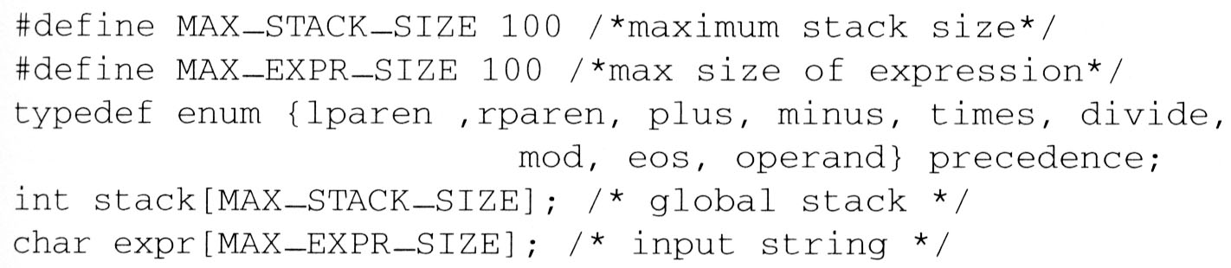
3.4 Evaluation of Expressions (6/14)
Representation
  We now consider the representation of both the stack and the expression

Slide 29
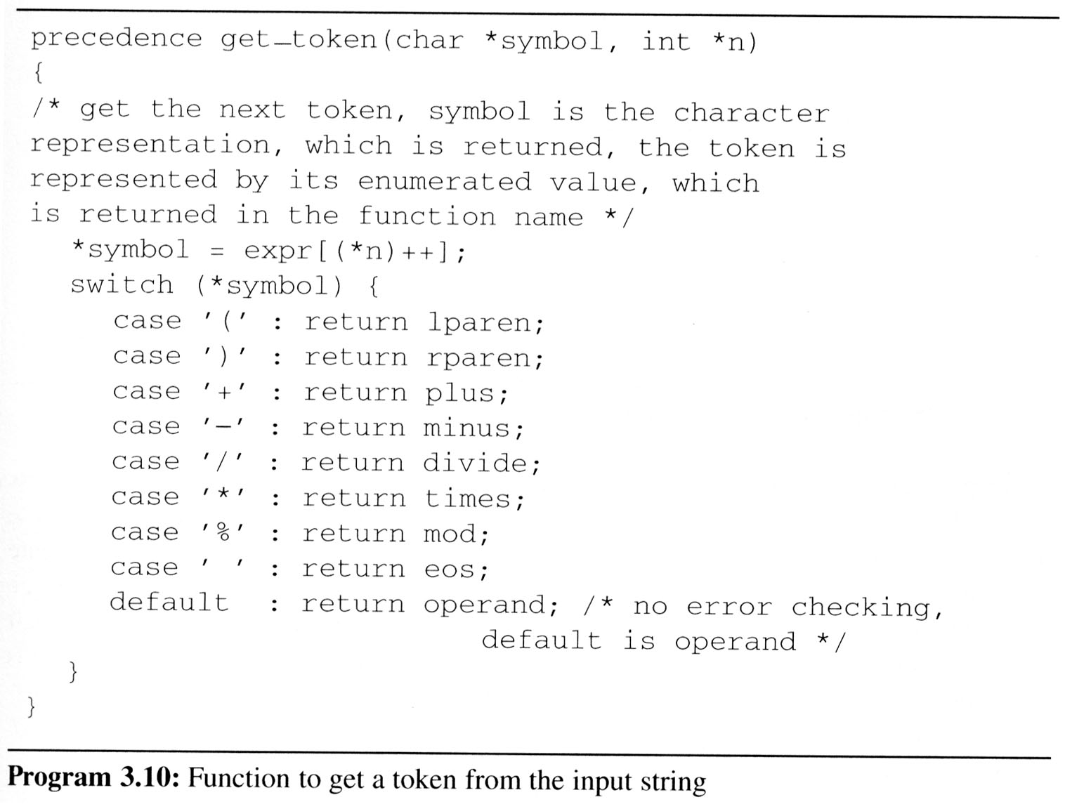
3.4 Evaluation of Expressions (7/14)
Get Token

Slide 30
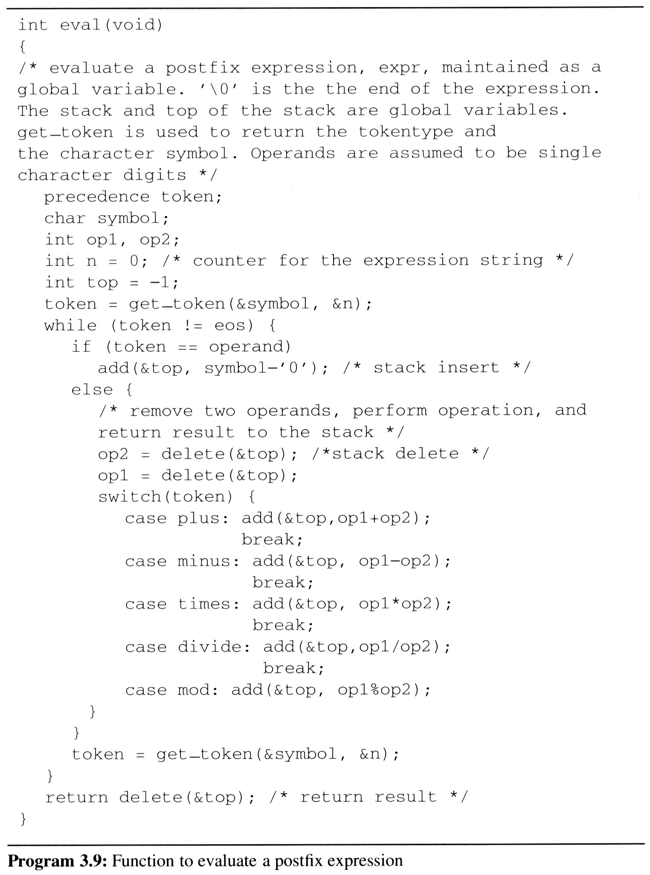
3.4 (8/14)
Evaluation of
Postfix Expression

Slide 31
3.4 Evaluation of Expressions (9/14)
string: 6 2/3-4 2*+
we make a single left-to-right scan of it
add the string with the operator
6 2 / 3 - 4 2 * +
2
2
the answer is
not an operator, put into the stack
not an operator, put into the stack
is an operator, pop two elements of the stack
not an operator, put into the stack
is an operator, pop two elements of the stack
not an operator, put into the stack
not an operator, put into the stack
is an operator, pop two elements of the stack
is an operator, pop two elements of the stack
end of string, pop the stack and get answer
1
2
3
4
4*2
6 / 2 - 3 + 4 * 2
6
6/2
6/2-3
0
6/2-3+4*2
top
STACK
now, top must +1
now, top must -2
now, top must -1

Slide 32
3.4 Evaluation of Expressions (10/14)
We can describe am algorithm for producing a postfix expression from an infix one as follows
  (1) Fully parenthesize expression
a / b - c + d * e - a * c
 ((((a / b) - c) + (d * e)) - (a * c))
  (2) All operators replace their corresponding right parentheses
((((a / b) - c) + (d * e)) - (a * c))
  (3)Delete all parentheses
a b / c - d e * + a c * -
 The order of operands is the same in infix and postfix
*
*
two passes
/
-
-
+

Slide 33
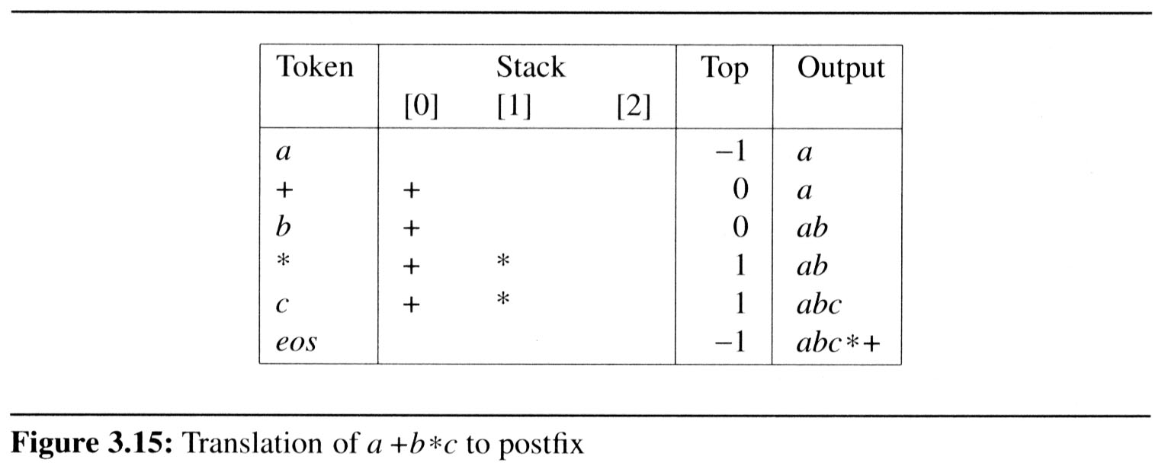
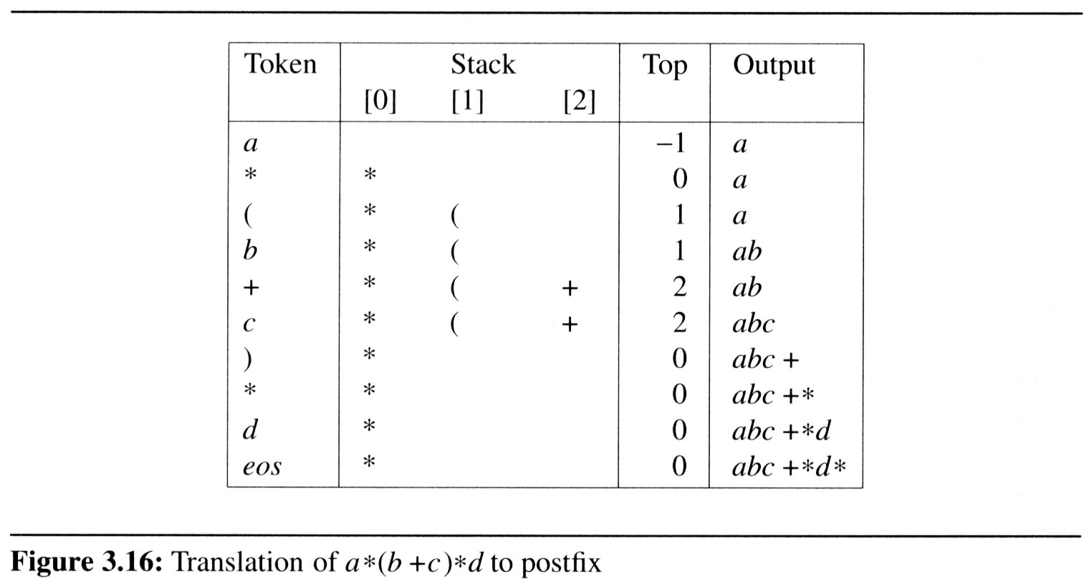
3.4 Evaluation of Expressions (11/14)
Example 3.3 [Simple expression]: Simple expression a+b*c, which yields abc*+ in postfix.
Example 3.5 [Parenthesized expression]: The expression a*(b+c)*d, which yields abc+*d*
in postfix
icp
isp
12
12
13
13
13
0
icp
isp
13
13
20
0
0
12
12
12
19
match )
13
13
13
13
0
13

Slide 34
3.4 Evaluation of Expressions (12/14)
Algorithm to convert from infix to postfix
  Assumptions:
    operators: (, ), +, -, *, /, %
    operands: single digit integer or variable of one character
  Operands are taken out immediately
  Operators are taken out of the stack as long as their in-stack precedence (isp) is higher than or equal to the incoming precedence (icp) of the new operator
  ‘(‘ has low isp, and high icp
    op ( ) + - * / % eos
    Isp 0 19 12 12 13 13 13 0
    Icp 20 19 12 12 13 13 13 0
  precedence stack[MAX_STACK_SIZE];
  /* isp and icp arrays -- index is value of precedence lparen, rparen, plus, minus, times, divide, mod, eos */
  static int isp [ ] = {0, 19, 12, 12, 13, 13, 13, 0};
  static int icp [ ] = {20, 19, 12, 12, 13, 13, 13, 0};

Slide 35
3.4 Evaluation of Expressions (13/14)
a * ( b + c ) / d
operand, print out
operator
operator
operand, print out
operator
operand, print out
operator
operator
operand, print out
eos
push into the stack
+
pop the stack and printout
2
the isp of “( “ is 0 and the icp of “* “ is 13
the isp of “/ “ is 13 and the icp of “* “ is 13
the isp of “+“ is 12 and the icp of “( “ is 20
operator “)”, pop and print out until “(”
(
1
*
output
0
/
a
b
c
+
*
d
/
top
stack
now, top must +1
now, top must - 1

Slide 36
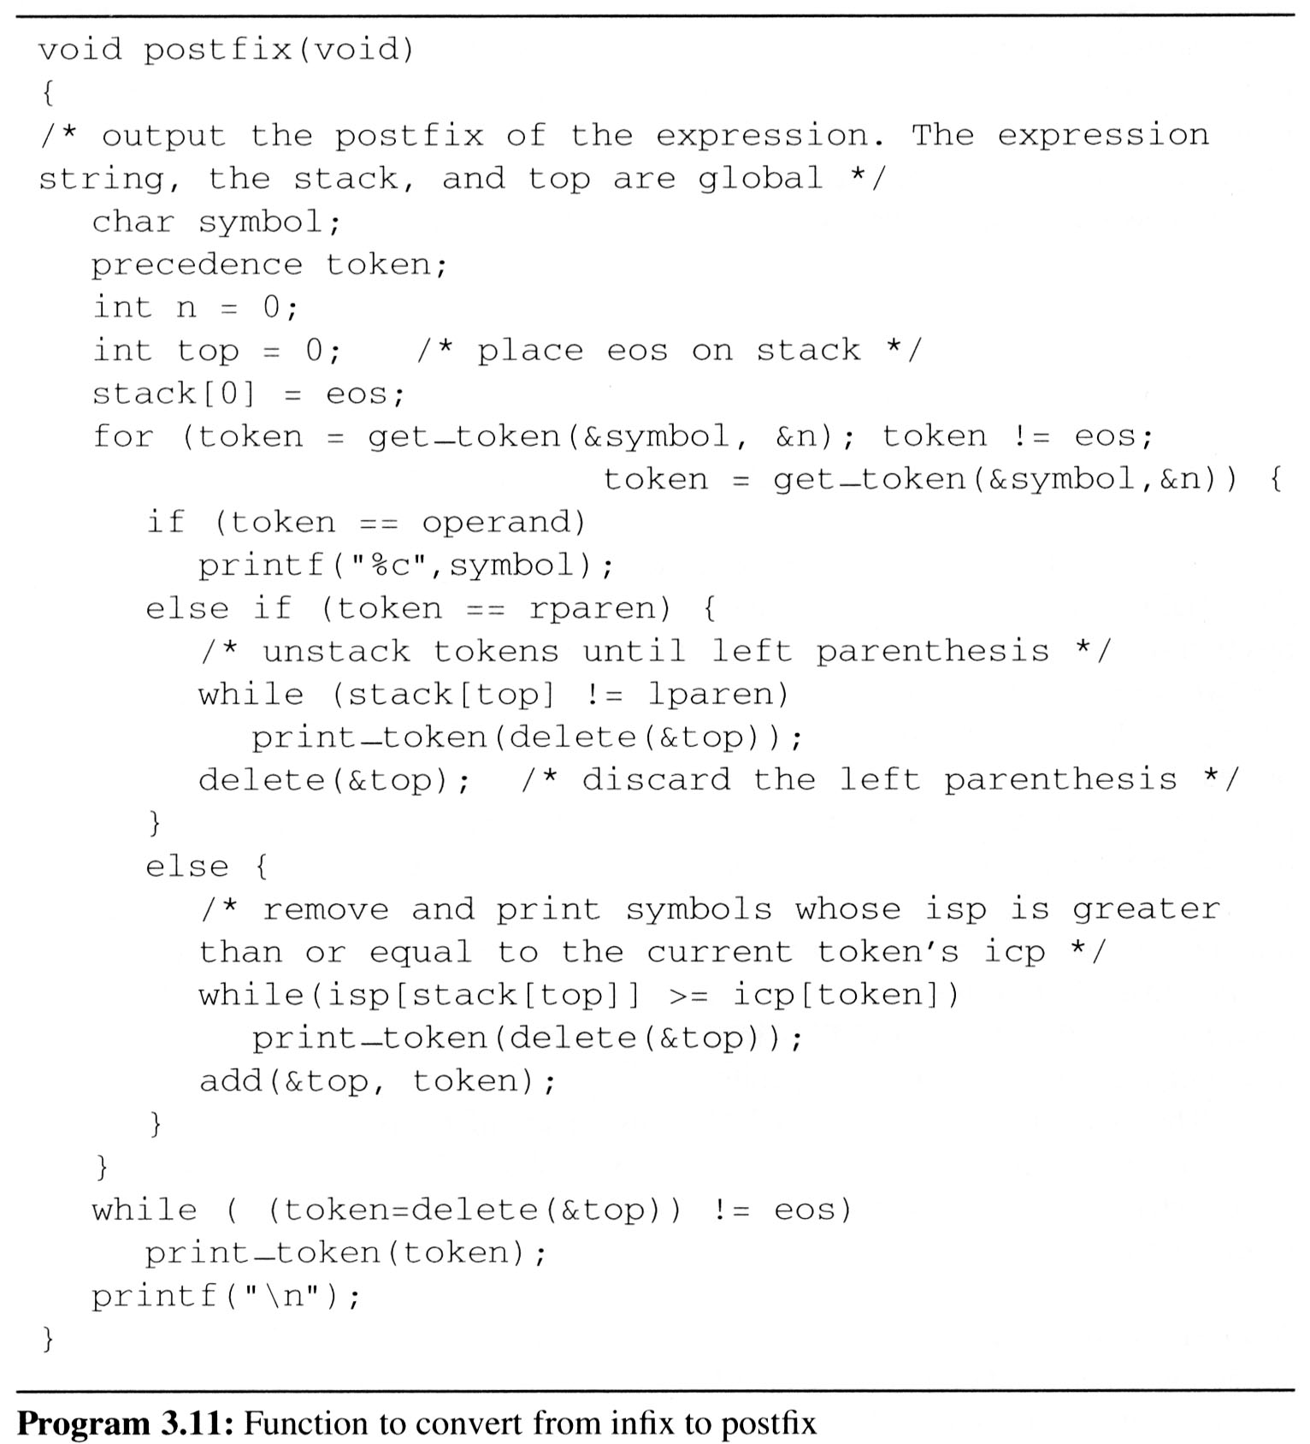
3.4 Evaluation of Expressions (14/14)
Complexity: Θ(n)
  The total time spent here is Θ(n) as the number of tokens that get stacked and unstacked is linear in n
  where n is the number of tokens in the expression

