Slide 1
CS235102
Data Structures
Chapter 5 Trees

Slide 2
Chapter 5 Trees: Outline
Introduction
  Representation Of Trees
Binary Trees
Binary Tree Traversals
Additional Binary Tree Operations
Threaded Binary Trees
Heaps
Binary Search Trees
Selection Trees
Forests

Slide 3
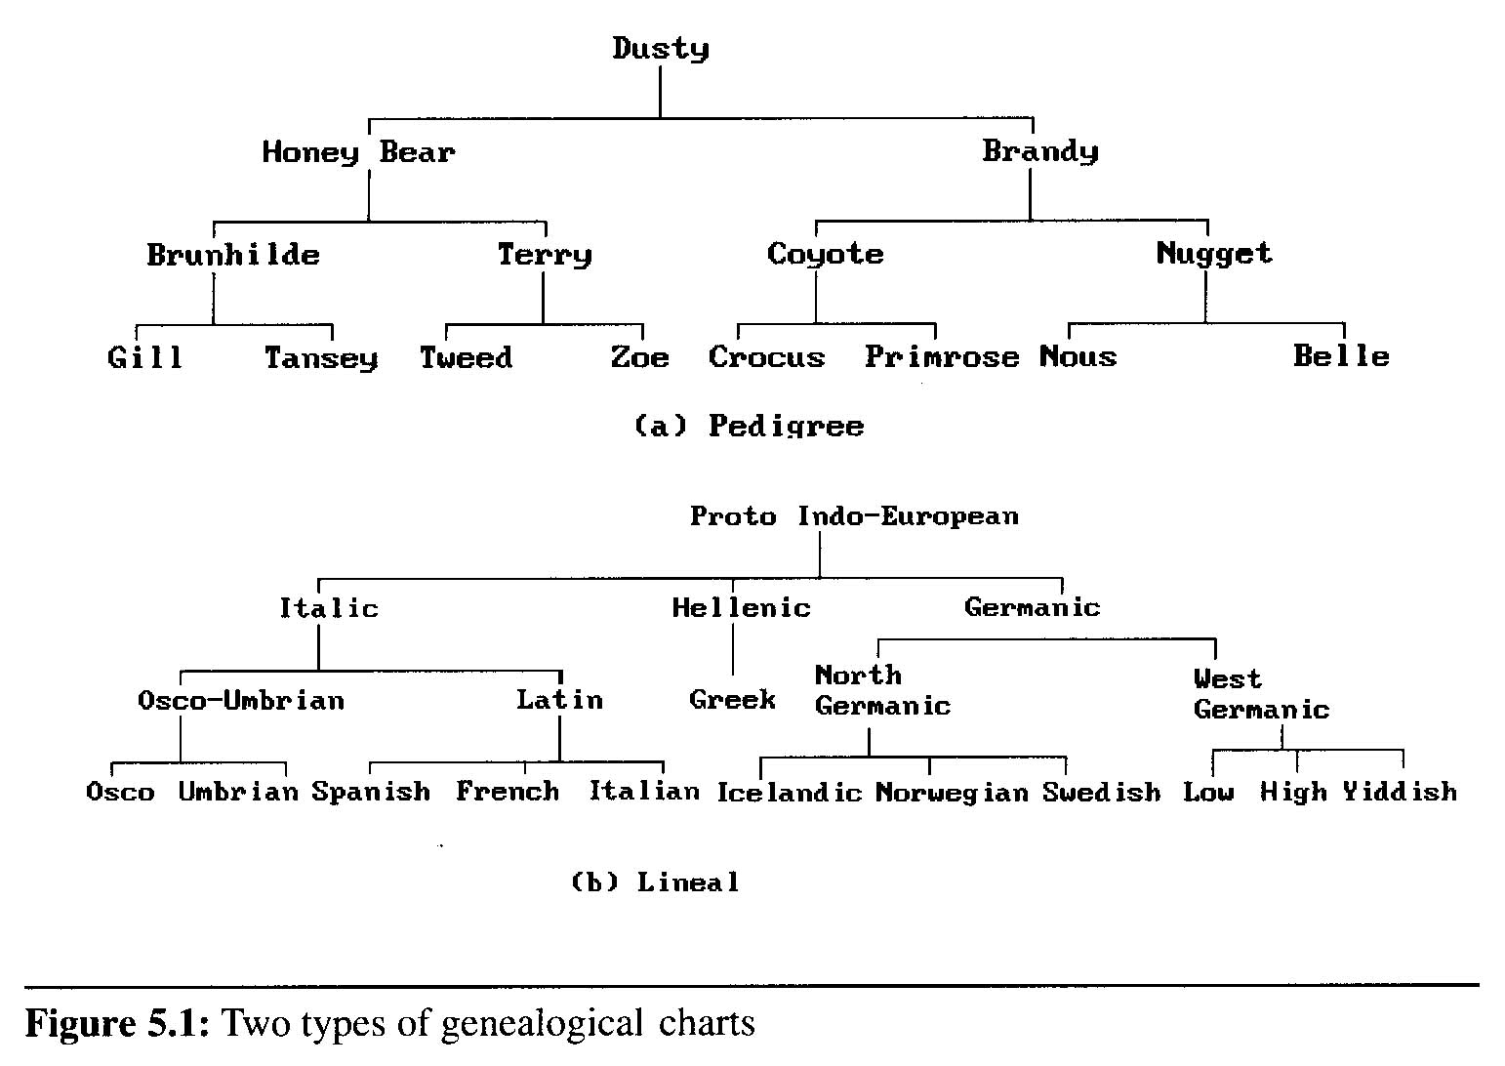
Introduction (1/8)
A tree structure means that the data are organized so that items of information are related by branches
Examples:

Slide 4
Introduction (2/8)
Definition (recursively): A tree is a finite set of one or more nodes such that
  There is a specially designated node called root.
  The remaining nodes are partitioned into n>=0 disjoint set T₁,…,T_{n}, where each of these sets is a tree. T₁,…,T_{n} are called the subtrees of the root.
Every node in the tree is the root of some subtree

Slide 5
Introduction (3/8)
Some Terminology
  node: the item of information plus the branches to each node.
  degree: the number of subtrees of a node
  degree of a tree: the maximum of the degree of the nodes in the tree.
  terminal nodes (or leaf): nodes that have degree zero
  nonterminal nodes: nodes that don’t belong to terminal nodes.
  children: the roots of the subtrees of a node X are the children of X
  parent: X is the parent of its children.

Slide 6
Introduction (4/8)
Some Terminology (cont’d)
  siblings: children of the same parent are said to be siblings.
  Ancestors of a node: all the nodes along the path from the root to that node.
  The level of a node: defined by letting the root be at level one. If a node is at level l, then it children are at level l+1.
  Height (or depth): the maximum level of any node in the tree

Slide 7
Introduction (5/8)
Example
  A is the root node
  B is the parent of D and E
  C is the sibling of B
  D and E are the children of B
  D, E, F, G, I are external nodes, or leaves
  A, B, C, H are internal nodes
  The level of E is 3
  The height (depth) of the tree is 4
  The degree of node B is 2
  The degree of the tree is 3
  The ancestors of node I is A, C, H
  The descendants of node C is F, G, H, I
Property: (# edges) = (#nodes) - 1
Level
A
1
B
C
2
H
3
D
E
F
G
I
4

Slide 8
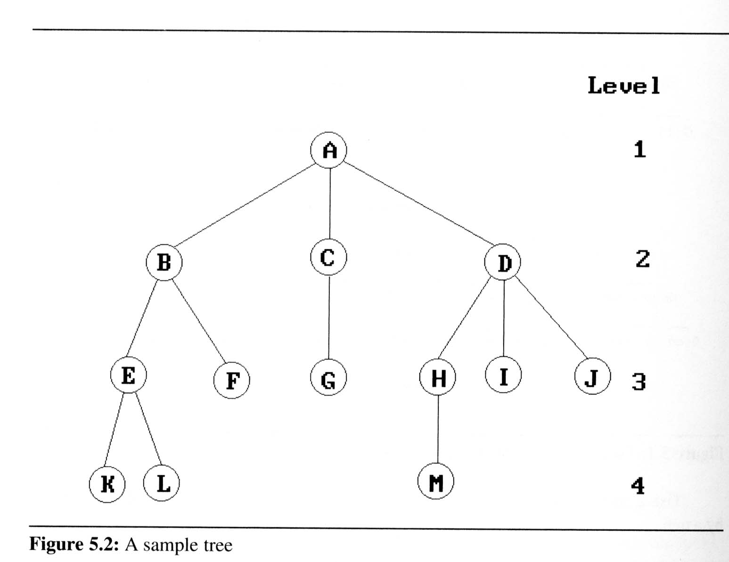
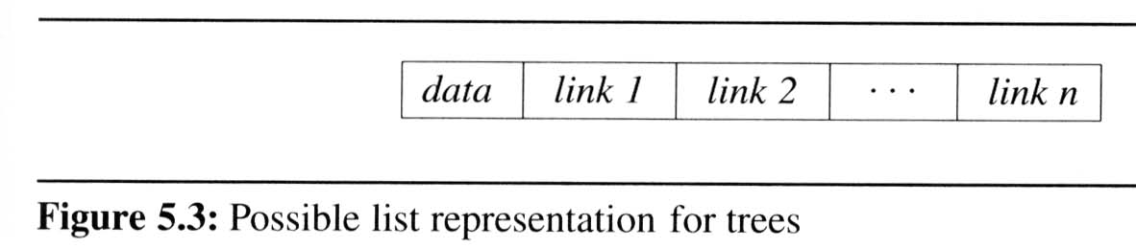
Introduction (6/8)
Representation Of Trees
  List Representation
    we can write of Figure 5.2 as a list in which each of the subtrees is also a list
  ( A ( B ( E ( K, L ), F ), C ( G ), D ( H ( M ), I, J ) ) )
    The root comes first,
    followed by a list of sub-trees

Slide 9
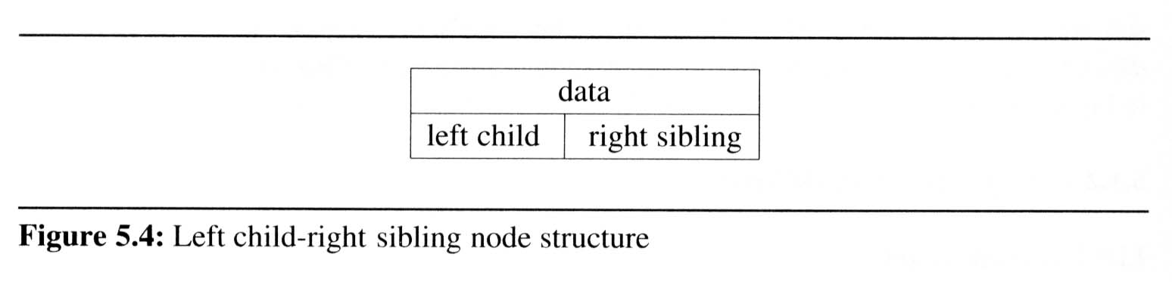
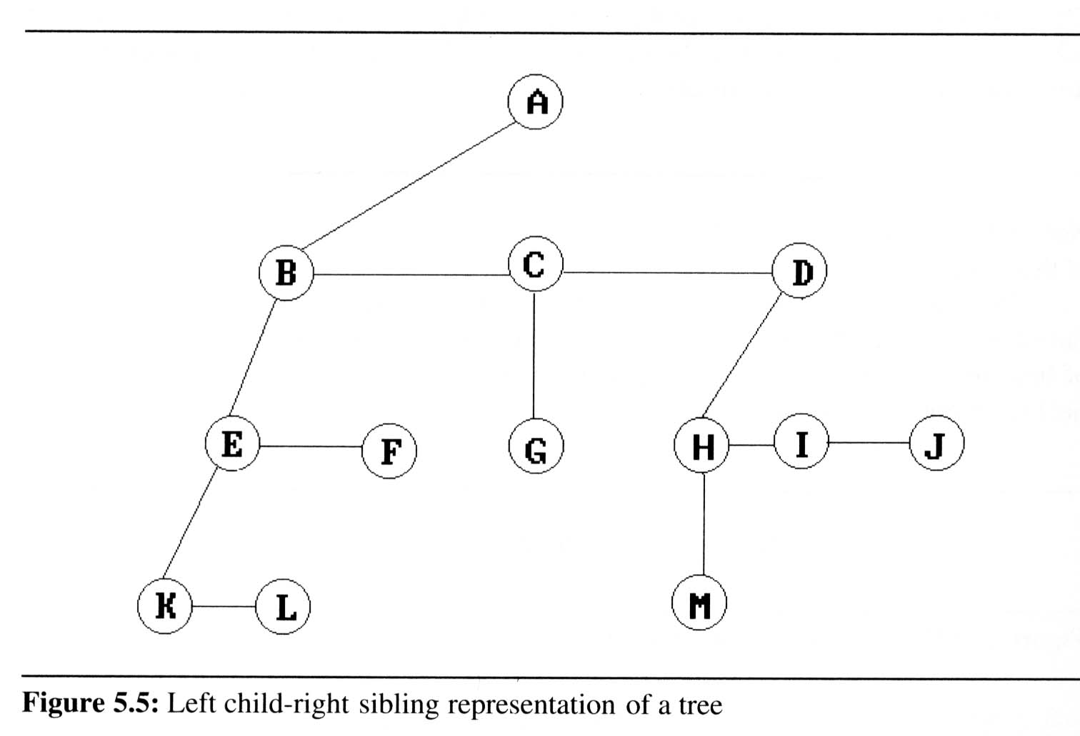
Introduction (7/8)
Representation Of
Trees (cont’d)
  Left Child-
  Right Sibling
  Representation

Slide 10
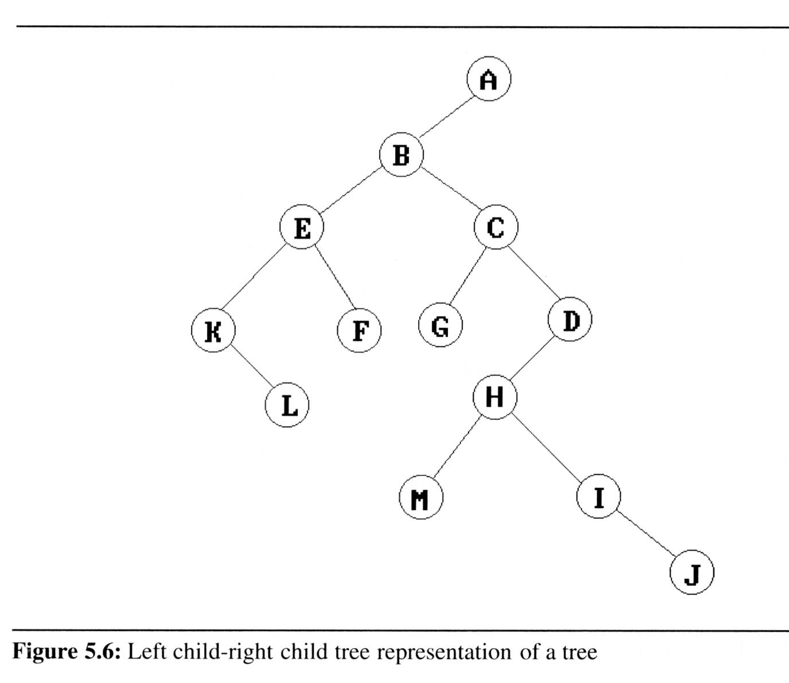
Introduction (8/8)
Representation Of Trees (cont’d)
  Representation
  As A Degree
  Two Tree

Slide 11
Binary Trees (1/9)
Binary trees are characterized by the fact that any node can have at most two branches
Definition (recursive):
  A binary tree is a finite set of nodes that is either empty or consists of a root and two disjoint binary trees called the left subtree and the right subtree
Thus the left subtree and the right subtree are distinguished
Any tree can be transformed into binary tree
  by left child-right sibling representation
A
A
B
B

Slide 12
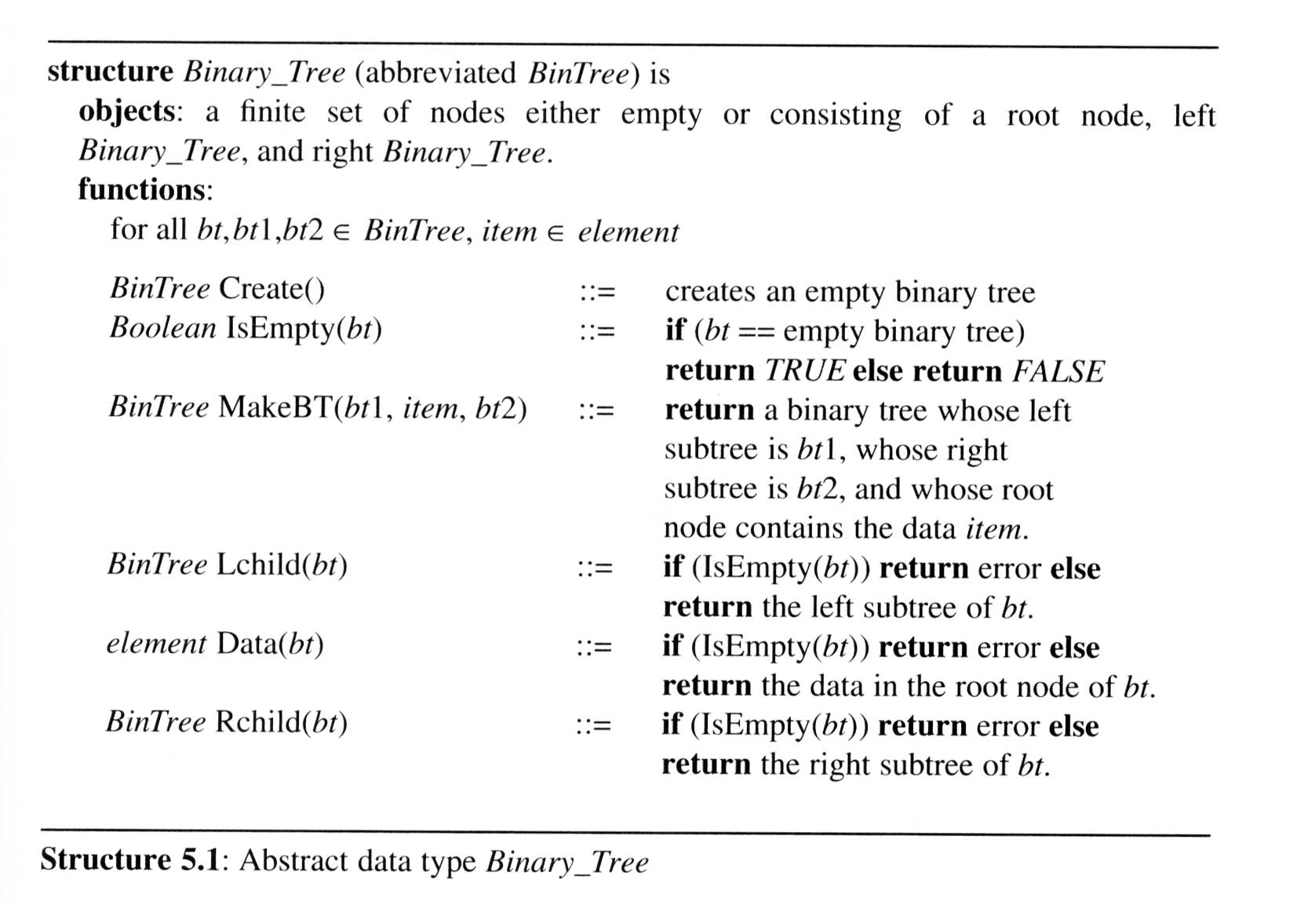
Binary Trees (2/9)
The abstract data type of binary tree

Slide 13
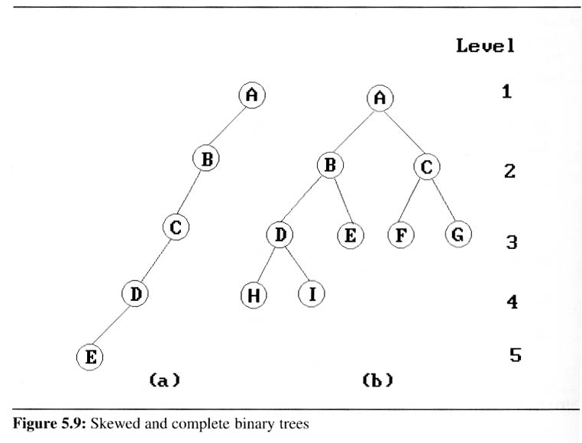
Binary Trees (3/9)
Two special kinds of binary trees:
(a) skewed tree, (b) complete binary tree
  The all leaf nodes of these trees are on two adjacent levels

Slide 14
Binary Trees (4/9)
Properties of binary trees
  Lemma 5.1 [Maximum number of nodes]:
  The maximum number of nodes on level i of a binary tree is 2^{i-1}, i ≥1.
  The maximum number of nodes in a binary tree of depth k is 2^{k}-1, k≥1.
  Lemma 5.2 [Relation between number of leaf nodes and degree-2 nodes]:
  For any nonempty binary tree, T, if n₀ is the number of leaf nodes and n₂ is the number of nodes of degree 2, then n₀ = n₂ + 1.
These lemmas allow us to define full and complete binary trees

Slide 15
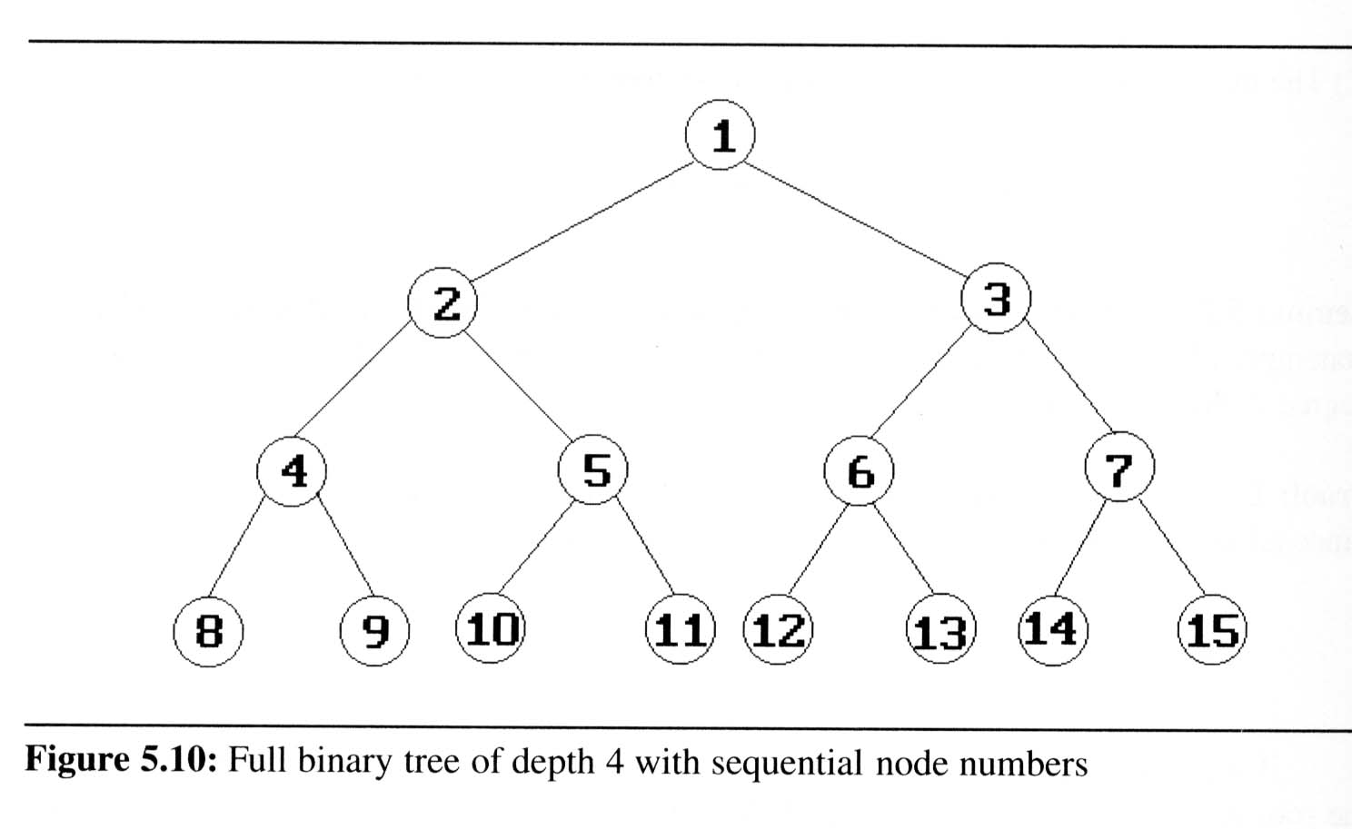
Binary Trees (5/9)
Definition:
  A full binary tree of depth k is a binary tree of death k having 2^{k}-1 nodes, k ≥ 0.
  A binary tree with n nodes and depth k is complete iff its nodes correspond to the nodes numbered from 1 to n in the full binary tree of depth k.
  From Lemma 5.1, the
  height of a complete
  binary tree with n nodes
  is ⎡log₂(n+1)⎤

Slide 16
Binary Trees (6/9)
Binary tree representations (using array)
  Lemma 5.3: If a complete binary tree with n nodes is represented sequentially, then for any node with index i, 1 ≤ i ≤ n, we have
  parent(i) is at ⎣i /2⎦ if i ≠ 1.
  If i = 1, i is at the root and has no parent.
  LeftChild(i) is at 2i if 2i ≤ n.
  If 2i > n, then i has no left child.
  RightChild(i) is at 2i+1 if 2i+1 ≤ n.
  If 2i +1 > n, then i has no left child
A
1
[1]
[2]
[3]
[4]
[5]
[6]
[7]
B
2
C
3
A B C — D — E
Level 1
D
E
Level 2
Level 3
4
5
6
7

Slide 17
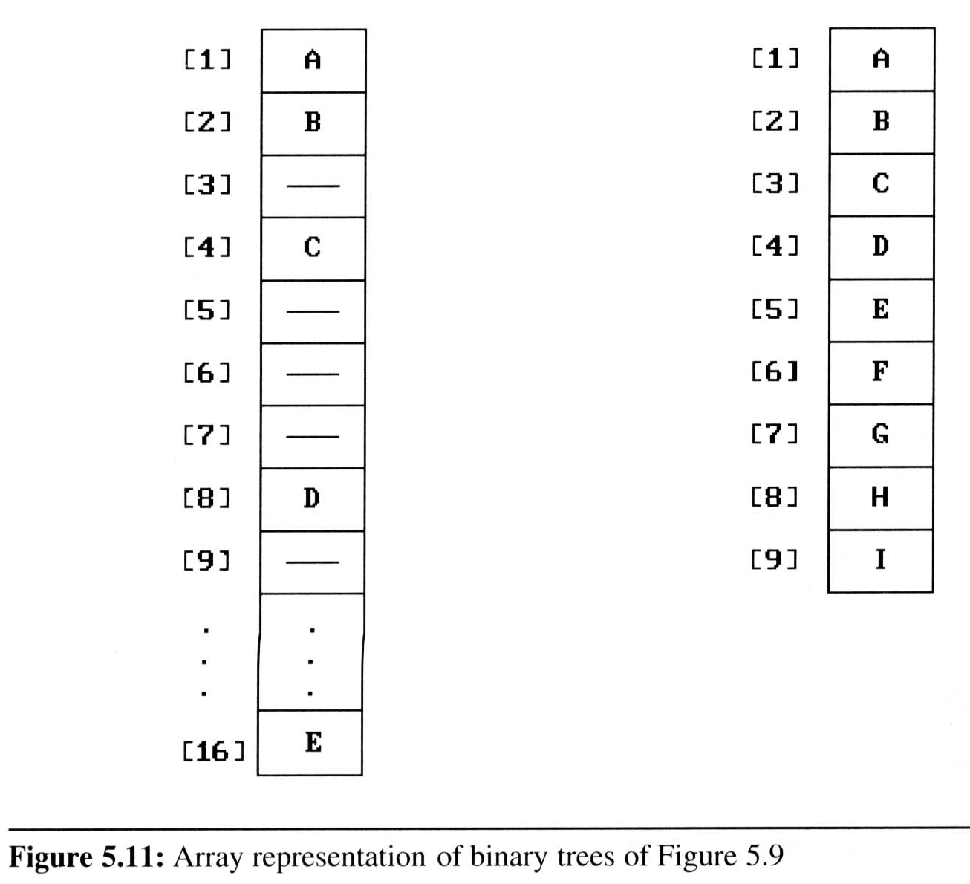
Binary Trees (7/9)
Binary tree representations (using array)
  Waste spaces: in the worst case, a skewed tree of depth k requires 2^{k}-1 spaces. Of these, only k spaces will be occupied
  Insertion or deletion
  of nodes from the
  middle of a tree
  requires the
  movement of
  potentially many nodes
  to reflect the change in
  the level of these nodes

Slide 18
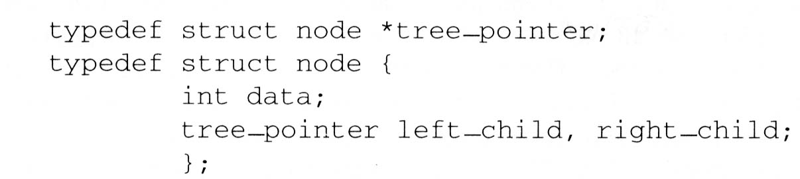
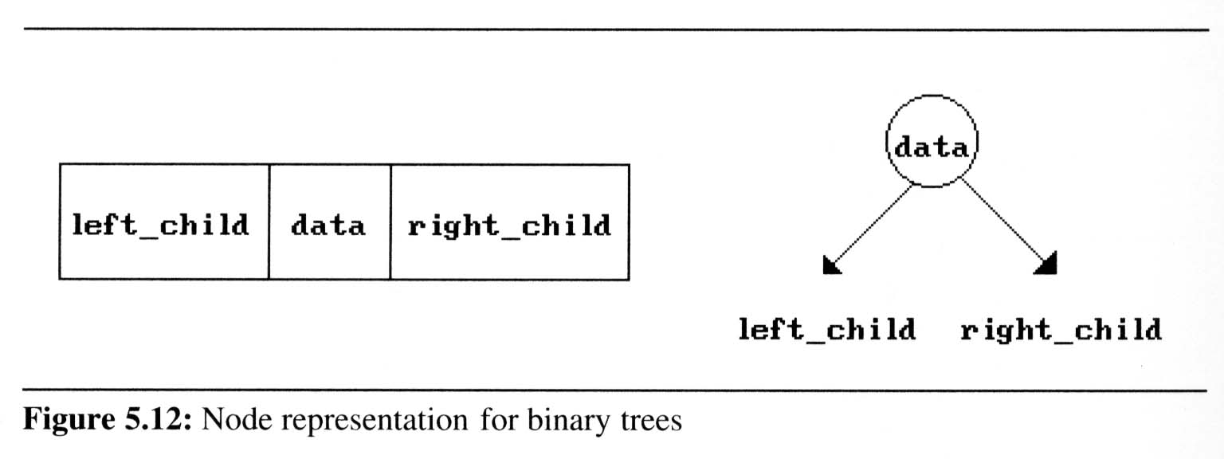
Binary Trees (8/9)
Binary tree representations (using link)

Slide 19
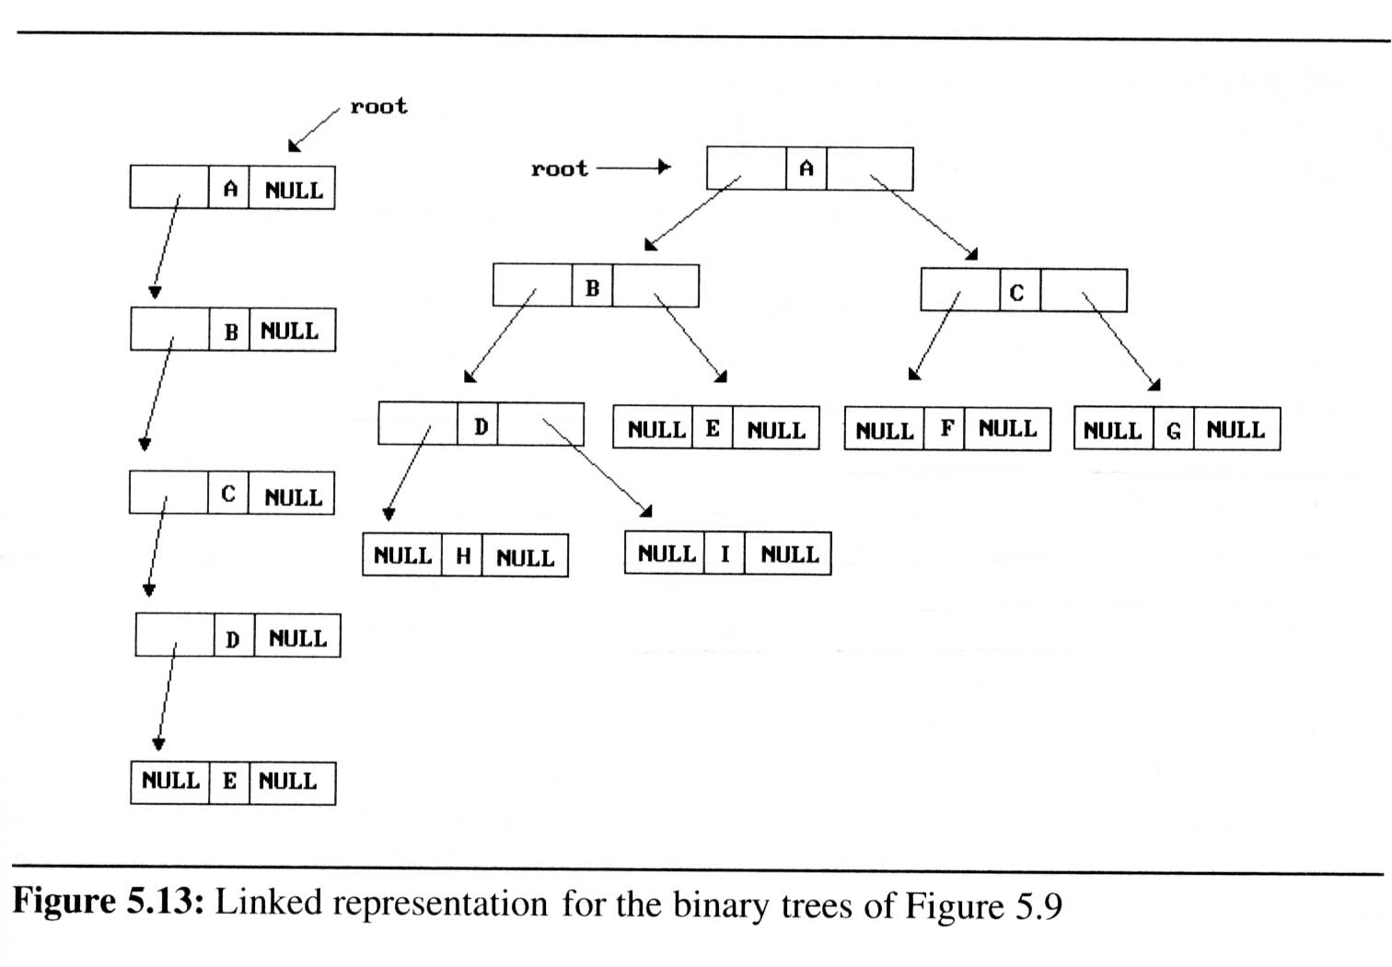
Binary Trees (9/9)
Binary tree representations (using link)

Slide 20
Binary Tree Traversals (1/9)
How to traverse a tree or visit each node in the tree exactly once?
  There are six possible combinations of traversal
LVR, LRV, VLR, VRL, RVL, RLV
  Adopt convention that we traverse left before
  right, only 3 traversals remain
LVR (inorder), LRV (postorder), VLR (preorder)
left_child
data
right_child
V
:
visiting
node
L: moving left
R: moving right

Slide 21
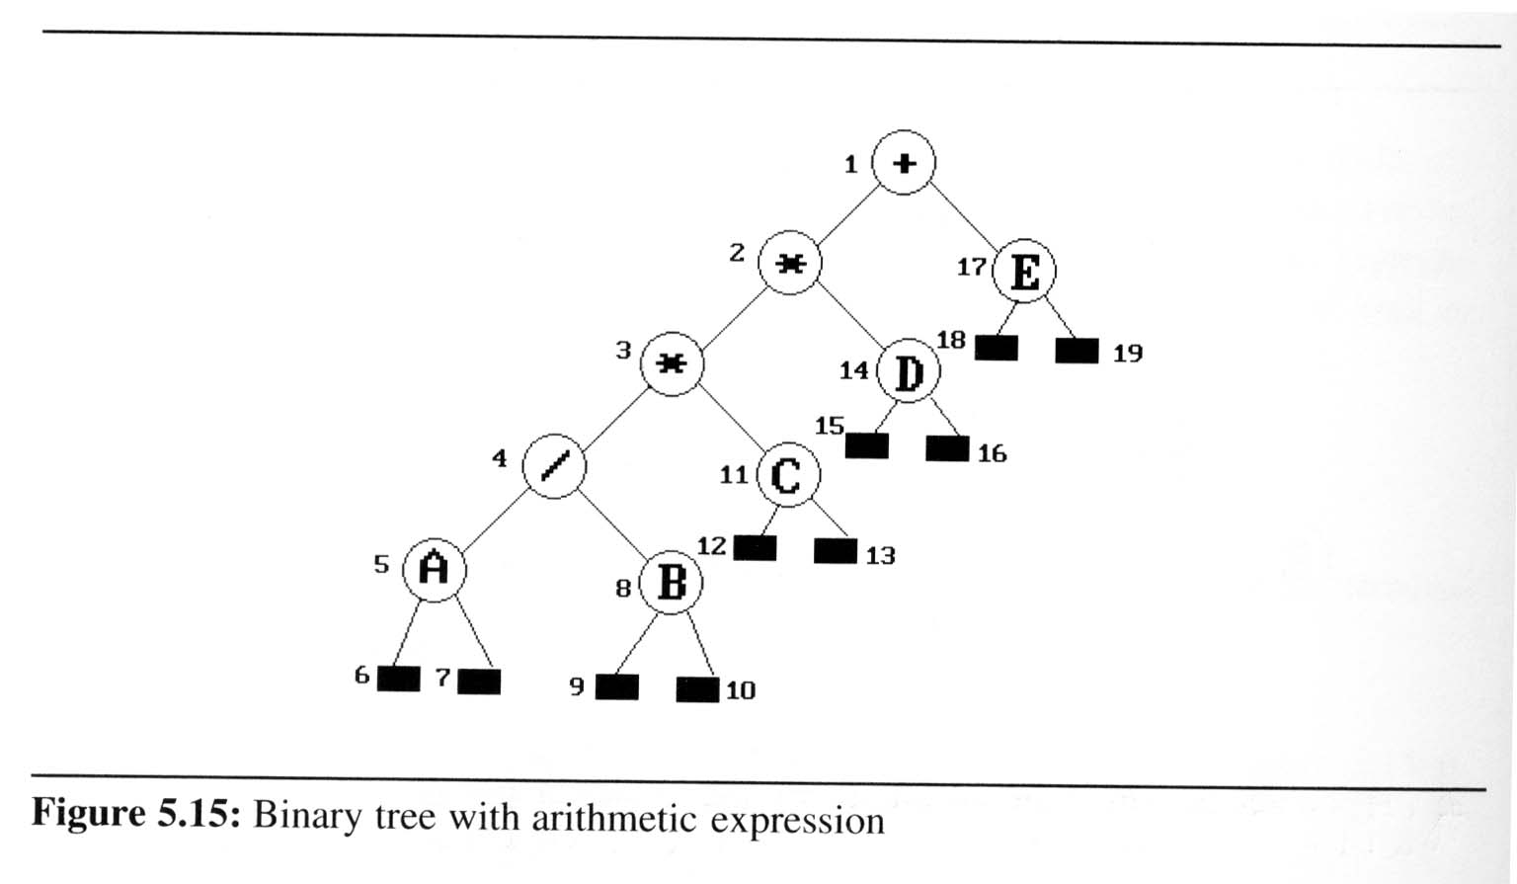
Binary Tree Traversals (2/9)
Arithmetic Expression using binary tree
  inorder traversal (infix expression)
  A / B * C * D + E
  preorder traversal (prefix expression)
  + * * / A B C D E
  postorder traversal
  (postfix expression)
  A B / C * D * E +
  level order traversal
  + * E * D / C A B

Slide 22
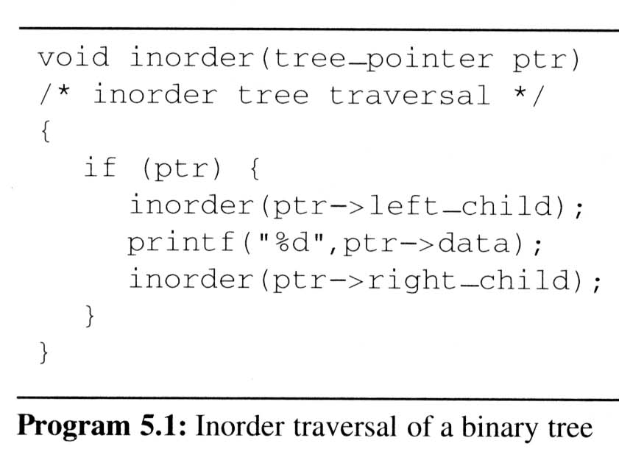
Binary Tree Traversals (3/9)
Inorder traversal (LVR) (recursive version)
output:
A
/
B
*
C
*
D
+
E
ptr
L
V
R

Slide 23
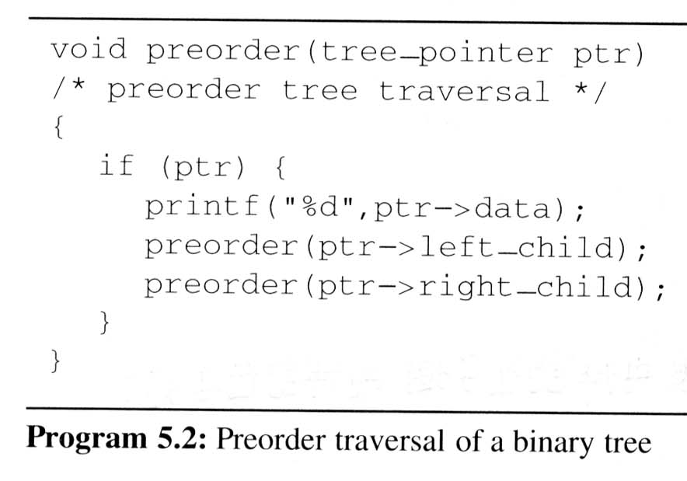
Binary Tree Traversals (4/9)
Preorder traversal (VLR) (recursive version)
output:
+
*
*
/
A
B
C
D
E
V
L
R

Slide 24
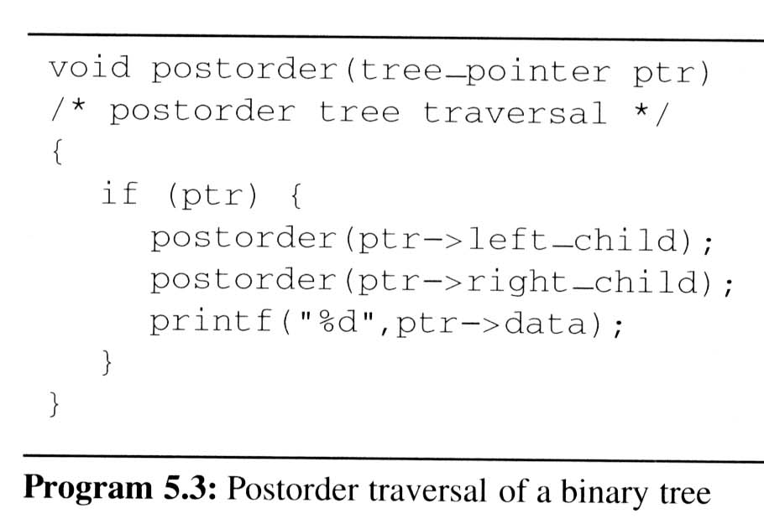
Binary Tree Traversals (5/9)
Postorder traversal (LRV) (recursive version)
output:
A
B
/
C
*
D
*
E
+
L
R
V

Slide 25
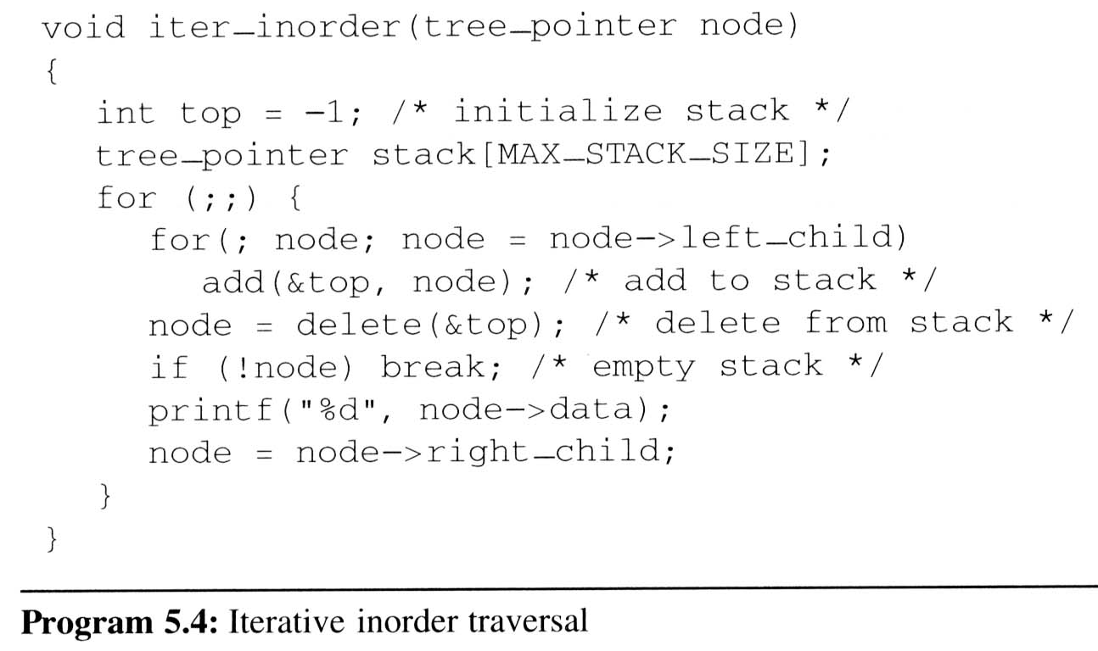
Binary Tree Traversals (6/9)
Iterative inorder traversal
  we use a stack to simulate recursion
5
4
8
11
3
14
2
17
1
A
/
B
*
C
D
*
E
+
L
V
R
output:
A
/
B
*
C
*
D
+
E
node

Slide 26
Binary Tree Traversals (7/9)
Analysis of inorder2 (Non-recursive Inorder traversal)
  Let n be the number of nodes in the tree
  Time complexity: O(n)
    Every node of the tree is placed on and removed
    from the stack exactly once
  Space complexity: O(n)
    equal to the depth of the tree which
    (skewed tree is the worst case)

Slide 27
Binary Tree Traversals (8/9)
Level-order traversal
  method:
    We visit the root first, then the root’s left child, followed by the root’s right child.
    We continue in this manner, visiting the nodes at each new level from the leftmost node to the rightmost nodes
  This traversal requires a queue to implement

Slide 28
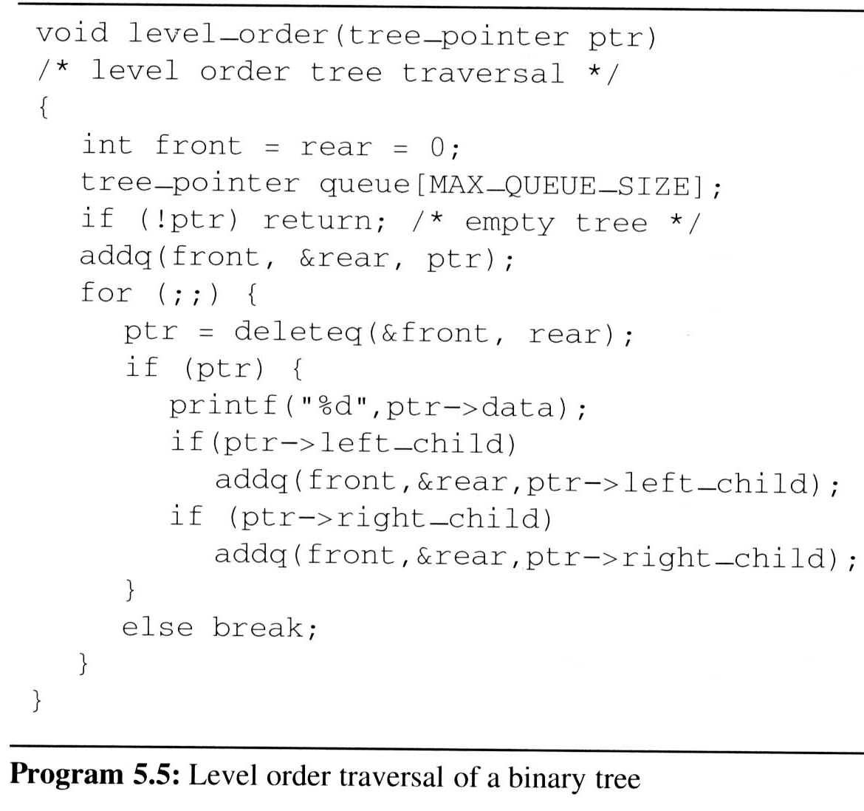
Binary Tree Traversals (9/9)
Level-order traversal (using queue)
output:
+
*
E
*
D
/
C
A
B
1
2
17
3
14
4
11
5
8
+
*
E
*
D
/
C
A
B
FIFO
ptr

Slide 29
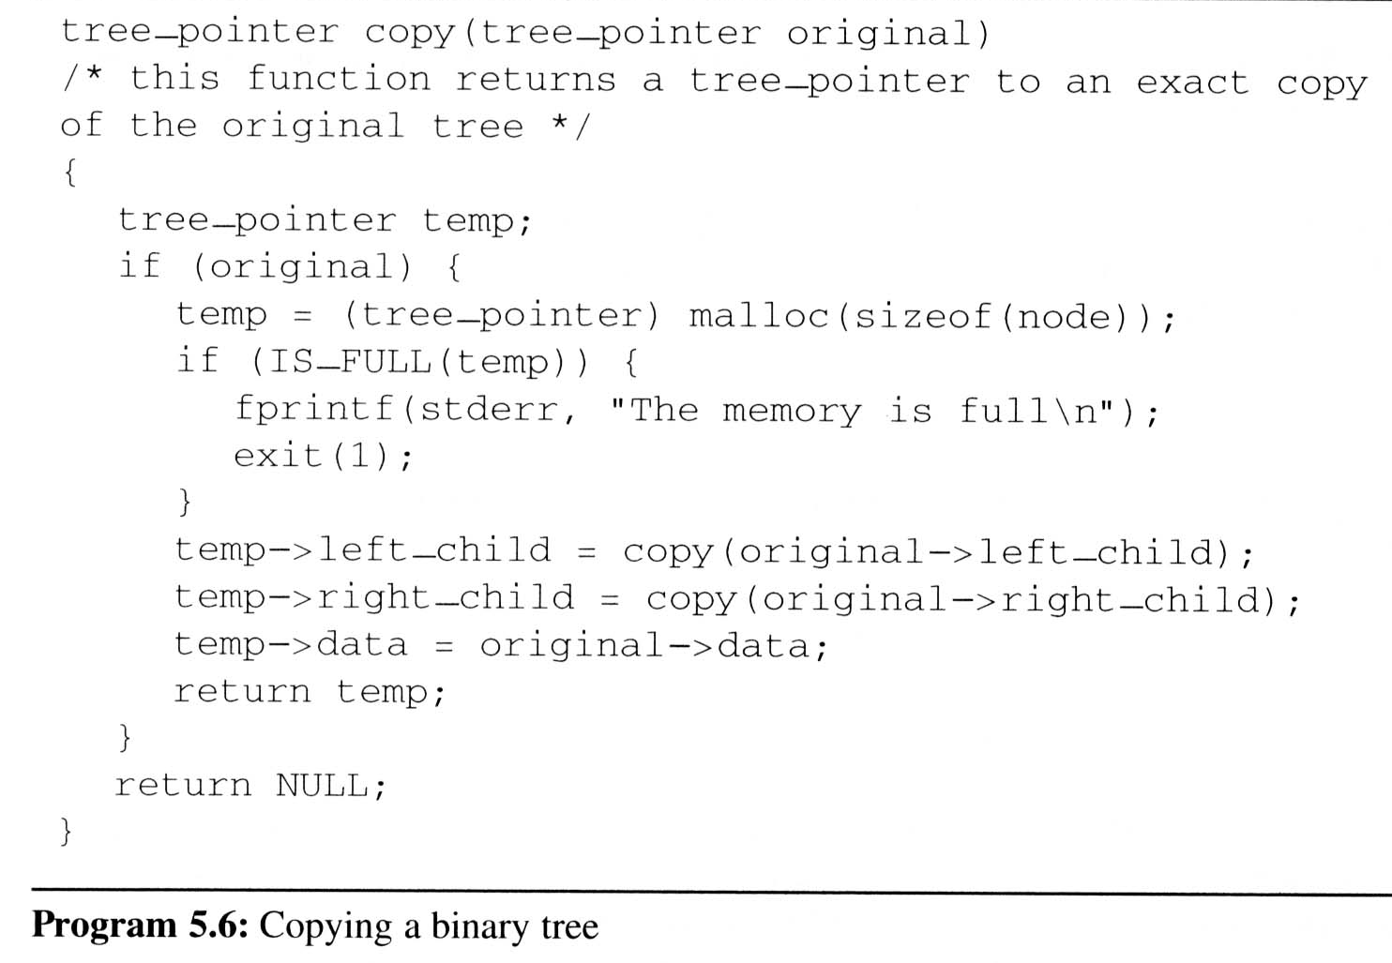
Additional Binary Tree Operations (1/7)
Copying Binary Trees
  we can modify the postorder traversal algorithm only slightly to copy the binary tree
similar as Program 5.3

Slide 30
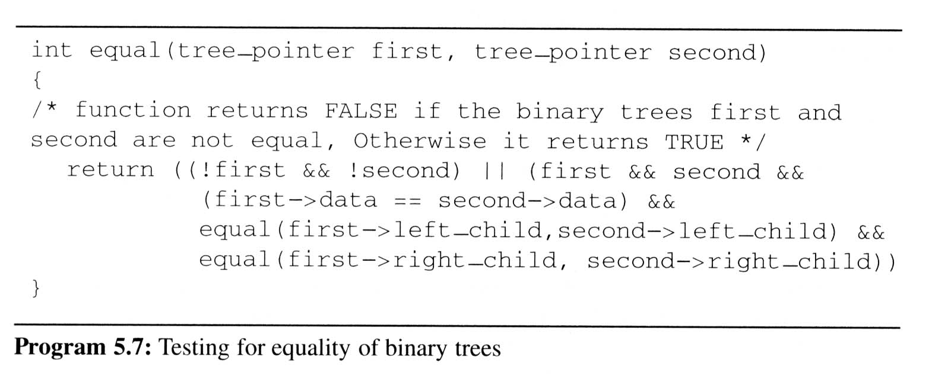
Additional Binary Tree Operations (2/7)
Testing Equality
  Binary trees are equivalent if they have the same topology and the information in corresponding nodes is identical
V
L
R
the same topology and data as Program 5.6

Slide 31
Additional Binary Tree Operations (3/7)
Variables: x₁, x₂, …, x_{n} can hold only of two possible values, true or false
Operators: ∧(and), ∨(or), ¬(not)
Propositional Calculus Expression
  A variable is an expression
  If x and y are expressions, then ¬x, x∧y, x∨y are expressions
  Parentheses can be used to alter the normal order of evaluation (¬ > ∧ > ∨)
  Example: x₁ ∨ (x₂ ∧ ¬x₃)

Slide 32
Additional Binary Tree Operations (4/7)
Satisfiability problem:
  Is there an assignment to make an expression true?
Solution for the Example x₁ ∨ (x₂ ∧ ¬x₃) :
  If x₁ and x₃ are false and x₂ is true
  false ∨ (true ∧ ¬false) = false ∨ true = true
For n value of an expression, there are 2^{n} possible combinations of true and false

Slide 33
Additional Binary Tree Operations (5/7)
(x₁ ∧ ¬x₂) ∨ (¬ x₁ ∧ x₃) ∨ ¬x₃
postorder traversal
∨
data
∨
¬
value
∧
∧
X₃
X₁
¬
¬
X₃
X₂
X₁

Slide 34
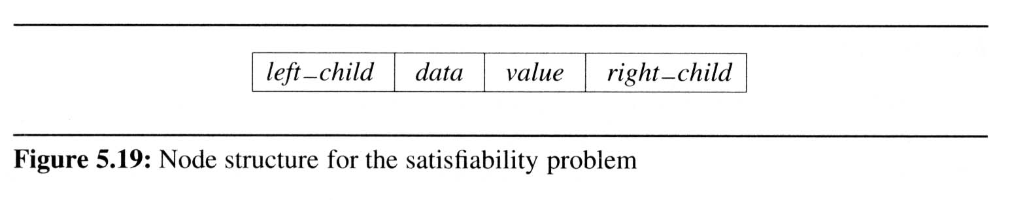
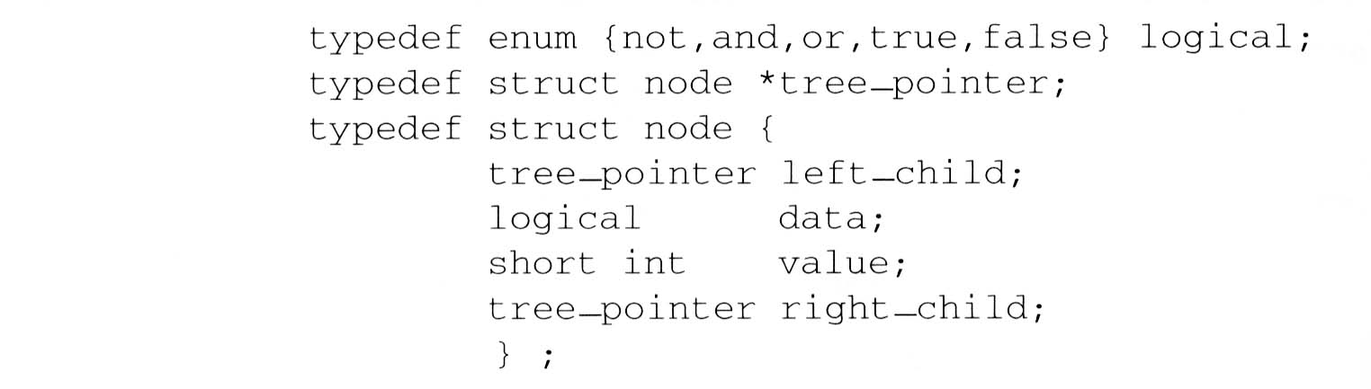
Additional Binary Tree Operations (6/7)
node structure
  For the purpose of our evaluation algorithm, we assume each node has four fields:
  We define this node structure in C as:

Slide 35
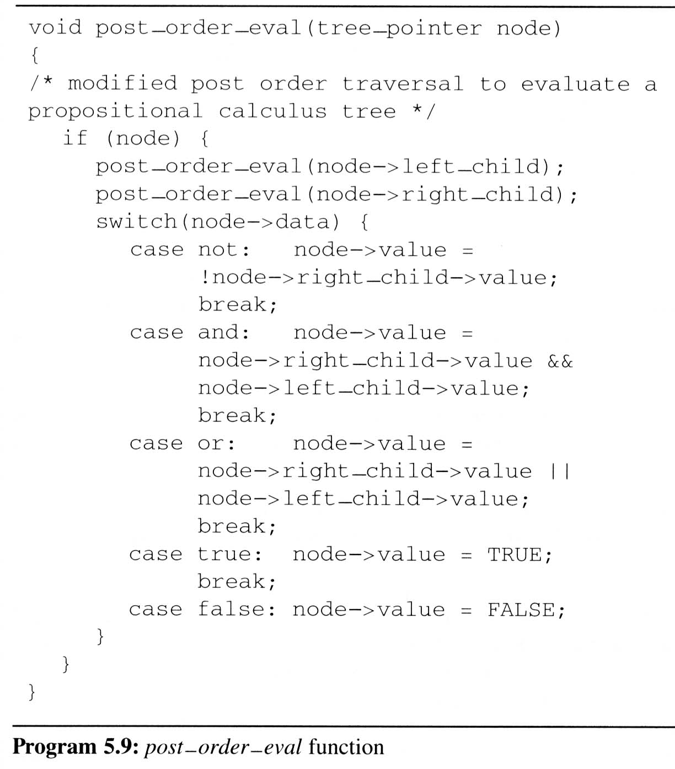
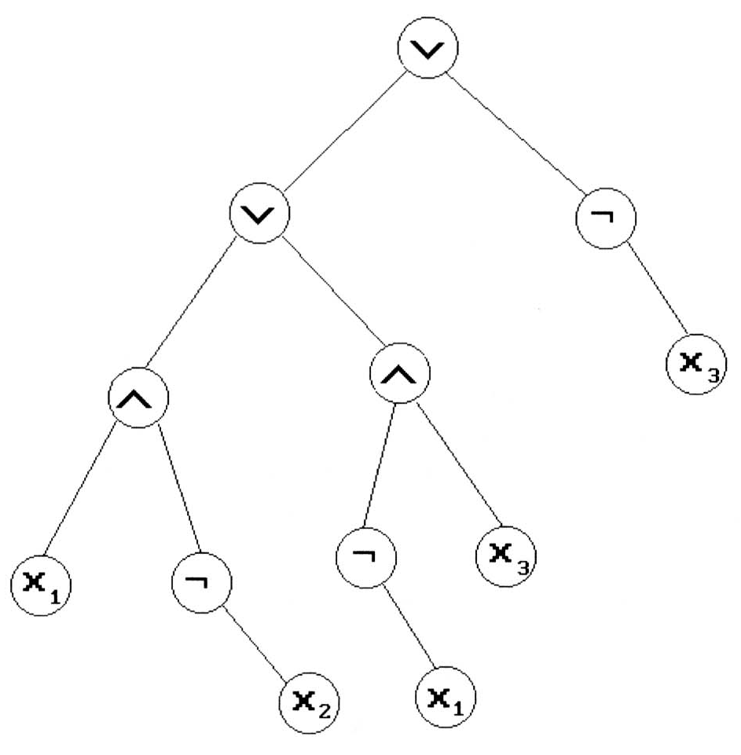
Additional Binary Tree Operations (7/7)
Satisfiability function
  To evaluate the tree is
  easily obtained by
  modifying the original
  recursive postorder
  traversal
L
R
V
node
TRUE
TRUE
FALSE
FALSE
T
TRUE
TRUE
T
F
TRUE
FALSE
FALSE
TRUE
F
T
FALSE
TRUE

Slide 36
Threaded Binary Trees (1/10)
Threads
  Do you find any drawback of the above tree?
  Too many null pointers in current representation of binary trees
  n: number of nodes
  number of non-null links: n-1
  total links: 2n
  null links: 2n-(n-1) = n+1
  Solution: replace these null pointers with some useful “threads”

Slide 37
Threaded Binary Trees (2/10)
Rules for constructing the threads
  If ptr->left_child is null,
  replace it with a pointer to the node that would be visited before ptr in an inorder traversal
  If ptr->right_child is null,
  replace it with a pointer to the node that would be visited after ptr in an inorder traversal

Slide 38
Threaded Binary Trees (3/10)
A Threaded Binary Tree
root
A
t: true ⇒ thread
f: false ⇒ child
dangling
f
B
f
C
D
t
E
t
F
G
dangling
inorder traversal:
H
I
H D I B E A F C G

Slide 39
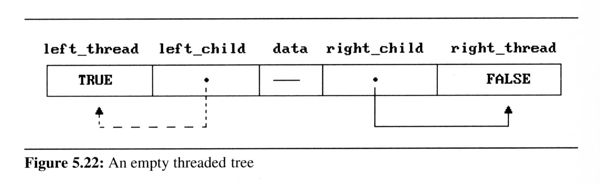
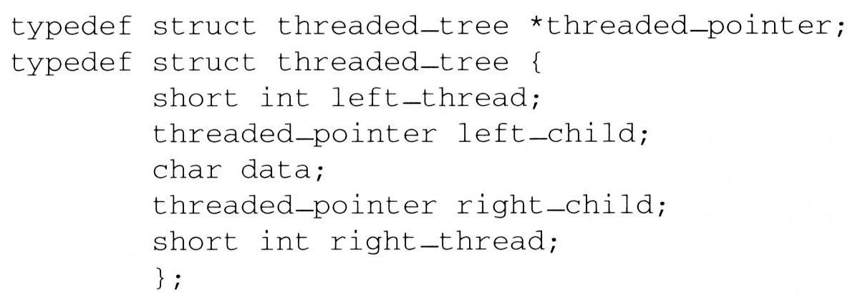
Threaded Binary Trees (4/10)
Two additional fields of the node structure,
left-thread and right-thread
  If ptr->left-thread=TRUE,
  then ptr->left-child contains a thread;
  Otherwise it contains a pointer to the left child.
  Similarly for the right-thread

Slide 40
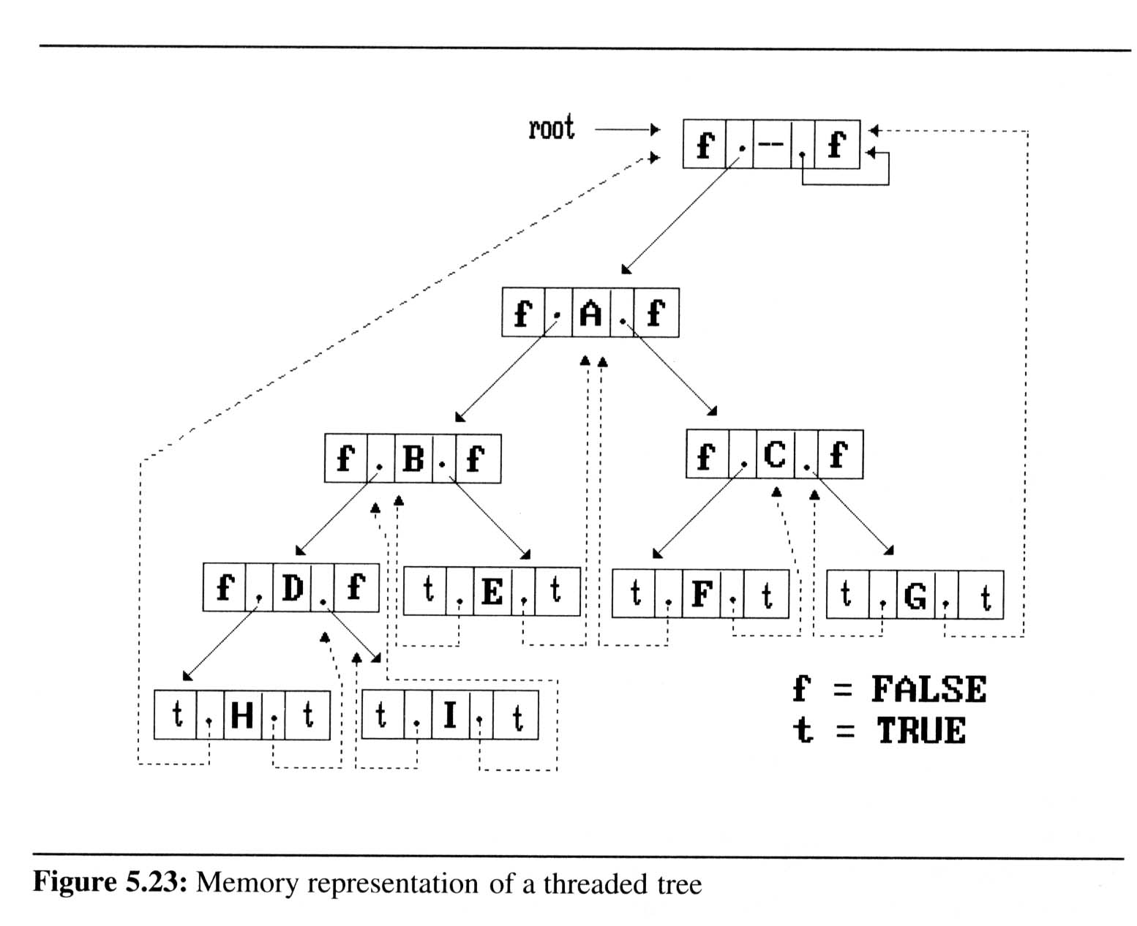
Threaded Binary Trees (5/10)
If we don’t want the left pointer of H and the right pointer of G to be dangling pointers, we may create root node and assign them pointing to the root node

Slide 41
Threaded Binary Trees (6/10)
Inorder traversal of a threaded binary tree
  By using of threads we can perform an inorder traversal without making use of a stack (simplifying the task)
  Now, we can follow the thread of any node, ptr, to the “next” node of inorder traversal
  If ptr->right_thread = TRUE, the inorder successor of ptr is ptr->right_child by definition of the threads
  Otherwise we obtain the inorder successor of ptr by following a path of left-child links from the right-child of ptr until we reach a node with left_thread = TRUE

Slide 42
Threaded Binary Trees (7/10)
Finding the inorder successor (next node) of a node
  threaded_pointer insucc(threaded_pointer tree){
  threaded_pointer temp;
  temp = tree->right_child;
  if (!tree->right_thread)
  while (!temp->left_thread)
  temp = temp->left_child;
  return temp;
  }
tree
temp
Inorder

Slide 43
Threaded Binary Trees (8/10)
Inorder traversal of a threaded binary tree
  void tinorder(threaded_pointer tree){
  /* traverse the threaded binary tree inorder */
  threaded_pointer temp = tree;
  for (;;) {
  temp = insucc(temp);
  if (temp==tree)
  break;
  printf(“%3c”,temp->data);
  }
  }
output:
H
D
I
B
E
A
F
C
G
tree
Time Complexity: O(n)

Slide 44
Threaded Binary Trees (9/10)
Inserting A Node Into A Threaded Binary Tree
  Insert child as the right child of node parent
  change parent->right_thread to FALSE
  set child->left_thread and child->right_thread to TRUE
  set child->left_child to point to parent
  set child->right_child to parent->right_child
  change parent->right_child to point to child

Slide 45
Threaded Binary Trees (10/10)
Right insertion in a threaded binary tree
  void insert_right(thread_pointer parent, threaded_pointer child){
  /* insert child as the right child of parent in a threaded binary tree */
  threaded_pointer temp;
  child->right_child = parent->right_child;
  child->right_thread = parent->right_thread;
  child->left_child = parent;
  child->left_thread = TRUE;
  parent->right_child = child;
  parent->right_thread = FALSE;
  If(!child->right_thread){
  temp = insucc(child);
  temp->left_child = child;
  }
  }
root
A
parent
B
C
X
child
parent
temp
A
B
child
X
C
D
First Case
Second Case
E
F
successor

Slide 46
Heaps (1/6)
The heap abstract data type
  Definition: A max(min) tree is a tree in which the key value in each node is no smaller (larger) than the key values in its children. A max (min) heap is a complete binary tree that is also a max (min) tree
  Basic Operations:
    creation of an empty heap
    insertion of a new elemrnt into a heap
    deletion of the largest element from the heap

Slide 47
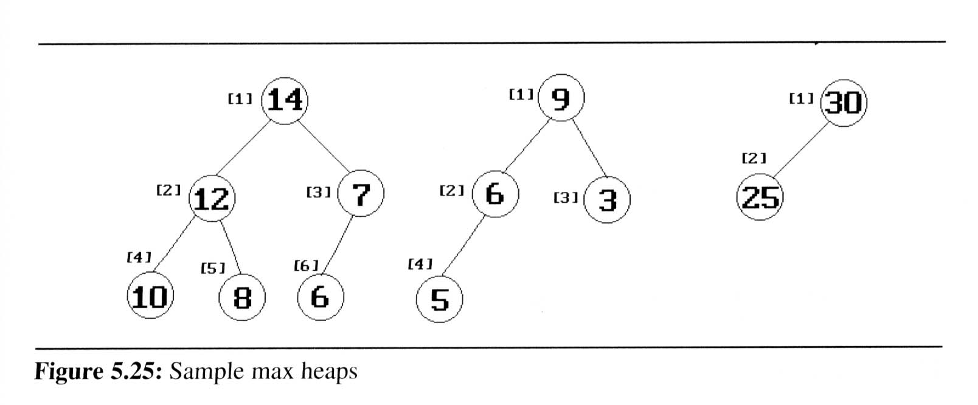
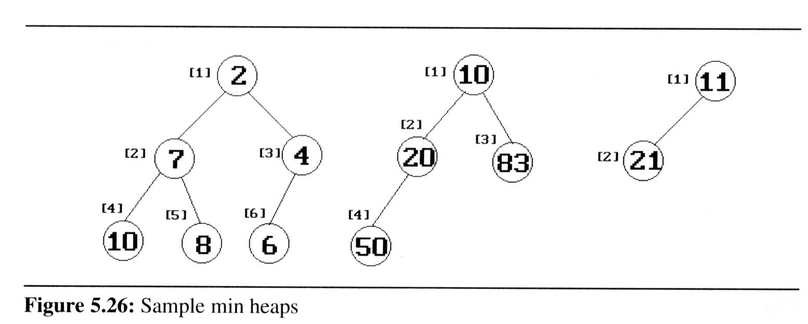
Heaps (2/6)
The examples of max heaps and min heaps
  Property: The root of max heap (min heap) contains the largest (smallest) element

Slide 48
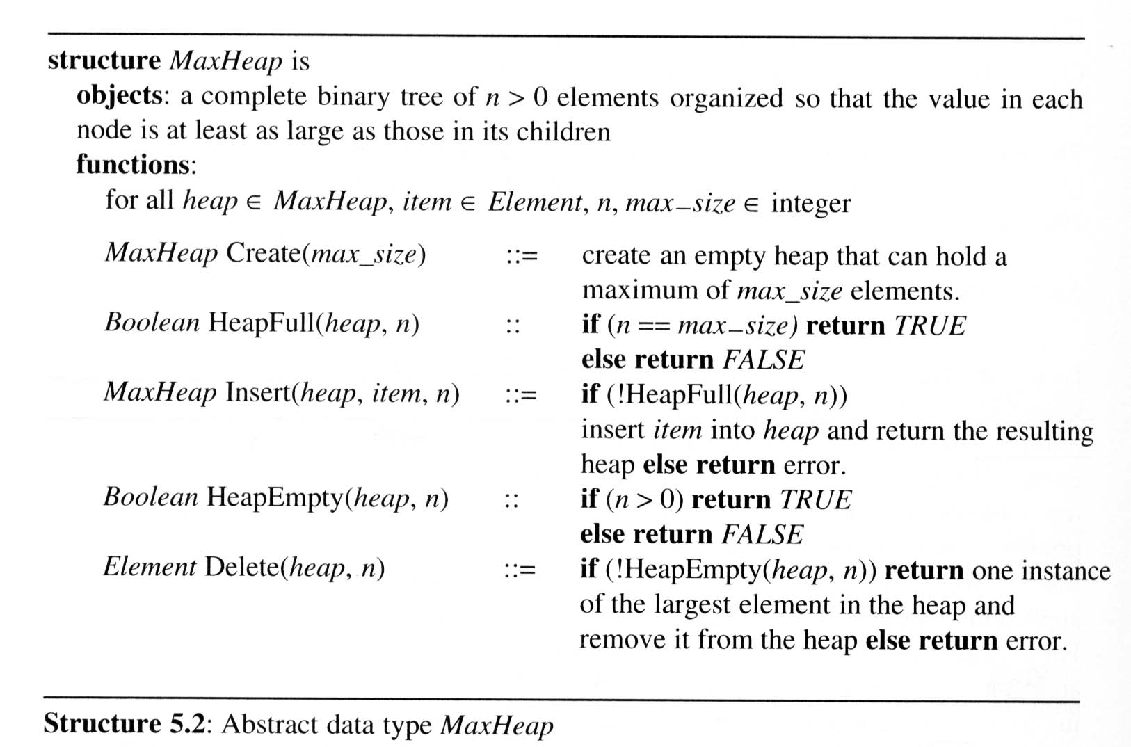
Heaps (3/6)
Abstract data type of Max Heap

Slide 49
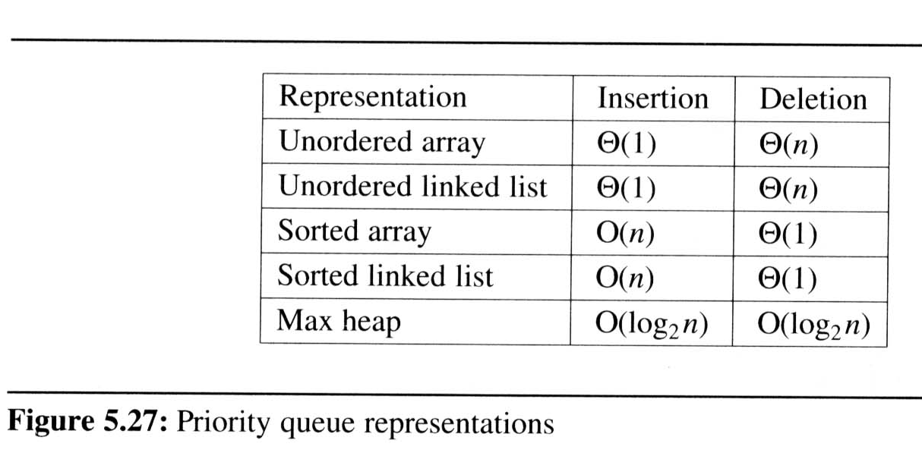
Heaps (4/6)
Queue in Chapter 3: FIFO
Priority queues
  Heaps are frequently used to implement priority queues
  delete the element with highest (lowest) priority
  insert the element with arbitrary priority
  Heaps is the only way to implement priority queue
machine service:
amount of time
(min heap)
amount of payment
(max heap)
factory:
time tag

Slide 50
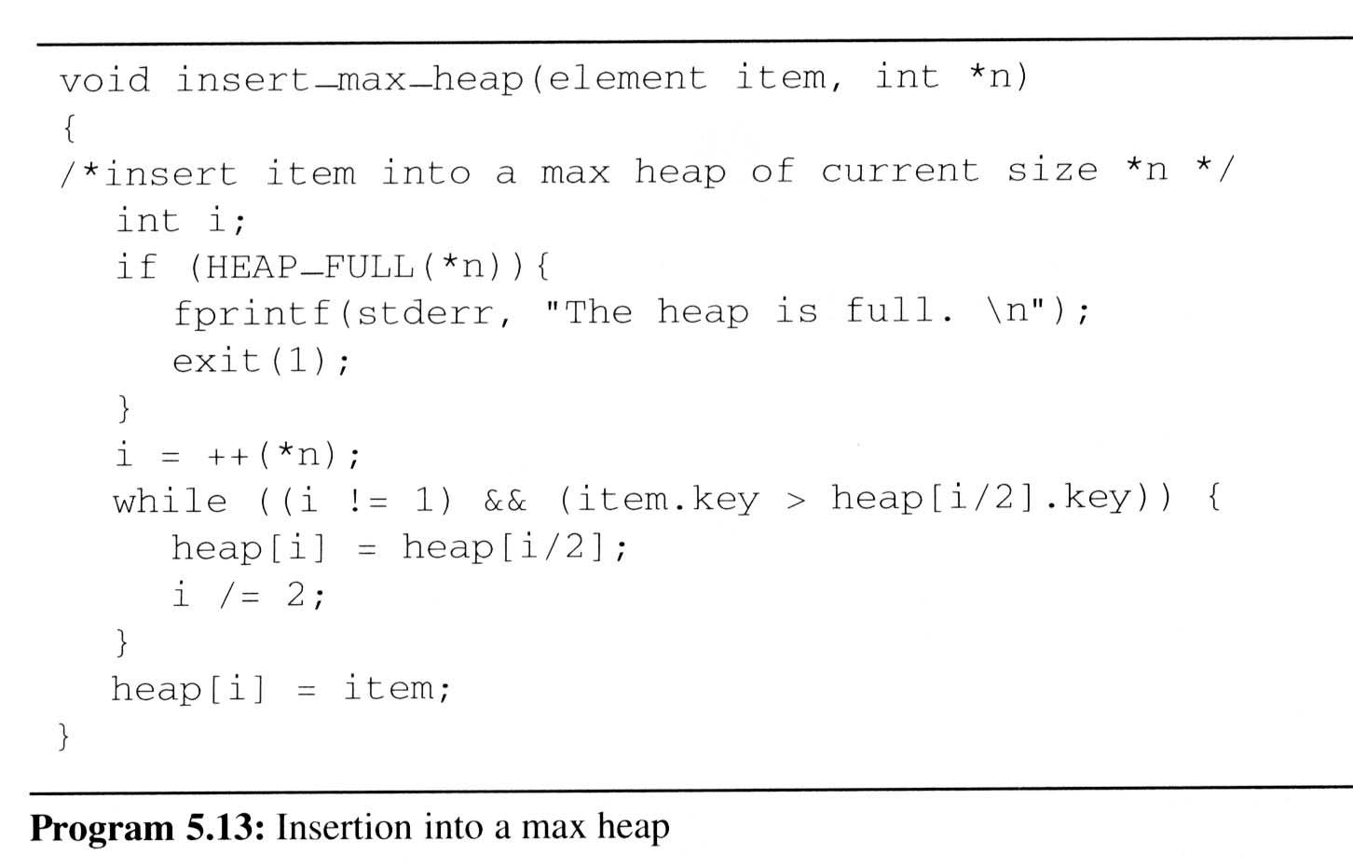
Heaps (5/6)
Insertion Into A Max Heap
  Analysis of insert_max_heap
    The complexity of the insertion function is O(log₂ n)
insert
21
5
*n=
6
5
i=
6
3
7
3
1
[1]
20
21
parent sink
[2]
[3]
item upheap
15
20
2
5
[4]
[5]
[6]
[7]
14
10
2
5

Slide 51
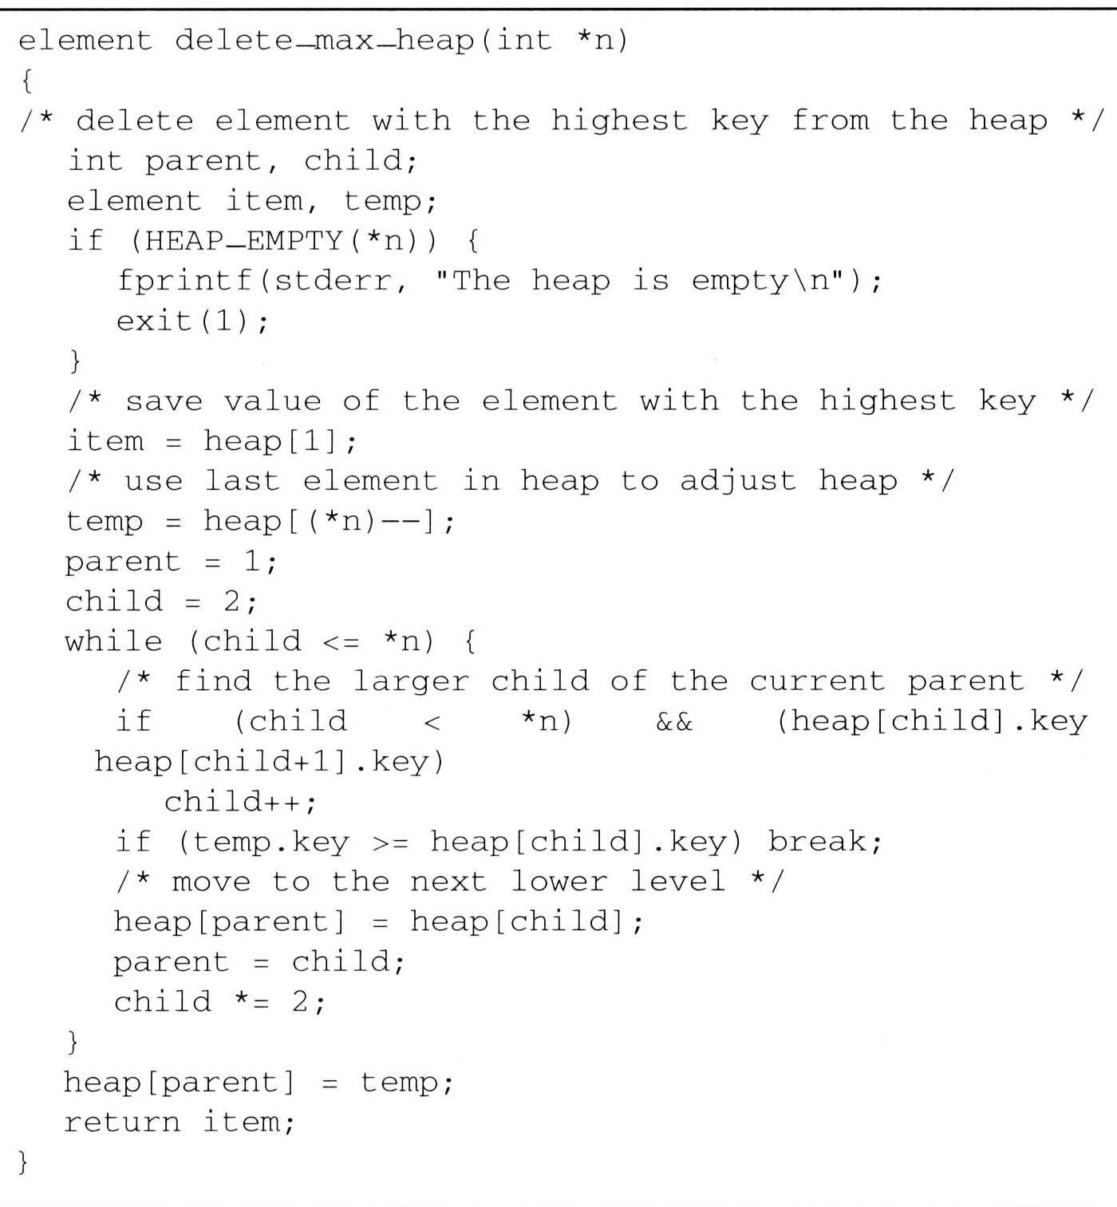
Heaps (6/6)
Deletion from a max heap
  After deletion, the
  heap is still a
  complete binary tree
  Analysis of
  delete_max_heap
    The complexity of the
    insertion function
    is O(log₂ n)
parent =
1
2
4
*n=
5
4
child =
2
4
8
[1]
15
<
20
[2]
[3]
15
14
2
item.key =
20
[4]
[5]
temp.key =
10
14
10
10

Slide 52
Binary Search Trees (1/8)
Why do binary search trees need?
  Heap is not suited for applications in which arbitrary elements are to be deleted from the element list
    a min (max) element is deleted O(log₂n)
    deletion of an arbitrary element O(n)
    search for an arbitrary element O(n)
Definition of binary search tree:
  Every element has a unique key
  The keys in a nonempty left subtree (right subtree) are smaller (larger) than the key in the root of subtree
  The left and right subtrees are also binary search trees

Slide 53
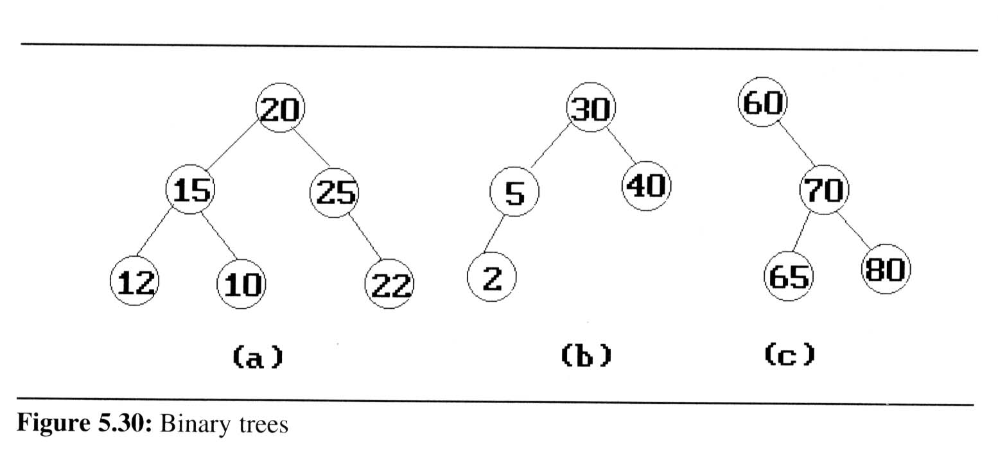
Binary Search Trees (2/8)
Example: (b) and (c) are binary search trees
medium
smaller
larger

Slide 54
Binary Search Trees (3/8)
Search:
Search(25)
Search(76)
44
17
88
32
65
97
28
54
82
29
76
80

Slide 55
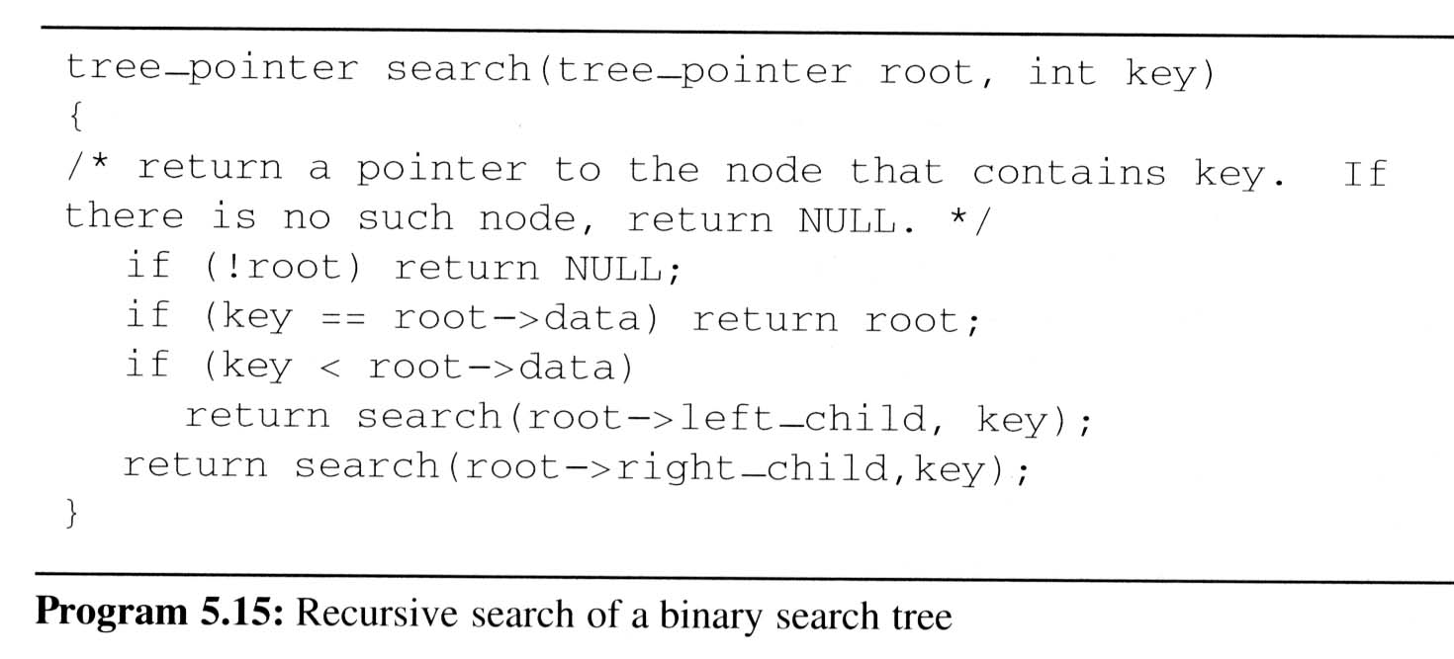
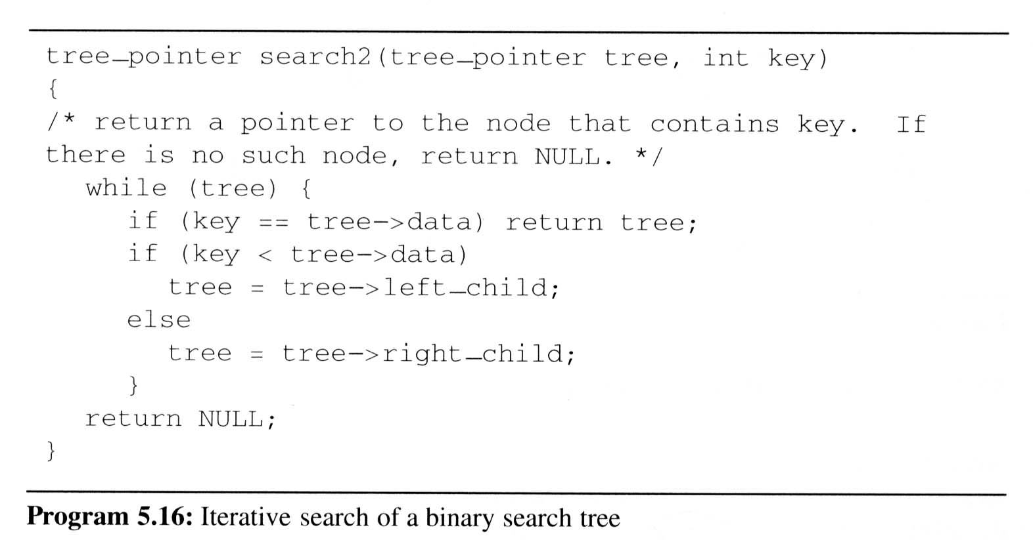
Binary Search Trees (4/8)
Searching a
binary search
tree
O(h)

Slide 56
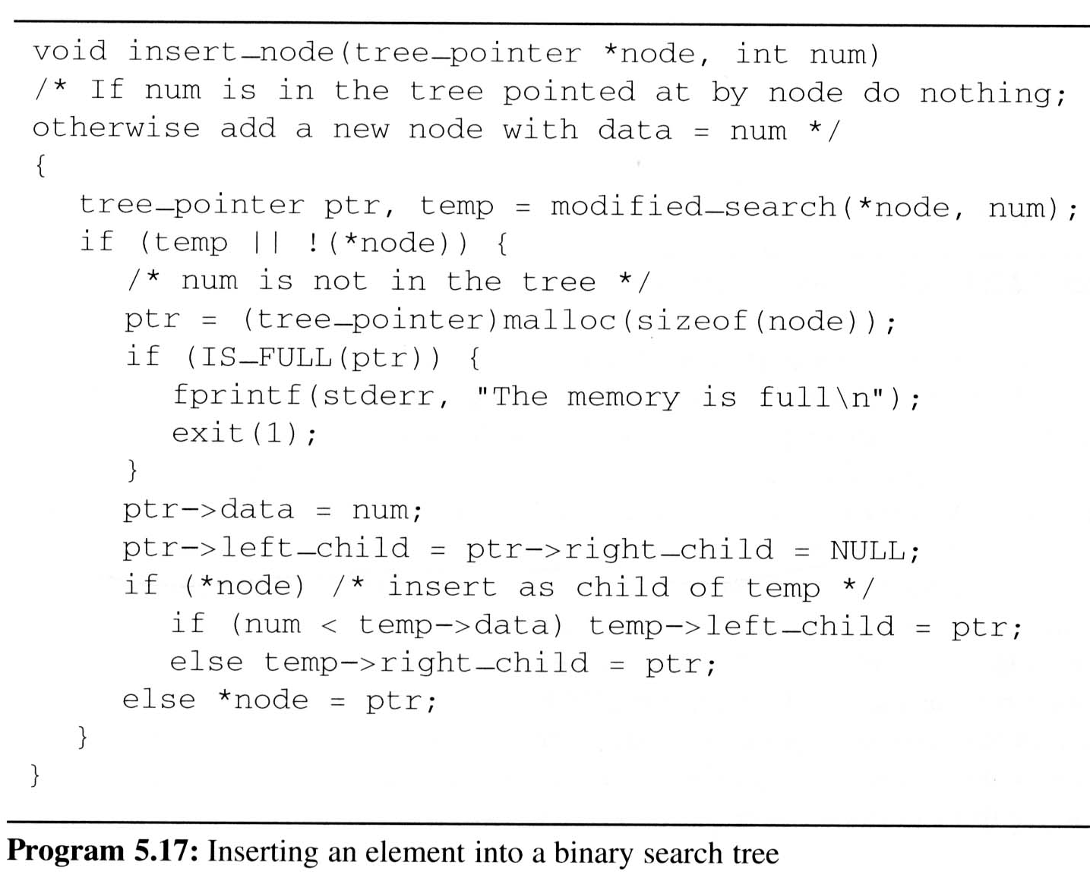
Binary Search Trees (5/8)
Inserting into a binary search tree
An empty tree

Slide 57
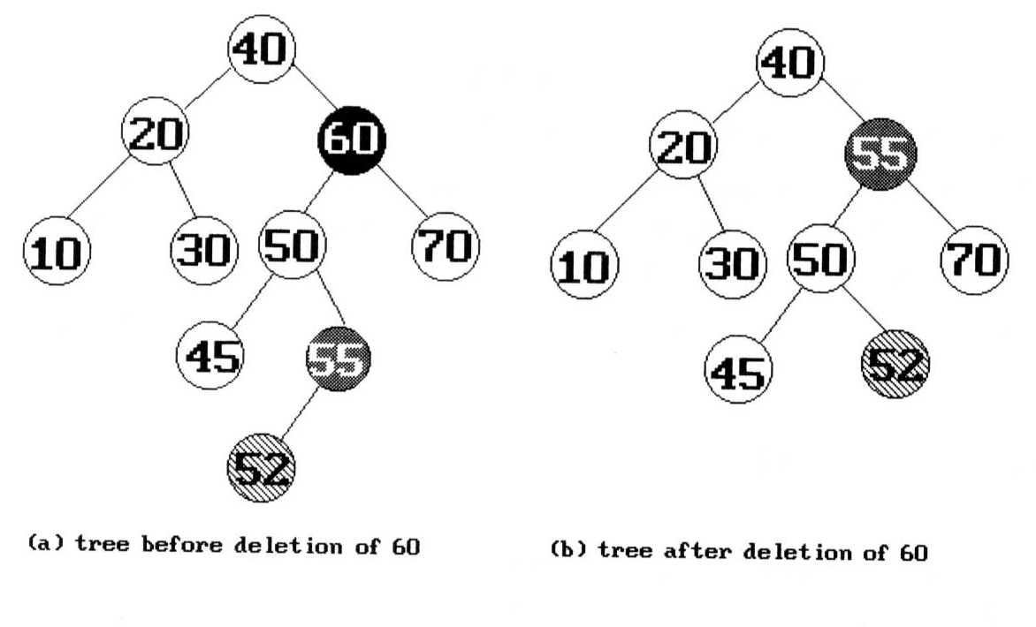
Binary Search Trees (6/8)
Deletion from a binary search tree
  Three cases should be considered
  case 1. leaf → delete
  case 2.
  one child → delete and change the pointer to this child
  case 3. two child → either the smallest element in the right subtree or the largest element in the left subtree

Slide 58
Binary Search Trees (7/8)
Height of a binary search tree
  The height of a binary search tree with n elements can become as large as n.
  It can be shown that when insertions and deletions are made at random, the height of the binary search tree is O(log₂n) on the average.
  Search trees with a worst-case height of O(log₂n) are called balance search trees

Slide 59
Binary Search Trees (8/8)
Time Complexity
  Searching, insertion, removal
    O(h), where h is the height of the tree
  Worst case - skewed binary tree
    O(n), where n is the # of internal nodes
Prevent worst case
  rebalancing scheme
  AVL, 2-3, and Red-black tree

Slide 60
Selection Trees (1/6)
Problem:
  suppose we have k order sequences, called runs, that are to be merged into a single ordered sequence
Solution:
  straightforward : k-1 comparison
  selection tree : ⎡log₂k⎤+1
There are two kinds of selection trees:
winner trees and loser trees

Slide 61
Selection Trees (2/6)
Definition: (Winner tree)
  a selection tree is the binary tree where each node represents the smaller of its two children
  root node is the smallest node in the tree
  a winner is the record with smaller key
Rules:
  tournament : between sibling nodes
  put X in the parent node ⇒ X tree
  where X = winner or loser

Slide 62
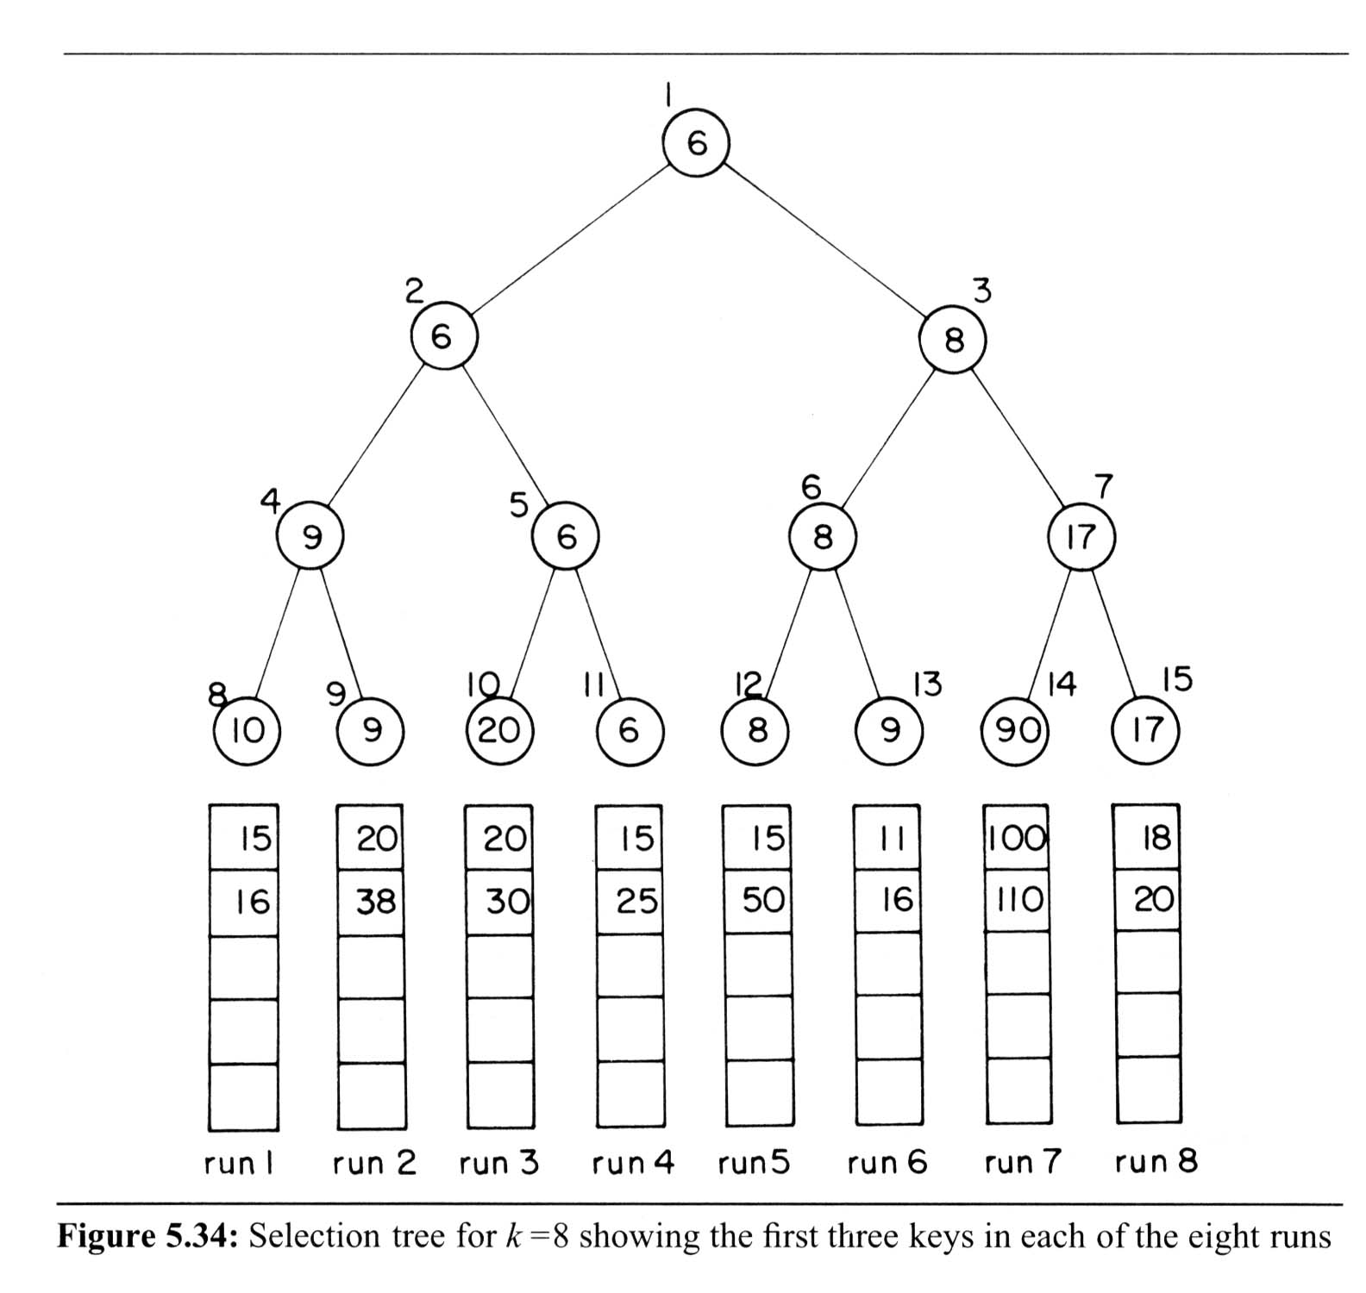
Selection Trees (3/6)
Winner Tree
sequential allocation
scheme
(complete
binary tree)
Each node represents
the smaller of its two
children
ordered sequence

Slide 63
Selection Trees (4/6)
Analysis of merging runs using winner trees
  # of levels: ⎡log₂K ⎤ +1 ⇒ restructure time: O(log₂K)
  merge time: O(nlog₂K)
  setup time: O(K)
  merge time: O(nlog₂K)
Slight modification: tree of loser
  consider the parent node only (vs. sibling nodes)

Slide 64
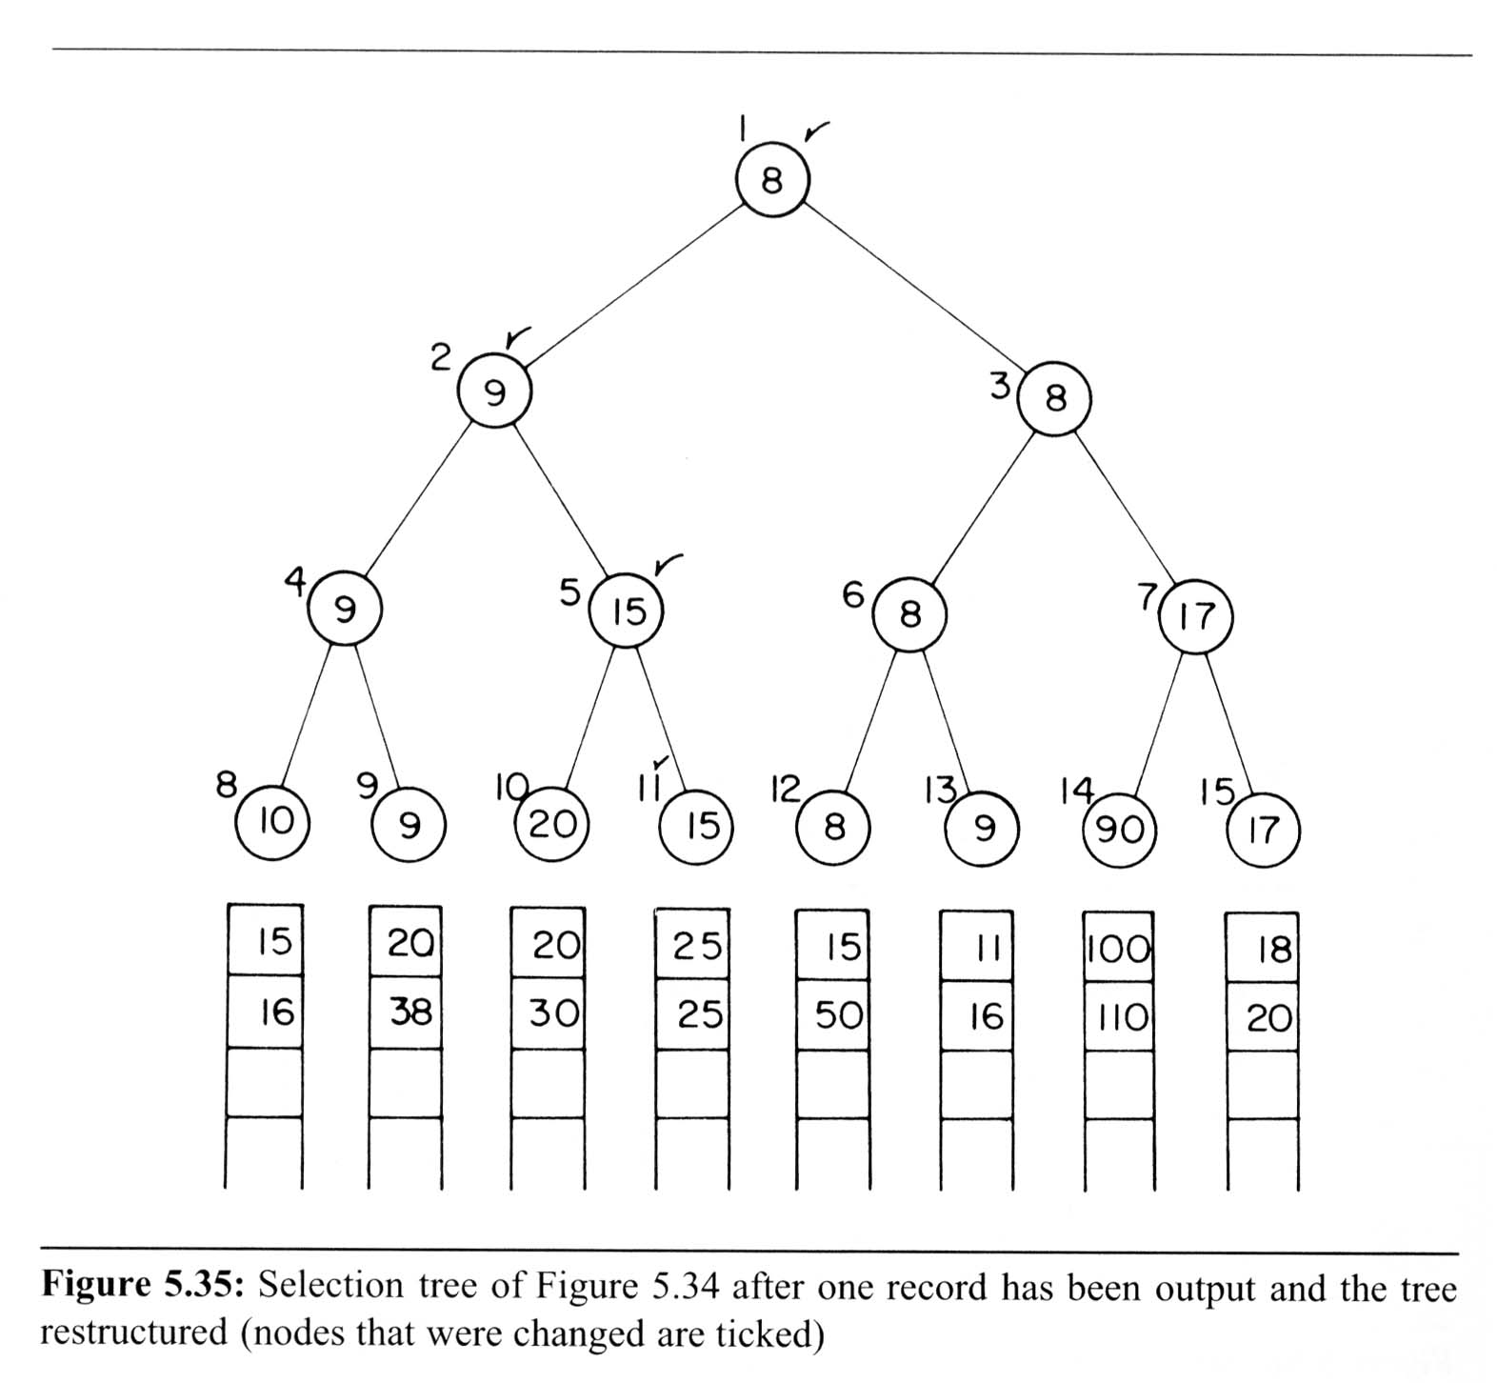
Selection Trees (5/6)
After one record has been output
6
6
6
6
15

Slide 65
Selection Trees (6/6)
Tree of losers can be conducted by Winner tree
0
6
8
9
17
10
20
9
90

Slide 66
Forests (1/4)
Definition:
  A forest is a set of n ≥ 0 disjoint trees
Transforming a forest into a binary tree
  Definition: If T₁,…,T_{n} is a forest of trees, then the binary tree corresponding to this forest, denoted by B(T₁,…,T_{n} ):
  is empty, if n = 0
  has root equal to root(T₁); has left subtree equal to B(T₁₁,T₁₂,…,T_{1m}); and has right subtree equal to B(T₂,T₃,…,T_{n})
    where T₁₁,T₁₂,…,T_{1m} are the subtrees of root (T₁)

Slide 67
Forests (2/4)
Rotate the tree clockwise by 45 degrees
Leftmost child
A
A
E
G
B
E
B
C
D
F
H
I
C
F
G
Right sibling
D
H
I

Slide 68
Forests (3/4)
Forest traversals
  Forest preorder traversal
    If F is empty, then return.
    Visit the root of the first tree of F.
    Traverse the subtrees of the first tree in tree preorder.
    Traverse the remaining tree of F in preorder.
  Forest inorder traversal
    If F is empty, then return
    Traverse the subtrees of the first tree in tree inorder
    Visit the root of the first tree of F
    Traverse the remaining tree of F in inorder
  Forest postorder traversal
    If F is empty, then return
    Traverse the subtrees of the first tree in tree postorder
    Traverse the remaining tree of F in postorder
    Visit the root of the first tree of F

Slide 69
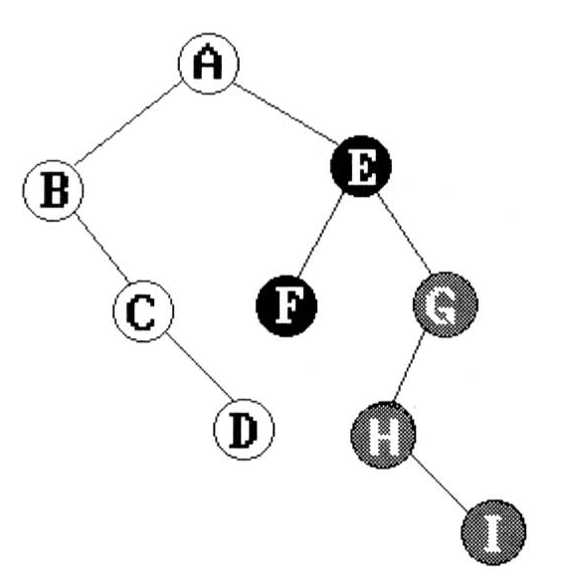
Forests (4/4)
preorder: A B C D E F G H I
inorder: B C A E D G H F I
A
B, C
E, D, G, H, F, I
preorder: A B C (D E F G H I)
inorder: B C A (E D G H F I)
A
B
D
C
E
F, G, H, I

