Slide 1
CS235102
Data Structures
Chapter 7 Sorting
(Concentrating on Internal Sorting)

Slide 2
Chapter 7 Sorting: Outline
Introduction
  Searching and List Verification
  Definitions
Insertion Sort
Quick Sort
Merge Sort
  Merge
  Iterative / Recursive Merge Sort
Heap Sort
Radix Sort
Summary of Internal Sorting

Slide 3
Introduction (1/9)
Why efficient sorting methods are so important ?
The efficiency of a searching strategy depends on the assumptions we make about the arrangement of records in the list
No single sorting technique is the “best” for all initial orderings and sizes of the list being sorted.
We examine several techniques, indicating when one is superior to the others.

Slide 4
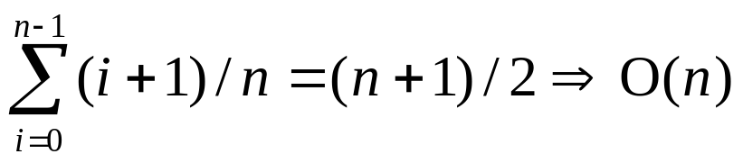
Introduction (2/9)
Sequential search
  We search the list by examining the key values list[0].key, … , list[n-1].key.
    Example: List has n records.
    4, 15, 17, 26, 30, 46, 48, 56, 58, 82, 90, 95
  In that order, until the correct record is located, or we have examined all the records in the list
  Unsuccessful search: n+1 ⇒ O(n)
  Average successful search

Slide 5
Introduction (3/9)
Binary search
  Binary search assumes that the list is ordered on the key field such that list[0].key ≤ list[1]. key ≤ … ≤ list[n-1]. key.
  This search begins by comparing searchnum (search key) and list[middle].key where
  middle=(n-1)/2
[5]
46
[2]
[8]
4, 15, 17, 26, 30, 46, 48, 56, 58, 82, 90, 95
17
58
[0]
[3]
[6]
[10]
4
26
48
90
Figure 7.1:
Decision tree for
binary search (p.323)
[1]
[4]
[7]
[9]
[11]
15
30
56
82
95

Slide 6
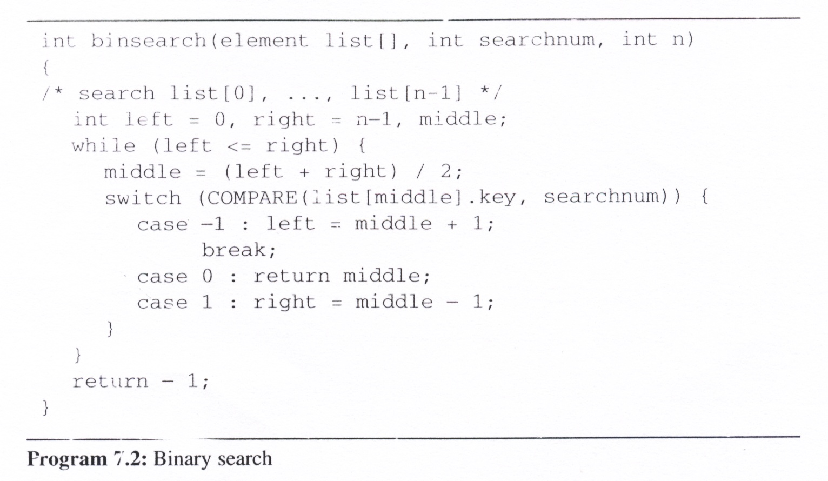
Introduction (4/9)
Binary search (cont’d)
  Analysis of binsearch: makes no more than O(log n) comparisons

Slide 7
Introduction (5/9)
List Verification
  Compare lists to verify that they are identical or identify the discrepancies.
Example
  International Revenue Service (IRS)
  (e.g., employee vs. employer)
Reports three types of errors:
  all records found in list1 but not in list2
  all records found in list2 but not in list1
  all records that are in list1 and list2 with the same key but have different values for different fields

Slide 8
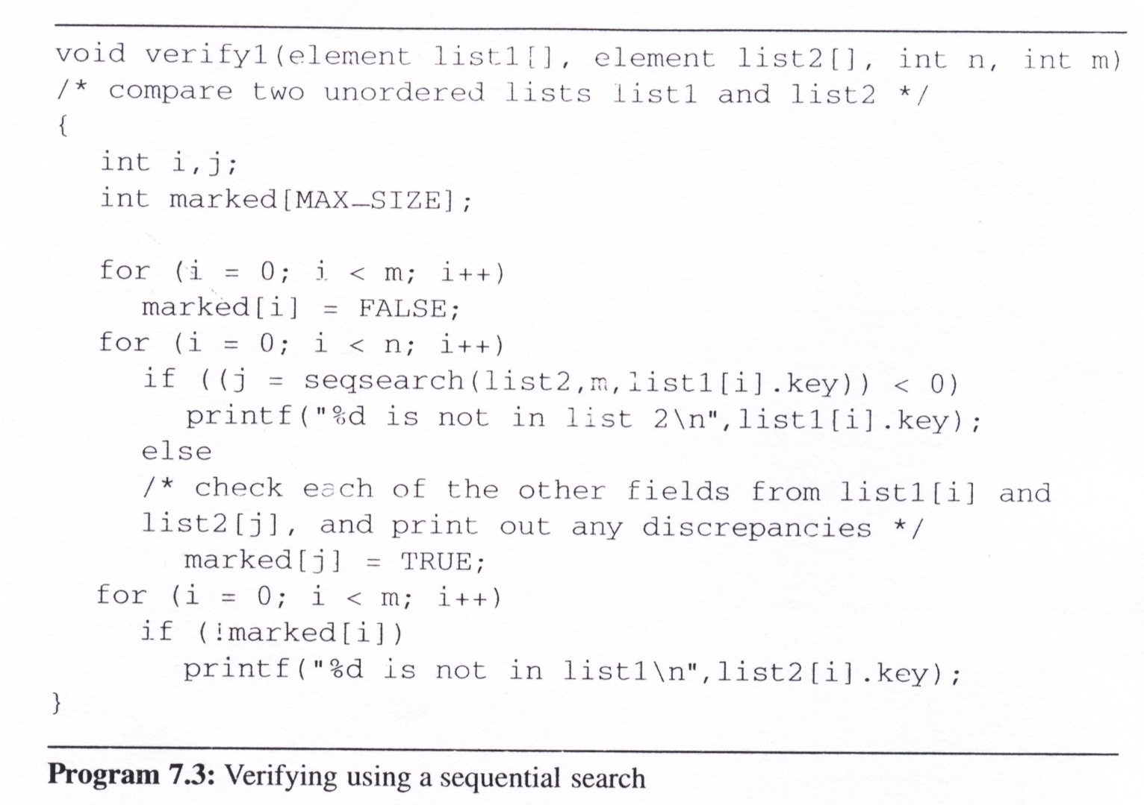
Introduction (6/9)
Verifying using a sequential search
Check whether the elements in list1 are also in list2
And the elements in list2 but not in list1 would be show up

Slide 9
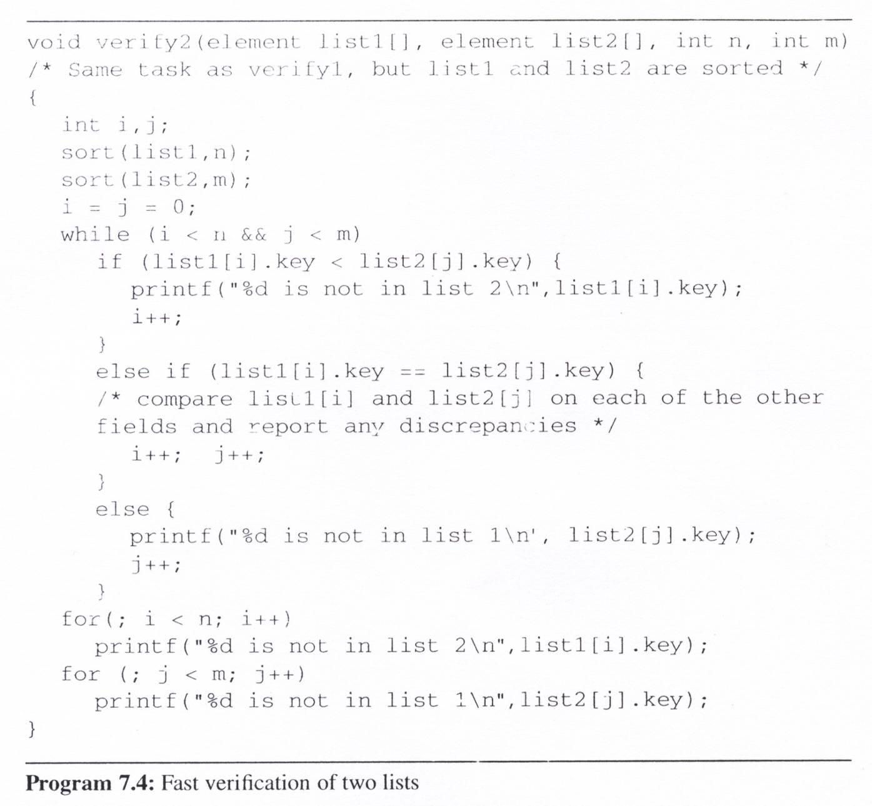
Introduction (7/9)
Fast
verification
of two lists
The element of list1 is not in list2
The element of two lists are matched
The element of list2 is not in list1
The remainder elements of a list is not a member of another list

Slide 10
Introduction (8/9)
Complexities
  Assume the two lists are randomly arranged
  Verify1: O(mn)
  Verify2: sorts them before verification
  O(tsort(n) + tsort(m) + m + n) ⇒ O(max[nlogn, mlogm])
    tsort(n): the time needed to sort the n records in list1
    tsort(m): the time needed to sort the m records in list2
    we will show it is possible to sort n records in O(nlogn) time
Definition
  Given (R₀, R₁, …, R_{n-1}), each R_{i} has a key value K_{i}
  find a permutation σ, such that K_{σ(i-1)} ≤ K_{σ(i)}, 0<i ≤ n-1
  σ denotes an unique permutation
  Sorted: K_{σ(i-1)} ≤ K_{σ(i)}, 0<i<n-1
  Stable: if i < j and K_{i} = K_{j} then R_{i} precedes R_{j} in the sorted list

Slide 11
Introduction (9/9)
Two important applications of sorting:
  An aid to search
  Matching entries in lists
Internal sort
  The list is small enough to sort entirely in main memory
External sort
  There is too much information to fit into main memory

Slide 12
Insertion Sort (1/3)
Concept:
  The basic step in this method is to insert a record R into a sequence of ordered records, R₁, R₂, …, R_{i} (K₁ ≤ K₂ ≤, …, ≤ K_{i}) in such a way that the resulting sequence of size i is also ordered
Variation
  Binary insertion sort
    reduce search time
  List insertion sort
    reduce insert time

Slide 13
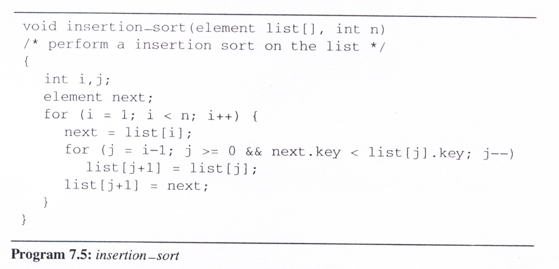
Insertion Sort (2/3)
list
[0]
[1]
[2]
[3]
[4]
Insertion sort program
5
2
1
2
5
3
2
3
5
3
1
5
4
4
5
i =
1
3
4
2
next =
3
1
4
2

Slide 14
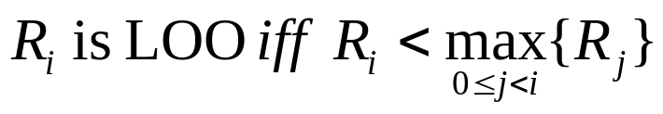
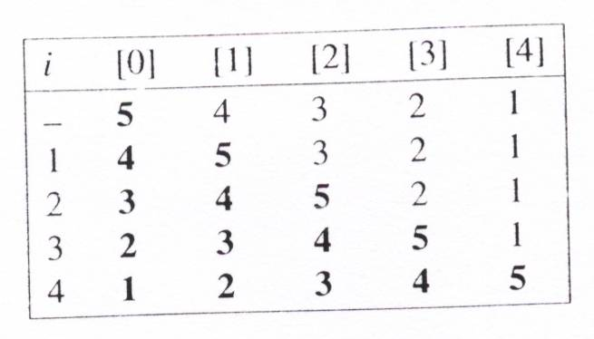
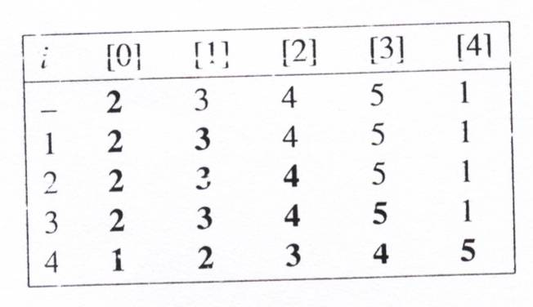
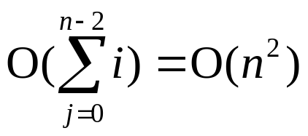
Insertion Sort (3/3)
Analysis of InsertionSort:
  If k is the number of records LOO, then the computing time is O((k+1)n)
  The worst-case time is O(n²).
  The average time is O(n²).
  The best time is O(n).
left out of order (LOO)
O(n)

Slide 15
Quick Sort (1/6)
The quick sort scheme developed by C. A. R. Hoare has the best average behavior among all the sorting methods we shall be studying
Given (R₀, R₁, …, R_{n-1}) and K_{i} denote a pivot key
If K_{i} is placed in position s(i),
then K_{j} ≤ K_{s(i)} for j < s(i), K_{j} ≥ K_{s(i)} for j > s(i).
After a positioning has been made, the original file is partitioned into two subfiles, {R₀, …, R_{s(i)-1}}, R_{s(i)}, {R_{s(i)+1}, …, R_{s(n-1)}}, and they will be sorted independently

Slide 16
Quick Sort (2/6)
Quick Sort Concept
  select a pivot key
  interchange the elements to their correct positions according to the pivot
  the original file is partitioned into two subfiles and they will be sorted
  independently
R₀
R₁
R₂
R₃
R₄
R₅
R₆
R₇
R₈
R₉
26
5
37
1
61
11
59
15
48
19
11
5
19
1
15
26
59
61
48
37
1
5
11
19
15
26
59
61
48
37
1
5
11
19
15
26
59
61
48
37
1
5
11
15
19
26
59
61
48
37
1
5
11
15
19
26
48
37
59
61
1
5
11
15
19
26
37
48
59
61
1
5
11
15
19
26
37
48
59
61

Slide 17
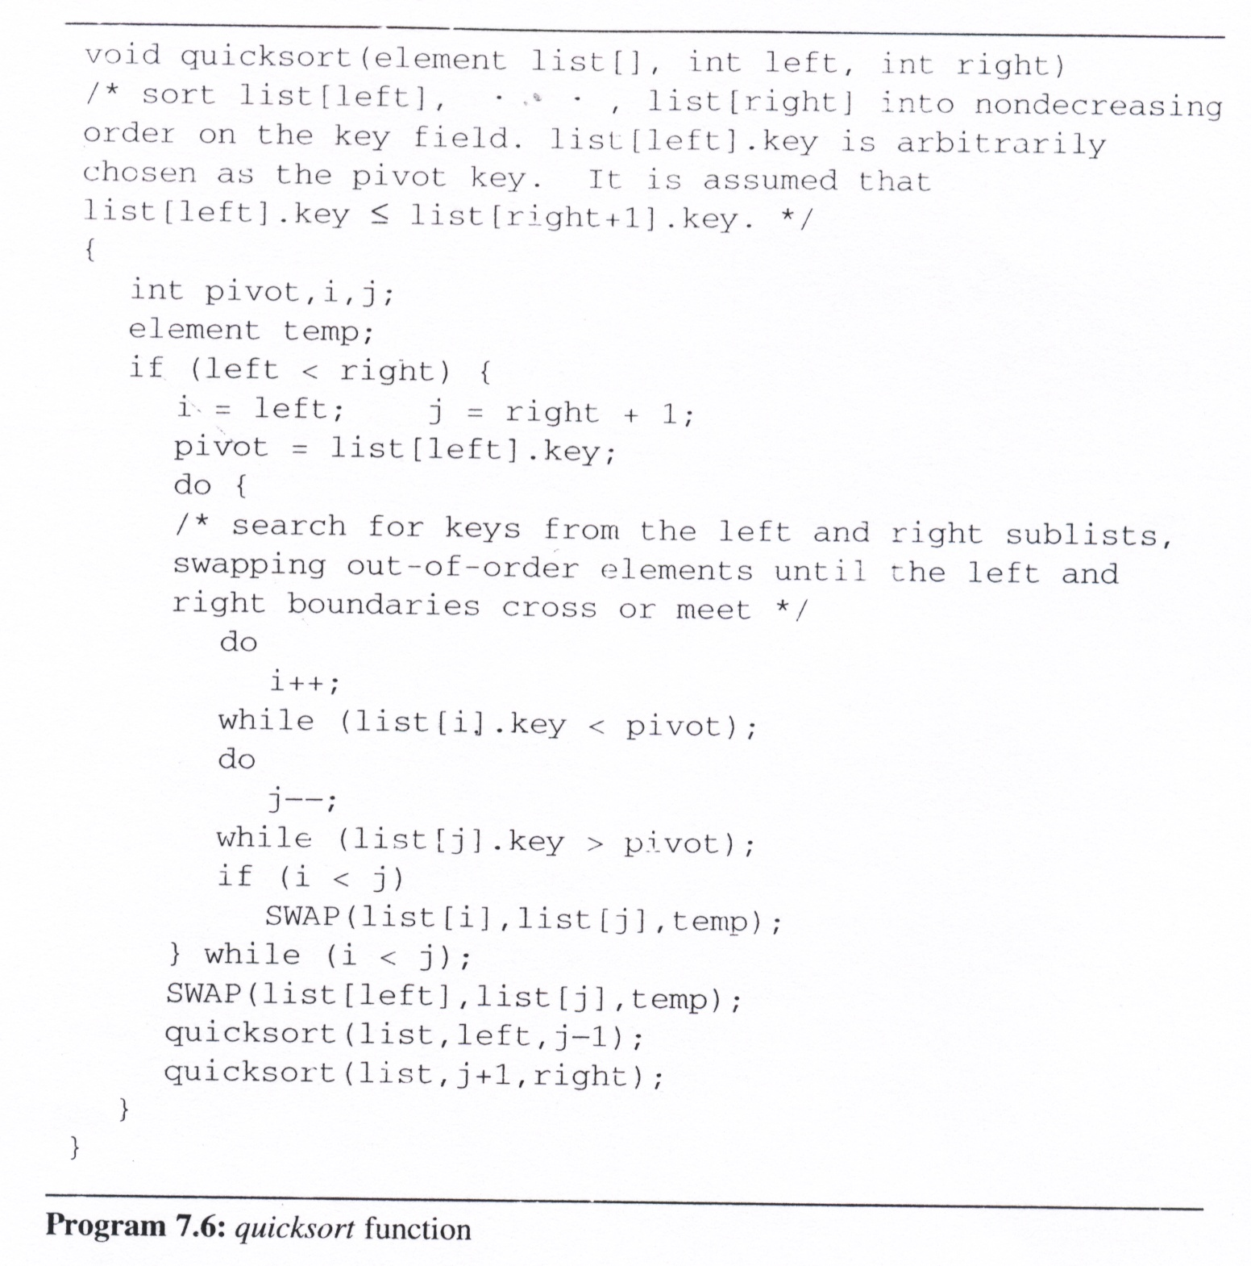
Quick Sort Program
i:
j:
R₀
R₁
R₂
R₃
R₄
R₅
R₆
R₇
R₈
R₉
pivot=
26
11
26
1
11
1
1
5
37
19
1
11
1
19
15
61
15
19
11
26
59
48
37
15
61
37
48
48
59
19
37
61
19
59
48
left
0
1
0
3
5
3
0
6
8
6
9
6
0
right
-1
9
4
1
4
4
9
6
7
9
1
3
7

Slide 18
Quick Sort (4/6)
Analysis for Quick Sort
  Assume that each time a record is positioned, the list is divided into the rough same size of two parts.
  Position a list with n element needs O(n)
  T(n) is the time taken to sort n elements
  T(n)<=cn+2T(n/2) for some c
  <=cn+2(cn/2+2T(n/4))
  ...
  <=cnlog₂n+nT(1)=O(nlogn)
Time complexity
  Average case and best case: O(nlogn)
  Worst case: O(n²)
  Best internal sorting method considering the average case
Unstable

Slide 19
Quick Sort (5/6)
Lemma 7.1:
  Let T_{avg}(n) be the expected time for quicksort to sort a file with n records. Then there exists a constant k such that T_{avg}(n) ≤ knlog_{e}n for n ≥ 2
Space for Quick Sort
  The smaller of the two subarrays is always stored first, the maximum stack space is less than 2logn
Stack space complexity:
  Average case and best case: O(logn)
  Worst case: O(n)

Slide 20
Quick Sort (6/6)
Quick Sort Variations
  Quick sort using a median of three: Pick the median of the first, middle, and last keys in the current sublist as the pivot. Thus, pivot = median{K_{l}, K_{(l+r)/2}, K_{r}}.

Slide 21
Merge Sort (1/13)
Before looking at the merge sort algorithm to sort n records, let us see how one may merge two sorted lists to get a single sorted list.
Merging
  The first one, Program 7.7, uses O(n) additional space.
  It merges the sorted lists
  (list[i], … , list[m]) and (list[m+1], …, list[n]),
  into a single sorted list, (sorted[i], … , sorted[n]).

Slide 22
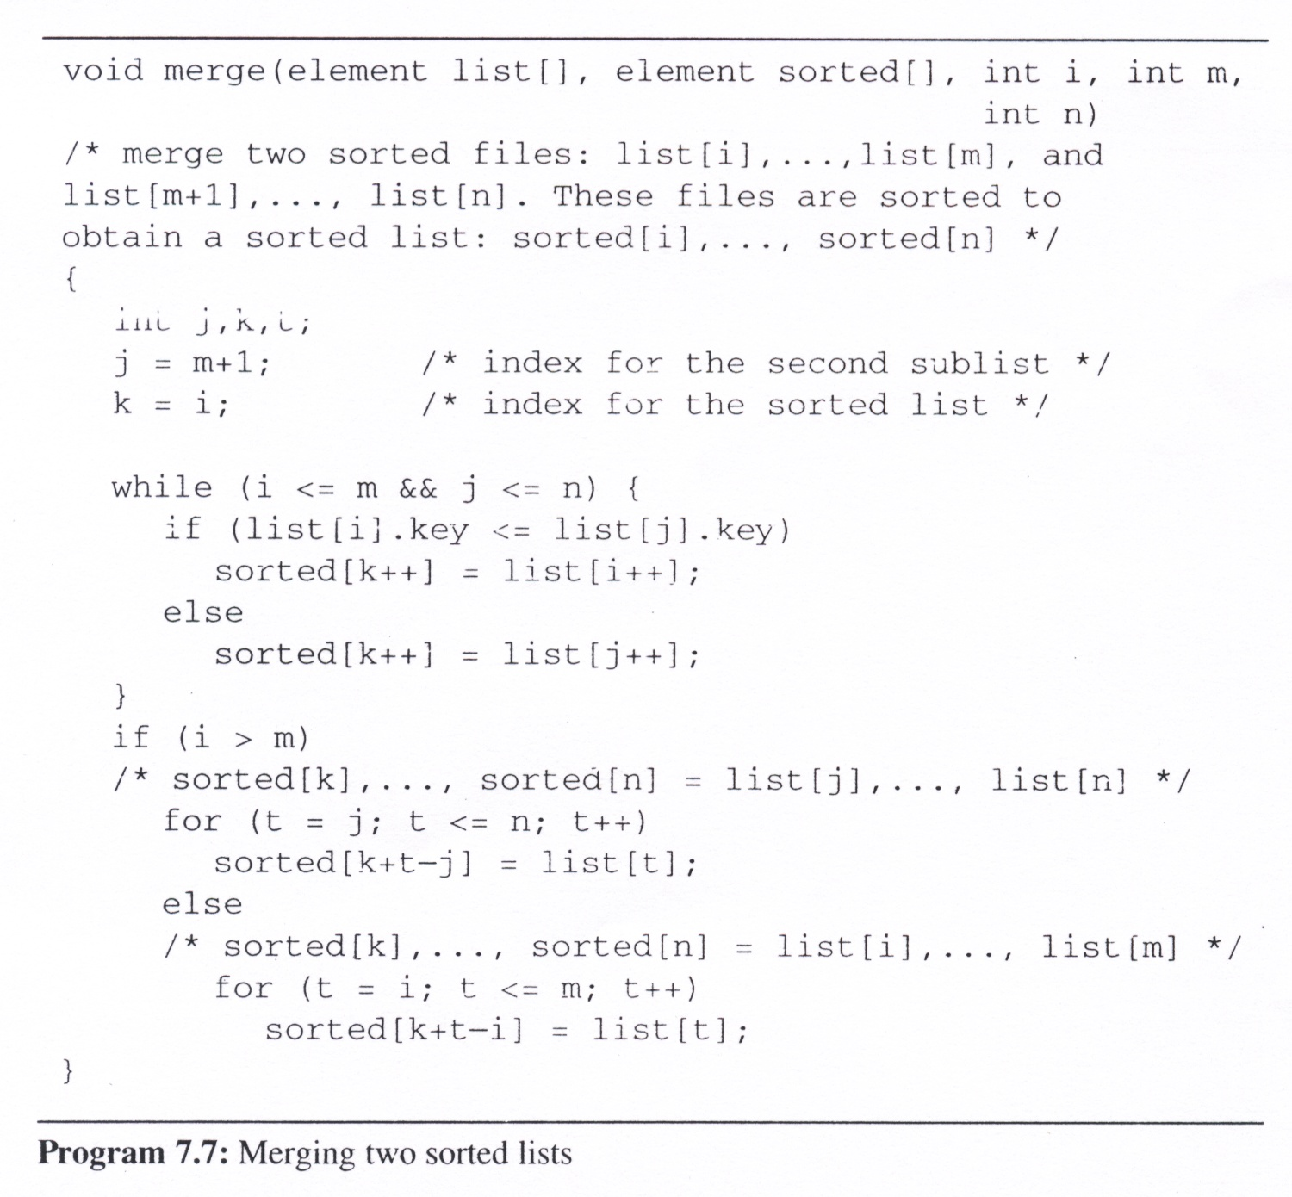
Merge (using O(n) space)

Slide 23
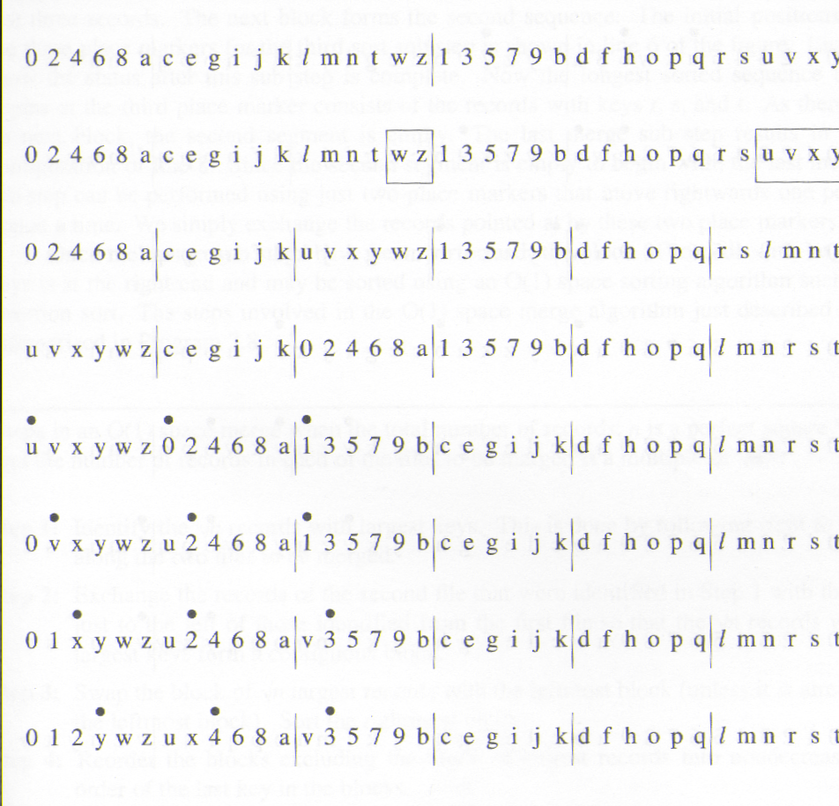
Merge Sort (3/13)
O(1) space merge
  Steps in an O(1) space merge when the total number of records, n is a perfect square */
  and the number of records in each of the files to be merged is a multiple of √n */
  Step1:
  Identify the √n records with largest key. This is done by following right to left along the two files to be merged.
  Step2:
  Exchange the records of the second file that were identified in Step1 with those just to the left of those identified from the first file so that the √n record with largest keys form a contiguous block

Slide 24
Merge Sort (4/13)
O(1) space merge (cont’d)
  Step3:
  Swap the block of √n largest records with the leftmost block (unless it is already the leftmost block). Sort the rightmost block
  Step4:
  Reorder the blocks excluding the block of largest records into nondecreasing order of the last key in the blocks

Slide 25
Merge Sort (5/13)
O(1) space merge (cont’d)
  Step5:
  Perform as many merge sub steps as needed to merge the √n-1 blocks other than the block with the largest keys.
•
•
•
0 1 2 3 w z u x 4 6 8 a | v y 5 7 9 b | c e g i j k | d f h o p q | l m n r s t
•
•
•
0 1 2 3 4 z u x w 6 8 a | v y 5 7 9 b | c e g i j k | d f h o p q | l m n r s t

Slide 26
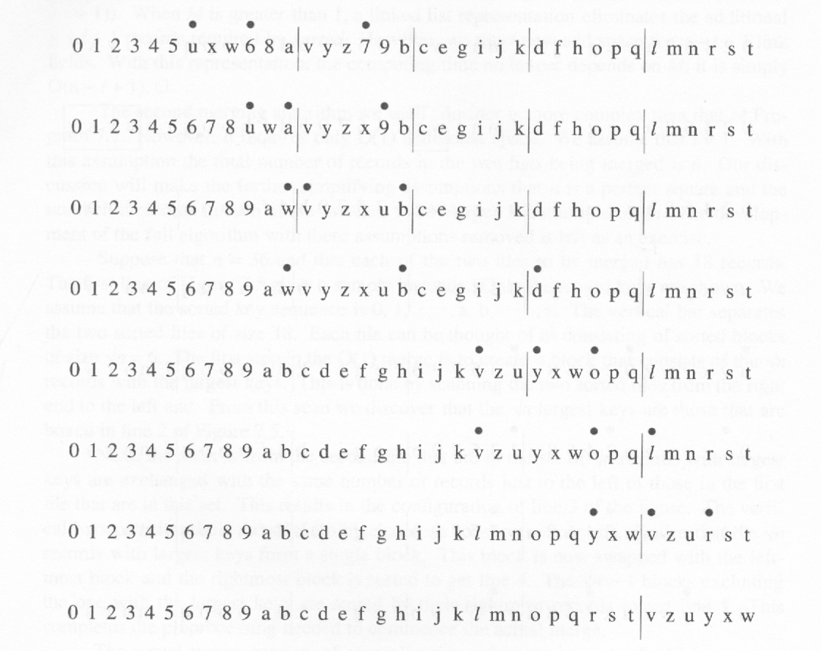
Merge Sort (6/13)
6, 7, 8 are merged
Segment one is merged (i.e., 0, 2, 4, 6, 8, a)
Change place marker (longest sorted sequence of records)
Segment one is merged (i.e., b, c, e, g, i, j, k)
Change place marker
Segment one is merged (i.e., o, p, q)
No other segment. Sort the largest keys.
  Step6:
  Sort the block with the largest keys

Slide 27
Merge Sort (7/13)
Iterative merge sort
  We assume that the input sequence has n sorted lists, each of length 1.
  We merge these lists pairwise to obtain n/2 lists of size 2.
  We then merge the n/2 lists pairwise, and so on, until a single list remains.
Analysis
  Total number of passes is the celling of log₂n
  merge two sorted list in linear time: O(n)
  The total computing time is O(n log n).

Slide 28
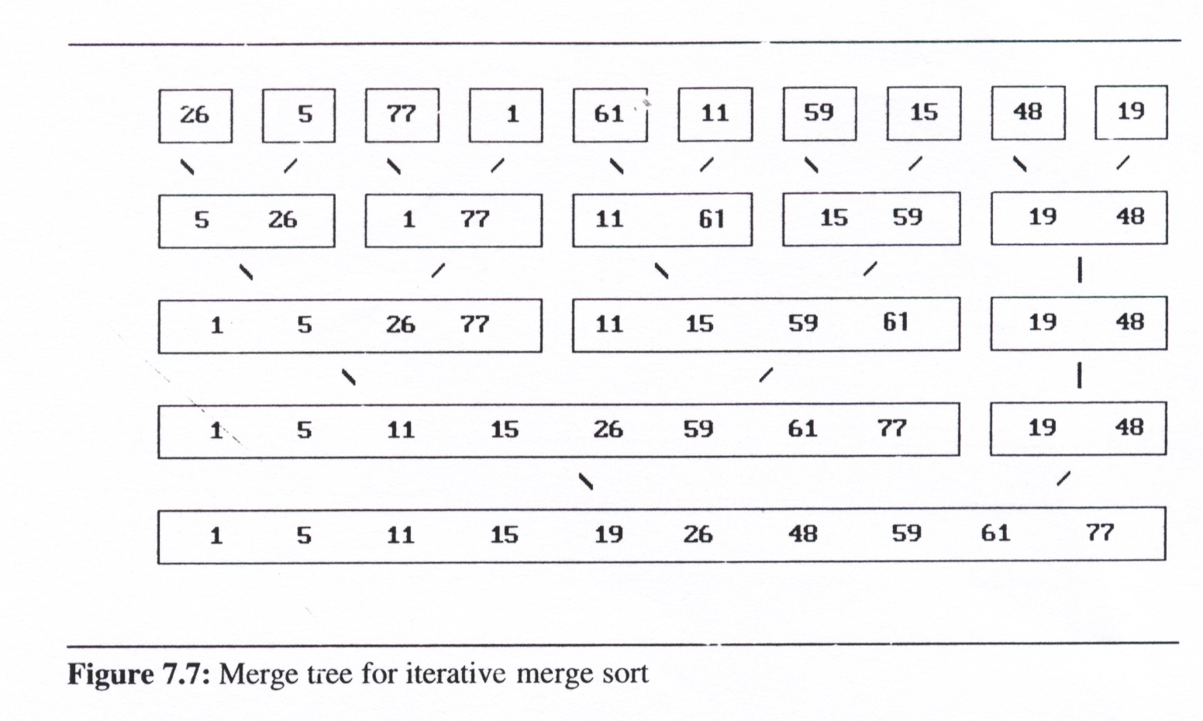
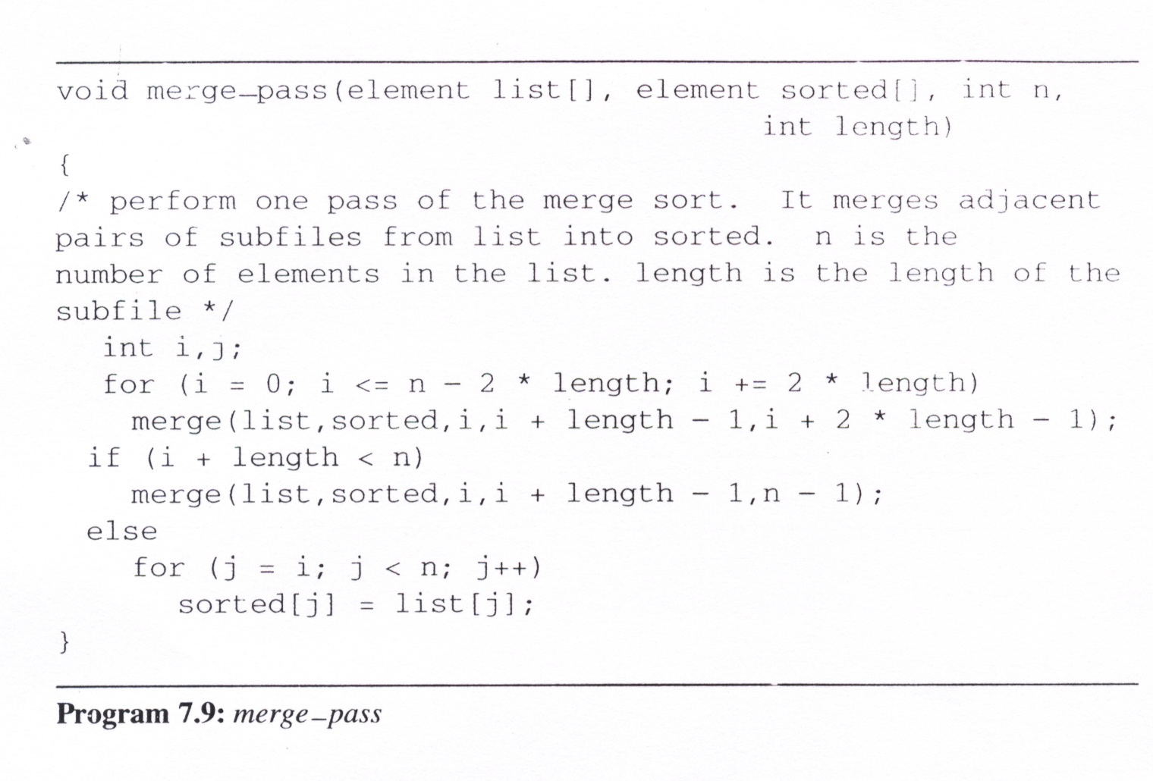
Merge Sort (8/13)
merge_pass
  Invokes merge (Program 7.7) to merge the sorted sublists
  Perform one pass of the merge sort. It merges adjancent pairs of subfiles from list into sorted.
[0]
[1]
[2]
[3]
[4]
[5]
[6]
[7]
[8]
[9]
length=2
list
n=10
i=
0
4
8
sorted
the length of the subfile
the number of elements in the list
0
4
5
1
3
7

Slide 29
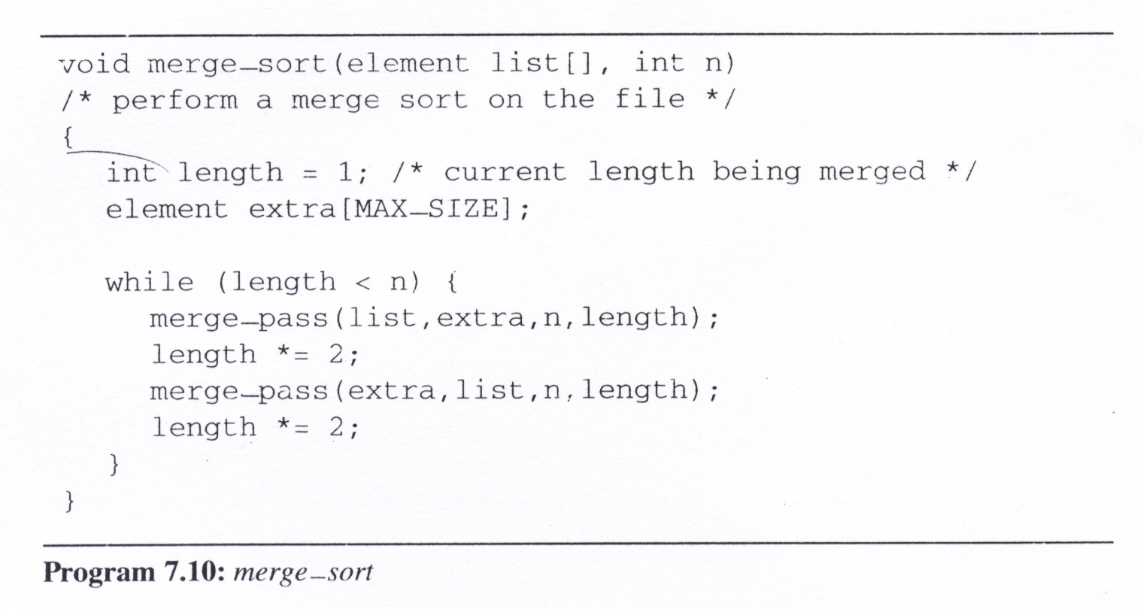
merge_sort: Perform a merge sort on the file
length=
1
2
4
8
16
n=10
[0]
[1]
[2]
[3]
[4]
[5]
[6]
[7]
[8]
[9]
list
extra
list
extra
list

Slide 30
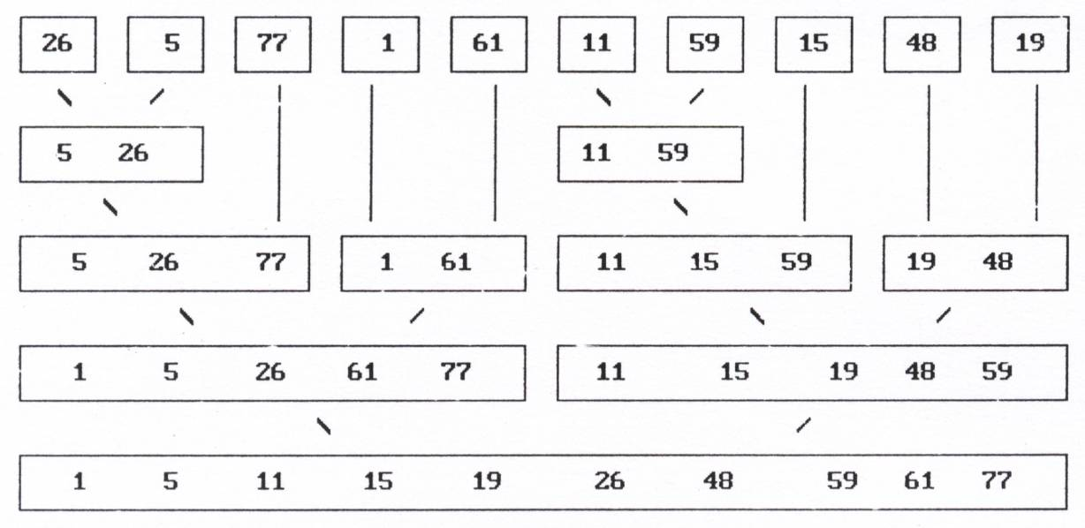
Merge Sort (10/13)
Recursive merge sort concept

Slide 31
Merge Sort (10/13)
Recursive merge sort concept

Slide 32
Merge Sort (10/13)
Recursive merge sort concept

Slide 33
Merge Sort (10/13)
Recursive merge sort concept

Slide 34
Merge Sort (10/13)
Recursive merge sort concept

Slide 35
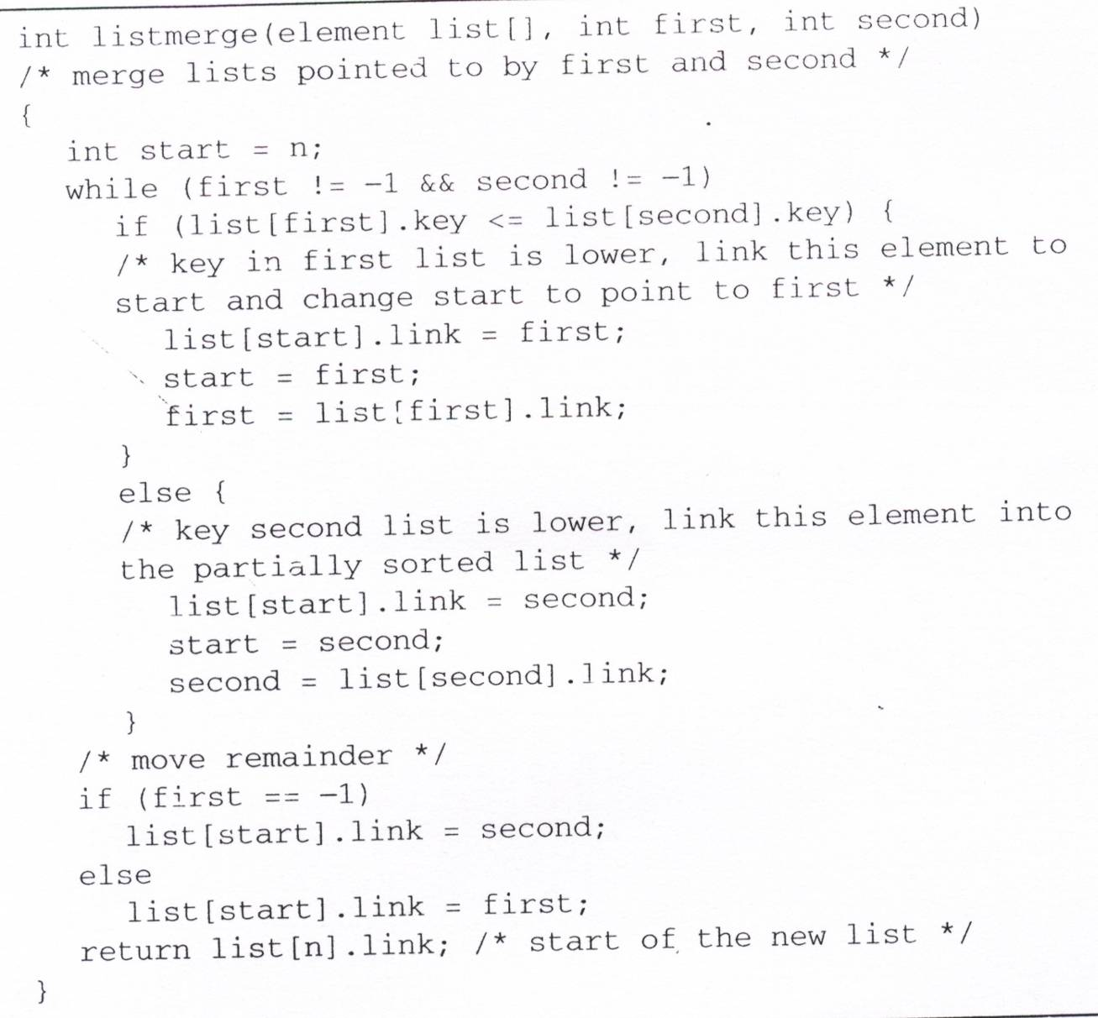
listmerge:
  Takes two sorted chains and returns an integer that points to the start of
  the sorted list
The link field in each record is initially set to -1
Since the elements were numbered
from 0 to n-1,
we use list[n] to
store the start pointer

Slide 36
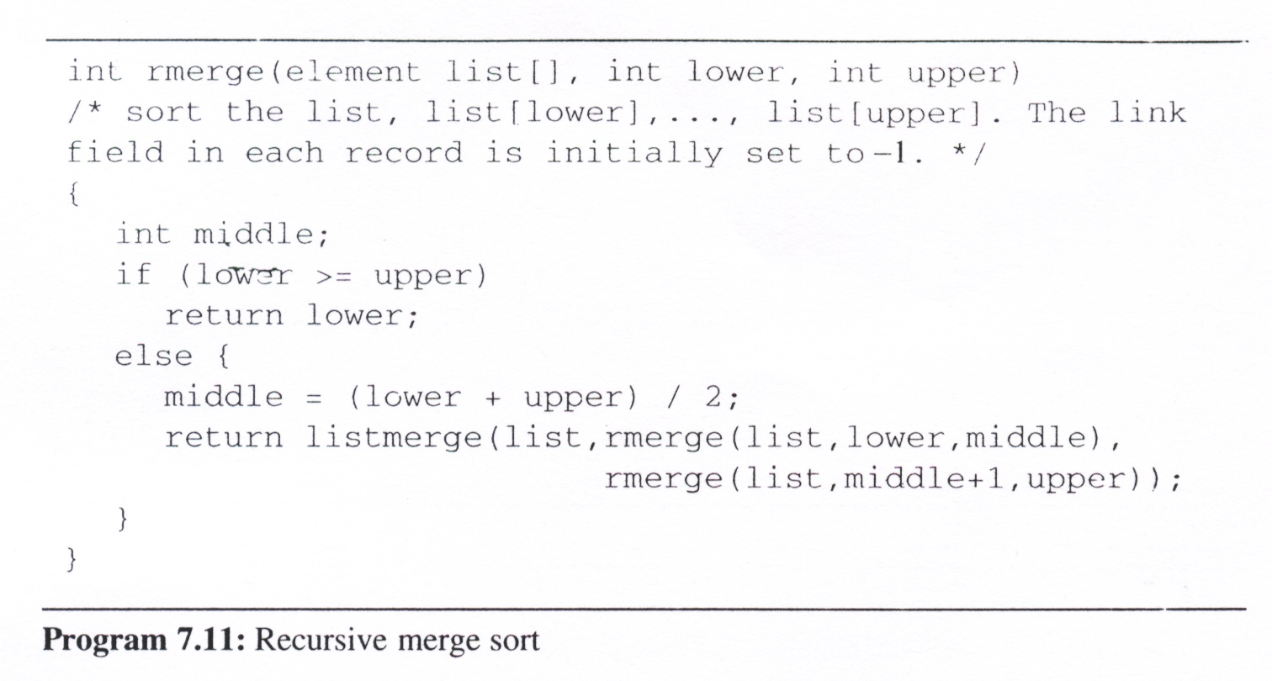
rmerge: sort the list, list[lower], …, list[upper].
The link field in each record is initially set to -1
lower=
0
1
0
2
0
3
4
3
0
5
6
5
7
5
8
9
8
5
0
start = rmerge(list, 0, n-1);
upper=
2
4
9
4
2
1
0
1
4
3
9
7
6
5
6
7
9
8
9
= 0
middle=
4
2
1
0
1
2
3
2
4
7
6
5
6
7
8
7
4
0
3
0
5
8
5
0
1
2
4
3
6
7
9
8
5
list
[0]
[1]
[2]
[3]
[4]
[5]
[6]
[7]
[8]
[9]

Slide 37
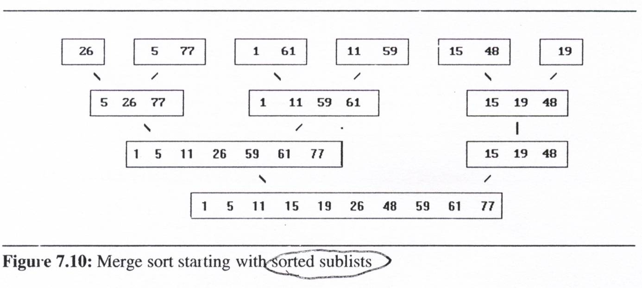
Merge Sort (13/13)
Variation: Natural merge sort :
  We can modify merge_sort to take into account the prevailing order within the input list.
  In this implementation we make an initial pass over the data to determine the sequences of records that are in order.
  The merge sort then uses these initially ordered sublists for the remainder of the passes.

Slide 38
Heap Sort (1/3)
The challenges of merge sort
  The merge sort requires additional storage proportional to the number of records in the file being sorted.
  By using the O(1) space merge algorithm, the space requirements can be reduced to O(1), but significantly slower than the original one.
Heap sort
  Require only a fixed amount of additional storage
  Slightly slower than merge sort using O(n) additional space
  Faster than merge sort using O(1) additional space.
  The worst case and average computing time is O(n log n), same as merge sort
  Unstable

Slide 39
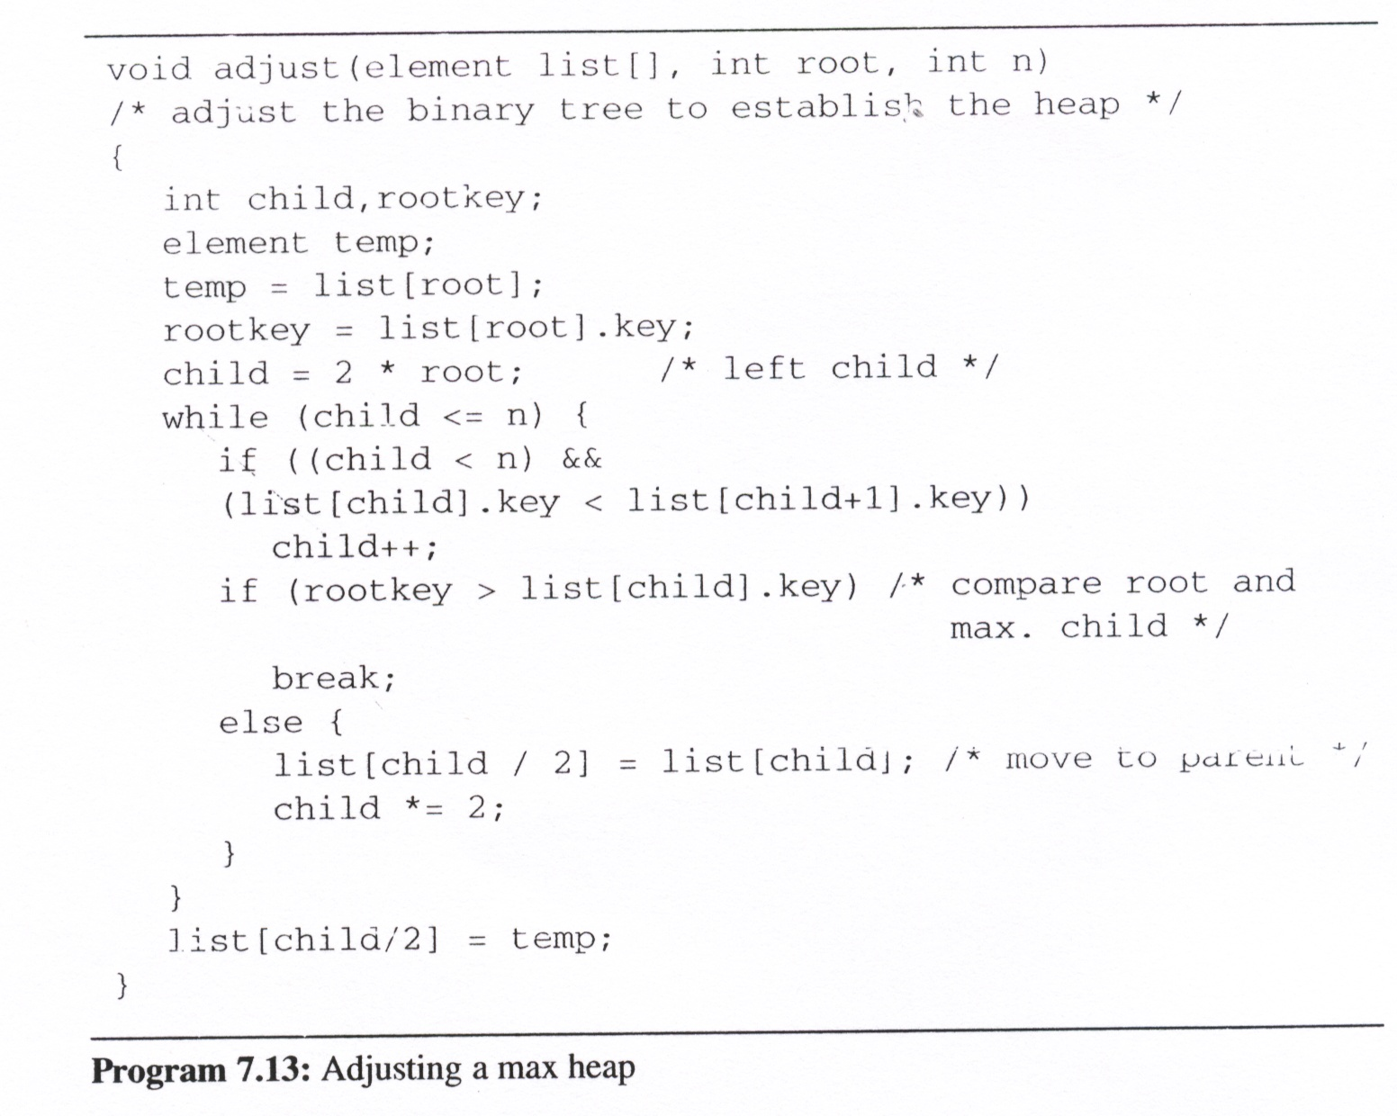
adjust
  adjust the binary tree to establish the heap
root = 1
n = 10
rootkey =
26
child =
2
3
6
7
14
/* compare root and max. root */
[1]
77
/* move to parent */
26
5
77
[2]
[3]
59
1
61
11
26
[4]
[5]
[6]
[7]
59
[8]
15
[9]
48
19
[10]

Slide 40
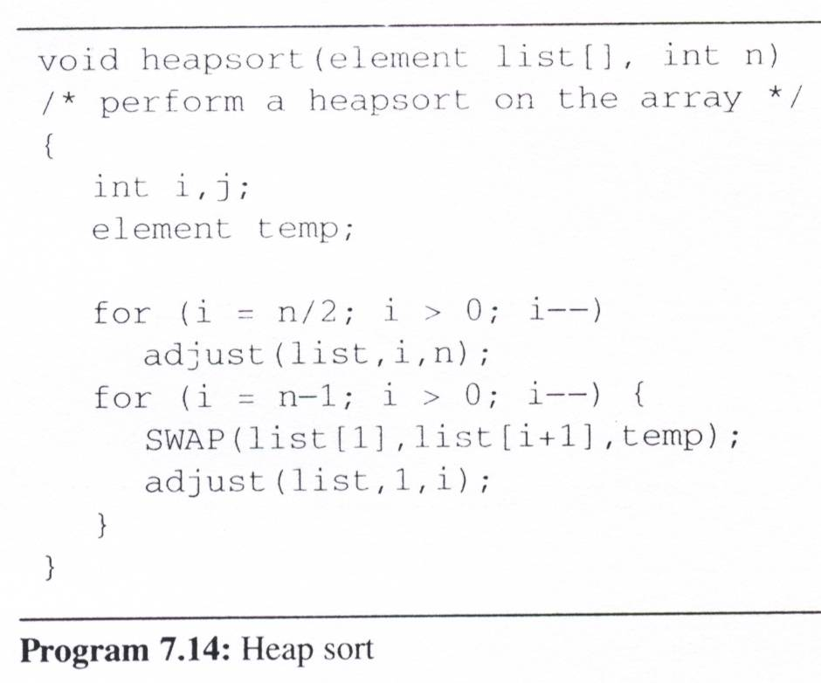
Heap Sort (3/3)
heapsort
n = 10
i =
5
4
3
2
1
9
8
7
6
5
4
3
2
1
bottom-up
ascending order
(max heap)
[1]
26
61
48
19
1
77
59
26
15
11
5
1
5
1
5
1
1
5
top-down
1
[2]
5
77
15
61
5
1
5
[3]
11
59
26
11
48
1
19
1
61
11
59
48
15
15
1
[4]
[5]
19
19
5
26
1
[6]
[7]
26
48
1
[8]
15
48
19
59
5
[9]
1
61
5
77
[10]

Slide 41
Radix Sort (1/8)
We considers the problem of sorting records that have several keys
  These keys are labeled K⁰ (most significant key), K¹, … , K^{r-1} (least significant key).
  Let K_{i} ^{j} denote key K^{j} of record R_{i}.
  A list of records R₀, … , R_{n-1}, is lexically sorted with respect to the keys K⁰, K¹, … , K^{r-1} iff
  (K_{i}⁰, K_{i}¹, …, K_{i}^{r-1}) ≤ (K⁰_{i+1}, K¹_{i+1}, …, K^{r-1}_{i+1}), 0≤ i < n-1

Slide 42
Radix Sort (2/8)
Example
  sorting a deck of cards on two keys, suit and face value, in which the keys have the ordering relation:
  K⁰ [Suit]: ♣ < ♦ < ♥ < ♠
  K¹ [Face value]: 2 < 3 < 4 < … < 10 < J < Q < K < A
  Thus, a sorted deck of cards has the ordering:
  2♣, …, A♣, … , 2♠, … , A♠
  Two approaches to sort:
    MSD (Most Significant Digit) first: sort on K₀, then K₁, ...
    LSD (Least Significant Digit) first: sort on K_{r-1}, then K_{r-2}, ...

Slide 43
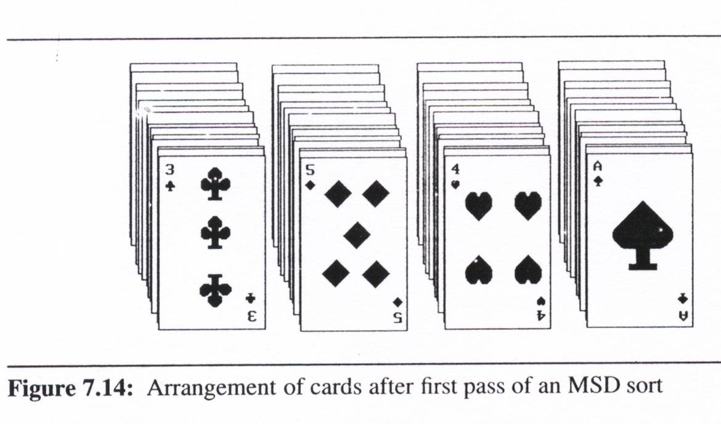
Radix Sort (3/8)
MSD first
  MSD sort first, e.g., bin sort, four bins ♣ ♦ ♥ ♠
  LSD sort second
  Result: 2♣, …, A♣, … , 2♠, … , A♠

Slide 44
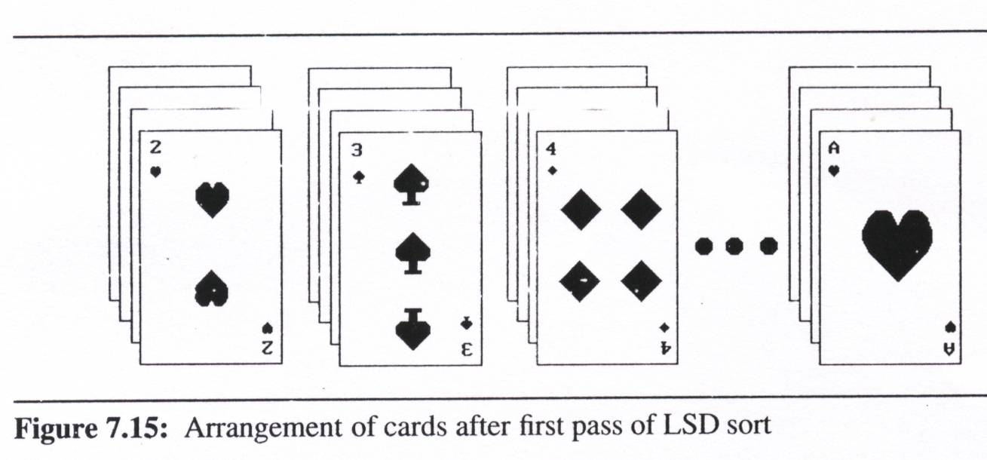
Radix Sort (4/8)
LSD first
  LSD sort first, e.g., face sort,
  13 bins 2, 3, 4, …, 10, J, Q, K, A
  MSD sort second (may not needed, we can just classify these 13 piles into 4 separated piles by considering them from face 2 to face A)
  Simpler than the MSD one because we do not have to sort the subpiles independently
Result:
2♣, …, A♣, … ,
2♠, …, A♠

Slide 45
Radix Sort (5/8)
We also can use an LSD or MSD sort when we have only one logical key, if we interpret this key as a composite of several keys.
Example:
  integer: the digit in the far right position is the least significant and the most significant for the far left position
  range: 0 ≤ K ≤ 999
  using LSD or MSD sort for three keys (K⁰, K¹, K²)
  since an LSD sort does not require the maintainence of independent subpiles, it is easier to implement
MSD
LSD
0-9
0-9
0-9

Slide 46
Radix Sort (6/8)
radix sort
  decompose the sort key into digits using a radix r.
  Ex: When r =10, we get the common base 10 or decimal decomposition of the key
LSD radix r sort
  The records, R₀, … ,R_{n-1}
  Keys: d-tuples (x₀, x₁, …, x_{d-1}) and that 0 ≤ x_{i} < r.
  Each record has a link field, and that the input list is stored as a dynamically linked list.
  We implement the bins as queues
    front[i], 0 ≤ i < r, pointing to the first record in bin i
    rear[i], 0 ≤ i < r, pointing to the last record in bin i
#define MAX_DIGIT 3 /* 0 to 999 */
#define RADIX_SIZE 10
typedef struct list_node *list_pointer;
typedef struct list_node {
int key[MAX_DIGIT];
list_pointer link;};

Slide 47
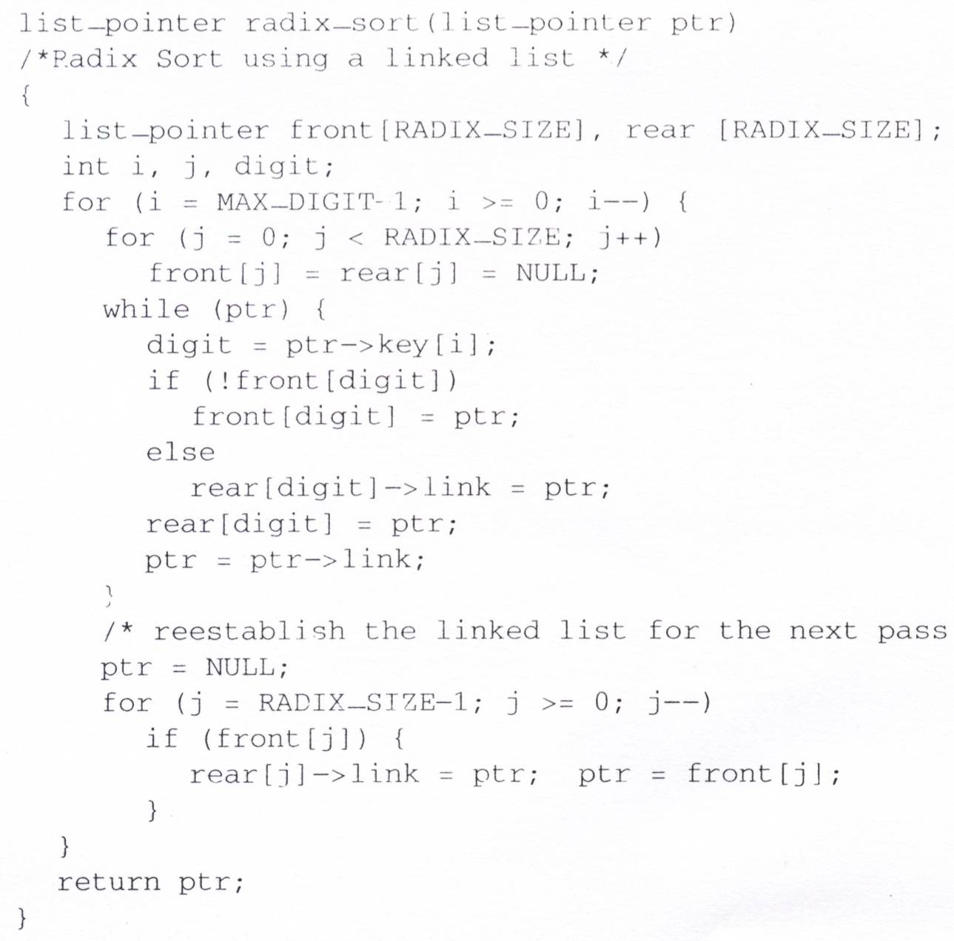
LSD Radix Sort
Time complexity: O(MAX_DIGIT(RADIX_SIZE+n))
RADIX_SIZE = 10
MAX_DIGIT = 3
Initial input:
179→208→306→93→859
→984→55→9→271→33
MAX_DIGIT passes
f[0]
r[0]
O(RADIX_SIZE)
f[1]
271
NULL
r[1]
O(n)
f[2]
r[2]
f[3]
93
33
NULL
r[3]
f[4]
984
NULL
r[4]
f[5]
55
NULL
r[5]
f[6]
306
NULL
r[6]
O(RADIX_SIZE)
f[7]
r[7]
f[8]
208
NULL
r[8]
f[9]
179
859
Chain after first pass, i=2:
271→93→33→984→55→
306→208→179→859→9
9
NULL
r[9]

Slide 48
Radix Sort (8/8)
Simulation of radix_sort
f[0]
306
Chain after
second pass, i=1:
306→208→9→33
→55→859→271
→179→984→93
f[0]
9
r[0]
Chain after
third pass, i=0:
9→33→55→93
→179→208→271
→306→859→984
208
33
9
NULL
r[0]
55
f[1]
r[1]
93
NULL
f[2]
r[2]
f[1]
179
NULL
r[1]
f[3]
33
NULL
r[3]
f[2]
208
f[4]
55
271
NULL
r[2]
859
r[4]
f[3]
306
NULL
r[3]
NULL
f[5]
r[5]
f[4]
r[4]
f[6]
r[6]
f[5]
r[5]
f[7]
271
r[7]
f[6]
r[6]
179
NULL
f[7]
r[7]
f[8]
984
NULL
r[8]
f[8]
859
NULL
r[8]
f[9]
93
NULL
r[9]
f[9]
984
r[9]
NULL

Slide 49
Summary of Internal Sorting (1/2)
Insertion Sort
  Works well when the list is already partially ordered
  The best sorting method for small n
Merge Sort
  The best/worst case (O(nlogn))
  Require more storage than a heap sort
  Slightly more overhead than quick sort
Quick Sort
  The best average behavior
  The worst complexity in worst case (O(n²))
Radix Sort
  Depend on the size of the keys and the choice of the radix

Slide 50
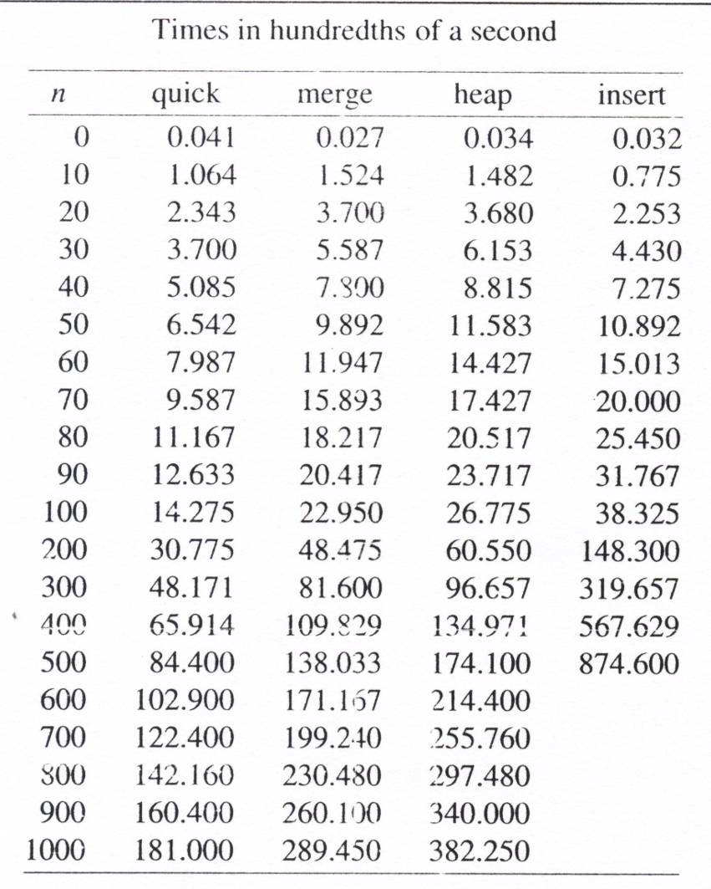
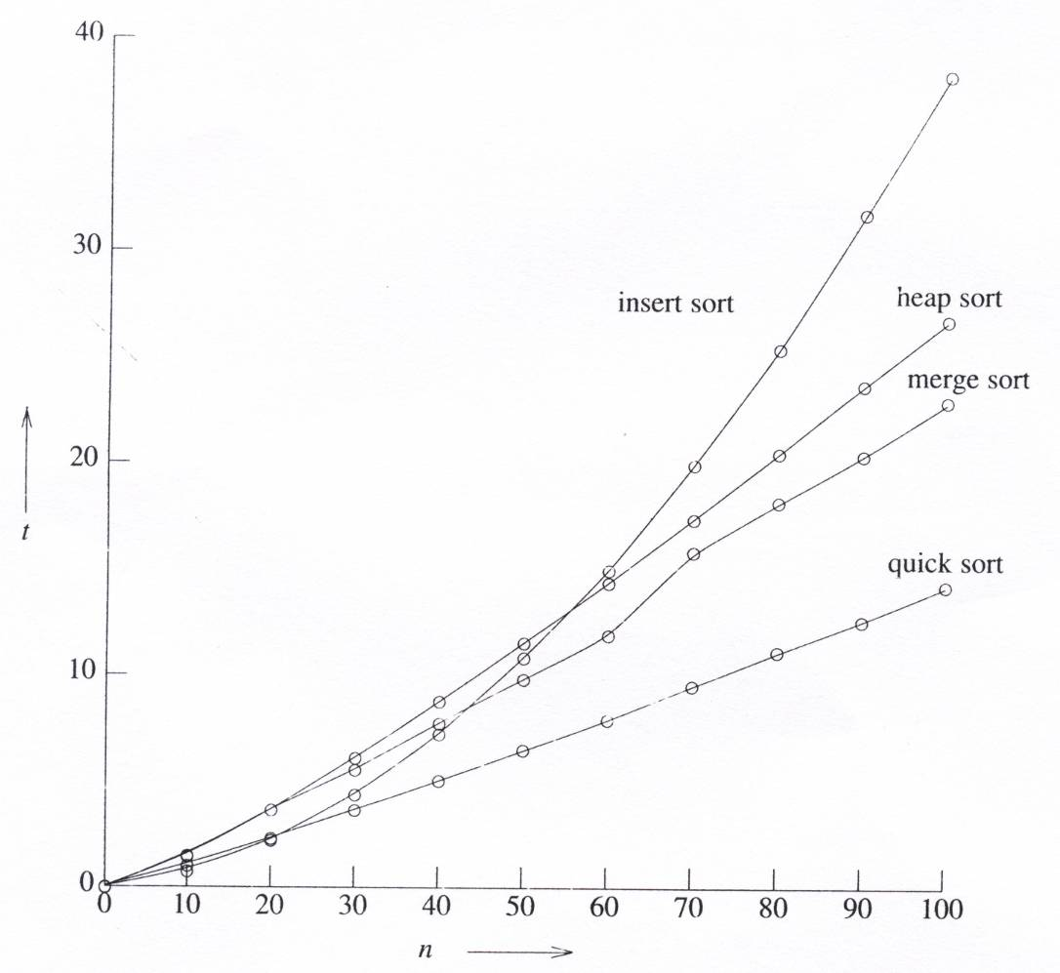
Summary of Internal Sorting (2/2)
Analysis of the average running times

