Slide 1
CS235102
Data Structures
Chapter 9 Heap Structures
(Selected Topics)

Slide 2
MIN-MAX Heaps (1/10)
Definition
  A double-ended priority queue is a data structure that supports the following operations:
    Insert an element with arbitrary key
    Delete an element with the largest key
    Delete an element with the smallest key
  Min heap or Max heap:
    Only insertion and one of the two deletion operations are supported
  Min-Max heap:
    Supports all of the operations just described.

Slide 3
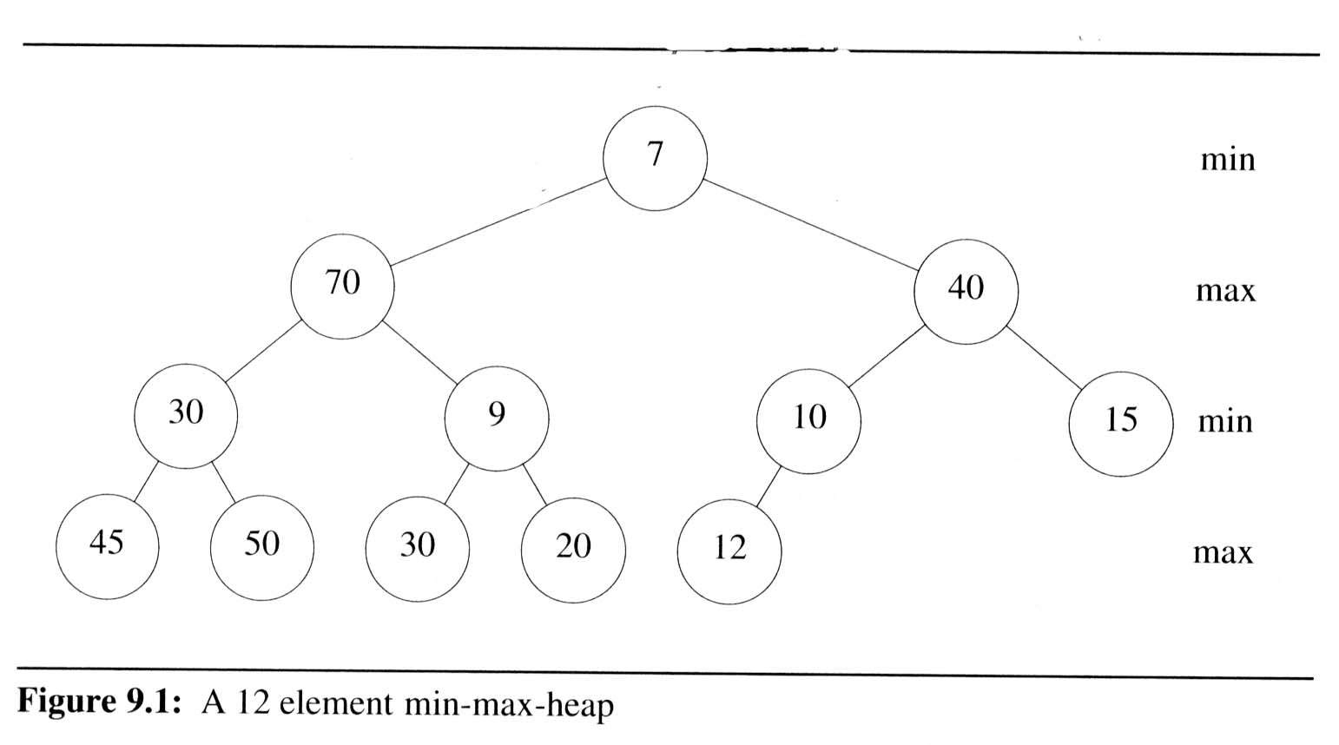
MIN-MAX Heaps (2/10)
Definition:
  A mix-max heap is a complete binary tree such that if it is not empty, each element has a field called key.
  Alternating levels of this tree are min levels and max levels, respectively.
  Let x be any node in a min-max heap. If x is on a min (max) level then the element in x has the minimum (maximum)
  key from among
  all elements in
  the subtree with
  root x. We call
  this node a min
  (max) node.

Slide 4
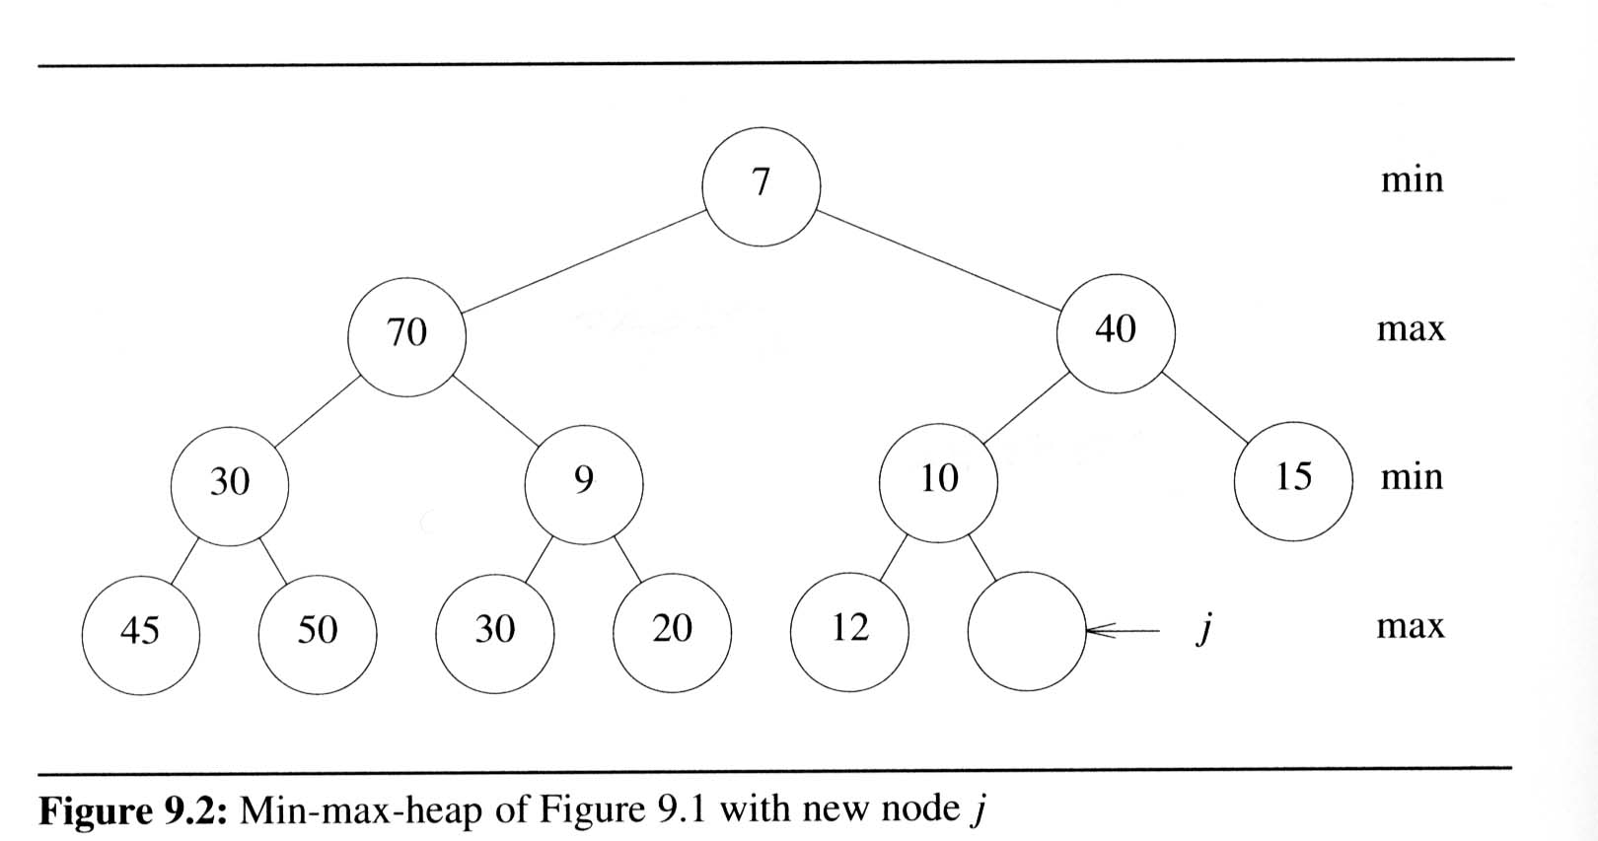
MIN-MAX Heaps (3/10)
Insertion into a min-max heap (at a “max” level)
  If it is smaller/greater than its father (a “min”), then it must be smaller/greater than all “max”/“min” above. So simply check the “min”/“max” ancestors
  There exists a similar approach at a “min” level

Slide 5
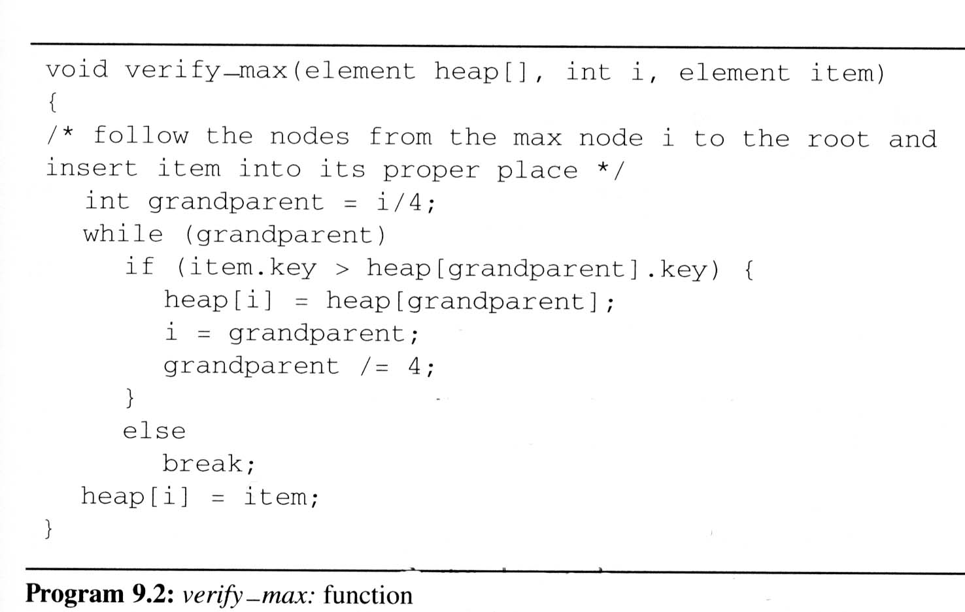
MIN-MAX Heaps (4/10)
verify_max
  Following the nodes the max node i to the root and insert into its proper
  place
item = 80
i =
13
3
grandparent =
3
0
#define MAX_SIZE 100
#define FALSE 0
#define TRUE 1
#define SWAP(x,y,t)
((t)=(x), (x)=(y),
(y)=(t))
typedef struct {
int key;
/* other fields */
}element;
element heap[MAX_SIZE];
[1]
[2]
[3]
80
[4]
[5]
[6]
[7]
[8]
[9]
[10]
[11]
[12]
[13]
40

Slide 6
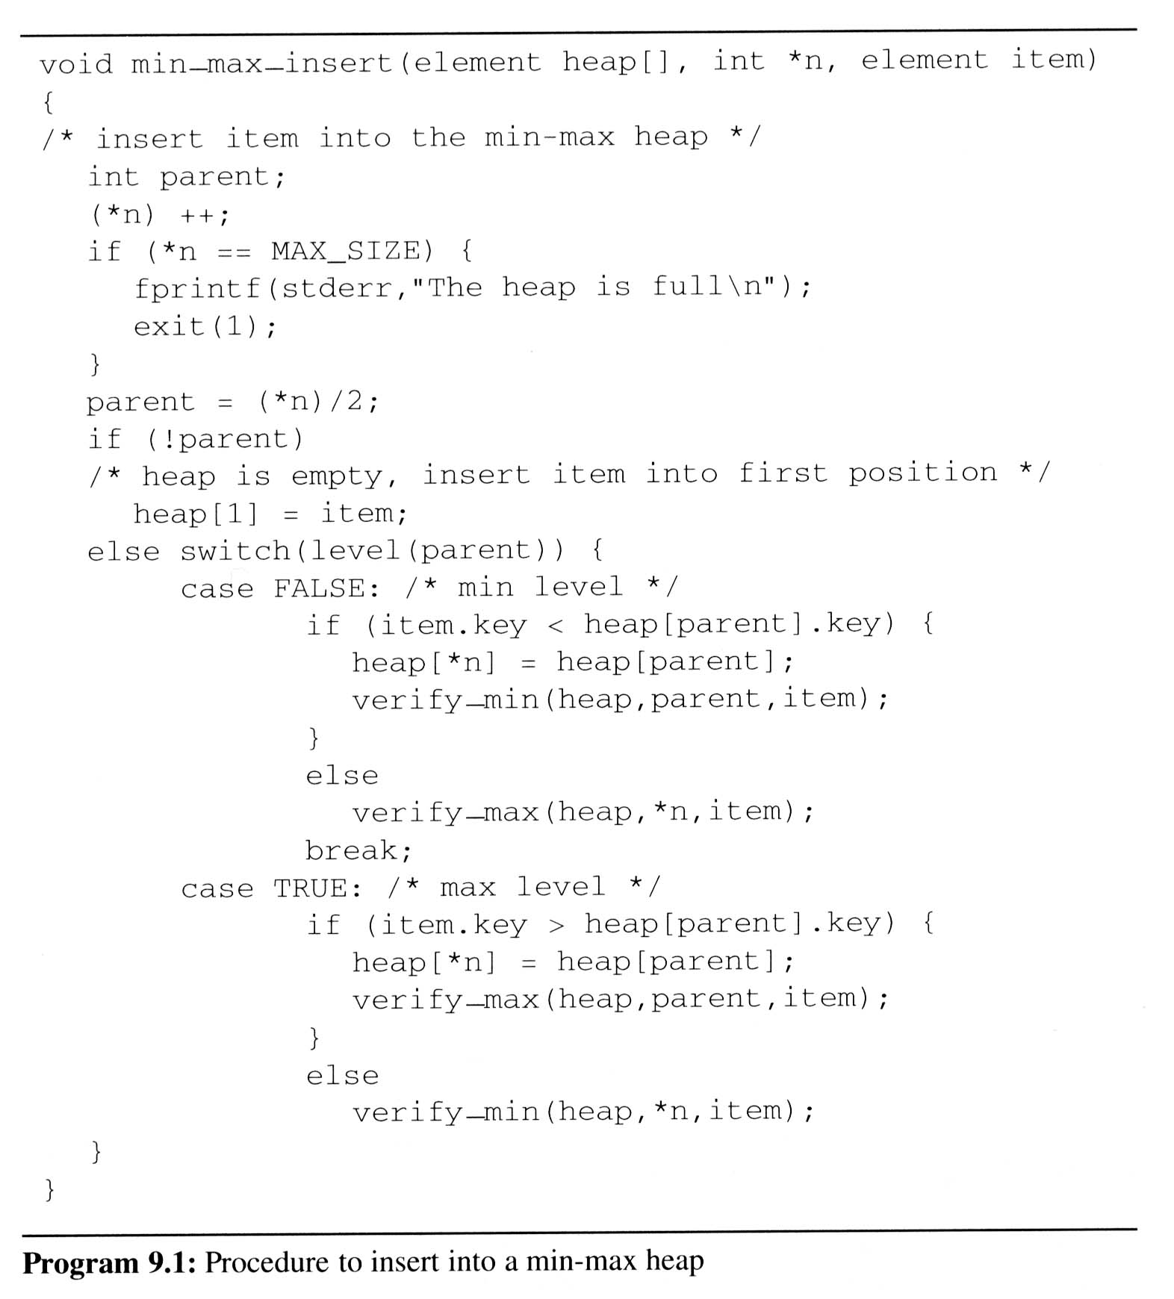
MIN-MAX Heaps (5/10)
min_max_insert: Insert item into the min-max heap
item.key =
5
80
*n =
12
13
14
complexity: O(log n)
parent =
6
7
[1]
7
min
5
[2]
70
[3]
40
max
80
[4]
[5]
[6]
[7]
30
9
10
7
15
min
45
50
30
20
12
10
40
max
[8]
[9]
[10]
[11]
[12]
[13]
[14]

Slide 7
MIN-MAX Heaps (6/10)
Deletion of min element
  If we wish to delete the element with the smallest key, then this element is in the root.
  In general situation, we are to reinsert an element item into a min-max-heap, heap, whose root is empty.
We consider the two cases:
  The root has no children
    Item is to be inserted into the root.
  The root has at least one child.
    The smallest key in the min-max-heap is in one of the children or grandchildren of the root. We determine the node k has the smallest key.
  The following possibilities need to be considered:

Slide 8
MIN-MAX Heaps (7/10)
item.key ≤ heap[k].key
  No element in heap with key smaller than item.key
  Item may be inserted into the root.
item.key > heap[k].key, k is a child of the root
  Since k is a max node, it has no descendants with key larger than heap[k].key. Hence, node k has no descendants with key larger than item.key.
  heap[k] may be
  moved to the
  root and item
  inserted into
  node k.

Slide 9
MIN-MAX Heaps (8/10)
item.key > heap[k].key,
k is a grandchild of the root
  In this case, heap[k] may be moved to the root, now heap[k] is seen as presently empty.
  Let parent be the parent of k.
  If item.key > heap[parent].key, then interchange them. This ensures that the max node parent contains the largest key in the sub-heap with root parent.
  At this point, we are faced with the problem of inserting item into the
  sub-heap with
  root k.
  Therefore, we
  repeat the above
  process.

Slide 10
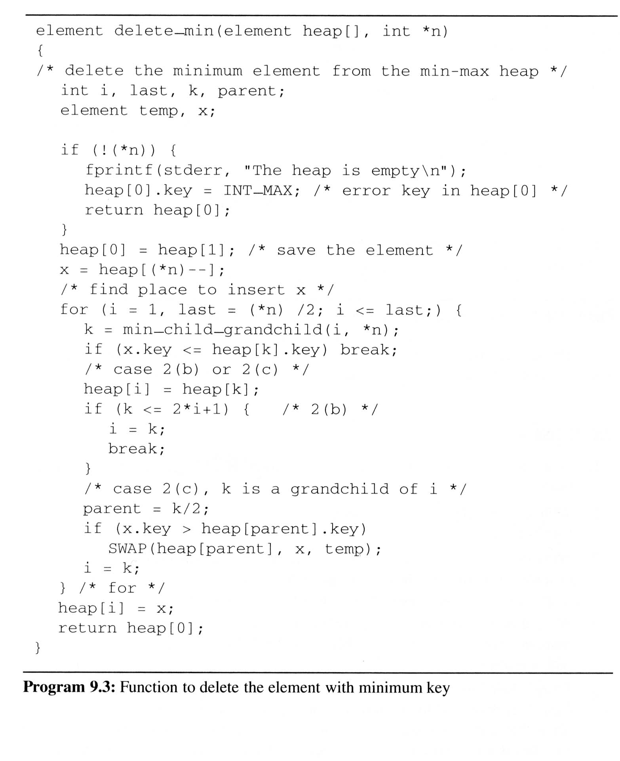
delete_min:
  Delete the minimum element from the min-max heap
complexity: O(log n)
*n =
12
11
i =
5
1
last =
5
k =
5
11
parent =
2
temp.key =
x.key =
12
[1]
7
[0]
9
7
[2]
70
[3]
40
[4]
[5]
[6]
[7]
30
9
12
10
15
45
50
30
20
12
[8]
[9]
[10]
[11]
[12]

Slide 11
MIN-MAX Heaps (10/10)
Deletion of max element
  Determine the children of the root which are located on max-level, and find the larger one (node) which is the largest one on the min-max heap
  We would consider the node as the root of a max-min heap
  There exist a
  similar
  approach
  (deletion of
  max element)
  as we
  mentioned
  above
max-min heap

