Slide 1
CS235102
Data Structures
Chapter 2 Arrays and Structures

Slide 2
Chapter 2 Arrays and Structures
The array as an Abstract Data Type
Structures and Unions
The polynomial Abstract Data Type
The Sparse Matrix Abstract Data Type
The Representation of Multidimensional Arrays

Slide 3
2.1 The array as an ADT (1/6)
Arrays
  Array: a set of pairs, <index, value>
  data structure
    For each index, there is a value associated with that index.
  representation (possible)
    Implemented by using consecutive memory.
    In mathematical terms, we call this a correspondence or a mapping.

Slide 4
2.1 The array as an ADT (2/6)
When considering an ADT we are more concerned with the operations that can be performed on an array.
  Aside from creating a new array, most languages provide only two standard operations for arrays, one that retrieves a value, and a second that stores a value.
  Structure 2.1 shows a definition of the array ADT
  The advantage of this ADT definition is that it clearly points out the fact that the array is a more general structure than “a consecutive set of memory locations.”

Slide 5
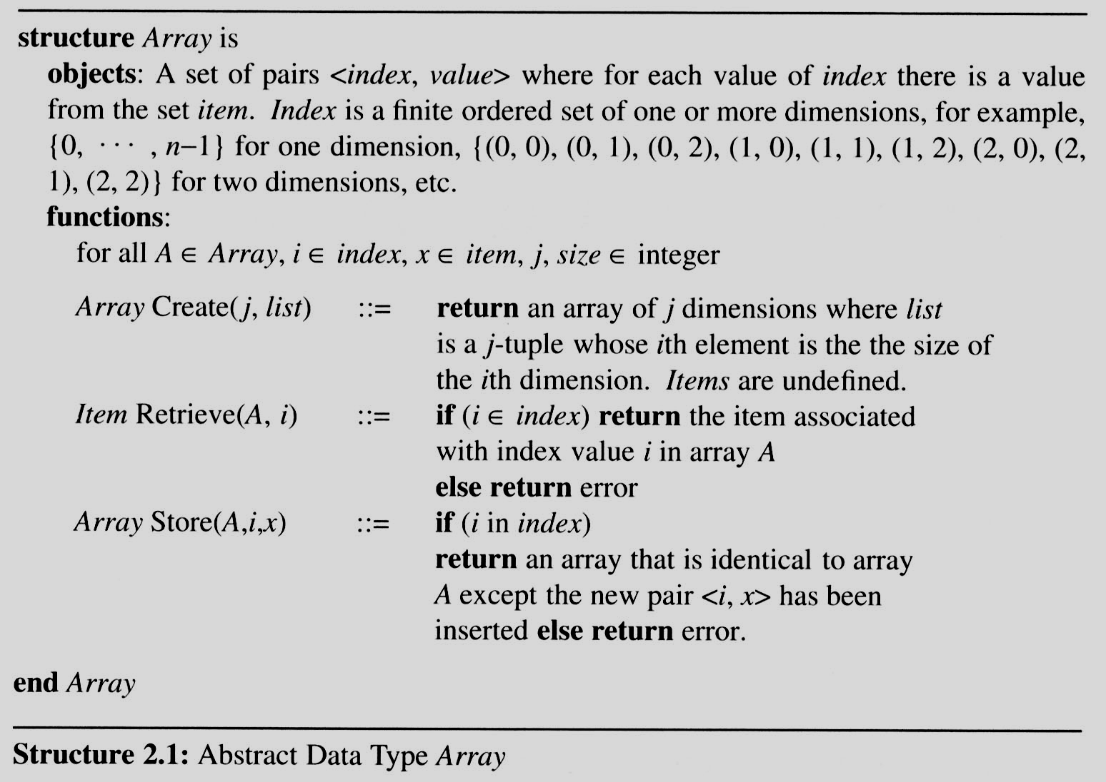
2.1 The array as an ADT (3/6)

Slide 6
2.1 The array as an ADT (4/6)
Arrays in C
  int list[5], *plist[5];
  list[5]: (five integers) list[0], list[1], list[2], list[3], list[4]
  *plist[5]: (five pointers to integers)
    plist[0], plist[1], plist[2], plist[3], plist[4]
  implementation of 1-D array
  list[0] base address = α
  list[1] α + sizeof(int)
  list[2] α + 2*sizeof(int)
  list[3] α + 3*sizeof(int)
  list[4] α + 4*sizeof(int)

Slide 7
2.1 The array as an ADT (5/6)
Arrays in C (cont’d)
  Compare int *list1 and int list2[5] in C.
  Same: list1 and list2 are pointers.
  Difference: list2 reserves five locations.
  Notations:
  list2 － a pointer to list2[0]
  (list2 + i) － a pointer to list2[i] (&list2[i])
  *(list2 + i) － list2[i]

Slide 8
2.1 The array (6/6)
Example:
1-dimension array addressing
  int one[] = {0, 1, 2, 3, 4};
  Goal: print out address and value
    void print1(int *ptr, int rows) {
    /* print out a one-dimensional array using a pointer */
    int i;
    printf(“Address Contents\n”);
    for (i=0; i < rows; i++)
    printf(“%8u%5d\n”, ptr+i, *(ptr+i) );
    printf(“\n”);
    }

Slide 9
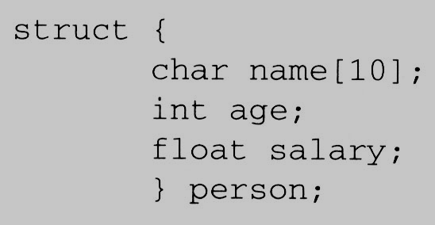
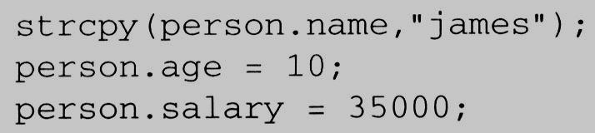
2.2 Structures and Unions (1/6)
2.2.1 Structures (Records)
  Arrays are collections of data of the same type. In C there is an alternate way of grouping data that permit the data to vary in type.
    This mechanism is called the struct, short for structure.
  A structure is a collection of data items, where each item is identified as to its type and name.

Slide 10
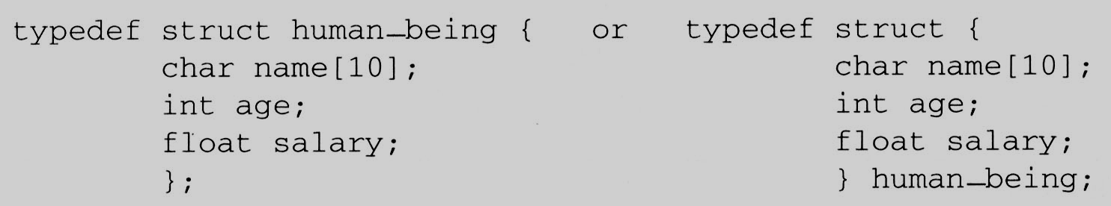
2.2 Structures and Unions (2/6)
Create structure data type
  We can create our own structure data types by using the typedef statement as below:
    This says that human_being is the name of the type defined by the structure definition, and we may follow this definition with declarations of variables such as:
    human_being person1, person2;

Slide 11
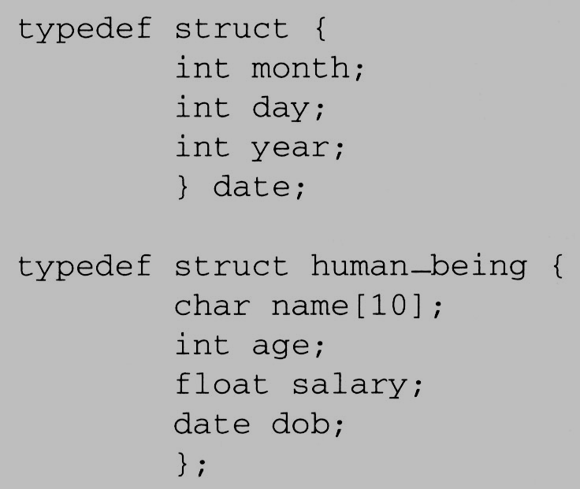
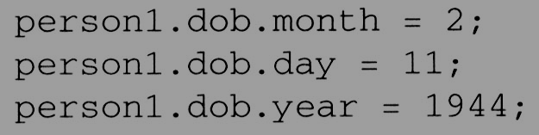
2.2 Structures and Unions (3/6)
Memory Layout
  We can also embed a structure within a structure.
  A person born on February 11, 1994, would have have values for the date struct set as
char name[10]
Memory Layout
human_being
int age
int month
date
float salary
int day
int month
int year
date
int day
int year
Padding [2]

Slide 12
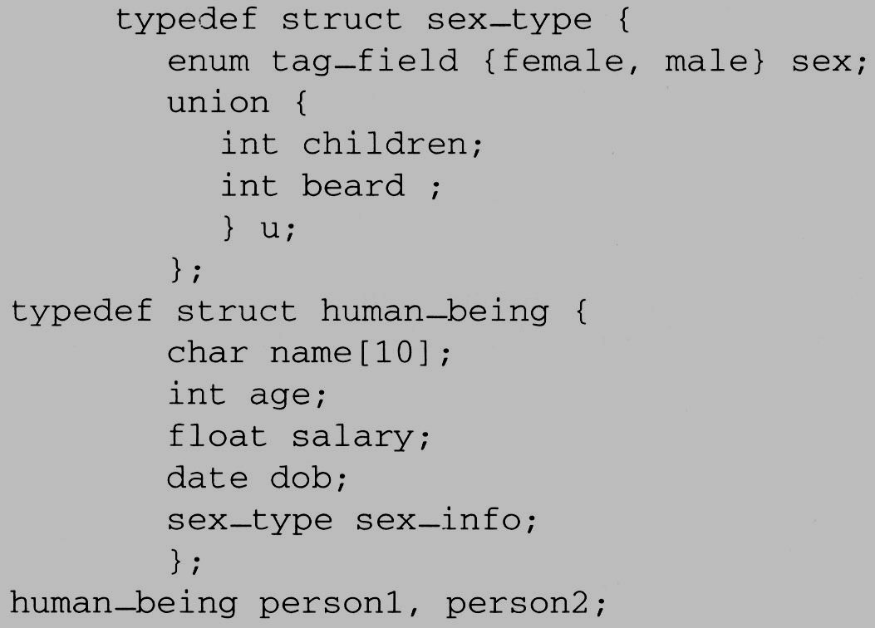
2.2 Structures and Unions (4/6)
2.2.2 Unions
  A union declaration is similar to a structure.
  The fields of a union must share their memory space.
  Only one field of the union is “active” at any given time
Memory Layout
sex_type
enum tag_field
u
int children
int beard
person1.sex_info.sex = male;
person1.sex_info.u.beard = FALSE;
and
person2.sex_info.sex = female;
person2.sex_info.u.children = 4;

Slide 13
2.2 Structures and Unions (5/6)
2.2.3 Internal implementation of structures
  The fields of a structure in memory will be stored in the same way using increasing address locations in the order specified in the structure definition.
  Holes or padding may actually occur
    Within a structure to permit two consecutive components to be properly aligned within memory
  The size of an object of a struct or union type is the amount of storage necessary to represent the largest component, including any padding that may be required.

Slide 14
2.2 Structures and Unions (6/6)
2.2.4 Self-Referential Structures
  One or more of its components is a pointer to itself.
  typedef struct list {
  char data;
  list *link;
  }
  list item1, item2, item3;
  item1.data=‘a’;
  item2.data=‘b’;
  item3.data=‘c’;
  item1.link=item2.link=item3.link=NULL;
Construct a list with three nodes
item1.link=&item2;
item2.link=&item3;
malloc: obtain a node (memory)
free: release memory
a
b
c

