Slide 1
CS235102
Data Structures
Chapter 2 Arrays and Structures

Slide 2
2.3 The polynomial ADT (1/12)
Ordered or Linear List Examples
  Ordered (linear) list: (item1, item2, item3, …, itemn)
    (Sunday, Monday, Tuesday, Wednesday, Thursday, Friday, Saturday)
    (Ace, 2, 3, 4, 5, 6, 7, 8, 9, 10, Jack, Queen, King)
    (basement, lobby, mezzanine, first, second)
    (1941, 1942, 1943, 1944, 1945)
    (a1, a2, a3, …, an-1, an)

Slide 3
2.3 The polynomial ADT (2/12)
Operations on Ordered List
  Finding the length, n , of the list.
  Reading the items from left to right (or right to left).
  Retrieving the i’th element.
  Storing a new value into the i’th position.
  Inserting a new element at the position i , causing elements numbered i, i+1, …, n to become numbered i+1, i+2, …, n+1
  Deleting the element at position i , causing elements numbered i+1, …, n to become numbered i, i+1, …, n-1
Implementation
  sequential mapping (1)~(4)
  non-sequential mapping (5)~(6)

Slide 4
2.3 The polynomial ADT (3/12)
Polynomial examples:
  Two example polynomials are:
    A(x) = 3x²⁰+2x⁵+4 and B(x) = x⁴+10x³+3x²+1
  Assume that we have two polynomials,
  A(x) = Σa_{i}x^{i} and B(x) = Σb_{i}x^{i} where x is the variable, a_{i} is the coefficient, and i is the exponent, then:
    A(x) + B(x) = Σ(a^{i} + b^{i})x^{i}
    A(x) · B(x) = Σ(a^{i}x^{i} · Σ(b^{j}x^{j}))
    Similarly, we can define subtraction and division on polynomials, as well as many other operations.

Slide 5
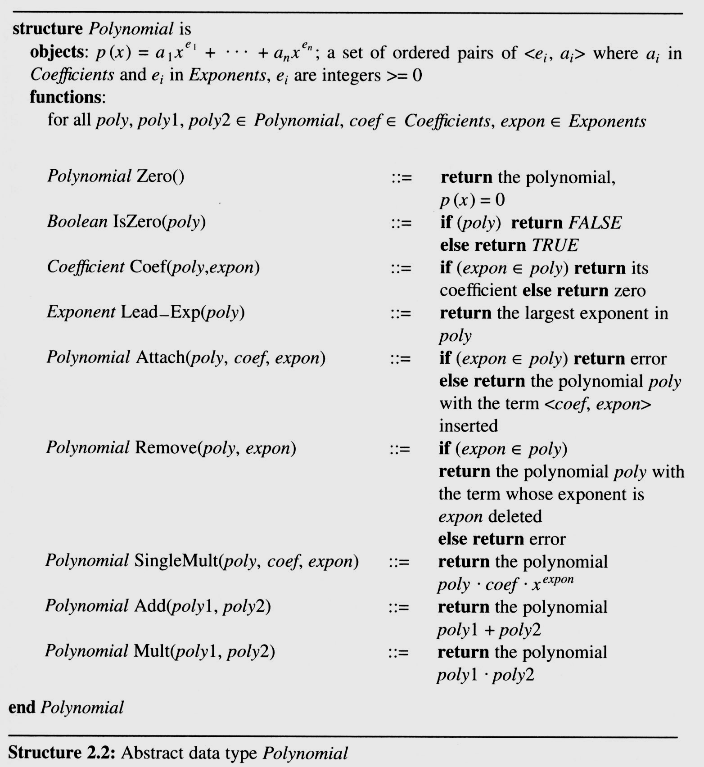
2.3 The polynomial ADT (4/12)
An ADT definition
of a polynomial

Slide 6
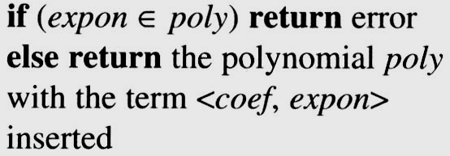
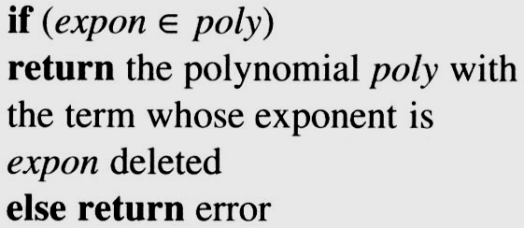
2.3 (5/12)
Polynomial Addition
  /* d =a + b, where a, b, and d are polynomials */
  d = Zero( )
  while (! IsZero(a) && ! IsZero(b)) do {
  switch ( COMPARE (Lead_Exp(a), Lead_Exp(b) ) {
  case -1: d =
  Attach(d, Coef (b, Lead_Exp(b)), Lead_Exp(b));
  b = Remove(b, Lead_Exp(b));
  break;
  case 0: sum = Coef (a, Lead_Exp (a)) + Coef ( b, Lead_Exp(b));
  if (sum) {
  Attach (d, sum, Lead_Exp(a));
  a = Remove(a , Lead_Exp(a));
  b = Remove(b , Lead_Exp(b));
  }
  break;
  case 1: d =
  Attach(d, Coef (a, Lead_Exp(a)), Lead_Exp(a));
  a = Remove(a, Lead_Exp(a));
  }
  }
  insert any remaining terms of a or b into d
  *Program 2.4 :Initial version of padd function(p.62)

Slide 7
2.3 (6/12)
EX: A(x) = 3x²⁰+2x⁵+4 and B(x) = x⁴+10x³+3x²+1
D(x) = A(x) + B(x)
d = Zero( ) ; // Let d is a Null polynomial
while (! IsZero(a) && ! IsZero(b)) do {
switch ( COMPARE (Lead_Exp(a), Lead_Exp(b) ) {
case -1: d =
Attach(d, Coef (b, Lead_Exp(b)), Lead_Exp(b));
b = Remove(b, Lead_Exp(b));
break;
case 0: sum = Coef (a, Lead_Exp (a)) + Coef ( b, Lead_Exp(b));
if (sum) {
Attach (d, sum, Lead_Exp(a));
a = Remove(a , Lead_Exp(a));
b = Remove(b , Lead_Exp(b));
}
break;
case 1: d =
Attach(d, Coef (a, Lead_Exp(a)), Lead_Exp(a));
a = Remove(a, Lead_Exp(a));
}
}
A(x) = ZERO
B(x) = ZERO
A(x) = ZERO
B(x) = ZERO
D(x) = 3x²⁰+2x⁵+x⁴+10x³+3x²+5
A(x) = 3x²⁰+2x⁵+4
B(x) = x⁴+10x³+3x²+1
A(x) != ZERO B(x) != ZERO
A(x) = 3x²⁰+2x⁵+4
B(x) = x⁴+10x³+3x²+1
Lead_Exp(a) = 20 > Lead_Exp(b) = 4
A(x) = 3x²⁰+2x⁵+4
B(x) = x⁴+10x³+3x²+1
D(x) = 3x²⁰
A(x) = 2x⁵+4
B(x) = x⁴+10x³+3x²+1
D(x) = 3x²⁰
A(x) = 2x⁵+4
B(x) = x⁴+10x³+3x²+1
A(x) != ZERO B(x) != ZERO
A(x) = 2x⁵+4
B(x) = x⁴+10x³+3x²+1
Lead_Exp(a) = 5 > Lead_Exp(b) = 4
A(x) = 2x⁵+4
B(x) = x⁴+10x³+3x²+1
D(x) = 3x²⁰ ⁺ 2x⁵
A(x) = 4
B(x) = x⁴+10x³+3x²+1
D(x) = 3x²⁰ ⁺ 2x⁵
A(x) = 4
B(x) = x⁴+10x³+3x²+1
A(x) != ZERO B(x) != ZERO
A(x) = 4
B(x) = x⁴+10x³+3x²+1
Lead_Exp(a) = 0 < Lead_Exp(b) != 4
A(x) = 4
B(x) = x⁴+10x³+3x²+1
D(x) = 3x²⁰+2x⁵ ⁺ x⁴
A(x) = 4
B(x) = 10x³+3x²+1
D(x) = 3x²⁰+2x⁵ ⁺ x⁴
A(x) = 4
B(x) = 10x³+3x²+1
A(x) != ZERO B(x) != ZERO
A(x) = 4
B(x) = 10x³+3x²+1
Lead_Exp(a) = 0 < Lead_Exp(b) = 3
A(x) = 4
B(x) = 10x³+3x²+1
D(x) = 3x²⁰+2x⁵ + x⁴+10x³
A(x) = 4
B(x) = 3x²+1
D(x) = 3x²⁰+2x⁵ + x⁴+10x³
A(x) = 4
B(x) = 3x²+1
A(x) != ZERO B(x) != ZERO
A(x) = 4
B(x) = 3x²+1
Lead_Exp(a) = 0 < Lead_Exp(b) = 2
A(x) = 4
B(x) = 3x²+1
D(x) = 3x²⁰+2x⁵ +x⁴+10x³+3x²
A(x) = 4
B(x) = 1
D(x) = 3x²⁰+2x⁵ +x⁴+10x³+3x²
A(x) = 4
B(x) = 1
A(x) != ZERO B(x) != ZERO
A(x) = 4
B(x) = 1
Lead_Exp(a) = 0 == Lead_Exp(b) = 0
A(x) = 4
B(x) = 1
Sum(x) = A(x) + B(x) = 4 + 1 = 5
A(x) = 4
B(x) = 1
D(x) = 3x²⁰+2x⁵+x⁴+10x³+3x²+5

Slide 8
2.3 The polynomial ADT (7/12)
There are two ways to create the type
polynomial in C
Representation I
  #define MAX_degree 101
  /*MAX degree of polynomial+1*/
  typedef struct{
  int degree;
  float coef [MAX_degree];
  }polynomial;
Drawback: The first
representation may
waste space.

Slide 9
2.3 The polynomial ADT (8/12)
Representation II
  #define MAX_TERMS 100
  /*size of terms array*/
  typedef struct{
  float coef;
  int expon;
  }polynomial;
  polynomial terms [MAX_TERMS];
  int avail = 0;

Slide 10
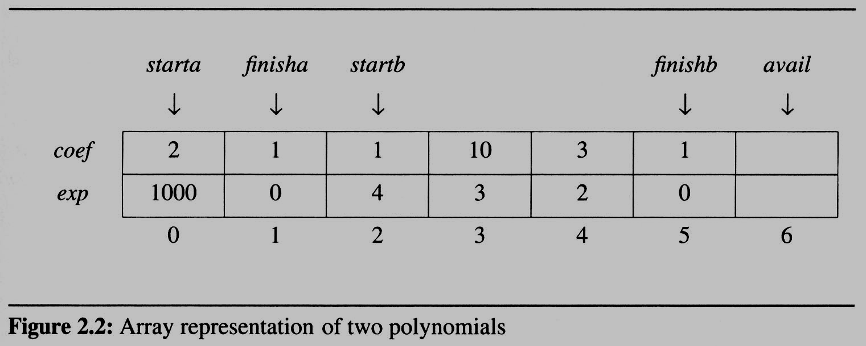
2.3 The polynomial ADT (9/12)
Use one global array to store all polynomials
  Figure 2.2 shows how these polynomials are stored in the array terms.
specification representation
poly <start, finish>
A <0,1>
B <2,5>
A(x) = 2x¹⁰⁰⁰+1
B(x) = x⁴+10x³+3x²+1
storage requirements: start, finish, 2*(finish-start+1)

Slide 11
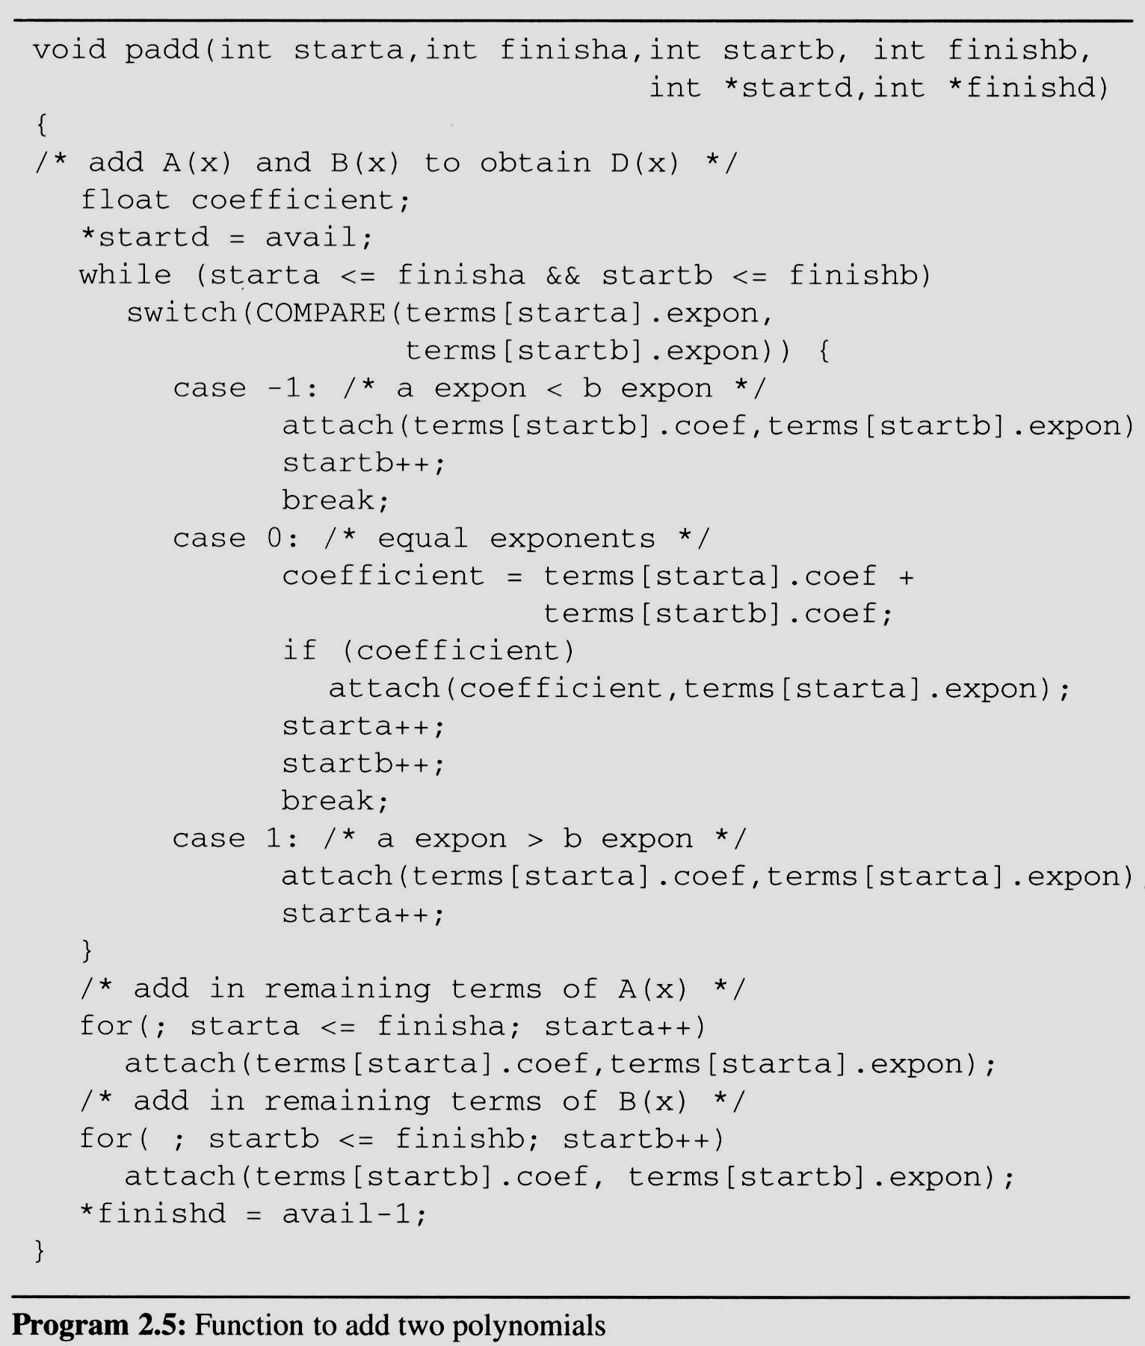
2.3 The polynomial ADT (10/12)
A C function that adds two polynomials,
A and B, represented as above to obtain D = A + B.
  To produce D(x), padd (Program 2.5) adds A(x) and B(x) term by term.
Analysis: O(n+m)
where n (m) is the number
of nonzeros in A (B).

Slide 12
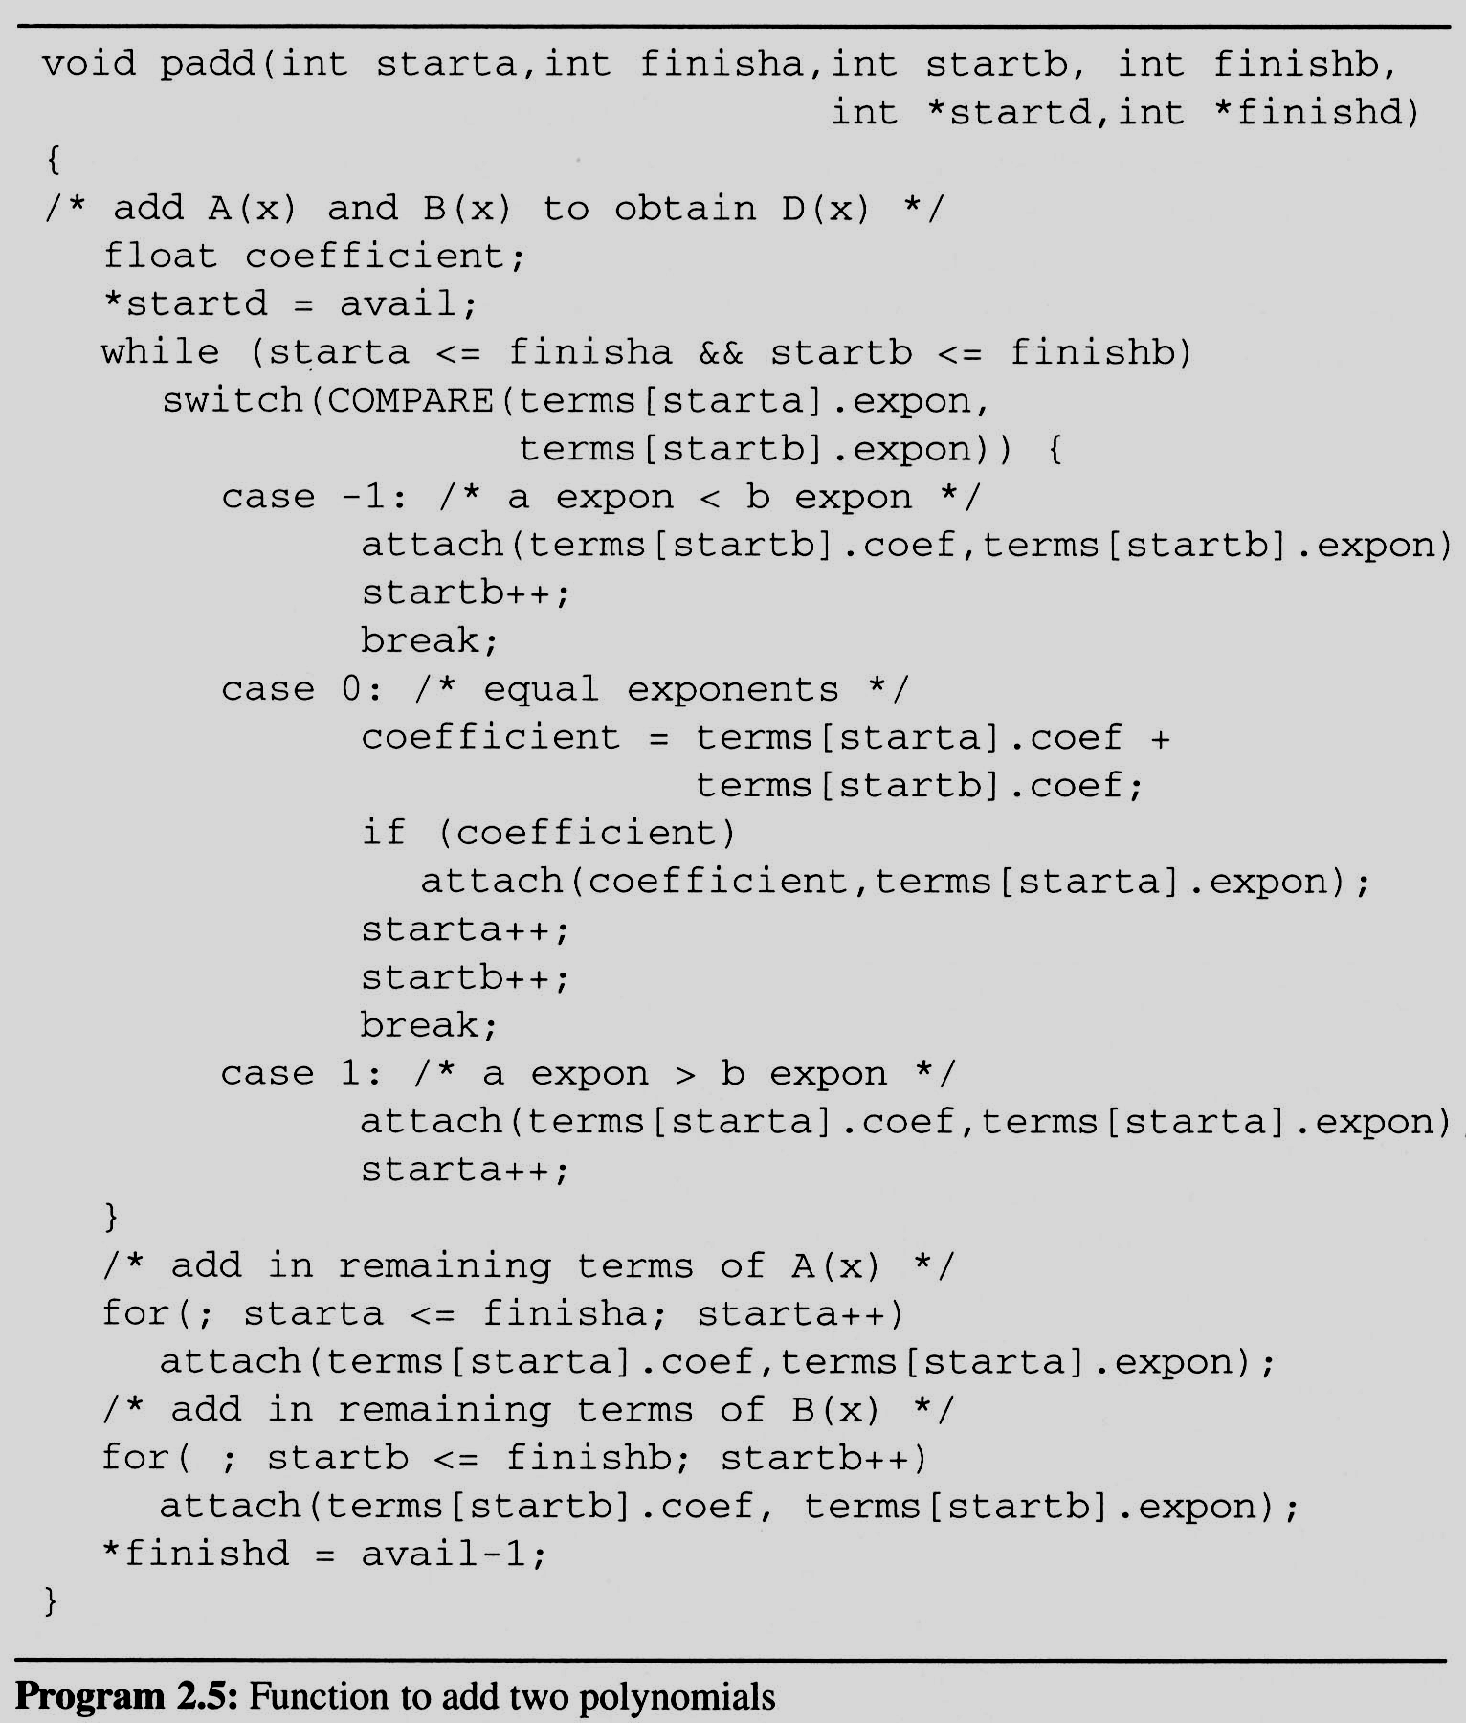
A(x) = 2x¹⁰⁰⁰+1
B(x) = x4+10x3+3x2+1
starta = 0 finisha = 1
startb = 2 finishb = 5
starta <= finisha = TRUE
startb <= finishb = TRUE
A(x) = 2x¹⁰⁰⁰+1
B(x) = x4+10x3+3x2+1
term[starta].expon = 1000 >
term[startb].expon = 4
A(x) = 2x¹⁰⁰⁰+1
B(x) = x⁴+10x³+3x²+1
starta ++ ;
starta = 1;
A(x) = 2x¹⁰⁰⁰+1
B(x) = x4+10x3+3x2+1
starta = 1 finisha = 1
startb = 2 finishb = 5
starta <= finisha = TRUE
startb <= finishb = TRUE
A(x) = 2x¹⁰⁰⁰+1
B(x) = x4+10x3+3x2+1
term[starta].expon = 0 >
term[startb]. expon = 4
A(x) = 2x¹⁰⁰⁰+1
B(x) = x⁴+10x³+3x²+1
startb++ ;
startb = 3;
A(x) = 2x¹⁰⁰⁰+1
B(x) = x4+10x3+3x2+1
starta = 1 finisha = 1
startb = 3 finishb = 5
starta <= finisha = TRUE
startb <= finishb = TRUE
A(x) = 2x¹⁰⁰⁰+1
B(x) = x4+10x3+3x2+1
term[starta].expon = 0 <
term[startb]. expon = 3
A(x) = 2x¹⁰⁰⁰+1
B(x) = x⁴+10x³+3x²+1
startb++ ;
startb = 4;
A(x) = 2x¹⁰⁰⁰+1
B(x) = x4+10x3+3x2+1
starta = 1 finisha = 1
startb = 4 finishb = 5
starta <= finisha = TRUE
startb <= finishb = TRUE
A(x) = 2x¹⁰⁰⁰+1
B(x) = x4+10x3+3x2+1
term[starta].expon = 0 <
term[startb]. expon = 2
A(x) = 2x¹⁰⁰⁰+1
B(x) = x⁴+10x³+3x²+1
startb++ ;
startb = 5;
A(x) = 2x¹⁰⁰⁰+1
B(x) = x4+10x3+3x2+1
starta = 1 finisha = 1
startb = 5 finishb = 5
starta <= finisha = TRUE
startb <= finishb = TRUE
A(x) = 2x¹⁰⁰⁰+1
B(x) = x4+10x3+3x2+1
term[starta].expon = 0 ==
term[startb]. expon = 0
coeffieicent =
term[starta] + term [startb] =
2
A(x) = 2x¹⁰⁰⁰+1
B(x) = x⁴+10x³+3x²+1
starta ++ ;
startb++ ;
starta = 2;
startb = 6;
A(x) = 2x¹⁰⁰⁰+1
B(x) = x4+10x3+3x2+1
starta = 2 finisha = 1
startb = 6 finishb = 5
starta <= finisha = FALSE
startb <= finishb = FALSE
Term
2x¹⁰⁰⁰
1
x⁴
10x³
3x²
1
2x¹⁰⁰⁰
x⁴
10x³
10x²
2

Slide 13
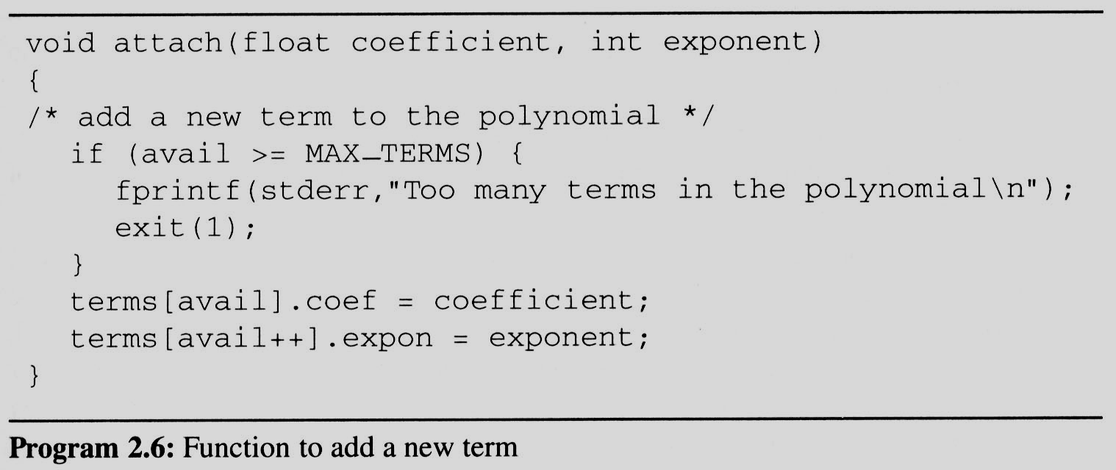
2.3 The polynomial ADT (12/12)
Problem: Compaction is required
when polynomials that are no longer needed.
(data movement takes time.)

