Slide 1
CS235102
Data Structures
Chapter 3 Stacks and Queues

Slide 2
Chapter 3 Stacks and Queues
The Stack Abstract Data Type
The Queue Abstract Data Type
A Mazing Problem
Evaluation of Expressions

Slide 3
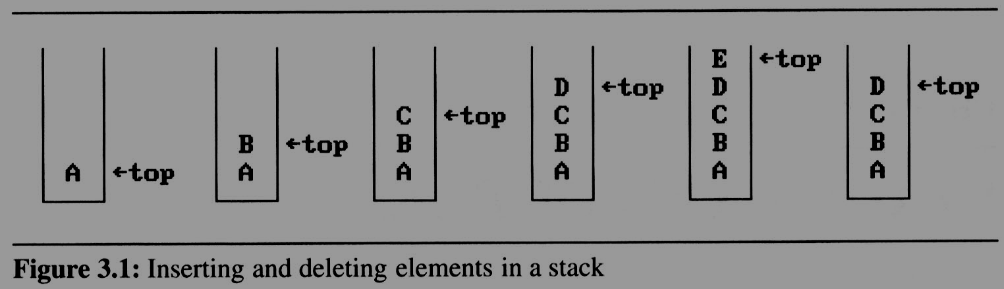
3.1 The stack ADT (1/5)
A stack is an ordered list in which insertions and deletions are made at one end called the top.
If we add the elements A, B, C, D, E to the stack, in that order, then E is the first element we delete from the stack
A stack is also known as a Last-In-First-Out (LIFO) list.
C
Top
B
Top
A
Top

Slide 4
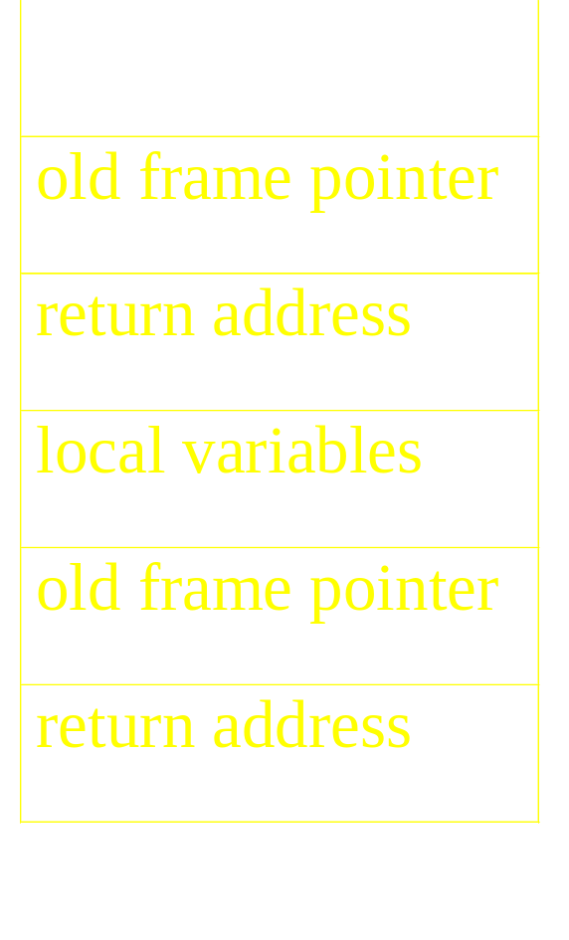
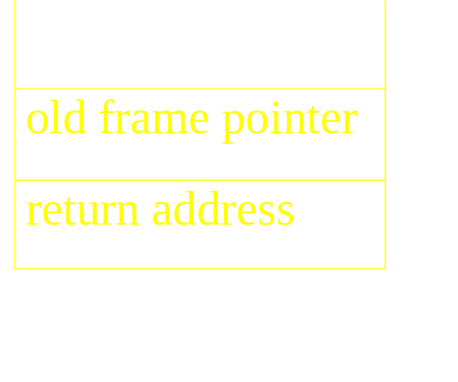
3.1 The stack ADT (2/5)
An application of stack: stack frame of function call
fp
al
(activation record)
fp: a pointer to current stack frame
fp
main
fp
main
stack frame of invoking function
system stack before a1 is invoked
system stack after a1 is invoked
(a) (b)
*Figure 3.2: System stack after function call a1 (p.103)

Slide 5
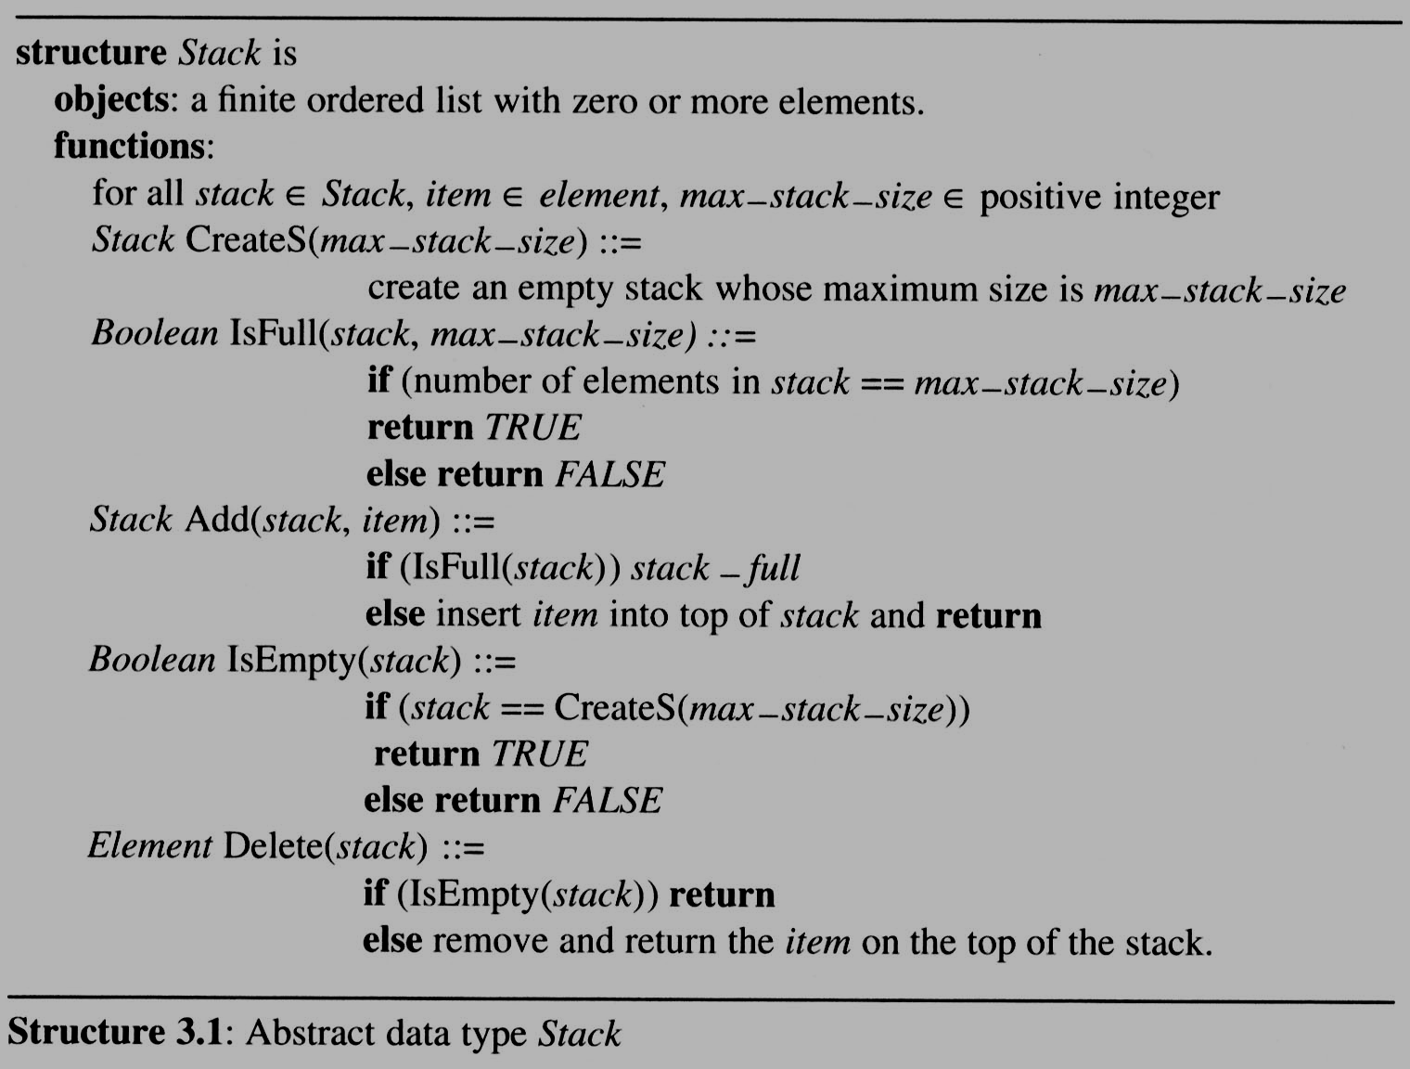
3.1 The stack ADT (3/5)

Slide 6
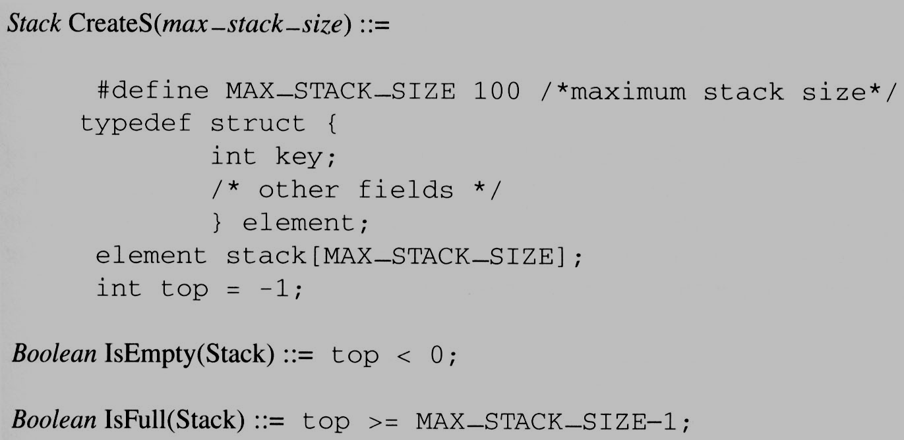
3.1 The stack ADT (4/5)
Implementation: using array

Slide 7
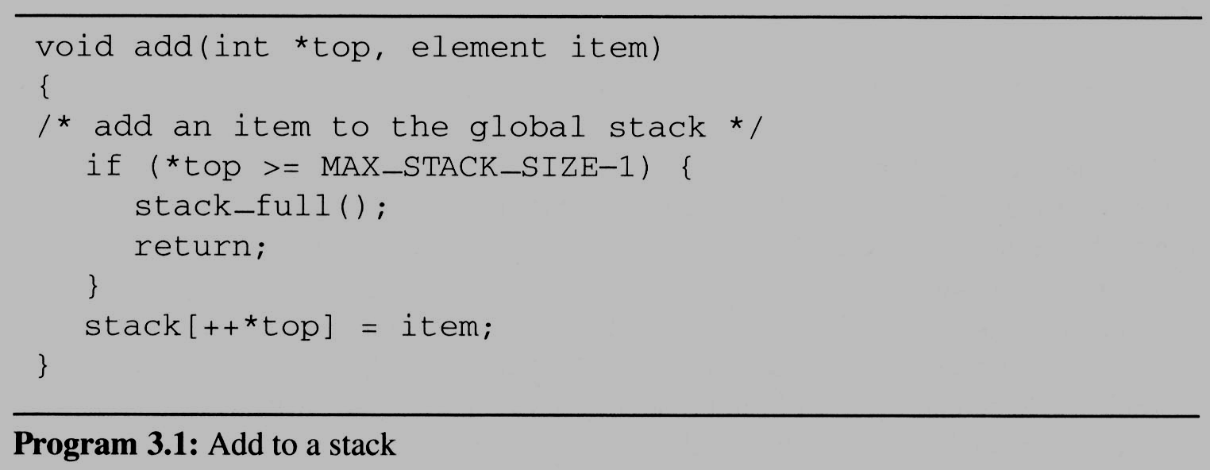
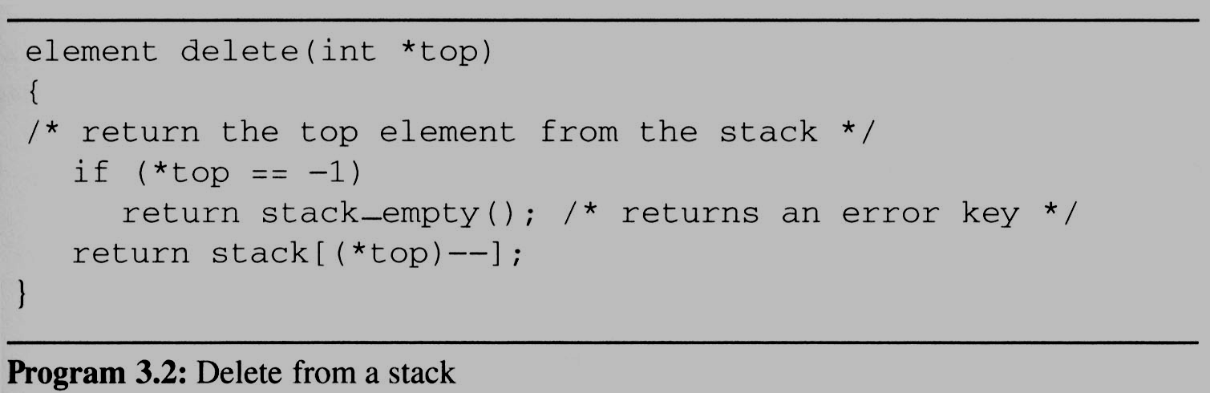
3.1 The stack ADT (5/5)
stack
item
Top
stack
item
Top

Slide 8
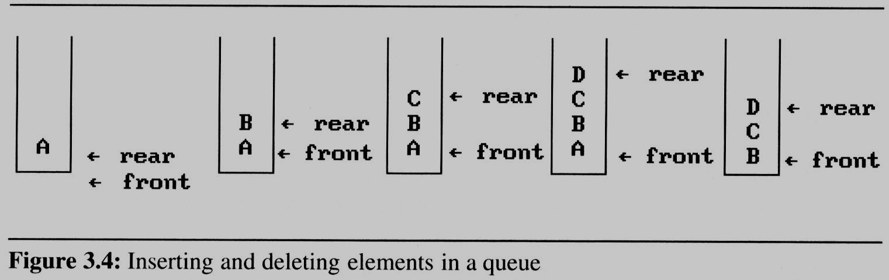
3.2 The queue ADT (1/7)
A queue is an ordered list in which all insertion take place one end, called the rear and all deletions take place at the opposite end called the front
First-In-First-Out (FIFO) list
If we insert the elements A, B, C, D, E, in that order, then A is the first element we delete from the queue as a
C
Rear
B
Rear
A
Front

Slide 9
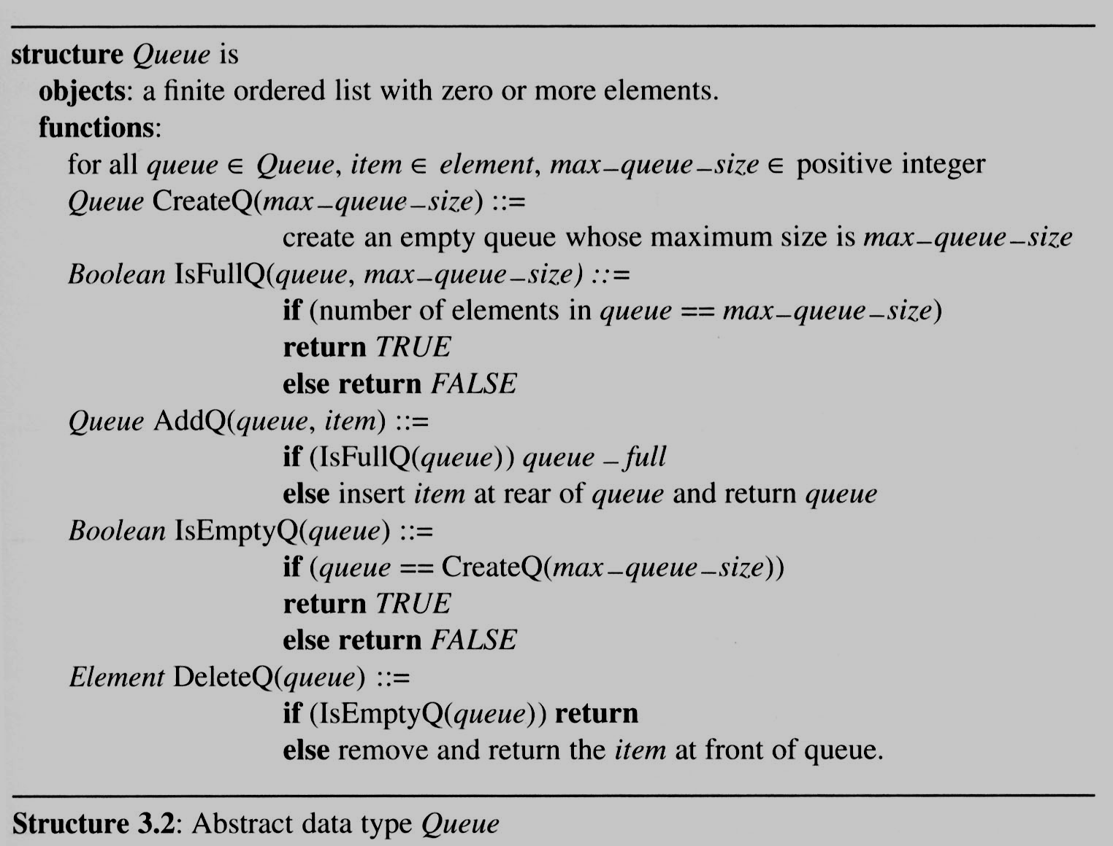
3.2 The queue ADT (2/7)

Slide 10
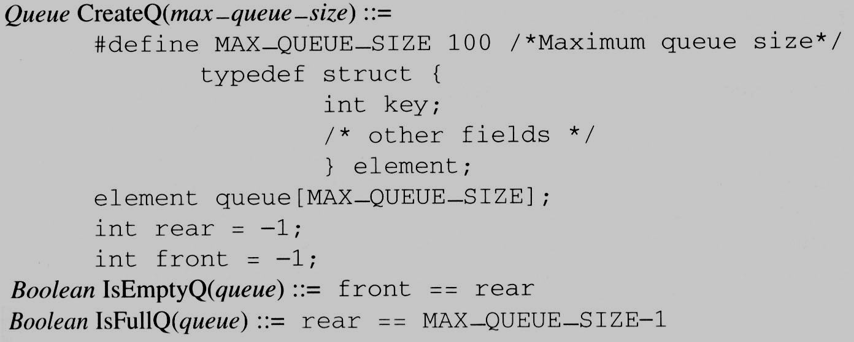
3.2 The queue ADT (3/7)
Implementation 1:
using a one dimensional array and
two variables, front and rear

Slide 11
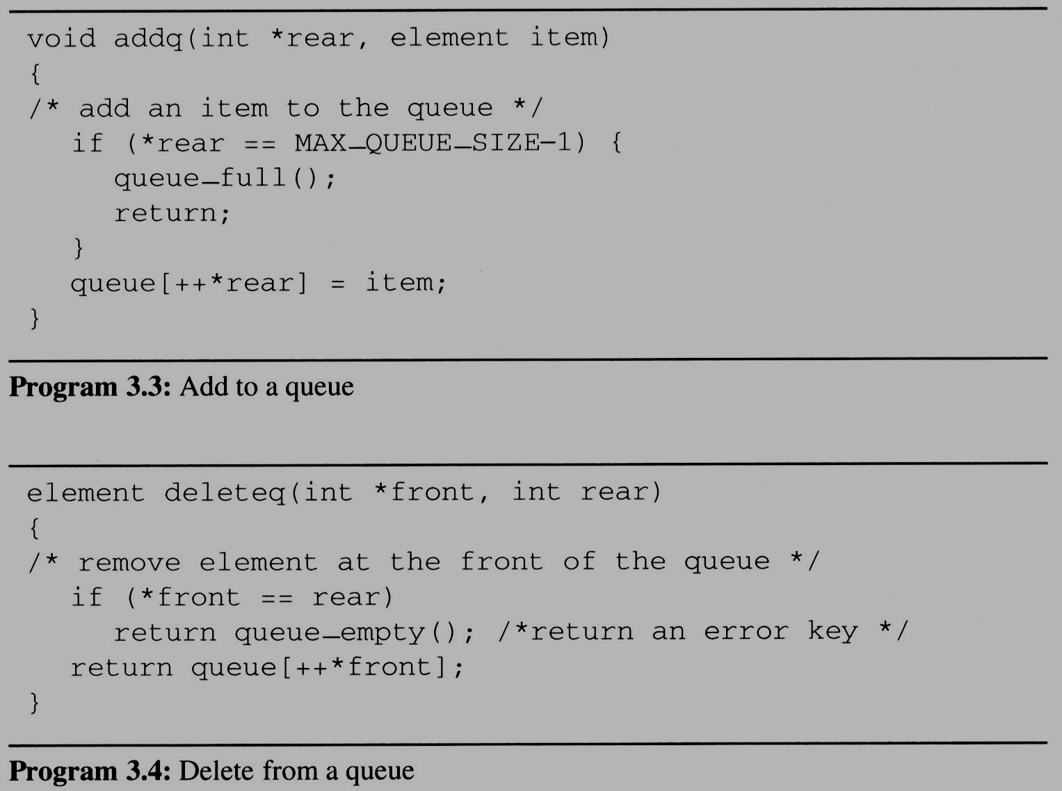
3.2 The queue ADT (4/7)
problem: there may be available space when IsFullQ is true i.e. movement is required.

Slide 12
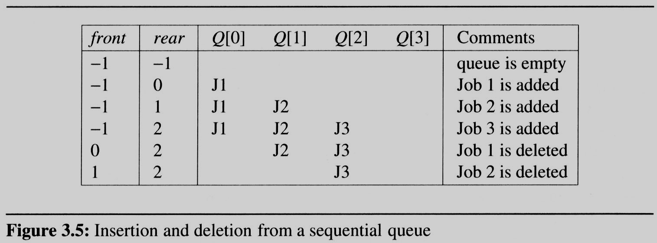
3.2 The queue ADT (5/7)
Example 3.2 [Job scheduling]:
  Figure 3.5 illustrates how an operating system might process jobs if it used a sequential representation for its queue.
    As jobs enter and leave the system, the queue gradually shift to right.
    In this case, queue_full should move the entire queue to the left so that the first element is again at queue[0], front is at -1, and rear is correctly positioned.
      Shifting an array is very time-consuming, queue_full has a worst case complexity of O(MAX_QUEUE_SIZE).

Slide 13
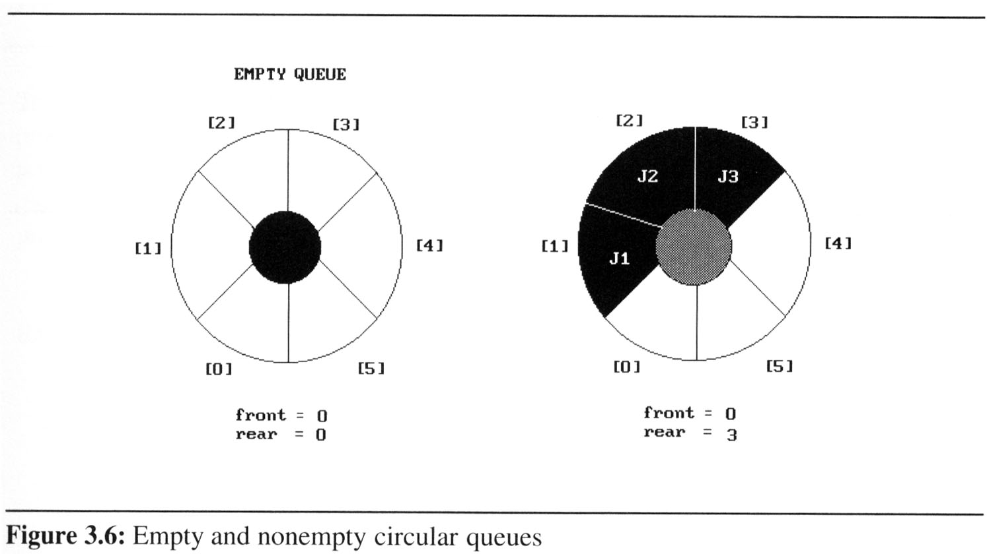
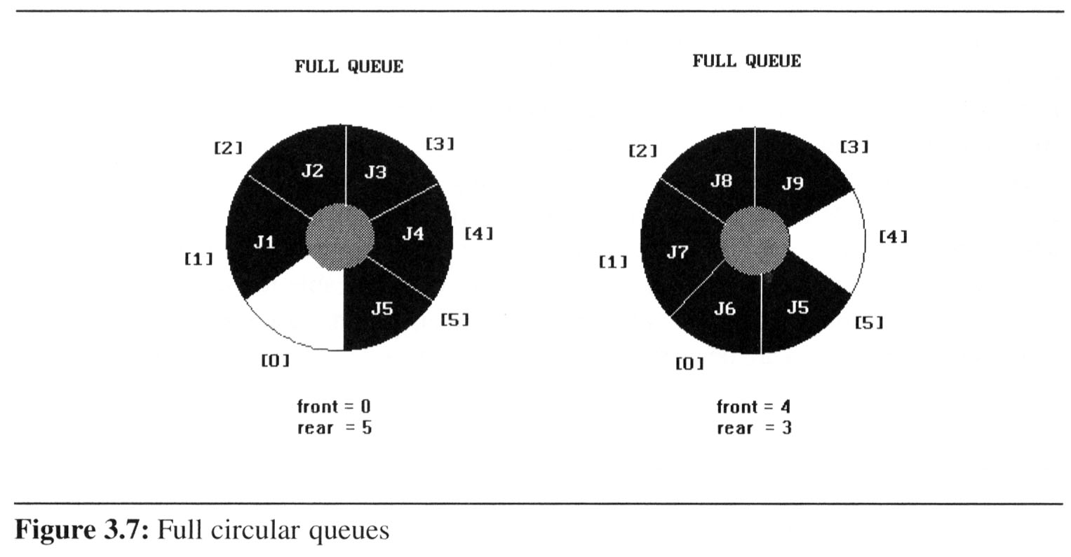
3.2 (6/7)
We can obtain a more efficient representation if we regard the array queue[MAX_QUEUE_SIZE] as circular.
Implementation 2:
regard an array as a circular
queue
front: one position
counterclockwise from the
first element
rear: current end
Problem: one space is left when queue is full.

Slide 14
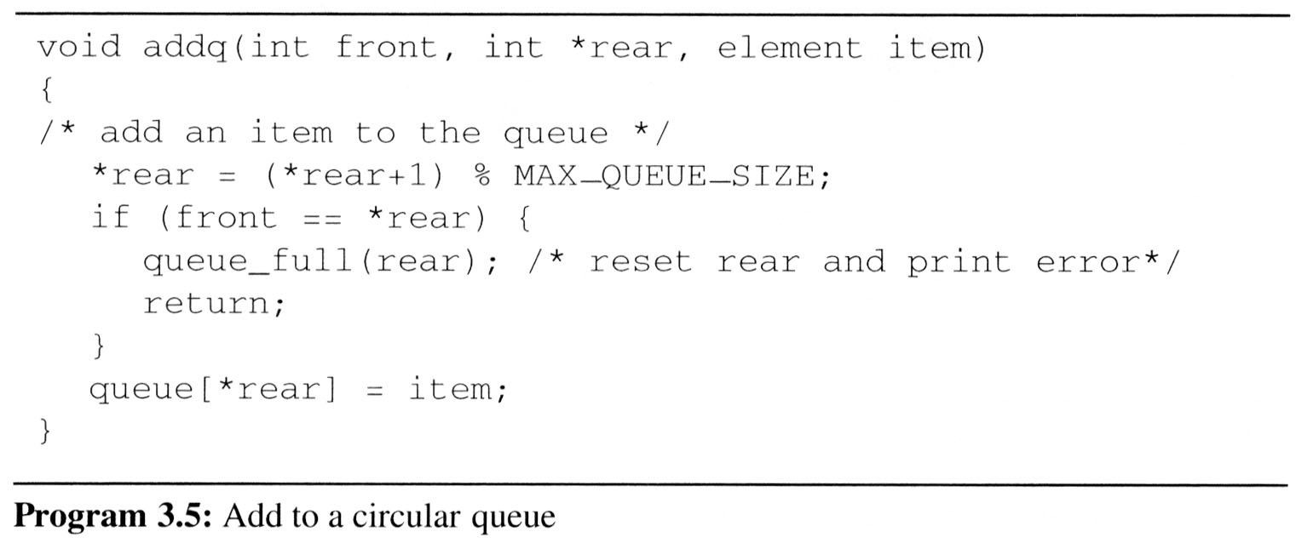
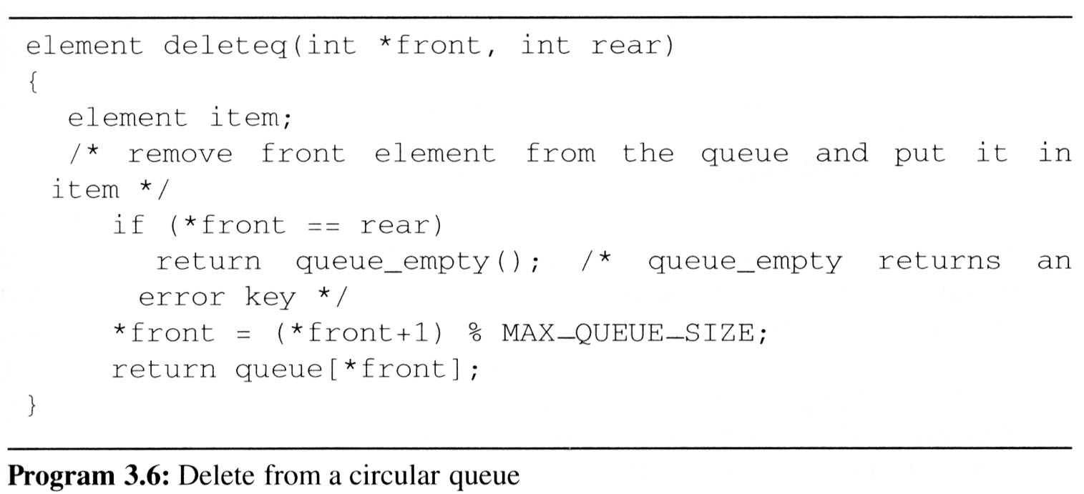
3.2 (7/7)
Implementing addq and deleteq for a circular queue is slightly more difficult since we must assure that a circular rotation occurs.

