Slide 1
CS235102
Data Structures
Chapter 4 Lists

Slide 2
Chain (1/3)
Chain:
  A singly linked list in which the last node has a null link
Operations for chains
  Inverting a chain
    For a list of length ≧1 nodes, the while loop is executed length times and so the computing time is linear or O(length).
...
NULL
lead
invert
×
...
NULL
lead

Slide 3
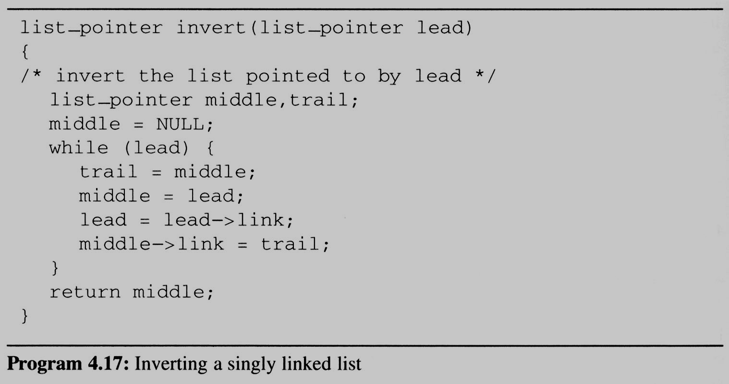
Chain (2/3)
Two extra pointers
trial
middle
middle
trial
lead
lead
NULL
...
NULL

Slide 4
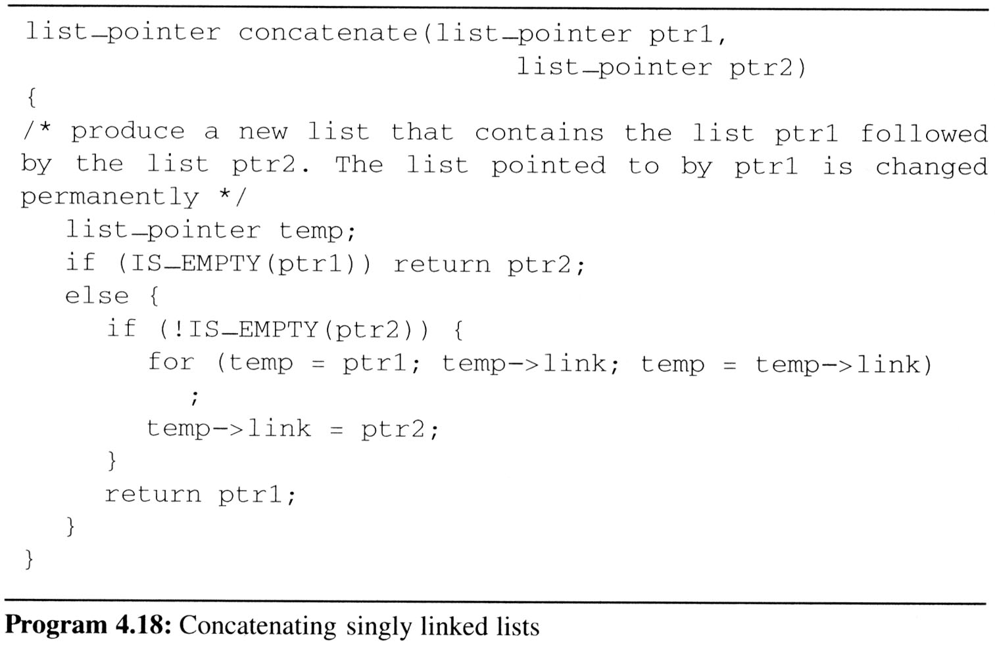
Chain (3/3)
Concatenates two chains
  Concatenates two chains, ptr1 and ptr2.
  Assign the list
  ptr1 followed
  by the list ptr2.
O(length of list ptr1)
temp
NULL
NULL
ptr1
ptr2

Slide 5
Circularly Linked Lists (1/10)
Circular Linked list
  The link field of the last node points to the first node in the list.
Example
  Represent a polynomial ptr = 3x¹⁴+2x⁸+1 as a circularly linked list.
ptr
3 | 14
2 | 8
1 | 0

Slide 6
Circularly Linked Lists (2/10)
Maintain an Available List
  We free nodes that are no longer in use so that we may reuse these nodes later
  We can obtain an efficient erase algorithm for circular lists, by maintaining our own list (as a chain) of nodes that have been “freed”.
  Instead of using malloc and free, we now use get_node (program 4.13) and ret_node (program 4.14).
...
avail
NULL
List of freed nodes

Slide 7
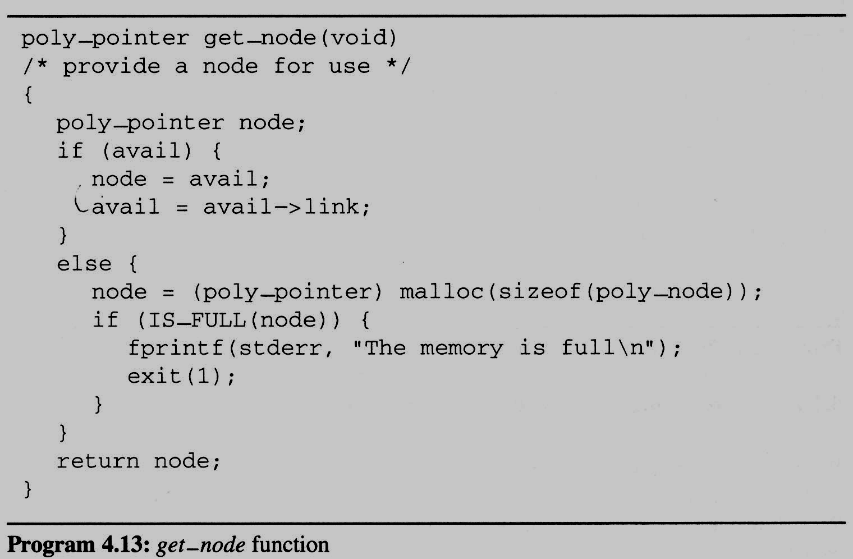
Circularly Linked Lists (3/10)
Maintain an Available List (cont’d)
  When we need a new node, we examine this list.
  If the list is not empty, then we may use one of its nodes.
  Only when the
  list is empty we
  do need to use
  malloc to
  create a new
  node.

Slide 8
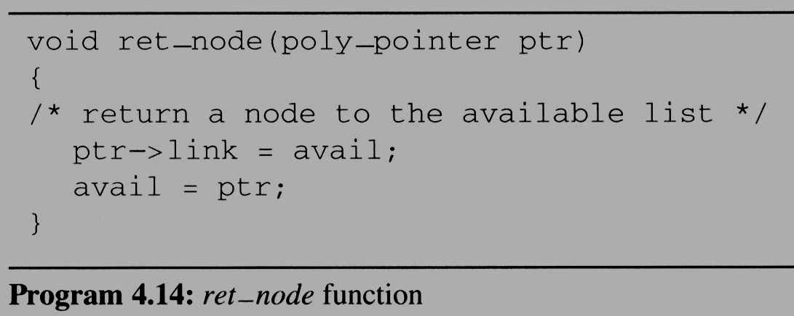
Circularly Linked Lists (4/10)
Maintain an Available List (cont’d)
Insert ptr to the front of this list
  Let avail be a variable of type poly_pointer that points to the first node in our list of freed nodes.
  Henceforth, we call this list the available space list or avail list.
  Initially, we set avail to NULL

Slide 9
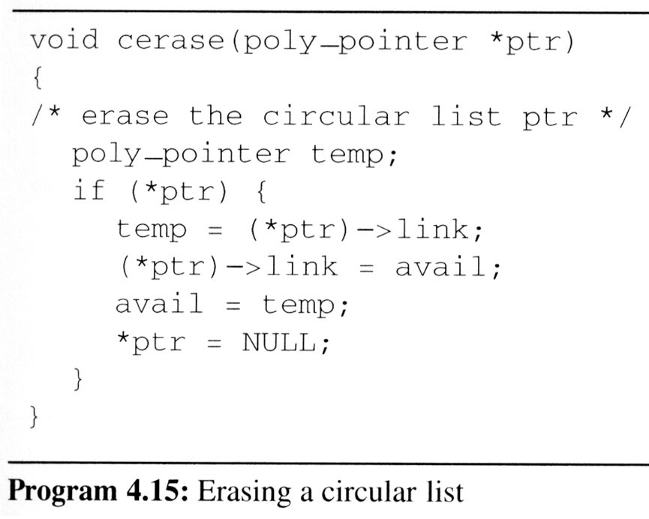
Circularly Linked Lists (5/10)
Maintain an Available List
  Erase a circular list in a fixed amount (constant) of time O(1) independent of the number of nodes in the list using cerase
ptr
•
•
• • •
•
temp
avail
•
•
• • •
NULL
紅色link所連接而成的 chain

Slide 10
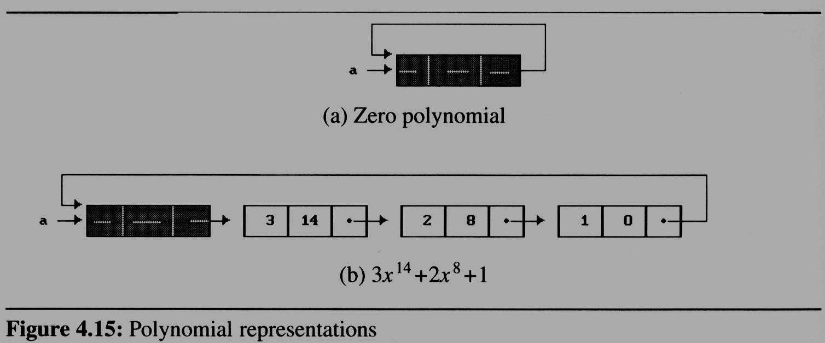
Circularly Linked Lists (6/10)
We must handle the zero polynomial as a special case. To avoid it, we introduce a head node into each polynomial
  each polynomial, zero or nonzero, contains one additional node.
  The expon and coef fields of this node are irrelevant.
Why ?
So !

Slide 11
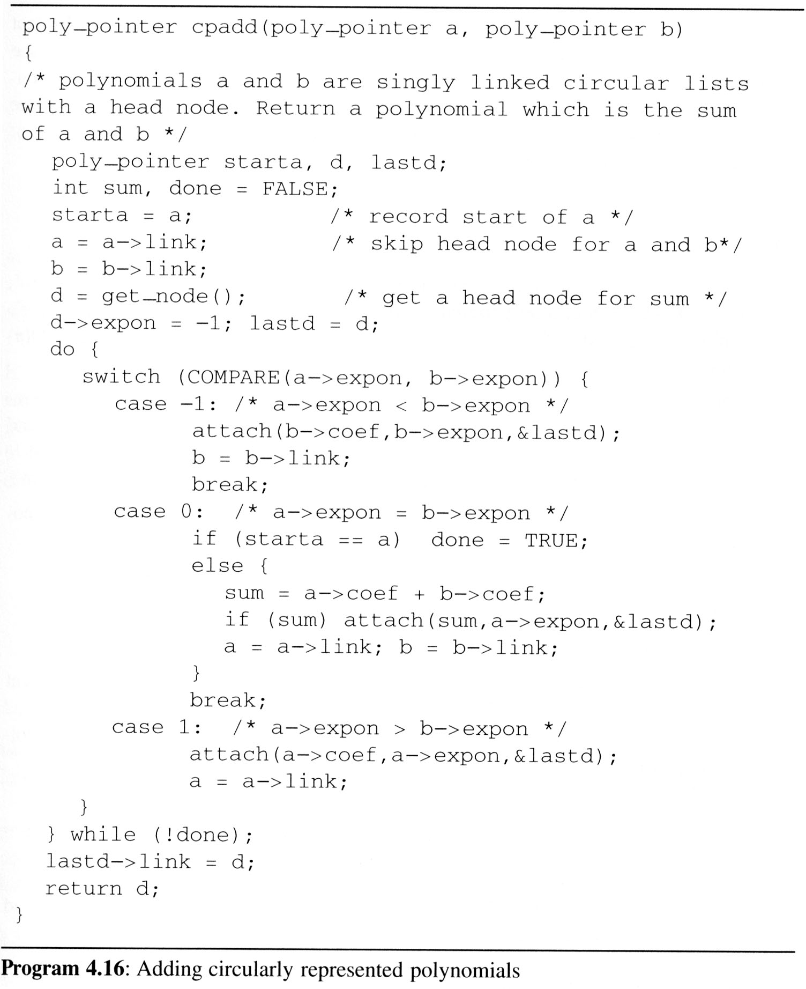
Circularly Linked Lists (7/10)
For fit the
circular list with head node representation
  We may remove the test for (*ptr) from cerase
  Changes the original padd to cpadd
/* head node */
/*a->expon=-1, so b->expont > -1 */
/* link to the first node */

Slide 12
Circularly Linked Lists (8/10)
Operations for circularly linked lists
  Question:
    What happens when we want to insert a new node at the front of the circular linked list ptr?
  Answer:
    move down the entire length of ptr.
  Possible Solution:
ptr
x₁
x₂
x₃
x₁
x₂
x₃
ptr

Slide 13
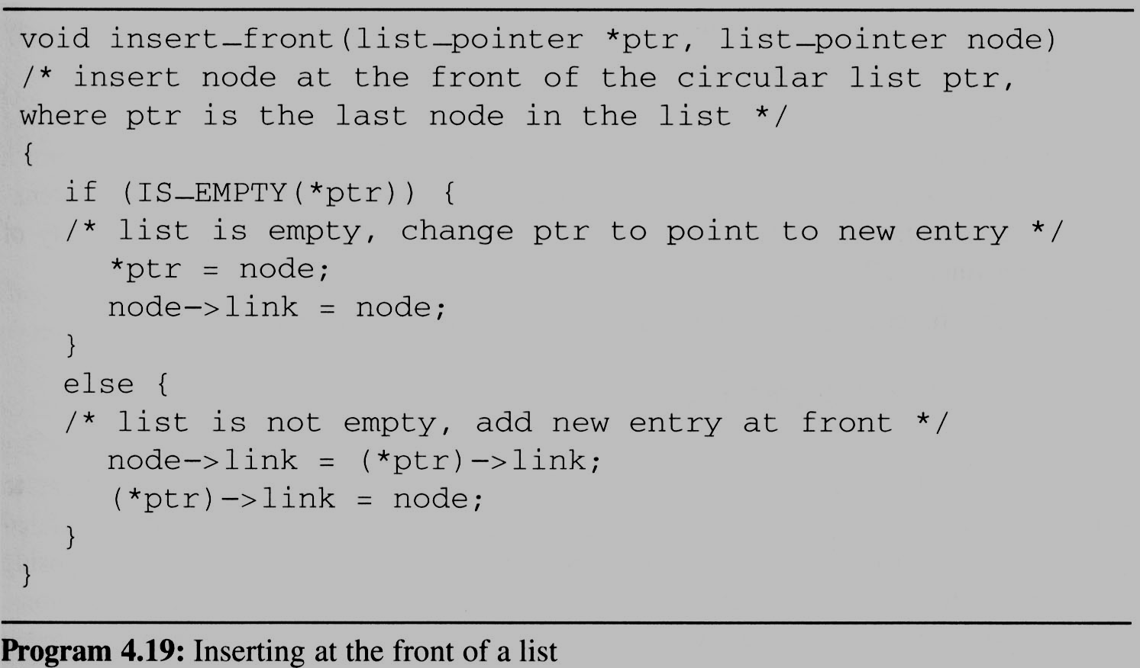
Circularly Linked Lists (9/10)
Insert a new node at the front of a circular list
To insert node at the rear, we only need to add the additional statement *ptr = node to the else clause of insert_front
x₁
x₂
x₃
ptr
node

Slide 14
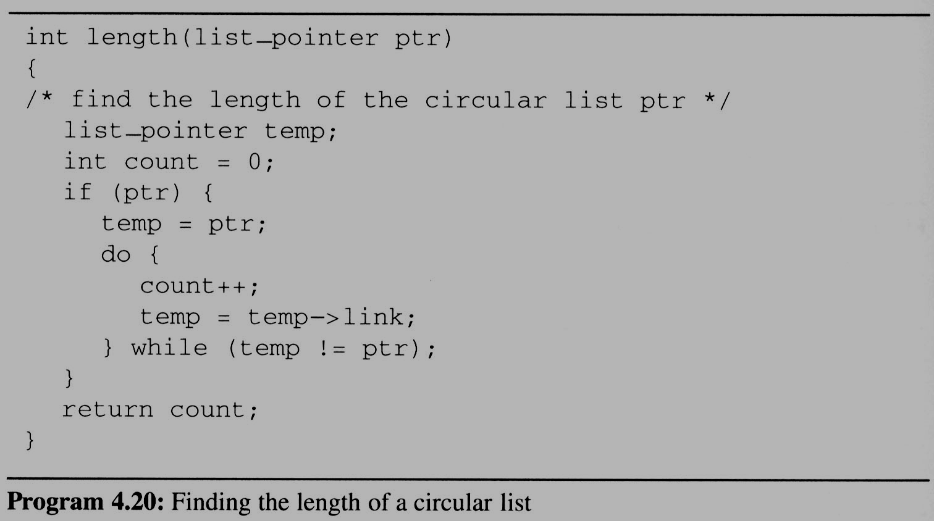
Circularly Linked Lists (10/10)
Finding the length of a circular list

Slide 15
Equivalence Relations (1/6)
Reflexive Relation
  for any polygon x, x ≡ x (e.g., x is electrically equivalent to itself)
Symmetric Relation
  for any two polygons x and y, if x ≡ y, then y ≡ x.
Transitive Relation
  for any three polygons x, y, and z, if x ≡ y and y ≡ z, then x ≡ z.
Definition:
  A relation over a set, S, is said to be an equivalence relation over S iff it is symmertric, reflexive, and transitive over S.
Example:
  “equal to” relationship is an equivalence relation

Slide 16
Equivalence Relations (2/6)
Example:
  if we have 12 polygons numbered 0 through 11
  0 ≡ 4, 3 ≡ 1, 6 ≡ 10, 8 ≡ 9, 7 ≡ 4, 6 ≡ 8, 3 ≡ 5, 2 ≡ 11, 11 ≡ 0
  we can partition the twelve polygons into the following equivalence classes:
{0, 2, 4, 7, 11};{1, 3, 5};{6, 8, 9,10}
Two phases to determine equivalence
  First phase: the equivalence pairs (i, j) are read in and stored.
  Second phase:
    we begin at 0 and find all pairs of the form (0, j).
    Continue until the entire equivalence class containing 0 has been found, marked, and printed.
Next find another object not yet output, and repeat the above process.

Slide 17
Equivalence Relation (3/6)
Program to find equivalence classes
  void main(void){
  short int out[MAX_SIZE];
  node_pointer seq[MAX_SIZE];
  node_pointer x, y, top;
  int i, j, n;
  printf(“Enter the size (<=%d) ”, MAX_SIZE);
  scanf(“%d”, &n);
  for(i=0; i<n; i++){
  /*initialize seq and out */
  out[i] = TRUE; seq[i] = NULL;
  }
  /* Phase 1 */
  /* Phase 2 */
  }
#include <stdio.h>
#define MAX_SIZE 24
#define IS_FULL(ptr) (!(ptr))
#define FALSE 0
#define TRUE 1
typedef struct node *node_pointer;
typedef struct node {
int data;
node_pointer link;
};

Slide 18
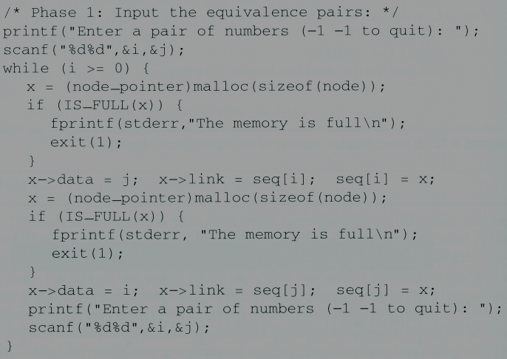
Equivalence Relations (4/6)
Phase 1: read in and store the equivalence pairs <i, j>
[0]
11
4
NULL
[1]
3
NULL
[2]
11
NULL
[3]
5
1
NULL
[4]
7
0
NULL
(1)
(2)
[5]
3
NULL
Insert x to the top of lists seq[i]
[6]
8
10
NULL
[7]
4
NULL
[8]
6
9
NULL
[9]
8
NULL
[10]
6
NULL
Insert x to the top of lists seq[j]
[11]
0
2
NULL
0 ≡ 4, 3 ≡ 1, 6 ≡ 10, 8 ≡ 9, 7 ≡ 4, 6 ≡ 8, 3 ≡ 5, 2 ≡ 11, 11 ≡ 0

Slide 19
Equivalence Relations (5/6)
Phase 2:
  begin at 0 and find all pairs of the form <0, j>, where 0 and j are in the same equivalence class
  by transitivity, all pairs of the form <j, k> imply that k in the same equivalence class as 0
  continue this way until we have found, marked, and printed the entire equivalent class containing 0

Slide 20
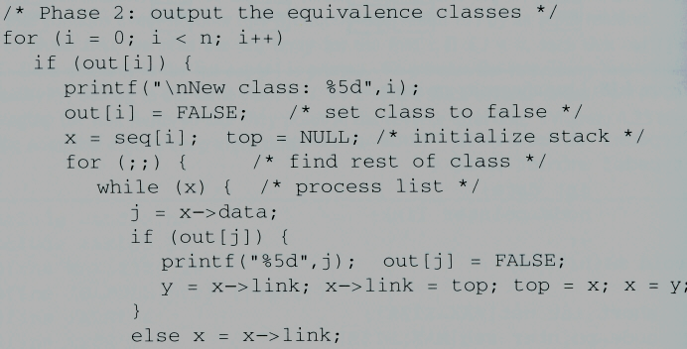
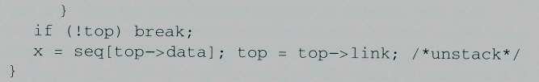
Equivalence Relations (6/6)
x
y
[0]
[1]
[2]
[3]
[4]
[5]
[6]
[7]
[8]
[9]
i=
1
0
j=
11
4
7
0
4
0
2
11
[10]
[11]
Phase 2
top
out:
[0]
11
4
NULL
[1]
3
NULL
[2]
11
NULL
[3]
5
1
NULL
[4]
7
0
NULL
[5]
3
NULL
[6]
8
10
NULL
[7]
4
NULL
[8]
6
9
NULL
[9]
8
NULL
[10]
6
NULL
[11]
0
2
NULL
New class: 0
11
4
7
2

Slide 21
Doubly Linked Lists (1/4)
Singly linked lists pose problems because we can move easily only in the direction of the links
Doubly linked list has at least three fields
  left link field(llink), data field(item), right link field(rlink).
  The necessary declarations:
    typedef struct node *node_pointer;
    typedef struct node{
    node_pointer llink;
    element item;
    node_pointer rlink;
    };
...
NULL
?
ptr

Slide 22
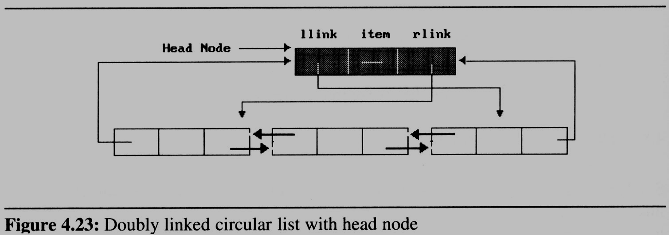
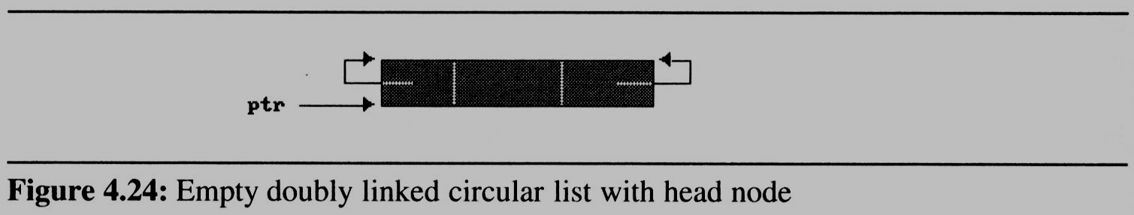
Doubly Linked Lists (2/4)
Sample
  doubly linked circular with head node: (Figure 4.23)
  empty double linked circular list with head node (Figure 4.24)
  suppose that ptr points to any node in a doubly linked list, then:
    ptr = ptr -> llink -> rlink = ptr -> rlink -> llink

Slide 23
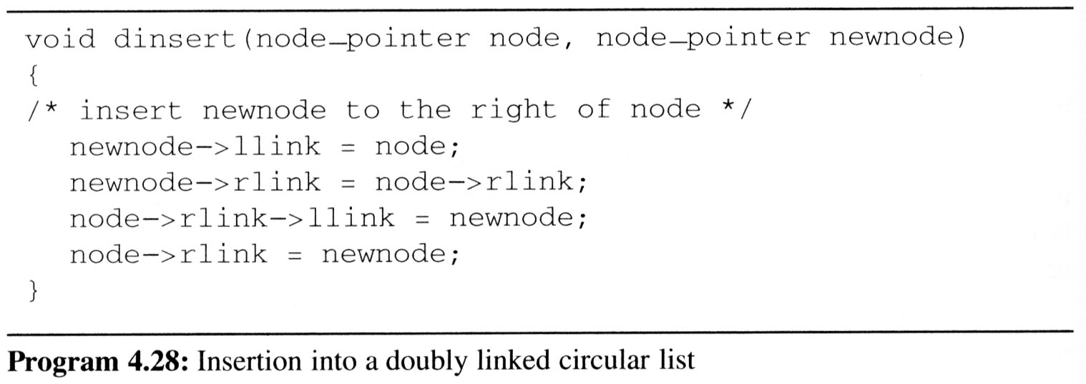
Doubly Linked Lists (3/4)
Insert node
Head node
node
llink item rlink
New node

Slide 24
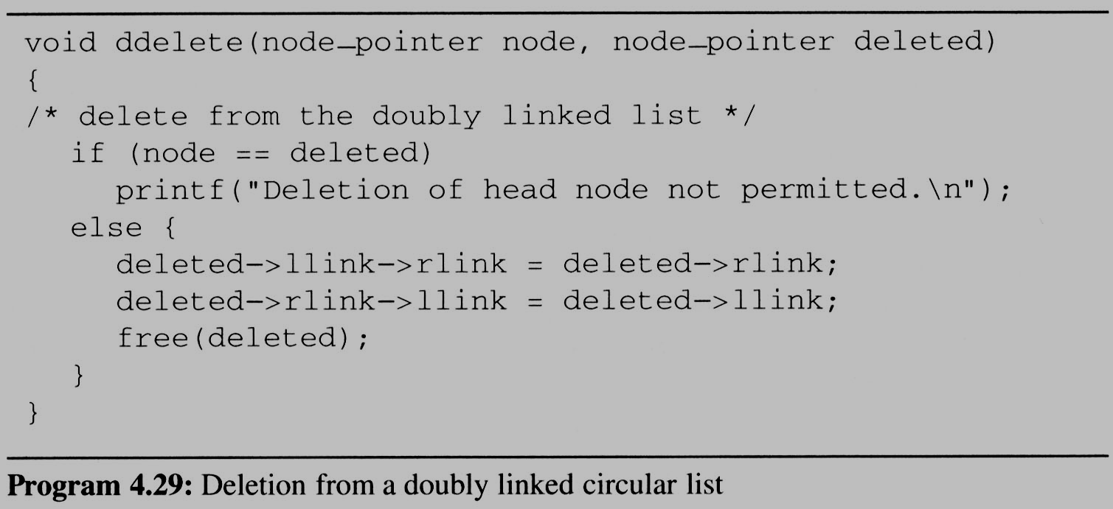
Doubly Linked Lists (4/4)
Delete node
Head node
llink item rlink
deleted node

