Slide 1
CS235102
Data Structures
Chapter 5 Trees

Slide 2
Forests
Definition: A forest is a set of n ≥ 0 disjoint trees.
When we remove a root from a tree, we’ll get a forest. E.g., Removing the root of a binary tree will get a forest of two trees.
E
G
A
B
C
D
F
H
I
Figure 5.34 Three-tree forest

Slide 3
Transforming A Forest Into A Binary Tree (1/2)
T₁, …, T_{n}
  forest of trees
B(T₁, …, T_{n})
  binary tree
Algorithm
  Is empty if n = 0
  Has root equal to root(T₁)
  Has left subtree equal to B(T₁₁, …, T_{1m})
  Has right subtree equal to B(T₂, …, T_{n})

Slide 4
Transforming A Forest Into A Binary Tree (2/2)
A
A
B
C
D
B
E
E
C
F
G
G
D
H
F
H
I
I

Slide 5
Set Representation
Trees can be used to represent sets.
Disjoint set Union
  If S_{i} and S_{j} are two disjoint sets, then their union
  S_{i} ∪S_{j} = {all elements x such that x is in S_{i} or S_{j}}.
Find (i)
  Find the set containing element i.

Slide 6
Possible Tree Representation of Sets
Set 2 = {4 , 1 ,9}
S₁
S₂
S₃
0
4
2
6
7
8
1
9
3
5
Set I = {0 , 6 ,7 ,8 }
Set 3 = {2 , 3 , 5}

Slide 7
Unions of Sets
To obtain the union of two sets, just set the parent field of one of the roots to the other root.
To figure out which set an element is belonged to, just follow its parent link to the root and then follow the pointer in the root to the set name.

Slide 8
Possible Representations of S₁ ∪S₂
S₁
S₂
0
4
S₂
6
7
8
4
1
9
1
9

Slide 9
Possible Representations of S₁ ∪S₂
S₁
S₂
0
4
S₁
6
7
8
0
1
9
6
7
8

Slide 10
Data Representation for S_{1,} S₂, S₃
Set
Name
0
Pointer
4
2
S₁
S₂
6
7
8
1
9
3
5
S₃

Slide 11
Array Representation
We could use an array for the set name. Or the set name can be an element at the root.
Assume set elements are numbered 0 through n-1.
i
[0]
[1]
[2]
[3]
[4]
[5]
[6]
[7]
[8]
[9]
parent
-1
4
-1
2
-1
2
0
0
0
4
Root

Slide 12
Array Representation
void Union1( int i , int j )
{
parent[i] = j ;
}
EX: S1 ∪ S2 Union1( 0 , 2 ) ;
i
[0]
[1]
[2]
[3]
[4]
[5]
[6]
[7]
[8]
[9]
parent
-1
4
-1
-1
0
0
0
4
2
2
2
EX: Find1( 5 ) ;
i
= 2
int Find1( int i )
{
for(;parent[i] >= 0 ; I = parent[i]) ;
return i ;
}

Slide 13
Analysis Union-Find Operations
For a set of n elements each in a set of its own, then the result of the union function is a degenerate tree.
The time complexity of the following union-find operations is O(n²).
The complexity can be improved by using
weighting rule for union.
n-1
n-2
union(0, 1), find(0)
Union operation
O(n)
union(1, 2), find(0)
Find operation
O(n²)
union(n-2, n-1), find(0)
0

Slide 14
Weighting Rule
Definition [Weighting rule for union(i, j) ]
  If the number of nodes in the tree with root i is less than the number in the tree with root j, then make j the parent of i ; otherwise make i the parent of j.

Slide 15
i
[0]
[1]
[2]
[3]
[4]
[5]
[6]
[7]
[8]
[9]
parent
-1
-1
-1
-1
-1
-1
-1
-1
-1
-1
-2
-3
0
0
void union2 (int i, int j)
{
int temp = parent[i] + parent[j];
if ( parent[i]>parent[j]) {
parent[i]=j;
parent[j]=temp;
}
else {
parent[j]=i;
parent[i]=temp;
}
}
unoin2 (0 , 1 )
unoin2 (0 , 2 )
unoin2 (0 , 3 )
temp = -2
temp = -3
0
1
2
3
n-1
1
1
2
1
2
3
EX: unoin2 (0 , 1 ) , unoin2 (0 , 2 ) , unoin2 (0 , 2 )

Slide 16

Weighted Union
Lemma 5.5: Assume that we start with a forest of trees, each having one node. Let T be a tree with m nodes created as a result of a sequence of unions each performed using function WeightedUnion. The height of T is no greater than .
For the processing of an intermixed sequence of u – 1 unions and f find operations, the time complexity is O(u + f*log u).

Slide 17
Trees Achieving Worst-Case Bound
[-1]
[-1]
[-1]
[-1]
[-1]
[-1]
[-1]
[-1]
0
1
2
3
4
5
6
7
(a) Initial height trees
[-2]
[-2]
[-2]
[-2]
0
2
4
6
1
3
5
7
(b) Height-2 trees following union (0, 1), (2, 3), (4, 5), and (6, 7)

Slide 18
Trees Achieving Worst-Case Bound (Cont.)
[-4]
[-4]
[-8]
0
4
0
1
2
5
6
1
2
4
3
7
3
5
6
(c) Height-3 trees following union (0, 2), (4, 6)
7
(d) Height-4 trees following union (0, 4)

Slide 19
Collapsing Rule
Definition [Collapsing rule]
  If j is a node on the path from i to its root and parent[i]≠ root(i), then set parent[j] to root(i).
The first run of find operation will collapse the tree. Therefore, all following find operation of the same element only goes up one link to find the root.

Slide 20
Ex: find2 (7)
int find2(int i)
{
int root, trail, lead;
for (root=i; parent[root]>=0; root=parent[root]);
for (trail=i; trail!=root; trail=lead) {
lead = parent[trail];
parent[trail]= root;
}
return root:
}
[-8]
0
Root
6
7
1
2
4
Trail
3
5
6
Lead
7

Slide 21
Analysis of WeightedUnion and CollapsingFind
The use of collapsing rule roughly double the time for an individual find. However, it reduces the worst-case time over a sequence of finds.

Slide 22
Revisit Equivalence Class
The aforementioned techniques can be applied to the equivalence class problem.
Assume initially all n polygons are in an equivalence class of their own: parent[i] = -1,
0 ≤ i < n.
  Firstly, we must determine the sets that contains i and j.
  If the two are in different set, then the two sets are to be replaced by their union.
  If the two are in the same set, then nothing need to be done since they are already in the equivalence class.
  So we need to perform two finds and at most one union.

Slide 23
Example 5.3
[-1]
[-1]
[-1]
[-1]
[-1]
[-1]
[-1]
[-1]
[-1]
[-1]
[-1]
[-1]
0
1
2
3
4
5
6
7
8
9
10
11
(a) Initial trees
[-2]
[-2]
[-2]
[-2]
[-1]
[-1]
[-1]
[-1]
0
3
6
8
2
5
7
11
4
1
10
9
(b) Height-2 trees following 0≡4, 3≡1, 6≡10, and 8≡9

Slide 24
Example 5.3 (Cont.)
[-3]
[-4]
[-3]
[-2]
0
6
3
2
4
7
10
8
1
5
11
9
(c) Tree following 7≡4, 6≡8, 3≡5, and 2≡11

Slide 25
Example 5.3 (Cont.)
[-3]
[-4]
[-3]
0
6
3
4
7
2
10
8
1
5
11
9
(d) Tree following 11≡0

Slide 26
Revisit Equivalence Class
If we have n polygons and m equivalence pairs, we need
  O(n) to set up the initial n-tree forest.
  2m finds
  at most min{n-1, m} unions.
If weightedUnion and CollapsingFind are used, the time complexity is O(n+m(2m, min{n-1, m})).
  This seems to slightly worse than section 4.7 (O(m+n)). But this scheme demands less space.

Slide 27
Counting Binary Tree
We consider the following three disparate problems:
  The number of distinct binary trees having n nodes
  The number of distinct permutations of the numbers from 1 through n obtainable by a stack
  The number of distinct ways of multiplying n+1 matrices .
They amazingly have the same solution .

Slide 28
Distinct Binary Trees
There are 5 distinct binary tree

Slide 29
Stack permutation (1/4)
In section 5.3 we introduced preorder, inorder, and postorder traversal of a binary tree and indicated that each traversal requires a stack.
Every binary tree has a unique pair of preorder/inorder sequences .
The number of distinct binary trees is equal to the number of inorder permutations obtainable from binary trees having the preorder permutation, 1 , 2 , … , n .

Slide 30
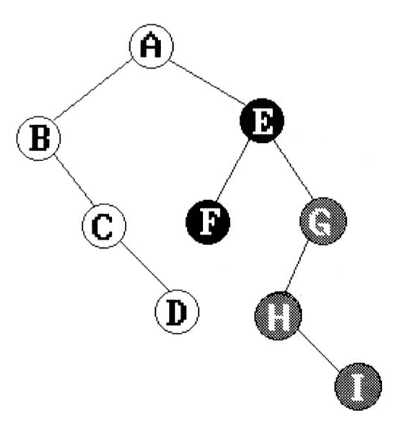
preorder: A B C D E F G H I
inorder: B C A E D G H F I
Stack permutation (2/4)
A
B, C
E, D, G, H, F, I
preorder: A B C (D E F G H I)
inorder: B C A (E D G H F I)
A
B
D
C
E
F, G, H, I

Slide 31
Stack permutation (3/4)
So, we can show that the number of distinct permutations obtainable by passing the numbers 1 through n through a stack is equal to the number of distinct binary trees with n nodes .
Example : if we start with the numbers 1 , 2 , and 3 , then the possible permutations obtainable by a stack are
(1,2,3) (1,3,2) (2,1,3) (2,3,1) (3,2,1)

Slide 32
Stack permutation (4/4)
1
1
1
1
1
2
2
2
3
2
2
3
3
3
3
(1, 2, 3)
(1, 3, 2)
(2, 1, 3)
(2, 3, 1)
(3, 2, 1)
Binary trees corresponding to five permutation

Slide 33
Matrix Multiplication (1/2)
The number of distinct binary trees is equal to the number of distinct inorder permutations obtainable from binary trees having the preorder permutation, 1, 2, …, n.
Computing the product of n matrices are related to the distinct binary tree problem.
M₁ * M₂ * … * M_{n}
n = 3 (M₁ * M₂) * M₃ M₁ * (M₂ * M₃ )
n = 4 ((M₁ * M₂) * M₃) * M₄
(M₁ * (M₂ * M₃)) * M₄
M₁ * ((M₂ * M₃) * M₄ )
(M₁ * (M₂ * (M₃ * M₄ )))
((M₁ * M₂) * (M₃ * M₄ ))

Slide 34
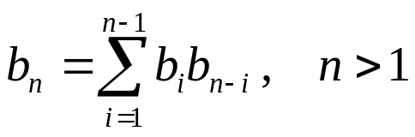
Matrix Multiplication (2/2)
Let bn be the number of different ways to compute the product of n matrices. b₂ = 1, b₃ = 2, and b₄ = 5.

Slide 35

Number of Distinct Binary Trees (1/2)
The number of distinct binary trees of n nodes is
b_{n}
b_{i}
b_{n-i-1}

Slide 36
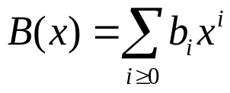
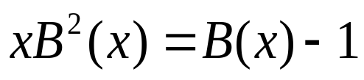
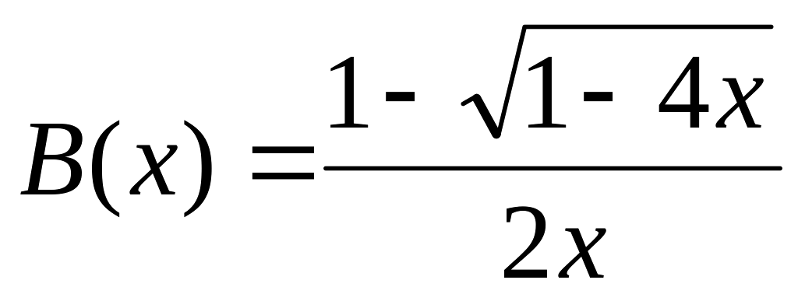
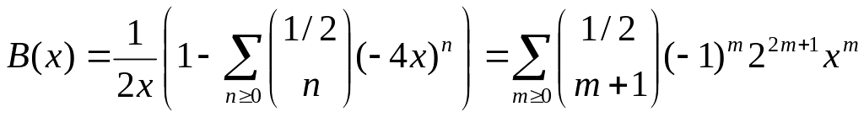
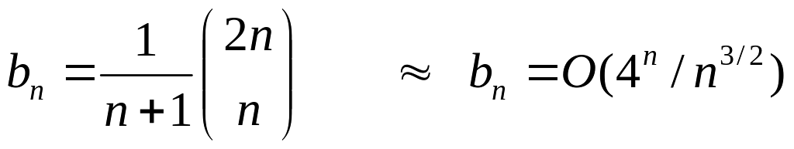
Distinct Binary Trees (2/2)
Assume we let which is the generating function for the number of binary trees.
By the recurrence relation we get

