Slide 1
CS235102
Data Structures
Chapter 6 Graphs

Slide 2
Chapter 6 Graphs: Outline
The Graph Abstract Data Type
  Graph Representations
Elementary Graph Operations
  Death First and Breadth First Search
  Spanning Tree
Minimum Cost Spanning Trees
  Kruskal’s, Prim’s and Sollin’s Algorithm
Shortest Paths
  Transitive Closure
Topological Sorts
  Activity Networks
  Critical Paths

Slide 3
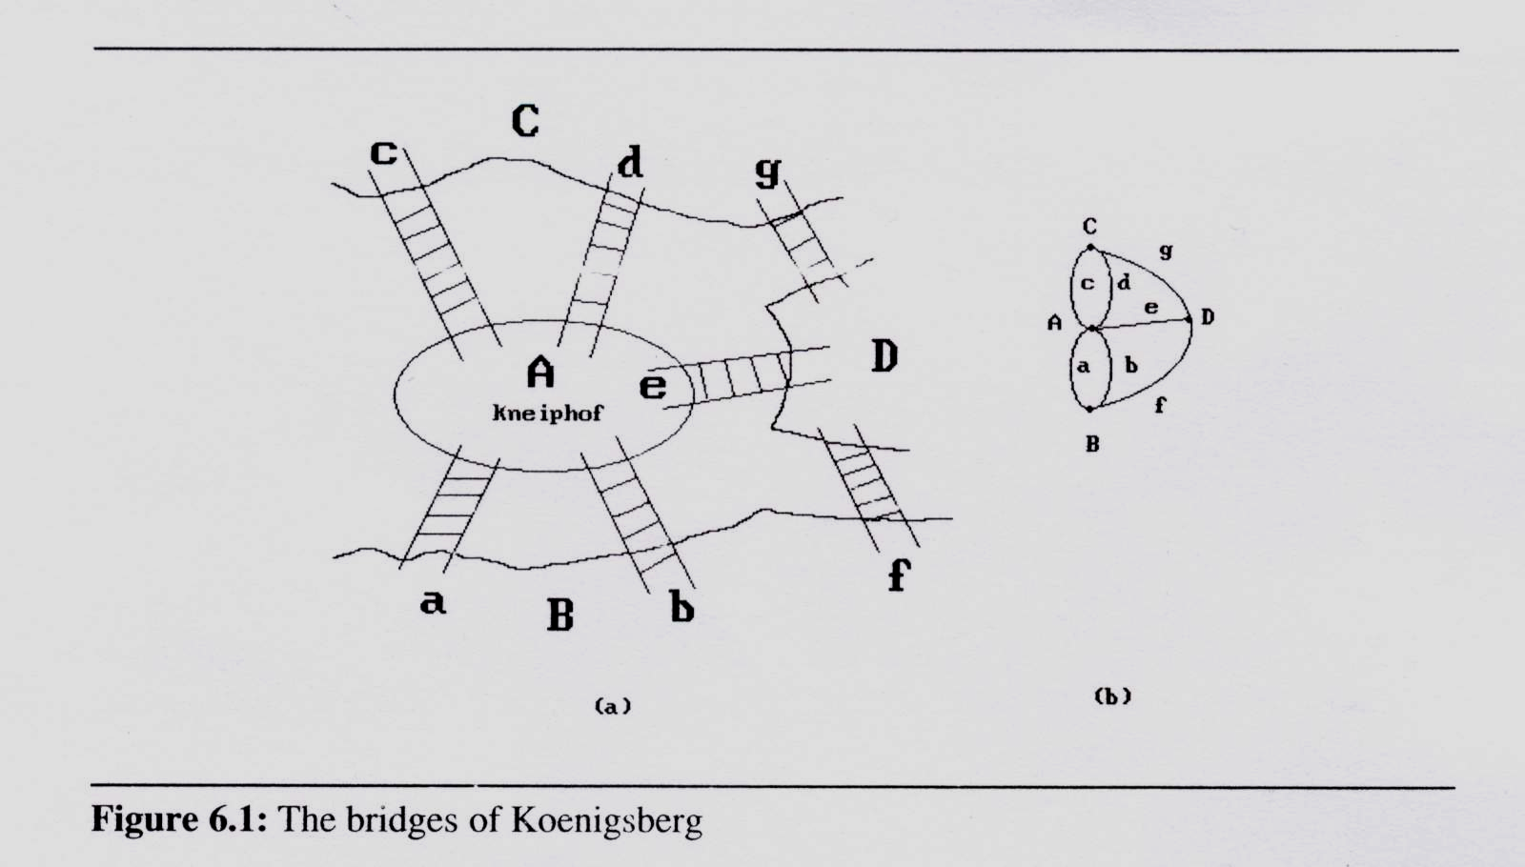
The Graph ADT (1/13)
Introduction
  A graph problem example: Köenigsberg bridge problem

Slide 4
The Graph ADT (2/13)
Definitions
  A graph G consists of two sets
    a finite, nonempty set of vertices V(G)
    a finite, possible empty set of edges E(G)
  G(V,E) represents a graph
  An undirected graph is one in which the pair of vertices in an edge is unordered, (v0, v1) = (v1,v0)
  A directed graph is one in which each edge is a directed pair of vertices, <v0, v1> != <v1, v0>
tail
head

Slide 5
The Graph ADT (3/13)
Examples for Graph
  complete undirected graph: n(n-1)/2 edges
  complete directed graph: n(n-1) edges
0
0
0
0
1
2
1
1
2
1
2
3
3
4
5
6
2
G1
3
G2
G3
complete graph
incomplete graph
V(G1)={0,1,2,3} E(G1)={(0,1),(0,2),(0,3),(1,2),(1,3),(2,3)}
V(G2)={0,1,2,3,4,5,6} E(G2)={(0,1),(0,2),(1,3),(1,4),(2,5),(2,6)}
V(G3)={0,1,2} E(G3)={<0,1>,<1,0>,<1,2>}

Slide 6
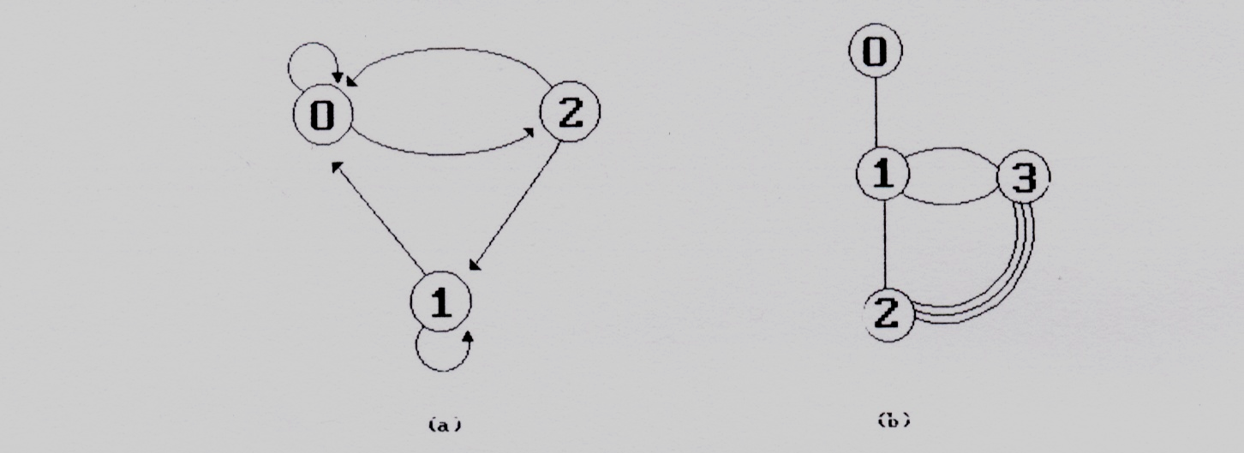
The Graph ADT (4/13)
Restrictions on graphs
  A graph may not have an edge from a vertex, i, back to itself. Such edges are known as self loops
  A graph may not have multiple occurrences of the same edge. If we remove this restriction, we obtain a data referred to as a multigraph
feedback loops
multigraph

Slide 7
The Graph ADT (5/13)
Adjacent and Incident
If (v0, v1) is an edge in an undirected graph,
  v0 and v1 are adjacent
  The edge (v0, v1) is incident on vertices v0 and v1
If <v0, v1> is an edge in a directed graph
  v0 is adjacent to v1, and v1 is adjacent from v0
  The edge <v0, v1> is incident on v0 and v1
V₀
V₁
V₀
V₁

Slide 8
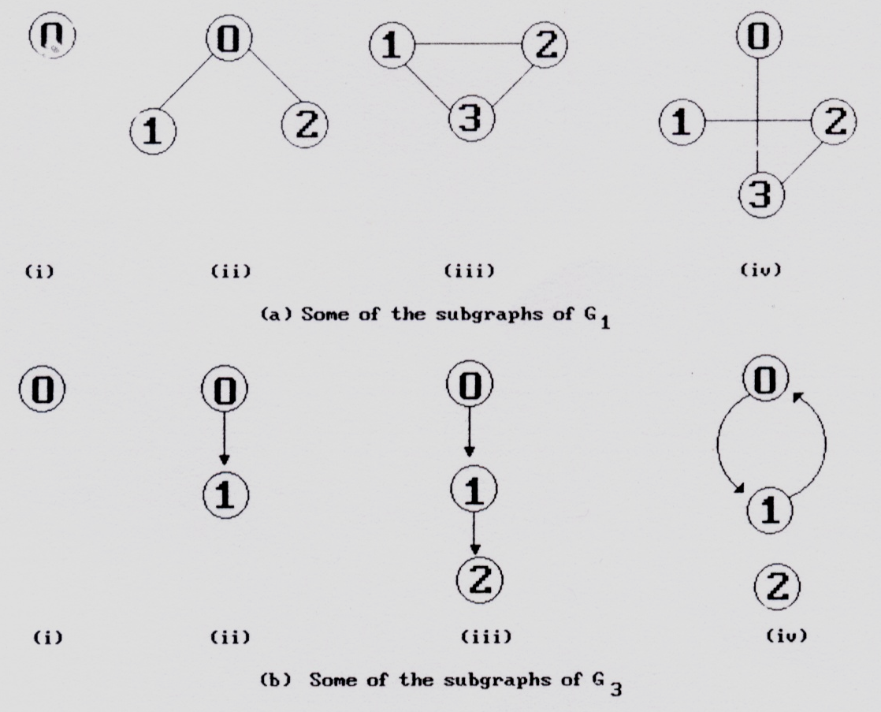
The Graph ADT (6/13)
A subgraph of G is a graph G’ such that V(G’) ⊆ V(G) and E(G’) ⊆ E(G).
0
1
2
3
G1
0
1
2
G3

Slide 9
The Graph ADT (7/13)
Path
  A path from vertex vp to vertex vq in a graph G, is a sequence of vertices, vp, vi1, vi2, ..., vin, vq, such that (vp, vi1), (vi1, vi2), ..., (vin, vq) are edges in an undirected graph.
    A path such as (0, 2), (2, 1), (1, 3) is also written as 0, 2, 1, 3
  The length of a path is the number of edges on it
0
0
0
1
2
1
2
1
2
3
3
3

Slide 10
The Graph ADT (8/13)
Simple path and cycle
  simple path (simple directed path): a path in which all vertices, except possibly the first and the last, are distinct.
  A cycle is a simple path in which the first and the last vertices are the same.
0
1
2
3

Slide 11
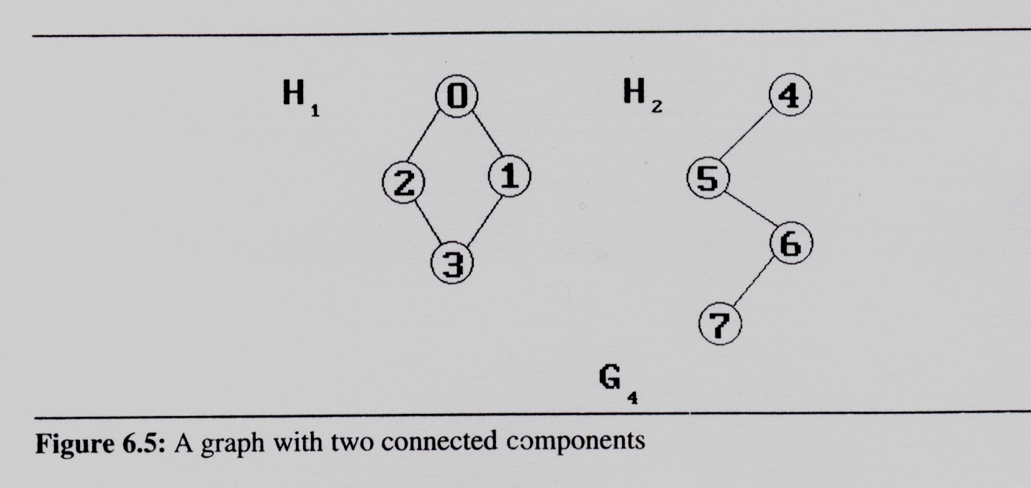
The Graph ADT (9/13)
Connected graph
  In an undirected graph G, two vertices, v₀ and v₁, are connected if there is a path in G from v₀ to v₁
  An undirected graph is connected if, for every pair of distinct vertices v_{i}, v_{j}, there is a path from v_{i} to v_{j}
Connected component
  A connected component of an undirected graph is a maximal connected
  subgraph.
  A tree is a graph
  that is connected
  and acyclic (i.e,
  has no cycle).

Slide 12
The Graph ADT (10/13)
Strongly Connected Component
  A directed graph is strongly connected if there is a directed path from vi to vj and also from vj to vi
  A strongly connected component is a maximal subgraph that is strongly connected
0
strongly connected component
(maximal strongly connected subgraph)
0
1
2
not strongly connected
1
2
G3

Slide 13
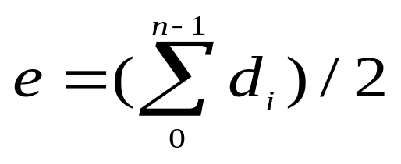
The Graph ADT (11/13)
Degree
  The degree of a vertex is the number of edges incident to that vertex.
For directed graph
  in-degree (v) : the number of edges that have v as the head
  out-degree (v) : the number of edges that have v as the tail
If di is the degree of a vertex i in a graph G with n vertices and e edges, the number of edges is

Slide 14
The Graph ADT (12/13)
Degree (cont’d)
We shall refer to a directed graph as a digraph. When we us the term graph, we assume that it is an undirected graph
directed graph
undirected graph
in-degree & out-degree
degree
2
0
in:1, out: 1
3
0
0
3
3
1
2
1
in: 1, out: 2
3
1
2
3
1
1
1
1
3
3
4
5
6
2
in: 1, out: 0
3
G1
G2
G3

Slide 15
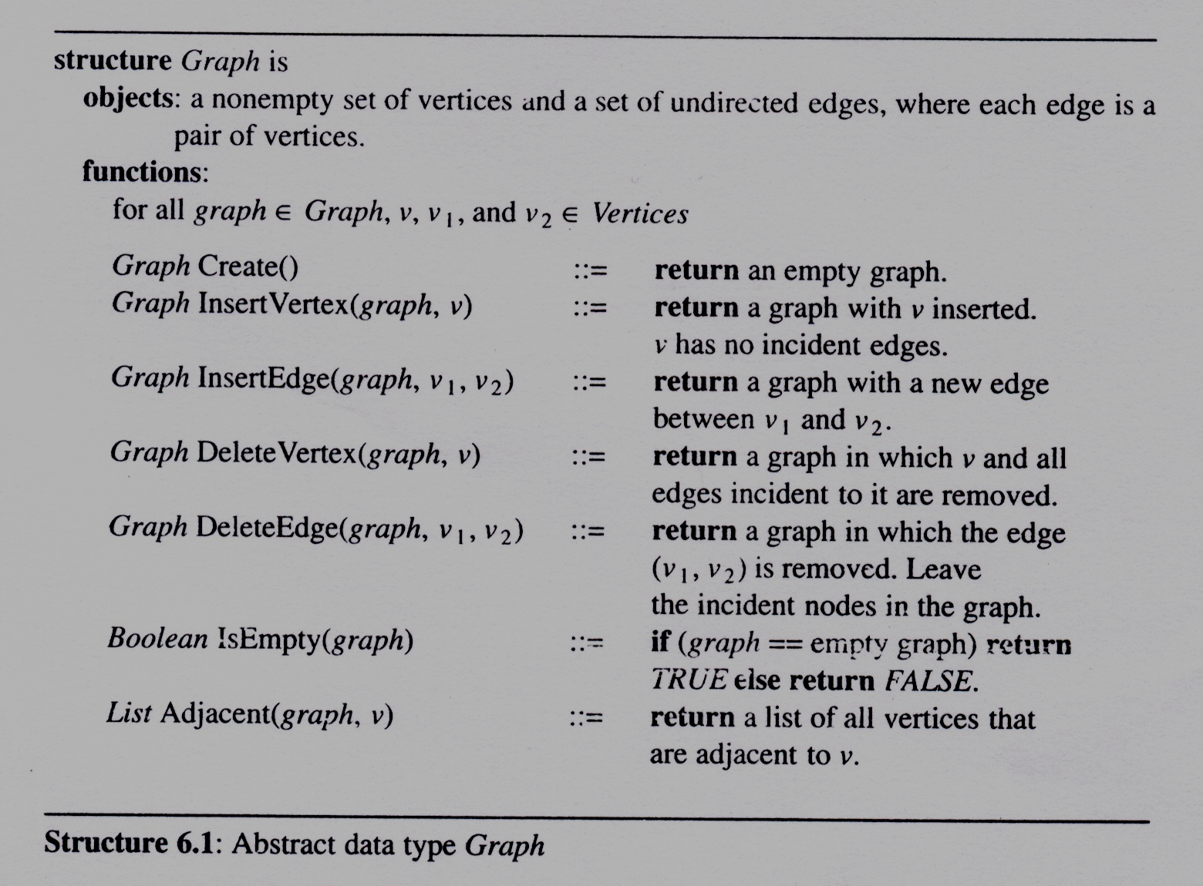
The Graph ADT (13/13)
Abstract Data Type Graph

Slide 16
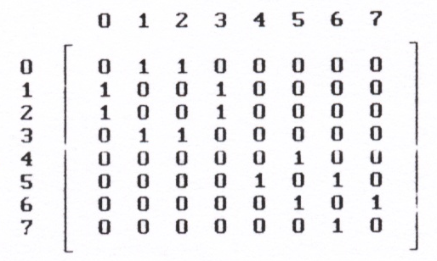
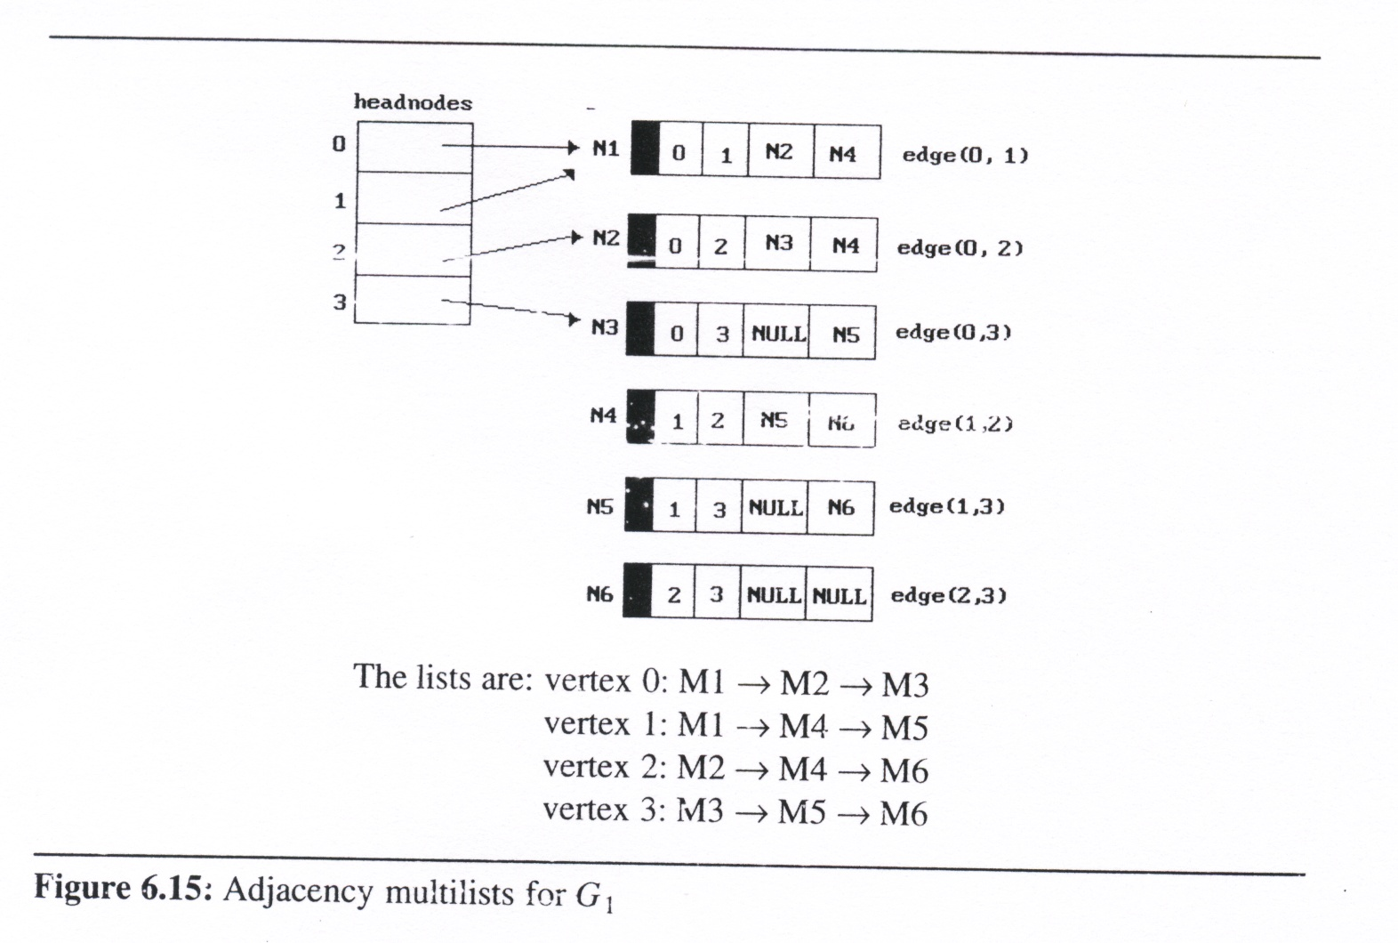
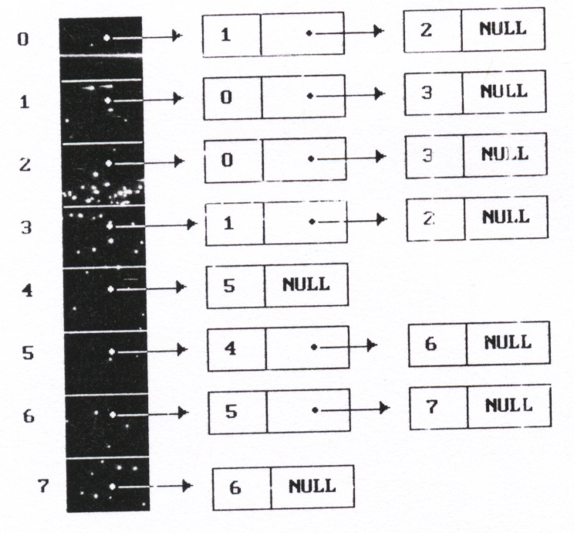
Graph Representations (1/13)
Adjacency Matrix
Adjacency Lists
Adjacency Multilists

Slide 17
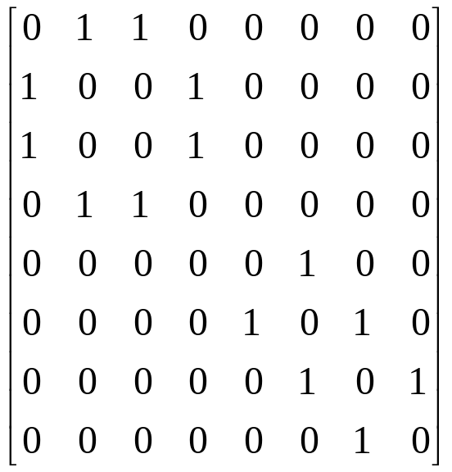
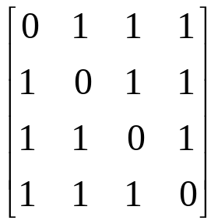
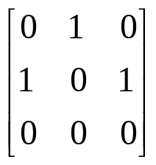
Graph Representations (2/13)
4
Adjacency Matrix
  Let G = (V,E) be a graph with n vertices.
  The adjacency matrix of G is a two-dimensional
  n x n array, say adj_mat
  If the edge (vi, vj) is(not) in E(G), adj_mat[i][j]=1(0)
  The adjacency matrix for an undirected graph is symmetric; the adjacency matrix for a digraph
  need not be symmetric
5
6
7
0
2
1
3
G4
0
0
1
2
1
3
G1
2
G3

Slide 18
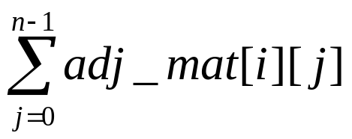
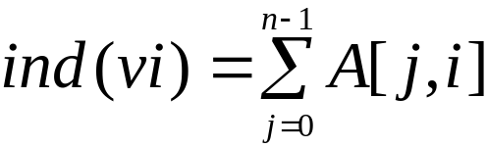
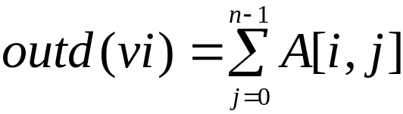
Graph Representations (3/13)
Merits of Adjacency Matrix
  For an undirected graph, the degree of any vertex, i, is its row sum:
  For a directed graph, the row sum is the out-degree, while the column sum is the in-degree.
  The complexity of checking edge number or examining if G is connect
    G is undirected: O(n²/2)
    G is directed: O(n²)

Slide 19
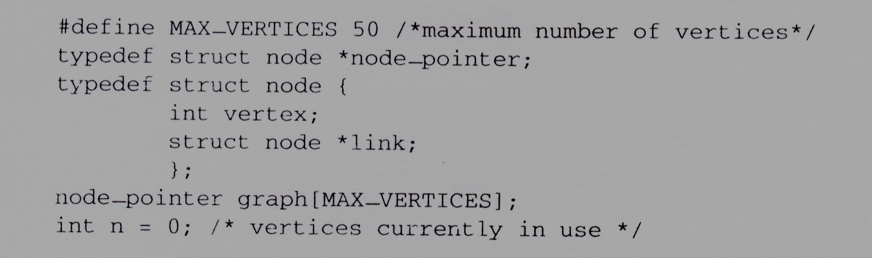
Graph Representations (4/13)
Adjacency lists
  There is one list for each vertex in G. The nodes in list i represent the vertices that are adjacent from vertex i
  For an undirected graph with n vertices and e edges, this representation requires n head nodes and 2e list nodes
  C declarations for adjacency lists

Slide 20
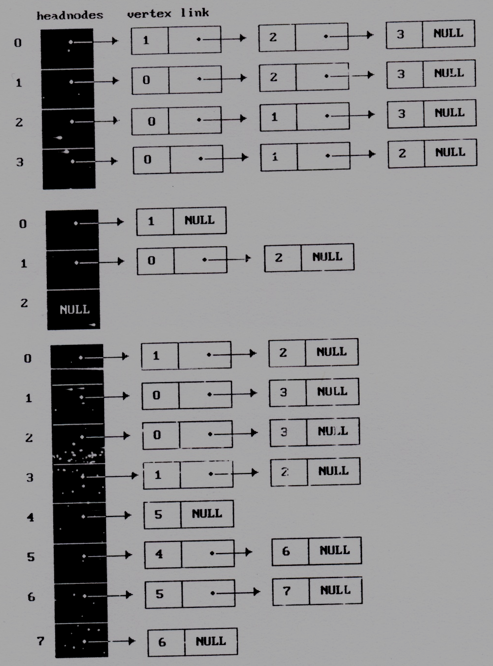
Graph Representations (5/13)
Example
0
1
2
G3
G1
3
0
G4
1
0
4
2
1
5
2
3
6
7

Slide 21
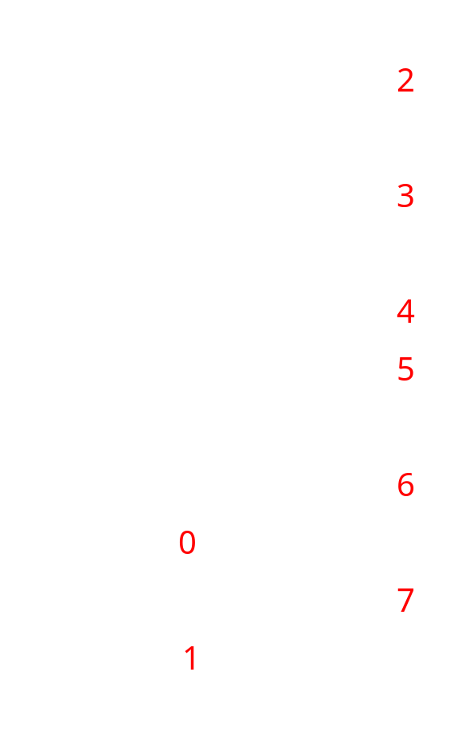
Graph Representations (6/13)
Sequential Representation of Graph
  Sequentially pack the nodes on the adjacency lists
  node[0] ~ node[n-1] gives the starting
  point of the list for vertex i , 0≦i<n
  node[n] = n+2e+1
  The vertices adjacent from vertex i are
  stored in node[node[i]], … ,
  node[node[i+1]-1], 0≦i<n
  The number of edges in G may be
  determined in O(n+e) time

Slide 22
Graph Representations (7/13)
Interesting Operations
  degree of a vertex in an undirected graph
    # of nodes in adjacency list
  # of edges in a graph
    determined in O(n+e)
  out-degree of a vertex in a directed graph
    # of nodes in its adjacency list
  in-degree of a vertex in a directed graph
    traverse the whole data structure

Slide 23
Graph Representations (8/13)
Finding In-degree of Vertices
0
0
1
2
•
•
•
1 NULL
0 NULL
1
1 NULL
2
Inverse adjacency list of G₃
tail head column link for head row link for tail
Alternate node structure of adjacency lists

Slide 24
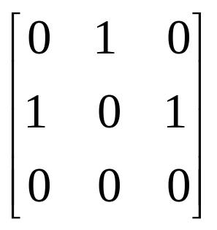
Graph Representations (9/13)
Example of Changing Node Structure
0
1
2
0
0 1 NULL NULL
0
1
1 0 NULL
1 2 NULL NULL
1
2 NULL
Orthogonal representation of G₃
2

Slide 25
Graph Representations (10/13)
Vertices in Any Order
Order is of no significance
Head nodes vertex links
0
•
3 •
1 •
2 NULL
0
1
•
2 •
0 •
3 NULL
1
2
2
•
3 •
0 •
1 NULL
3
3
•
2 •
1 •
0 NULL

Slide 26
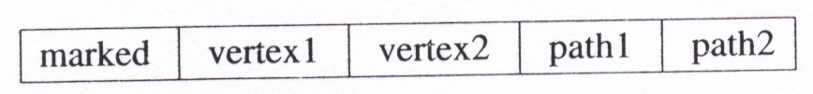
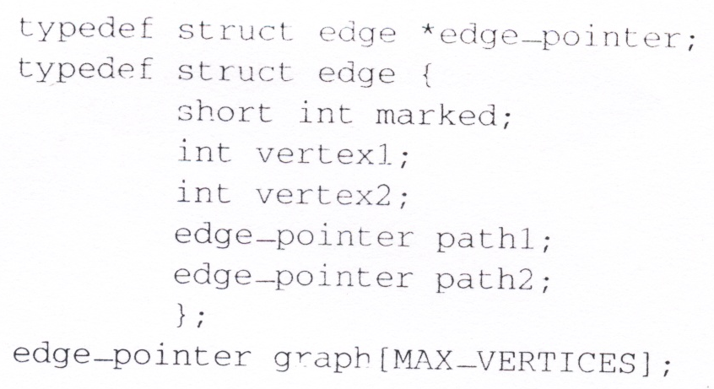
Graph Representations (11/13)
Adjacency Multilists
  Lists in which nodes may be shared among several lists. (an edge is shared by two different paths)
  There is exactly one node for each edge.
  This node is on the adjacency list for each of the two vertices it is incident to

Slide 27
Graph Representations (12/13)
Example for Adjacency Multlists
0
1
2
3

Slide 28
Graph Representations (13/13)
Weighted edges
  The edges of a graph have weights assigned to them.
  These weights may represent as
    the distance from one vertex to another
    cost of going from one vertex to an adjacent vertex.
  adjacency matrix: adj_mat[i][j] would keep the weights.
  adjacency lists: add a weight field to the node structure.
  A graph with weighted edges is called a network

Slide 29
Graph Operations (1/20)
Traversal
Given G=(V,E) and vertex v, find all w∈V, such that w connects v
  Depth First Search (DFS): preorder traversal
  Breadth First Search (BFS): level order traversal
Spanning Trees
Biconnected Components

Slide 30
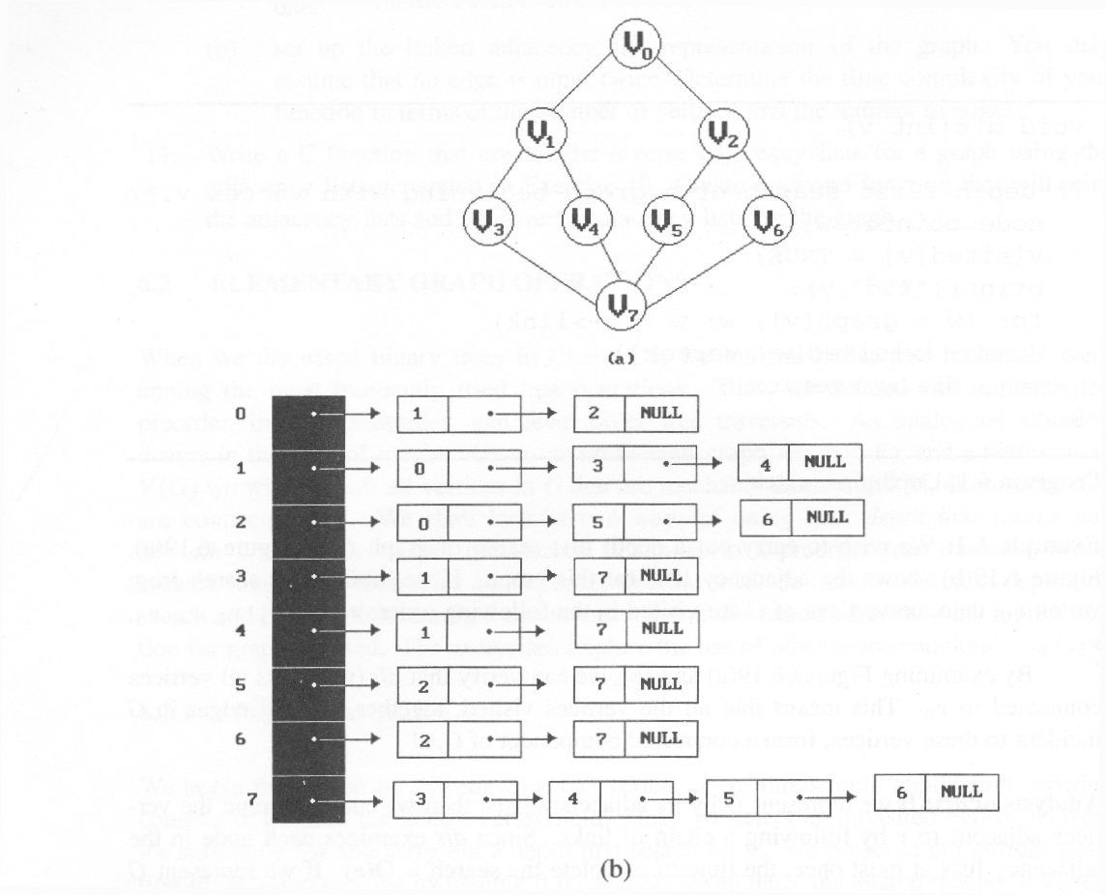
Graph Operations (2/20)
Example for traversal
(using Adjacency List representation of Graph)
depth first search (DFS): v₀, v₁, v₃, v₇, v₄, v₅, v₂, v₆
breadth first search (BFS): v₀, v₁, v₂, v₃, v₄, v₅, v₆, v₇

Slide 31
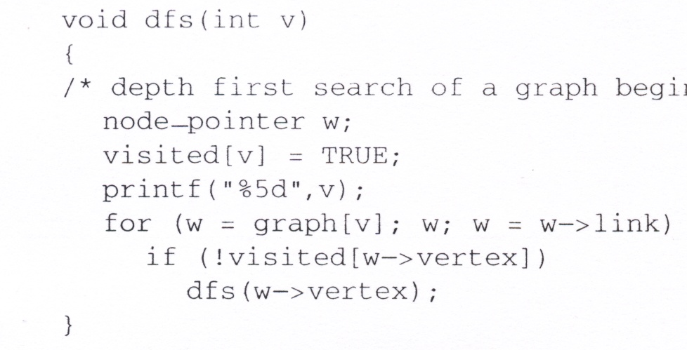
w
Depth First Search
Data structure
adjacency list: O(e)
adjacency matrix: O(n²)
#define FALSE 0
#define TRUE 1
short int visited[MAX_VERTICES];
visited:
[0]
[1]
[2]
[3]
[4]
[5]
[6]
[7]
output:
0
1
3
7
4
5
2
6

Slide 32
Graph Operations (4/20)
Breadth First Search
  It needs a queue to implement breadth-first search
  void bfs(int v): breadth first traversal of a graph
    starting with node v the global array visited is initialized to 0
    the queue operations are similar to those described in Chapter 4
typedef struct queue *queue_pointer;
typedef struct queue {
int vertex;
queue_pointer link;
};
void addq(queue_pointer *, queue_pointer *, int);
int deleteq(queue_pointer *);

Slide 33
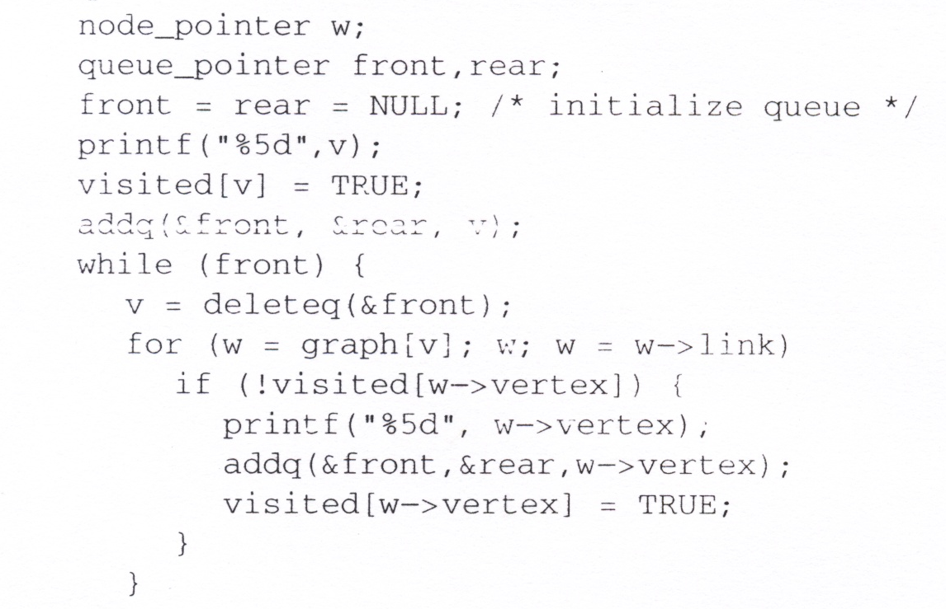
Breadth First Search : Example
visited:
[0]
[1]
[2]
[3]
[4]
[5]
[6]
[7]
out
0
1
2
3
4
5
6
7
in
output:
0
1
2
3
4
5
6
7
adjacency list: O(e)
adjacency matrix: O(n²)
w

Slide 34
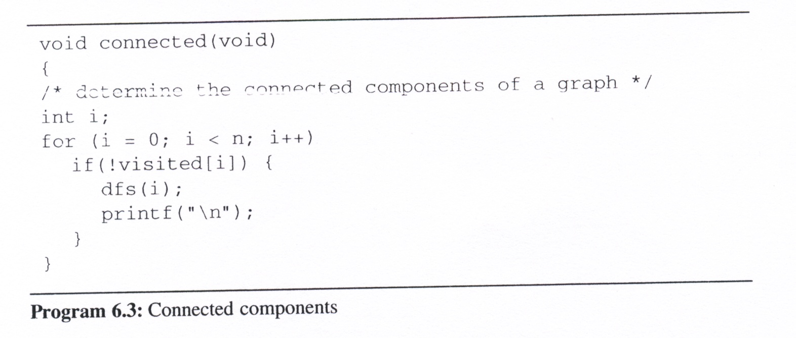
Graph Operations (6/20)
Connected components
  If G is an undirected graph, then one can determine whether or not it is connected:
    simply making a call to either dfs or bfs
    then determining if there is any unvisited vertex
adjacency list: O(n+e)
adjacency matrix: O(n²)

Slide 35
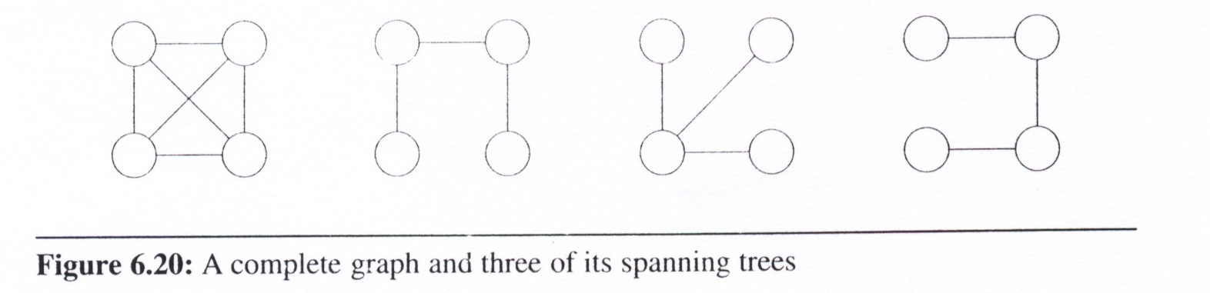
Graph Operations (7/20)
Spanning trees
  Definition: A tree T is said to be a spanning tree of a connected graph G if T is a subgraph of G and T contains all vertices of G.
  E(G): T (tree edges) + N (nontree edges)
    T: set of edges used during search
    N: set of remaining edges

Slide 36
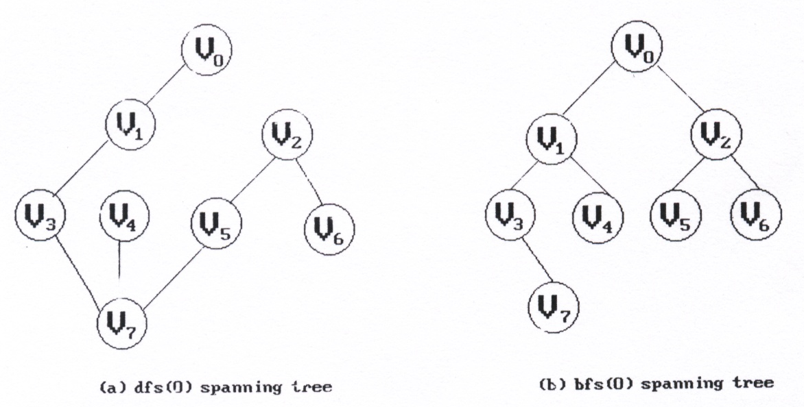
Graph Operations (8/20)
When graph G is connected, a depth first or breadth first search starting at any vertex will visit all vertices in G
We may use DFS or BFS to create a spanning tree
  Depth first spanning tree when DFS is used
  Breadth first spanning tree when BFS is used

Slide 37
Graph Operations (9/20)
Properties of spanning trees :
  If a nontree edge (v, w) is introduced into any spanning tree T, then a cycle is formed.
  A spanning tree is a minimal subgraph, G’, of G such that V(G’) = V(G) and G’ is connected.
    We define a minimal subgraph as one with the fewest number of edge
    A spanning tree has n-1 edges

Slide 38
Graph Operations (10/20)
Biconnected Graph & Articulation Points
    Assumption: G is an undirected, connected graph
  Definition: A vertex v of G is an articulation point iff the deletion of v, together with the deletion of all edges incident to v, leaves behind a graph that has at least two connected components.
  Definition: A biconnected graph is a connected graph that has no articulation points.
  Definition: A biconnected component of a connected graph G is a maximal biconnected subgraph H of G.
    By maximal, we mean that G contains no other subgraph that is both biconnected and properly contains H.

Slide 39
Graph Operations (11/20)
Examples of Articulation Points (node 1, 3, 5, 7)
0
8 9
0
8 9
0
8 9
2
7
1
7
7
1
1
3
5
2
3
5
2
3
5
4
6
4
6
4
6
Connected graph
two connected
components
one connected graph

Slide 40
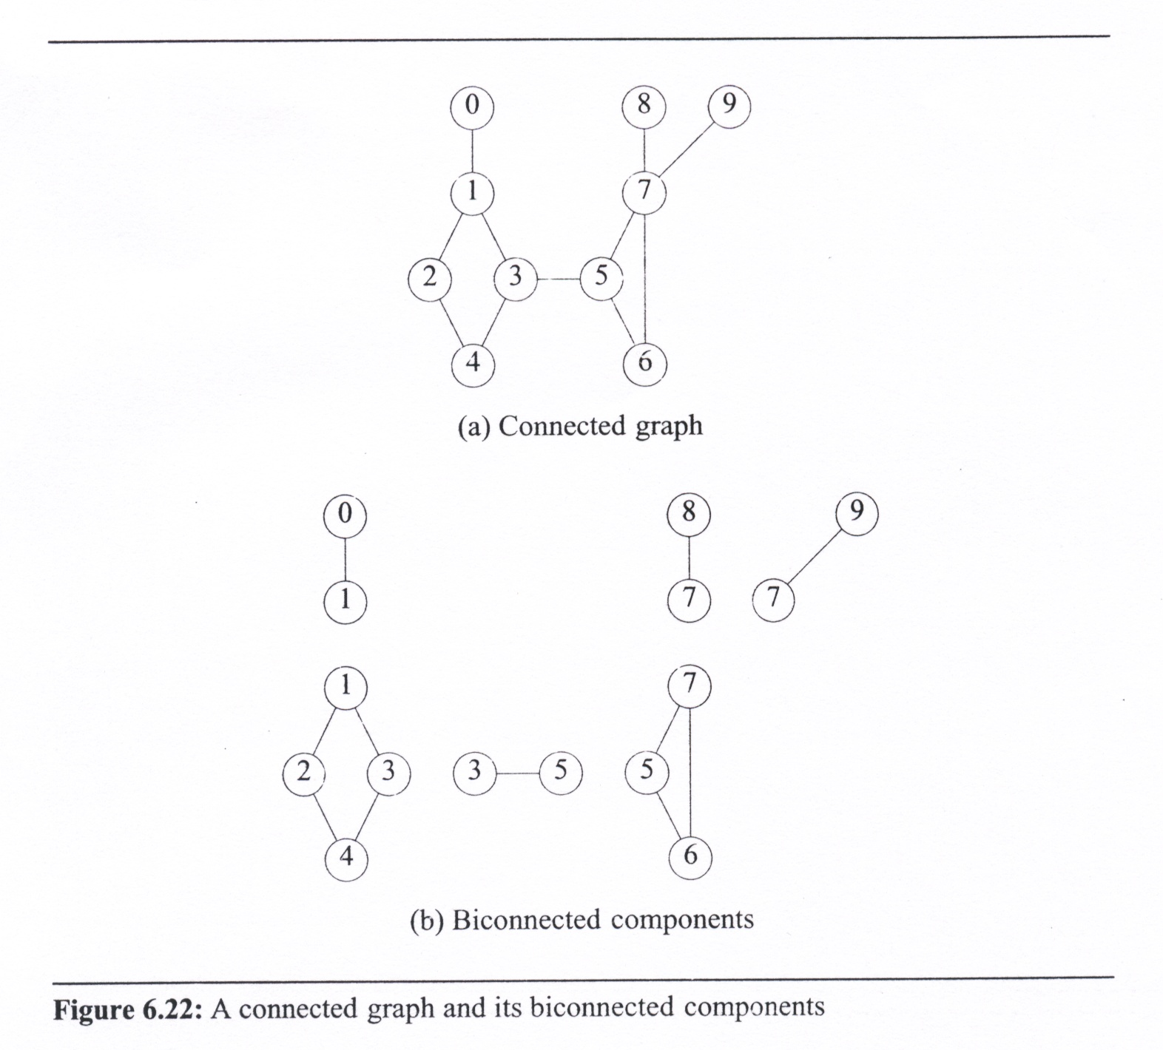
Graph Operations (12/20)
Biconnected component:
a maximal connected subgraph H
  no subgraph that is both biconnected and properly contains H

Slide 41
Graph Operations (13/20)
Finding the biconnected components
  By using depth first spanning tree of a connected undirected graph
  The depth first number (dfn) outside the vertices in the figures gives the DFS visit sequence
  If u is an ancestor of v then dfn(u) < dfn(v)
(b)
3
0
(a) depth first
spanning tree
4
0
9 8 9 8
1 5
4
5
3
7 7
1
0 5
3 5
2
4
6
7
2
6
2
2
1
7
3
4 6
1 6
8 9
result of dfs(3)
0
9
8

Slide 42
Graph Operations (14/20)
nontree edge
(back edge)
dfn and low
  Define low(u): the lowest dfn
  that we can reach from u using
  a path of descendants followed
  by at most one back edge
  low(u) = min{ dfn(u),
  min{ low(w) | w is a child of u },
  min{ dfn(w) |
  (u, w) is a back edge } }
3
0
1 5
4
5
2
4
2
6
7
6
1
7
3
8 9
0
9
8

Slide 43
Graph Operations (15/20)
Finding an articulation point in a graph:
Any vertex u is an articulation point iff
  u is the root of the spanning tree and has two or more children
  u is not the root and has at least one child w
  such that we cannot reach an ancestor of u
  using a path that consists of only
  (1) w
  (2) descendants of w
  (3) a single back edge
  thus, low(w) ≥ dfn(u)
nontree edge
(back edge)
3
0
1 5
4
5
2
4
2
6
7
6
1
7
3
8 9
0
9
8

Slide 44
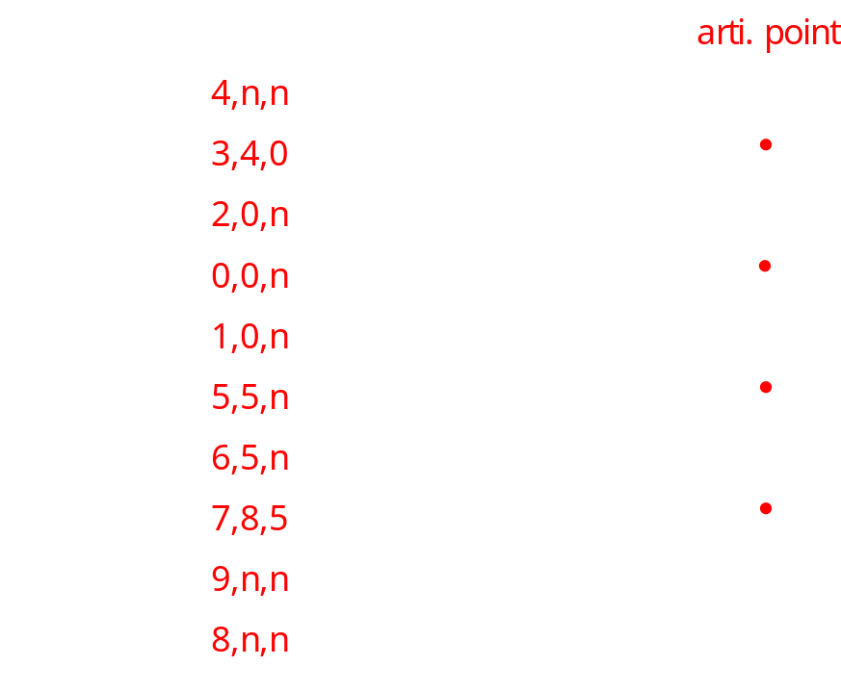
Graph Operations (16/20)
dfn and low values for dfs spanning tree with root = 3
  low(u) = min{ dfn(u), min{ low(w) | w is a child of u }, min{ dfn(w) | (u, w) is a back edge } }
3
0
1 5
4
5
2
2
4
6
7
6
1
3
7
8 9
0
9
8

Slide 45
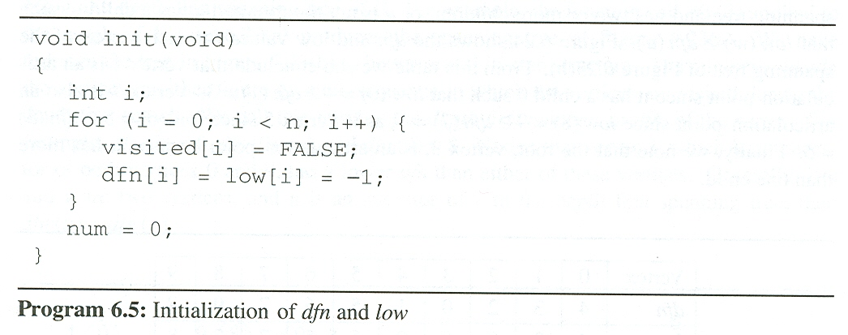
Graph Operations (17/20)
Determining dfn and low
  we can easily modify dfs( ) to compute dfn and low for each vertex of a connected undirected graph
#define MIN2 (x, y) ((x) < (y) ? (x) : (y))
short int dfn[MAX_VERTICES];
short int low[MAX_VERTICES];
int num;

Slide 46
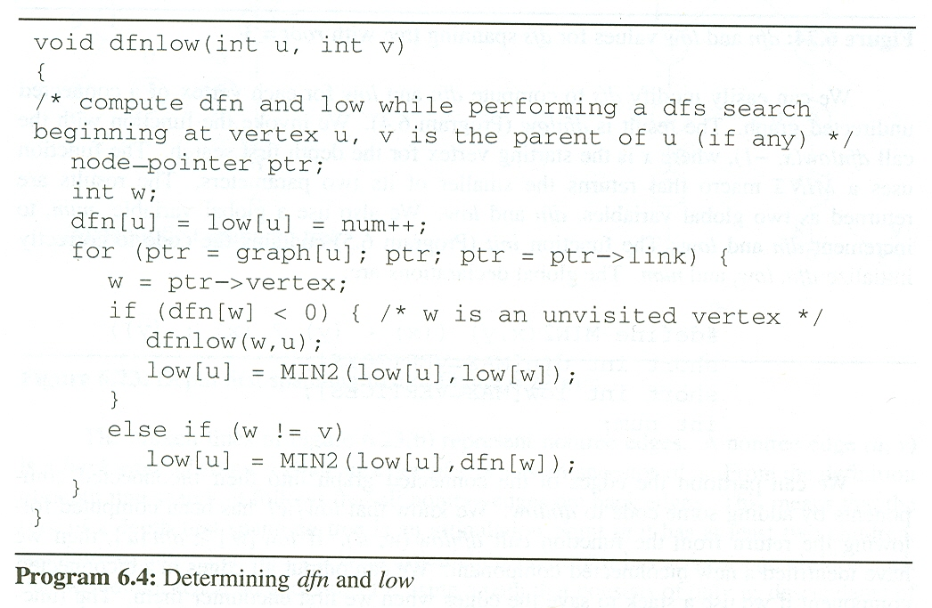
Determining dfn and low (cont’d)
  we invoke the function with call dfnlow(x, -1), where
  x is the starting vertex (root) for the depth first search
u:
3
4
2
1
0
1
v is the parent of u (if any)
-1
3
4
2
1
v:
2
w:
4
1
2
0
2
1
0
3
num:
2
3
4
0
1
5
w is a child of u
ptr
dfn(u)
(u, w) is a back edge
0
1
2
3
4
5
6
7
8
9
dfn:
-1
4
-1
3
-1
2
-1
0
-1
1
-1
-1
-1
-1
-1
low:
-1
4
-1
3
0
-1
2
-1
-1
-1
-1
-1
-1
0
-1
1

Slide 47
Graph Operations (19/20)
Partition the edges of the connected graph into their biconnected components
  In dfnlow, we know that low[w] has been computed following the return from the function call dfnlow(w, u)
  If low[w] ≥ dfn[u], then we have identified a new biconnected component
  We can output all edges in a biconnected component if we use a stack to save the edges when we first encounter them
  The function bicon (Program 6.6) contains the code modified from dfnlow, and the same initialization is used

Slide 48
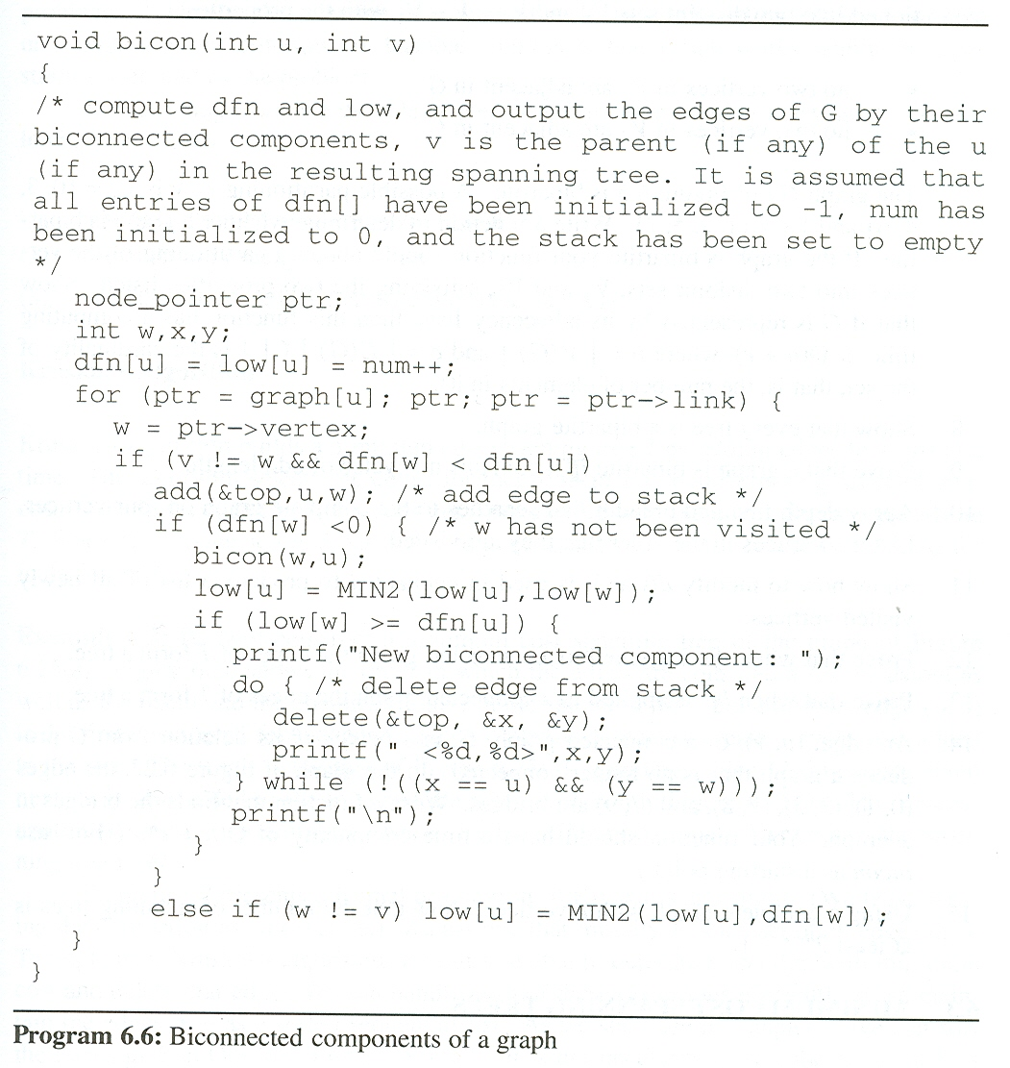
0
1
2
3
4
5
6
7
8
9
Find Biconnected components
dfn:
-1
-1
-1
-1
-1
-1
-1
-1
-1
-1
4
3
2
0
1
5
6
7
9
8
output:
<1, 0>
<1, 3>
<2, 1>
<4, 2>
<3, 4>
low:
-1
-1
-1
-1
-1
-1
-1
-1
4
3
7
0
2
0
-1
0
-1
0
5
6
1
5
5
9
8
<7, 9>
u:
3
<7, 8>
4
2
1
0
1
2
4
5
6
7
9
7
8
7
6
5
3
3
10
13
79
78
75
21
67
42
56
34
35
<7, 5>
<6, 7>
-1
-1
-1
3
4
2
1
2
4
3
3
5
6
7
6
7
6
5
v:
3
<5, 6>
w:
4
2
1
0
2
3
1
4
2
3
5
6
7
9
7
9
8
7
8
6
5
7
5
6
7
3
1
0
4
5
<3, 5>
back edge or not yet visited
num:
0
1
2
3
4
5
6
7
8
9
10
ptr
w is a child of u
(u, w) is a back edge

Slide 49
Minimum Cost Spanning Trees (1/7)
Introduction
  The cost of a spanning tree of a weighted, undirected graph is the sum of the costs (weights) of the edges in the spanning tree.
  A minimum-cost spanning tree is a spanning tree of least cost.
  Three different algorithms can be used to obtain a minimum cost spanning tree.
    Kruskal’s algorithm
    Prim’s algorithm
    Sollin’s algorithm
  All the three use a design strategy called the greedy method

Slide 50
Minimum Cost Spanning Trees (2/7)
Greedy Strategy
  Construct an optimal solution in stages
  At each stage, we make the best decision (selection) possible at this time.
    using least-cost criterion for constructing minimum-cost spanning trees
  Make sure that the decision will result in a feasible solution
  A feasible solution works within the constraints specified by the problem
Our solution must satisfy the following constrains
  Must use only edges within the graph.
  Must use exactly n - 1 edges.
  May not use edges that produce a cycle

Slide 51
Minimum Cost Spanning Trees (3/7)
Kruskal’s Algorithm
  Build a minimum cost spanning tree T by adding edges to T one at a time
  Select the edges for inclusion in T in non-decreasing order of the cost
  An edge is added to T if it does not form a cycle
  Since G is connected and has n > 0 vertices, exactly n-1 edges will be selected
  Time complexity: O(e log e)
  Theorem 6.1:
  Let G be an undirected connected graph. Kruskal’s algorithm generates a minimum cost spanning tree

Slide 52
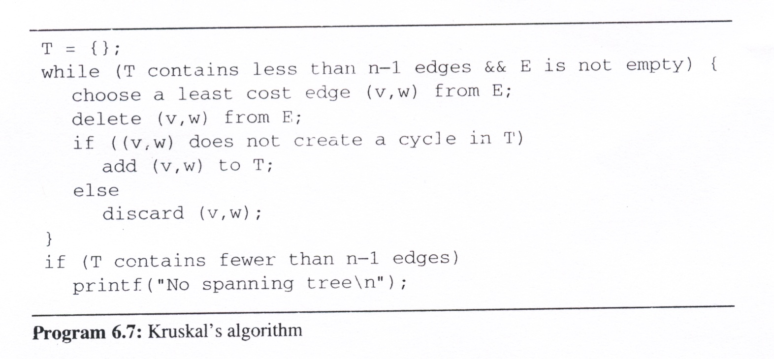
Minimum Cost Spanning Trees (4/7)
Kruskal’s Algorithm (cont’d)
0
28
10
1
14
16
5
6
2
24
25
✗
18
12
4
✗
choose
22
3

Slide 53
Minimum Cost Spanning Trees (5/7)
Prim’s Algorithm
  Build a minimum cost spanning tree T by adding edges to T one at a time.
  At each stage, add a least cost edge to T such that the set of selected edges is still a tree.
  Repeat the edge addition step until T contains n-1 edges.

Slide 54
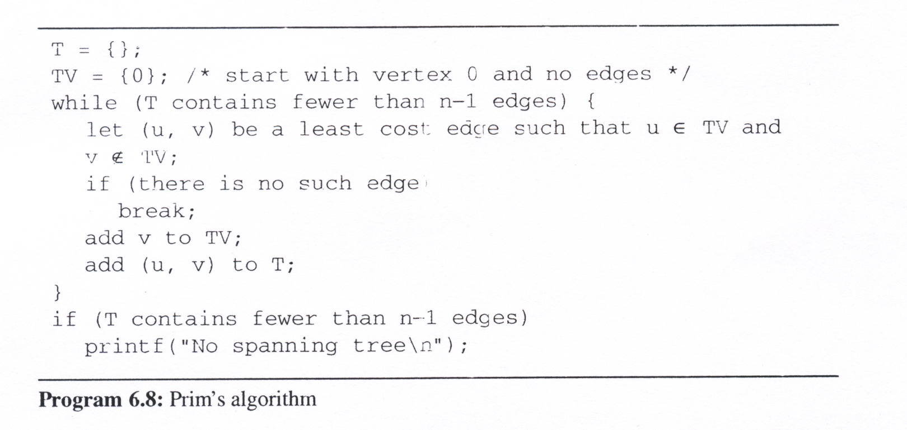
Minimum Cost Spanning Trees (6/7)
Prim’s Algorithm (cont’d)
0
28
10
1
14
16
5
6
2
24
25
18
12
4
22
3

Slide 55
Minimum Cost Spanning Trees (7/7)
Sollin’s Algorithm
  Selects several edges for inclusion in T at each stage.
  At the start of a stage, the selected edges forms a spanning forest.
  During a stage we select a minimum cost edge that has exactly one vertex in the tree edge for
  each tree in the forest.
  Repeat until only one tree at the end of
  a stage or no edges remain for selection.
    Stage 1: (0, 5), (1, 6), (2, 3), (3, 2), (4, 3),
    (5, 0), (6, 1)⇨{(0, 5)}, {(1, 6)}, {(2, 3), (4, 3)}
    Stage 2: {(0, 5), (5, 4)}, {(1, 6), (1, 2)},
    {(2, 3), (4, 3), (1, 2)}
    Result: {(0, 5), (5, 4), (1, 6), (1, 2), (2, 3), (4, 3)}
0
28
10
1
14
16
5
6
2
24
25
18
12
4
22
3

