Slide 1

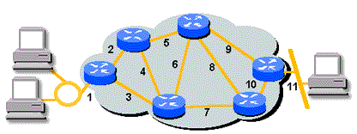
Shortest Paths (1/11)
In this section, we shall study the path problems such like
  Is there a path from city A to city B?
  If there is more than one path from A to B, which path is the shortest?

Slide 2
Shortest Paths (2/11)
Single source/All destinations:
nonnegative edge cost
  Problem: given a directed graph G = (V, E), a length function length(i, j), length(i, j) ≥ 0, for the edges of G, and a source vertex v.
  Need to solve: determine a shortest
  path from v to each of the remaining
  vertices of G.
  Let S denote the set of vertices
  dist[w]: the length of shortest path
  starting from v, going through only
  the vertices that are in S, ending at w.
45
50 10
V₀
V₁
V₄
20 10 15 20 35 30
15 3
V₂
V₃
V₅
path length
1) v0 v2 10
2) v0 v2 v3 25
3) v0 v2 v3 v1 45
4) v0 v4 45

Slide 3
Shortest Paths (3/11)
Dijkastra’s Algorithm
  Find the min cost of the path from a given source node to every other node.
  Given: the cost e(v_{i}, v_{j}) of all edges; v₀ is the source node; e(v_{i}, v_{j}) = ∞, if v_{i} and v_{j} are not adjacent
  S ← {v₀};
  dist[v₀] ← 0;
  for each v in V - {v₀} do dist[v] ← e(v₀, v);
  while S≠V do
    choose a vertex w in V-S such that dist[w] is a minimum;
    add w to S;
    for each v in V-S do
      dist[v] ← min(dist[v], dist[w]+e(w, v));

Slide 4
Shortest Paths (4/11)
Declarations for the Shortest Path Algorithm
#define MAX_VERTICES 6
int cost[ ][MAX_VERTICES]=
{ { 0, 50, 10, 1000, 45, 1000},
{1000, 0, 15, 1000, 10, 1000},
{ 20, 1000, 0, 15, 1000, 1000},
{1000, 20, 1000, 0, 35, 1000},
{1000, 1000, 30, 1000, 0, 1000},
{1000, 1000, 1000, 3, 1000, 0}};
int distance[MAX_VERTICES];
short int found{MAX_VERTICES];
int n = MAX_VERTICES;
45
V₀
50 10
V₁
V₄
20 10 15 20 35 30
V₂
15 3
V₃
V₅

Slide 5
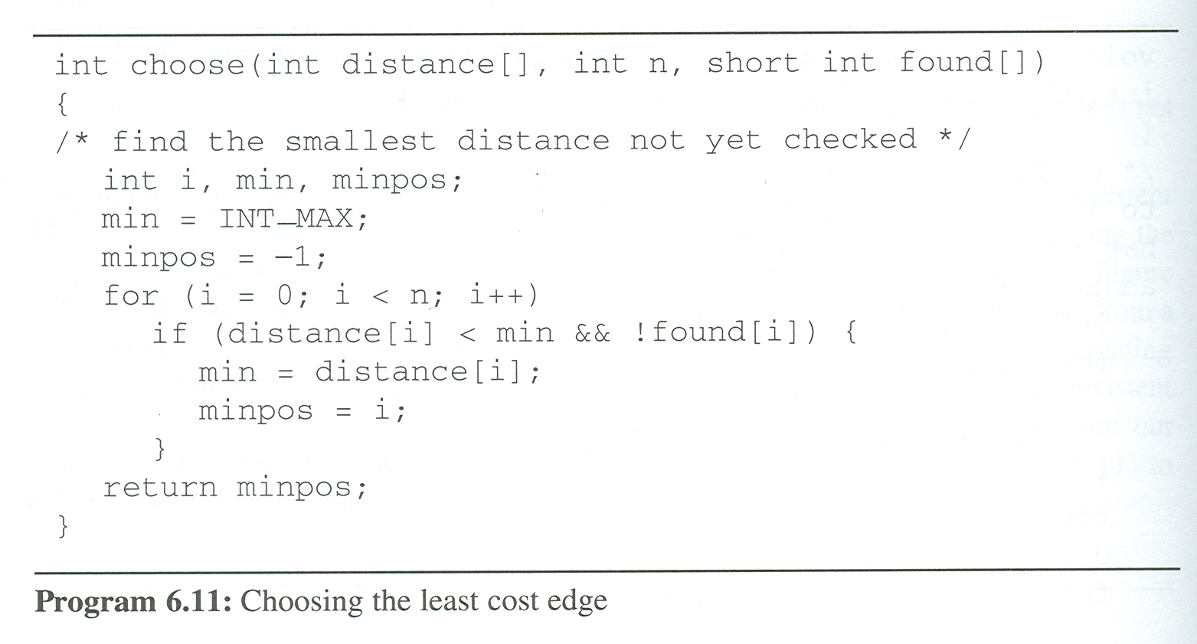
Shortest Paths (5/11)
Choosing the least cost edge

Slide 6
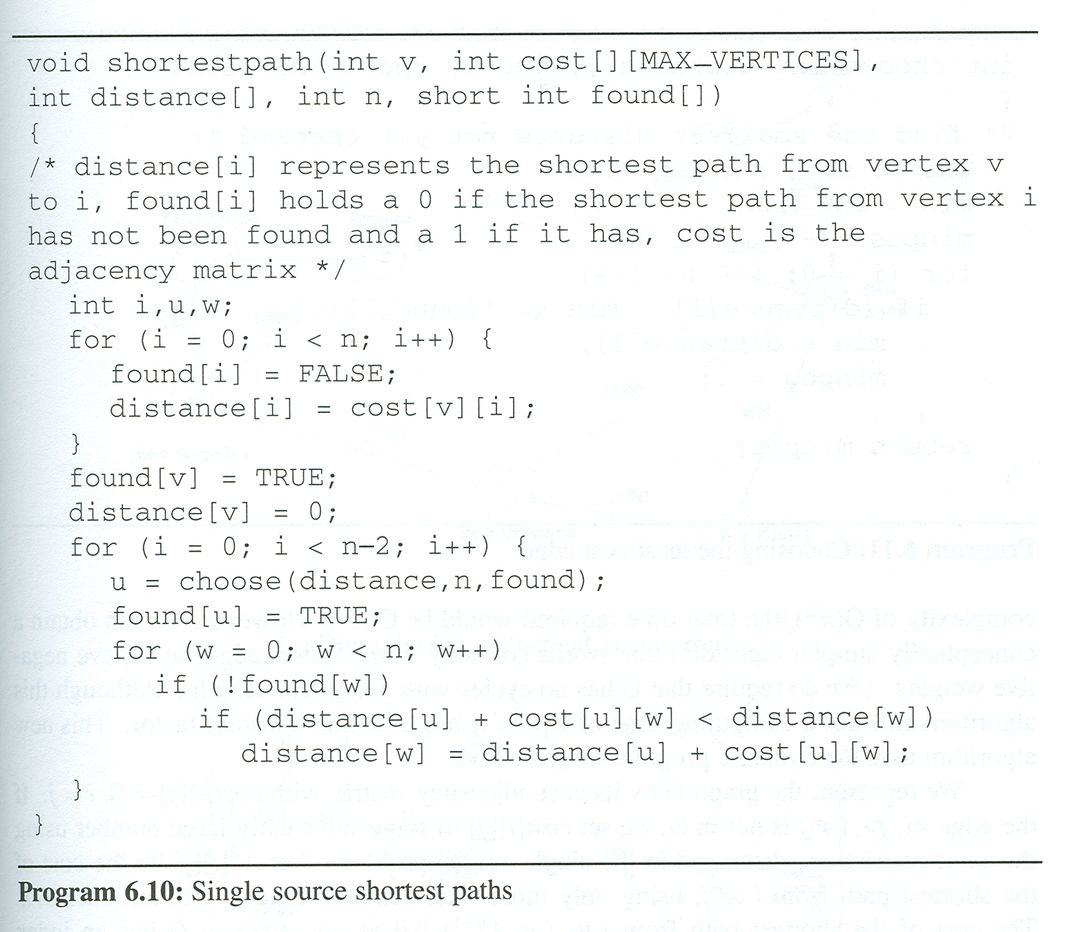
Single Source Shortest Paths Program (v=0)
visited:
[0]
[1]
[2]
[3]
[4]
[5]
cost:
45
V₀
50 10
V₁
V₄
20 10 15 20 35 30
V₂
15 3
V₃
V₅
distance:
0
50
45
10
1000
25
45
1000
i:
1
2
3
0
u:
2
3
1
4
w:
0
1
2
3
4
5

Slide 7
Shortest Paths (7/11)
All Pairs Shortest Paths
  we could solve this problem using shortestpath with each of the vertices in V(G) as the source. (O(n³))
  we can obtain a conceptually simpler algorithm that works correctly even if some edges in G have negative weights, require G has no cycles with a negative length (still O(n³))

Slide 8
Shortest Paths (8/11)
Another solution
  Use dynamic programming method.
  Represent the graph G by its cost adjacency matrix with cost[i][j].
    If i = j, cost[i][j] = 0.
    If <i, j> is not in G, cost[i][j] is set to some sufficiently large number.
  Let A^{k}[i][j] be the cost of shortest path from i to j, using only those intermediate vertices with an index ≤ k.
    The shortest path from i to j is A^{n-1}[i][j] as no vertex in G has an index greater than n - 1.

Slide 9
Shortest Paths (9/11)
Algorithm concept
  The basic idea in the all pairs algorithm is begin with the matrix A⁻¹ and successively generated the matrices A⁻¹, A⁰, A², …, A^{n}
  A⁻¹[i][j]=cost[i][j]
  Calculate the A⁰, A¹, A², ..., A^{n-1} from A⁻¹ iteratively
  A^{k}[i][j]=min{A^{k-1}[i][j], A^{k-1}[i][k]+A^{k-1}[k][j]}, k>=0

Slide 10
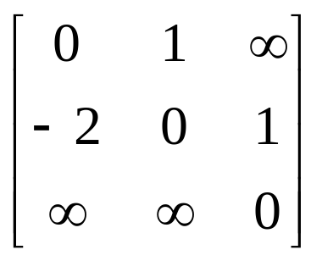
Shortest Paths (10/11)
Graph with Negative Cycle
  The length of the shortest path from vertex 0 to vertex 2 is -∝
-2
0
1
2
1
1
(a) Directed graph (b) A⁻¹
0, 1, 0, 1, 0, 1, …, 0, 1, 2

Slide 11
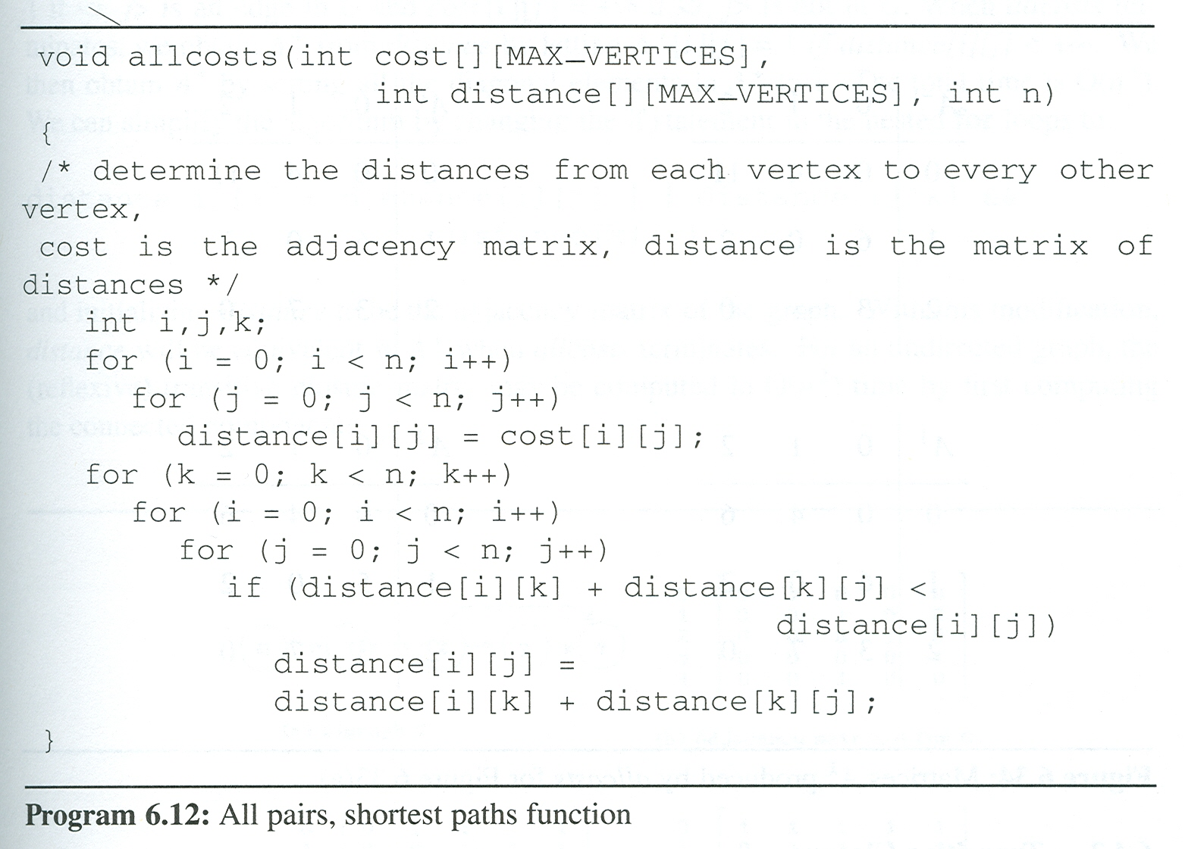
Shortest Paths (11/11)
final distance:
0 | 4 | 11
6 | 0 | 2
3 | 1000 | 0
All pairs shortest paths program
cost:
7
0 | 4 | 11
6 | 0 | 2
3 | 1000 | 0
K
0
I
0
1
2
J
2
0
1
1
0
2
0
1
6
4
V₀
V1
3 11 2
V₂

Slide 12
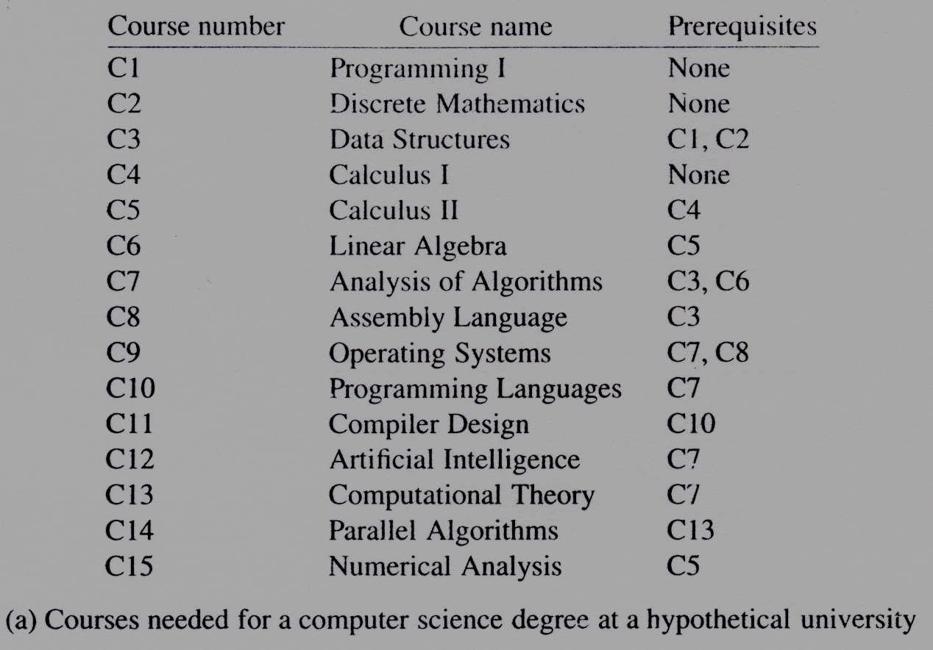
Topological Sorts (1/19)
Activity on vertex (AOV) networks
  All but the simplest of projects can be divided into several subprojects called activities.
  The successful completion of these activities results in the completion of
  the entire project
  Example:
  A student working
  toward a degree in
  computer science
  must complete
  several courses
  successful

Slide 13
Topological Sorts (2/19)
Definition:
  Activity On Vertex (AOV) Network:
  a directed graph in which the vertices represent tasks or activities and the edges represent precedence relations between tasks.
  predecessor (successor):
  vertex i is a predecessor of vertex j iff there is a directed path from i to j. j is a successor of i.
  partial order:
  a precedence relation which is both transitive
  (∀i, j, k, i  j & j  k → i  k ) and irreflexive (∀x ¬x  x)
  acylic graph:
  a directed graph with no directed cycles

Slide 14
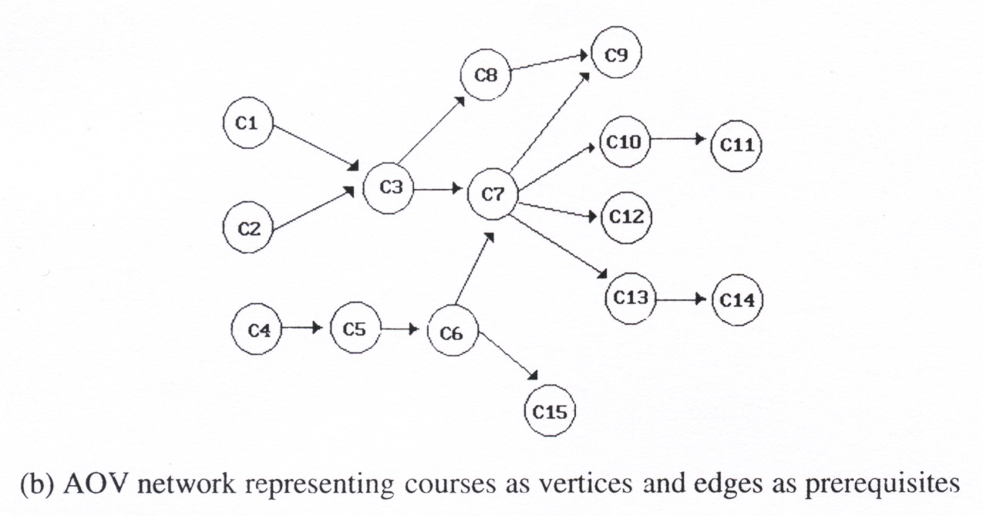
Topological Sorts (3/19)
Definition: Topological order
  linear ordering of vertices of a graph
  ∀i, j if i is a predecessor of j, then i precedes j in the linear ordering
C1, C2, C4, C5, C3, C6, C8, C7,
C10, C13, C12, C14, C15, C11, C9
C4, C5, C2, C1, C6, C3,
C8, C15, C7, C9, C10,
C11, C13, C12, C14

Slide 15
Topological Sorts (4/19)
Topological sort Algorithm
  for (i = 0; i <n; i++) {
  if every vertex has a predecessor {
  fprintf (stderr, “Network has a cycle. \n “ );
  exit(1);
  }
  pick a vertex v that has no predecessors;
  output v;
  delete v and all edges leading out of v from the network;
  }
V₁
V₀
V₂
V₄
V₃
V₅
Topological order generated:
v₀
v₃
v₂
v₅
v₁
v₄

Slide 16
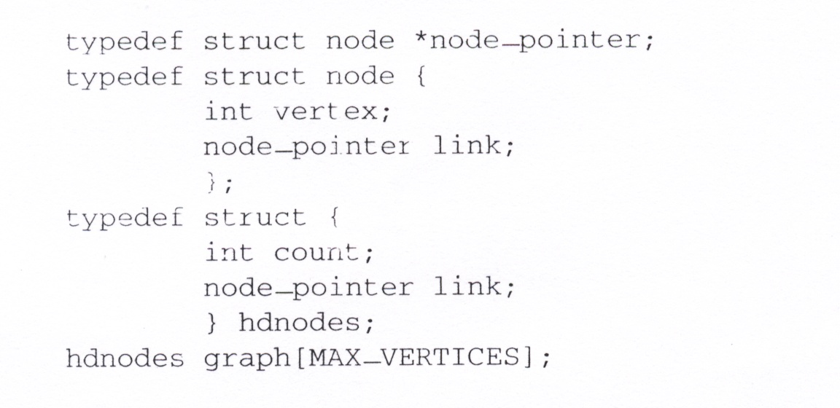
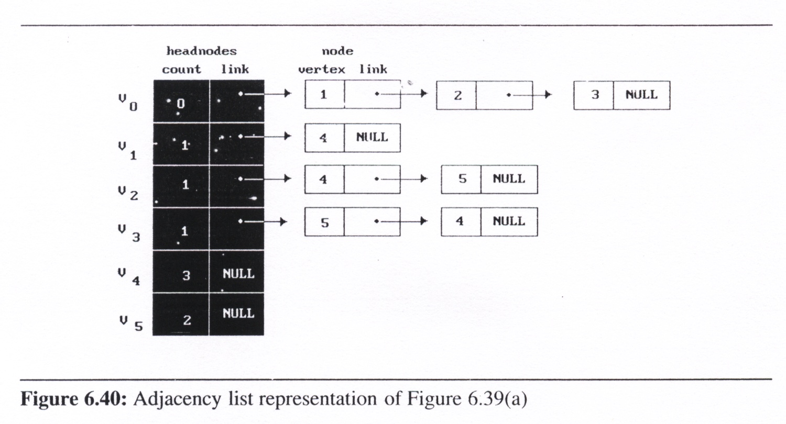
Topological Sorts (5/19)
decide whether a vertex
has any predecessors
Declarations used
in topsort
data representation
the in-degree of that vertex
V₁
V₀
V₂
V₄
decide a vertex together
with all its incident edges
V₃
V₅

Slide 17
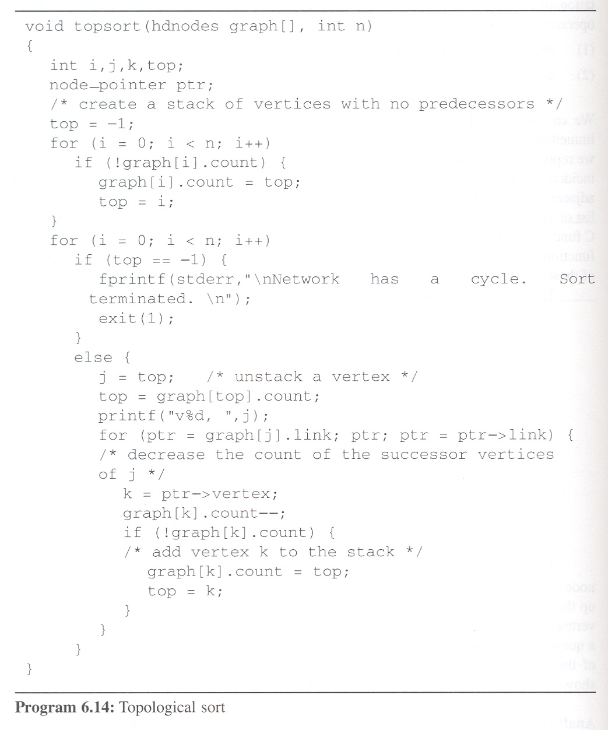
Topological
sort Program
headnode
V₁
V₀
V₁
V₂
V₃
V₄
V₅
count
-1
-1
0
0
1
0
2
-1
2
1
0
1
0
0
1
1
1
3
1
2
V₀
V₂
V₄
link
node
1
4
4
5
V₃
V₅
2
5
4
ptr
3
top:
-1
-1
-1
0
2
3
2
1
5
1
1
4
j:
3
2
5
1
4
0
k:
1
2
3
5
4
5
4
output:
v0
v3
v2
v5
v1
v4
Time complexity: O(n+e)

Slide 18
Topological Sorts (7/19)
Activity on Edge (AOE) Networks
  AOE is related to the AOV network.
AOE networks have proved very useful for evaluating the performance of many types of projects.
  What is the least amount of time in which the project may be complete (assuming there are no cycle in the network)?
  Which activities should be speeded to reduce project length?

Slide 19
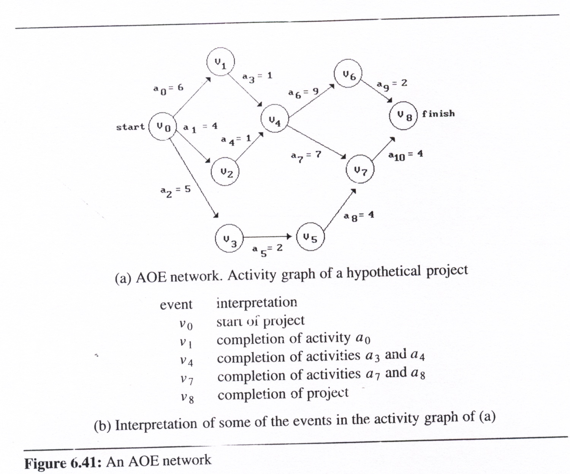
Topological Sorts (8/19)
An AOE network
  directed edge: tasks
  or activities to be
  performed
  vertex: events which
  signal the completion
  of certain activities
  number: associated
  with each edge
  (activity) is the time
  required to
  perform the activity

Slide 20
Topological Sorts (9/19)
Application of AOE Network
  Evaluate performance
    minimum amount of time
    activity whose duration
    time should be shortened
    …
  Critical path
    a path that has the
    longest length
    minimum time required
    to complete the project
v₀, v₁, v₄, v₆, v₈ or v₀, v₁, v₄, v₇, v₈ (18)

Slide 21
Topological Sorts (10/19)
Critical-path analysis
  The purpose of critical-path analysis is to identify critical activities so that resource may be concentrated on these activities in an attempt to reduce a project finish time.
  Critical-path analysis can also be carried out with AOV network
Determine Critical Paths
  Delete all noncritical activities
  Generate all the paths from the start to finish vertex

Slide 22
Topological Sorts (11/19)
Various Factors
  The earliest time of an event v_{i}
    the length of the longest path from v₀ to v_{i} (Ex. 7 for v₄)
  early(i): earliest event occurrence (Earliest activity) time of i
    the earliest start time for all activities responded by edges leaving v_{i}
    early(6) = early(7)=7
  late(i): latest event
  occurrence (latest
  activity) time of i
    the latest time the
    activity may start
    without increasing
    the project duration
    early(5)=5, late(5)=8
    early(7)=7, late(7)=7
=18-2-4-4

Slide 23
Topological Sorts (12/19)
Various Factors (cont’d)
  late(i)-early(i)
    measure of how critical an activity is (ex. late(5)-early(5)=8-5=3)
  Critical activity
    an activity for which early(i)=late(i) (ex. early(7)=late(7))
  earliest[j]:
  earliest event occurrence time for all event j in the network
  latest[j]:
  latest event occurrence time for all event j in the network
  If activity a_{i} is represented by edge <k, i>
    early(i) = earliest[k]
    late(i) = latest[i] - duration of activity a_{i}
  We compute the times earliest[j] and latest[j] in two stages: a forward stage and a backward stage
a_{i}
v_{k}
v_{i}

Slide 24
Topological Sorts (13/19)
Calculation of Earliest Times
  During the forwarding stage, we start with earliest[0] = 0 and compute the remaining start times using the formula:
  Where P(j) is the set of immediate predecessors of j
  We can easily obtain an algorithm
  that does this by inserting the
  following statement at the end of the
  else clause in topsort
v_{i1}
v_{i2}
v_{j}
.
.
.
.
if (earliest[k] < earliest[j] + ptr->duration)
earliest[k] = earliest[j] + ptr->duration;
v_{in}
forward stage

Slide 25
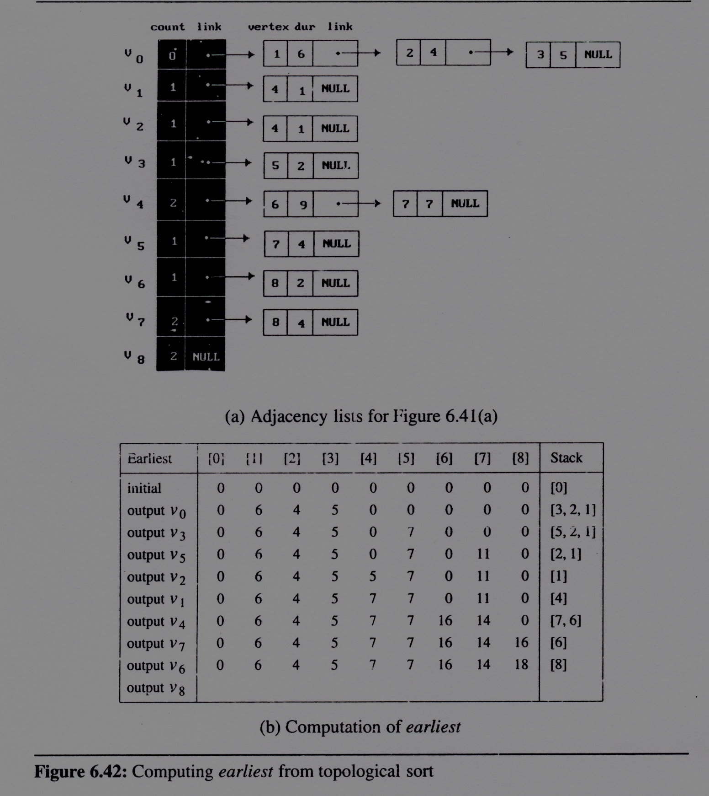
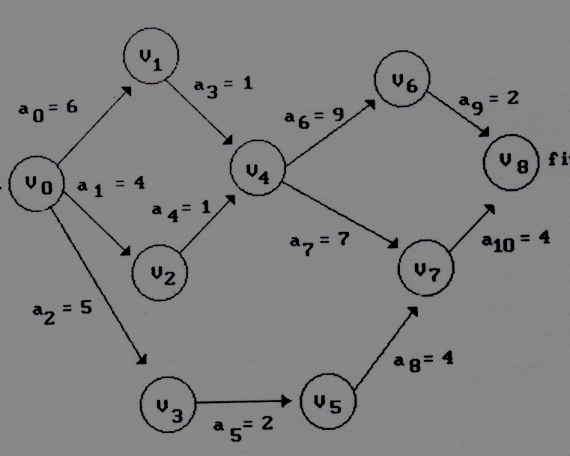
Calculation of Earliest
Times (cont’d)
for (ptr=graph[j].link;ptr;ptr=ptr->link){
k=ptr->vertex;
graph[k].count--;
if(!graph[k].count){
graph[k].count=top;
top=k;}
if(earliest[k]<
earliest[j]+ptr->duration)
earliest[k] =
earliest[j]+ptr->duration;
}

Slide 26
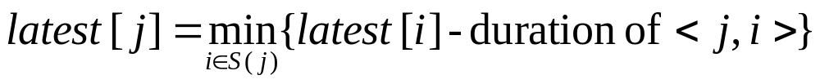
Topological Sorts (15/19)
Calculation of latest times
  In the backward stage, we compute the values of latest[i] using a procedure analogous to that used in the forward stage.
  We start with latest[n-1] = earliest[n-1] and use the formula:
  Where S(j) is the set of vertices adjacent from vertex j
  Use inverse adjacency list
  Insert the following statement at the
  end of the else clause in topsort
v_{i1}
v_{j}
v_{i2}
.
.
.
if (latest[k] > latest[j] - ptr->duration)
latest[k] = latest[j] - ptr->duration;
backward stage
v_{in}

Slide 27
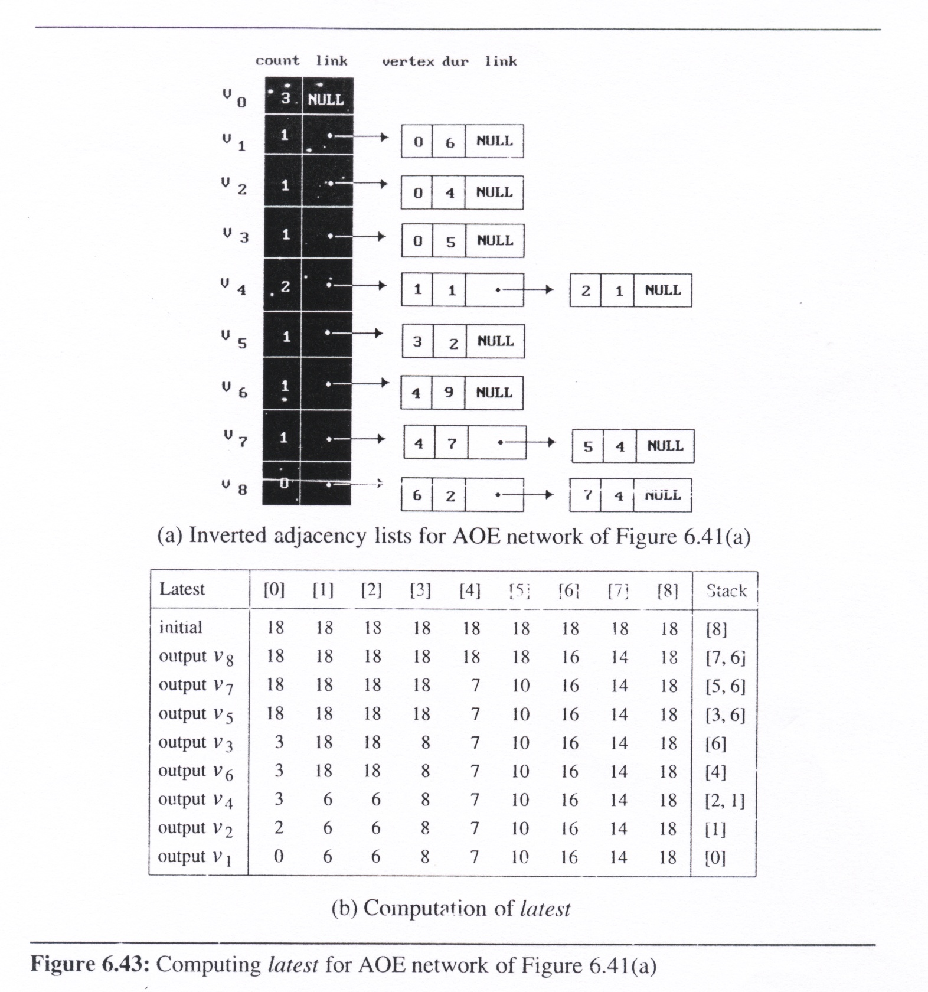
Calculation of latest
Times (cont’d)
for (ptr=graph[j].link;ptr;
ptr=ptr->link){
k=ptr->vertex;
graph[k].count--;
if(!graph[k].count){
graph[k].count=top;
top=k;}
if(latest[k]>
latest[j]-ptr->duration)
latest[k] =
latest[j]-ptr->duration;
}

Slide 28
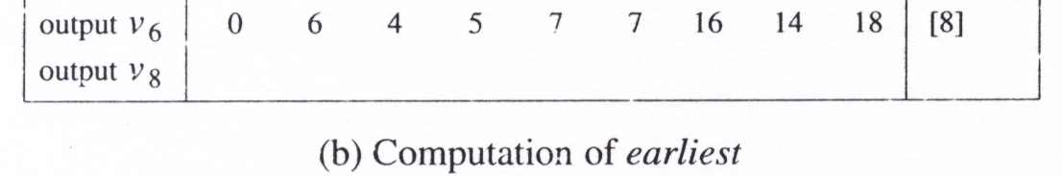
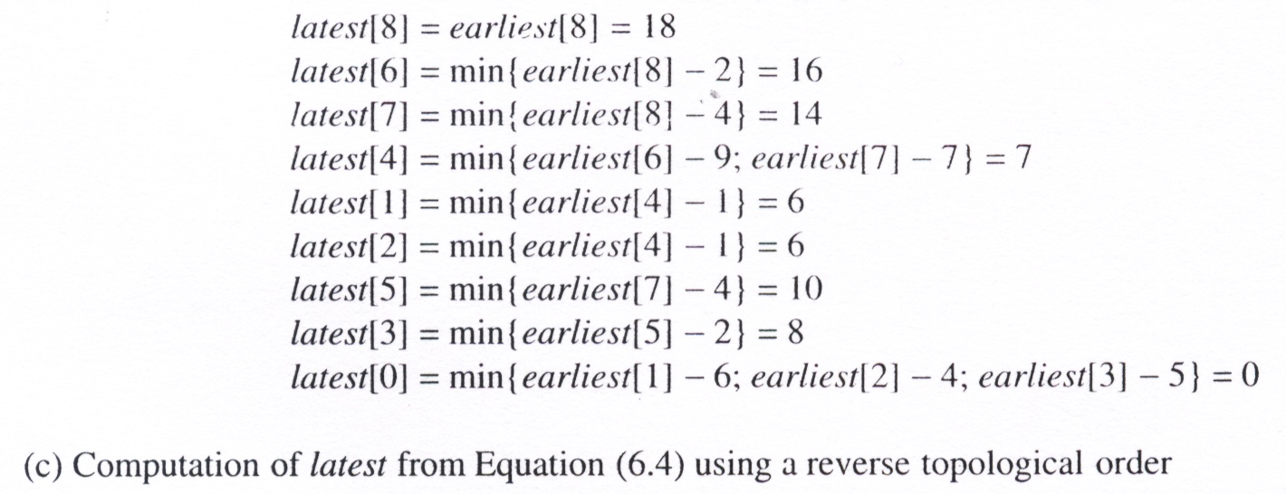
Calculation of latest
Times (cont’d)

Slide 29
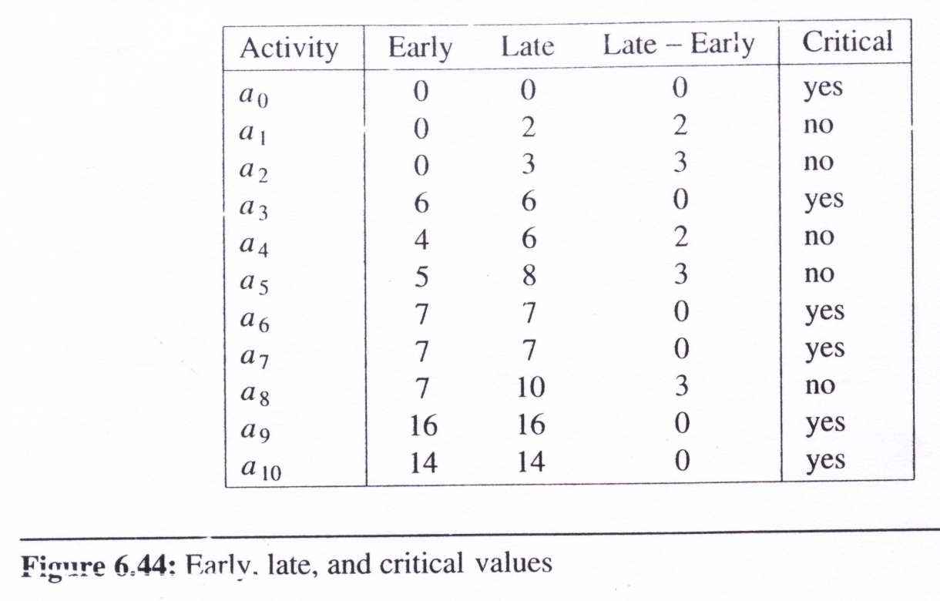
Topological Sorts (18/19)
Non-critical activities deleted
  earliest and latest values ⇒ early(i) and late(i)
  ⇒ the degree of criticality for each task

Slide 30
Topological Sorts (19/19)
We note that the topsort detects only directed cycles in the network.
There may be other flaws in the network, including
  vertices that are not reachable from
  the start vertex
  We can also use critical path
  analysis to detect this kind of
  fault in project planning
earliest[i] = 0
a₄
V₃
V₄
a₅
V₁
a₆
a₀
a₂
V₀
V₅
a₁
a₃
V₂

