Slide 1

Operating System and Profiling Tool
Speaker: 交通大學蔡上仁
交通大學鄭亦呈

Slide 2

outline
What is profilling and profiler?
How to proflie?
HAS profiler - Code XL introduction.
  Profile types.
    CPU profiler
    GPU profiler
    Kernel Occupancy
  Analysis processor kernel
  Estimate performance

Slide 3
What is profiling?
Profiling:
Dynamic program analysis that measures, for example,
  Space (memory) or time complexity of a program.
  Usage of particular instruction.
  Frequency and duration of function calls .
Aim at program optimization.
Achieved by instrumenting either the program source code or its
binary executable form using a tool called profiler.

Slide 4
What is profiler?
Profiler:
Profilers use a wide variety of techniques to collect data:
  Hardware interrupt
  Code instrumentation
  Instruction set simulation
  Performance counter
Who will use these kind of tool?
  Computer architects:
  Emulate how well programs will perform on new architecture.
  Software writer:
  Analyze their programs and identify critical sections of code.
  Compiler writer:
  Find out how well their instruction scheduling or branch prediction
  algorithm is performing.
Notes:
1.知道怎麼改進程式或舊程式在新架構下的效能

Slide 5
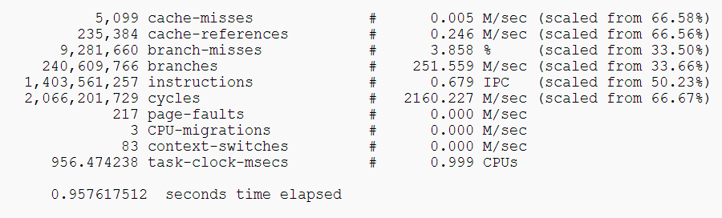
Perf&oprofil
Linux profiling tool:
  Run on linux based system.
  The perf tool supports a list of measurable events such as:
    SW events
      Contex-switches
      CPU migrations
      Page faults…
    HW events (PMU hardware events)
      Caches misses count
      TLB miss count
      CPU cycles…
Example:

Slide 6
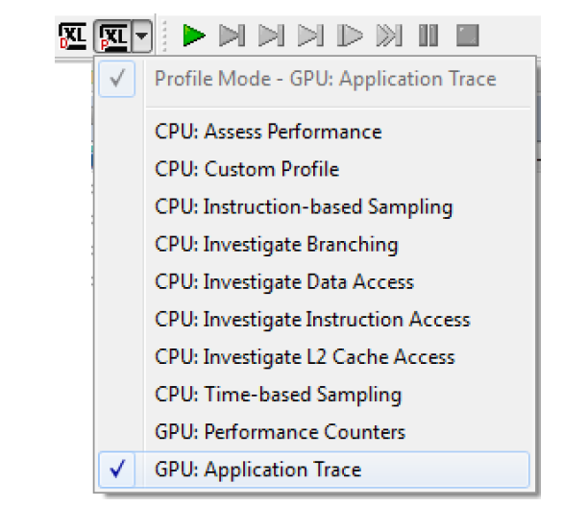
Code-XL
The CodeXL GPU Profiler is a performance analysis tool that gathers data from the OpenCL run-time and AMD GPUs during the execution of an OpenCL application
Provide variety of profiling types:

Slide 7
Code-Xl System Requirements
Operating Systems
    Microsoft Windows 7 (32 bit / 64 bit)
    Microsoft Windows 8 (32 bit / 64 bit)
    Microsoft Windows 8.1 (32 bit / 64 bit)
    Linux 64-bit (Red Hat, Ubuntu)
Profiling OpenCL™ Applications
  [GPU device] AMD Catalyst driver with OpenCL™ GPU support
  [GPU device] AMD Radeon™ HD 5000 series or newer
  AMD APP SDK

Slide 8
CODEXL CPU Profiler
Three profile modes:
  Time-Based Profile (TBP)
  Event-Based Profile (EBP)
  Instruction-Based Sampling (IBS)

Slide 9
Time-Based Profiling
CodeXL configures a timer that periodically interrupts the program executing on a processor core
When a timer interrupt occurs, a sample is created and saved for post-processing.
Post-processing builds up a type of histogram, which describes what the system and its software components were doing.
The most time-consuming parts of a program have the most samples

Slide 10
Event-Based Profile
The CPU Profiler uses the Performance Monitor Counters ,PMCs, to monitor the various micro-architectural events
Ex:
  Investigate Data Access(pre-define configuration in CODEXL)
    Hardware Events:
    Retired Instructions
    Data cache accesses
    Data cache misses
    Data cache refills from L2 or Northbridge
    L1 DTLB miss and L2 DTLB hit
    L1 DTLB and L2 DTLB misses
    Misaligned accesses

Slide 11
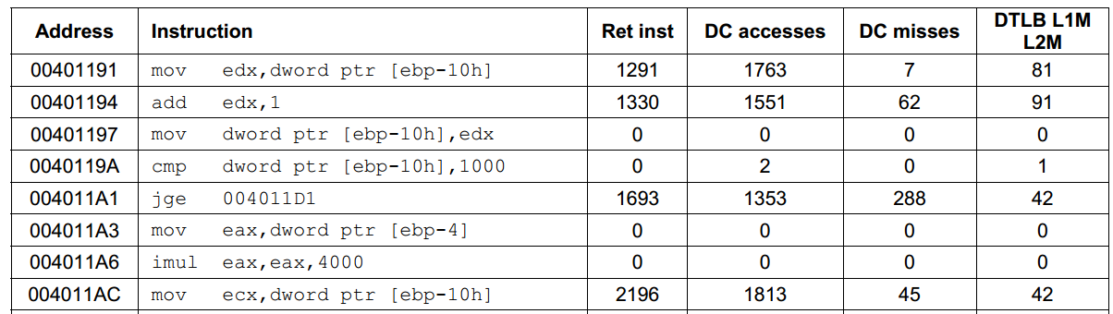
Instruction-Based Sampling
When running IBS, hardware events are linked with the instructions that caused them.
IBS is supported starting from the AMD processor family 10h.

Slide 12
Event-Counter Multiplexing
Monitored PMC events <= available performance counters
  each event can be monitored 100% of the time
Monitored PMC events > available performance counters
  the CPU Profiler time-shares the available HW PMC counters
The CPU Profiler auto-scales the sample counts to compensate for this event counter multiplexing

Slide 13
CPU Profile Data Analysis
Profile Session Call Graph View
- Displays a list of functions with their Call Graph information
Profile Session Functions View
- Displays list of functions called during profiling of the current session
Profile Session Source or Disassembly View
- Shows the source lines annotated with assembly instructions and
sample count for a selected function
Profile Session Modules View
  - Displays a module-by-module detailing of performance data

Slide 14
Using the GPU Profiler
The GPU Profiler provides two modes:
  Application Timeline Trace
    1. An API Trace, showing all OpenCL™ APIs called by the application.
    2. A timeline showing the call sequence and duration of all OpenCL™
    APIs called by the host
    3. Data transfers and kernels executing on a device.
    4. Statistics for the application, as well as the results of detailed analysis
    of the application.
  Performance Counters
  1. Collects performance counters from the AMD GPU or APU for each kernel
  dispatched to the device.
  2. Display the kernel source code, the generated IL code, and the compiled
  ISA code for a kernel dispatched to a GPU

Slide 15
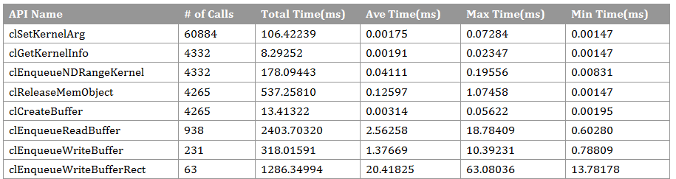
Profiler view
  Application Timeline Trace:
Performance counter:
Name | Description
Wavefronts | Total wavefronts.
ALUInsts | The average number of ALU instructions executed per work-item (affected by flow control).
FetchInsts | The average number of Fetch instructions from the video memory executed per work-item (affected by flow control).
WriteInsts | The average number of Write instructions to the video memory executed per work-item (affected by flow control).
ALUBusy | The percentage of GPU time ALU instructions are processed. Value range: 0% (bad) to 100% (optimal).
CacheHit | The percentage of fetches that hit the data cache. Value range: 0% (no hit) to 100% (optimal).

Slide 16
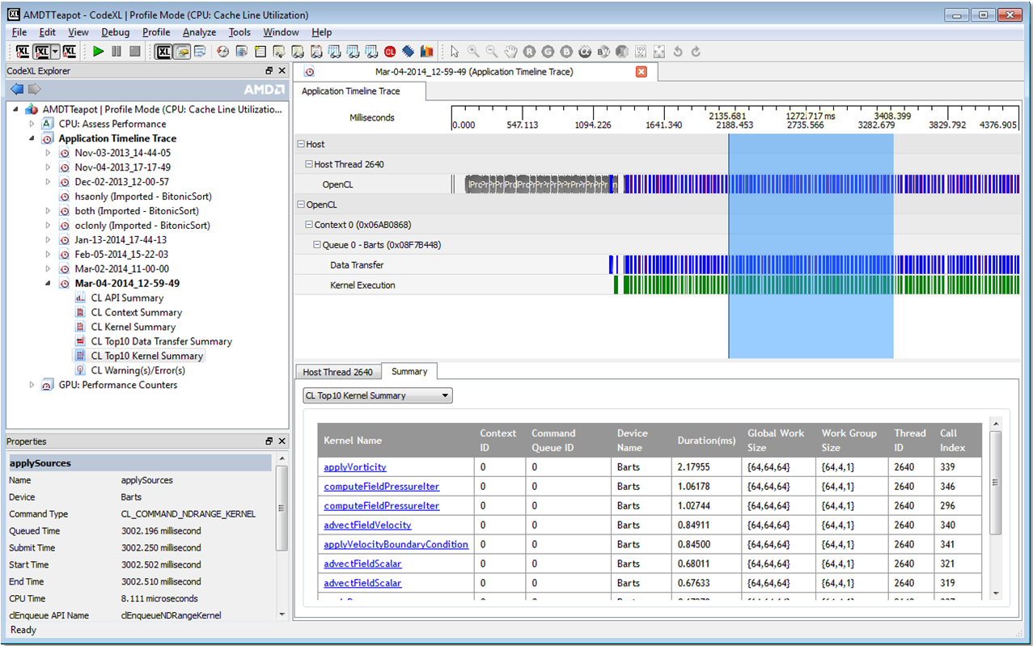
Application trace
Timeline View:
  The Timeline View provides a visual representation of the execution of the application

Slide 17
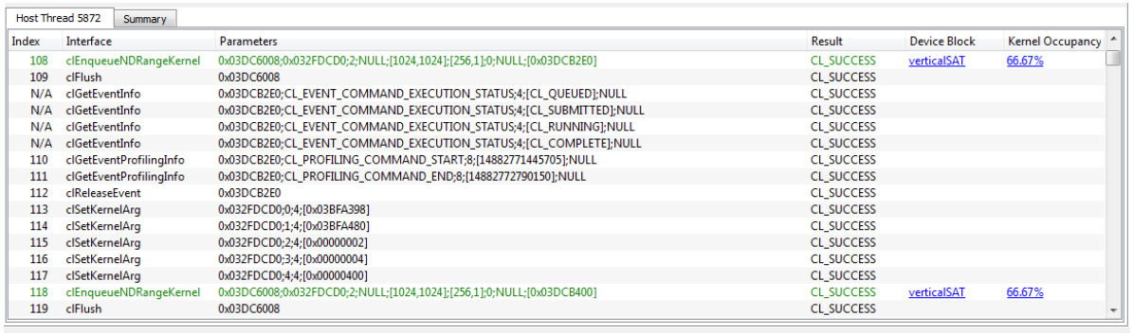
API trace view
The API Trace lists all the OpenCL API calls made by the application.

Slide 18
It helps…
Verifying that the number of queues and contexts created as you expected
Confirm that synchronization has been performed properly
Confirm that the application has been using the hardware efficiently

Slide 19
Performance counter
Find the number of resources (general-purpose registers, local memory sizes, and flow control stack size) allocated for the kernel
Determine the number of bytes fetched from, and written to, the global memory
Determine the use of the SIMD engines and memory units in the system
View the efficiency of the shader compiler in packing ALU instructions into the VLIW instructions used by AMD GPUs.

Slide 20
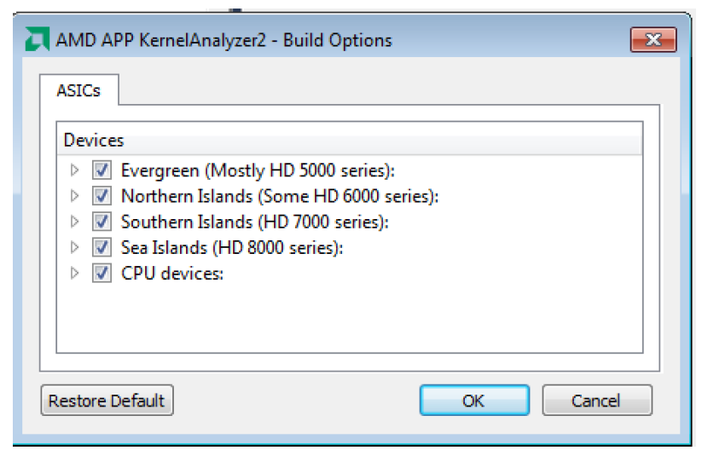
AMD APP Kernel Analyzer
AMD APP KernelAnalyzer2 analyzes the performance of OpenCL kernels for
AMD GPUs:
  It gives accurate kernel performance estimates and lets you view
  kernel compilation results and assembly code for multiple GPUs, without
  requiring actual GPU hardware.

Slide 21
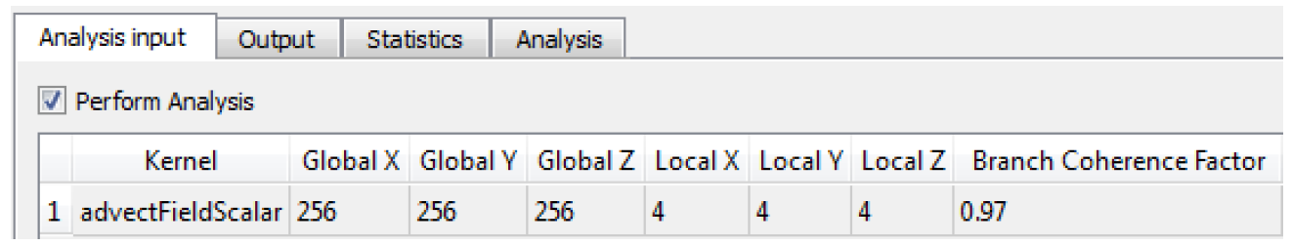
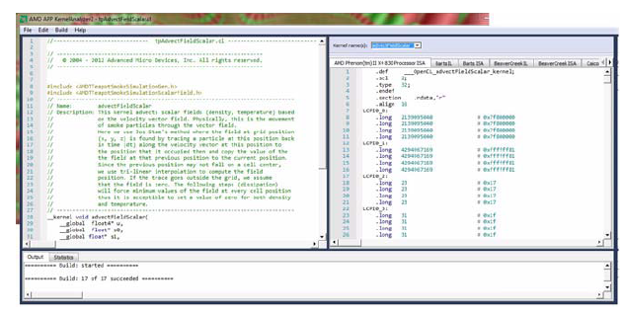
Analysis Input
For each kernel, you can set the global and local work size.
After build:

Slide 22
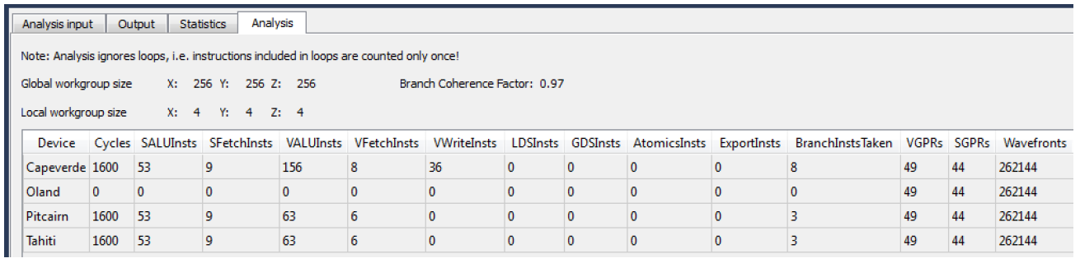
Analysis result

Slide 23
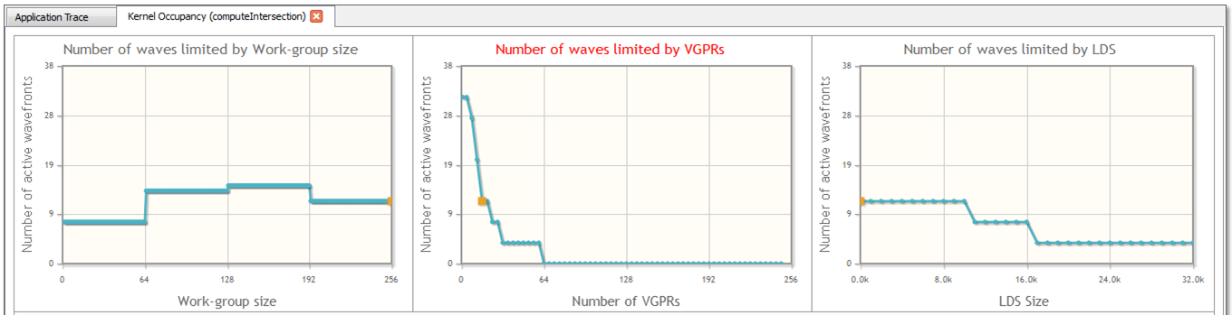
GPU Profiler Kernel Occupancy
How the number of active wavefronts is affected by the size of the work-group for the dispatched kernel.
How the number of active wavefronts is affected by the number of vector GPRs used by the dispatched kernel.
How the number of active wavefronts is affected by the amount of LDS used by the dispatched kernel.

Slide 24
GPU Profiler Kernel Occupancy
The number of wavefronts that are scheduled is constrained by
three significant factors:
The number of general purpose registers (GPR) required by each work- item
The amount of shared memory (LDS for local data store) used by each work-group.
The configuration of the work-group (the work-group size).

Slide 25
Estimate performance
Measuring Execution Time
Using the OpenCL timer with Other System Timers
Estimating Memory Bandwidth

Slide 26
Measuring Execution Time
The OpenCL runtime provides a built-in mechanism for timing the execution of kernels by setting the CL_QUEUE_PROFILING_ENABLE
OpenCL provides four timestamps
  CL_PROFILING_COMMAND_QUEUED
  CL_PROFILING_COMMAND_SUBMIT
  CL_PROFILING_COMMAND_START
  CL_PROFILING_COMMAND_END
Notes:
Enabling profiling on a command queue adds approximately 10 μs
to 40 μs overhead to all clEnqueue calls. Much of the profiling overhead affects
the start time; thus, it is visible in the launch time. Be careful when interpreting

Slide 27
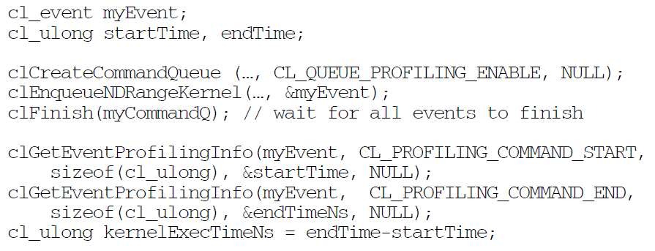
Measuring Execution Time
Simple example:

Slide 28
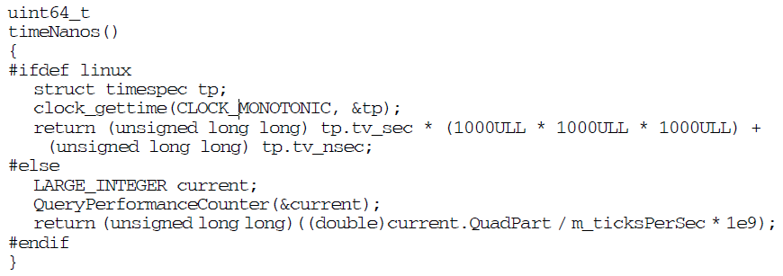
OpenCL timer with Other System Timers
AMD CPUs and GPUs report a timer resolution of 1 ns.
OpenCL uses the same time-domain for all devices in the platform; thus, profiling timestamps can be directly compared across the CPU and GPU devices.

Slide 29
OpenCL timer with Other System Timers
Normal CPU time-of-day routines can provide a rough measure of the elapsed
time of a GPU kernel.
In OPENCL, you can force CPU to wait GPU idle by clFinish().
Inserting calls to clFinish() before and after the sequence you want to time;
this increases the timing accuracy of the CPU routines.
clFinish()
block CPU until all the commands have been finished
clKernel
block CPU until clKernel has been finished
clFinish()

Slide 30
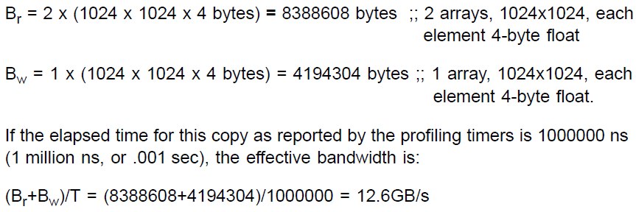
Estimating Memory Bandwidth
Effective bandwidth = (Br + Bw)/T (GB/s)
  Br = total number of bytes read from global memory. (bytes)
  Bw = total number of bytes written to global memory. (bytes)
  T = time required to run kernel, specified in nanoseconds. (ns)
Example: (If you thorough understanding of the kernel algorithm)
+
=
1024*1024
1024*1024
1024*1024

Slide 31
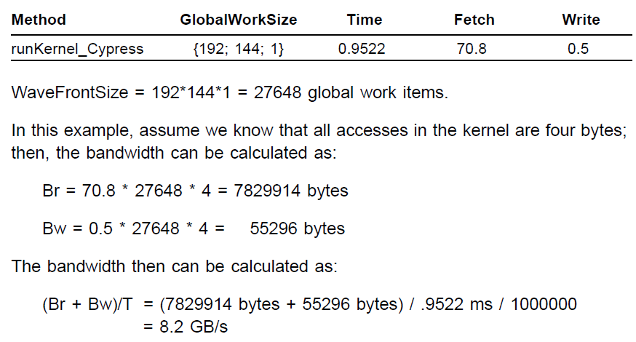
How profiler estimate?
Br = Fetch * GlobalWorkitems * Size
Bw = Write * GlobalWorkitems * Size
Profiler tell us:

Slide 32
Profiler for HSA
We may interested
  TLB miss count.
  Latency for getting data.
We still can not have a overall HAS system profiler.

Slide 33
AMD GPU Performance API
The GPU Performance API (GPUPerfAPI, or GPA) is a powerful tool to help analyze the performance and execution characteristics of applications using the GPU

Slide 34
reference
CodeXL_User_Guide
AMD_Accelerated_Parallel_Processing_OpenCL_Programming_Guide-rev-2.7
完全看懂 HD 7970 新架構，GPU 如何跑出更高的效能？
CUDA reference guide

