Slide 1
GPU simulation Technology
GPGPU-sim, Gem5-gpu, GPUWattch

Slide 2
Outline
GPGPU-Sim
  functional/timing GPU simulator
Gem5-gpu
  Merge Gem5 and GPGPU-Sim.
  Case study: GPU MMU design
GPUWattch
  Add power model for GPGPU-Sim

Slide 3
What GPGPU-Sim Simulates
Functional model for PTX/SASS
  PTX = Parallel Thread eXecution
    Virtual ISA defined by Nvidia
  SASS = Native ISA for Nvidia GPUs
Timing model for the compute part of a GPU
  Not for CPU or PCIe
  Only model micro-architecture timing relevant to GPU compute.

Slide 4
Functional Model (PTX)
Low-level, data-parallel virtual machine by Nvidia
  Instruction level
  Unlimited registers
  Parallel threads running in blocks; barrier synchronization instruction
Intermediate representation in CUDA tool chain:
G80
.cu
NVCC
GT200
PTX
ptxas
Fermi
.cl
OpenCL Drv
Kepler

Slide 5
Functional Model (SASS)
SASS = Native ISA for Nvidia GPUs
  Better correlation with HW GPU
  “SASS” is what NVIDIA’s cuobjdump calls it.
For simplicity GPGPU-Sim uses assembly syntax that can represent both SASS and PTX. Called PTXPlus.
SASS mapped into PTXPlus instructions.
CUDA
Executable
cuobjdump
SASS
conversion
PTXPlus

Slide 6
Timing Model for Compute Parts of a GPU
Gfx DRAM
GPGPU-Sim models timing for:
  SIMT Core (SM, SIMD Unit)
  Caches (Texture, Constant, …)
  Interconnection Network
  Memory Partition
  Graphics DRAM
It does NOT model timing for:
  CPU, PCIe
  Graphics Specific HW (Rasterizer, Clipping, Display… etc.)
GPU
Interconnect
Cache
Mem Part.
SIMT Cores
Gfx HW
PCIe
Raster…
CPU

Slide 7
Timing Model for GPU Micro-architecture
GPGPU-Sim is a detailed cycle-level simulator:
  Cycle-level model for each part of the microarchitecture
  Research focused
    Ignoring rare corner cases to reduce complexity
  In most cases we can only guess at details.
  Guesses “informed” by studying patents and microbenchmarking.
  CUDA manual provides some hints.
  NVIDIA IEEE Micro articles provide other hints.

Slide 8
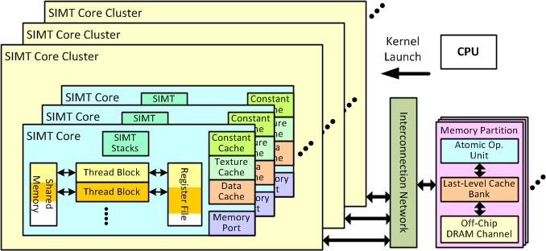
GPU Microarchitecture Overview
SIMT Core
Interconnection Network
Clock Domains
Memory Partition
Figure from: http://gpgpu-sim.org/manual/images/2/21/Overall-arch.png

Slide 9
Inside a SIMT Core (3.0)
SIMT Front End
SIMD Datapath
Branch Target PC
Fetch
SIMT-Stack
Scheduler 1
Scheduler 3
ALU
Valid[1:N]
Active
ALU
I-Buffer
Pred.
ALU
Mask
ALU
I-Cache
Decode
Issue
Operand
Scheduler 2
Collector
Score
MEM
Board
Done (WID)
Design Model
  Fetch + Decode
  Instruction Issue
  Scoreboard
  SIMT Stack
  Operand collector
  ALU
  Memory unit

Slide 10
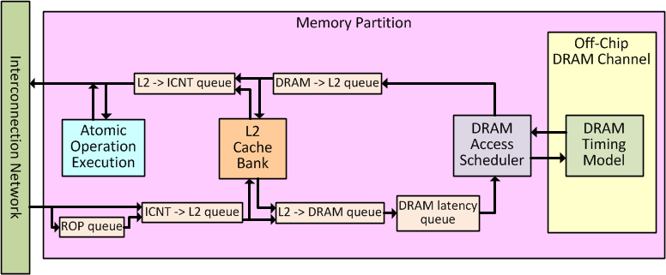
Memory Partition
Service memory request (Load/Store/AtomicOp)
  Contains L2 cache bank, DRAM timing model
Figure from:http://gpgpu-sim.org/manual/index.php5/File:Mempart-arch.png

Slide 11
Accuracy
Similarity Score
copyChunks_kernel()
Back Propagation
bpnn_layerforward_CUDA()
HotSpot
calculate_temp()

Slide 12
Accuracy

Slide 13
Gem5-gpu
Gem5 simulator
  Full-system simulation
  Multiple ISA support(arm, x86…etc)
  detailed, event-driven memory system
Gem5-gpu merges 2 popular simulators:
  gem5 and gpgpu-sim.
Support detail timing simulation of CPU, GPU and memory hierarchy.

Slide 14
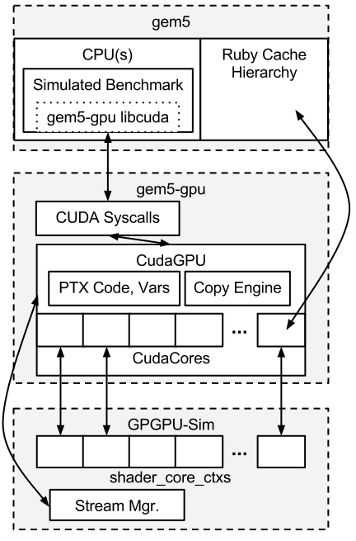
Gem5-gpu: Gem5 + GPGPU-Sim
CudaCore
  Wrapper for GPGPU-Sim shader_core_ctx
  Sends instruction, global and const memory requests to Ruby cache hierarchy.
CudaGPU
  Acts as gem5 structure for organizing the GPU hardware
Shader TLB
  Manages GPU memory space page table
  If flag “--access-host-pagetable” is set,
  GPU will use CPU page table for translations.
  Const latency for each event(hit, miss…)
Figure from:https://gem5-gpu.cs.wisc.edu/wiki/_detail/current_gem5-gpu_architecture_1_31_2013-cropped.png?id=cur-arch

Slide 15
Case study: GPU MMU design
Related paper:
  Topic: Address translation(VA->PA) on GPU
    Supporting x86-64 address translation for 100s of gpu lanes(HPCA '14)
      Jason Power(gem5-gpu author), Mark D. Hill , David A. Wood
      (University of Wisconsin–Madison )

Slide 16
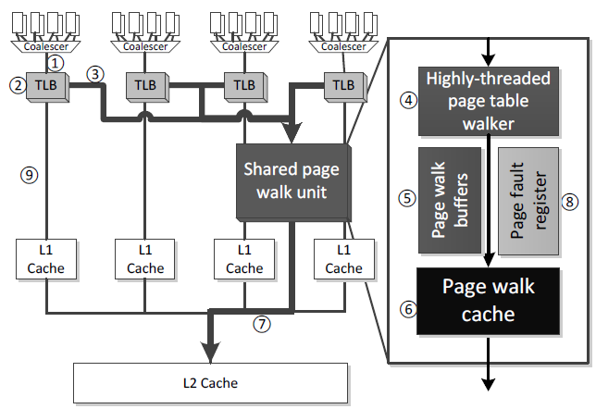
Target simulation architecture
Simulate GPU TLB, MMU behavior
Assign constant delay latency for each event(hit, miss...)

Slide 17
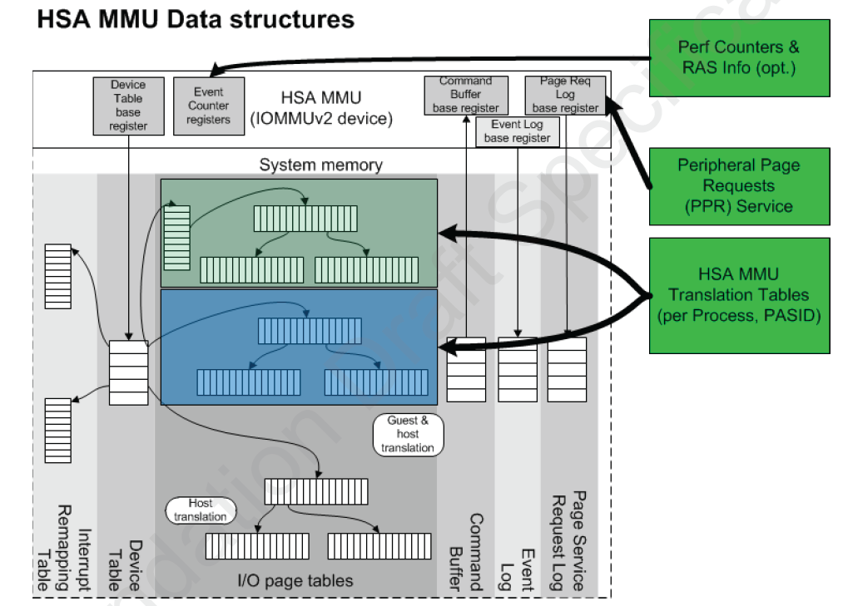
MMU design for HSA
IOMMU in HSA architecture
  Use Device ID, PASID ID to separate different device process.
  Walk page table to find physical address.
Problem
  The overhead of address translation mechanism.
  Unlike a simple IO device, GPU issues much more memory requests than accesses to I/O.
Figure from HSA hardware specification

Slide 18
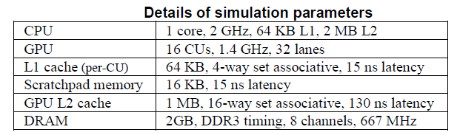
Discussion of GPU MMU design
The fundamental problems
  Low temporal locality, increase TLB miss.
  GPU has hundreds of cores.
  Memory instructions dispatch on several lanes
  at the same time.
  Some memory instructions will hit and others will miss in TLB.
  What is the frequency of TLB miss or page fault?
Simulation target platform

Slide 19
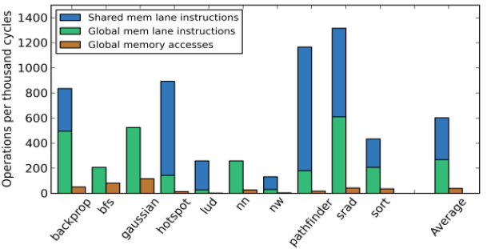
Paper’s observation 1: global memory access
Frequently global memory access
  Every 1000 cycles
    Average 602 mem inst.
    268 global instructions.
    Coalescing can reduce
    global inst to 39 accesses.
  Solution:
  Use coalescer to reduce
  global memory access.
Memory instructions every 1000 cycles

Slide 20
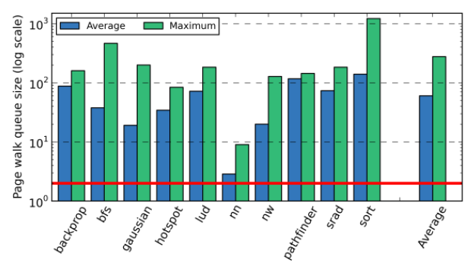
Paper’s observation 2: memory bandwidth
Average 60 page table walks
are active at that CU.
Worst workload averages 140
concurrent PTW.
observation:
  90% page walks issued within
  500 cycles of previous PTW.
  Solution: shared multi-threaded page table walker(PTW)
  (up to 32 threads).
Log scale

Slide 21
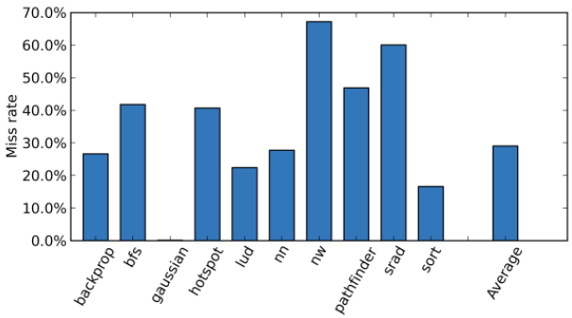
Paper’s observation 3:TLB miss rate
High TLB miss rate
  Average 29%,
  the highest is 67%.
  Solution:
  Add page walk cache to
  reduce PTW latency.

Slide 22
Paper’s proposed architecture
Coalescer for global memory accesses
multi-threaded page table walker
page walk cache

Slide 23
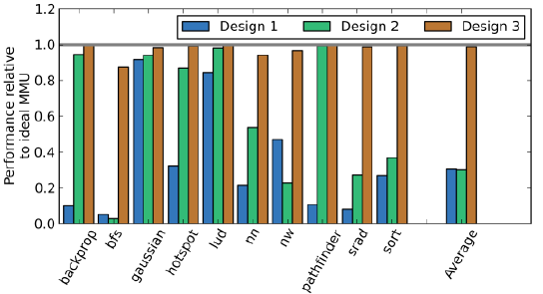
MMU performance
Design 1: Coalescer
Design 2: Coalescer + multi-threaded PTW
Design 3: Coalescer + multi-threaded PTW + PTW cache

Slide 24
GPUWattch

Slide 25
Power Model: GPUWattch
GPGPU-Sim introduces such a power model
  Cycle-accurate: Integrates GPGPU-Sim v3.1.2 with McPAT v0.8
  Configurable: GPGPU-Sim/McPAT configuration files
  Fine-grained: Performance/event counter driven.
  McPAT: Circuit level implementation
  Extensible: Can model new components or add more fine-grained per-component metrics
  Validated: Rigorously validated against NVIDIA GTX480 and Quadro Fx 5600 GPUs
Enables the exploration of new energy-efficiency optimizations for GPGPU research

Slide 26
GPUWattch: GPGPU-Sim with McPAT
Modified McPAT
Modifications: Specific micro-architectural components
Interface
Interface
GPGPU-Sim
Modifications: Add required performance counters
Performance counters
Feedback-driven
Optimizations
Static Power
Dynamic Power
Detailed Performance Stats
Detailed Power Stats
A Comprehensive Framework for Performance and Energy Optimization Research

Slide 27
Modeling Bottom Up: McPAT Modifications
Baseline McPAT
  Multi-core CPU power simulator
  Detailed models for CPU microarchitectural blocks
Modified McPAT to account for GPU specific microarchitectural components
Some of the main components that were added/modified:
  SM Pipeline
  Register File
  Caches
  Shared Memory
  Execution Units
  Main Memory

Slide 28
Modeling: Bottom Up: GPGPU-Sim modifications
Added performance counters required by McPAT
Structures added to manage performance counters
Files added to interface with McPAT
Existing timing model not affected by any GPGPU-Sim modifications

Slide 29
Modeling: Bottom Up: GPGPU-Sim modifications
Current version utilizes 30 performance counters
Main Component | Performance Counters | Main Component | Performance Counters
Instruction cache | Read hit | L2 Data cache | Read hit
 | Read miss |  | Read miss
L1 Data cache | Read hit |  | Write hit
 | Read miss |  | Write miss
 | Write hit | Memory | Reads
 | Write miss |  | Writes
Texture cache | Read hit |  | Precharges
 | Read miss | Register file | Reads
Constant cache | Read hit |  | Writes
 | Read miss |  | Non-register file operand

Slide 30
Modeling: Bottom Up: GPGPU-Sim modifications
Current version utilizes 30 performance counters
Main Component | Performance Counters | Main Component | Performance Counters
Decoding/Scheduling | Total # instructions | Shared Memory | Accesses
 | FP_INT instructions
Pipeline dutycycle | Fraction of committed instructions per cycle | Execution Units | SP accesses
Idle core | Number of cycles each SM is idle |  | SFU accesses
Interconnect | # of flits from SIMT cores to Memory Partition
 |  |  | FPU accesses
 | # of flits from Memory Partition to SIMT cores

Slide 31
Accuracy (Average Power)

Slide 32
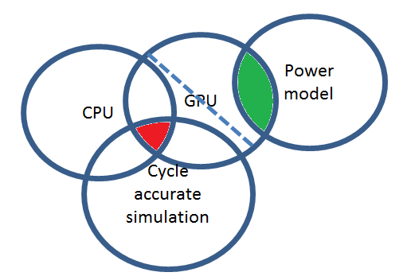
Status
CPU power model
GPUWattch
Gem5-gpu
Different GPGPU-Sim version

Slide 33
Reference
Slides p3~p12, p25~p31 are from gpgpusim tutorial at MICRO 2012.
  Following pages are used:
    1-Tutorial-Intro: 21,22
    2-GPGPU-Sim-Overview: 4,5,7,10,12
    4-Microarchitecture: 9,47
    5c-GPUWattch: 5,9,13,15,19~21
Slides p13~p23 are mainly from
  Gem5-gpu simulator(http://gem5-gpu.cs.wisc.edu)
  Supporting x86-64 address translation for 100s of gpu lanes(HPCA '14)

