Slide 1
  The Heterogeneous System Architecture Intermediate Language
HSAIL

Slide 2
Contents
Overview
Arithmetic Operations
Memory Operations
Image Operations
Branch Operations
Parallel Synchronization and Communication Operations
Function Operations
Special Operations
BRIG: HSAIL Binary Format

Slide 3
Note
In this slides, we didn’t list all the HSAIL instruction and feature.
For further detail description, see HSA Programmers Reference Manual.
This slides on based on version 1.0 Final, 6 Mar 2015

Slide 4
Overview

Slide 5
What is HSAIL?
HSA is designed to efficiently support data-parallel and task-parallel programming models.
A single HSA system can support multiple instructions sets based on CPU(s), GPU(s) and specialized processor(s).
Programmers normally build code for HSA in a virtual machine and intermediate language called HSAIL (Heterogeneous System Architecture Intermediate Language).
Using HSAIL allows a single program to execute on a wide range of platforms, because the native instruction set has been abstracted away.

Slide 6
HSAIL Virtual Machine (1)
A device that participates in the HSA memory model is called an agent.
An HSAIL virtual machine consists of multiple agents including at least 1 host CPU and 1 kernel agent:
  A host CPU is an agent that also supports the native CPU instruction set and runs the host operating system and the HSA runtime.
  As an agent, the host CPU can dispatch commands to an Kernel Agent using memory operations to construct and enqueue AQL packets.
In some systems, a host CPU can also act as an Kernel Agent(with appropriate HSAIL finalizer and AQL mechanisms).

Slide 7
HSAIL Virtual Machine (2)
An Kernel Agent is an agent that supports the HSAIL instruction set and the AQL packet format.
As an agent, an Kernel Agent can dispatch commands to any Kernel Agent (including itself) using memory operations to construct and enqueue AQL packets.

Slide 8
HSAIL Virtual Machine (3)
An Kernel Agent does not need to execute HSAIL code directly:
- it can execute ISA generated from HSAIL code by a finalizer provided by the runtime.
Different implementations can choose to invoke the finalizer at various times:
- built time
- install time
- load time
- execution time

Slide 9
Kernels
Certain sections of code, called kernels, are executed in a data-parallel way by Kernel agents.
Kernels are written in HSAIL and then separately translated (statically, at install time, at load time, or dynamically) by a finalizer to the target instruction set.
Kernel does not return a value.

Slide 10
HSAIL Virtual Language (1)
HSAIL is a virtual instruction set designed for parallel processing.
Each implementation of HSA might be different, but all implementations will run any program written in HSAIL.
Can be translated into many different native instruction set.
HSAIL has no explicit parallel constructs, each kernel contains operations for a single work-item.

Slide 11
HSAIL Virtual Language (2)
HSAIL program looks like a simple RISC-liked assembly program.
HSAIL Operations
  opcode with a set of suffixes(data type, length, others)
  3 operand
  RISC-like constructs
Have pseudo-operations used to declare variables.
All operations except mem op are register-to-register only.

Slide 12
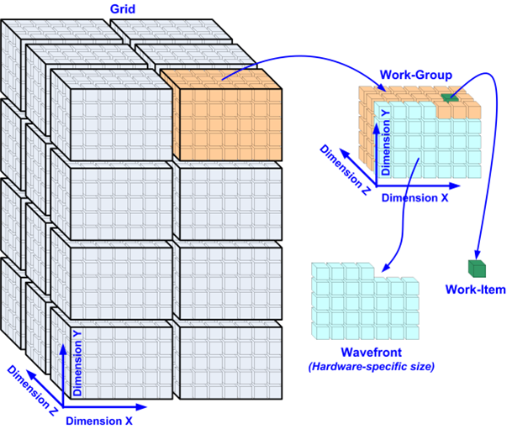
HSAIL Programming Model (1)
When the kernel starts, a multidimensional cube-shaped grid is defined and one work-item is launched for each point in the Grid.
A typical grid will be large, so a single kernel might launch thousands of work-items.

Slide 13
HSAIL Programming Model (2)
Each launched work-item executes the same kernel code, but might take different control flow paths.
Execution of the kernel is complete when all work-items of the grid have been launched and have completed their execution.

Slide 14
HSAIL Programming Model (3)
Work-items are extremely lightweight, the overhead of context switching among work-items is low.

Slide 15
HSAIL Programming Model (4)
Work-items within a work-group can be executed in an extended SIMD style. That is, work-items are gang-scheduled in chunks called wavefronts.
Executing work-items in wavefronts can allow implementations to improve computational density.

Slide 16
HSAIL Programming Model (5)
A lane is an element of a wavefront. The wavefront size is the number of lanes in a wavefront.

Slide 17
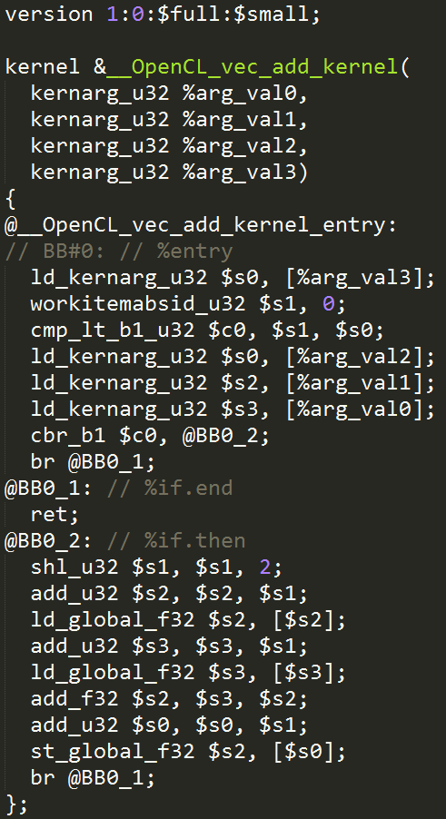
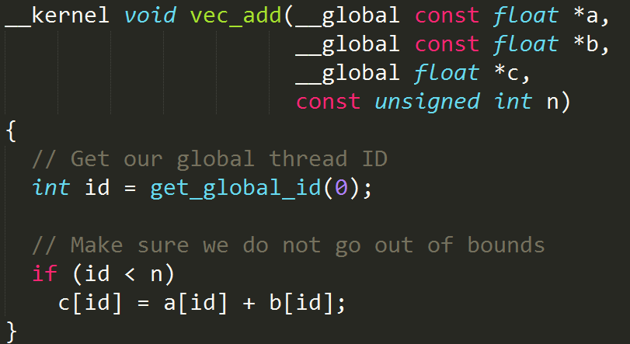
HSAIL Example
OpenCL Kernel
HSAIL Kernel

Slide 18
HSA Runtime support for HSAIL Life Cycle

Slide 19
Unified Memory Model (1)
HSA has a unified memory model, where all HSAIL work-items and agents can use the same pointers, and a pointer can address any kind of HSA memory.
Programmers are relieved of much of the burden of memory management.
The HSA system determines if a load or store address should be visible to all agents in the system (global memory), visible only to work-items in a group (group memory), or private to a work-item (private memory).

Slide 20
Unified Memory Model (2)
The same pointer can be used by all agents in the system including all host CPUs and all Kernel agents.
Global memory (but not group memory or private memory) is coherent between all agents.

Slide 21
Types of Memory
HSAIL memory is organized into three types:
Flat memory: Flat memory is a simple interface using byte addresses. Loads and stores can be used to reference any visible location in the flat memory.
Registers: 1bit, 32bit, 64bit, 128bit.
  Registers are untyped.
Image memory
  Image memory is a special kind of memory access that can make use of dedicated hardware often provided for graphics.
  Only programmers seeking extreme performance need to understand image memory.

Slide 22
Segments (1)
Flat memory is divided into segments based on:
  The way data can be shared
  The intended usage
A segment is a block of memory. The characteristics of a segment space include its size, addressability, access speed, access rights, and level of sharing between work-items.

Slide 23
Segments (2)
The segment determines the part of memory that will hold the object, how long the storage allocation exists, and the properties of the memory.
The finalizer uses the segment to determine the intended usage of the memory.
No access protection between segments is provided. That is, the behavior is undefined when memory operations generate addresses that are outside the bounds of a segment.

Slide 24
Types of Segments
Global - hold variables that are shared by all agents.
Group - hold variables that are shared by the work-items of a work-group.
Private - hold variables that are local to a single work-item.
Kernarg - Read-only memory is used to pass arguments into a kernel.
Readonly - hold variables that remain constant during the execution of a kernel dispatch.
Spill - HSAIL has a fixed number of registers, and the spill segment can be used to load or store register spills.
Arg - pass arguments into and out of functions.

Slide 25
Memory Segment Access Rules(1)
Segment | HSA Component interaction (HSAIL) | Non-HSA Component Agent interaction | Persistence | Allocation | Definition can be initialized? | Where can variables be defined? | Can be accessed by a flat address?
Global | General global space; non-const variables read-write; const variables read-only and value must not change during storage duration of variable. | Read-write by all agents. | Application | Program or agent | Optional for non-const variables; required for const variables | module; kernel or function code block | Yes
Readonly | Read-only; value must not change during execution of kernel dispatch. | Can be written by host CPU agent using HSA runtime, provided no kernel dispatch is executing that is using variable. | Application | Agent | Optional | module; kernel or function code block | No
Kernarg | Holds kernel arguments; read-only; value must not change during execution of kernel dispatch. | Initial values provided by the agent when the kernel dispatch is queued. Initial values must not be changed while kernel dispatch is executing. | Kernel | Automatic | No | kernel formal argument list | No
Group | Read-write. | Inaccessible. | Work-group | Automatic | No | module; kernel or function code block | Yes

Slide 26
Memory Segment Access Rules(2)
Segment | HSA Component interaction (HSAIL) | Non-HSA Component Agent interaction | Persistence | Allocation | Definition can be initialized? | Where can variables be defined? | Can be accessed by a flat address?
Arg | Holds function input and output arguments; actual input arguments can be written, actual output argument can be read, formal input arguments can be read and formal output argument can be written; cannot have address taken with lda operation. | Inaccessible. | Work-item | Automatic | No | kernel or function arg block; function formal arguments | No
Private | Holds work-item local variables; read-write. | Inaccessible. | Work-item | Automatic | No | module; kernel or function code block | Yes
Spill | Holds spilled register values; read-write; cannot have address taken with lda operation. | Inaccessible. | Work-item | Automatic | No | kernel or function code block | No

Slide 27
Machine Models
 | Small | Large
Flat address | 32-bit | 64-bit
Global segment address | 32-bit | 64-bit
Readonly segment address | 32-bit | 64-bit
Kernarg segment address | 32-bit | 64-bit
Group segment address | 32-bit | 32-bit
Arg segment address | 32-bit | 32-bit
Private segment address | 32-bit | 32-bit
Spill segment address | 32-bit | 32-bit
Fbarrier address | 32-bit | 32-bit
Address expression offset | 32-bit | 64-bit
Atomic value | 32-bit | 32-bit & 64-bit
Signal value | 32-bit | 64-bit
Kernel code handle | 64-bit | 64-bit
Indirect function code handle | 32-bit | 64-bit

Slide 28
REGISTERS (1)
Four types of registers
  C: 1-bit, Control Registers. ($c0, $c1, $c2 and so on.)
  S: 32-bit, Single-precision FP or Int. ($s0, $s1, $s2 and so on.)
  D: 64-bit, Double-precision FP or Long Int. ($d0, $d1, $d2, and so on.)
  Q: 128-bit, Packed data. ($q0, $q1, $q2 and so on.)
All registers have function scope, so there is no way to pass an argument into a function through a register.
Every work-item has its own set of registers.
No registers are shared between work-items.
Preserved by call sites.

Slide 29
REGISTERS (2)
C use a single pool os resources per function scope
=> If (C_{max}+1 ) >128 in the kernel/function code block then an error occurred!
The C_{max} is the highest register in the kernel/function, or -1 if no C registers are used.
S, D, Q share a single pool of resources per function scope
=> If ( (S_{max}+1) + 2(D_{max}+1) + 4(Q_{max}+1) ) >2048 in the kernel/function code block then an error occurred!
The S_{max} , D_{max ,} Q_{max} are the highest register in the kernel/function,
or -1 if no registers of that type are used.

Slide 30
REGISTERS (3)
Some architectures have an inverse relationship between register usage and occupancy, and high-level compilers may choose to target fewer registers than the HSAIL register limits to optimize for performance.
Registers are a limited resource in HSAIL, so high-level compilers are expected to manage registers carefully.

Slide 31
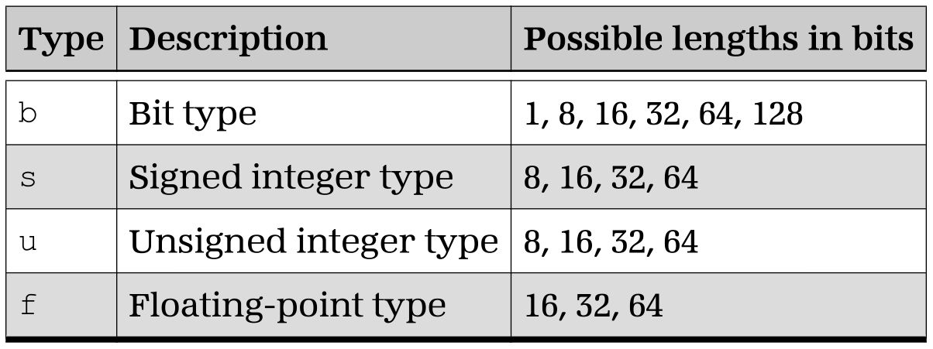
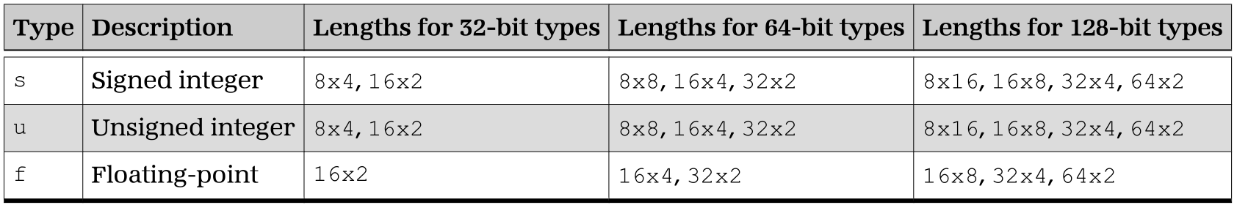
Data Types
HSAIL has four base data types, each of which supports a number of bit lengths.
Packed data allows multiple small values to be treated as a single object.

Slide 32
Packing Controls for Packed Data(1)
One Source Input
Two Source Input
Control | Description
p | The single source is treated as packed. The operation is applied to each element separately.
p_sat | Same as p, except that each result is saturated. (Cannot be used with floating-point values.)
s | The lower element of the source is used. The result is written into the lower element of the destination. The other bits of the destination are not modified.
s_sat | Same as s, except that the result is saturated. (Cannot be used with floating-point values.)
Control | Description
pp | Both sources are treated as packed. The operation is applied pairwise to corresponding elements independently.
pp_sat | Same as pp, except that each result is saturated. (Cannot be used with floating-point values.)
ps | The first source operand is treated as packed and the lower element of the second source operand is broadcast and used for all its element positions. The operation is applied independently pairwise between the elements of the first packed source operand and the lower element of the second packed operand. The result is stored in the corresponding element of the packed destination operand.
ps_sat | Same as ps, except that each result is saturated. (Cannot be used with floating-point values.)

Slide 33
Packing Controls for Packed Data(2)
Two Source Input
Control | Description
sp | The lower element of the first source operand is broadcast and used for all its element positions, and the second source operand is treated as packed. The operation is applied independently pairwise between the lower element of the first packed operand and the elements of the second packed operand. The result is stored in the corresponding element of the packed destination operand.
sp_sat | Same as sp, except that each result is saturated. (Cannot be used with floating-point values.)
ss | The lower element of both sources is used. The result is written into the lower element of the destination. The other bits of the destination are not modified.
ss_sat | Same as ss, except that the result is saturated. (Cannot be used with floating-point values.)

Slide 34
Arithmetic Operations

Slide 35
Arithmetic Operations
Arithmetic operations expect all inputs to be in registers, immediate values, or WAVESIZE, and to produce a single result in a register.
EX: max_s32 $s1, $s2, $s3;
Type: s (signed), Length :32
Dest: s1, Source: s2,s3

Slide 36
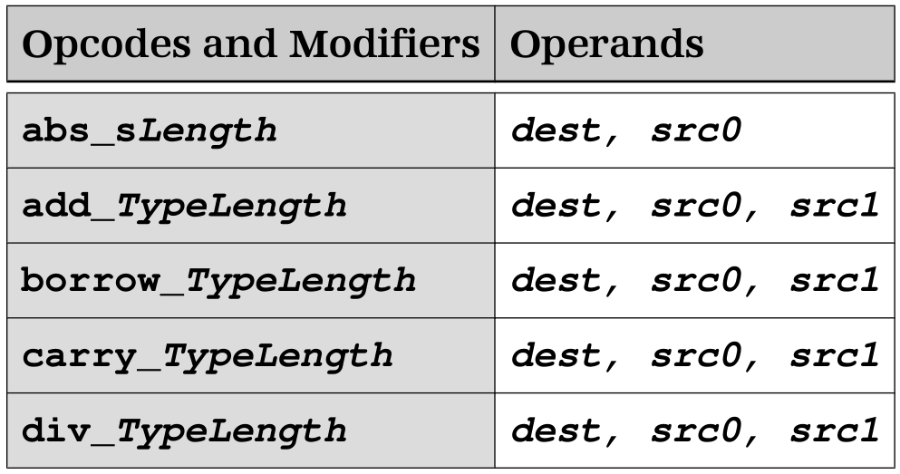
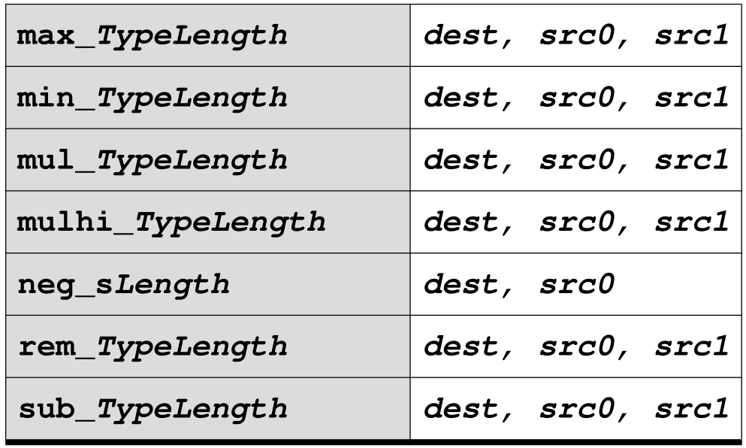
Integer Arithmetic Operations (1)
Integer arithmetic operations treat the data as signed (two's complement) or unsigned data types of 32-bit or 64-bit lengths.
Type: s, u.
Length:32, 64.
Dest: reg, Src: reg, immediate.

Slide 37
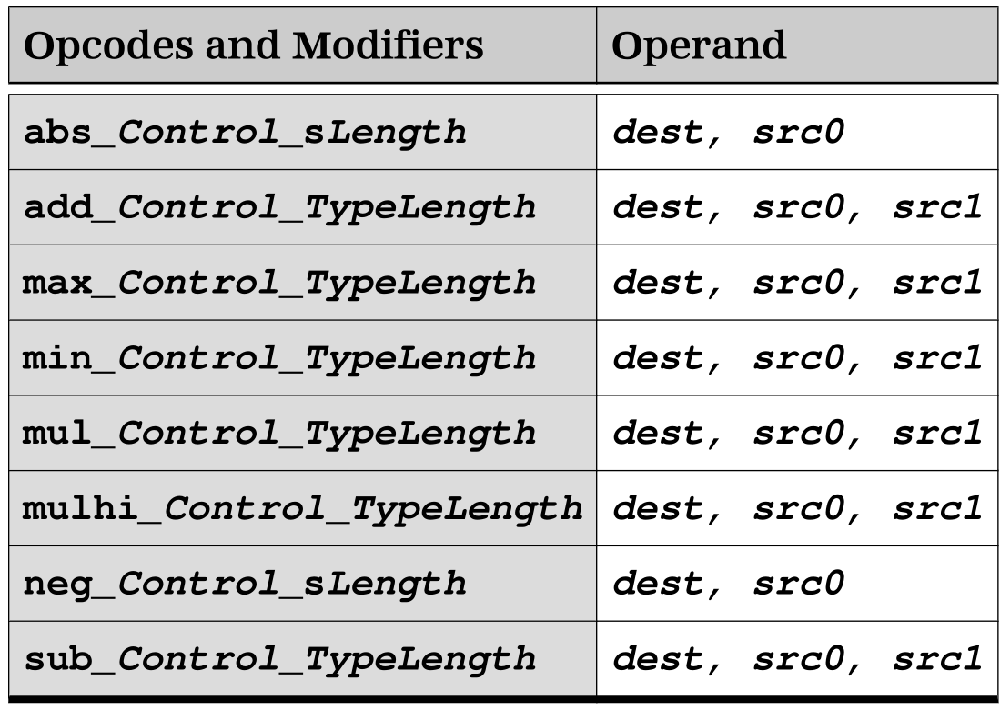
Integer Arithmetic Operations (2)
HSAIL supports packed versions of some integer arithmetic operations.
Type : s, u.
Length:
8x4, 8x8, 8x16,
16x2, 16x4, 16x8,
32x2, 32x4,
64x2.
For floating and other arithmetic operations, see HSA PRM.

Slide 38
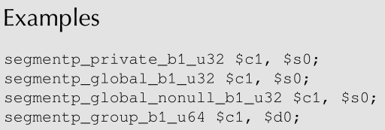
Segment Checking Operation
segmentp - tests whether or not a given flat address is within a specific memory segment.
This operation sets the dest to 1 if the flat address in src is either the nullptr value for the flat address, or is within the address range of the specified segment. If the source is a register, it must match the size of a flat address.

Slide 39
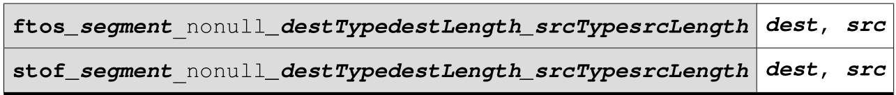
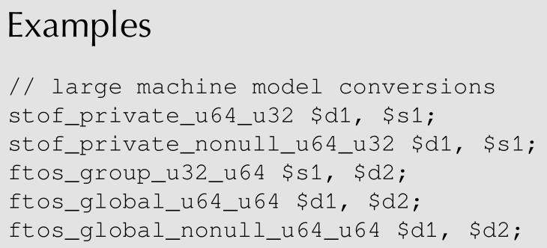
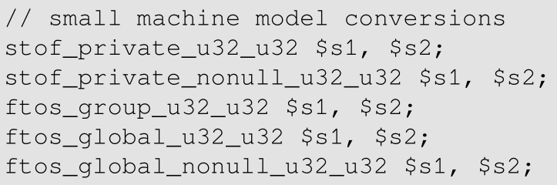
Segment Conversion Operations
The segment conversion operations convert a flat address into a segment address, or a segment address into a flat address.

Slide 40
Memory Operations

Slide 41
Memory and Addressing (1)
Memory operations transfer data between registers and memory and can define memory synchronization between work-items and other agents:
The ordinary load and atomic load operations move contents from memory to a register.
The ordinary store and atomic store operations move contents of a register into memory.

Slide 42
Memory and Addressing (2)
The atomic read-modify-write memory operations update the contents of a memory location based on the original value of the memory location and the value in a register.
The memory fence operation defines the memory synchronization between work-items and other agents.

Slide 43
Memory and Addressing (3)
A flat memory, global segment, readonly segment, or kernarg segment address is a 32- or 64-bit value, depending on the machine model. A group segment, private segment, spill segment, or arg segment address is always 32 bits regardless of machine model.
Memory operations can do either of the following:
  Specify the particular segment used, in which case the address is relative to the start of the segment.
  Use flat addresses, in which case hardware will recognize when an address is within a particular segment.

Slide 44
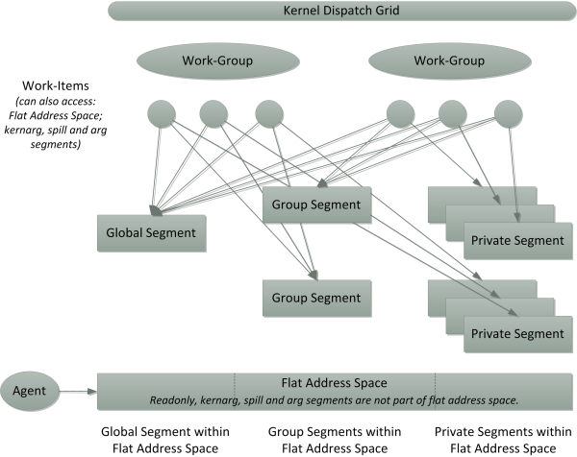
HSA Memory Hierarchy

Slide 45
Equivalence Classes (1)
Equivalence classes can be used to provide aliasing information to the finalizer. There are 256 equivalence classes.
Class 0, the default, is general memory. It can interact with all other classes.
The finalizer will assume that any two memory operations in different classes N > 0 and M > 0 (with N not equal to M) do not overlap and can be reordered.
Equivalence classes in different segments never overlap.

Slide 46
Equivalence Classes (2)
EX:
  Memory specified by the ld or st operations as class 1 can only interactwith class 1 and class 0 memory.
  Memory specified as class 2 can only interact with class 2 and class 0 memory.
  Memory specified as class 3 can only interact with class 3 and class 0 memory. And so on.

Slide 47
Synchronizing and Non-Synchronizing
A synchronizing memory operation and memory fence only affects memory operations to the segments specified by the operation.
  group segment, global segment and image segment.
A Non-Synchronizing memory is the operation only support to ordinary memory operations are supported for below segments.
  private segment, spill segment, arg segment, kernarg segment, readonly segment.

Slide 48
Memory Order
The memory synchronization of an operation is specified by the memory order modifier which can have the following values:
  scacq : specifies the operation is a sequentially consistent acquire memory operation.
  screl : specifies the operation is a sequentially consistent release memory operation.
  scar : specifies the operation is both a sequentially consistent acquire and sequentially consistent release memory operation.
  rlx : specifies the operation is a relaxed memory operation.

Slide 49
Load Operation
load - loads from memory using a segment or flat address expression and places the result into one or more registers.
There are four variants of the ld operation, depending on the number of destinations: 1, 2, 3 or 4.
Opcode and Modifiers | Operands
ld_segment_align(n)_const_equiv(n)_width_TypeLength | dest0, address
ld_v2_segment_align(n)_const_equiv(n)_width_TypeLength | (dest0,dest1), address
ld_v3_segment_align(n)_const_equiv(n)_width_TypeLength | (dest0,dest1,dest2), address
ld_v4_segment_align(n)_const_equiv(n)_width_TypeLength | (dest0,dest1,dest2,dest3), address

Slide 50
Store Operation
store - stores a value from one or more registers, or an immediate, into memory using a segment or flat address expression.
There are four variants of the sore operation, depending on the number of destinations: 1, 2, 3 or 4.
Opcode and Modifiers | Operands
st_segment_align(n)_equiv(n)_TypeLength | src0, address
st_v2_segment_align(n)_equiv(n)_TypeLength | (src0,src1), address
st_v3_segment_align(n)_equiv(n)_TypeLength | (src0,src1,src2), address
st_v4_segment_align(n)_equiv(n)_TypeLength | (src0,src1,src2,src3), address

Slide 51
Memory Scope (1)
The scope of an atomic operation and memory fence can also be specified.
wi - includes only the executing work-item.
wave - includes all work-items in the same wavefront as the executing work-item.
wg - includes all work-items in the same work-group as the executing work-item.

Slide 52
Memory Scope (2)
agent - includes all work-items on the same kernel agent executing kernel dispatches for the same application process as the executing work-item. Only supported for the global segment.
system - includes all work-items on all kernel agents executing kernel dispatches for the same application process, together with all agents executing the same application process as the executing work-item. Only supported for the global segment.

Slide 53
Atomic Memory Operations
Atomic memory operations guaranteed that when a work-item issues an atomic memory operation on a memory location, no write to the same memory location using the same memory scope from outside the current atomic operation by any work-item or agent can occur between the read and write performed by the operation.
If multiple atomic memory operations from different work-items or agents target the same memory location, the operations are serialized in an undefined order. In particular, if multiple work-items in the same wavefront target the same memory location, they will be serialized in an undefined order.
Atomic memory operations only allow global segment, group segment and flat addresses.

Slide 54
Atomic Operations
Opcode and Modifiers | Operands
atomic_ld_segment_order_scope_equiv(n)_TypeLength | dest, address
atomic_and_segment_order_scope_equiv(n)_TypeLength | dest, address, src0
atomic_or_segment_order_scope_equiv(n)_TypeLength | dest, address, src0
atomic_xor_segment_order_scope_equiv(n)_TypeLength | dest, address, src0
atomic_exch_segment_order_scope_equiv(n)_TypeLength | dest, address, src0
atomic_add_segment_order_scope_equiv(n)_TypeLength | dest, address, src0
atomic_sub_segment_order_scope_equiv(n)_TypeLength | dest, address, src0
atomic_wrapinc_segment_order_scope_equiv(n)_TypeLength | dest, address, src0
atomic_wrapdec_segment_order_scope_equiv(n)_TypeLength | dest, address, src0
atomic_max_segment_order_scope_equiv(n)_TypeLength | dest, address, src0
atomic_min_segment_order_scope_equiv(n)_TypeLength | dest, address, src0
atomic_cas_segment_order_scope_equiv(n)_TypeLength | dest, address, src0, src1
Above is atomicRet, for atomic no return see HSA PRM.

Slide 55
Signal Operations (1)
Signal operations are used for notification between threads and work-items belonging to a single process potentially executing on different agents in the HSA system.
While notification can be performed with regular atomic memory operations, the HSA platform architecture signals allow implementations to optimize for power and performance during signal operations.

Slide 56
Signal Operations (2)
For example, spin loops involving atomic memory operations can be replaced with signal wait operations that can be implemented using more efficient hardware features.
Signals are used in the HSA User Mode Queue architecture for notification of packet submission, completion and dependencies.
Signals can also be used for user communication between work-items and threads within the same agent and between different agents.

Slide 57
Signal Operations (3)
A signal can only be created and destroyed by HSA Runtime operations. It cannot be created or destroyed directly in HSAIL.
A signal is referenced by a signal handle. The value of a signal handle is implementation defined, except that the value 0 is reserved and used to represent the null signal handle.
The signal value can only be manipulated by the signal operations provided by the HSA Runtime and by the HSAIL signal operations.

Slide 58
Signal Operations (4)
Opcode and Modifiers | Operands
signal_ld_order_TypeLength_signalType | dest, signalHandle
signal_and_order_TypeLength_signalType | dest, signalHandle, src0
signal_or_order_TypeLength_signalType | dest, signalHandle, src0
signal_xor_order_TypeLength_signalType | dest, signalHandle, src0
signal_exch_order_TypeLength_signalType | dest, signalHandle, src0
signal_add_order_TypeLength_signalType | dest, signalHandle, src0
signal_sub_order_TypeLength_signalType | dest, signalHandle, src0
signal_cas_order_TypeLength_signalType | dest, signalHandle, src0, src1
signal_wait_waitOp_order_TypeLength_signalType | dest, signalHandle, src0
signal_waittimeout_waitOp_order_TypeLength_signalType | dest, signalHandle, src0, timeout
signalnoret_st_order_TypeLength_signalType | signalHandle, src0
signalnoret_and_order_TypeLength_signalType | signalHandle, src0
signalnoret_or_order_TypeLength_signalType | signalHandle, src0
signalnoret_xor_order_TypeLength_signalType | signalHandle, src0
signalnoret_add_order_TypeLength_signalType | signalHandle, src0
signalnoret_sub_order_TypeLength_signalType | signalHandle, src0

Slide 59
Signal Operations (5)
ld, st, and, or, xor, exch, add, sub, cas
  The signal operations have the same definition as the corresponding atomic operations.
wait
  The wait operation suspends a work-item's execution until a signal value satisfies a specified condition, a certain amount of time has elapsed or it spuriously returns.
waittimeout
  Same as wait except src1 is used as the timeout value.

Slide 60
Memory Fence Operation
Opcode and Modifier
memfence_order_scope
memfence - either be a release memory fence, an acquire memory fence, or both an acquire and a release memory fence.
EX:
st_global_u32 1, [&x];
memfence_screl_system; // Will ensure 1 is visible to work-items that
// subsequently perform an acquire at system scope.

Slide 61
Branch Operations

Slide 62
Branch Operations (1)
Opcode and Modifier | Operands
br | label
cbr_width_b1 | src, label
sbr_width_uLength | src [labelList]
Br - unconditional branch.
Cbr - conditional branch which transfers execution to the label specified if the condition value in src is true.
Sbr - A switch branch which transfers control to the label in the labelList that corresponds to the index value in src.

Slide 63
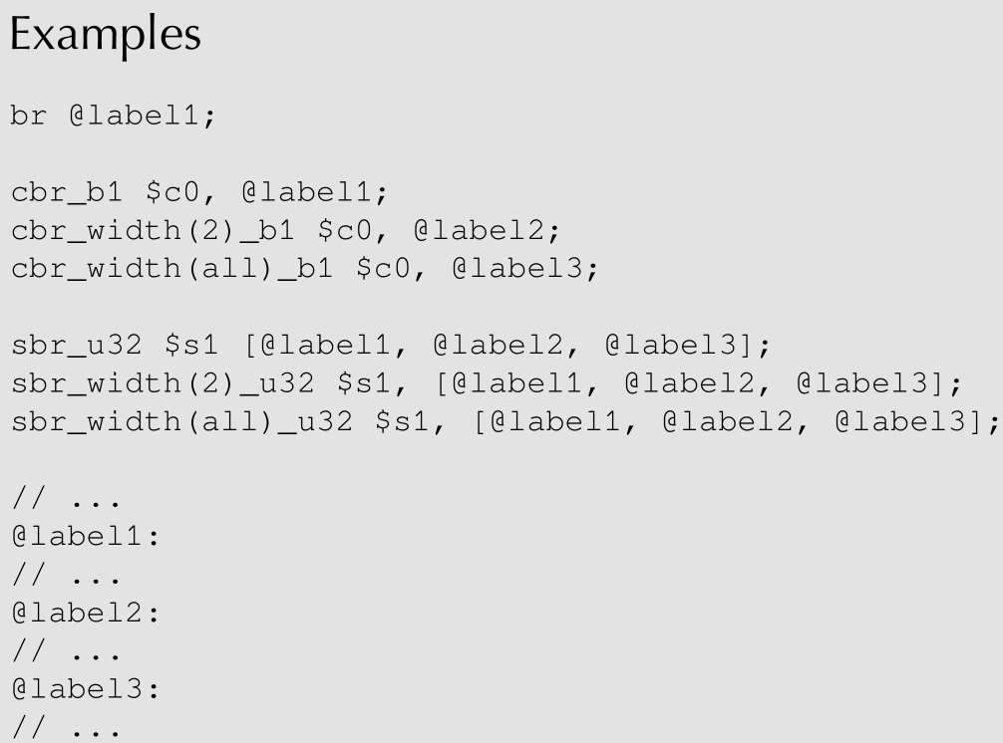
Branch Operations (2)

Slide 64
Parallel Synchronization and
Communication Operations

Slide 65
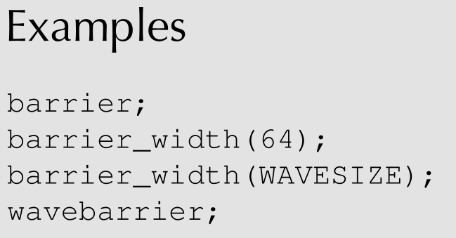
Barrier Operations
Opcode and Modifiers
barrier_width
wavebarrier
barrier used to synchronize work-item execution in a work-group.
wavebarrier used to synchronize work-item execution in wavefront.

Slide 66
Fine-Grain Barrier (fbar) Operations (1)
In certain situations, barrier synchronization (which is synchronization over all work-items in a work-group) is too coarse.
Applications might find it convenient to synchronize at a finer level, over a subset of the work-items within the work-group. A fine-grain barrier object called an fbarrier is needed for this subset.

Slide 67
Fine-Grain Barrier (fbar) Operations (2)
An fbarrier is an opaque entity and its size and representation are implementation-defined. It is also implementation-defined in which kind of memory fbarriers are allocated.
For example, an fbarrier can use dedicated hardware, or can use memory in the group or global segments.
An fbarrier conceptually contains three fields:
(not restricted for implementers)
  member_count – # of wavefronts in the work-group are members of fbarrier.
  arrive_count – # of wavefronts in the work-group are watting or arrived.
  wait_set - the set of wavefronts currently waiting on the fbarrier.

Slide 68
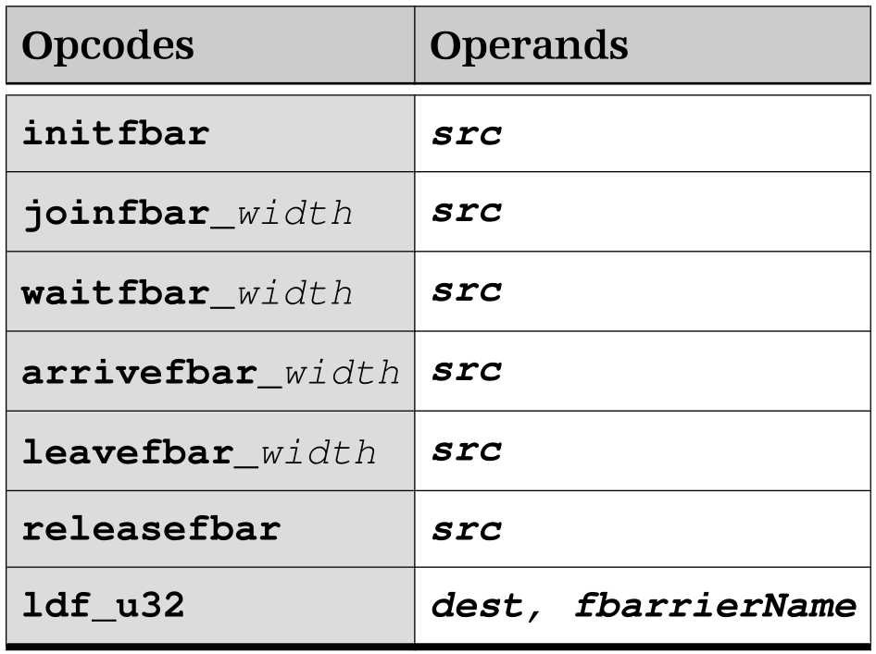
Fine-Grain Barrier (fbar) Operations (3)
Initfbar - Before an fbarrier can be used, it must be initialized.
Joinfbar - Causes the work-item to become a member of the fbarrier.
Waitfbar - Indicates that the work-item has arrived at the fbarrier, and causes execution of the work-item to wait until all other work-items of the same work-group that are members of the same fbarrier have arrived at the fbarrier.
Src – the name of an fbarrier or an s register containing a value produce by ldf.
fbarrierName - Name of the fbarrier.

Slide 69
Fine-Grain Barrier (fbar) Operations (4)
Arrivefbar - indicates that the work-item has arrived at the fbarrier, but does not wait for other work-items that are members of the fbarrier to arrive at the same fbarrier.
If the work-item is the last of the fbarrier members to arrive, then any work-items waiting on the fbarrier can proceed and the fbarrier is reset.
Src – the name of an fbarrier or an s register containing a value produce by ldf.
fbarrierName - Name of the fbarrier.

Slide 70
Fine-Grain Barrier (fbar) Operations (5)
leavefbar - indicates that the work-item has arrived at the fbarrier, but does not wait for other work-items that are members of the fbarrier to arrive at the same fbarrier.
If the work-item is the last of the fbarrier members to arrive, then any work-items waiting on the fbarrier can proceed and the fbarrier is reset.
Src – the name of an fbarrier or an s register containing a value produce by ldf.
fbarrierName - Name of the fbarrier.

Slide 71
Fine-Grain Barrier (fbar) Operations (6)
releasefbar - Before all work-items of a work-group exit, every fbarrier that has been initialized by a work-item of the work-group using initfbar must be released.
ldf - Places the address of an fbarrier into the destination dest.
Src – the name of an fbarrier or an s register containing a value produce by ldf.
fbarrierName - Name of the fbarrier.

Slide 72
Function Operations

Slide 73
Functions in HSAIL (1)
Like other programming languages, HSAIL provides support for user functions. A call operation transfers control to the start of the code block of the user function.
In order that HSAIL can execute efficiently on a wide range of compute units, an abstract method is used for passing arguments, with the finalizer determining what to do.

Slide 74
Functions in HSAIL (2)
This is necessary because, on a GPU, stacks are not a good use of resources, especially if each work-item has its own stack. If an application is simultaneously running 30,000 work-items, then the stack-per-work-item is very limited.
Having one return address per wavefront (not one address per work-item) is desirable.
Implementations should map the abstractions into appropriate hardware.

Slide 75
Example of a Simple Function
The simplest function has no arguments and does not return a value.
Execution of the call operation transfers control to foo, implicitly saving the return address.
Execution of the ret operation within foo transfers control to the operation following the call.
function &foo()()
{
ret;
};
function &bar()()
{
{ //start argument scope
call &foo()();
} //end argument scope
};

Slide 76
Example of a More Complex Function
// Call a compare function with two floating-point arguments
// Allocate multiple arg variables to hold arguments
function &compare(arg_f32 %res)(arg_f32 %left, arg_f32 %right)
{
ld_arg_f32 $s0, [%left];
ld_arg_f32 $s1, [%right];
cmp_eq_f32_f32 $s0, $s1, $s0;
st_arg_f32 $s0, [%res];
ret;
};
kernel &main()
{ // ...
{ //start argument scope
arg_f32 %a;
arg_f32 %b;
arg_f32 %res;
// Fill in the arguments
st_arg_f32 4.0f, [%a];
st_arg_f32 $s0, [%b];
call &compare(%res)(%a, %b);
ld_arg_f32 $s0, [%res];
} // End argument scope
// ...
};

Slide 77
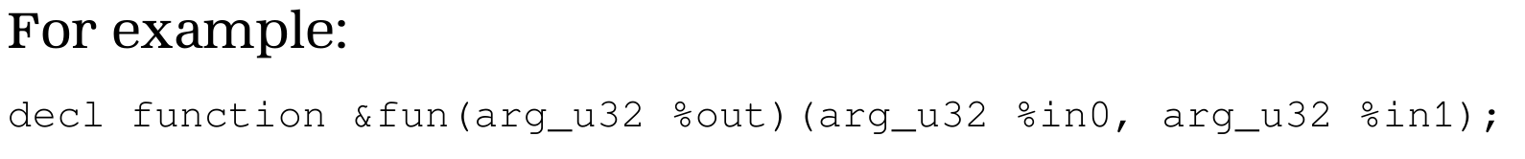
Function Declaration
A function declaration is a function header, prefixed by decl, without a code block.
A function declaration declares a function, providing attributes, the function name, and names and types of the output and input arguments.

Slide 78
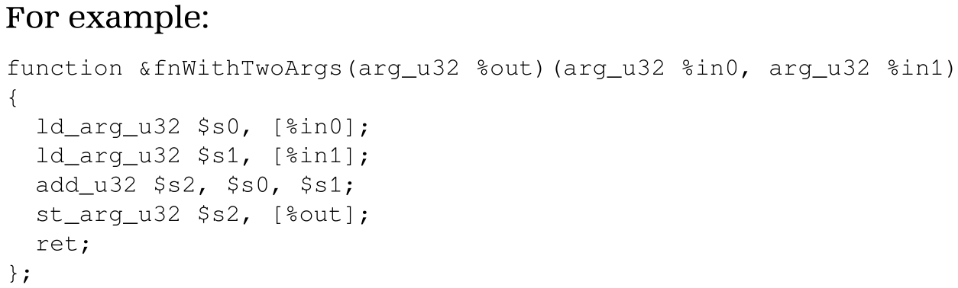
Function Definition
A function definition defines a function. It is a function header, followed by a code block.

Slide 79
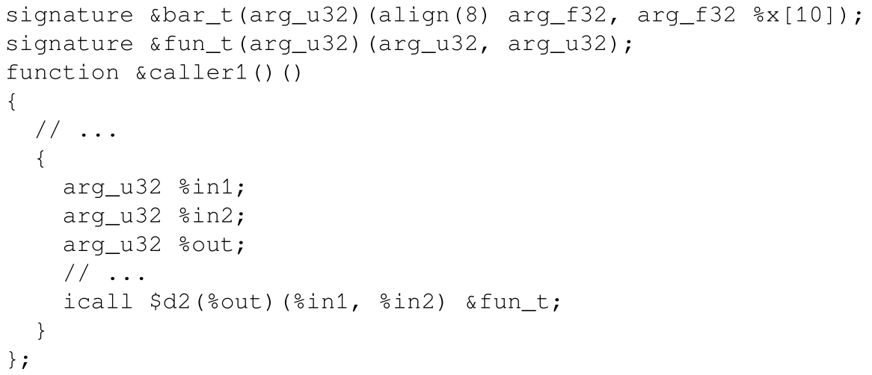
Function Signature
A signature is used to describe the type of a function. It cannot be called directly, but instead is used to specify the target of an indirect function call icall operation.
In the following example, assume that $d2 in each work-item contains the address of an indirect function descriptor whose arguments meet this signature:

Slide 80
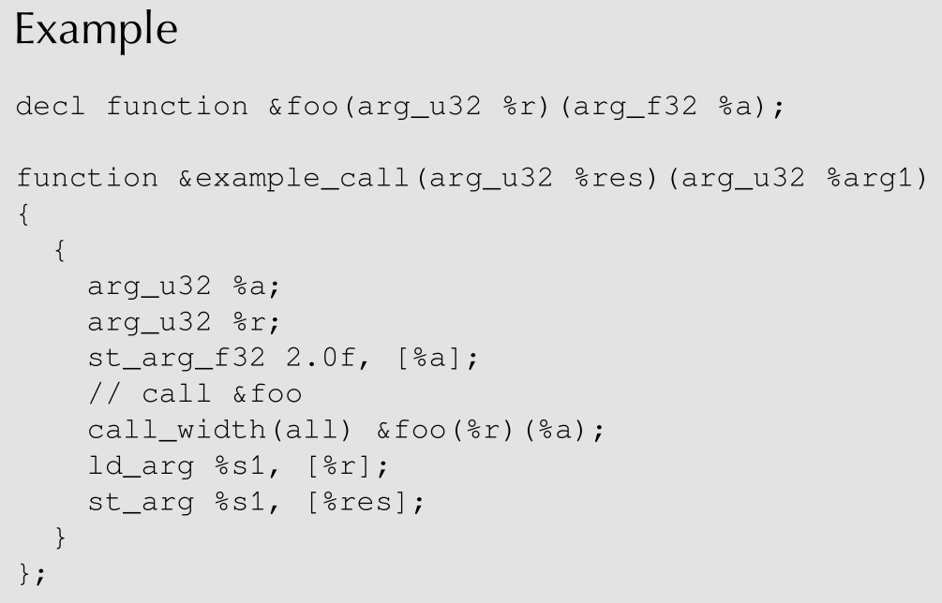
Direct Call Operation
call - transfers control to a specific function specified by the function operand.

Slide 81
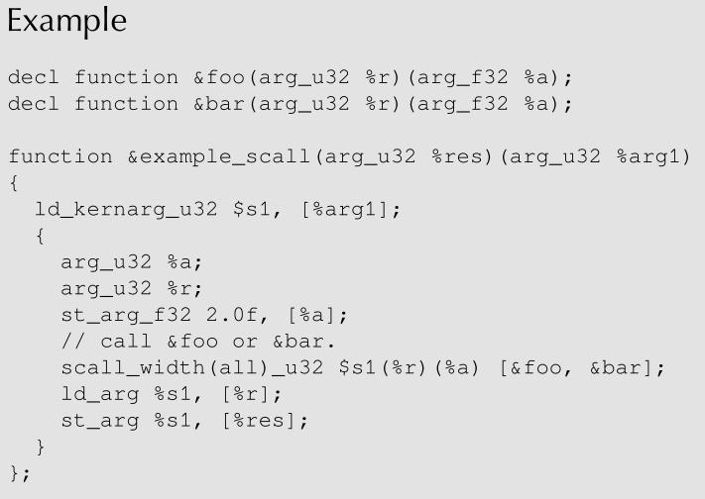
Switch Call Operations
scall - transfers control to the function in the functionList that corresponds to the index value in src.

Slide 82
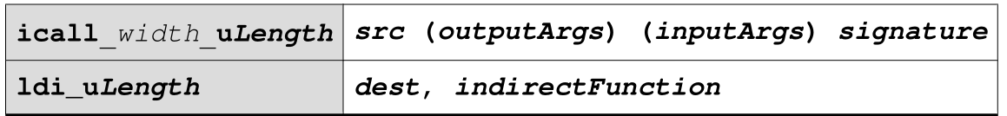
Indirect Call Operations
Indirect functions allow an application to incrementally finalize the code for functions that can be called by kernels that have already been finalized.
For example, this may be useful for languages that can incrementally load and finalize derived classes.
icall - An indirect call transfers control to the indirect function that corresponds to the indirect function code handle in src.
The indirect function being called has formal arguments matching those of signature.

Slide 83
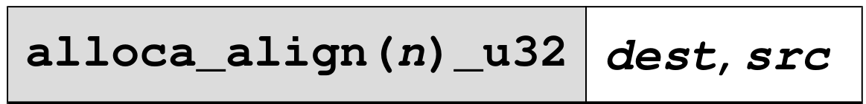
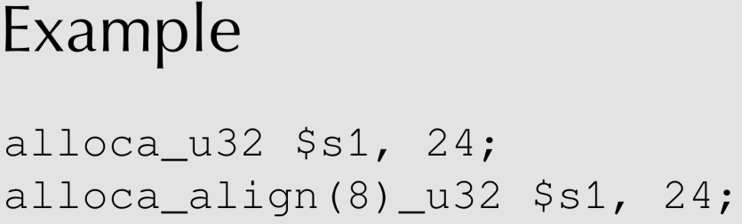
Allocate Memory Operation
The allocate memory operation is used by kernels or functions to allocate per-work-item private memory at run time.
The allocated memory is freed automatically when the kernel or function exits.

Slide 84
Special Operations

Slide 85
Kernel Dispatch Packet Operations (1)
The kernel dispatch packet operations can be used to obtain information about the currently executing kernel dispatch packet.
packetcompletionsig - Returns the signal handle of the completion signal specified for this dispatch.
packetid - Returns a 64-bit User Mode queue packet ID that is unique for the User Mode Queue used for this dispatch.
Opcodes and Modifier | Operands
currentworkgroupsize_u32 | dest, dimNumber
currentworkitemflatid_u32 | dest
dim_u32 | dest
gridgroups_u32 | dest, dimNumber
gridsize_uLength | dest, dimNumber
packetcompletionsig_signalType | dest
packetid_u64 | dest
workgroupid_u32 | dest, dimNumber
workgroupsize_u32 | dest, dimNumber
workitemabsid_uLength | dest, dimNumber
workitemflatabsid_uLength | dest
workitemflatid_u32 | dest
workitemid_u32 | dest, dimNumber

Slide 86
Kernel Dispatch Packet Operations (2)
The kernel dispatch packet operations can be used to obtain information about the currently executing kernel dispatch packet.
workitemabsid - Accesses the work-item absolute identifier (ID) within the entire grid.
workitemflatabsid - Accesses the flattened form of the work-item absolute identifier (ID) within the entire grid.
Opcodes and Modifier | Operands
currentworkgroupsize_u32 | dest, dimNumber
currentworkitemflatid_u32 | dest
dim_u32 | dest
gridgroups_u32 | dest, dimNumber
gridsize_uLength | dest, dimNumber
packetcompletionsig_signalType | dest
packetid_u64 | dest
workgroupid_u32 | dest, dimNumber
workgroupsize_u32 | dest, dimNumber
workitemabsid_uLength | dest, dimNumber
workitemflatabsid_uLength | dest
workitemflatid_u32 | dest
workitemid_u32 | dest, dimNumber

Slide 87
Kernel Dispatch Packet Operations (3)
The kernel dispatch packet operations can be used to obtain information about the currently executing kernel dispatch packet.
workitemflatid - Accesses the flattened form of the work-item ID within the work-group.
workitemid - Accesses the work-item ID within the work-group.
Opcodes and Modifier | Operands
currentworkgroupsize_u32 | dest, dimNumber
currentworkitemflatid_u32 | dest
dim_u32 | dest
gridgroups_u32 | dest, dimNumber
gridsize_uLength | dest, dimNumber
packetcompletionsig_signalType | dest
packetid_u64 | dest
workgroupid_u32 | dest, dimNumber
workgroupsize_u32 | dest, dimNumber
workitemabsid_uLength | dest, dimNumber
workitemflatabsid_uLength | dest
workitemflatid_u32 | dest
workitemid_u32 | dest, dimNumber

Slide 88
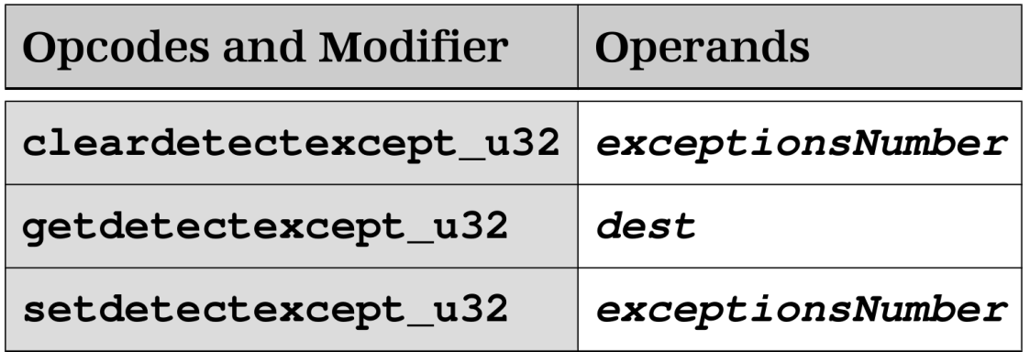
Exception Operations (1)
The exception operations can be used to determine what exceptions have been generated.
cleardetectexcept - Clears DETECT exception flags specified in exceptionsNumber for the work-group containing the work-item.
getdetectexcept - Returns the current value of DETECT exception flags, which is a summarization for all work-items in the work-group containing the work-item.
exceptionsNumber:
bit:0=INVALID_OPERATION
bit:1=DIVIDE_BY_ZERO
bit:2=OVERFLOW
bit:3=UNDERFLOW
bit:4=INEXACT

Slide 89
Exception Operations (2)
The exception operations can be used to determine what exceptions have been generated.
setdetectexcept - Sets DETECT exception flags specified in exceptionsNumber for the work-group containing the current work-item.
exceptionsNumber: bit:0=INVALID_OPERATION
bit:1=DIVIDE_BY_ZERO
bit:2=OVERFLOW
bit:3=UNDERFLOW
bit:4=INEXACT

Slide 90
User Mode Queue Operations (1)
The User Mode Queue operations can be used to enqueue work to be executed by other agents.
Opcodes and Modifier | Operands
addqueuewriteindex_segment_order_u64 | dest, address, src
casqueuewriteindex_segment_order_u64 | dest, address, src0, src1
ldqueuereadindex_segment_order_u64 | dest, address
ldqueuewriteindex_segment_order_u64 | dest, address
stqueuereadindex_segment_order_u64 | address, src
stqueuewriteindex_segment_order_u64 | address, src
addqueuewriteindex - Atomically adds the value in src to the current value of the write index associated with the User Mode Queue.
casqueuewriteindex - Atomically compares src0 to the current value of the write index associated with the User Mode Queue.

Slide 91
User Mode Queue Operations (2)
Opcodes and Modifier | Operands
addqueuewriteindex_segment_order_u64 | dest, address, src
casqueuewriteindex_segment_order_u64 | dest, address, src0, src1
ldqueuereadindex_segment_order_u64 | dest, address
ldqueuewriteindex_segment_order_u64 | dest, address
stqueuereadindex_segment_order_u64 | address, src
stqueuewriteindex_segment_order_u64 | address, src
ldqueuereadindex - Atomically loads the current value of the read index associated with the User Mode Queue.
ldqueuewriteindex - Atomically loads the current value of the write index associated with the User Mode Queue.

Slide 92
User Mode Queue Operations (2)
Opcodes and Modifier | Operands
addqueuewriteindex_segment_order_u64 | dest, address, src
casqueuewriteindex_segment_order_u64 | dest, address, src0, src1
ldqueuereadindex_segment_order_u64 | dest, address
ldqueuewriteindex_segment_order_u64 | dest, address
stqueuereadindex_segment_order_u64 | address, src
stqueuewriteindex_segment_order_u64 | address, src
stqueuereadindex - Atomically stores src into the read index associated with the User Mode Queue.
stqueuewriteindex - Atomically stores src into the write index associated with the User Mode Queue.

Slide 93
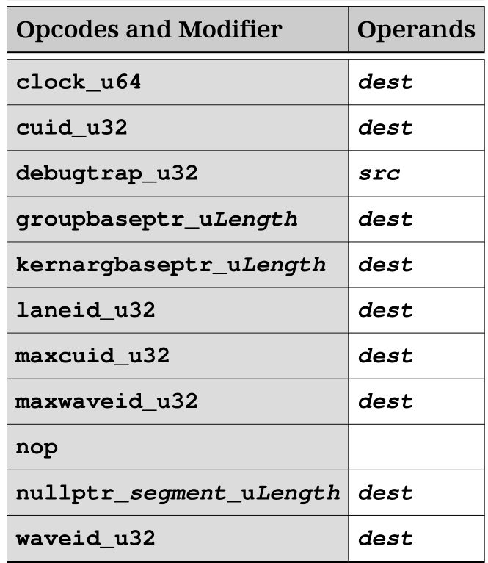
Miscellaneous Operations
The miscellaneous operations include various query and special operations.
groupbaseptr - Returns the group segment address of the base of the group segment for the work-group of the work-item executing the operation.
nullptr - Sets the destination dest to a value that is not a legal address within the segment.

Slide 94
BRIG: HSAIL Binary Format

Slide 95
BRIG: HSAIL Binary Format
BRIG is a binary representation of the HSAIL. (HSAIL is textual representation.)
It is an in-memory binary representation, not a file based container format. However, a file container format (e.g. ELF) may choose to use the binary representation of the BRIG segments.
The HSA runtime uses the BRIG in the API for the finalization and linking services.

Slide 96
Summary
Covered
  HSA Programmer’s Reference Manual Version 1.0
  HSAIL Programming Model
  Arithmetic Operations
  Memory Operations
  Image Operations
  Branch Operations
  Parallel Synchronization and Communication Operations
  Function Operations
  Special Operations
  BRIG: HSAIL Binary Format

