Slide 1

Introduction to Heterogeneous System Architecture (HSA)
鍾葉青教授
System Software Laboratory
Department of Computer science
National Tsing Hua University

Slide 2
Agenda
Computing Trend
HSA
Challenges and Opportinuty

Slide 3

Computing trend

Slide 4
Computing (1)
Single Processor
SISD
(Single Instruction Single Data)
Sequential Program
CPU
Memory
IO

Slide 5
Computing (2)
Single Processor
SIMD
(Single Instruction Multiple Data)
Sequential Program
CPU
Memory
SIMD
IO

Slide 6
Computing (3)
Single Processor
SIMT
(Single Instruction Multiple Threads)
Sequential Program
CPU
Memory
SIMD
SIMT
IO

Slide 7
Computing (4)
Multi-Processors
SIMT
(Single Instruction Multiple Threads)
Parallel Program
CPU
Memory
SIMD
SIMT
IO

Slide 8
Computing (5)
Multi-core Processor
Parallel Program
CPU
CPU
Memory
CPU
CPU
IO

Slide 9
Computing (6)
Multi-core Processor
GPU
Parallel Program
+ Kernel Program
CPU
CPU
Memory
CPU
CPU
GPU
IO

Slide 10
Computing (7)
APU
Parallel Program
+ Kernel Program
CPU
GPU
Memory
CPU
GPU
IO

Slide 11
Computing (8)
APU with big.LITTLE
MIMT + SPMD
Parallel Program
+ Kernel Program
CPU
(Big)
GPU
Memory
CPU
(Little)
GPU
IO

Slide 12
Computing (9)
APU with big.LITTLE
DSP & ASIC
MIMT + SPMD
Parallel Program
+ Heterogeneous
Program
CPU
(Big)
GPU
Memory
CPU
(Little)
GPU
DSP
ASIC
IO

Slide 13
Computing (10)
Cloud Computing
CPU
(Big)
GPU
Memory
CPU
(Little)
GPU
Mobile Computing
DSP
ASIC
IO
Heterogeneous System Architecture is future

Slide 14
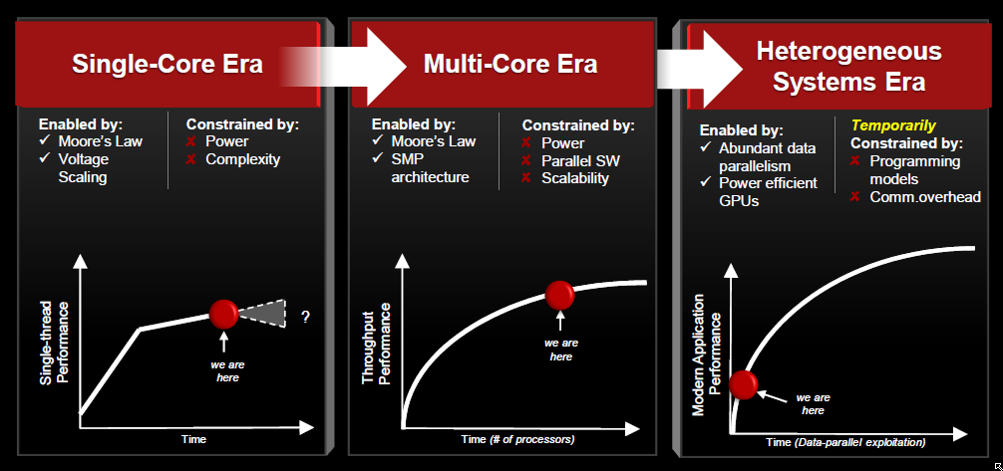
Computing System Era

Slide 15
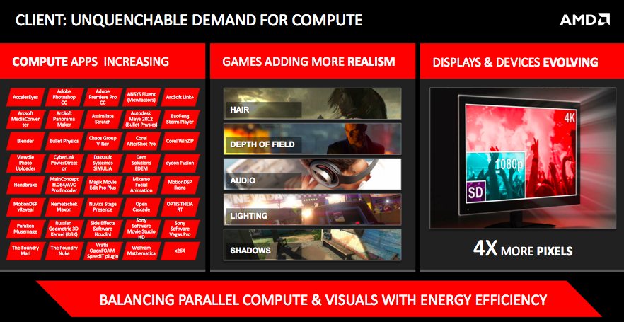
Computing demand is increasing

Slide 16
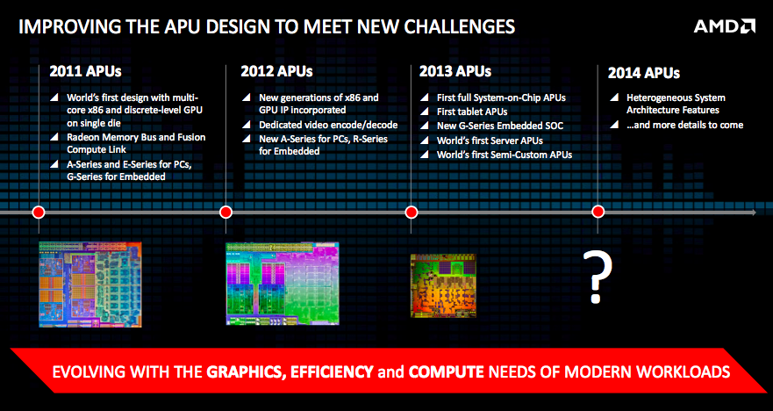
What’s next computing system?

Slide 17
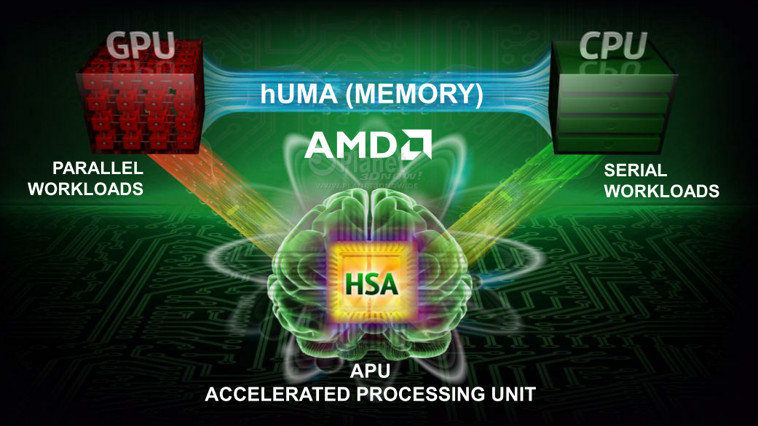
HSA is coming

Slide 18
Introduction to HSA
HSA Foundation is not for profit - industry standards body to create software/hardware standards for heterogeneous computing
  simplify the programing environment
  make compute at low power pervasive
  introduce new capabilities in modern computing devices
Core founders include AMD, ARM, Imagination Technology, MediaTek, Qualcomm, Samsung, and Texas Instruments
Open membership to deliver royalty free specifications, and API’s
Founded June 12, 2012

Slide 19
HSA Foundation Benefits
Semiconductor | Neutral platform governance gives vendors the opportunity to influence heterogeneous architecture standards Ability to lower development cost for critical runtime foundations Technical sustainability of HSA via close alignment with key industry initiatives Diverse application ecosystem
Platform & OS Vendors | Commercial sustainability via multiple semiconductor members’ support Foundation that opens up innovative solutions to drive differentiation Diverse application ecosystem
Device Manufacturers | Commercial sustainability via multiple semiconductor members’ support Foundation that opens up innovative solutions to drive differentiation Strong platform & OS support
ISVs & Developers | Programming environment for advanced innovation Large addressable market Diverse routes to market Ability to contribute to HSA future in verticals of interest Commercial sustainability via strong commitments of HSA members
Notes:
ISV: Independent Software Vendor

Slide 20
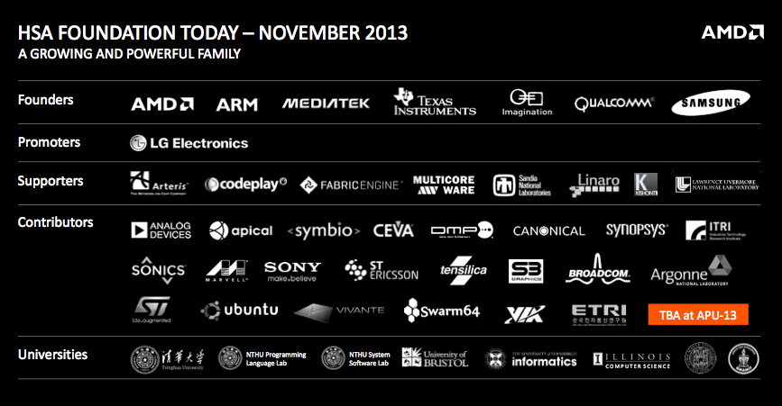

HSA Foundation

Slide 21
HSA Foundation’s Initial Focus
Attract mainstream programmers
  Support broader set of languages beyond traditional GPGPU languages
  Support for task parallel runtimes & nested data parallel programs
  Rich debugging and performance analysis support
Bring the GPU forward as a first class processor
  Unified coherent address space (hUMA)
  User mode dispatch/scheduling
  Can utilize pagable system memory
  Fully coherent memory between the CPU and GPU
  Pre-emption and context switching
  Relaxed consistency memory model
  Quality of Service

Slide 22
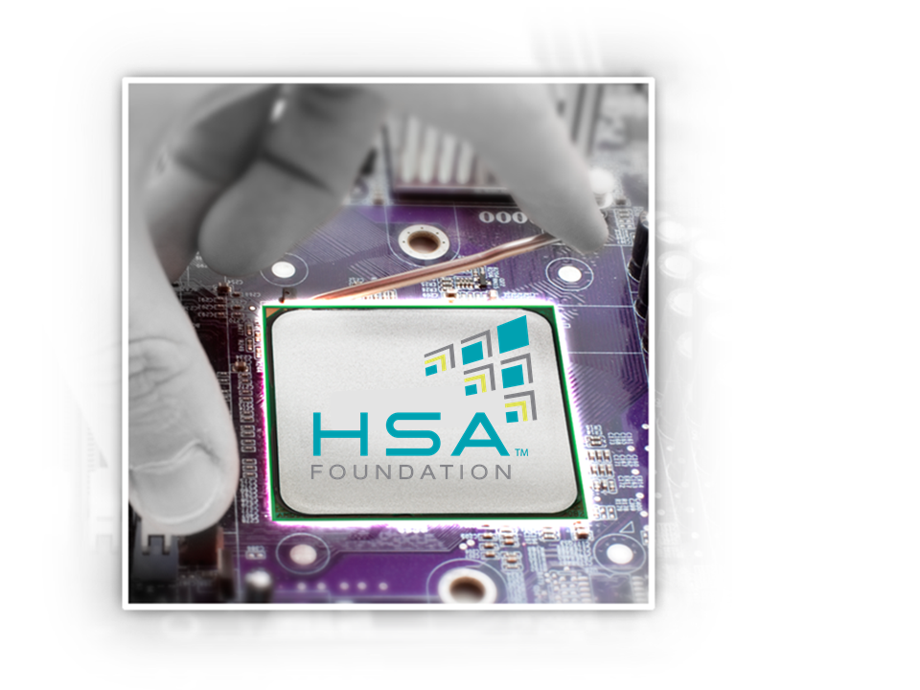
What HSA Are Trying to Solve
The SOC are quickly following into the same many CPU core bottlenecks of the PC
  To move beyond this we need to look at right processor(s) and/or execution device for given workload at reasonable power
While addressing the core issues of
  Easier to program
  Easier to optimize
  Easier to load balance
  High performance
  Lower power

Slide 23
Pillars of HSA*
Unified addressing across all processors
Operation into pageable system memory
Full memory coherency
User mode dispatch
Architected queuing language
Scheduling and context switching
HSA Intermediate Language (HSAIL)
High level language support for GPU compute processors

Slide 24
HSA Specifications
HSA System Architecture Specification
  Version 1.0 Provisional, Released April 2014
  Defines discovery, memory model, queue management, atomics, etc
HSA Programmers Reference Specification
  Version 1.0 Provisional, Released June 2014
  Defines the HSAIL language and object format
HSA Runtime Software Specification
  Version 1.0 Provisional, expected to be released in July 2014
  Defines the APIs through which an HSA application uses the platform

Slide 25

HSA - An Open Platform
Open Architecture, membership open to all
  HSA Programmers Reference Manual
  HSA System Architecture
  HSA Runtime
Delivered via royalty free standards
  Royalty Free IP, Specifications and APIs
ISA agnostic for both CPU and GPU
Membership from all areas of computing
  Hardware companies
  Operating Systems
  Tools and Middleware
  Applications
  Universities
Notes:
We will be open on this.
We will reach out to partners and collaborate to bring this to market in the right form

Slide 26
HSA Taking Platform to Programmers
Balance between CPU and GPU for performance and power efficiency
Make GPUs accessible to wider audience of programmers
  Programming models close to today’s CPU programming models
  Enabling more advanced language features on GPU
  Shared virtual memory enables complex pointer-containing data structures (lists, trees, etc.) and hence more applications on GPU
  Kernel can enqueue work to any other device in the system
    Enabling task-graph style algorithms, Ray-Tracing, etc
Clearly defined HSA memory model enables effective reasoning for parallel programming
HSA provides a compatible architecture across a wide range of programming models and HW implementations

Slide 27
HSA Is Designed to Go Beyond the GPU
CPU
Audio
Processor
Video
Hardware
Security
Processor
SM&C
Shared Memory and Coherency
GPU
Fixed
Function
Accelerator
DSP
Image
Signal Processing
Notes:
Inclusive of fixed function devices and all programmable devices in a SOC.

Slide 28
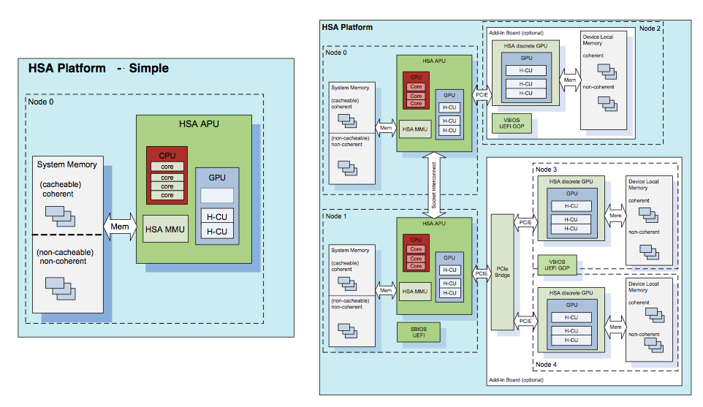
HSA Platform
Notes:
Inclusive of fixed function devices and all programmable devices in a SOC.

Slide 29
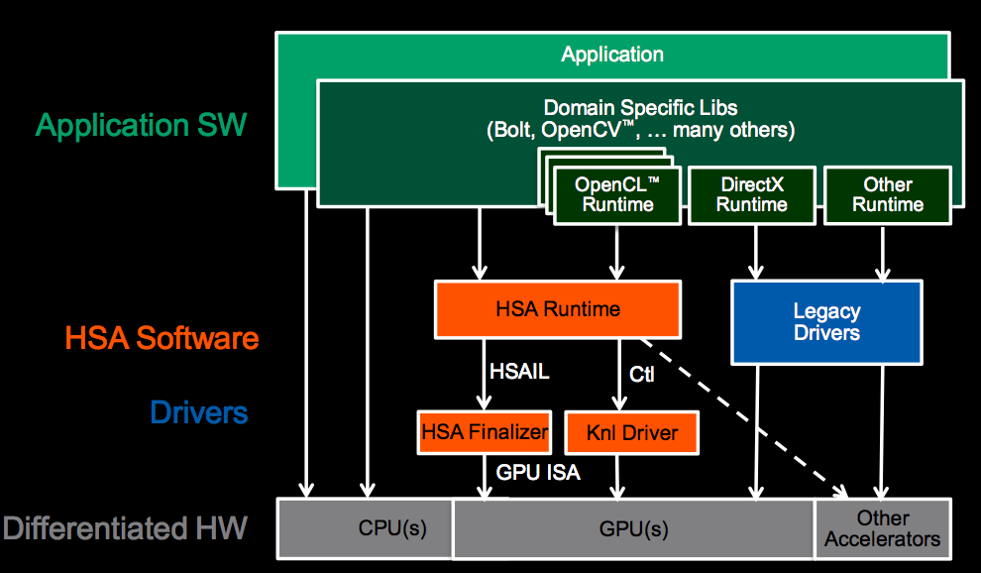
Simplified HSA Solution Stack
Notes:
With HSA, there is an alternate path to the accelerators in the system, besides the legacy driver model.
We are moving beyond the platform architecture of the last 25 years, to unlock software innovation for modern workloads.
Applications will be able to deliver work *directly* to the queues fetched by the parallel processor in the GPU.
We abstract the parallel processor with a new virtual ISA, called HSAIL. A low level IL that allows multiple hardware vendors to continue to innovate within a standard platform. There is a “finalizer” between the HSAIL generated by the high level compiler and the GPU ISA. The architecture supports the finalizer being run at multiple possible times: at run time, install time or compile time, depending on the target platform.
Overall Vision:
Make GPU easily accessible
Support mainstream languages
Expandable to domain specific languages
Make compute offload efficient
Direct path to GPU (avoid Graphics overhead)
Eliminate memory copy
Low-latency dispatch
Make it ubiquitous
Drive HSA as a standard through HSA Foundation
Open Source key components

Slide 30

HSA Intermediate Layer - HSAIL
HSAIL is a virtual ISA for parallel programs
  Finalized to ISA by a JIT compiler or “Finalizer”
  ISA independent by design for CPU & GPU
Explicitly parallel
  Designed for data parallel programming
Support for exceptions, virtual functions,
and other high level language features
Syscall methods
  GPU code can call directly to system services, IO, printf, etc
Debugging support
Notes:
Lets take a deeper dive here into the details of the architecture …

Slide 31
HSA Runtime (1)
The HSA core runtime is a thin, user-mode API that provides the interface necessary for the host to launch compute kernels to the available HSA components.
The overall goal of the HSA core runtime design is to provide a high-performance dispatch mechanism that is portable across multiple HSA vendor architectures.
  The dispatch mechanism differentiates the HSA runtime from other language runtimes by architected argument setting and kernel launching at the hardware and specification level.
  The HSA core runtime API is standard across all HSA vendors, such that languages which use the HSA runtime can run on different vendor’s platforms that support the API.

Slide 32
HSA Runtime (2)
The software architecture stack without HSA runtime
The software architecture stack with HSA runtime
OpenCL
App
Java
App
…
OpenMP
App
DSL
App
Programming Model
OpenCL
Runtime
Java
Runtime
…
OpenMP
Runtime
DSL
Runtime
Language Runtime
HSA Runtime
Driver
Driver
HSA
Finalizer
HSA Runtime
…
…
HSA
Finalizer
…
…
Component 1
…
…
Component 1
Component N
Component N
Component 1
Component 1
Component N
Component N
HSA Vendor 1
Vendor 1
HSA Vendor m
Vendor m

Slide 33
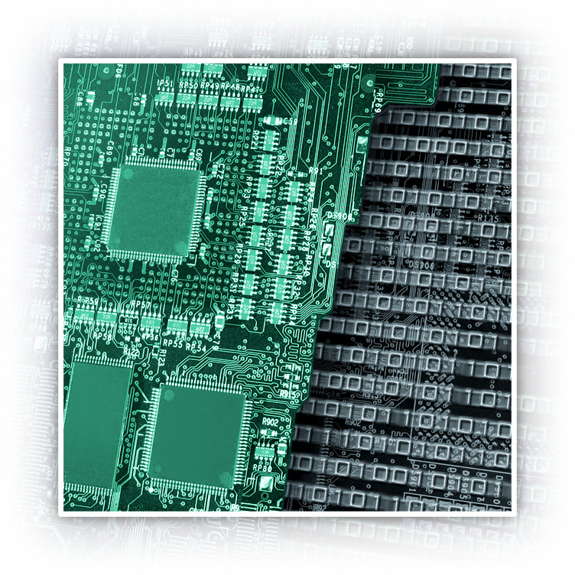
HSA Memory Model
Designed to be compatible with C++11, Java and .NET Memory Models
Relaxed consistency memory model for parallel compute performance
Loads and stores can be re-ordered by the finalizer
Visibility controlled by:
  Load.Acquire
  Store.Release
  Barriers
Notes:
The memory model for a new architecture is key

Slide 34
Intersection of HSA and Graphics
OpenGL can share data with HSA Runtime
  Buffer (Vertex/Pixelbuffer)
  Texture
  Renderbuffer
Mapping
  HSA Image -> OpenGLTexture, renderbuffer
  HSA buffer -> OpenGL buffer
Sync
  Acquire and Release mechanism

Slide 35
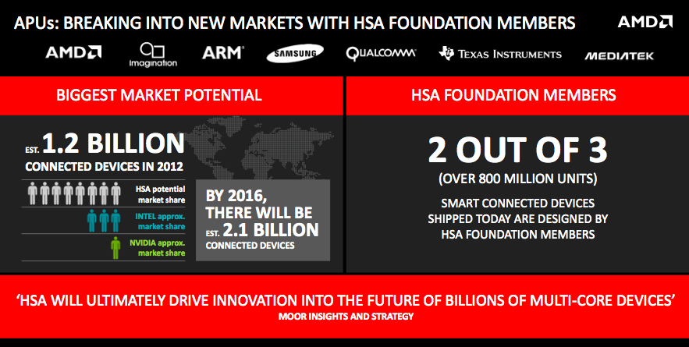
Big market size for HSA

Slide 36
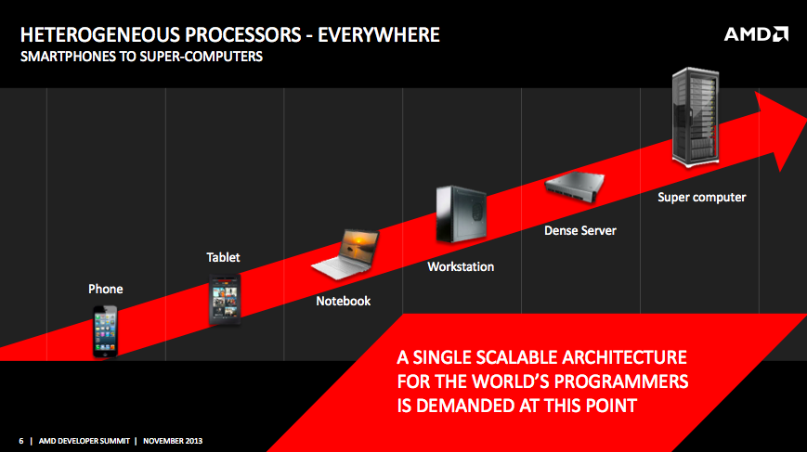
HSA is Everywhere

Slide 37
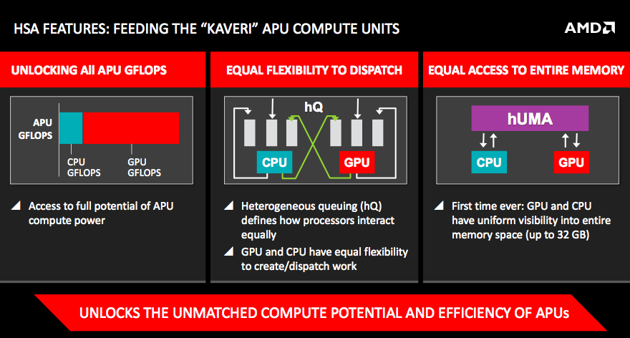
hQ and hUMA

Slide 38
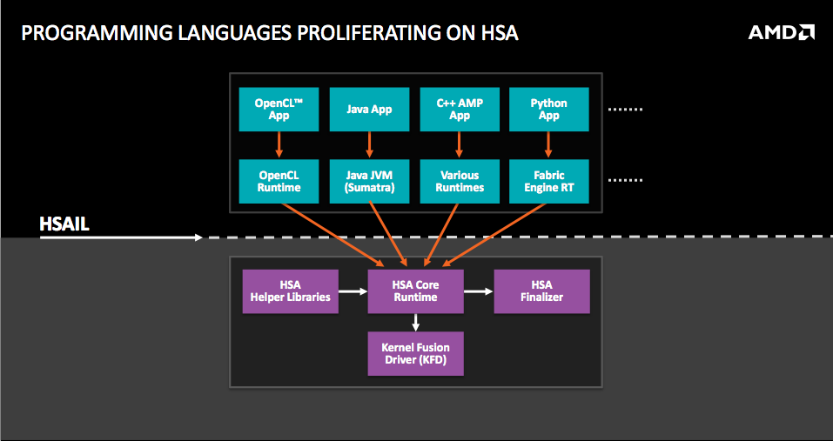
HSA Programming

Slide 39
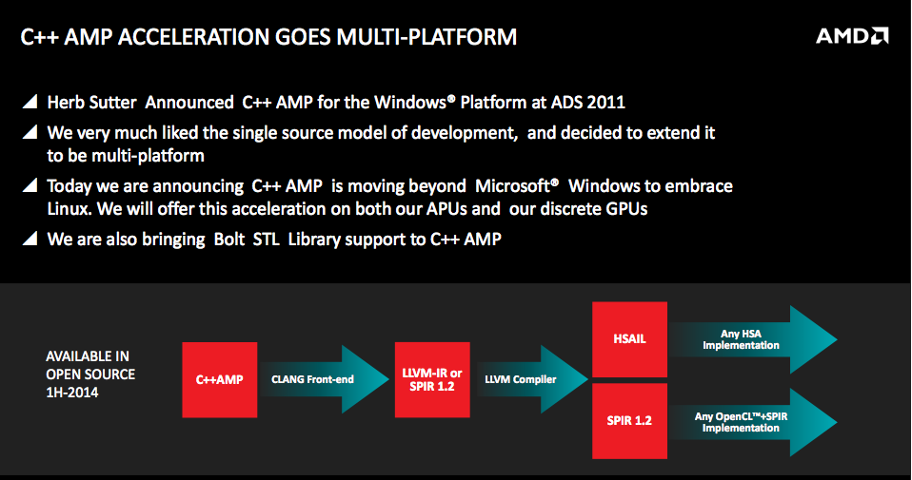
C++ AMP

Slide 40
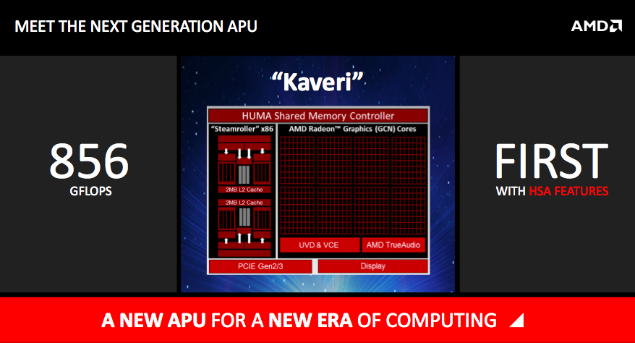
First APU is coming

Slide 41

Challenges and Opportunities

Slide 42
Challenges and Opportunities
Domain Specific Applications
HSA Programming Languages
HSA Frontend Compiler & Developing Tool
HSA Runtime System & Libraries
HSA Backend Compiler
HSA Operating System
HSA SoC

Slide 43
HSA SoC
Compatible with HSA specifications with the following features
  hMMU and cache coherence
  hQ
  Hardwaer Preemptive scheduling
  Interrupt mechanism
  Exception handling
  Debugging infrastructure

Slide 44
HSA Operating System
Enable operating system to aware HSA architecture
  Implement hUMA mechanism by IO-MMU
  New scheduling algorithms to support QoS
  Exception handling for heterogeneous processors
  Software interrupt
  Virtualization

Slide 45
HSA Backend Compiler
Finalizer to translate HSAIL to binary code of target heterogeneous processors, such as GPUs, DSPs, CPUs, ASOC and so on.
Just-in-time compilation
Compilation optimization

Slide 46
HSA Runtime System and Library
HSA Runtime System is aware of underlying HSA platform to run compute tasks adaptively
Support user-level heterogeneous queuing and AQL specification
Implement HSA Runtime API Specification to run on different platforms and support different high-level parallel programming languages

Slide 47
HSA Frontend Compiler and Developing Tool
Translate high-level parallel programming languages to HSAIL binaries
Debugging tools
Performance profiling tools
Benchmarking
Emulator/Simulator

Slide 48
HSA Programming Languages
OpenCL support
Java support
Web support
Android programming support
Map Reduce support
Python support

Slide 49
Domain Specific Applications
Image processing
Computer vision
Gaming
Big data analysis
Mobile computing

