Slide 1
HSAemu - A Full System Emulator for HSA Platform
Prof. Yeh-Ching Chung
System Software Laboratory
Department of Computer science
National Tsing Hua University

Slide 2
Outline
Introduction to HSA
Design of HSAemu
Performance Evaluation
Conclusions and Future Work

Slide 3
Introduction to HSA
HSA Foundation is a non-profit industry standards body to create software/hardware standards for heterogeneous computing
  simplify the programing environment
  make compute at low power pervasive
  introduce new capabilities in modern computing devices
Core founders include AMD, ARM, Imagination Technology, MediaTek, Qualcomm, Samsung, and Texas Instruments
Open membership to deliver royalty free specifications, and API’s
Founded June 12, 2012

Slide 4


























































Members of HSA Foundation – 2014/6
Membership consists of 43 companies and 16 universities
Adding 1-2 new members each month
Founders
Needs Updating – Add Toshiba Logo
Promoters
Supporters
Contributors
Academic

Slide 5
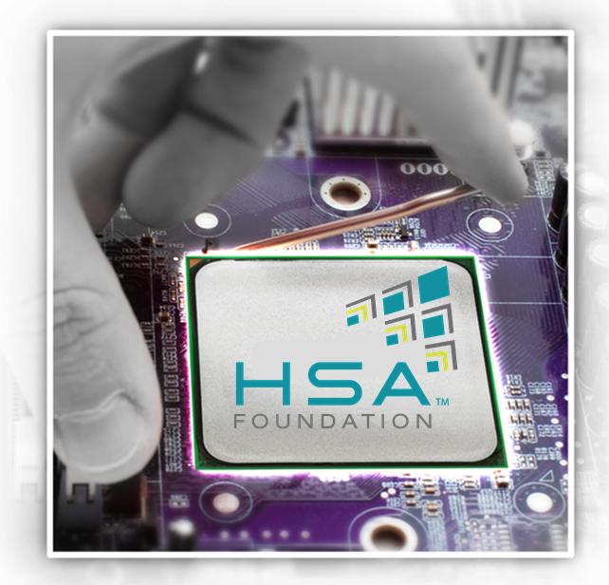
HSA Foundation’s Initial Focus (1)
Heterogeneous SOCs have arrived and are a tremendous advance over previous platforms
SOCs combine CPU cores, GPU cores and
other accelerators, with high bandwidth access to memory
How do we make them even better?
  Easier to program
  Easier to optimize
  Higher performance
  Lower power

Slide 6
HSA Foundation’s Initial Focus (2)
HSA unites accelerators architecturally
  Bring the GPU forward as a first class processor
    Unified coherent address space (hUMA)
    User mode dispatch/scheduling
    Can utilize pagable system memory
    Fully coherent memory between the CPU and GPU
    Pre-emption and context switching
    Relaxed consistency memory model
    Quality of Service
Attract mainstream programmers
  Support broader set of languages beyond traditional GPGPU languages
  Support for task parallel runtimes & nested data parallel programs
  Rich debugging and performance analysis support

Slide 7
HSA Foundation’s Initial Focus (3)
Early focus on the GPU compute accelerator, but HSA will go well beyond the GPU
CPU
Audio
Processor
Video
Hardware
Security
Processor
SM&C
Shared Memory and Coherency
GPU
Fixed
Function
Accelerator
DSP
Image
Signal Processing
Notes:
Inclusive of fixed function devices and all programmable devices in a SOC.

Slide 8
Pillars of HSA*
Unified addressing across all processors
Operation into pageable system memory
Full memory coherency
User mode dispatch
Architected queuing language
Scheduling and context switching
HSA Intermediate Language (HSAIL)
High level language support for GPU compute processors

Slide 9
HSA Specifications
HSA System Architecture Specification
  Version 1.01, released March 16, 2015
  Defines discovery, memory model, queue management, atomics, etc
HSA Programmers Reference Specification
  Version 1.02, released March 16, 2015
  Defines the HSAIL language and object format
HSA Runtime Software Specification
  Version 1.0, released March 16, 2015
  Defines the APIs through which an HSA application uses the platform
All released specifications can be found at the HSA Foundation web site:
  www.hsafoundation.com/standards

Slide 10
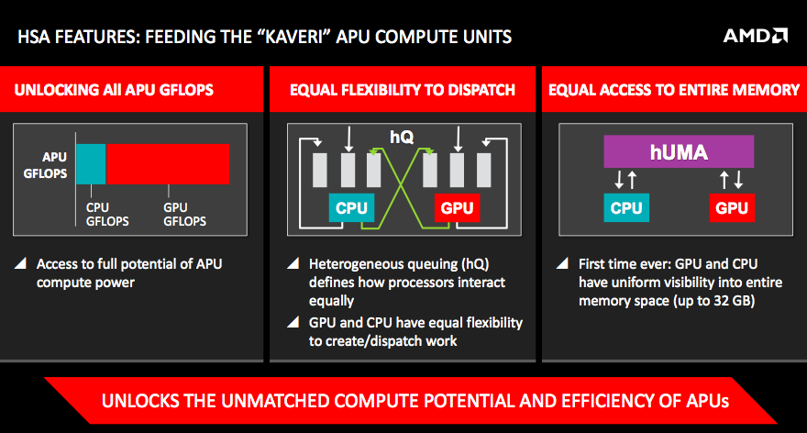
hQ and hUMA

Slide 11

HSA Intermediate Layer — HSAIL
HSAIL is a virtual ISA for parallel programs
  Finalized to ISA by a JIT compiler or “Finalizer”
  ISA independent by design for CPU & GPU
Explicitly parallel
  Designed for data parallel programming
Support for exceptions, virtual functions,
and other high level language features
Lower level than OpenCL SPIR
  Fits naturally in the OpenCL compilation stack
Suitable to support additional high level languages and programming models:
  Java, C++, OpenMP, C++, Python, etc
Notes:
Lets take a deeper dive here into the details of the architecture …

Slide 12
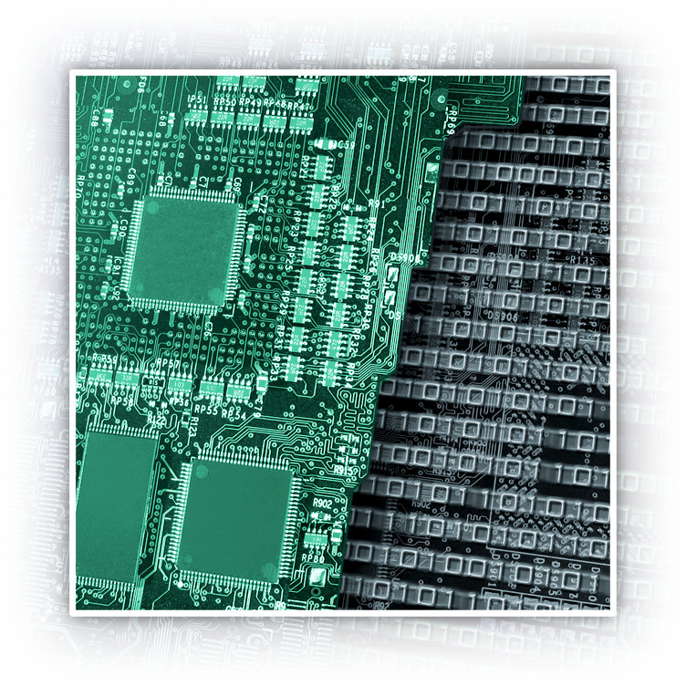
HSA Memory Model
Defines visibility ordering between all threads in the HSA System
Designed to be compatible with C++11, Java, OpenCL and .NET Memory Models
Relaxed consistency memory model for parallel compute performance
Visibility controlled by:
  Load.Acquire
  Store.Release
  Fences
Notes:
The memory model for a new architecture is key

Slide 13
HSA Queuing Model
User mode queuing for low latency dispatch
  Application dispatches directly
  No OS or driver required in the dispatch path
Architected Queuing Layer
  Single compute dispatch path for all hardware
  No driver translation, direct to hardware
Allows for dispatch to queue from any agent
  CPU or GPU
GPU self enqueue enables lots of solutions
  Recursion
  Tree traversal
  Wavefront reforming
Notes:
The memory model for a new architecture is key

Slide 14
HSA Runtime
The HSA core runtime is a thin, user-mode API that provides the interface necessary for the host to launch compute kernels to the available HSA components.
The overall goal of the HSA core runtime design is to provide a high-performance dispatch mechanism that is portable across multiple HSA vendor architectures.
  The dispatch mechanism differentiates the HSA runtime from other language runtimes by architected argument setting and kernel launching at the hardware and specification level.
  The HSA core runtime API is standard across all HSA vendors, such that languages which use the HSA runtime can run on different vendor’s platforms that support the API.

Slide 15
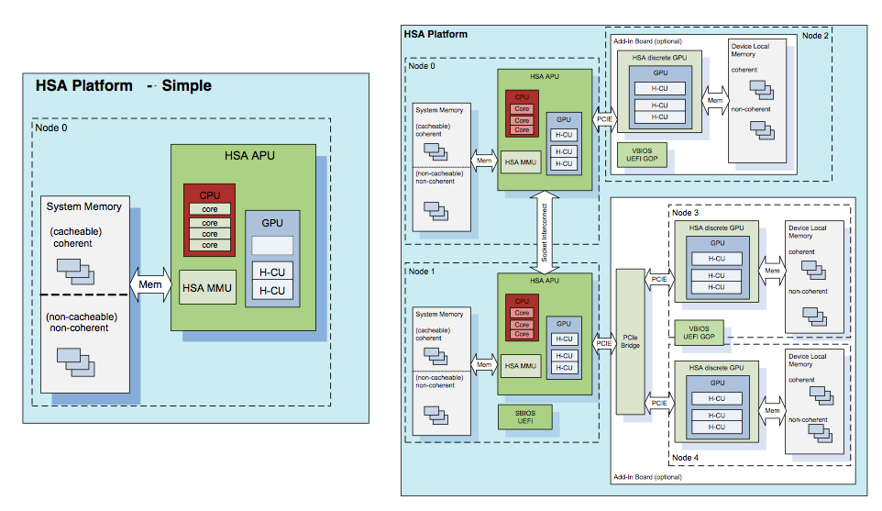
HSA Platform
Notes:
Inclusive of fixed function devices and all programmable devices in a SOC.

Slide 16
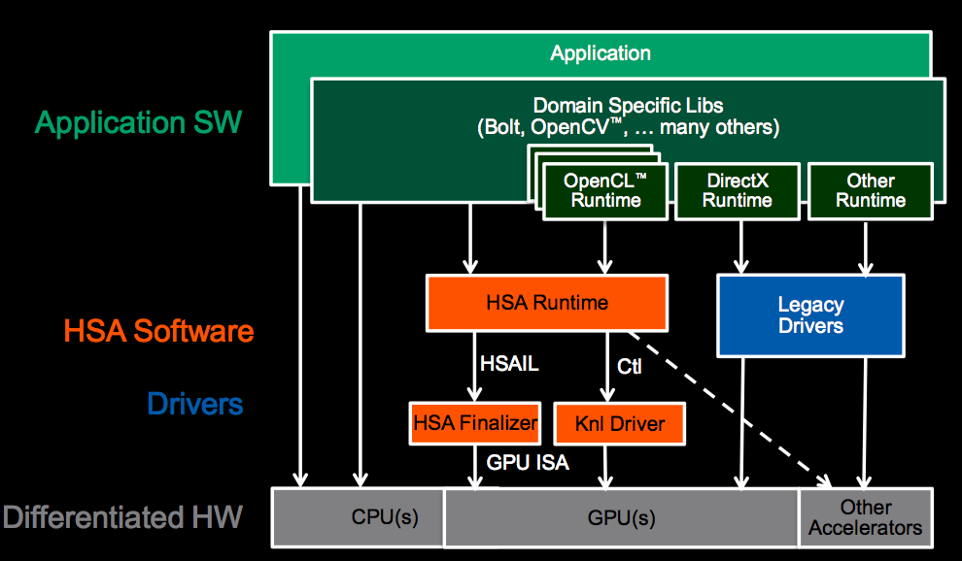
Simplified HSA Software Stack
Notes:
With HSA, there is an alternate path to the accelerators in the system, besides the legacy driver model.
We are moving beyond the platform architecture of the last 25 years, to unlock software innovation for modern workloads.
Applications will be able to deliver work *directly* to the queues fetched by the parallel processor in the GPU.
We abstract the parallel processor with a new virtual ISA, called HSAIL. A low level IL that allows multiple hardware vendors to continue to innovate within a standard platform. There is a “finalizer” between the HSAIL generated by the high level compiler and the GPU ISA. The architecture supports the finalizer being run at multiple possible times: at run time, install time or compile time, depending on the target platform.
Overall Vision:
Make GPU easily accessible
Support mainstream languages
Expandable to domain specific languages
Make compute offload efficient
Direct path to GPU (avoid Graphics overhead)
Eliminate memory copy
Low-latency dispatch
Make it ubiquitous
Drive HSA as a standard through HSA Foundation
Open Source key components

Slide 17
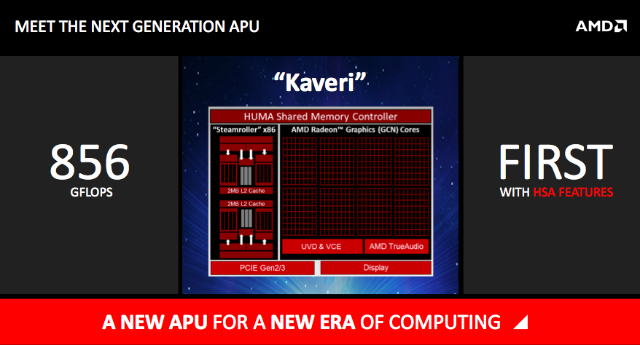
First HSA APU

Slide 18
What Is HSAemu
HSAemu is a full system emulator that supports the following HSA features
  Shared virtual memory between CPU and GPU
  Memory based signaling and synchronization
  Multiple user level command queues
  Preemptive GPU context switching
  Concurrent execution of CPU threads and GPU threads
  HSA runtime
  Finalizer
A project sponsored by MediaTek (MTK)
Currently, it supports simple HSA platform simulation
  Functional-accurate simulation
  Cycle-accurate simulation

Slide 19
Goals of HSAemu
Verify software stack implementation
  Tool chain/SDK
  HSA runtime
  Finalizers
Assist application software development in parallel to hardware development
  HSA feature support
  functional correctness guaranteed
Easy to plug-in different simulators/emulators
  Provide a command buffer interface

Slide 20
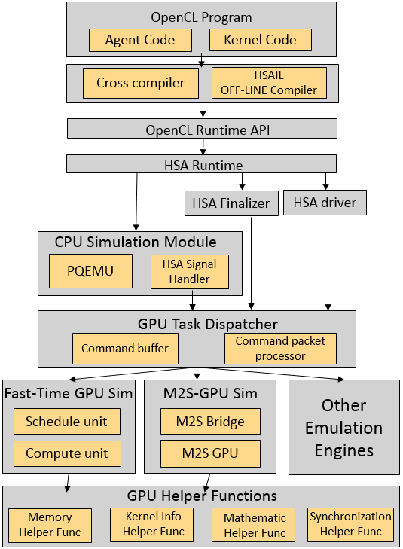
Architecture of HSAemu
HSAemu consists of 9 components
  HSAIL Off-line Compiler
  HSA Runtime
  HSA Driver
  HSA Finalizer
  CPU Simulation Module
  GPU Task Dispatcher
  Functional-Accurate GPU Simulator (Fast-Time GPU Simulator)
  Cycle-Accurate GPU Simulator (Multi2Sim)
  GPU Helper Functions

Slide 21
OpenCL 1.2 Benchmarks
AMD-APPSDK OpenCL benchmarks
  20+ benchmarks can be run on HSAemu
  For example: NBODY, Mandelbrot set, Histogram, etc.
Rodina OpenCL benchmark
  Kmeans, Gaussian…etc

Slide 22
Compliation Framework (1)
OpenCL Kernel
HSAIL Compiler
HSAIL Compiler
  Convert OpenCL kernel to HSAIL
HSAIL
HSAIL Decoder
HSAIL Decoder
  Convert HSAIL to binary format (BRIG)
BRIG
HSAIL Finalizer
HSAIL Finalizer
  Finalize the BRIG to the real ISA which is selected by the HSA Runtime
Device Native

Slide 23
Compliation Framework (2)
Components and compilation flow
OpenCL
Kernel
CL2HSAIL
HSAIL
Text
HSAIL Binary
(BRIG)
HSAIL2BRIG
HSAIL Finalization
OpenCL 2.0
Runtime
BRIG2OBJ
Object File
HSA Runtime
Kernel Descriptor

Slide 24
Compliation Framework (3)
CL2HSAIL
  CL2HSAIL is based on LLVM
  Compiling OpenCL to LLVM should include a self-defined OpenCL library header
  Use LLVM backend and HSAIL Target module to translate LLVM to HSAIL
OpenCL
Kernel
Clang
LLVM IR
Llc
HSAIL
Text
HSAIL Target
include
Library Header
Built-In Function
Library
OpenCL Type Header
Library

Slide 25
Compliation Framework (4)
HSAIL2BRIG
  Based on Lex and Yacc
BRIG is an ELF format binary file following HSAIL specification
HSAIL
Text
HSAIL2BRIG
HSAIL Binary
(BRIG)

Slide 26
Compliation Framework (4)
BRIG2OBJ is based on LLVM
  Flow Constructor: Covert BRIG to control flow tree
  Hdecoder: Covert control flow tree to LLVM bitcode
  Hassembler: Covert LLVM bitcode to host native
HSAIL Binary
(BRIG)
BRIG2OBJ
Object File
Flow
Constructor
HDecoder
LLVM
BitCode
HAssembler

Slide 27
HSAIL Finalization (1)
HSAIL Finalization
BRIG2OBJ
BRIG
Flow Constructor
BRIG
OpenCL
Runtime
Control Flow Tree
HSA Runtime
BRIG2OBJ
Translate LLVM IR to LLVM Target Object File
HDecoder
Construct The Control Flow Graph of HSAIL Program
Call the Coresponding HSA Runtime
Link to Helper Functions
Loader
LLVM BitCode
HAssembler
Read BRIG File, Generate The Kernel Descriptor And Launch BRIG2OBJ
Store The Target Binary Code to Code Cache
Translate HSAIL to LLVM IR
Linker
Load Target Object File
Target Executable
Object File
descriptor
Code Cache

Slide 28
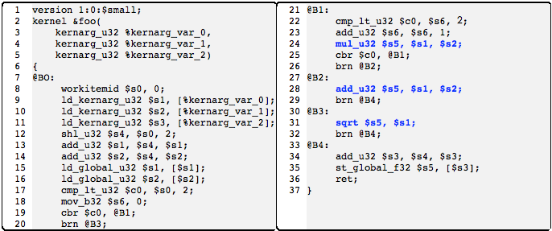
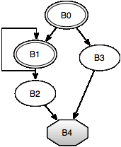
HSAIL Finalization (2)
Host SSE instruction Optimization
  Reconstruct the control flow graph of kernel function
  Use bitmap masking and packing/unpacking algorithms to generate host SSE instructions
Example : The control flow graph for kernel function $foo

Slide 29
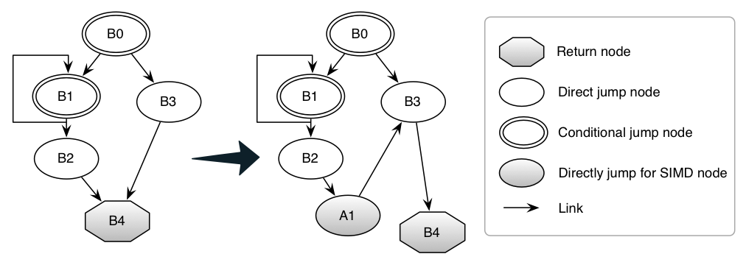
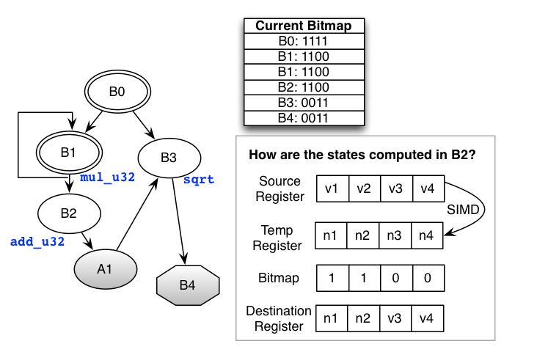
HSAIL Finalization (3)
Reconstruct the control flow graph by depth-first traversal
Perform bitmap masking
and packing & unpacking
algorithms

Slide 30
OpenCL Runtime
Most of OpenCL 1.2 APIs were implemented
  Based on the Multi2Sim runtime architecture
In OpenCL APIs, they call HSA runtime APIs to do the tasks
  OpenCL device init -> hsa_init API
  OpenCL command queue -> hsa_queue and AQL packet

Slide 31
HSA Runtime
Follow the HSA runtime specification v1.0
The following features were implemented
  HSA init and shutdown
  HSA notification mechanism
  HSA system and agent information
  HSA queue
  HSA AQL packet
  HSA signal
  HSA memory

Slide 32
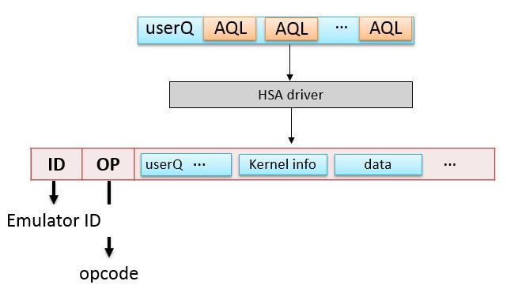
HSA Driver
Command buffer packet
HSA Driver
  Provide hardware information for HSA runtime
  Provide Memory Operation for HSA runtime
  Pack AQL packets to a command
  Dispatch command to Command Buffer

Slide 33
CPU Simulation Module (1)
Act as an HSA host
  PQEMU
Agent code, HSA runtime, and operating system are running on PQEMU

Slide 34
CPU Simulation Module (2)
PQEMU
  A parallel system emulator based on QEMU
  Can simulate up to 256 cores
  Dynamic binary translation (DBT) technique
  A project sponsored by MTK
Code Cache
DBT
DBT
DBT
DBT
CPU
CPU
CPU
CPU

Slide 35
CPU simulation Module (3)
HSA Signal Handler
  Receive doorbell signal from HSA runtime and decode the signal handle (start kernel program)
  Encode completion signal, and send it to the user program (finish kernel program)
  Inform command packet processor to process commands

Slide 36
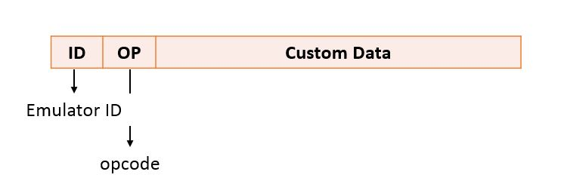
GPU Task Dispatcher (1)
Command packet
Command Buffer
  Define command buffer interface for easy emulator/simulator plug-in
    MMIO, syscall, interrupt…etc
  Receive the command packets from applications
    A command packet contains device id , opcode, and AQL packets which are enqueued by HSA runtime

Slide 37
GPU Task Dispatcher (2)
Command packet processor
  Fetch command packets from Command Buffer (FIFO)
  Decode the command packets to extract AQL packet or custom data
  Copy kernel object (executable code) to shared virtual memory
  Link kernel object to emulator
  Put kernel object to code cache
  Dispatch jobs to HSA kernel agents or other emulation engines

Slide 38
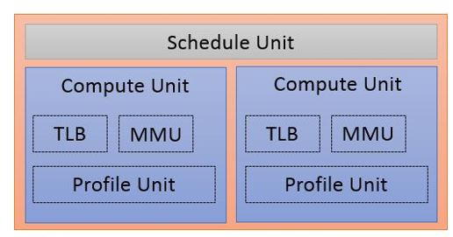
Fast-Time GPU Simulator (1)
Simulate a generic GPU model
  The schedule unite assigns work groups to free CU threads in the GPU Thread Pool
  Each CU thread executes all work items in a work group
  The maximum number of CU threads is limited by host operating system

Slide 39
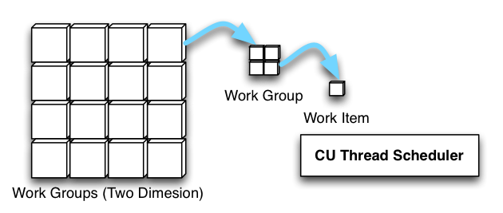
Fast-Time GPU Simulator (2)
Schedule Unit
  Master of compute units
  Manages a centralized work pool
  Treat a workgroup data as a atomic task(a workgroup as a basic unit)
  Use spinlock to keep the synchronization of compute unit threads
  Task distribution order is according to workgroup number order (increment order)

Slide 40
Fast-Time GPU Simulator (3)
Compute Unit
  Standalone thread
  Has its own MMU (IOMMU) for share virtual memory access
  Send the completion signal to HSA Signal Handler (CompletetionSignal) when job is done
  Profile job information (TLB Hits/Misses)

Slide 41
M2S-GPU Simulator (1)
A cycle-accurate simulator for AMD Southern Islands GPU model simulation
  M2S Bridge
    Bridge Multi2Sim GPU Model to HSAemu
  M2S GPU Module
    Simulate a cycle-accurate GPU model

Slide 42
M2S-GPU Simulator (2)
M2S Bridge : An interface to launch M2S GPU Module
  Initialize the data structures used by AMD Southern Islands GPU, including a memory register for AMD Southern Islands GPU to access the shared system memory in HSAemu
  Invoke M2S GPU Module (the AMD Southern Islands GPU module in Multi2Sim)

Slide 43
M2S-GPU Simulator (3)
M2S GPU Module
  A cycle-accurate AMD Southern Islands GPU simulator in Multi2Sim
Memory access is performed by HSAemu memory helper function to comply the hUMA model

Slide 44
GPU Helper Functions (1)
Memory Helper Function
  A soft-mmu of GPU with a page table worker and a TLB to enable hUMA model
  Support the redirect access of a local segment memory to a non-shared private memory in GPU
Kernel Information Helper Function
  Collect and return information of GPU simulation and current execution state
  Retrieve kernel information such as working item ID, work group size, etc, from AQL packet

Slide 45
GPU Helper Functions (2)
Mathematic Helper Function
  Simulate special mathematical instructions such as trigonometric instructions by calling the corresponding mathematical functions in standard library
Synchronization Helper Function
  Barrier synchronization implementation for generic GPU model simulation

Slide 46
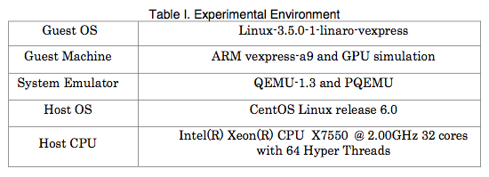
Performance Evaluation
Experimental Environment
Benchmarks:
  Nearest Neightbor (NN), K-Means, FFT, FWT, N-Body
  Binary Search, Bitonic Sort, Reduction, FWT

Slide 47
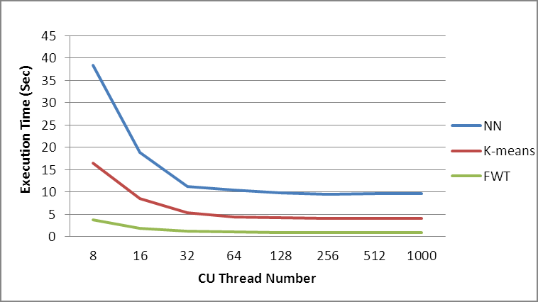
Scalability of Fast-Time GPU Simulator
Comparison of NN, K-means and FWT benchmarks on 32 physical cores
The speedup is scalable when # of CU threads < # of host physical cores

Slide 48
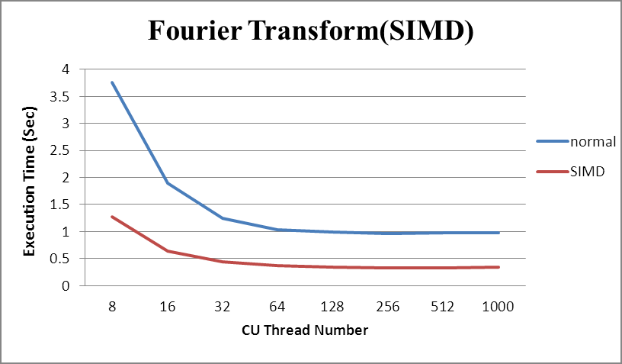
SSE Optimization of Fast-Time GPU Simulator
Performance comparison of FFT when turn on/off SSE optimization

Slide 49
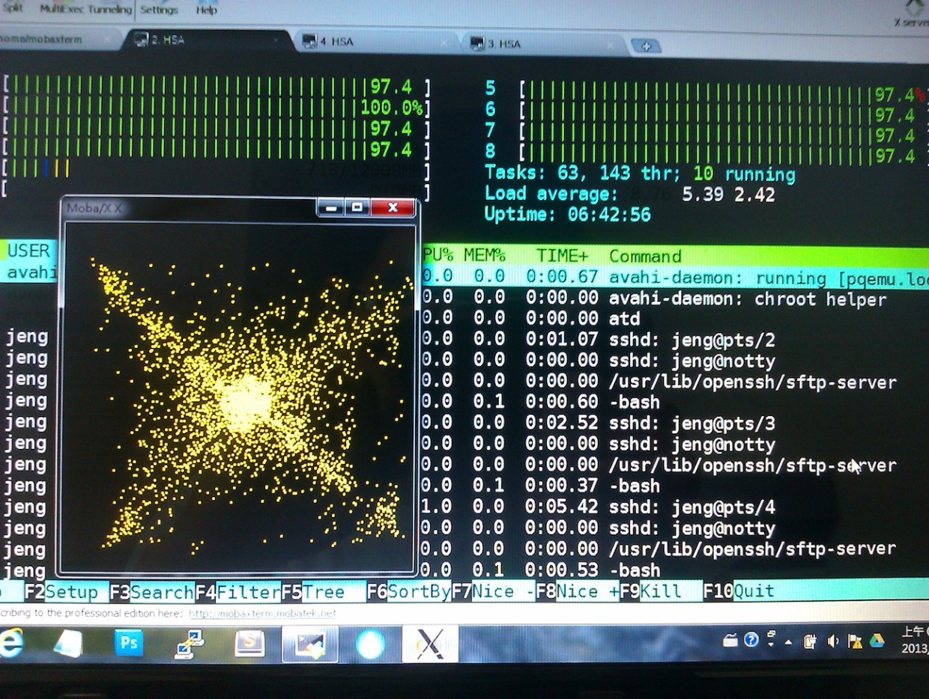
N-Body Simulation by Fast-Time GPU Simulator
N-Body Simulation
All of host physical CPUs are running

Slide 50
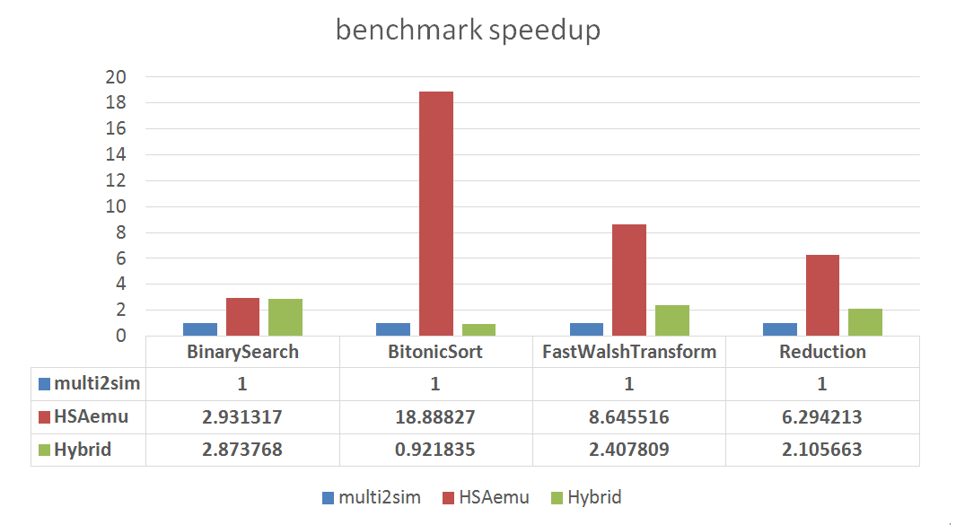
Comparison of HSAemu and Multi2Sim (1)

Slide 51
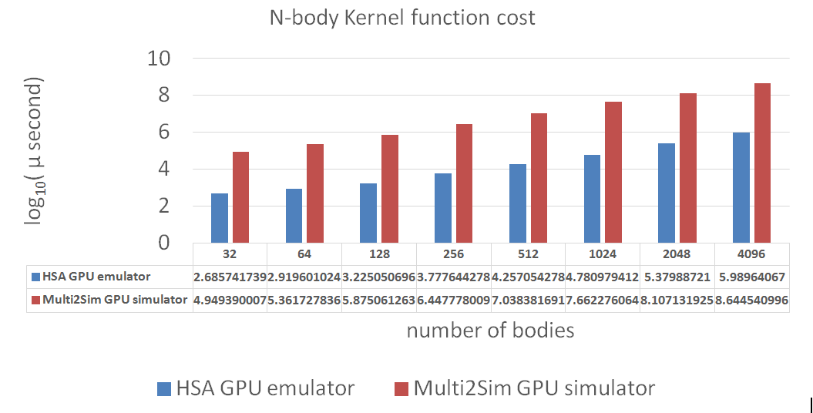
Comparison of HSAemu and Multi2Sim (2)

Slide 52
Conclusions
An HSA-compliant full system emulator has been implemented
  A functional-accurate simulator for generic GPU model
  A cycle-accurate simulator for AMD Southern Islands GPU model (from Multi2Sim)
An HSA tool chain/SDK for OpenCL 1.2
Easy to plug-in different simulators/emulators
  Provide a command buffer interface

Slide 53
Future work
OpenCL 2.0 support
Enhance HSAemu by implementing more HSA features
Integrate HSAemu with some existing cycle-accurate GPU simulators
Design a cycle-accurate simulator based on PQEMU for generic CPU model
Deisgn a cycle-accurate simulator based on PQEMU for big.LITTLE CPU model

Slide 54
Q & A

