Slide 1
HSA Runtime Specification

Slide 2
Outline
Introduction
HSA Core Runtime API (v1.0)
  Initialization and Shut Down
  Runtime Notifications
  System and Agent Information
  Signals and Synchronization (Memory-Based)
  Queues and Architected Dispatch
  Memory Management

Slide 3
Introduction
The HSA core runtime is a thin, user-mode API that provides the interface necessary for the host to launch compute kernels to the available HSA agents.
This document describes the architecture and APIs for the HSA runtime. Key sections of the runtime API include:
  Runtime initialization and shutdown
  Runtime Notifications
  System and agent information
  Signals and synchronization
  Architected dispatch
  Memory management

Slide 4
Introduction
The HSA software architecture stack
OpenCL
App
Java
App
…
OpenMP
App
DSL
App
Programming Model
OpenCL
Runtime
Java
Runtime
…
OpenMP
Runtime
DSL
Runtime
Language Runtime
HSA Runtime
Driver
Driver
HSA
Finalizer
HSA Runtime
…
…
HSA
Finalizer
…
…
Component 1
…
…
Component 1
Component N
Component N
Component 1
Component 1
Component N
Component N
HSA Vendor 1
Vendor 1
HSA Vendor m
Vendor m

Slide 5
Initialization
Before the HSA runtime can be used by an application, the HSA runtime must be initialized.
  hsa_status_t hsa_init();
hsa_init stpes:
Reference count > 0
hsa_init
Increase the value reference count
Reference count = 0
Allocate resources that hsa runtime needed and create runtime instance.

Slide 6
Initialization
When your program is going to be end, you need to call shutdown API.
  hsa_status_t hsa_shut_down();
hsa_shut_down stpes:
Reference count > 0
Decrease the value reference count.
hsa_shut_down
Reference count = 0
Release resources that allocated by hsa_init API.

Slide 7

Initialization
Execution flow of HSA initialization API.
hsa_init
hsa_shutdown

Slide 8
Runtime Notifications
The runtime can report notifications (errors or events) synchronously or asynchronously.
  The runtime uses the return value of functions in the HSA API to pass synchronous notifications to the application.
  The runtime passes asynchronous notifications in a different fashion.
When the runtime detects an asynchronous event, it invokes an application-defined callback.

Slide 9
Runtime Notifications
The HSA runtime defines a status code as an enumeration, hsa_status_t, to capture the return status of HSA runtime API.
  Except for accessors and mutators APIs.
A success status is represented by HSA_STATUS_SUCCESS, which is equivalent to zero.
  An error status is assigned a positive integer.
Besides status emuneration, there is another API hsa_status_string for applications to query additional information of status code.

Slide 10
Runtime Notifications
The asynchronous notifications may occur in many fashions.
  For example, queues are a common source of asynchronous events.
When the runtime detects an error in a queue, it invokes the callback associated with that queue and passes it a status code (indicating what happened) and a pointer to the erroneous queue.
  The callback functions must be thread-safe, callbacks that don’t return will cause the runtime into undefined state.

Slide 11
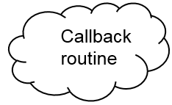
Runtime Notifications
Synchronous notifications
Asynchronous notifications
Pass status code
Output
Synchronous
hsa_status_string
status string
Jump to callback function
Return
Asynchronous
Asynchronous point

Slide 12
  System and Agent Information
HSA runtime define a routine for applications to query information of system and agents.
To query informations, HSA runtime defines some enumerations to record the attributes of system and agents.
  For system : endianness (hsa_endianness_t), machine model (hsa_endianness_t) , profile (hsa_profile_t)…etc.
  For agent : agent_feature (hsa_agent_feature_t), device type (hsa_device_type_t)…etc

Slide 13
System and Agent Information
In order for an application knows the implementation of a given HSA system, HSA runtime also defines API for an application to get a value of a specified system attribute.
  hsa_status_t hsa_system_get_info
For extensions, HSA provides two APIs for applications to query.
  hsa_status_t hsa_system_extension_supported
  hsa_status_t hsa_system_get_extension_table

Slide 14
System and Agent Information
In order for an application knows the implementation of a given HSA agent, HSA runtime defines an opaque handle to represent an HSA agent and an enumerator.
  hsa_agent_t
The HSA runtime also defines a API to traverse the list of HSA agents that are available in the system.
  hsa_status_t hsa_iterate_agents
To get capacity of device, and other informations.
  hsa_status_t hsa_agent_get_info
  hsa_status_t hsa_agent_extension_supported
  hsa_status_t hsa_agent_get_exception_policies

Slide 15
Signal
HSA signal is one way that HSA agents communicate to each other.
  The other is coherent shared memory.
  The advantage of signals over shared memory is that signal performs better in power or speed.
The HSA signal can only be manipulated by the HSA runtime or HSAIL instructions.

Slide 16
Signal
HSA runtime provides the following operations for signals.
  Allocate an HSA signal
  Destroy an HSA signal
  Read the current HSA signal value
  Send an HSA signal value
  Atomic read-modify-write an HSA signal value
  Wait on an HSA signal to meet a specified condition
  Wait on an HSA signal to meet a specified condition, with a maximum wait duration requested

Slide 17
Signal
Signal handle, used by applications.
  hsa_signal_t
Signal value, used inside HSA runtime.
  hsa_signal_value_t
  It can be 32 bits or 64 bits, depends on your machine mode.
Find the mapping signal value
HSA runtime signal API
hsa_signal_value_t
hsa_signal_t

Slide 18
Signal
The HSA runtime provide two APIs to create an HSA signal and to destroy an HSA signal.
  hsa_status_t hsa_signal_create
  hsa_status_t hsa_signal_destroy
Since hsa_signal_value_t may be operated simultaneously, each read or write signal operation must support the memory semantics.
  relaxed
  release
  acquire
  acquire-release

Slide 19
Signal
The HSA runtime defines two APIs to read the current HSA signal value.
  hsa_signal_value_t hsa_signal_load_acquire
  hsa_signal_value_t hsa_signal_load_relaxed
For sending an HSA signal value, the HSA runtime defines two APIs.
Updating the value of a signal is equivalent to sending the signal value.
  void hsa_signal_store_relaxed
  void hsa_signal_store_release

Slide 20
Signal
The signal atomic read-modified-write operations include
  AND
  OR
  XOR
  Add
  Subtract
  Exchange
  Compare And Swap
The HSA runtime defines routines for the combinations of signal atomic read-modified-write update operations and memory orders.

Slide 21
Signal
The application may wait on a signal, with a condition specifying the terms of the wait.
The HSA runtime provide a API to wait specific signal value.
  hsa_signal_value_t hsa_signal_wait_acquire
  hsa_signal_value_t hsa_signal_wait_relaxed
HSA runtime define a hsa_signal_condition_t and the signal condition can be
  EQ
  NE
  LT
  GTE

Slide 22
Signal
While waiting the condition, application will be two waiting states, defines in hsa_wait_state_t.
  HSA_WAIT_STATE_BLOCKED
    The application thread may be rescheduled while waiting on the signal.
  HSA_WAIT_STATE_ACTIVE
    The application thread stays active while waiting on a signal.

Slide 23
Signal
The signal value returned by the wait operation is not guaranteed to satisfy the wait condition due to multiple reasons:
  A spurious wakeup interrupts the wait.
  The wait time exceeded the timeout, either user-specified or system timeout.
  The wait has been interrupted because the signal value satisfies the specified condition, but the value is modified before the implementation of the wait operation has the opportunity to read it.

Slide 24
Queue
HSA hardware supports command execution through user mode queues. A user mode command queue is characterized as
  Runtime-allocated,
  User-level,
  Accessible virtual memory of a certain size,
  Containing packets defined in the Architected Queueing Language (AQL).
A queue is associated with a specific agent. An agent may have several queues attached to it.

Slide 25
Queue
Queues are semi-opaque objects:
  there is a visible part, represented by the hsa_queue_t structure and the corresponding ring buffer (pointed to by base_address)
  invisible part, which contains at least the read and write indexes.
The hsa_queue_t structure is read-only. But ring buffer can be directly accessed by the application.
The read and write indexes of the queue can only be accessed using HSA runtime APIs.

Slide 26
Queue
The visible part in hsa_queue_t are the following list :
  hsa_queue_type_t type
    Single or multiple producer.
  Features
    Kernel dispatch or Agent dispatch.
  base_address
  hsa_signal_t doorbell_signal
  Size
    Maximum number of packets the queue can hold. Must be a power of 2.
  id

Slide 27
Queue
The HSA runtime defines a API to allocate an HSA queue.
  hsa_status_t hsa_queue_create
The HSA runtime defines a API to allocate an Agent dispatch queue.
  hsa_status_t hsa_soft_queue_create
The HSA runtime defines a API to destroy an HSA queue.
  hsa_status_t hsa_queue_destroy
The HSA runtime defines a API to change the queue to a non-active state.
  hsa_status_t hsa_queue_inactivate

Slide 28
Queue
The runtime exposes several functions to increment the value of the write index with different memory semantic.
  void hsa_queue_store_write_index
  uint64_t hsa_queue_load_write_index
  uint64_t hsa_queue_cas_write_index
  uint64_t hsa_queue_add_write_index
For read index, the runtime exposes the following functions
  void hsa_queue_store_read_index
  uint64_t hsa_queue_load_read_index

Slide 29



Example - Enqueue packet
Allocate an AQL packet slot
Initialize packet
Copy the packet into queue.
WriteIndex
Dispatch Queue
ReadIndex
Send doorbell signal to notify HSA packet processor

Slide 30

Example - Enqueue packet
Check whether this queue is empty or not
WriteIndex
Dispatch Queue
ReadIndex
Send packet to component and change the packet type to invalid.
Increase the read index
Receive doorbell signal

Slide 31
Architected Queuing Language (AQL)
The Architected Queuing Language (AQL) is a standard binary interface used to describe commands.
An AQL packet is a user-mode buffer with a specific format that encodes one command.
Application uses regular memory operation to access the contents of packets, and user-level allocators to create a packet.
  HSA API does not provide any functionality to create, destroy or manipulate AQL packets.

Slide 32
Architected Queuing Language (AQL)
The HSA API defines the format of the different packet types:
  kernel dispatch.
  agent dispatch.
  barrier-AND.
  barrier-OR.
All formats share a common header hsa_packet_type_t that describes their type, barrier bit (force the packet processor to complete packets in order), and other properties.

Slide 33
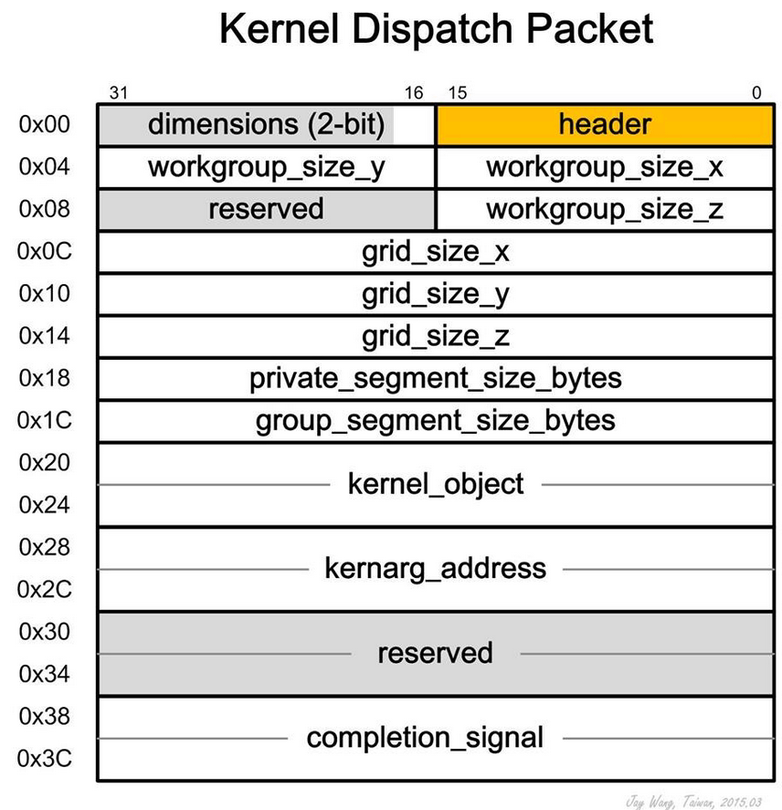
Architected Queuing Language (AQL)
Kernel dispatch packet hsa_kernel_dispatch_packet_t is used for submiting a kernel to a kernel agent.

Slide 34
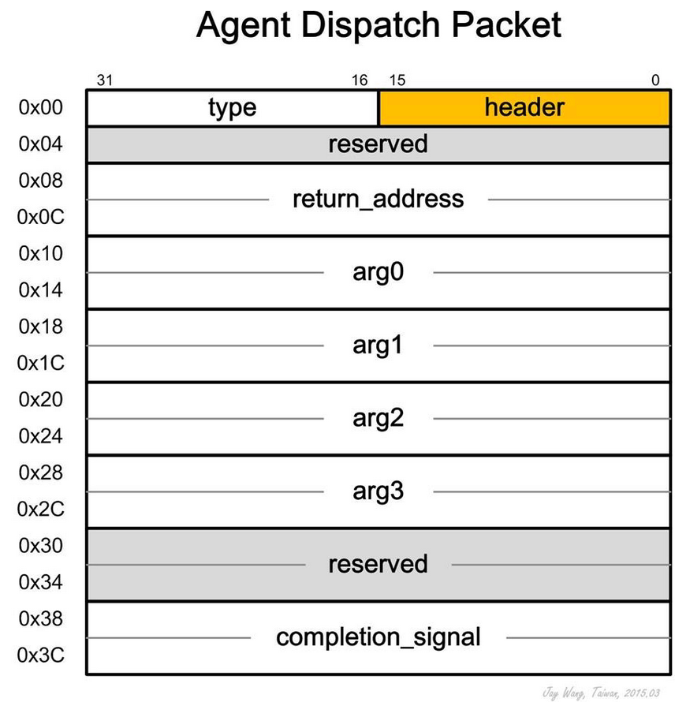
Architected Queuing Language (AQL)
Applications use agent dispatch packets to launch built-in functions in agents.
There is no need to indicate the address of the function to run.
  The HSA runtime use type instead.

Slide 35
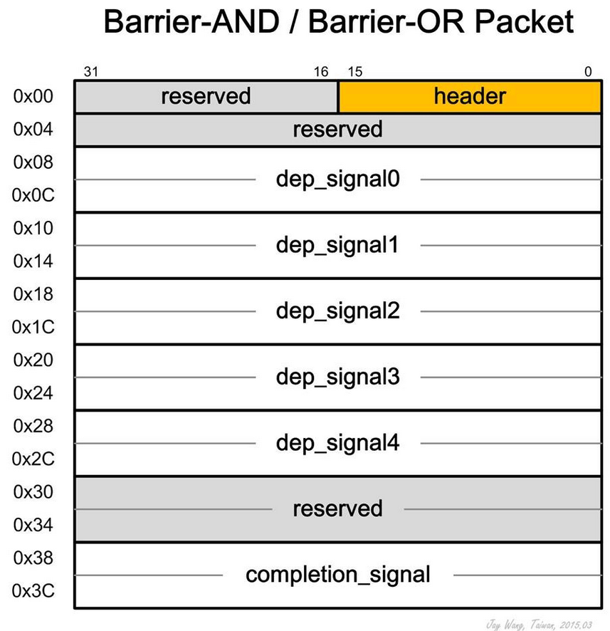
Architected Queuing Language (AQL)
The barrier-AND packet hsa_barrier_and_packet_t allows an application to specify up to five signal dependencies
  Requires the packet processor to resolve those dependencies before proceeding.
The packet processor will not launch any further packets in that queue until the barrier-AND packet is complete.

Slide 36
Architected Queuing Language (AQL)
All packet formats share a common header, hsa_packet_header_t, which describes their type, barrier bit (force the packet processor to complete packets in order), and other properties.
There are six types of AQL packets:
  Kernel dispatch packet
  Agent dispatch packet
  Barrier-AND packet
  Barrier-OR packet
  Vender-specific packet
  Invalid packet

Slide 37
Architected Queuing Language (AQL)
A AQL packet can be in one of the following five states:
  in queue
  launch
  error
  active
  complete

Slide 38
Architected Queuing Language (AQL)
In queue
  The packet processor has not started to parse the current packet.
  If barrier bit is set in the header, the transition to launch state occurs after all the preceding packets have completed their execution.
Launch
  The packet is being parsed, but it has not started execution.
Active
  The execution of the packet has started.
Error
  An error was encountered during the launch or active phases.

Slide 39
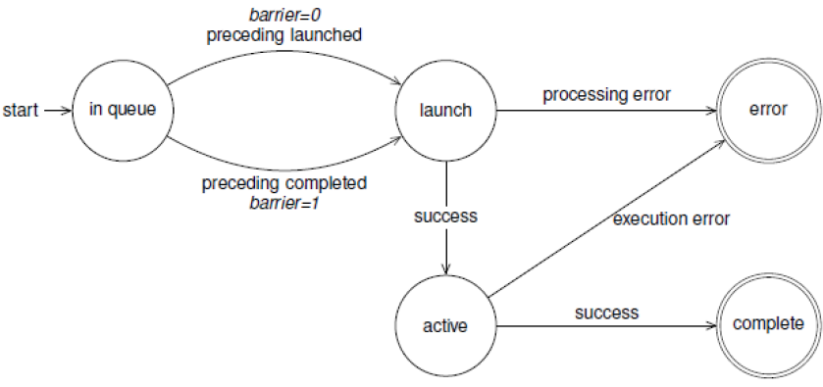
Architected Queuing Language (AQL)

Slide 40
Memory
The HSA runtime API provides a set of functions for inspecting the memory regions that are accessible from an agent, and (if applicable) allocating memory on those regions.
A memory region represents a block of virtual memory with certain characteristics that is accessible by one or more agents.
The HSA runtime defines a region object, hsa_region_t to representation each block of region.

Slide 41
Memory
The HSA memory region is classified into four different segments,
  Global
  Readonly
  Group
  Private
The HSA runtime defines an enumerator hsa_region_segment_t for all possible segments that a region can be associated with.

Slide 42
Memory
Regions associated with the global segment are divided into two broad categories: fine-grained and coarse-grained.
The main difference between these memory types is that fine-grained memory is directly accessible to all the agents in the system at the same time
The coarse-grained memory may be accessible to multiple agents, but never at the same time

Slide 43
Memory
Memory allocated outside of the HSA runtime routines (for example, malloc) is considered fine-grained only for those agents in the system that supports the Full profile.
If the allocated fine-grained memory via malloc is accessed by a kernel agent, the user is encouraged to register the corresponding address range by HSA runtime API hsa_memory_register.
  Full profile support can access any regular host pointer, a registered buffer can result in improved access performance.

Slide 44
Memory
In agents that only support the Base profile, fine-grained semantics are constrained to buffers allocated by using hsa_memory_allocate.
  This is used to allocate memory in global and readonly segments
If the same region handle is accessible to several agents, the application can explicitly transfer the ownership of buffers
The HSA runtime exposes the function hsa_memory_assign_agent to assign ownership of a buffer to an agent.

Slide 45
Memory
The read-only segment is used to store constant information of a kernel.
Kernel agents are only permitted to perform read operations on the addresses of variables that reside in read-only memory.
The contents of a read-only buffer can be initialized or changed from one kernel dispatch execution to another by using hsa_memory_copy.

Slide 46
Memory
The group segment is used to store information that is shared by all the work-items in the same workgroup.
Group memory is visible to the work-items of a single work-group of a kernel dispatch.
A variable in group memory can be read and written by any work-item in the same work-group
  Not by work-items in other work-groups or by other agents.

Slide 47
Memory
The private segment is used to store information local to a work-item. Private memory is visible only to a single work-item of a kernel dispatch.
A variable in private memory can be read and written only by the work-item with which it is associated.
  Not by any other work-items or other agents.

Slide 48
Memory
Memory usage in the group and private segments is similar to that of global and readonly segments.
  But not allowed to allocate memory in these regions using hsa_memory_allocate.
  nor copy any contents into them using hsa_memory_copy.
the user must specify the amount of group and private memory that needs to be allocated for a particular execution of a kernel by populating the group_segment_size and private_segment_size fields in the kernel dispatch packet.

