Slide 1
Image

Slide 2
Outline
Why image?
Image Overview
Image in OpenCL runtime
Image in System Architecture
Image in HSA runtime
Image in HSAIL

Slide 3
Why Image?

Slide 4
What is image?
Images are a graphics feature that can sometimes be useful in data-parallel computing.
Images can be accessed in one, two, or three dimensions
Image memory is a special kind of memory access that can make use of dedicated hardware often provided for graphics.

Slide 5
Why Use Images?
Special caches and tiling modes that reorder the memory locations of 2D and 3D images. Implementations can also insert gaps in the memory layout to improve alignment. These can save bandwidth by improving data locality and cache line usage compared to traditional linear arrays.

Slide 6
Why Use Images?
Image implementations can create caching hints using read-only images.
Hardware support for out-of-bounds coordinates.
Image coordinates can be unnormalized, or normalized floating-point values. When a normalized coordinate is used, it is scaled to the image size of the corresponding dimension, allowing values in the range 0.0 to +1.0 to access the entire image.

Slide 7
Why Use Images?
Values can be converted between linear RGB and sRGB color spaces.
Image memory offers different addressing modes, as well as data filtering, for some specific image formats. For example, linear filtering is a way to determine a value for a normalized floating-point coordinate by averaging the values in the image that are around the coordinate. Mathematically, this tends to smooth out the values or filter out high-frequency changes.

Slide 8
Image overview

Slide 9
Image Overview
An image consists of the following information:
•Image geometry
•Image format
•Image size
•Reference to the actual image data

Slide 10
Image Geometry
1D
  A 1D image contains image data that is organized in one dimension with a size specified by width. It can be addressed with a single coordinate x.
2D
  A 2D image contains image data that is organized in two dimensions with a size specified by width and height. It can be addressed by two coordinates (x, y) corresponding to the width and height respectively.
3D
  A 3D image contains image data that is organized in three dimensions with a size specified by width, height and depth. It can be addressed by three coordinates (x, y, z) corresponding to the width, height and depth respectively.

Slide 11
Image Geometry
1DA
  A 1DA image contains an array of a homogeneous collection of one-dimensional images, all with the same size, format and order, with a size specified by width and array index. It can be addressed by two coordinates (x, y) corresponding to the width and array index respectively.
2DA
  A 2DA image contains an array of a homogeneous collection of two-dimensional images, all with the same size, format and order, with a size specified by width, height and array size. It can be addressed by three coordinates (x, y, z) corresponding to the width, height and array index respectively.
Notes:
If a sampler is used, special rules apply to the array index y coordinate.
It is always treated as unnormalized even if the sampler specifies normalized. It is rounded to an integral value using round to nearest even integer, and clamped to the range 0 to array size - 1.
An important difference between 1DA and 2D images is that samplers never cause values in different images layers of the array to be combined when computing the returned image element

Slide 12
Image Geometry
1DB
  A 1DB image contains image data that is organized in one dimension with a size specified by width. It can be addressed with a single coordinate x.
  An important difference between 1DB and 1D images is that the image data can be allocated in the global segment and can have larger limits on the maximum image size supported.
  On some implementations this may result in a 1DB image having lower performance than an equivalent 1D image.

Slide 13
Image Geometry
2DDEPTH
  Same as the 2D geometry except the image operations only have a single access component instead of four. Requires that the image component order be depth or depth_stencil.
2DADEPTH
  Same as the 2DA geometry except the image operations only have a single access component instead of four. Requires that the image component order be depth or depth_stencil.

Slide 14
Image Format
The image format specifies the properties of the image elements in terms of their channel order and channel type. Each element in the image has the same image format. Associated with an image format there is a number called the bits per pixel (bpp) which is the number of bits needed to hold one element of an image.

Slide 15
Channel Order
Each image element in the image data has one, two, three or four values called memory components (also known as channels). Typically the memory components are named r, g, b and a (for red, green, blue, and alpha respectively, which can correspond to the color and transparency of the pixel), although some image orders use other names such as I, L and D (for intensity, luminance and depth respectively).
The image access operations always specify four access components regardless of the number of memory components present in the image data. The exception is the 2DDEPTH and 2DADEPTH image geometries which only have one access component.

Slide 16
Channel Order
The channel order specifies how many memory components each image element has and how those memory components are mapped to the four access components. The mapping is also referred to as swizzling.
Each channel order has an associated border color that is used as the access value by some coordinate addressing modes when an image is accessed by out of range coordinates.

Slide 17
Channel Type
The channel type specifies both the component memory type and the component access type. The component memory type specifies how the value of the memory component is encoded in the image data.
The component access type specifies how the value of the memory component is returned by image read operations, or specified to image store operations.
Each channel type has a conversion method that is used to converted from the component memory type to the component access type by image read operations, and from the component access type to the component memory type by image write operations.

Slide 18
Channel Type
The memory type is specified as the number of bits occupied by the component (also known as the bit depth), and whether the value is represented as a two's complement signed or unsigned integer or as an IEEE/ANSI Standard 754-2008 for floating-point value
For the packed representations of unorm_short_555 , unorm_short_565 and unorm_int_101010, the components are the specified bit fields within the image element. For unorm_short_565 the bit size varies according to whether the r, g or b component.
The access type is the HSAIL type used in the operands of the image operations that specify the image component

Slide 19
Image Access Permission
The image access permissions refer to how an image can be accessed using image operations. If the access permissions of a specific image include:
•read-only, then image read operations are allowed
•write-only, then write operations are allowed
•read-write, then both read and write operations are allowed

Slide 20
Image Coordinate
Image operations use image coordinates to specify which image element, and for image arrays, which image layer, to access. An image geometry uses either one, two or three coordinates, named x, y and z.
The processing of each image coordinate is controlled by three properties:
1.Coordinate normalization mode
2.Coordinate addressing mode
3.Coordinate filter mode
Notes:
These properties are specified by a sampler when using an rdimage image operation
The 1DB image geometry does not support samplers and so cannot be used with the rdimage image operation.

Slide 21
Opencl runtime

Slide 22
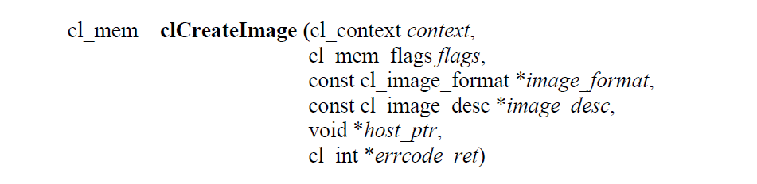
Creating Image Objects
A 1D image, 1D image buffer, 1D image array, 2D image, 2D image array and 3D image object can be created using the following function
context is a valid OpenCL context on which the image object is to be created

Slide 23
Creating Image Objects
flags is a bit-field that is used to specify allocation and usage information about the image memory object being created
ex: CL_MEM_READ_WRITE，CL_MEM_WRITE_ONLY

Slide 24
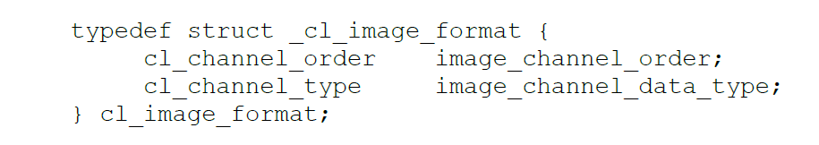
Creating Image Objects
image_format is a pointer to a structure that describes format properties of the image to be allocated.

Slide 25
Creating Image Objects
image_desc is a pointer to a structure that describes type and dimensions of the image to be allocated.

Slide 26
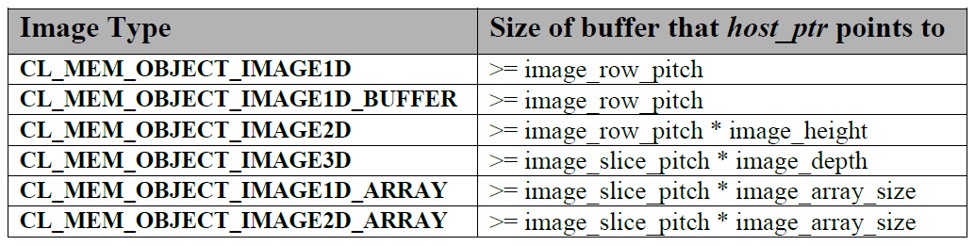
Creating Image Objects
host_ptr is a pointer to the image data that may already be allocated by the application

Slide 27
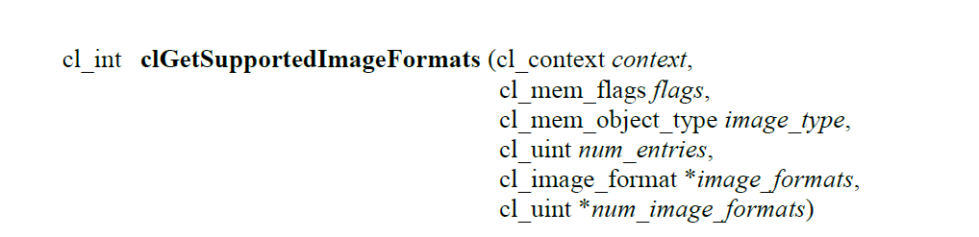
Querying List of Supported Image Formats
to get the list of image formats supported by an OpenCL implementation when the following information about an image memory object is specified:
Context
Image type – 1D, 2D, or 3D image, 1D image buffer, 1D or 2D image array.
Image Object allocation information

Slide 28
Querying List of Supported Image Formats
num_entries
  specifies the number of entries that can be returned in the memory location given by image_formats.

Slide 29
Querying List of Supported Image Formats
image_formats
  is a pointer to a memory location where the list of supported image formats are returned. Each entry describes a cl_image_format structure supported by the OpenCL implementation. If image_formats is NULL, it is ignored.

Slide 30
Querying List of Supported Image Formats
num_image_formats
  is the actual number of supported image formats for a specific context and values specified by flags. If num_image_formats is NULL, it is ignored.

Slide 31
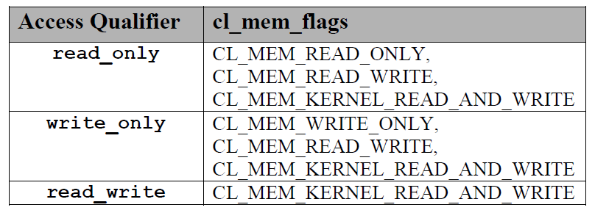
Image format mapping to OpenCL C image access qualifiers
For each access qualifier, only images whose format is in the list of formats returned by clGetSupportedImageFormats with the given flag arguments
in table below are permitted.
Notes:
Image arguments to kernels may have the read_only, write_only or read_write qualifier. Not all image formats supported by the device and platform are valid to be passed to all of these access qualifiers
It is not valid to pass an image supporting writing as both a read_only image and a write_only image parameter, or to a read_write image parameter and any other image parameter.

Slide 32
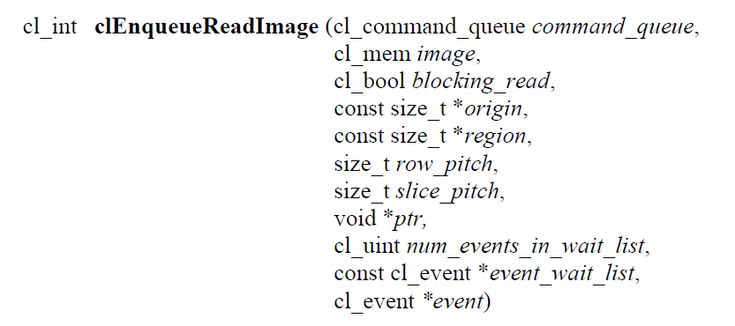
Reading Image Objects
command_queue
  refers to the host command-queue in which the read / write command will be queued. command_queue and image must be created with the same OpenCL context.

Slide 33
Reading Image Objects
blocking_read indicate if the read and write operations are blocking or non-blocking.

Slide 34
Reading Image Objects
If blocking_read is CL_TRUE i.e. the read command is blocking, clEnqueueReadImage does not return until the buffer data has been read and copied into memory pointed to by ptr.
If blocking_read is CL_FALSE i.e. the read command is non-blocking, clEnqueueReadImage queues a non-blocking read command and returns. The contents of the buffer that ptr points to cannot be used until the read command has completed. The event argument returns an event object which can be used to query the execution status of the read command. When the read command has completed, the contents of the buffer that ptr points to can be used by the application.

Slide 35
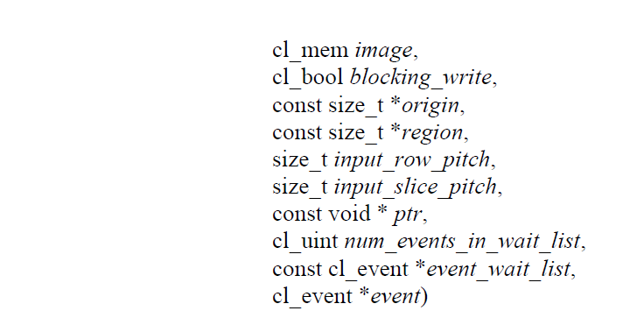
Writing Image Objects

Slide 36
Writing Image Objects
If blocking_write is CL_TRUE, the OpenCL implementation copies the data referred to by ptr and enqueues the write command in the command-queue. The memory pointed to by ptr can be reused by the application after the clEnqueueWriteImage call returns.
If blocking_write is CL_FALSE, the OpenCL implementation will use ptr to perform a non-blocking write. As the write is non-blocking the implementation can return immediately. The memory pointed to by ptr cannot be reused by the application after the call returns. The event argument returns an event object which can be used to query the execution status of the write command. When the write command has completed, the memory pointed to by ptr can then be reused by the application.

Slide 37
Reading Image Objects
origin
  defines the (x, y, z) offset in pixels in the 1D, 2D or 3D image, the (x, y) offset and the image index in the 2D image array or the (x) offset and the image index in the 1D image array.
Notes:
If image is a 2D image object, origin[2] must be 0. If image is a 1D image or 1D image buffer object, origin[1] and origin[2] must be 0.
If image is a 1D image array object, origin[2] must be 0. If image is a 1D image array object, origin[1] describes the image index in the 1D image array.
If image is a 2D image array object, origin[2] describes the image index in the 2D image array

Slide 38
Reading Image Objects
region
  defines the (width, height, depth) in pixels of the 1D, 2D or 3D rectangle, the (width, height) in pixels of the 2D rectangle and the number of images of a 2D image array or the (width) in pixels of the 1D rectangle and the number of images of a 1D image array.
Notes:
If image is a 2D image object, region[2] must be 1.
If image is a 1D image or 1D image buffer object, region[1] and region[2] must be 1.
If image is a 1D image array object, region[2] must be 1. The values in region cannot be 0

Slide 39
Reading Image Objects
row_pitch
  in clEnqueueReadImage and input_row_pitch in clEnqueueWriteImage is the length of each row in bytes.
  This value must be greater than or equal to the element size in bytes * width.
Notes:
If row_pitch (or input_row_pitch) is set to 0, the appropriate row pitch is calculated based on the size of each element in bytes multiplied by width.

Slide 40
Reading Image Objects
slice_pitch
  in clEnqueueReadImage and input_slice_pitch in clEnqueueWriteImage is the size in bytes of the 2D slice of the 3D region of a 3D image or each image of a 1D or 2D image array being read or written respectively.
Notes:
This must be 0 if image is a 1D or 2D image. Otherwise this value must be greater than or equal to row_pitch * height.
If slice_pitch (or input_slice_pitch) is set to 0, the appropriate slice pitch is calculated based on the row_pitch * height.

Slide 41
Reading Image Objects
ptr
  is the pointer to a buffer in host memory where image data is to be read from or to be written to.
event_wait_list and num_events_in_wait_list
  specify events that need to complete before this particular command can be executed.
Notes:
If event_wait_list is NULL, then this particular command does not wait on any event to complete.
If event_wait_list is NULL, num_events_in_wait_list must be 0.
If event_wait_list is not NULL, the list of events pointed to by event_wait_list must be valid and num_events_in_wait_list must be greater than 0.
The events specified in event_wait_list act as synchronization points. The context associated with events in event_wait_list and command_queue must be the same.
The memory associated with event_wait_list can be reused or freed after the function returns.

Slide 42
Reading Image Objects
event
  returns an event object that identifies this particular read / write command and can be used to query or queue a wait for this particular command to complete.
  event can be NULL in which case it will not be possible for the application to query the status of this command or queue a wait for this command to complete.

Slide 43
Reading Image Objects
Calling clEnqueueReadImage to read a region of the image with the ptr argument value set to host_ptr + (origin[2] * image slice pitch + origin[1] * image row pitch + origin[0] * bytes per pixel), where host_ptr is a pointer to the memory region specified when the image being read is created with CL_MEM_USE_HOST_PTR, must meet the following requirements in order to avoid undefined behavior:
All commands that use this image object have finished execution before the read command begins execution

Slide 44
Reading Image Objects
The row_pitch and slice_pitch argument values in clEnqueueReadImage must be set to the image row pitch and slice pitch.
The image object is not mapped.
The image object is not used by any command-queue until the read command has finished execution.

Slide 45
Writing Image Objects
Calling clEnqueueWriteImage to update the latest bits in a region of the image with the ptr argument value set to host_ptr + (origin[2] * image slice pitch + origin[1] * image row pitch + origin[0] * bytes per pixel), where host_ptr is a pointer to the memory region specified when the image being written is created with CL_MEM_USE_HOST_PTR, must meet the following requirements in order to avoid undefined behavior:
The host memory region being written contains the latest bits when the enqueued write command begins execution.

Slide 46
Writing Image Objects
The input_row_pitch and input_slice_pitch argument values in clEnqueueWriteImage must be set to the image row pitch and slice pitch.
The image object is not mapped.
The image object is not used by any command-queue until the write command has finished execution.

Slide 47
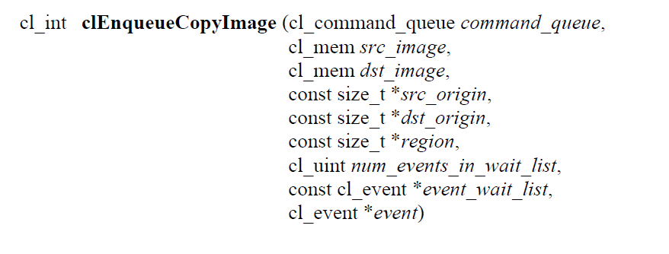
Copying Image Objects
src_origin and dst_origin
  defines the (x, y, z) offset in pixels in the 1D, 2D or 3D image, the (x, y) offset and the image index in the 2D image array or the (x) offset and the image index in the 1D image array.

Slide 48
Copying Image Objects
region
  defines the (width, height, depth) in pixels of the 1D, 2D or 3D rectangle, the (width, height) in pixels of the 2D rectangle and the number of images of a 2D image array or the (width) in pixels of the 1D rectangle and the number of images of a 1D image array.

Slide 49
Copying Image Objects
It is currently a requirement that the src_image and dst_image image memory objects for clEnqueueCopyImage must have the exact same image format (i.e. the cl_image_format descriptor specified when src_image and dst_image are created must match).
clEnqueueCopyImage returns CL_SUCCESS if the function is executed successfully.

Slide 50
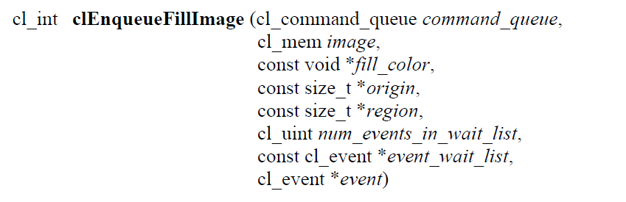
Filling Image Objects
fill_color
  is the fill color. The fill color is a four component RGBA floating-point color value if the image channel data type is not an unnormalized signed or unsigned integer type, is a four component signed integer value if the image channel data type is an unnormalized signed integer type and is a four component unsigned integer value if the image channel data type is an unnormalized unsigned integer type. The fill color will be converted to the appropriate image channel format and order.

Slide 51
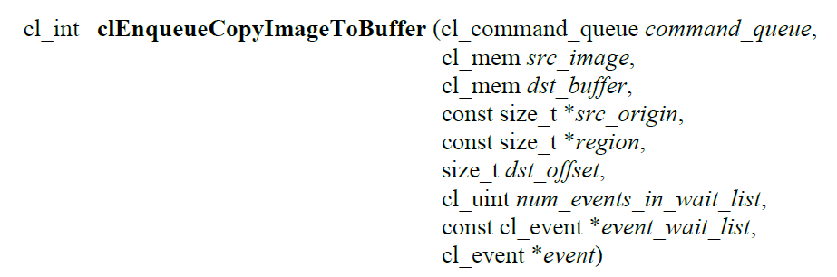
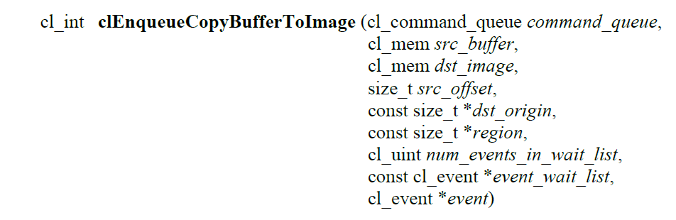
Copying between Image and Buffer Objects

Slide 52
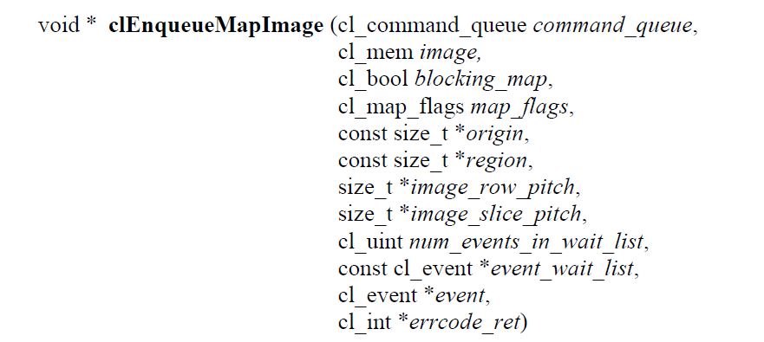
Mapping Image Objects

Slide 53
Mapping Image Objects
blocking_map
  -indicates if the map operation is blocking or non-blocking.
If blocking_map is CL_TRUE, clEnqueueMapImage does not return until the specified region in image is mapped into the host address space and the application can access the contents of the mapped region using the pointer returned by clEnqueueMapImage.

Slide 54
Mapping Image Objects
If blocking_map is CL_FALSE i.e. map operation is non-blocking, the pointer to the mapped region returned by clEnqueueMapImage cannot be used until the map command has completed. The event argument returns an event object which can be used to query the execution status of the map command. When the map command is completed, the application can access the contents of the mapped region using the pointer returned by clEnqueueMapImage.
map_flags
  is a bit-field
errcode_ret
  will return an appropriate error code. If errcode_ret is NULL, no error code is returned
Notes:
If the image object is created with CL_MEM_USE_HOST_PTR set in mem_flags, the following will be true:
The host_ptr specified in clCreateImage is guaranteed to contain the latest bits in the region being mapped when the clEnqueueMapImage command has completed.
The pointer value returned by clEnqueueMapImage will be derived from the host_ptr specified when the image object is created.

Slide 55
Mapping Image Objects
If the image object is created with CL_MEM_USE_HOST_PTR set in mem_flags, the following will be true:
  The host_ptr specified in clCreateImage is guaranteed to contain the latest bits in the region being mapped when the clEnqueueMapImage command has completed.
  The pointer value returned by clEnqueueMapImage will be derived from the host_ptr specified when the image object is created.
  Mapped image objects are unmapped using clEnqueueUnmapMemObject.

Slide 56
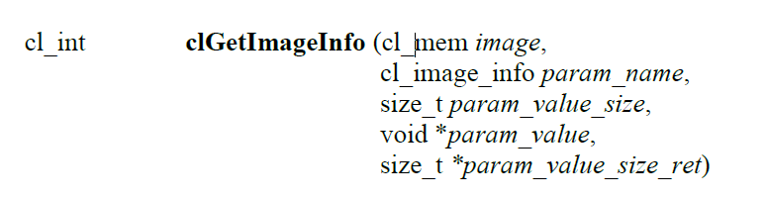
Image Object Queries
param_name
  specifies the information to query. The list of supported param_name types and the information returned in param_value by clGetImageInfo.
param_value
  is a pointer to memory where the appropriate result being queried is returned. If param_value is NULL, it is ignored.
  EX: CL_IMAGE_FORMAT , CL_IMAGE_ROW_PITCH

Slide 57
Image Object Queries
param_value_size
  is used to specify the size in bytes of memory pointed to by param_value. This size must be >= size of return type.
param_value_size_ret
  returns the actual size in bytes of data being queried by param_value. If param_value_size_ret is NULL, it is ignored.

Slide 58
HSA System architecture

Slide 59
Image – from system architecture view
HSA-compliant platform shall optionally provide for the ability of HSA software to define and use image objects, which are used to store one-, two-, or three-dimensional images
The elements of an image object are defined from a list of predefined image formats.
Image primitives accessible from kernel agents, operate on an image value, which is referenced using an opaque 64-bit image handle.

Slide 60
Image -- requirement
Images are created by the HSA platform and may be initialized from data copied from the global segment.
After initialization, the image structure
  retains no reference to the global segment that provided the initializing data.
  data is not stored in the global segment.

Slide 61
Image -- requirement
An image object can only be used by a single agent, the agent specified when creating the image object.
Image data can only be accessed via interfaces exposed by the HSA platform or kernel agent primitives.
The layout of the image data storage is implementation defined, and need not be the same for different agents in the same HSA implementation.
Images are not part of the shared virtual address space. A consequence of this is that in general, agent access to image data must be performed via interfaces exposed by the HSA platform.

Slide 62
Image -- requirement
Image operations do not contribute to memory orderings defined by the HSA memory model. The following rules apply for image operation visibility:
  Modifications to image data through HSA runtime API require the following sequence to occur in order to be visible to subsequent AQL packet dispatches:
    HSA runtime operation modifying the image data completes
    A packet processor acquire fence applying to image data is executed on the agent for the image (this may be part of the AQL packet dispatch that reads the modified image data).

Slide 63
Image -- requirement
  Modifications to image data by a kernel agent packet dispatch are visible as follows:
  Image data modifications made by an AQL packet dispatch require the following sequence to occur in order to be visible to subsequent AQL packet dispatches:
    The active phase of the AQL packet dispatch modifying the image completes.

Slide 64
Image -- requirement
    A packet processor release fence applying to image data is executed on the agent for the image (this may be part of the AQL packet dispatch that modified the image).
    A packet processor acquire fence applying to image data is executed on the agent for the image (this may be part of the AQL packet dispatch that reads the modified image data).

Slide 65
Image --requirement
Image data modifications made by an AQL packet dispatch require the following sequence to occur in order to be visible to HSA runtime operations:
  -1. The active phase of the AQL packet dispatch modifying the image completes.
  -2. A packet processor release fence applying to image data is executed on the agent for the image (this may be part of the AQL packet dispatch that modified the image).

Slide 66
Image – requirement
Stores to, an image by a single work-item are visible to loads by the same work-item after execution of a work-item scope image fence operation.
Stores to an image by a work-item are visible to loads by the same work-item and other work-items in the same work-group after both the writing and reading work-item(s) execute work-group execution uniform image acquire/release fences at work-group scope.

Slide 67
Image – requirement
Note that there is no image acquire/release fence at agent scope. Therefore, it is not possible to make image stores performed by a work-item visible to image loads performed by another work-item in a different work-group of the same dispatch.
Image accesses and image fences by a single work-item cannot be reordered.
Image fences and barrier/wavebarrier operations cannot be reordered. The ordering between barrier/wavebarrier operations and image fences is visible to all work-items that participate in the barrier/wavebarrier operations.

Slide 68
Image – requirement
A read/write image may alias a read-only or write-only image that is allocated for the same kernel agent. Additionally, a write-only image may alias a read-only image that is allocated for the same kernel agent.
If the data of a read-only image is modified while it is being read by a kernel agent kernel dispatch, then the behavior is undefined. If the data of a write-only image is read while it is being modified by a kernel agent kernel dispatch, then the behavior is undefined.
As described above, images are not part of shared virtual memory and thus are not included in the HSA Memory Model, as defined in HSA memory consistency model

Slide 69
Hsa runtime

Slide 70
HSA runtime requirement and feature
The HSA runtime uses an opaque image handle (hsa_ext_image_t) to represent images.
The image handle references the image data in memory and stores information about resource layout and other properties.
HSA decouples the storage of the image data and the description of how the agent interprets that data.

Slide 71
HSA runtime requirement and feature
An image format is specified using a channel type and a channel order
Channel type:
  -- describes how the data is to be interpreted along with the bit size.
Channel order:
  -- describes the number and the order of memory components.

Slide 72
HSA runtime requirement and feature
Not all image channel types and channel order combinations are valid on an agent, but an agent must support a minimum set of image formats.
An application can use hsa_ext_image_get_capability to obtain the image format capabilities for a given combination of agent, geometry, and image format.
An implementation-independent image format descriptor (hsa_ext_image_descriptor_t) is composed of a geometry along with the image format.

Slide 73
HSA runtime requirement and feature
The image descriptor is used to inquire the runtime for the agentspecific image data size and alignment details by calling hsa_ext_image_data_get_info for the purpose of determining the implementation’s storage requirements.
The memory requirements (hsa_ext_image_data_info_t) include the size of the memory needed as well as any alignment constraints.
An application can either allocate new memory for storing the image data, or use an existing buffer. Before the image data is used, an agent-specific image handle must be created using it and if necessary, cleared and prepared according to the intended use.

Slide 74
HSA runtime requirement and feature
The function hsa_ext_image_create creates an agent-specific image from an image format descriptor, an application-allocated buffer that conforms to the requirements provided by hsa_ext_image_data_get_info, and access permissions.
The returned handle can used by the HSAIL operations rdimage, ldimage, and stimage.

Slide 75
HSA runtime requirement and feature
While the image data is technically accessible from its pointer in the raw form, the data layout and organization is agent-specific and should be treated as opaque.
The internal implementation of an optimal image data organization could vary depending on the attributes of the image format descriptor.
There are no guarantees on the data layout when accessed from another agent. The only reliable way to import or export image data from optimally organized images is to copy their data to and from a linearly organized data layout in memory, as specified by the image’s format attributes.

Slide 76
HSA runtime requirement and feature
The HSA runtime provides interfaces to allow operations on images. Image data transfer to and from memory with a linear layout can be performed using hsa_ext_image_export and hsa_ext_image_import respectively.
A portion of an image could be copied to another image using hsa_ext_image_copy. An image can be cleared using hsa_ext_image_clear.
It is the application’s responsibility to ensure proper synchronization and preparation of images on accesses from other image operations.

Slide 77
HSA runtime requirement and feature
An agent-specific sampler handle (hsa_ext_sampler_t) is used by the HSAIL language to describe how images are processed by the rdimage HSAIL operation.
The function hsa_ext_sampler_create creates a sampler handle from an agent-independent sampler descriptor (hsa_ext_sampler_descriptor_t).

Slide 78
HSAIL IMAGE

Slide 79
Read Image (rdimage) Operation
The read image (rdimage) operation uses image coordinates together with a sampler to perform an image memory lookup.
The operation loads data from a read-only image, specified by source operand image at coordinates given by source operands coordWidth, coordHeight, coordDepth, and coordArrayIndex, into destination operands destR, destG, destB, and destA. A sampler specified by source operand sampler defines how to process the read.
rdimage used with integer coordinates has restrictions on the sampler:
  •coord must be unnormalized.
  •filter must be nearest.
  •The boundary mode must be undefined, clamp_to_edge or clamp_to_border.

Slide 80
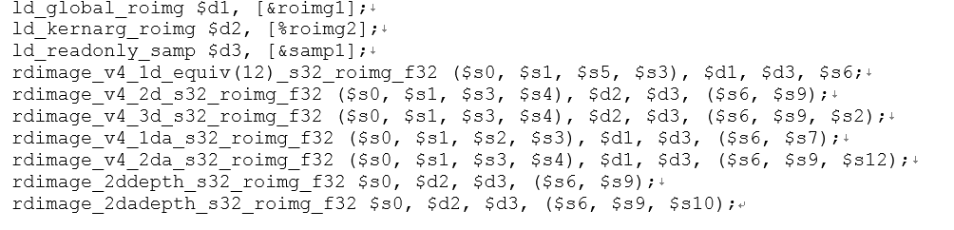
Read Image (rdimage) Operation
image:
  A source operand d register that contains a value of an image object of type imageType.
sampler:
  A source operand d register that contains a value of a sampler object. It is always of type samp.

Slide 81
Load Image (ldimage) Operation
The load image (ldimage) operation uses image coordinates to load from image memory
The operation loads data from a read-write or read-only image, specified by source operand image at integer coordinates given by source operands coordWidth, coordHeight, coordDepth, and coordArrayIndex, into destination operands destR, destG, destB, and destA.

Slide 82
Load Image (ldimage) Operation
While ldimage does not have a sampler, it works as though there is a sampler with coord = unnormalized, filter = nearest and address_mode = undefined. It is undefined if a coordinate is out of bounds (that is, greater than the dimension of the image or less than 0).
The differences between the ldimage operation and the rdimage operation are:
  •rdimage takes a sampler and therefore supports additional modes.
  •The value returned if a coordinate is out of bounds (that is, greater than the dimension of the image or less than 0) for rdimage depends on the sampler; for ldimage it is undefined.

Slide 83
Store Image (stimage) Operation
The store image (stimage) operation stores to image memory using image coordinates. The operation stores data specified by source operands srcR, srcG, srcB, and srcA to a write-only or read-write image specified by source operand image at integer coordinates given by source operands coordWidth, coordHeight, coordDepth, coordArrayIndex, and coordByteIndex.
It is undefined if a coordinate is out of bounds (that is, greater than the dimension of the image or less than 0).

Slide 84
Store Image (stimage) Operation
The source elements are interpreted left-to-right as r, g, b, and a components of the image format. These elements are written to the corresponding components of the image element. Source elements that do not occur in the image element are ignored.
For example, an image format of r has only one component in each element, so only source operand srcR is stored.
For all geometries, coordinates are in elements.
Type conversions are performed as needed between the source data type specified by srcType (s32, u32, or f32) and the destination image data element type and format.

Slide 85
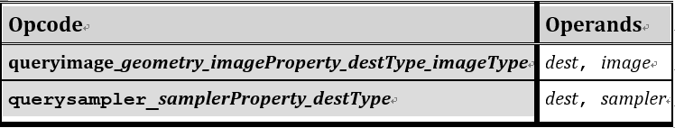
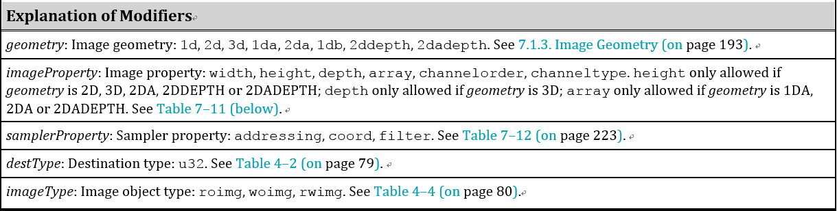
Query Image and Query Sampler Operations

Slide 86
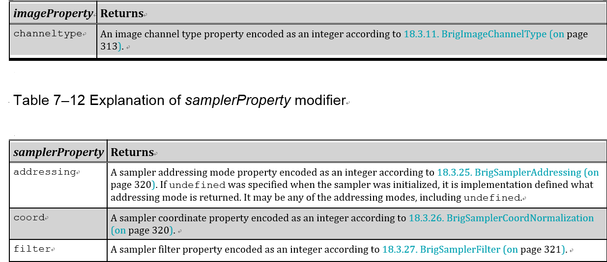
Query Image and Query Sampler Operations

Slide 87
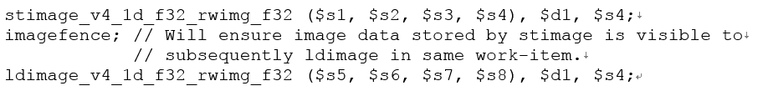
Image Fence (imagefence) Operation
The imagefence operation allows image data access and updates to be synchronized both within a single work-item, and, when combined with an execution barrier, between work-items in the same wavefront or work-group. In addition, when combined with memfence and execution barriers it can synchronize both image operations and global and group segment memory operations. Execution is undefined when memory is accessed without synchronization

Slide 88
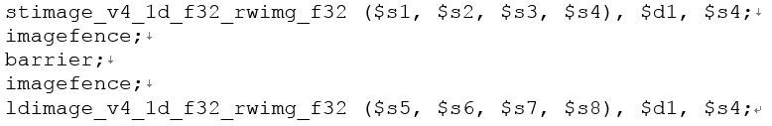
Image Fence (imagefence) Operation
To make the image writes performed by work-item A visible to the image reads performed by work-item B, it is necessary for A to execute an imagefence after the image write, followed by a barrier or wavebarrier that both A and B participate in; and for B to execute an imagefence after the barrier or wavebarrier but before the image reads. For example:

Slide 89
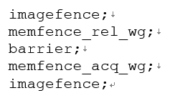
Image Fence (imagefence) Operation
Note that this is not enough to ensure an ordering between between the image operations and memory operations performed by A and B to the global or group segment. To ensure that ordering it is also necessary for A to perform a release memfence after the memory operations but before the barrier or wavebarrier, and for B for perform an acquire memfence after the barrier or wavebarrier and before the memory operations. A and B must both be inclusive members of the scope instances specified by the memfence operations. For example:

Slide 90
Image Fence (imagefence) Operation
Note that an fbarrier cannot be used to achieve synchronization in the current version of HSAIL.
It is not possible to synchronize at a wider scope than work-group except at kernel dispatch granularity by using User Mode Queue packet memory fences.
The imagefence operation can be used in conditional code.

