Slide 1
HSA Kernel Code Trace
2014/5/26
Advisor: Wei-Chung Hsu
Student: Yu-Ju Huang

Slide 2
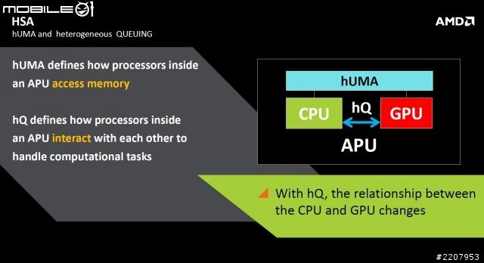

Slide 3
Agenda
Code Overview
HSA Driver
  Concepts
    Flow Overview
    User & Hardware Queues
  Source Code Detail
IOMMU
  Concepts
    GCR3
    PPR
  Source Code Detail
Flow Review

Slide 4
Code Overview
A new HSA kernel driver ("radeon-kfd") which works with the radeon graphics driver.
Fixes and improvements to the radeon and amd_iommu(v2) drivers, mm and mmu_notifier code.
KFD driver (HSA driver)
  module_init: drivers/gpu/hsa/radeon/kfd_module.c
  device_init: drivers/gpu/hsa/radeon/kfd_device.c
  kfd_fops: drivers/gpu/hsa/radeon/kfd_chardev.c
  scheduler_class: drivers/gpu/hsa/radeon/kfd_sched_cik_static.c
IOMMU
  drivers/iommu/amd_iommu_v2.c
Notes:
kfd_fops: user-space including library

Slide 5
Agenda
Code Overview
HSA Driver
  Concepts
    Flow Overview
    User & Hardware Queues
  Source Code Detail
IOMMU
  Concepts
    GCR3
    PPR
  Source Code Detail
Flow Review

Slide 6
Concepts - HSA Run Flow
User Space
Kernel Space
Create user queues
(Up to 1024 user queues per process)
Create HW queue with user queue information
(Up to 64 HW queue)
Initialization
User - HW interaction
Enqueu AQL packets, kick doorbell, and wait signal
Nothing
Computation
Application finish and destroy queues
Release HW queue
Finish

Slide 7
Each process can have up to 1024 queues
pasid=0
queue_id=0
pasid=0
queue_id=1
pasid=1
queue_id=0
pasid=1
queue_id=1
ring_base_address
ring_base_address
ring_base_address
ring_base_address
doorbell
doorbell
doorbell
doorbell
HQ0
HQ1
HQ2
HQ3
Free hardware queue_id bitmap
(Up to 64 hardware queues)
queue select register
Physical Address
HSA GPU’s configuration register mmio address
Notes:
Driver’s help
ring VA

Slide 8
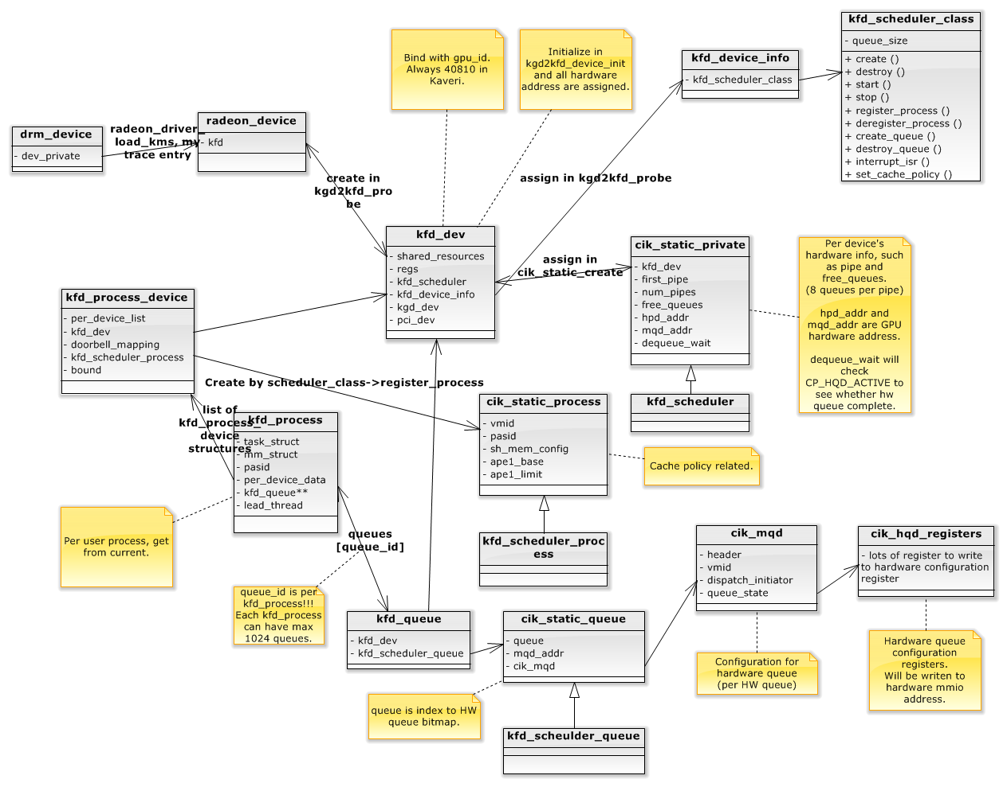
Per Device
Per Application
HW Priv
HWP
Per HW Queue
HWQ
Notes:
per_device_data
scheduler_class

Slide 9
HSA Driver Flow
System intialization
  module_init
  device_init (Called by radeon)
Application open “/dev/kfd” device
Application call gate
Application send ioctl
  KFD_IOC_SET_MEMORY_POLICY
  KFD_IOC_CREATE_QUEUE
Application send ioctl
  KFD_IOC_DESTROY_QUEUE
Application termination
Notes:
Start code

Slide 10
module_init(kfd_module_init)
radeon_kfd_pasid_init
  Initialize pasid bitmap
  PASID 0 is reserved
radeon_kfd_chardev_init
  register_chrdev: /dev/kfd
  kfd_ops
    Define open, ioctl, mmap member function
kfd_topology_init
  Most related to ACPI (advanced configuration and power interface)

Slide 11
kgd2kfd_device_init
kfd->regs = gpu_resources->mmio_registers;
  Hardware MMIO address
radeon_kfd_doorbell_init(kfd);
radeon_kfd_interrupt_init(kfd);
device_iommu_pasid_init(kfd);
kfd_topology_add_device(kfd);
amd_iommu_set_invalidate_ctx_cb(kfd->pdev, iommu_pasid_shutdown_callback);
scheduler_class->create();
scheduler_class->start();

Slide 12
scheduler_class Call Sequence
cik_static_create
  Called in kgd2kfd_device_init
  Create kfd->scheduler (HW priv)
    Initialize free_queues
cik_static_start
  Called in kgd2kfd_device_init
  init_pipes
  init_ats
  enable_interrupts
===== Before application =====
Notes:
priv用來記HW info

Slide 13
User Open “/dev/kfd”
radeon_kfd_create_process(current)
  If this user process already open kfd, find its kfd_process and return
  Else
    Create kfd_process
    Assign pasid
      There are 1<<20 possible pasid
      Use a bitmap to put&get pasid for kfd_process

Slide 14
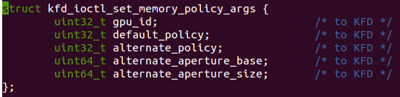

KFD_IOC_SET_MEMORY_POLICY
Two policy for now
  cache_policy_coherent
  cache_policy_noncoherent
Okra
  default policy=cache_policy_coherent
  alternate policy=cache_policy_noncoherent
Write to hardware queue register
  SH_MEM_CONFIG
  SH_MEM_APE1_BASE
  SH_MEM_APE1_LIMIT
Notes:
Wait for spec

Slide 15
radeon_kfd_bind_process_to_device
Called when user application send ioctl command
  ioctl(SET_MEMORY_POLICY) for now.
amd_iommu_bind_pasid()
  Register iommu with this kfd_process
scheduler_class->register_process()
  Create and initialize scheduler_process (HWP)
Notes:
per_device_data

Slide 16
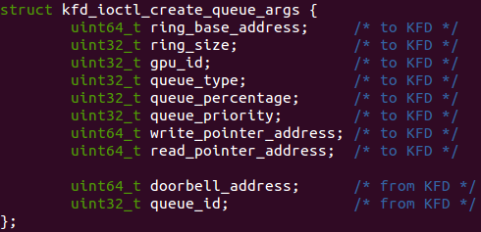
KFD_IOC_SET_CREATE_QUEUE
Create queue from user-space’s info
Get kfd_dev by gpu_id
Allocate kfd_queue for kfd_process
  Get queue_id from kfd_process’ queue_bitmap
  software queue_id (up to 1024)
scheduler_class->create_queue
  set hardware queue
Return queue_id and doorbell_address to user-space
  *** doorbell_address map to mmio address ***

Slide 17
scheduler_class->create_queue()
allocate_hqd()
  Get hardware queue_id from free_queues bitmap
activate_queue()
  Write value to hardware mmio to activate hardware queue
    *** queue_select ***

Slide 18
Each process can have up to 1024 queues
pasid=0
queue_id=0
pasid=0
queue_id=1
pasid=1
queue_id=0
pasid=1
queue_id=1
ring_base_address
ring_base_address
ring_base_address
ring_base_address
doorbell
doorbell
doorbell
doorbell
HQ0
HQ1
HQ2
HQ3
Free hardware queue_id bitmap
(Up to 64 hardware queues)
queue select register
Physical Address
HSA GPU’s configuration register mmio address
Notes:
Driver’s help

Slide 19
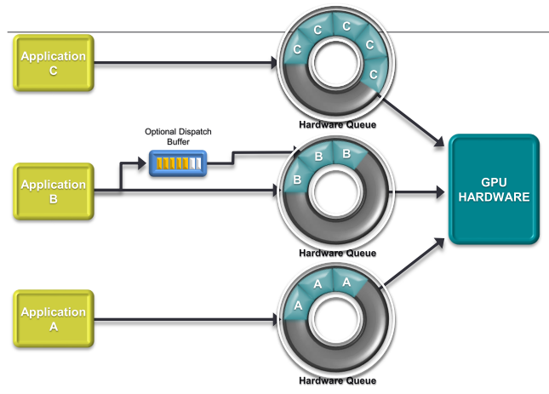

Slide 20
Application Computation ...
HW has ring_base_addr user-space address
  Including write&read ring
  Use to write&read AQL packet and wait signal
User application has HW doorbell mmio address
  Use to kick hardware
Driver do nothing
Until application send ioctl(KFD_IOC_DESTROY_QUEUE) or application finish

Slide 21
Haredware Queue Deactivation
Task exit notifier
Application send ioctl(KFD_IOC_DESTROY_QUEUE)

Slide 22
Haredware Queue Deactivation (1)
Task exit notifier will call iommu_pasid_shutdown_callback
  amd_iommu_v2’s profile_nb->task_exit
  task_exit will check whether there is pasid->task map to this task which is exiting
scheduler_class->destroy_queue
  release hardware queue
scheduler_class->deregister_process
  release pasid, vmid, iommu binding

Slide 23
Haredware Queue Deactivation (2)
For now, Okra don’t use this call gate
scheduler_class->destroy_queue
  Only release hardware queue
  WRITE_REG(CP_HQD_DEQUEUE_REQUEST)
  wait_event(dequeue_wait)
  Keep user-level pasid, vmid, iommu binding

Slide 24
scheduler_class->interrupt_isr()
wake_up_all(dequeue_wait)
  Wait event will check CP_HQD_ACTIVE==0?
    If so, release hqd
    Else, keep waiting

Slide 25
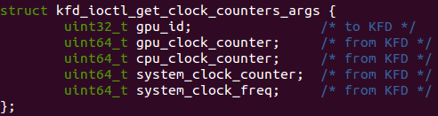
KFD_IOC_GET_CLOCK_COUNTERS
Get clock count from GPU

Slide 26
Agenda
Code Overview
HSA Driver
  Concepts
    Flow Overview
    User & Hardware Queues
  Source Code Detail
IOMMU
  Concepts
    GCR3
    PPR
  Source Code Detail
Flow Review

Slide 27
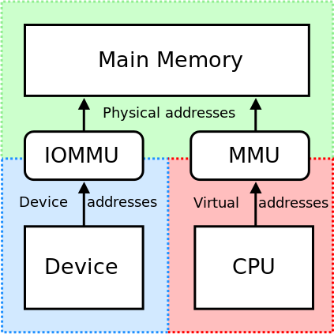
Introduction to IOMMU
User application send AQL packet into ring address which is virtual address
Device accessing need translate VA to PA
Ring Address
Doorbell

Slide 28
Assign this entry with kfd_process->mm->pgd
PASID=2
GCR3
HSA GPU
Device table

Slide 29
PRI & PPR
The operating system is usually required to pin memory pages used for I/O.
IOMMU Provide mechnism to let peripheral to use unpinned pages for I/O.
Only support in AMD IOMMU_v2
Notes:
以前沒差,IOMMU只摸device address
For now, data in AQL packet is VA

Slide 30
PRI & PPR
PRI(page request interface)
  peripheral request memory management service from a host OS or hypervisor (eg, page fault service for peripheral)
  Issued by peripheral
﻿PPR(peripheral page service request)
  When IOMMU receives a valid PRI request, it creates a PPR message in request log to request changes to virtual address space
  Issued by IOMMU as interrupt
Above use to request IO page table change
  IOMMU driver can register PPR notifier

Slide 31
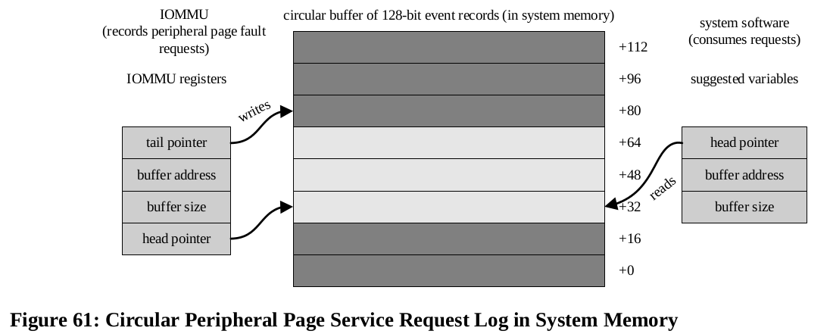

Slide 32
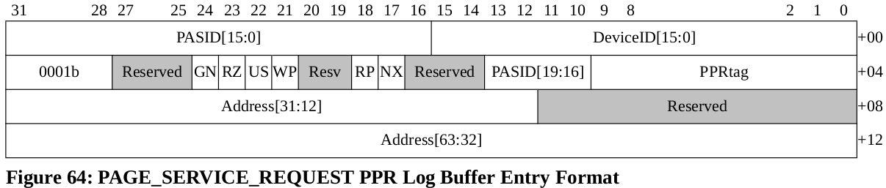
GN | Guest/nested. 1=Address[63:12] is a GVA and PASID is valid. 0=Address[63:12] is a GPA and PASID should be ignored by software.
US | User/Supervisor. The U/S request received from the peripheral. 1=user and supervisor access are allowed. 0=supervisor access is allowed.
WP | Write permission requested.
RP | Read permission requested.
NX | Execute permission requested.
PPR tag | Protocol tag.

Slide 33
module_init(amd_iommu_v2_init)
amd_iommu_register_ppr_notifier(&ppr_nb);
  PPR callback
    ppr_notifier function
profile_event_register(PROFILE_TASK_EXIT, &profile_nb);
  Task exit callback
    Clear gcr3
    Call scheduler_class->destroy_queue

Slide 34
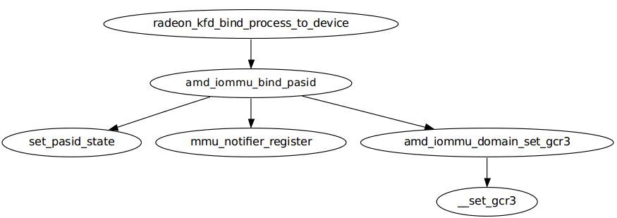
Set IOMMU With PASID

Slide 35
amd_iommu_bind_pasid
Called when kfd_process create
  mmu_notifier_register(&pasid_state->mn, pasid_state->mm);
  amd_iommu_domain_set_gcr3(dev_state->domain, pasid, __pa(pasid_state->mm->pgd));
Notes:
IO page fault service and need to notify CPU page service

Slide 36
Assign this entry with kfd_process->mm->pgd
PASID=2
GCR3
HSA GPU
Device table

Slide 37
PRI & PPR Flow
IOMMU driver can stop the IOMMU from processing PRI request
Peripheral issue PRI to IOMMU
IOMMU write PPR request to PPR log
(log contains fault address, pasid, device_id, tag, flags)
IOMMU send interrupt to CPU

Slide 38
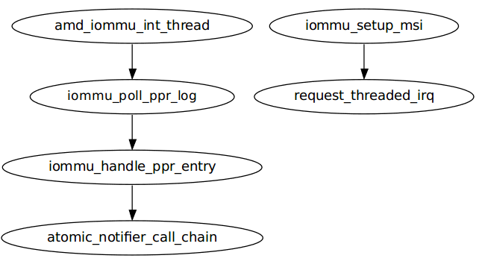
PPR Flow
When irq comes
readl(iommu->mmio_base + MMIO_STATUS_OFFSET);
if (status & MMIO_STATUS_PPR_INT_MASK)
ppr_notifier
Register in amd_iommv_v2_init
deferred work
do_fault

Slide 39
do_fault
get_user_pages() - pin user pages in memory
  @tsk: task_struct to use for page fault accounting
  @mm: mm_struct of target mm
  @start: starting user address
  @nr_pages: number of pages from start to pin
  @write: whether pages will be written by the caller
  @force: whether to force write access even if user mapping is readonly.
  @pages: pointers to the pages pinned.
  @vmas: pointers to vmas corresponding to each page.

Slide 40
Agenda
Code Overview
HSA Driver
  Concepts
    Flow Overview
    User & Hardware Queues
  Source Code Detail
IOMMU
  Concepts
    GCR3
    PPR
  Source Code Detail
Flow Review

Slide 41
Flow Review
Application
Runtime Library
open(“/dev/kfd”)
ioctl(KFD_IOC_SET_MEMORY_POLICY)
ioctl(KFD_IOC_CREATE_QUEUE)
ioctl(KFD_IOC_DESTROY_QUEUE)
ioctl(KFD_IOC_GET_CLOCK_COUNTERS)
HSA-aware Kernel
KFD
IOMMU Driver
HSA Device
IOMMU

Slide 42
Q&A
Thanks!

