Slide 1
異質架構模擬器-multi2sim

Slide 2

Introduction
Multi2Sim is a cycle based simulation framework for CPU-GPU heterogeneous computing.
Includes models for superscalar, multithreaded, and multicore CPUs, as well as GPU architectures.
OpenCL benchmark suite, but need prebuilt ELF.

Slide 3
Introduction
Guest → any property of the simulated program.
  instructions of the program whose execution is being simulated.
Host → simulator properties.
  the set of instructions executed by Multi2Sim natively in the user’s machine.

Slide 4
可模擬硬體
x86 CPU
MIPS CPU
ARM CPU
AMD Evergreen GPU
AMD Southern Island GPU
NVIDIA Fermi GPU
Memory hierarchy
Interconnection network

Slide 5
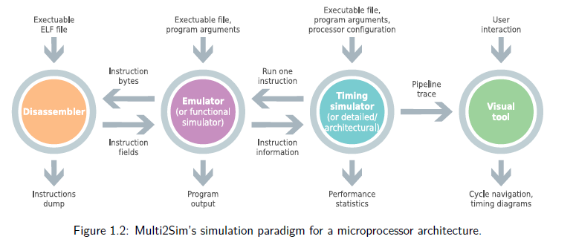
Four-Stage Architectural

Slide 6
Four-Stage Architectural(cont.)
These four software modules communicate with each other with clearly defined interfaces, but can also work independently.
Disassembler
  Give a bit stream representing machine instruction for a specific ISA
  decode these instructions into an alternative representation by a straightforward interpretation of the instructions.
  the disassembler reads from a binary buffer in memory, and outputs machine instructions one by one.

Slide 7
Four-Stage Architectural(cont.)
Functional Simulator
  called the emulator
  reproduce the original behavior of a guest program
  Needs to keep track of the guest program state, dynamically update until finish
  Program state can be expressed as its virtual memory and architected register file

Slide 8
Four-Stage Architectural(cont.)
Detailed simulator
  referred to as timing or architectural simulator
  models hardware structures and keeps track of their access time
  the detailed simulator body is structured as a main loop, calling all pipeline stages in each iteration.
  One iteration of the loop models one clock cycle on the real hardware.

Slide 9
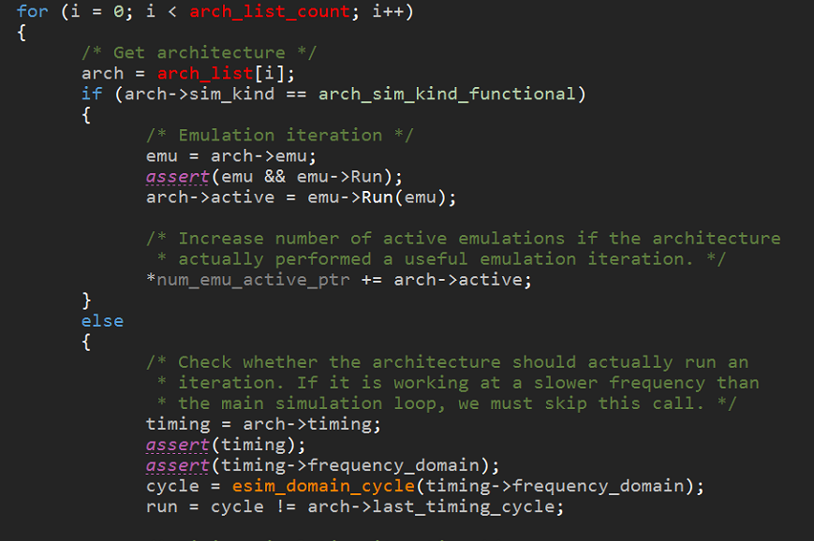

Four-Stage Architectural(cont.)

Slide 10
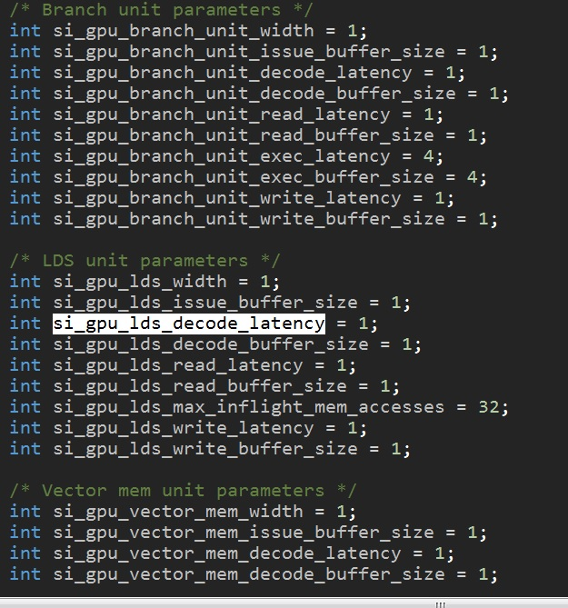
Four-Stage Architectural(cont.)

Slide 11
Four-Stage Architectural(cont.)
Visual tool
  graphic visualization tool
  detailed simulator generates a compressed text-based trace in an output file, which is consumed by the visual tool in a second execution of Multi2Sim.

Slide 12
Four-Stage Architectural(cont.)
  a cycle-based interactive navigation
  the state of the processor pipelines
  instructions in flight
  memory accesses traversing the cache hierarchy

Slide 13
Full-System vs. Application-Only Emulation
Full-System Emulation
  A full-system emulator runs the entire software stack that would normally run on a real machine
  begins execution by running the master-boot record of a disk image containing an unmodified operating system (guest OS)

Slide 14
Full-System vs. Application-Only Emulation
  Its state is represented as the physical memory image of the modeled machine, together with the values of the architected register file
  A full-system emulator behaves similarly to a virtual machine in the way it runs a guest OS and abstracts I/O.

Slide 15
Full-System vs. Application-Only Emulation
Application-Only Emulation
  an application-only emulator (Multi2Sim be classified as such) concentrates in the execution of a user-level application
  instruction emulation begins straight at the guest program entry point

Slide 16
Full-System vs. Application-Only Emulation
  a system call is intercepted, updates its internal state as specified by the requested service, as well as the guest program’s state, giving it the illusion of having executed the system call natively.
  the application-only model wholly runs the system service as a consequence of one single ISA instruction emulation — the software interrupt.

Slide 17
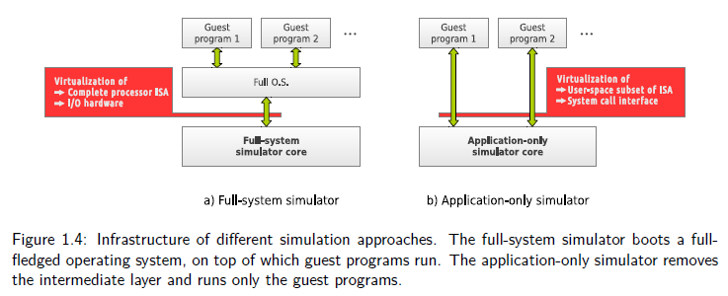
Full-System vs. Application-Only Emulation

Slide 18
Application running on OS
preparation of an initial memory image for the application (process known as program loading).
communication between the application and OS at runtime via system calls.
OS is removed from the guest software stack in an application-only simulation, these two services are abstracted by the emulator itself.

Slide 19
Application-Only Emulation loading program
three steps:
First, the application ELF binary is analyzed and those sections containing ISA instructions and initialized static data are extracted. An initial memory image is created for the guest program, copying these ELF sections into their corresponding base virtual addresses.
Second, the program stack is initialized mainly by copying the program arguments and environment variables to specific locations of the memory image.
third, the architected register file is initialized by assigning a value to the stack- and instruction-pointer registers.

Slide 20
Frequency domains
frequency domains are modeled independently for the memory system, the interconnection networks, and each CPU and GPU architecture model.
measured with an accuracy of 1ps (picosecond).
assume an x86 pipeline working at 1GHz with a memory system working at 667MHz.
In every iteration of the main simulation loop, the x86 pipeline model advances its state once, while the state update for the memory system is skipped once every three iterations.

Slide 21
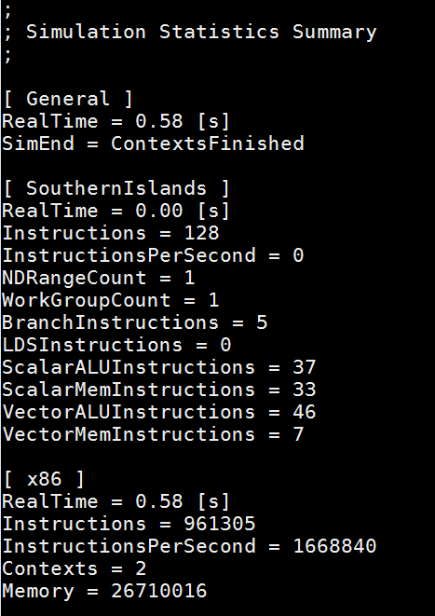
執行畫面
Functional simulator

Slide 22
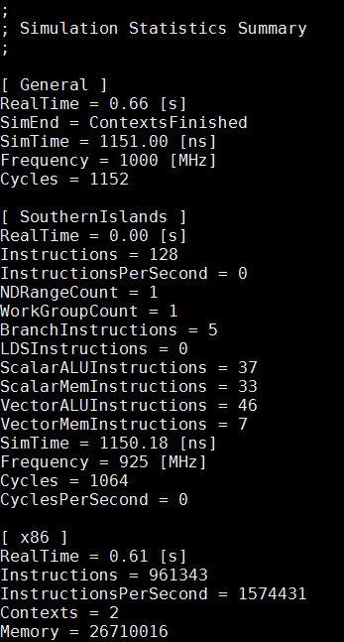
執行畫面
Detailed simulator

Slide 23
AMD southern Island GPU overview

Slide 24
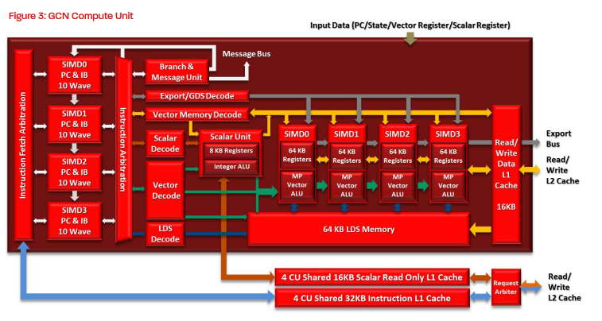
AMD Southern Island Architecture

Slide 25
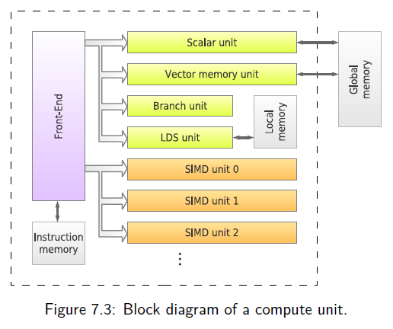
M2S Southern Island Architecture overview

Slide 26
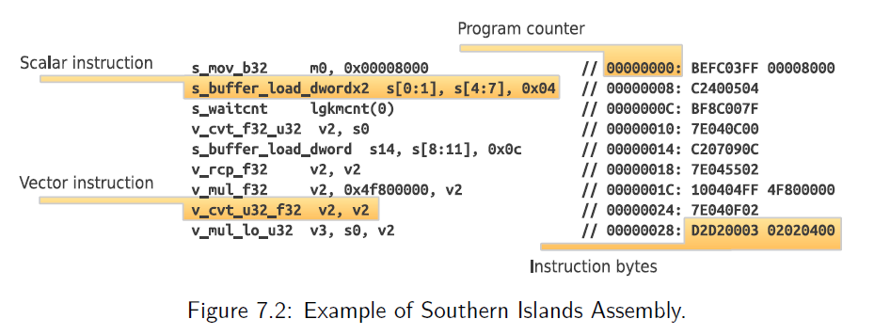
M2S Southern Island Architecture overview

Slide 27
Running openCL on Southern Island GPU
The Sorthern Islands family of GPUs (Radeon HD 7000-series).
The code execution on the GPU starts when the host program launches an OpenCL kernel.
When the ND-Range is launched by the OpenCL driver, the programming and execution models are mapped onto the Southern Islands GPU.

Slide 28
Running openCL on Southern Island GPU
An ultra-threaded dispatcher acts as a work-group scheduler.
The global memory scope accessible to the whole ND-Range corresponds to a physical global memory hierarchy on the GPU, formed of caches and main memory.

Slide 29
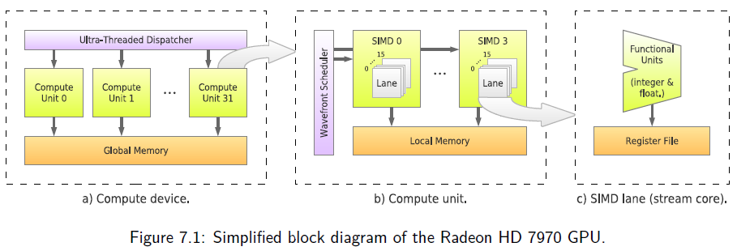
Running openCL on Southern Island GPU

Slide 30
Running openCL on Southern Island GPU
the compute unit combines sets of 64 work-items within a work-group to run in a SIMD (single-instruction-multiple-data) fashion.
64 work-items are known as wavefronts.
each SIMD contains 16 lanes or stream cores, each of which executes one instruction for 4 work-items from the wavefront mapped to the SIMD unit in a time-multiplexed manner.

Slide 31
Control Flow and Thread Divergence
Executing wavefronts on SIMD units causes the same machine instruction to be executed concurrently by all work-items within the wavefront.
a conditional branch instruction is resolved differently in any pair of work-items, causing thread divergence.

Slide 32
Control Flow and Thread Divergence
The Southern Islands ISA utilizes an execution mask to address work-item divergence.
a 64-bit mask, where each bit represents the active status of an individual work-item in the wavefront.

Slide 33
Front-end
Figure 7.4 shows the architecture of the compute unit front-end.
It is formed of a set of wavefront pools, a fetch stage, a set of fetch buffers, and an issue stage. The number of wavefront pools and fetch buffers match exactly the number of SIMD units.
all wavefronts in the work-group are always assigned to the same wavefront pool.

Slide 34
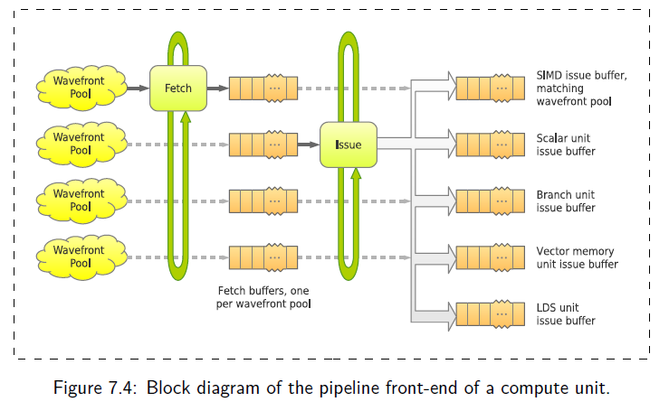
Front-end(cont.)

Slide 35


Front-end(cont.)

Slide 36
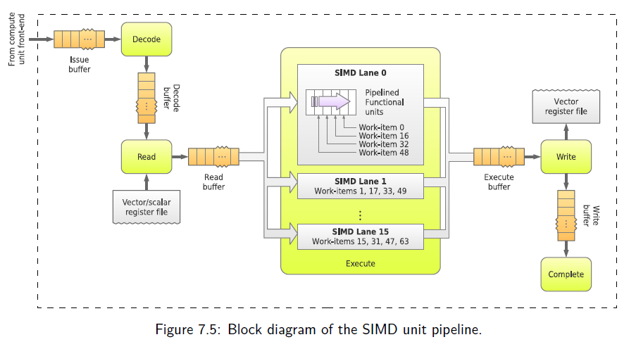
The SIMD unit

Slide 37

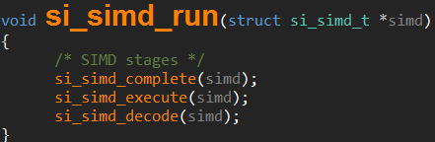
The SIMD unit

Slide 38
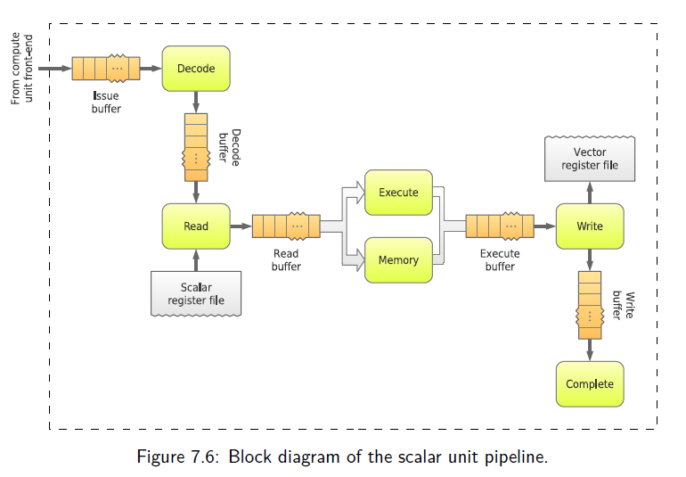
The scalar unit

Slide 39
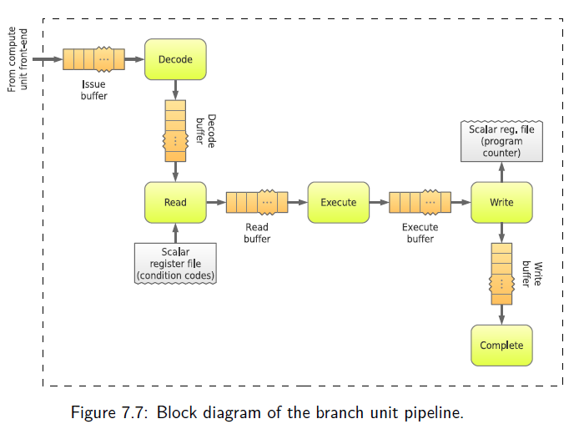
The branch unit

Slide 40
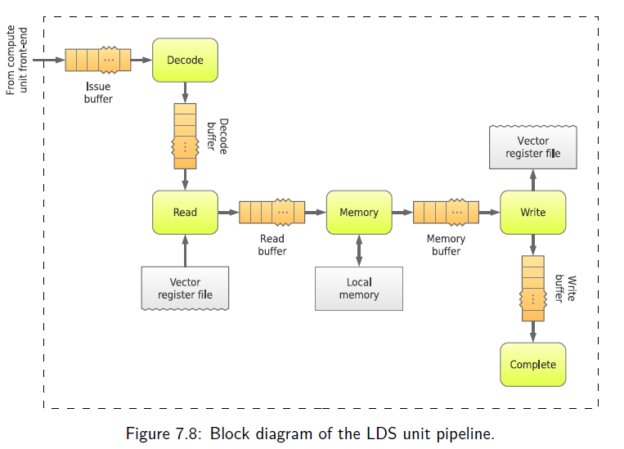
The Local Data Share (LDS) Unit

Slide 41
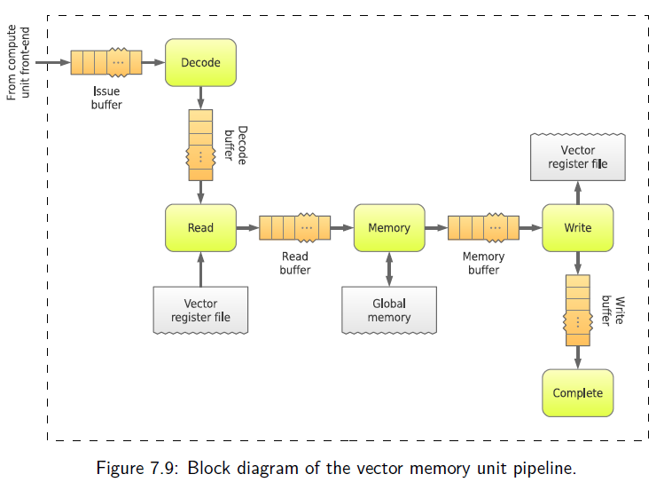
The Vector Memory Unit

Slide 42
The Memory Hierarchy
Multi2Sim provides a very flexible configuration of the memory hierarchy.
The configuration of the memory hierarchy is specified in a plain-text INI file, passed to the simulator with option --mem-config <file>.

Slide 43
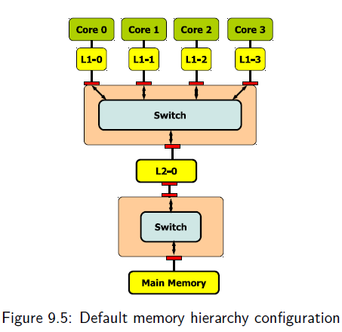
Default Memory Configuration
Both CPU and GPU

Slide 44
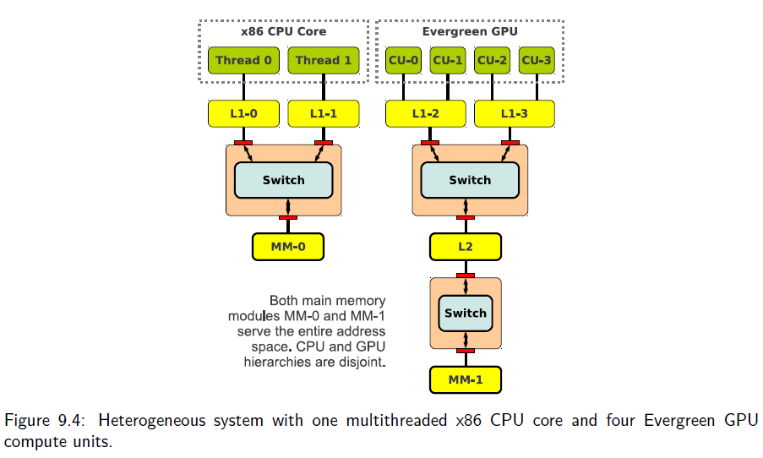
Heterogeneous System with CPU and GPU cores

Slide 45
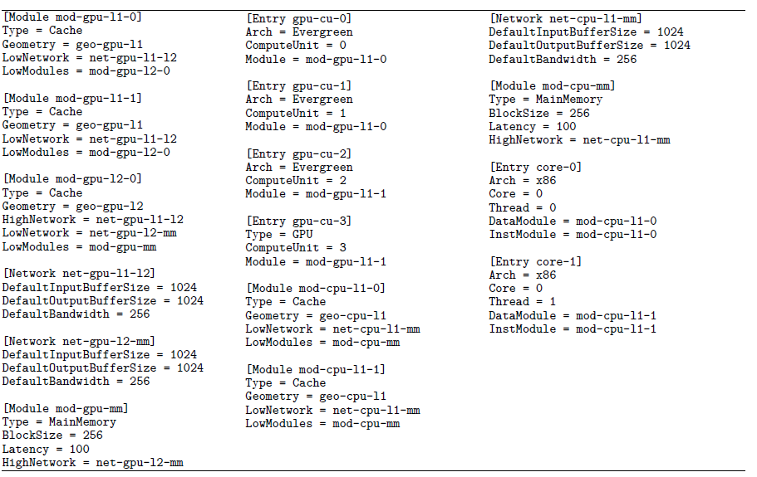
Heterogeneous System INI

Slide 46
OpenCL Programming model
the host program calls OpenCL API functions, such as clGetDeviceIDs, clCreateBuffer, etc.
This program is linked with a vendor-specific library, referred hereafter as the OpenCL runtime, that provides an implementation for all OpenCL API functions.

Slide 47
Runtime Libraries and Device Drivers
Many of the applications we run on our computers rely on vendor-specific libraries to communicate with hardware devices.
run an unmodified x86 executable normally on Multi2Sim, the program attempts to call external functions, its embedded dynamic loader searches for matching library names, and eventually stumbles upon the vendor-specific libraries installed on the machine.
these calls involve privileged actions on the system.

Slide 48
Runtime Libraries and Device Drivers
two major problems:
  the interface between the user-space libraries and the runtime are internally managed by the vendor of the involved hardware.
  this interface is unknown to us in the case of close-source drivers, such as most state-of-the-art GPU vendor software.

Slide 49
Runtime Libraries and Device Drivers
Re-linking the x86 program binary using Multi2Sim-specific libraries that implement all application’s external calls to solver the problem

Slide 50
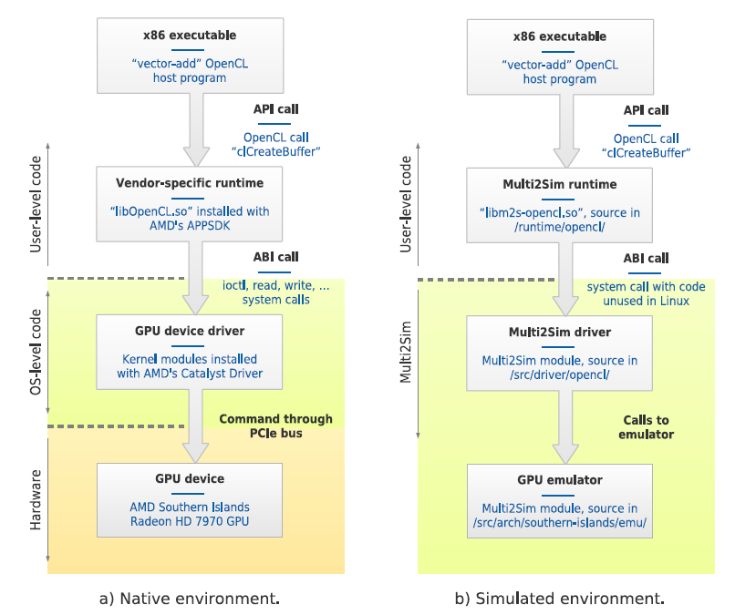
Runtime Libraries and Device Drivers

Slide 51
Definitions
The Application Programming Interface (API) is the interface between a runtime library and the user program. The API is exactly the same for a vendor-specific runtime as for a Multi2Sim runtime, which is why they can be used interchangeably to satisfy external references in the user program.

Slide 52
Definitions
The Application Binary Interface (ABI) is the interface provided between a device driver and a runtime library, based on system calls. On Multi2Sim, each ABI between a pair runtime-driver is assigned a unique system call code unused in Linux.

Slide 53
M2S-Visual

Slide 54
Introduction
Visualization tool
Observe the CPU, GPU pipeline and memory state
Provide the actions of above component in every cycle
Require GTK3.0 lib
Result will be compress to a gzip format(.gz)
Run multi2sim again to open the .gz file

Slide 55
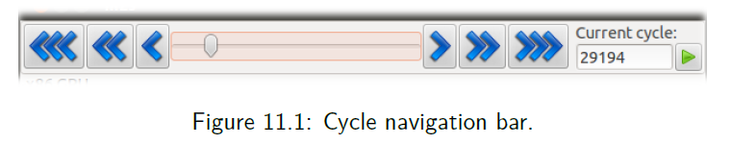
Main window
The cycle bar
  A scrollable bar
  Navigation buttons to step through simulation cycles

Slide 56
Main window
Panels
  Depends on the simulation settings
  The Hardware you select to simulate
  Display every CPU core, GPU compute unit and memory system

Slide 57
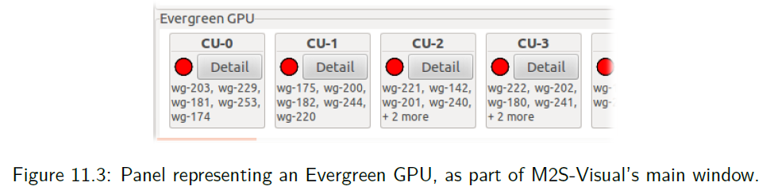
Main window
Panels
  Demonstrate all the CU according to the architecture you choose.

Slide 58
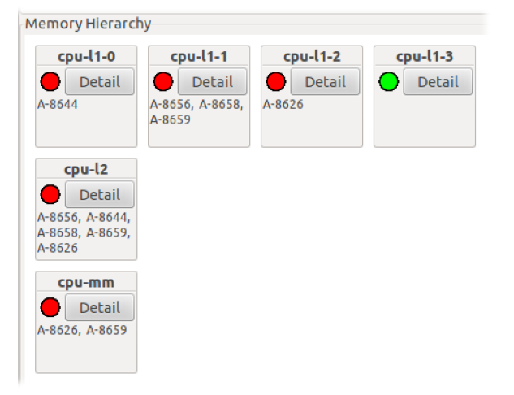
Main window
Demonstrate the GPU memory architecture.
You can write the configuration by yourself.

Slide 59
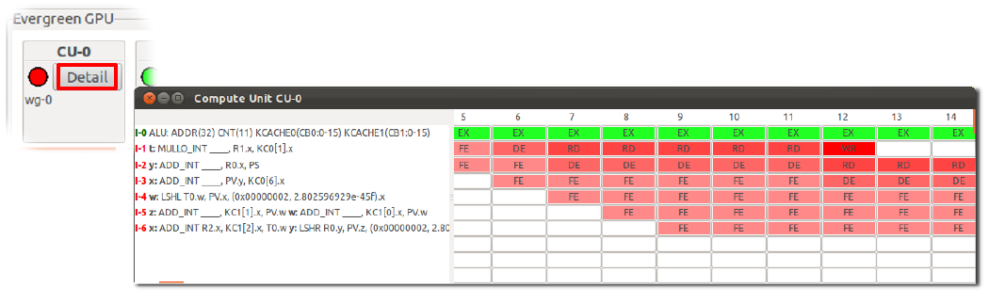
Main window
All the Instruction pipeline in every CU.

Slide 60
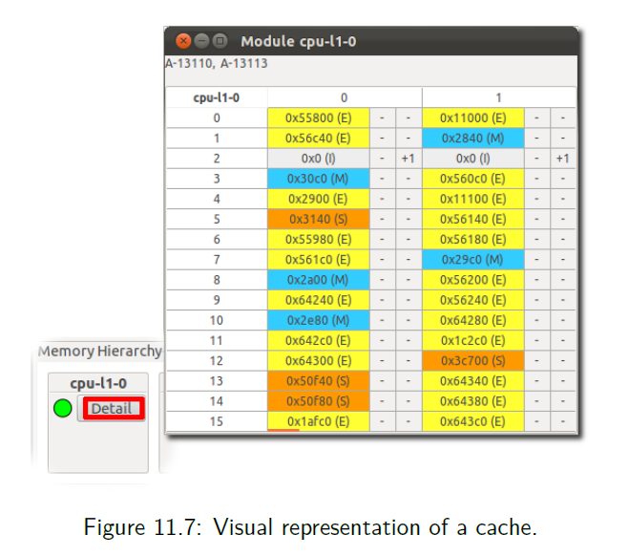
Main window
Demonstrate the i-th memory access will access which place.

Slide 61
參考資料

