Slide 1
Wireless Personal Area Networks

Slide 2
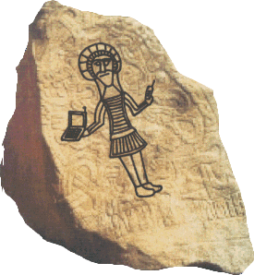
802.15.1 Bluetooth
Notes:
Harald I Bluetooth (Danish Harald Blåtand) was the King of Denmark between 940 and 985 AD. The name "Blåtand" was probably taken from two old Danish words, 'blå' meaning dark skinned and 'tan' meaning great man. He was born in 910 as the son of King Grom The Old (King of Jutland, the main peninsula of Denmark) and his wife Thyre Danebold (daughter of King Ethelred of England). Like many Vikings, Harald considered it honorable to fight for treasure in foreign lands. When Harald's sister Gunhild was widowed after the death of the violent Norwegian king Erik Blood Axe, she came to Denmark to seek Harald's help in securing control of Norway. Harald took the opportunity to seize control himself. By 960 he was at the height of his powers, ruling over both Denmark and Norway. He was baptized by a priest named Poppo, sent by the German emperor. He then created a monument that read: "King Harald raised this monument to the memory of Grom his father and Thyre his mother. Harald conquered all of Denmark and Norway and made the Danes Christian". These words were also carved in stone called rune stones. Harald was killed in a battle in 985. Harald completed the country's unification begun by his father, converted the Danes to Christianity, and conquered Norway. The expansion begun by Harald in Norway was continued by his son Sweyn I, who conquered England in 1013. Under Sweyn's son Canute there grew up a great Anglo-Scandinavian kingdom that included parts of Sweden.
Figure 1: Rune Stone
Old Harald Bluetooth united Denmark and Norway, Bluetooth of today will unite the worlds of computers and telecom (hopefully longer than the few years Harald's Viking kingdom survived). In 1994 Ericsson Mobile Communications initiated a study to investigate the feasibility of a low-power low-cost radio interface between mobile phones and their accessories. In Feb 1998, five companies Ericsson, Nokia, IBM, Toshiba and Intel formed a Special Interest Group (SIG). The group contained the necessary business sector members - two market leaders in mobile telephony, two market leaders in laptop computing and a market leader in digital signal processing technology. It is estimated that before year 2002, Bluetooth will be a built-in feature for more than 100 million mobile phones and several million communication devices ranging from handsets and portable PCs to desktop computers and notebooks.

Slide 3
Outline
Introduction
What is Bluetooth？
  Standard
  Architecture
  Transmission access
  Connection state controlling
  Bit transfer
  Security
Application
Now and future

Slide 4
Introduction
One of 802.15 group (Wireless PAN)
Named after Harald II. Blaatand.
Bluetooth Special Interest Group
  1998
  Founded by IBM, Nokia, Toshiba, Intel, Ericsson.
Notes:
Harald II. Blaatand 是挪威的一個國王，他一統挪威和丹麥。 Bla為Dark-skinned，tan為Big man，而big man 的意思就像國王之意。以此命名 有一統wireless PAN之意。

Slide 5
Introduction
The aim of Bluetooth in 1998 is something approaching wireless USB.
Specifications published time as blow.
Version | Date
v2.0 | 1999
v2.0b | 1999, Dec.
v2.1 | 2001

Slide 6
Standard of Bluetooth
Three application scenarios of Bluetooth
  replacing cables
  data and voice access point
  personal ad hoc network

Slide 7
Structure of Bluetooth Ver2.1
vCard/vCal
WAP
OBEX
UDP
TCP
IP
AT
commands
TCS
SDP
PPP
RFCOMM
Host Control Interface
L2CAP
Audio
Bluetooth core Protocol
LMP
Accepted Protocol
BaseBand
BSIG protocol develop based on ETIS and ITU
RF specification (Bluetooth Radio)
Notes:
BASEBAND
The Baseband and Link Control layer enables the physical RF link between Bluetooth units forming a piconet. This layer controls the Bluetooth unit's
synchronisation and transmission frequency hopping sequence. The two different link types defined in Bluetooth, Synchronous Connection Oriented, SCO, and Asynchronous Connectionless, ACL, described in the section Link types, are also managed by this layer. The ACL links, for data, and the SCO links, mainly for audio, can be multiplexed to use the same RF link [7].
Link Manager Protocol, LMP
The Link Manager Protocol, LMP, is responsible for link set-up between Bluetooth units. It handles the control and negotiation of packet sizes used when transmitting data. The Link Manager Protocol also handles management of power modes, power consumption, and state of a Bluetooth unit in a piconet. Finally, this layer handles generation, exchange and control of link and encryption keys for authentication and encryption [9].
Logical Link Control and Adaptation Protocol, L2CAP
The Bluetooth logical link control and adaptation protocol, L2CAP, is situated over the Baseband layer and beside the Link Manager Protocol in the Bluetooth protocol stack. The L2CAP layer provides connection-oriented and connectionless data services to upper layers.
The four main tasks for L2CAP are:
• Multiplexing – L2CAP must support protocol multiplexing since a number of protocols (e.g. SDP, RFCOMM and TCS Binary) can operate over L2CAP.
• Segmentation and Reassembly – Data packets exceeding the Maximum Transmission Unit, MTU, must be segmented before being transmitted. This and the reverse functionality, reassemble, is performed by L2CAP.
• Quality of Service – The establishment of an L2CAP connection allows the exchange of information regarding current Quality of Service for the
connection between the two Bluetooth units.
• Groups – The L2CAP specification supports a group abstraction that permits implementations for mapping groups on to a piconet.
An L2CAP implementation must be uncomplicated and implying low overhead since it must be compatible with the limited computational resources in a small Bluetooth unit [10].
RFCOMM
The RFCOMM protocol is a serial port emulation protocol. The protocol covers applications that make use of the serial ports of the unit. RFCOMM emulates RS-232 control and data signals over the Bluetooth baseband. It provides transport capabilities for upper level services, e.g. OBEX that use a serial line as the transport mechanism.

Slide 8
Structure of Bluetooth
Link Manager Protocol (LMP)
  responsible for connections
Logical Link Control and Adaptation Protocol (L2CAP)
  Connects the protocol of higher layers with tasks of the band
Service Discovery Protocol (SDP)
  recognizes different services and characteristics of each service
Wireless cable (RFCOMM)
  Modified to suit the Bluetooth standard
  Describes a point-to-point connection between two devices

Slide 9
Structure of Bluetooth
Telephone coupling (TCS Binary)
  Telephony Control Service
  for establishing and ending calls
  Only call establishment is carried out using TCS-Bin and L2CAP layer
Others application-relative protocol found in Bluetooth Standard
  OBEX ( IrDA standard for infrared connection)
  WAP ( transmitting WML resource on mobile telephones)

Slide 10
Architectures of Bluetooth
Master/Slave architecture
Piconet
  only one master
  mono-slave mode
  multi-slave mode
Scatternet
  scattered pico networks
  several masters in the scatternet
  a master can be a slave in another pico networks

Slide 11
Piconet
Piconet
mono-slave mode
Multi-slave mode
M
M
S
S
S
S
S
S

Slide 12
Scatternet Overview
Scatternet
S
M
S
M
M
S
S
S
S

Slide 13
Scatternet
One slave support up to two SCO links from different masters
Scatternet A
Scatternet B
Master A
Master B
Slave
Notes:
Synchronous Connection Oriented, SCO

Slide 14
Transmission Access
Link control
Control
Channel
Link Manager
Control
Channel
User
Asynchronous
User Channel
User
Isochronous
User Channel
User
Synchronous
User Channel
Header
Of
packet
Payload
Kinds of packets
Asynchronous Connectionless Link
(ACK link)
Synchronous Connection-oriented
Link (SCO link)

Slide 15
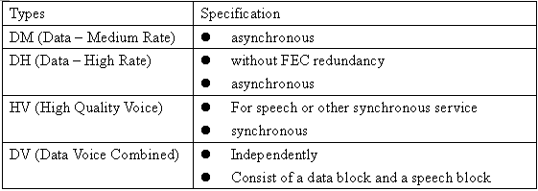
Packet Types

Slide 16
Connection type
Two basic communication type defined by the Bluetooth standard：
  Synchronous connection-oriented communication
  Asynchronous connectionless communication

Slide 17
Synchronous Connection-oriented Communication
SCO link
Symmetrical point to point between the master and a single slave
A master can establish up to three SCO links to one or more slaves
A slave can establish up to three SCO links to one master or support up to two SCO links from different master

Slide 18
Synchronous Connection-oriented Communication
Correspond to circuit-switched transmission
  The master reserve time slots
  The slave send data in each subsequent time slot
  T_{SCO} ：the time interval
Designed for efficient voice transmission
No delay tolerance
No data integrity checks

Slide 19
Asynchronous Connectionless Communication
ACL link
between the master and one or more slaves
created only if the channel is not reserved for SOC
Only one ACL link can be established between a master and a slave at any particular time
Support sending packets to all the slaves in the piconet by not specifying a target address as a broadcast
Slave broadcast are not support

Slide 20
Asynchronous Connectionless Communication
Correspond to packet-switched transmission
Data integrity is important
Delay tolerance
Retransmit when incorrect or missing some blocks
Designed to transmit data efficiently

Slide 21
Audio Transmission
An essential element of the Bluetooth standard is symmetrical and synchronous transmission of audio data
  A CODEC is based on a logarithmic Pulse Code Modulation (PCM)
  A Continuous Variable Delta Modulation (CVSD) CODEC

Slide 22
Connection State Controlling
STANDBY
PAGE
PAGE SCAN
INQUIRY
SCAN
INQUIRY
MASTER
RESPONSE
SLAVE
RESPONSE
INQUIRY
RESPONSE
CONNECTION

Slide 23
Connection State Controlling
Standby：initial state of each Bluetooth station
  Send page call or Send inquiry
  Received page call or inquiry call
A station sent the page call acts as the master
Inquiry call
  Find out the other station in transmission
Paging call
  Establish a connection

Slide 24
Inquiry
General Inquiry Access Code (GIAC)
  All stations present are to answer
Dedicated Inquiry Access Code (DIAC)
  Only certain types of devices are to answer
The station reply the inquiry acts as a slave
The station sent the inquiry and got the reply acts as a mater

Slide 25
Paging
The master use the Page state to establish a connection with a slave
Repeating Sending its Device Access Code (DAC) to access the slave
Only the slave in page scan state can receive
The difficulty of Frequency Hopping sequence ?
Cunning algorithm
Page response with information for connection

Slide 26
Modes In Connection
Connection
Active Mode
Park Mode
Sniff Mode
Hold Mode

Slide 27
Modes In Connection
Active Mode
  Actively
Sniff Mode
  The master and the slave negotiate the time interval
  T _{Sniff}
  ready to receive more packet immediately

Slide 28
Modes In Connection
Hold Mode
  Still needs to be able to receive any SCO packet
Park Mode
  No participate in ACL-based communication in the piconet at all
  Parked Member Address and Access Request Address
  Beacon for communication with park mode slave
  More than seven slaves

Slide 29
Bit Transfer
The Bluetooth standard is designed for use in the 2.4GHz ISM (industrial, scientific, and medical) band
Use spread spectrum technique
  Frequency Hopping Spread Spectrum (FHSS)
  two operating mode: 79 and 23 hopping frequencies
Slot No.
K=2n
K=2n+1
K=2n+2
Time multiplex between downlink and uplink
Frequency
f(K)
f(K+1)
f(K+2)
Master
Slave

Slide 30
Bluetooth Air Interface -
Frequency Hopping
Hop channels:
  23 for Spain and France
  79 for others.
1600 hops per second.
Multi-slot packets are also defined.
625 μs
625 μs

Slide 31
Bluetooth Networking
Master unit’s system clock and master identity are keys to the frequency hop technology.
Hop channels are determined by hop sequence (master identity) and phase in the sequence (master clock).
Hop Selection
Hop
Slave
Clock
Phase
Sequence
Offset
Master Identity

Slide 32
Bit Transfer
To support bi-directional traffic
  Time Division Duplex (TDD)
  Even-numbered time slot for the master
  Odd-numbered time slot for the slave

Slide 33
Security
128-bit authentication key is used to authenticate station
A key is also used to protect the information that is transferred
  The length of the code can be varied from 8 to 128 bits.
The Mechanisms for logon and encryption are similar with to those used in IEEE802.12

Slide 34
IEEE802.15.3 Ultra-Wideband (UWB)

Slide 35
Outline
Introduction
What is UWB?
UWB types
Where do UWB serve?
In the future ?

Slide 36
Introduction
UWB is a kind of technique
802.15.3a is one of UWB
802.15.4a is one of UWB
FCC allowed UWB for business in 2002
Sneaky wave
Notes:
FCC是美國聯邦通訊委員會 ; UWB一開始被稱為sneaky wave, 因為可以隱藏!

Slide 37
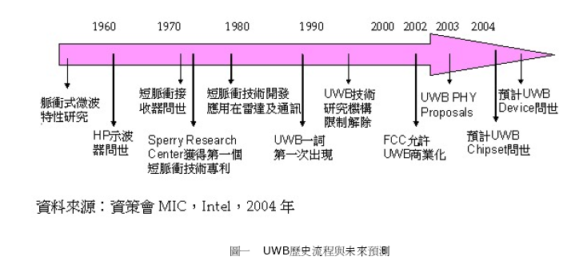
UWB History & Future

Slide 38
What is UWB?
Wireless Physical Layer technique
  Low power consumption by short impulse transmission
Fast transmission rate: 100Mbps, up to 500Mbps
  Channel Capacity theory: C=B*log2(1+S/N)
No interference Problem
Notes:
由Channel Capacity theory所導出來 UWB 可以到達約500Mbps的速度! B值越大 C值也跟著上升

Slide 39
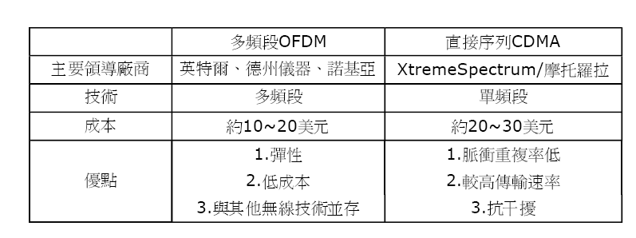
UWB Types
OFDM versus CDMA
Notes:
2003年11月 moto放棄超高頻專利授權費 來爭取802.15.3a group的同意 而Intel也在2003 12月 放棄授權費來競爭! 不過到目前尚未有定案!這也是UWB的隱憂之一!

Slide 40
UWB Types
UWB types
  direct sequence (CDMA)
  OFDM
  impulse radio
  Multi-band

Slide 41
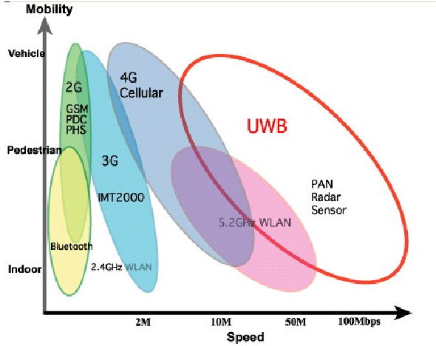
Where Do UWB Serve?

Slide 42
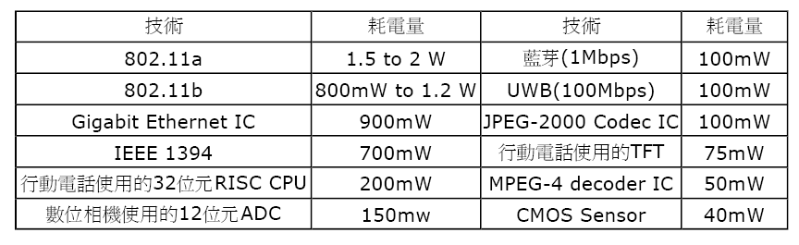
Comparison
Energy Consumption

Slide 43
In The Future?
Wireless USB?
  Wireless USB is one of the achievement that UWB wants to do
Transferring rate is higher than bluetooth/802.11g
Portable consumer digital imaging and multimedia applications like portal DVD player
Multi- hop application
  Overcome 10 M limit
  Other devices connecting to PC
Notes:
Wireless USB是IEEE802.15.4a想要達成的目標! 而UWB宣稱可以達到這樣的目標

Slide 44
IEEE802.15.4 ZigBee

Slide 45
Outline
Introduction
Characteristic
What is Zigbee?
  Structure
  architecture
  Channel access
  Bit transfer
  Zigbee net type
Where does Zigbee serve?
What Zigbee can do?

Slide 46
Introduction
One of IEEE802.15 group (WPAN)
IEEE802.15.4
  May 2003 new published
IEEE802.15.4a?
  UWB? Zigbee?

Slide 47
ZigBee
Name
  Takes its name from the zig-zag path of bees that form mesh networks between flowers
  Mesh networking provides redundancy required for unattended system operation and is essential for the reliability of the ZigBee network
Objective
  Addresses the needs of most remote monitoring and control and sensory network applications

Slide 48
The Wireless Market
TEXT
GRAPHICS
INTERNET
HI-FI
AUDIO
STREAMING
VIDEO
DIGITAL
VIDEO
MULTI-CHANNEL
VIDEO
802.11b
LAN
SHORT < RANGE > LONG
802.11a/HL2 & 802.11g
Bluetooth 2
ZigBee
PAN
Bluetooth1
LOW < DATA RATE > HIGH

Slide 49






The Application Space for 802.15.4/ZigBee
INDUSTRIAL & COMMERCIAL
CONSUMER ELECTRONICS
monitors
sensors
automation
control
TV
VCR
DVD/CD
remote
PERSONAL HEALTH CARE
PC & PERIPHERALS
monitors
diagnostics
sensors
ZigBee
LOW DATA-RATE
RADIO DEVICES
mouse
keyboard
joystick
TOYS &
GAMES
HOME AUTOMATION
consoles
portables
educational
security
HVAC
lighting
closures

Slide 50
What is ZigBee technology?
Cost-effective, standards-based wireless networking solution
It is developed for and targets applications that need
  Low to moderate data rates and low duty cycles
  Low average power consumption / long battery life
  Security and reliability
  Flexible and dynamic network topologies
    Star, cluster tree and mesh networks
Defines upper layers of protocol stack based on IEEE 802.15.4
  From network to application
ZigBee 1.0 spec will not be completely ratified until late 2004

Slide 51

IEEE 802.15.4 & ZigBee In Context
Application
Customer
  “the software”
  Network, Security & Application layers
  Brand management
IEEE 802.15.4
  “the hardware”
  Physical & Media Access Control layers
API
Security
32- / 64- / 128-bit encryption
ZigBee
Alliance
Network
Star / Mesh / Cluster-Tree
MAC
IEEE
802.15.4
PHY
868MHz / 915MHz / 2.4GHz

Slide 52
IEEE 802.15.4 Overview
Global Standard for Low Data Rate Networks
Approved May 2003, Initial Products 4Q04
Transmission Range of 30-100+ Meters
Reliability, Simplicity, Low Power & Low Cost Focus
BAND COVERAGE DATA RATE CHANNELS
2.4 GHz ISM Worldwide 250 kbps 16
915 MHz ISM Americas 40 kbps 10
868 MHz Europe 20 kbps 1

Slide 53
Characteristic
Low energy- consumption
Low transfer rate
Low price
Robust security
Highly reliable

Slide 54
What is Zigbee?
Zigbee Architecture
Three types of Zigbee deivces
  Network coordinator
  Full function Device
  Reduced function Device
ZigBee Application Framework
Networking App Layer (NWK)
Data Link Controller (DLC)
IEEE 802.15.4 LLC
IEEE 802.2
LLC, Type I
IEEE 802.15.4 MAC
IEEE 802.15.4
IEEE 802.15.4
868/915 MHz PHY
2400 MHz PHY

Slide 55
What is Zigbee ?
Channel access
  CSMA-CA
Addressing mode
  16 bit short address
  64 bit IEEE address
Bit transfer
  Direct Sequence Spread Spectrum (DSSS)
Automatic network establishment by the coordinator

Slide 56
802.11 DSSS
1
2
3
4
5
6
7
8
9
10
11
2483
2400
(11)22-MHz-wide stationary channels
X “chips per bit”, means each bit is sent redundantly
11-Mbps data rate
3 none-overlapping channels(1,6,11 channel)
3 APs can occupy same area – set at different frequencies

Slide 57
What is Zigbee ?
Band – transfer rate
  2.4GHz-250kbps
  868MHz-20kbps
  915MHz-40kbps
Channel numbers
  16 channels in 2.4GHz
  10 channels in 915MHz
  1 channels in 868MHz
Transfer range
  10M~75M

Slide 58
Zigbee net type
Zigbee net type
  Mesh
  Star
  Hybrid

Slide 59
Star Type
Simplicity
Long battery life
Single point of failure
Low cost
Controller
Node

Slide 60
Mesh Type
Reliability
No battery life
Routing complexity
Extended range
Router Node
Controller

Slide 61
Hybrid Type
Flexibility
Battery life of Star
Design complexity
Reliability/range of Mesh
Router Node
Node
Controller

Slide 62
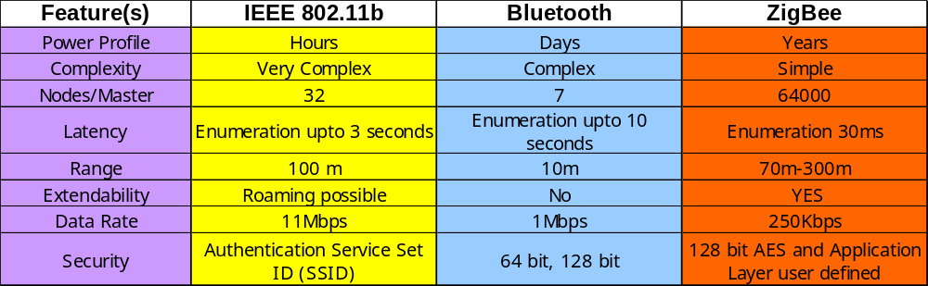
Comparison

Slide 63
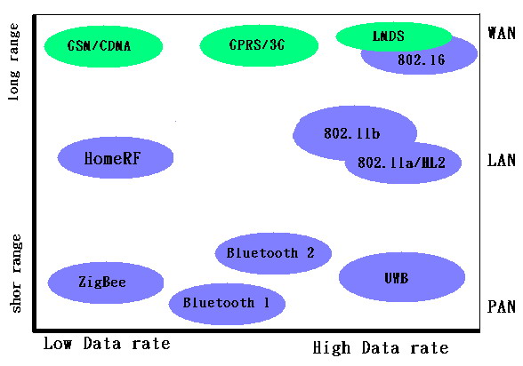
Where Zigbee Serve?

Slide 64
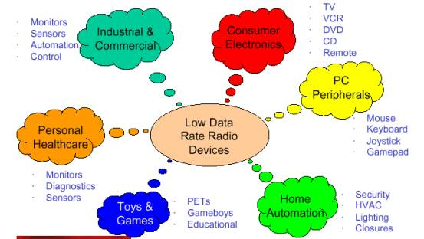
What Zigbee Can Do?

Slide 65
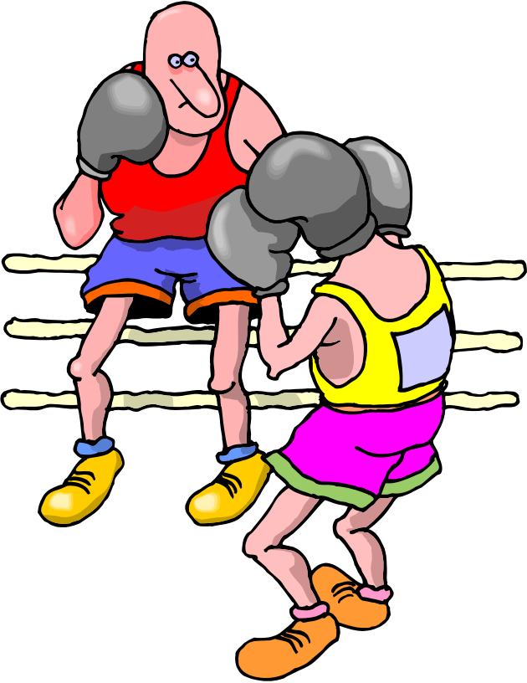
ZigBee and Bluetooth
Competitive or Complementary?

Slide 66





Optimized for different applications
ZigBee
  Smaller packets over large network
  Home automation, toys, remote controls, etc.
Bluetooth
  Larger packets over small network
  File transfer
  Hands-free audio, Mobile phones, headsets, PDAs, etc.

Slide 67
Power issue
Bluetooth
  Bluetooth is a cable replacement for items like Phones, Laptop Computers, Headsets
  Bluetooth expects regular charging
    Target is to use <10% of host power
ZigBee
  better for devices where the battery is ‘rarely’ replaced
  Targets are :
    Tiny fraction of host power
    New opportunities where wireless not yet used

Slide 68
Comparison Overview
Bluetooth ZigBee
AIR INTERFACE FHSS DSSS
PROTOCOL STACK 250 kb 4-32 kb
DEVICES/NETWORK 8 255
LINK RATE 1 Mbps 250 kbps
RANGE ~10 meters ~30 meters
POWER TX: 40mA TX: 30mA
standby: 0.2mA standby: 3μA

Slide 69
Home Radio Frequency (HomeRF)

Slide 70
Outline
Introduction
What is HomeRF ?
  Versions of HomeRF
  Architecture
    System Architecture
    Protocol Architecture
  Channel access
  Bit transfer
Where does it serve?
Sunset of HomeRF。

Slide 71
Introdution
Developed in 1998
Founded by Home Radio Frequency Working Group (HomeRF WG)
HomeRF members
  Intel, IBM, Compaq, Microsoft
  50 members at most
HomeRF organization disbanded in January, 2003
Notes:
成員最多到50個!

Slide 72
Versions of HomeRF
Versions | Bandwidth | Status
v2.0 | 2.6Mbps | 2000
v2.1 | 10Mbps | May 2001
v2.2 | 20Mbps | 2003?

Slide 73
System Architecture
Communication type
  Between nodes
  Between nodes and Central Point (CP)
Node types of different traffic types
  Asynchronous node (A-Node)
    Class data traffic
  Synchronous node (S-Node)
    Streaming data traffic
  Isochronous node (I-Node)
    Bi-directional traffic

Slide 74
Protocol Architecture
Application levels
TCP | UDP | DECT
IP
Existing protocol for high-levels
HomeRF MAC
CSMA/CA | Priority CSMA | TDMA
HomeRF PHY
HomeRF Protocol
Data path
Streaming media path
voice path

Slide 75
Channel Access
Shared Wireless Access Protocol-Cordless Access (SWAP-CA)
Data and voice traffic
  Priority traffic in the beginning of each frame
  Voice traffic can be retransmitted at the beginning of next frame
  Data is assigned fixed time slots by similar way to TDMA/TDD
Asynchronous transfer
  Similar to IEEE802.11
Synchronous transfer
  Support to eight bi-directional streaming media sessions
Isochronous transfer
  TDD

Slide 76
Bit Transfer
2.4GHz ISM band
Frequency Hopping Spread Spectrum (FHSS)
75 base channels
  Each has a bandwidth of 1 MHz
Transfer data rate each channel
  0.8Mbps level
  2.6Mbps level

Slide 77
Where Does It Serve?
It goes without saying： Home
Range : 50M
Hardware cheap
Connection with several household appliances like notebooks, air conditioners, lights, TV and so on
Notes:
連接各種家電!

Slide 78
Sunset of HomeRF
Intel go another side: Wi-Fi
HomeRF is give up in August, 2003
Reasons
  802.11 hardware cost down
  No standard authentication
Notes:
Intel投向Wi-FI的懷抱 而802.11的成本價格又降低!

Slide 79
Reference
BOOK
  Wireless Personal and Local Area Networks
    Author: Axel Sikora
    Publisher: John Wiley & Sons
    Published: April 2003
Website
  http://www.bluetooth.com
  http://www.zigbee.org/
  http://www.palowireless.com/homerf/

