Slide 1
Real-Time Programming (II)

Slide 2
Topics
General Rate Monotonic Scheduling
Applications of GRMS
  Pre-period deadlines
  High priority I/O

Slide 3
General Rate Monotonic Scheduling

Slide 4
Announcement
You have learned to program concurrent tasks for real time applications. When you have many real time tasks.
  How do you know if the deadline of all the tasks can be met?
  What happens if you modified a task, can the rest of task still meet their deadlines.
  ...
To answer these questions, we need to learn the basics of real time scheduling theory.
Reference: Sha, L., and Goodenough, J. B., “Real-Time Scheduling Theory and Ada”, IEEE Computers, April 1990. We will put a stack in the lab for you to pick up.
Notes:
2

Slide 5
Measure of Merit
 | Real time systems | Non-Real-Time Systems
Performance | Schedulable utilization (schedulability) | Throughput
Responsiveness | Worst case execution time of each task | Average response time
Overload | Stability (getting critical tasks done) | Fairness

Slide 6
A Sample Problem
Periodics Servers Aperiodics
100 msec
Emergency
T₁
50 msec
20 msec
Data Server
5 msec
2 msec
Deadline 6 msec after arrival
150 msec
20 msec
T₂
40 msec
Comm Server
Routine
10 msec
40 msec
350 msec
T₃
10 msec
2 msec
100 msec
Desired response 20 msec average
Notes:
13

Slide 7
What is GRMS for?
As the hardware becomes much faster and the RTOS market is gaining wide spread usage, the key required skills are no longer assembly programs executing on bare custom hardware.
The skills in demand now become the development of large and sophisticated multi-threaded real time applications.
GRMS is a practical theory that will enable you to design and analyze of multi-thread real time applications.

Slide 8
GRMS in Real World
"A major payoff...System designers can use this theory to predict whether task deadlines will be met long before the costly implementation phase of a project begins. It also eases the process of making modifications to application software." DoD 1991 Software Technology Strategy. pp. 8-15.
"Through the development of [Generalized] Rate Monotonic Scheduling, we now have a system that will allow [Space Station] Freedom's computers to budget their time, to choose between a variety of tasks, and decide not only which one to do first but how much time to spend in the process."
--- Aaron Cohen, former deputy administrator of NASA, "Charting The Future: Challenges and Promises Ahead of Space Exploration", October, 28, 1992, p. 3.
It also provides the theoretical foundation to solve MARS Pathfinders reset problem while it was on MARS. http://catless.ncl.ac.uk/Risks/19.49.html.
GRMS is supported by almost all the commercially available RTOS

Slide 9
Dynamic vs. “Static” Priority Scheduling in Theory
An instance of a task is called a job. “Static” priority assigns a (base) priority to all the jobs in a task. Dynamic priority scheduling adjust priorities in each task job by job.
What type of scheduling algorithm is used to schedule these two tasks?
An optimal “static” scheduling algorithm is the rate monotonic scheduling (RMS) algorithm. For a periodic task, the higher the rate (frequency) the higher the priority.
An optimal dynamic scheduling algorithm is the earlier deadline first (EDF) algorithm. Jobs closer to deadlines will have high priority. With independent periodic tasks, all tasks will meet their deadlines as long as the processor utilization is less than 1.
J_{1.1}
_{J1.2}
J_{2.1}
Notes:
10
For example, the parking brake is analytically redundant to the main brake with respect to the property, P_{i}, the range of braking force.
(answer EDF)

Slide 10
Periodic Tasks
A task T_{i} is said to be periodic if its inter-arrival time (period), P_{i} , is a constant.
Periodic tasks are common in real time systems because of the sampling actions.
(Can you give some examples?)
The utilization of task τ_{i} is the ratio of its execution time C_{i} to its period P_{i} , that is, U_{i} = C_{i} / P_{i}
The default deadline of a task is the end of period.

Slide 11
Importance and Priority
Task T₁ : if it does not get done in time, the world will end.
Task T₂: if it does not get done in time, you may miss a sweet dream.
Quiz: presume that the world is more important than your dream, should task T₁ has a higher priority?
Notes:
8

Slide 12
Why Faster Hardware is Not Enough
Τ₁
important
Τ₂
...
less important
If priorities are assigned according to importance, there is no lower bound of processor utilization.
Below which tasks deadlines can be guaranteed. (Why?)
C₁/P₁ + C₂/P₂ = U
U → 0, when C₂ → 0 and P₁ → ∞
Task T₂ will miss its deadline, as long as C₁ > P₂.
Notes:
9

Slide 13
Less Than 100% Utilization but not Schedulable
4
4
6
1
0 10 14
In this example, 2 tasks are not schedulable under RMS, an optimal static priority method
4/10 + 7/14 = 0.9
note: if tasks periods are harmonic, e.g, 2, 4, 8, 16 etc, the utilization bound is 1

Slide 14
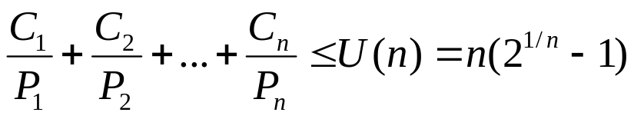
Schedulability: UB Test
Utilization bound(UB) test [Liu and Layland 73]: a set of n independent periodic tasks scheduled by the rate monotonic algorithm will always meet its deadlines, for all task phasing, if
  U(1) = 1.0 U(4) = 0.756 U(7) = 0.728
  U(2) = 0.828 U(5) = 0.743 U(8) = 0.724
  U(3) = 0.779 U(6) = 0.734 U(9) = 0.720
For harmonic task sets, the utilization bound is U(n)=1.00 for all n. For large n, the bound converges to ln 2 ~ 0.69.
Conventions, task 1 has shorter period than task 2 and so on.
Notes:
We say a set of tasks is schedulable if the task set is guaranteed to meet all its deadlines. The utilization bound test says that a task set is schedulable if its total utilization is less than a certain bound, called the Liu & Layland bound. The utilization bound test provides the basic formula underlying the theory. More complex formulas provide better bounds. This test is the application of a theorem, which was proved by Liu and Layland in “Scheduling Algorithms for Multiprogramming in a Hard Real-Time Environment”, JACM, 1973.
The utilization bound test assumes that:
1. The processor always executes the highest priority task.
2. Task priorities are assigned according to rate monotonic policy.
3. Tasks do not synchronize with each other.
4. Each task’s deadline is at the end of its period.
5. Tasks do not suspend themselves in the middle of computations.
The test takes into account the preemption time and execution time for each task under a worst-case combination of periods and execution times. As the number of tasks goes to infinity, the bound approaches ln(2) = 0.693; in other words, any number of independent periodic tasks will meet their deadlines if the total system utilization is under 69%
For a harmonic task set (in which the period of each task is a multiple of all higher-frequency tasks), the utilization bound is 1.0 for all task sets.

Slide 15
Sample Problem: Applying UB Test
 | Execution Time | Period | Utilization
Task T₁ | 20 | 100 | 0.200
Task T₂ | 40 | 150 | 0.267
Task T₃ | 100 | 350 | 0.286
Are all the tasks schedulable?
What if we double the execution time of task T₁?
Notes:
Since we are interested in worst-case behavior, tasks utilization are always rounded up. For example, U2 = 40/150 = .2666... becomes .267 and U3 = 100/350 = .2857143... becomes .286.
In this example, since the total utilization is under the bound for three tasks, all tasks are guaranteed to meet their deadlines, even under worst-case conditions. An additional 24.7% CPU capacity is available for lower-priority tasks that have no deadline.
Remember that there are several assumptions associated with the utilization bound test:
Zero context switch overhead.
Deadlines are at end of period.
No interrupts are used.
Priorities are assigned in rate monotonic order.
Tasks do not interact with one another.
Tasks do not suspend themselves.

Slide 16
The Exact Schedulability Test
Critical instant theorem: If a task meets its first deadline when all higher priority tasks are started at the same time, then this task’s future deadlines will always be met. The exact test for a task checks if this task can meet its first deadline [Liu73].
Τ₁
Τ₂
Timeline

Slide 17
Intuition for the Exact Schedulability Test
Suppose we have n tasks, and we pick a task, say i, to see if it is schedulable.
We initialize the testing by assuming all the higher priority tasks from 1 to i-1 will only preempt task i once. In other words, the initially presumed finishing time for task i is just the sum of C₁ to C_{i} , which we call a₀.
We now check the actual arrival of higher priority tasks within the duration a₀ and then presume that it will be all the preemption task i will experience. So we compute a₁ under this assumption.
We will repeat this process until one of the two conditions occur:
  The a_{n} eventually exceeds the deadline of task i. In this case we terminate the iteration and conclude that task i is not schedulable.
  The series a_{n} converges to a fixed point (I.e. it stops increasing). If this fixed point is less than the deadline, then the task is schedulable and we terminate the iteration.
Notes:
This remarkable theorem was proved by Liu and Layland and assumes:
Tasks are scheduled according to the rate monotonic algorithm.
Tasks are independent and do not interact.
Tasks do not suspend during execution.
The iterative formula for task response time was introduced in Joseph and Pandya, “Finding Response Times in a Real-Time System,” BCS Computing Journal, October 1986 (vol 29 no 5) pp 390-395.
The iterative formula is an application of fixed point iteration. Since the successive iterates are non-decreasing and approach the response time from below, the iterative formula is known to converge if there is a solution.
There is an alternative approach that we call the scheduling point version of the response time test (see slide 29). The mathematical characterization of this scheduling point version is presented in The Rate Monotonic Scheduling Algorithm -- Exact Characterization and Average Case Behavior, by Lehoczky, Sha, and Ding, Technical Report, Department of Statistics, Carnegie Mellon University, 1987. Also presented in this paper is the fact that for randomly generated task sets, the actual utilization bound is 88% rather than the worst-case bound of 69% presented in the UB test.

Slide 18
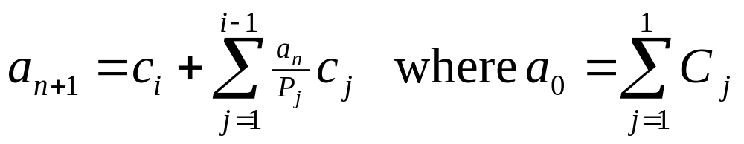
Exact Schedulability Test
Test terminates when a_{n+1} > P_{i} (not schedulable)
or when a_{n+1} = a_{n} < P_{i} (schedulable).
The subscript to a indicates the number of iterations in the calculation. The index i indicates it is the ith task being checked.
The index j runs from 1 to i-1, i.e., all the higher priority tasks. Recall from the convention - task 1 has a higher priority than task 2 and so on.

Slide 19
Example: Applying Exact Test -2
Use exact test to determine if τ₃ meets its first deadline:
3
∑
a
=
C
=
C
+
C
+
C
=
40
+
40
+
100
=
180
0
j
1
2
3
j
=
1
2
a
a
=
C
+
∑
0
C
1
3
P
j
j
=
1
j
=
100
+
180
(
180
40
)
+
(
40
)
=
100
+
80
+
80
=
260
100
150
Notes:
To apply the RT test, we do two steps
Use the iterative formula to compute the first response time W3 of t3.
Compare W3 to the first deadline for t3, namely T3.
If W3 < T3, then t3 is schedulable according to the RT test.
We start with an initial guess W3 = 0. This is labeled as the “zero-ith” iteration W3(0) = 0. To compute the first iteration, W3(1), we use the iteration formula with n = 0.
Substitute 0 for W3(0). All the terms in the summation drop out, so the first iteration is
W3(1) = C3 = 100.
Next we apply the formula with n=1 and n=2, and compute, respectively, W3(2) and W3(3). Since each successive iteration is different, the computation has not yet converged and we must continue.

Slide 20
Example: Applying the Exact Test -3
2
a
a
=
C
+
1
C
=
100
+
260
(40)
+
260
(40)
= 300
2
3
∑
j
j
P
100
150
=
1
j
2
a
a
=
C
+
2
C
=
100
+
300
(40)
+
300
(40)
= 300
3
3
∑
j
j
P
100
150
=
1
j
a
=
a
=
300
Done!
3
2
Task τ₃ is schedulable using exact test
a
=
300
<
P
=
350
3
Notes:
We continue by applying the iteration formula for n=3 and n=4.
Finally, the computed value for W3(5) is the same as W3(4).
W3(5) = W3(4) = 300.
The iteration has converged, and the first response time for t3 is
W3 = 300.
This must be compared to the first deadline for t3.
We have W3 < T3 since 300 < 350.
So t3 is schedulable using the response time test.

Slide 21
Timeline
0
100
200
300
τ
1
τ
2
τ
3
τ
completes its work at t = 300
3
Notes:
This slide illustrates an alternate version of the response time test based on scheduling points. Again, the test is being applied only to t3.
A scheduling point is a point in time when new work arrives; the beginning of a new period for some task in the task set. This version of the CT test checks to see if there exists a scheduling point (at or before the deadline of t3) at which all work initiated up to that point has been completed. Since the workload includes the compute time of t3 as well as all higher-priority tasks, if the work is completed, then t3 has met its deadline.
In this graphical representation of task execution under worst-case phasing, we can see that, when all tasks are ready to execute at t=0, task t3 cannot begin execution until t=80. As t3 tries to complete its work it gets preempted at the next scheduling point at t=100, where t1 introduces more work. Each time t3 resumes its work it is preempted before completion, until t=300. In this example, task t3 completes all its work at exactly the fourth scheduling point. It completes all its work before its first deadline at t=350, and is therefore schedulable.
The reason for introducing two ways to find the response time is that the iteration formula is easier to program, while the scheduling points are easier to visualize

Slide 22
Class Exercise
Suppose that we have three tasks
c₁ = 4, P₁ = 10
c₂ = 7, P₂ = 14
Use the exact formula to show task 2 is not schedulable. Draw a timeline to confirm that.
Can we add a task T₃ with C₃ = 1 and P₃ = 70. What would be the shortest period of T₃ that it can still meet its deadlines?

Slide 23
Summary
Today, we have introduced GRMS and the scheduling of periodic task.
We will then study synchronization protocols, the scheduling of aperiodic tasks and finally putting all them together.
We have now reviewed the UB test and exact test to determine if a set of independent periodic tasks are schedulable.
The schedulability analysis of independent periodic tasks are the foundation of GRMS and it is VERY IMPORTANT for you to master these test and can apply them correctly.
Next, we will take a more in depth look on the scheduling of periodic tasks

Slide 24
Pre-Period Deadlines

Slide 25
Review: Context Switch Time
An instance of a periodic task can cause at most two context switches. To simplify the analysis, we shall assume that this is always the case.
In the following example, the time left for t₂ is (150 - 3C₁ - 6S) = (150 - 3(C₁+2S)). Thus we can take the effect of context switching into account by replacing C₁ with (C₁ + 2S) and reuse analysis methods which assume that the context switching overhead is zero.
S S S S S S
」
T₁
C₁
C₁
C₁
0
50
100
T₂
0
150
The context overhead incurred by task τ_{i} is 2S/P_{i}, while the net processor
utilization by task τ_{i} is C_{i} /P_{i..}

Slide 26
Modeling Preperiod Deadlines
Suppose task τ, with compute time C and period P, has a preperiod deadline D.
  In UB tests, pre-period deadline can be modeled as if the task has a longer execution time (C+D), because if the task has execution time (C+D) can finish before time P, then we know it must finish D units before P if it has only execution time C.
  In exact schedulability test, just move the deadline from P to (P - D).
C
D
deadline
P

Slide 27
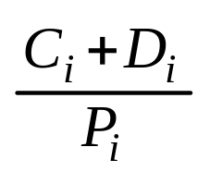
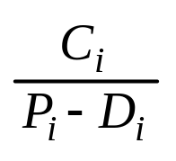
Quiz
We have modeled the effect of pre-period deadline by adding D to execution time C.
It was suggested that we may also subtract D from the period P. What do you think? (Hint: are the 2 methods equivalent? Is there a counter example?)

Slide 28
Counter Example for (P – D)
10
9
5
14
Consider the case of two tasks, {(C₁= 4, P₁= 10), (1, 14)}. If the pre-period is more than 9, then Task 2 will not be schedulable.
However, 4/10 + 1/(14 – 10) = 0.4 + 0.25 = 0.625 < U(2). That is, it tells us that even if the pre-period deadline is at t = 4, it is still schedulable. This is obviously wrong

Slide 29
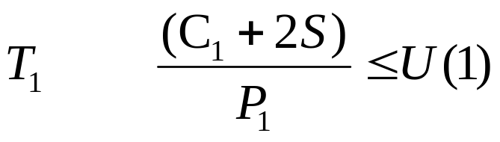
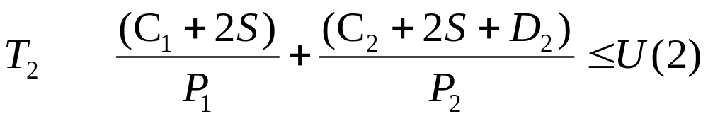
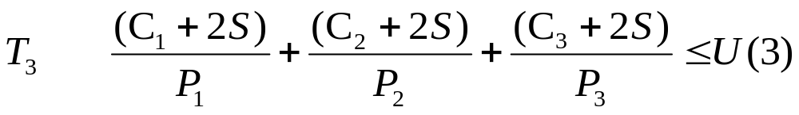
Task Switching and Pre-period Deadline
Suppose that task 2 has D₂ unit of preperiod deadline, we just add D₂ to task 2’s execution time LOCALLY (Why?)

Slide 30
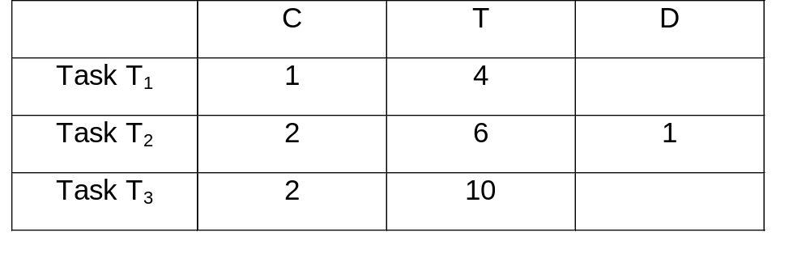
Example: Schedulability with Task Switching and Pre-period Deadline
Given the following tasks:
Assume S = 0.05, are these 3 tasks schedulable?

Slide 31
Solution: Schedulability with Task Switching and Pre-period Deadline
a0 = 1.1 + 2.1 + 2.1 = 5.3
a1 = 2.1 + ceil(5.3/4) * 1.1 + ceil(5.3/6) * 2.1 = 6.4
a2 = 2.1 + ceil(6.4/4) * 1.1 + ceil(6.4/6) * 2.1 = 8.5
a3 = 2.1 + ceil(8.5/4) * 1.1 + ceil(8.5/6) * 2.1 = 9.6
a4 = 2.1 + ceil(9.6/4) * 1.1 + ceil(9.6/6) * 2.1 = 9.6
Task 3 is schedulable, it completes by 10.00

Slide 32
The Concept of Blocking in GRMS
In GRMS, short period tasks are given higher priorities. When a long period task is delayed by the execution of short period tasks, the long period task is said to be PREEMPTED by short period tasks.
What if, for some reason, the long period task delays the execution of short period tasks? In this case, the short period task is said to be BLOCKED by long period tasks.
(NOTE: in OS literature, if a higher priority delays a lower priority task, it is called preemption, independent of periods.)

Slide 33
Blocking Due to I/O and Interrupt Handling
In this example, T₃ has the longest period. However its data I/O executes at top priority to reduce jitter. As a result, T₃‘s data I/O blocks the execution of shorter period tasks, T₁ and T₂.
Data I/O
T₃ I/O
T₁
T₂
T₃ exec
Similarly, if we use interrupts to perform the data I/O, the ISR for data I/O will have higher priority even if it is done for a longer period task

Slide 34
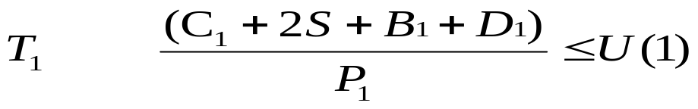
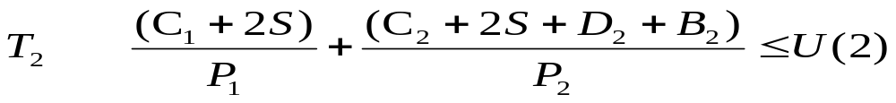
Task Switching and Pre-period Deadline and Blocking
Suppose that a task has D unit of preperiod deadline and blocking time B, we just add them to its execution time for each task in UB test. In exact schedulability test, we will move the deadline from P to (P - D - B).
Note that B₃ is always zero. It is the task with the longest period and therefore
it cannot be blocked by a task with longer period.

Slide 35
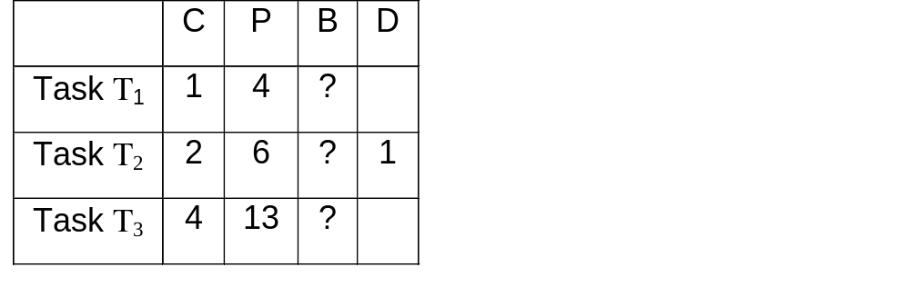
Example: Interrupt and I/O
Suppose that S=0.0. However, task 3 has two parts. part 1 is execution
time C₃ = 1 and part 2 is high priority I/O that is 3 units long.
Fill in the blocking times in the table and determine if all three tasks
are schedulable?

Slide 36
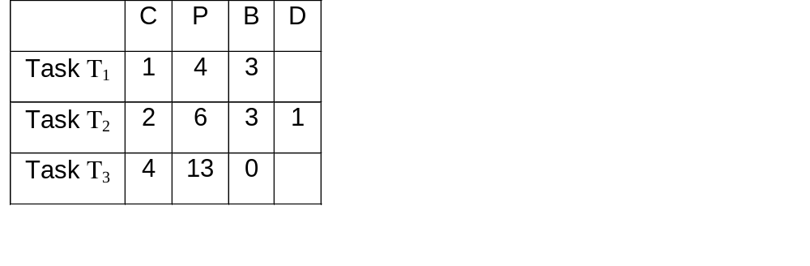
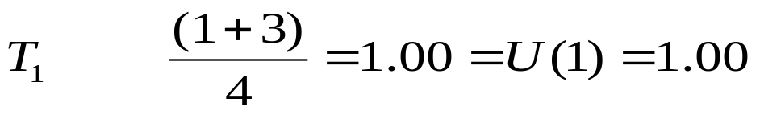


Example: I/O and Interrupts
a₀ = 1 + 2 = 3 > (6 - 1 - 3) = 2. Not schedulable
a₀ = 1+2+4 = 7,
a₁ = ceil(7/4)*1 + ceil(7/6)*2 + 4 = 10
a₂ = ceil(10/4)*1 + ceil(10/6)*2 + 4 = 11
a₃ = ceil(11/4)*1 + ceil(11/6)*2 + 4 = 11<13
(The lowest priority one is ok!!)

Slide 37
Summary
In this lecture, we learned
  how to model pre-period deadline
  the notion of blocking caused by giving longer period task I/O higher priorities
We will study real time task synchronization next.

