Slide 1
Introduction
What are embedded systems?
Challenges in embedded computing system design.
Design methodologies.
© 2000 Morgan Kaufman
Overheads for Computers as Components

Slide 2
Definition
Embedded system: any device that includes a programmable computer but is not itself a general-purpose computer.
An embedded system is a special-purpose computer system designed to perform one or a few dedicated functions, often with real-time computing constraints. [Wikipedia]
© 2000 Morgan Kaufman
Overheads for Computers as Components

Slide 3
Examples
Personal digital assistant (PDA).
Printer.
Cell phone.
Automobile: engine, brakes, dash, etc.
Television.
Household appliances.
PC keyboard (scans keys).
© 2000 Morgan Kaufman
Overheads for Computers as Components

Slide 4
Early history
Late 1940’s: MIT Whirlwind computer was designed for real-time operations.
  Originally designed to control an aircraft simulator.
First microprocessor was Intel 4004 in early 1970’s.
HP-35 calculator used several chips to implement a microprocessor in 1972.
© 2000 Morgan Kaufman
Overheads for Computers as Components

Slide 5
Early history, cont’d.
Automobiles used microprocessor-based engine controllers starting in 1970’s.
  Control fuel/air mixture, engine timing, etc.
  Multiple modes of operation: warm-up, cruise, hill climbing, etc.
  Provides lower emissions, better fuel efficiency.
© 2000 Morgan Kaufman
Overheads for Computers as Components

Slide 6
Microprocessor varieties
Microcontroller: includes I/O devices, on-board memory.
Digital signal processor (DSP): microprocessor optimized for digital signal processing.
Typical embedded word sizes: 8-bit, 16-bit, 32-bit.
© 2000 Morgan Kaufman
Overheads for Computers as Components

Slide 7
Application examples
Simple control: front panel of microwave oven, etc.
Canon EOS 3 has three microprocessors.
  32-bit RISC CPU runs autofocus and eye control systems.
Analog TV: channel selection, etc.
Digital TV: programmable CPUs + hardwired logic.
© 2000 Morgan Kaufman
Overheads for Computers as Components

Slide 8
Automotive embedded systems
Today’s high-end automobile may have 100 microprocessors:
  4-bit microcontroller checks seat belt;
  microcontrollers run dashboard devices;
  16/32-bit microprocessor controls engine.
© 2000 Morgan Kaufman
Overheads for Computers as Components

Slide 9
BMW 850i brake and stability control system
Anti-lock brake system (ABS): pumps brakes to reduce skidding.
Automatic stability control (ASC+T): controls engine to improve stability.
ABS and ASC+T communicate.
  ABS was introduced first---needed to interface to existing ABS module.
© 2000 Morgan Kaufman
Overheads for Computers as Components

Slide 10
BMW 850i, cont’d.
sensor
sensor
brake
brake
ABS
hydraulic
pump
brake
brake
sensor
sensor
© 2000 Morgan Kaufman
Overheads for Computers as Components

Slide 11
Characteristics of embedded systems
Sophisticated functionality.
Real-time operation.
Low manufacturing cost.
Low power.
Designed to tight deadlines by small teams.
© 2000 Morgan Kaufman
Overheads for Computers as Components

Slide 12
Functional complexity
Often have to run sophisticated algorithms or multiple algorithms.
  Cell phone, laser printer.
Often provide sophisticated user interfaces.
© 2000 Morgan Kaufman
Overheads for Computers as Components

Slide 13
Real-time operation
Must finish operations by deadlines.
  Hard real time: missing deadline causes failure.
  Soft real time: missing deadline results in degraded performance.
Many systems are multi-rate: must handle operations at widely varying rates.
© 2000 Morgan Kaufman
Overheads for Computers as Components

Slide 14
Non-functional requirements
Many embedded systems are mass-market items that must have low manufacturing costs.
  Limited memory, microprocessor power, etc.
Power consumption is critical in battery-powered devices.
  Excessive power consumption increases system cost even in wall-powered devices.
© 2000 Morgan Kaufman
Overheads for Computers as Components

Slide 15
Design teams
Often designed by a small team of designers.
Often must meet tight deadlines.
  6 month market window is common.
© 2000 Morgan Kaufman
Overheads for Computers as Components

Slide 16
Why use microprocessors?
Alternatives: field-programmable gate arrays (FPGAs), custom logic, etc.
Microprocessors are often very efficient: can use same logic to perform many different functions.
Microprocessors simplify the design of families of products.
© 2000 Morgan Kaufman
Overheads for Computers as Components

Slide 17
The performance paradox
Microprocessors use much more logic to implement a function than does custom logic.
But microprocessors are often at least as fast:
  heavily pipelined;
  large design teams;
  aggressive VLSI technology.
© 2000 Morgan Kaufman
Overheads for Computers as Components

Slide 18
Power
Custom logic is a clear winner for low power devices.
Modern microprocessors offer features to help control power consumption.
Software design techniques can help reduce power consumption.
© 2000 Morgan Kaufman
Overheads for Computers as Components

Slide 19
Challenges in embedded system design
How much hardware do we need?
  How big is the CPU? Memory?
How do we meet our deadlines?
  Faster hardware or cleverer software?
How do we minimize power?
  Turn off unnecessary logic? Reduce memory accesses?
© 2000 Morgan Kaufman
Overheads for Computers as Components

Slide 20
Challenges, etc.
Does it really work?
  Is the specification correct?
  Does the implementation meet the spec?
  How do we test for real-time characteristics?
  How do we test on real data?
How do we work on the system?
  Observability, controllability?
  What is our development platform?
© 2000 Morgan Kaufman
Overheads for Computers as Components

Slide 21
Design methodologies
A procedure for designing a system.
Understanding your methodology helps you ensure you didn’t skip anything.
Compilers, software engineering tools, computer-aided design (CAD) tools, etc., can be used to:
  help automate methodology steps;
  keep track of the methodology itself.
© 2000 Morgan Kaufman
Overheads for Computers as Components

Slide 22
Design goals
Performance.
  Overall speed, deadlines.
Functionality and user interface.
Manufacturing cost.
Power consumption.
Other requirements (physical size, etc.)
© 2000 Morgan Kaufman
Overheads for Computers as Components

Slide 23
Levels of abstraction
requirements
specification
architecture
component
design
system
integration
© 2000 Morgan Kaufman
Overheads for Computers as Components

Slide 24
Top-down vs. bottom-up
Top-down design:
  start from most abstract description;
  work to most detailed.
Bottom-up design:
  work from small components to big system.
Real design uses both techniques.
© 2000 Morgan Kaufman
Overheads for Computers as Components

Slide 25
Stepwise refinement
At each level of abstraction, we must:
  analyze the design to determine characteristics of the current state of the design;
  refine the design to add detail.
© 2000 Morgan Kaufman
Overheads for Computers as Components

Slide 26
Requirements
Plain language description of what the user wants and expects to get.
May be developed in several ways:
  talking directly to customers;
  talking to marketing representatives;
  providing prototypes to users for comment.
© 2000 Morgan Kaufman
Overheads for Computers as Components

Slide 27
Functional vs. non-functional requirements
Functional requirements:
  output as a function of input.
Non-functional requirements:
  time required to compute output;
  size, weight, etc.;
  power consumption;
  reliability;
  etc.
© 2000 Morgan Kaufman
Overheads for Computers as Components

Slide 28
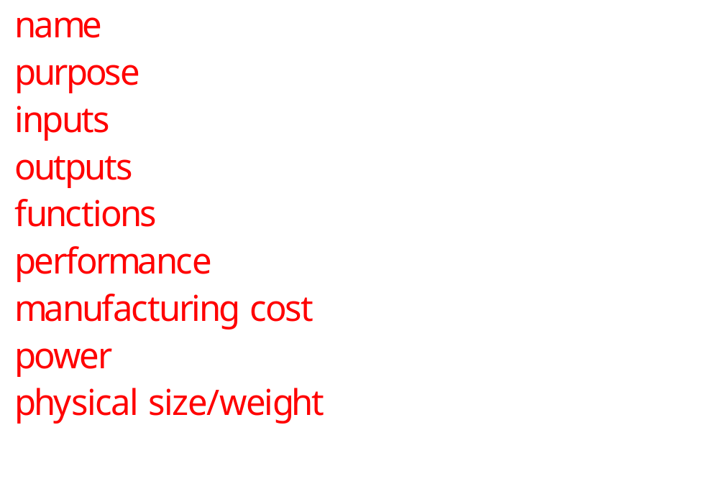
Our requirements form
© 2000 Morgan Kaufman
Overheads for Computers as Components

Slide 29
Example: GPS moving map requirements
Moving map obtains position from GPS, paints map from local database.
I-78
Scotch Road
lat: 40 13 lon: 32 19
© 2000 Morgan Kaufman
Overheads for Computers as Components

Slide 30
GPS moving map needs
Functionality: For automotive use. Show major roads and landmarks.
User interface: At least 400 x 600 pixel screen. Three buttons max. Pop-up menu.
Performance: Map should scroll smoothly. No more than 1 sec power-up. Lock onto GPS within 15 seconds.
© 2000 Morgan Kaufman
Overheads for Computers as Components

Slide 31
GPS moving map needs, cont’d.
Cost: $500 street price = approx. $100 cost of goods sold.
Physical size/weight: Should fit in hand.
Power consumption: Should run for 8 hours on four AA batteries.
© 2000 Morgan Kaufman
Overheads for Computers as Components

Slide 32
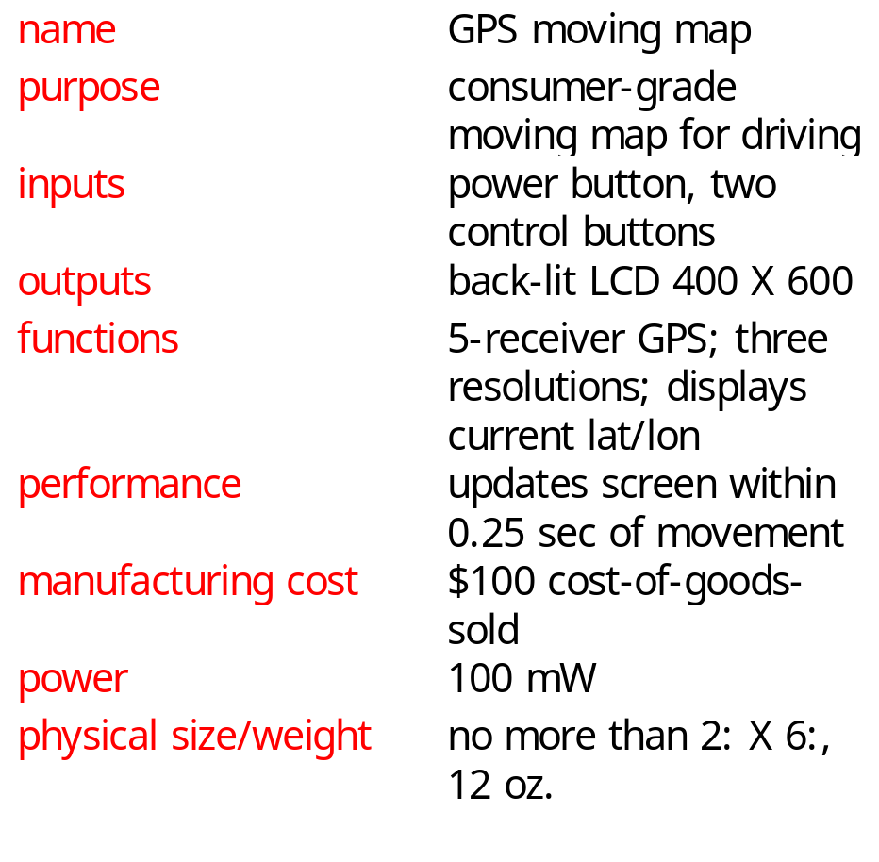
GPS moving map requirements form
© 2000 Morgan Kaufman
Overheads for Computers as Components

Slide 33
Specification
A more precise description of the system:
  should not imply a particular architecture;
  provides input to the architecture design process.
May include functional and non-functional elements.
May be executable or may be in mathematical form for proofs.
© 2000 Morgan Kaufman
Overheads for Computers as Components

Slide 34
GPS specification
Should include:
  What is received from GPS;
  map data;
  user interface;
  operations required to satisfy user requests;
  background operations needed to keep the system running.
© 2000 Morgan Kaufman
Overheads for Computers as Components

Slide 35
Architecture design
What major components go satisfying the specification?
Hardware components:
  CPUs, peripherals, etc.
Software components:
  major programs and their operations.
Must take into account functional and non-functional specifications.
© 2000 Morgan Kaufman
Overheads for Computers as Components

Slide 36
GPS moving map block diagram
GPS
receiver
search
engine
renderer
display
database
user
interface
© 2000 Morgan Kaufman
Overheads for Computers as Components

Slide 37
GPS moving map hardware architecture
display
frame
buffer
CPU
GPS
receiver
memory
panel I/O
Bus
© 2000 Morgan Kaufman
Overheads for Computers as Components

Slide 38
GPS moving map software architecture
database
search
renderer
pixels
user
interface
timer
position
© 2000 Morgan Kaufman
Overheads for Computers as Components

Slide 39
Designing hardware and software components
Must spend time architecting the system before you start coding.
Some components are ready-made, some can be modified from existing designs, others must be designed from scratch.
© 2000 Morgan Kaufman
Overheads for Computers as Components

Slide 40
System integration
Put together the components.
  Many bugs appear only at this stage.
Have a plan for integrating components to uncover bugs quickly, test as much functionality as early as possible.
© 2000 Morgan Kaufman
Overheads for Computers as Components

Slide 41
Summary
Embedded computers are all around us.
  Many systems have complex embedded hardware and software.
Embedded systems pose many design challenges: design time, deadlines, power, etc.
Design methodologies help us manage the design process.
© 2000 Morgan Kaufman
Overheads for Computers as Components

