Slide 1
CPUs
Input and output.
Supervisor mode, exceptions, traps.
Co-processors.
© 2000 Morgan Kaufman
Overheads for Computers as Components

Slide 2
I/O devices
Usually includes some non-digital components.
Typical digital interface to CPU:
CPU
status
reg
mechanism
data
reg
© 2000 Morgan Kaufman
Overheads for Computers as Components

Slide 3
Application: 8251 UART
Universal asynchronous receiver transmitter (UART) : provides serial communication.
8251 functions are integrated into standard PC interface chip.
Allows many communication parameters to be programmed.
© 2000 Morgan Kaufman
Overheads for Computers as Components

Slide 4
Serial communication
Characters are transmitted separately:
no
char
bit 0
bit 1
...
bit n-1
start
stop
time
© 2000 Morgan Kaufman
Overheads for Computers as Components

Slide 5
Serial communication parameters
Baud (bit) rate.
Number of bits per character.
Parity/no parity.
Even/odd parity.
Length of stop bit (1, 1.5, 2 bits).
© 2000 Morgan Kaufman
Overheads for Computers as Components

Slide 6
8251 CPU interface
8251
CPU
status
(8 bit)
xmit/
rcv
data
(8 bit)
serial
port
© 2000 Morgan Kaufman
Overheads for Computers as Components

Slide 7
Programming I/O
Two types of instructions can support I/O:
  special-purpose I/O instructions;
  memory-mapped load/store instructions.
Intel x86 provides in, out instructions. Most other CPUs use memory-mapped I/O.
I/O instructions do not preclude memory-mapped I/O.
© 2000 Morgan Kaufman
Overheads for Computers as Components

Slide 8
ARM memory-mapped I/O
Define location for device:
DEV1 EQU 0x1000
Read/write code:
  LDR r1,#DEV1 ; set up device adrs
  LDR r0,[r1] ; read DEV1
  LDR r0,#8 ; set up value to write
  STR r0,[r1] ; write value to device
© 2000 Morgan Kaufman
Overheads for Computers as Components

Slide 9
Peek and poke
Traditional HLL interfaces:
  int peek(char *location) {
  return *location; }
  void poke(char *location, char newval) {
  (*location) = newval; }
© 2000 Morgan Kaufman
Overheads for Computers as Components

Slide 10
Busy/wait output
Simplest way to program device.
  Use instructions to test when device is ready.
current_char = mystring;
while (*current_char != ‘\0’) {
poke(OUT_CHAR,*current_char);
while (peek(OUT_STATUS) != 0);
current_char++;
}
© 2000 Morgan Kaufman
Overheads for Computers as Components

Slide 11
Simultaneous busy/wait input and output
while (TRUE) {
/* read */
while (peek(IN_STATUS) == 0);
achar = (char)peek(IN_DATA);
poke(IN_STATUS,0);
/* write */
poke(OUT_DATA,achar);
poke(OUT_STATUS,1);
while (peek(OUT_STATUS) != 0);}
© 2000 Morgan Kaufman
Overheads for Computers as Components

Slide 12
Interrupt I/O
Busy/wait is very inefficient.
  CPU can’t do other work while testing device.
  Hard to do simultaneous I/O.
Interrupts allow a device to change the flow of control in the CPU.
  Causes subroutine call to handle device.
© 2000 Morgan Kaufman
Overheads for Computers as Components

Slide 13
Interrupt interface
intr request
CPU
status
reg
intr ack
mechanism
IR
PC
data/address
data
reg
© 2000 Morgan Kaufman
Overheads for Computers as Components

Slide 14
Interrupt behavior
Based on subroutine call mechanism.
Interrupt forces next instruction to be a subroutine call to a predetermined location.
  Return address is saved to resume executing foreground program.
© 2000 Morgan Kaufman
Overheads for Computers as Components

Slide 15
Interrupt physical interface
CPU and device are connected by CPU bus.
CPU and device handshake:
  device asserts interrupt request;
  CPU asserts interrupt acknowledge when it can handle the interrupt.
© 2000 Morgan Kaufman
Overheads for Computers as Components

Slide 16
Example: character I/O handlers
void input_handler() {
achar = peek(IN_DATA);
gotchar = TRUE;
poke(IN_STATUS,0);
}
void output_handler() {
}
© 2000 Morgan Kaufman
Overheads for Computers as Components

Slide 17
Example: interrupt-driven main program
main() {
while (TRUE) {
if (gotchar) {
poke(OUT_DATA,achar);
poke(OUT_STATUS,1);
gotchar = FALSE;
}
}
}
© 2000 Morgan Kaufman
Overheads for Computers as Components

Slide 18
Example: interrupt I/O with buffers
Queue for characters:
a
head
head
tail
tail
© 2000 Morgan Kaufman
Overheads for Computers as Components

Slide 19
Buffer-based input handler
void input_handler() {
char achar;
if (full_buffer()) error = 1;
else { achar = peek(IN_DATA);
add_char(achar); }
poke(IN_STATUS,0);
if (nchars() == 1)
{ poke(OUT_DATA, remove_char();
poke(OUT_STATUS,1); }
}
© 2000 Morgan Kaufman
Overheads for Computers as Components

Slide 20
Buffer-based input handler
void output_handler() {
char achar;
if (!empty_buffer()) {
poke(OUT_DATA, remove_char();
poke(OUT_STATUS,1); }
}
© 2000 Morgan Kaufman
Overheads for Computers as Components

Slide 21
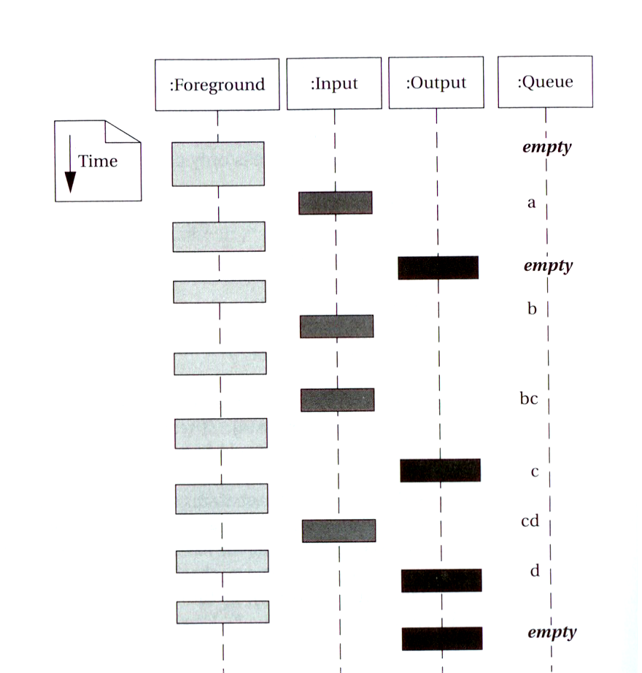
I/O sequence diagram
© 2000 Morgan Kaufman
Overheads for Computers as Components

Slide 22
Debugging interrupt code
What if you forget to change registers?
  Foreground program can exhibit mysterious bugs.
  Bugs will be hard to repeat---depend on interrupt timing.
© 2000 Morgan Kaufman
Overheads for Computers as Components

Slide 23
Priorities and vectors
Two mechanisms allow us to make interrupts more specific:
  Priorities determine what interrupt gets CPU first.
  Vectors determine what code is called for each type of interrupt.
Mechanisms are orthogonal: most CPUs provide both.
© 2000 Morgan Kaufman
Overheads for Computers as Components

Slide 24
Prioritized interrupts
device 1
device 2
device n
interrupt
acknowledge
CPU
L1 L2 .. Ln
© 2000 Morgan Kaufman
Overheads for Computers as Components

Slide 25
Interrupt prioritization
Masking: Interrupt with priority lower than current priority is not recognized until pending interrupt is completed.
Non-maskable interrupt (NMI): The highest-priority, never masked.
  Often used for power-down.
© 2000 Morgan Kaufman
Overheads for Computers as Components

Slide 26
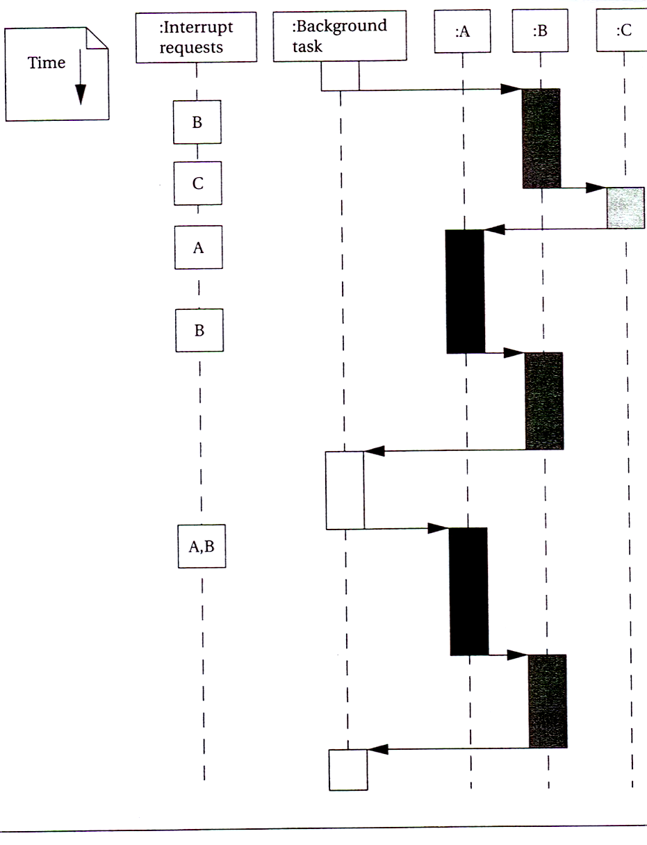
Example: Prioritized I/O
© 2000 Morgan Kaufman
Overheads for Computers as Components

Slide 27
Interrupt vectors
Allow different devices to be handled by different code.
Interrupt vector table:
Interrupt
vector
table head
handler 0
handler 1
handler 2
handler 3
© 2000 Morgan Kaufman
Overheads for Computers as Components

Slide 28
Interrupt vector acquisition
:CPU
:device
receive
request
receive
ack
receive
vector
© 2000 Morgan Kaufman
Overheads for Computers as Components

Slide 29
Generic interrupt mechanism
continue
execution
intr?
N
Assume priority selection is handled before this point.
Y
N
intr priority > current priority?
ignore
Y
ack
Y
bus error
Y
N
timeout?
vector?
Y
call table[vector]
© 2000 Morgan Kaufman
Overheads for Computers as Components

Slide 30
Interrupt sequence
CPU acknowledges request.
Device sends vector.
CPU calls handler.
Software processes request.
CPU restores state to foreground program.
© 2000 Morgan Kaufman
Overheads for Computers as Components

Slide 31
Sources of interrupt overhead
Handler execution time.
Interrupt mechanism overhead.
Register save/restore.
Pipeline-related penalties.
Cache-related penalties.
© 2000 Morgan Kaufman
Overheads for Computers as Components

Slide 32
ARM interrupts
ARM7 supports two types of interrupts:
  Fast interrupt requests (FIQs).
  Interrupt requests (IRQs).
Interrupt table starts at location 0.
© 2000 Morgan Kaufman
Overheads for Computers as Components

Slide 33
ARM interrupt procedure
CPU actions:
  Save PC. Copy CPSR to SPSR.
  Force bits in CPSR to record interrupt.
  Force PC to vector.
Handler responsibilities:
  Restore proper PC.
  Restore CPSR from SPSR.
  Clear interrupt disable flags.
© 2000 Morgan Kaufman
Overheads for Computers as Components

Slide 34
ARM interrupt latency
Worst-case latency to respond to interrupt is 27 cycles:
  Two cycles to synchronize external request.
  Up to 20 cycles to complete current instruction.
  Three cycles for data abort.
  Two cycles to enter interrupt handling state.
© 2000 Morgan Kaufman
Overheads for Computers as Components

Slide 35
Supervisor mode
May want to provide protective barriers between programs.
  Avoid memory corruption.
Need supervisor mode to manage the various programs.
© 2000 Morgan Kaufman
Overheads for Computers as Components

Slide 36
ARM supervisor mode
Use SWI instruction to enter supervisor mode, similar to subroutine:
  SWI CODE_1
Sets PC to 0x08.
Argument to SWI is passed to supervisor mode code.
Saves CPSR in SPSR.
© 2000 Morgan Kaufman
Overheads for Computers as Components

Slide 37
Exception
Exception: internally detected error.
Exceptions are synchronous with instructions but unpredictable.
Build exception mechanism on top of interrupt mechanism.
Exceptions are usually prioritized and vectorized.
© 2000 Morgan Kaufman
Overheads for Computers as Components

Slide 38
Trap
Trap (software interrupt): an exception generated by an instruction.
  Call supervisor mode.
ARM uses SWI instruction for traps.
© 2000 Morgan Kaufman
Overheads for Computers as Components

Slide 39
Co-processor
Co-processor: added function unit that is called by instruction.
  Floating-point units are often structured as co-processors.
ARM allows up to 16 designer-selected co-processors.
  Floating-point co-processor uses units 1 and 2.
© 2000 Morgan Kaufman
Overheads for Computers as Components

Slide 40
CPUs
Caches.
Memory management.
© 2000 Morgan Kaufman
Overheads for Computers as Components

Slide 41
Caches and CPUs
address
data
cache
main
memory
CPU
cache
controller
address
data
data
© 2000 Morgan Kaufman
Overheads for Computers as Components

Slide 42
Cache operation
Many main memory locations are mapped onto one cache entry.
May have caches for:
  instructions;
  data;
  data + instructions (unified).
Memory access time is no longer deterministic.
© 2000 Morgan Kaufman
Overheads for Computers as Components

Slide 43
Terms
Cache hit: required location is in cache.
Cache miss: required location is not in cache.
Working set: set of locations used by program in a time interval.
© 2000 Morgan Kaufman
Overheads for Computers as Components

Slide 44
Types of misses
Compulsory (cold): location has never been accessed.
Capacity: working set is too large.
Conflict: multiple locations in working set map to same cache entry.
© 2000 Morgan Kaufman
Overheads for Computers as Components

Slide 45
Memory system performance
h = cache hit rate.
t_{cache} = cache access time, t_{main} = main memory access time.
Average memory access time:
  t_{av} = ht_{cache} + (1-h)t_{main}
© 2000 Morgan Kaufman
Overheads for Computers as Components

Slide 46
Multiple levels of cache
L2 cache
CPU
L1 cache
© 2000 Morgan Kaufman
Overheads for Computers as Components

Slide 47
Multi-level cache access time
h₁ = cache hit rate.
h₂ = rate for miss on L1, hit on L2.
Average memory access time:
  t_{av} = h₁t_{L1} + (h₂-h₁)t_{L2 +} (1- h₂-h₁)t_{main}
© 2000 Morgan Kaufman
Overheads for Computers as Components

Slide 48
Replacement policies
Replacement policy: strategy for choosing which cache entry to throw out to make room for a new memory location.
Two popular strategies:
  Random.
  Least-recently used (LRU).
© 2000 Morgan Kaufman
Overheads for Computers as Components

Slide 49
Cache organizations
Fully-associative: any memory location can be stored anywhere in the cache (almost never implemented).
Direct-mapped: each memory location maps onto exactly one cache entry.
N-way set-associative: each memory location can go into one of n sets.
© 2000 Morgan Kaufman
Overheads for Computers as Components

Slide 50
Cache performance benefits
Keep frequently-accessed locations in fast cache.
Cache retrieves more than one word at a time.
  Sequential accesses are faster after first access.
© 2000 Morgan Kaufman
Overheads for Computers as Components

Slide 51
Direct-mapped cache
valid
tag
data
1
0xabcd
byte byte byte ...
cache block
tag
index
offset
=
hit
value
byte
© 2000 Morgan Kaufman
Overheads for Computers as Components

Slide 52
Write operations
Write-through: immediately copy write to main memory.
Write-back: write to main memory only when location is removed from cache.
© 2000 Morgan Kaufman
Overheads for Computers as Components

Slide 53
Direct-mapped cache locations
Many locations map onto the same cache block.
Conflict misses are easy to generate:
  Array a[] uses locations 0, 1, 2, …
  Array b[] uses locations 1024, 1025, 1026, …
  Operation a[i] + b[i] generates conflict misses.
© 2000 Morgan Kaufman
Overheads for Computers as Components

Slide 54
Set-associative cache
A set of direct-mapped caches:
Set 1
Set 2
Set n
...
hit
data
© 2000 Morgan Kaufman
Overheads for Computers as Components

Slide 55
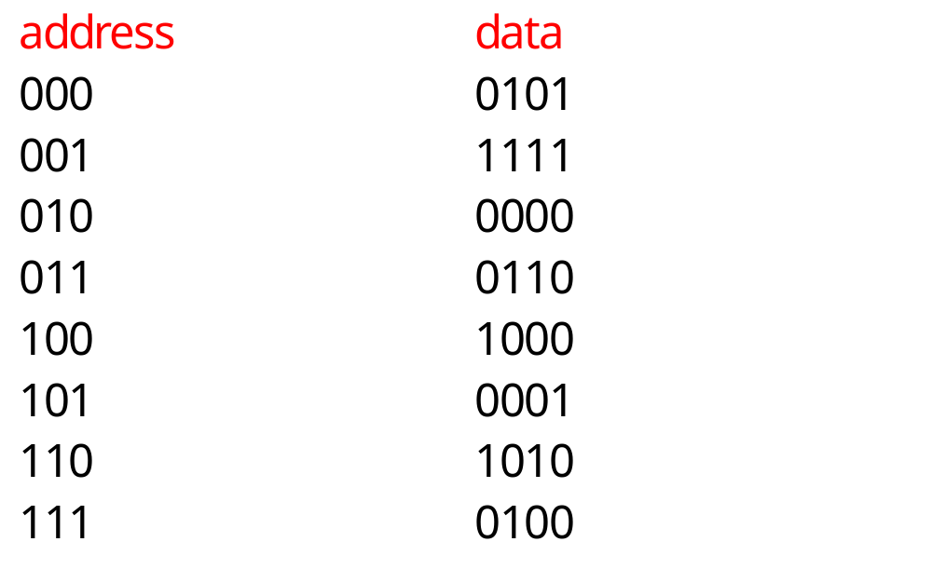
Example: direct-mapped vs. set-associative
© 2000 Morgan Kaufman
Overheads for Computers as Components

Slide 56
Direct-mapped cache behavior
After 001 access:
  block tag data
  00 - -
  01 0 1111
  10 - -
  11 - -
After 010 access:
  block tag data
  00 - -
  01 0 1111
  10 0 0000
  11 - -
© 2000 Morgan Kaufman
Overheads for Computers as Components

Slide 57
Direct-mapped cache behavior, cont’d.
After 011 access:
  block tag data
  00 - -
  01 0 1111
  10 0 0000
  11 0 0110
After 100 access:
  block tag data
  00 1 1000
  01 0 1111
  10 0 0000
  11 0 0110
© 2000 Morgan Kaufman
Overheads for Computers as Components

Slide 58
Direct-mapped cache behavior, cont’d.
After 101 access:
  block tag data
  00 1 1000
  01 1 0001
  10 0 0000
  11 0 0110
After 111 access:
  block tag data
  00 1 1000
  01 1 0001
  10 0 0000
  11 1 0100
© 2000 Morgan Kaufman
Overheads for Computers as Components

Slide 59
2-way set-associtive cache behavior
After 001 access:
  set blk 0 tag blk 0 data blk 1 tag blk 1 data
  - - - -
  01 0 1111 - -
  - - - -
  - - - -
After 010 access:
  set blk 0 tag blk 0 data blk 1 tag blk 1 data
  - - - -
  01 0 1111 - -
  10 0 0000 - -
  - - - -
© 2000 Morgan Kaufman
Overheads for Computers as Components

Slide 60
2-way set-associtive cache behavior, cont’d
After 011 access:
  set blk 0 tag blk 0 data blk 1 tag blk 1 data
  - - - -
  01 0 1111 - -
  10 0 0000 - -
  11 0 0110 - -
After 100 access:
  set blk 0 tag blk 0 data blk 1 tag blk 1 data
  00 1 1000 -
  01 0 1111 - -
  10 0 0000 - -
  11 0 0110 - -
© 2000 Morgan Kaufman
Overheads for Computers as Components

Slide 61
2-way set-associtive cache behavior, cont’d
After 101 access:
  set blk 0 tag blk 0 data blk 1 tag blk 1 data
  00 1 1000 -
  01 0 1111 01 1 0001
  10 0 0000 - -
  11 0 0110 - -
After 111 access (Final state of cache)
  set blk 0 tag blk 0 data blk 1 tag blk 1 data
  00 1 1000 -
  01 0 1111 01 1 0001
  10 0 0000 - -
  11 0 0110 11 1 0100
© 2000 Morgan Kaufman
Overheads for Computers as Components

Slide 62
2-way set-associative cache behavior
Final state of cache (same size as direct-mapped):
  set blk 0 tag blk 0 data blk 1 tag blk 1 data
  0 01 0000 10 1000
  1 10 0111 11 0100
© 2000 Morgan Kaufman
Overheads for Computers as Components

Slide 63
Example caches
StrongARM:
  16 Kbyte, 32-way, 32-byte block instruction cache.
  16 Kbyte, 32-way, 32-byte block data cache (write-back).
© 2000 Morgan Kaufman
Overheads for Computers as Components

Slide 64
Memory management units
Memory management unit (MMU) translates addresses:
main
memory
CPU
logical
address
memory
management
unit
physical
address
© 2000 Morgan Kaufman
Overheads for Computers as Components

Slide 65
Memory management tasks
Allows programs to move in physical memory during execution.
Allows virtual memory:
  memory images kept in secondary storage;
  images returned to main memory on demand during execution.
Page fault: request for location not resident in memory.
© 2000 Morgan Kaufman
Overheads for Computers as Components

Slide 66
Address translation
Requires some sort of register/table to allow arbitrary mappings of logical to physical addresses.
Two basic schemes:
  segmented;
  paged.
Segmentation and paging can be combined (x86).
© 2000 Morgan Kaufman
Overheads for Computers as Components

Slide 67
Segments and pages
memory
segment 1
page 1
page 2
segment 2
© 2000 Morgan Kaufman
Overheads for Computers as Components

Slide 68
Segment address translation
segment base address
logical address
+
segment lower bound
range
check
range
error
segment upper bound
physical address
© 2000 Morgan Kaufman
Overheads for Computers as Components

Slide 69
Page address translation
page
offset
page i base
concatenate
page
offset
© 2000 Morgan Kaufman
Overheads for Computers as Components

Slide 70
Page table organizations
page
descriptor
page descriptor
flat
tree
© 2000 Morgan Kaufman
Overheads for Computers as Components

Slide 71
Caching address translations
Large translation tables require main memory access.
TLB: cache for address translation.
  Typically small.
© 2000 Morgan Kaufman
Overheads for Computers as Components

Slide 72
ARM memory management
Memory region types:
  section: 1 Mbyte block;
  large page: 64 kbytes;
  small page: 4 kbytes.
An address is marked as section-mapped or page-mapped.
Two-level translation scheme.
© 2000 Morgan Kaufman
Overheads for Computers as Components

Slide 73
ARM address translation
Translation table
base register
1st index
2nd index
offset
1st level table
descriptor
concatenate
concatenate
2nd level table
descriptor
physical address
© 2000 Morgan Kaufman
Overheads for Computers as Components

Slide 74
CPUs
Example: data compressor.
© 2000 Morgan Kaufman
Overheads for Computers as Components

Slide 75
Goals
Compress data transmitted over serial line.
  Receives byte-size input symbols.
  Produces output symbols packed into bytes.
Will build software module only here.
© 2000 Morgan Kaufman
Overheads for Computers as Components

Slide 76
Collaboration diagram for compressor
1..m: packed
output
symbols
1..n: input
symbols
:input
:data compressor
:output
© 2000 Morgan Kaufman
Overheads for Computers as Components

Slide 77
Huffman coding
Early statistical text compression algorithm.
Select non-uniform size codes.
  Use shorter codes for more common symbols.
  Use longer codes for less common symbols.
To allow decoding, codes must have unique prefixes.
  No code can be a prefix of a longer valid code.
© 2000 Morgan Kaufman
Overheads for Computers as Components

Slide 78
Huffman example
character P
a .45
b .24
c .11
d .08
e .07
f .05
P=1
P=.55
P=.31
P=.19
P=.12
© 2000 Morgan Kaufman
Overheads for Computers as Components

Slide 79
Example Huffman code
Read code from root to leaves:
a 1
b 01
c 0000
d 0001
e 0010
f 0011
© 2000 Morgan Kaufman
Overheads for Computers as Components

Slide 80
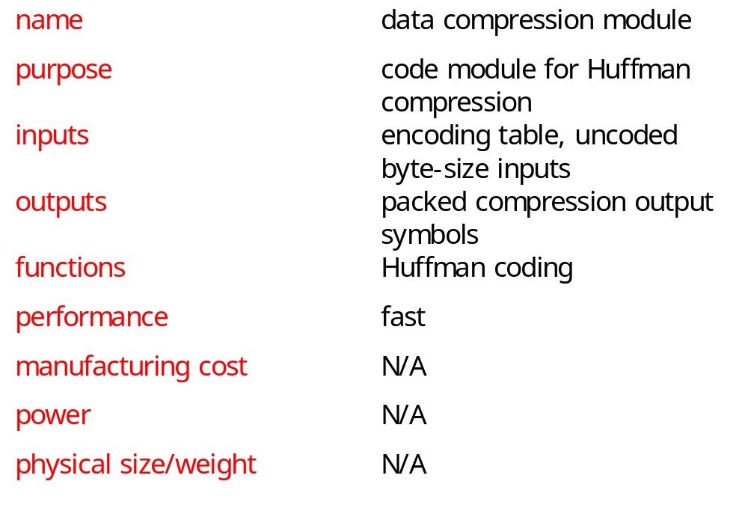
Huffman coder requirements table
© 2000 Morgan Kaufman
Overheads for Computers as Components

Slide 81
Building a specification
Collaboration diagram shows only steady-state input/output.
A real system must:
  Accept an encoding table.
  Allow a system reset that flushes the compression buffer.
© 2000 Morgan Kaufman
Overheads for Computers as Components

Slide 82
data-compressor class
data-compressor
buffer: data-buffer
table: symbol-table
current-bit: integer
encode(): boolean,
data-buffer
flush()
new-symbol-table()
© 2000 Morgan Kaufman
Overheads for Computers as Components

Slide 83
data-compressor behaviors
encode: Takes one-byte input, generates packed encoded symbols and a Boolean indicating whether the buffer is full.
new-symbol-table: installs new symbol table in object, throws away old table.
flush: returns current state of buffer, including number of valid bits in buffer.
© 2000 Morgan Kaufman
Overheads for Computers as Components

Slide 84
Auxiliary classes
data-buffer
symbol-table
databuf[databuflen] :
character
len : integer
symbols[nsymbols] :
data-buffer
len : integer
insert()
length() : integer
value() : symbol
load()
© 2000 Morgan Kaufman
Overheads for Computers as Components

Slide 85
Auxiliary class roles
data-buffer holds both packed and unpacked symbols.
  Longest Huffman code for 8-bit inputs is 256 bits.
symbol-table indexes encoded verison of each symbol.
  load() puts data in a new symbol table.
© 2000 Morgan Kaufman
Overheads for Computers as Components

Slide 86
Class relationships
data-compressor
1
1
1
1
data-buffer
symbol-table
© 2000 Morgan Kaufman
Overheads for Computers as Components

Slide 87
Encode behavior
create new buffer
add to buffers
return true
T
input symbol
encode
buffer filled?
F
add to buffer
return false
© 2000 Morgan Kaufman
Overheads for Computers as Components

Slide 88
Insert behavior
pack into
this buffer
input
symbol
T
update
length
fills buffer?
F
pack bottom bits
into this buffer,
top bits into
overflow buffer
© 2000 Morgan Kaufman
Overheads for Computers as Components

Slide 89
Program design
In an object-oriented language, we can reflect the UML specification in the code more directly.
In a non-object-oriented language, we must either:
  add code to provide object-oriented features;
  diverge from the specification structure.
© 2000 Morgan Kaufman
Overheads for Computers as Components

Slide 90
C++ classes
Class data_buffer {
char databuf[databuflen];
int len;
int length_in_chars() { return len/bitsperbyte; }
public:
void insert(data_buffer,data_buffer&);
int length() { return len; }
int length_in_bytes() { return (int)ceil(len/8.0); }
int initialize();
...
© 2000 Morgan Kaufman
Overheads for Computers as Components

Slide 91
C++ classes, cont’d.
class data_compressor {
data_buffer buffer;
int current_bit;
symbol_table table;
public:
boolean encode(char,data_buffer&);
void new_symbol_table(symbol_table);
int flush(data_buffer&);
data_compressor();
~data_compressor(); }
© 2000 Morgan Kaufman
Overheads for Computers as Components

Slide 92
C code
struct data_compressor_struct {
data_buffer buffer;
int current_bit;
sym_table table;
}
typedef struct data_compressor_struct data_compressor,
*data_compressor_ptr;
boolean data_compressor_encode(data_compressor_ptr mycmptrs, char isymbol, data_buffer *fullbuf) ...
© 2000 Morgan Kaufman
Overheads for Computers as Components

Slide 93
Testing
Test by encoding, then decoding:
symbol table
input symbols
encoder
decoder
result
compare
© 2000 Morgan Kaufman
Overheads for Computers as Components

Slide 94
Code inspection tests
Look at the code for potential problems:
  Can we run past end of symbol table?
  What happens when the next symbol does not fill the buffer? Does fill it?
  Do very long encoded symbols work properly? Very short symbols?
  Does flush() work properly?
© 2000 Morgan Kaufman
Overheads for Computers as Components

