Slide 1
The Embedded computing platform
CPU bus
Memory
I/O devices
Platform design
© 2000 Morgan Kaufman
Overheads for Computers as Components

Slide 2
CPU bus
Connects CPU to:
  memory;
  devices.
Protocol controls communication between entities.
© 2000 Morgan Kaufman
Overheads for Computers as Components

Slide 3
Bus protocol
Determines who gets to use the bus at any particular time.
Governs length, style of communication.
© 2000 Morgan Kaufman
Overheads for Computers as Components

Slide 4
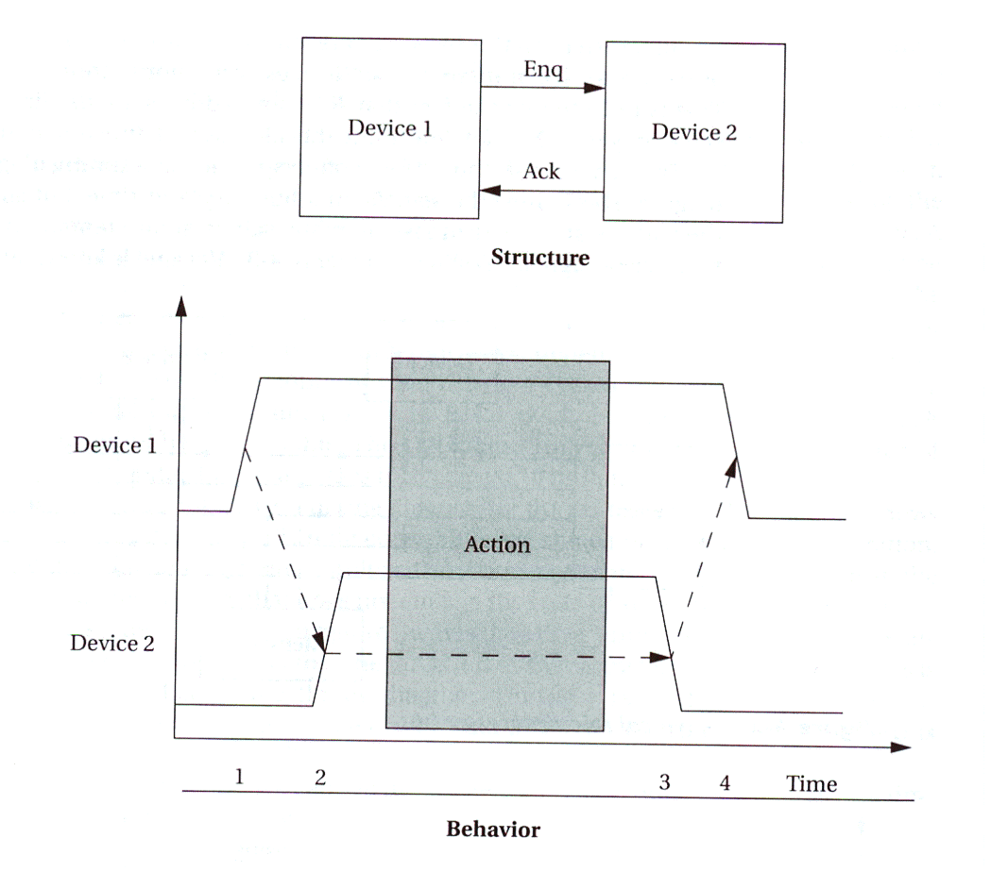
Four-cycle handshake
Basis of many bus protocols
Uses two wires:
  enq
  ack
enq
ack
© 2000 Morgan Kaufman
Overheads for Computers as Components

Slide 5
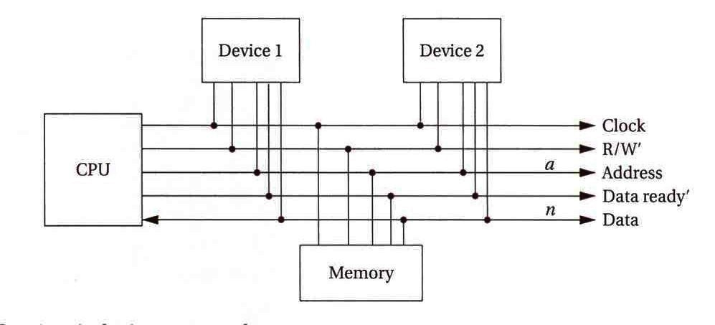
Typical bus signals
Clock: provide synchronization of components
R/W’: true when bus is reading.
Address: a-bit bundle.
Data: n-bit bundle.
Data ready’.
© 2000 Morgan Kaufman
Overheads for Computers as Components

Slide 6
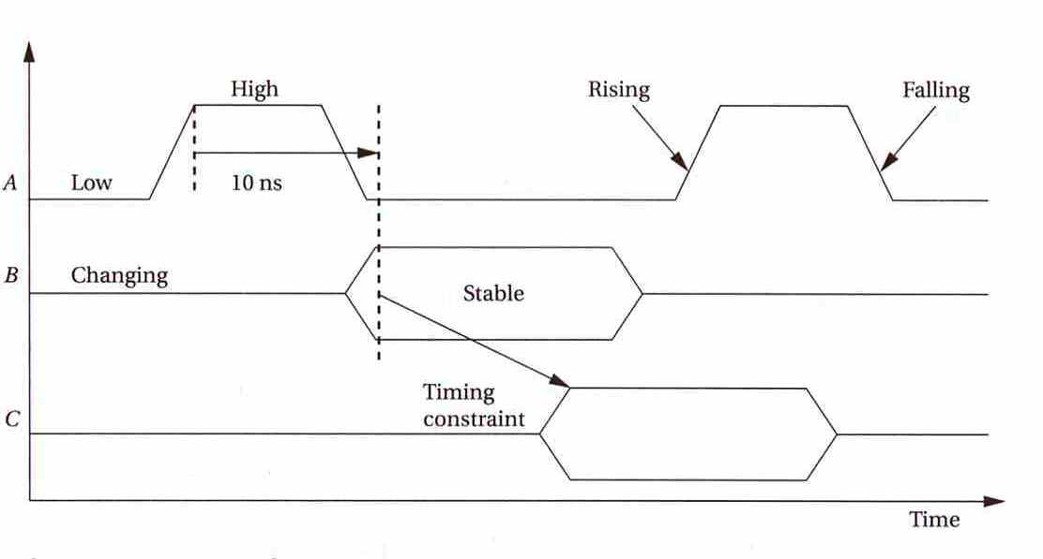
Timing diagrams
© 2000 Morgan Kaufman
Overheads for Computers as Components

Slide 7
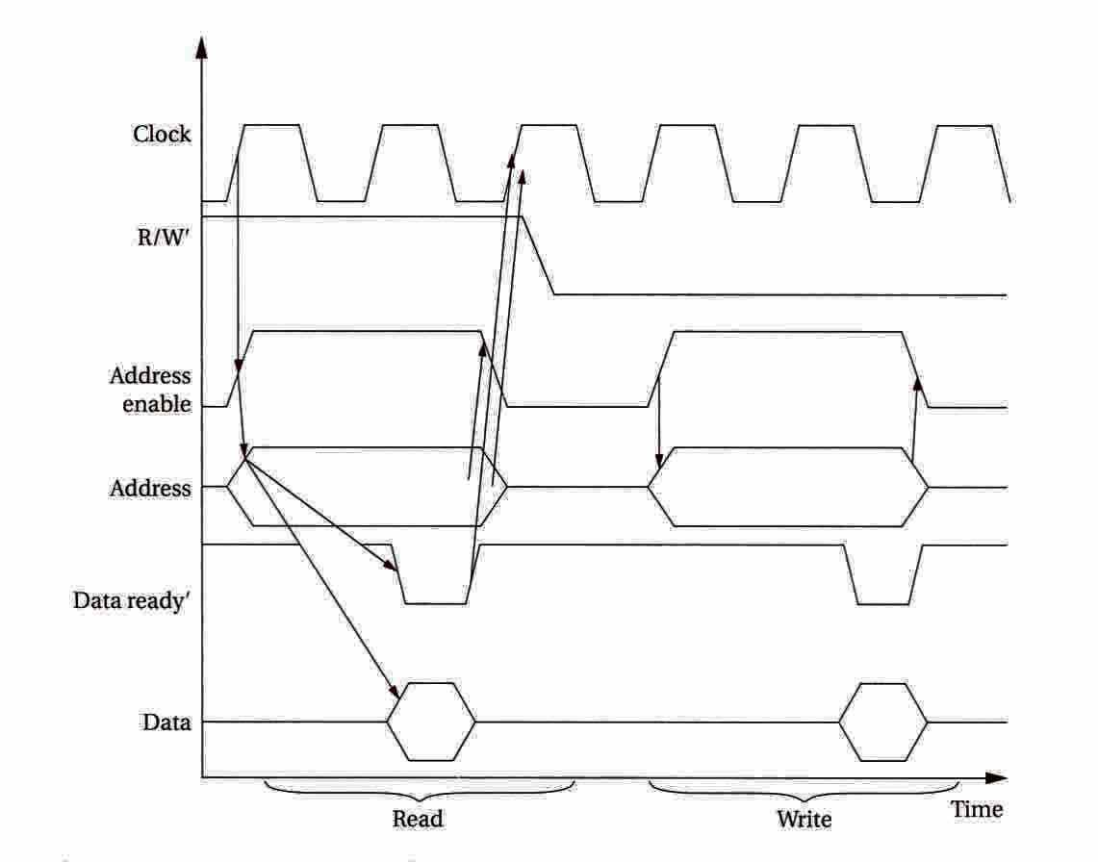
Typical bus timing for read
CPU:
  set R/W’=1;
  asserts address, address enable.
Memory:
  asserts data;
  asserts data ready’.
CPU:
  deasserts address, address enable.
© 2000 Morgan Kaufman
Overheads for Computers as Components

Slide 8
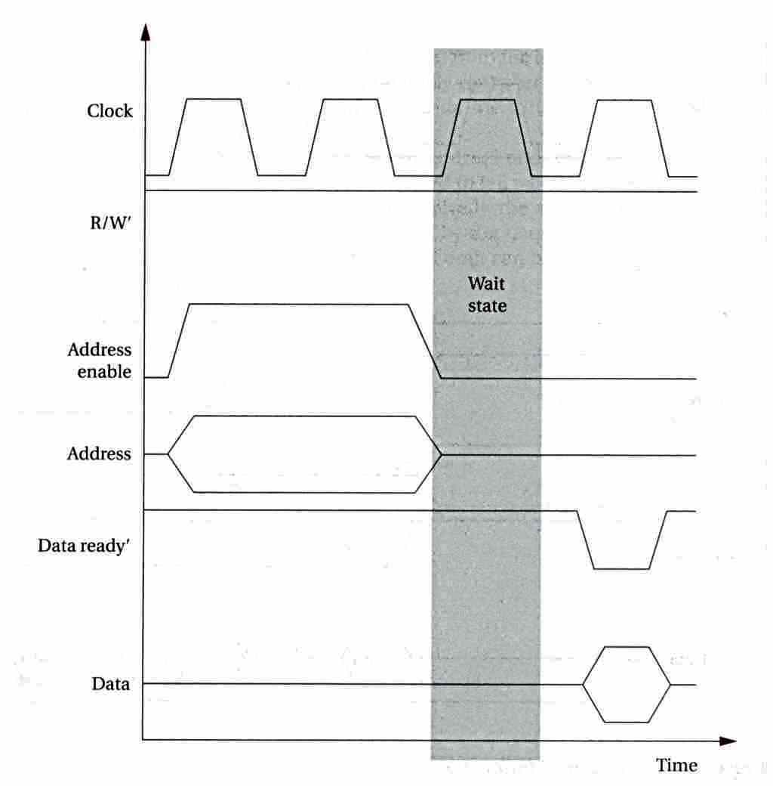
Typical bus timing for read with slow memory
© 2000 Morgan Kaufman
Overheads for Computers as Components

Slide 9
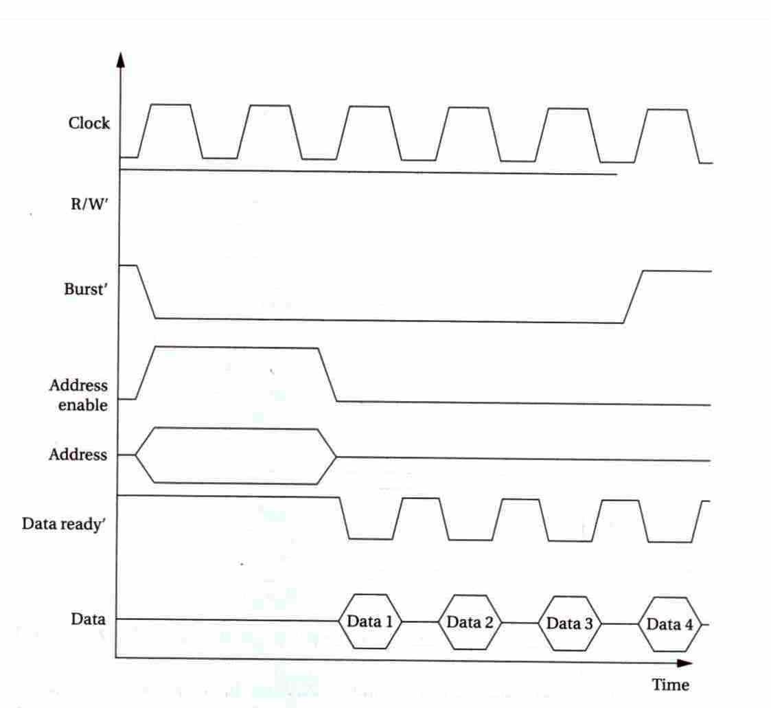
Typical bus timing for read with burst signal
© 2000 Morgan Kaufman
Overheads for Computers as Components

Slide 10
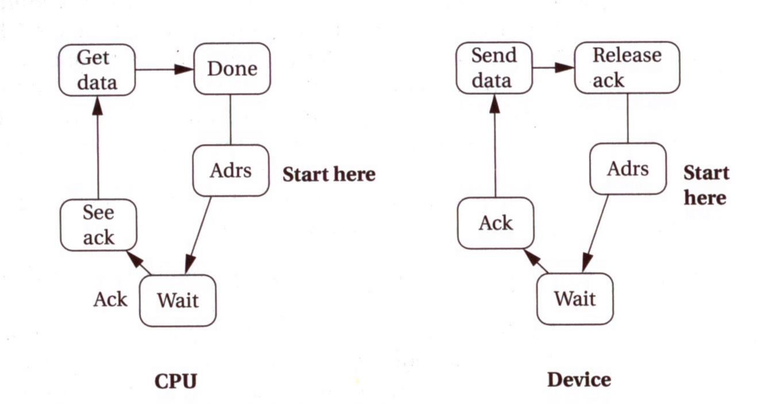
Bus read state diagram
© 2000 Morgan Kaufman
Overheads for Computers as Components

Slide 11
Transaction types
Wait state:
  state in a bus transaction to wait for acknowledgment.
Disconnected transfer:
  bus is free during wait state.
Burst:
  multiple transfers.
© 2000 Morgan Kaufman
Overheads for Computers as Components

Slide 12
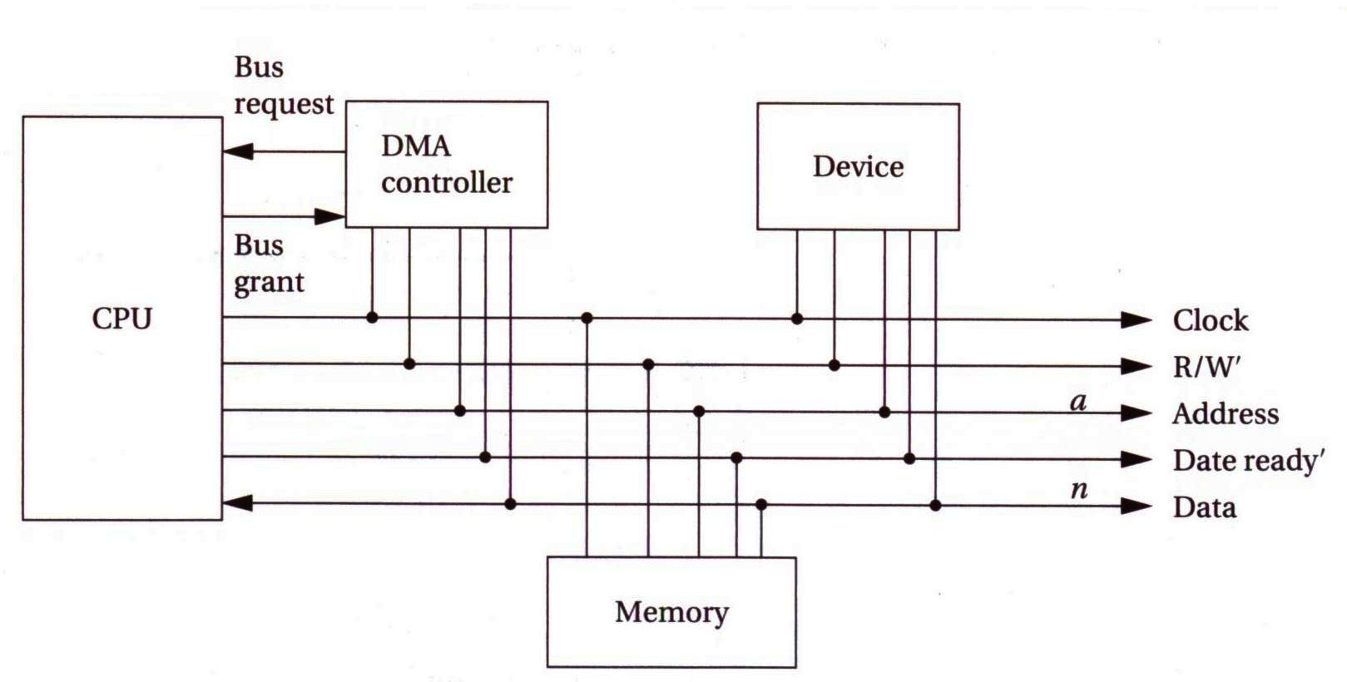
DMA
DMA is a bus operation that allows reads and writes not controlled by the CPU
The CPU controls the DMMA operation through registers in the DMA controller
  Starting address register, length register, and status register
© 2000 Morgan Kaufman
Overheads for Computers as Components

Slide 13
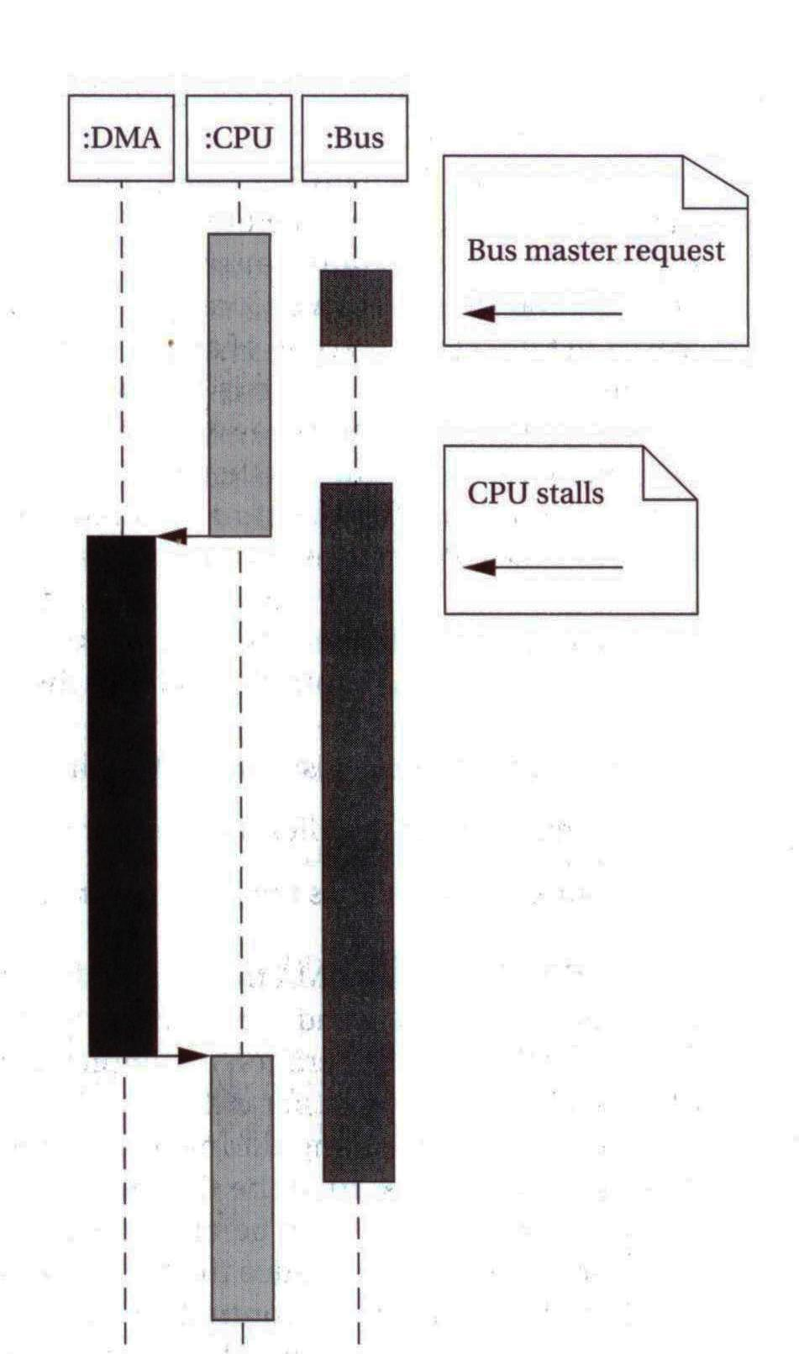
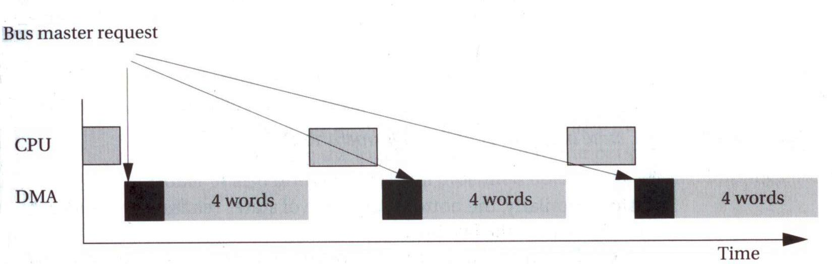
Concurrency during DMA
© 2000 Morgan Kaufman
Overheads for Computers as Components

Slide 14
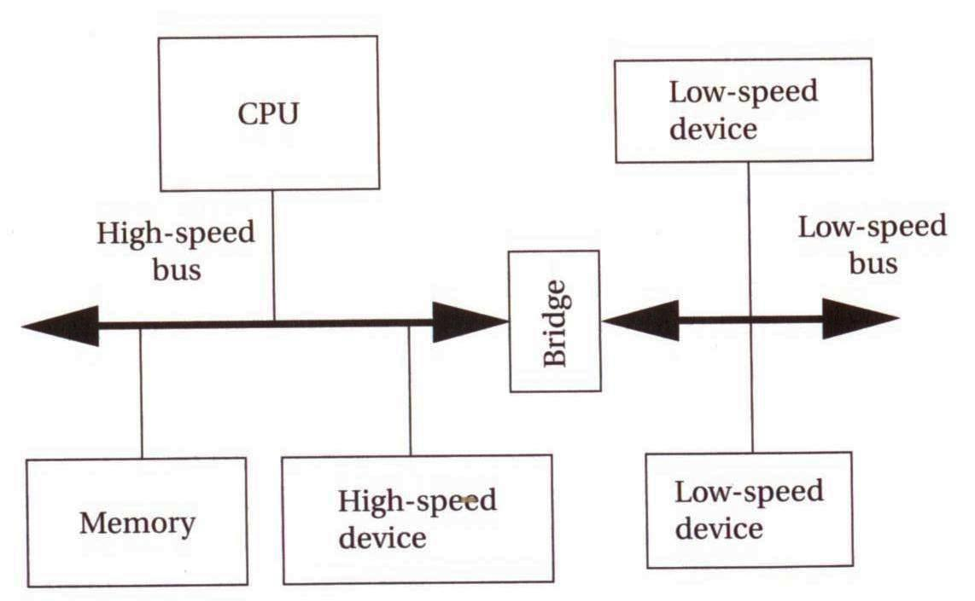
System bus configuration
© 2000 Morgan Kaufman
Overheads for Computers as Components

Slide 15
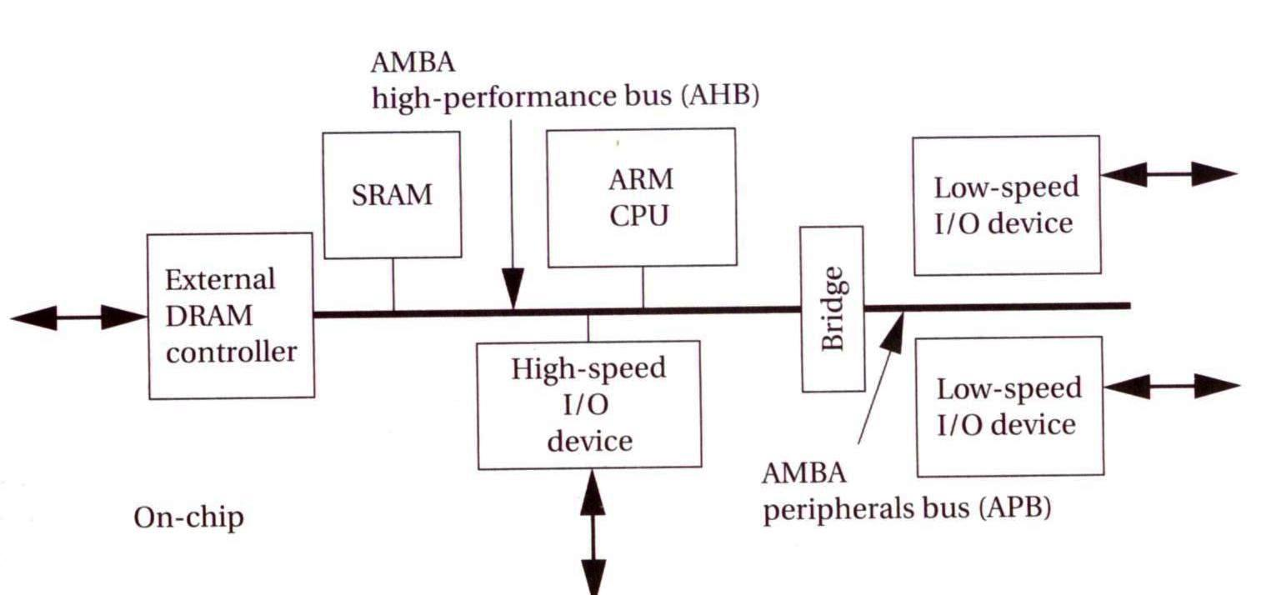
ARM system bus
© 2000 Morgan Kaufman
Overheads for Computers as Components

Slide 16
Memory device organization
A 4-Mbit memory can be organized as
  a 1M×4-bit array, a single memory access obtains a 4-bit data item (20-bit address lines)
  a 4M×1-bit array, a single memory access obtains a 1-bit data item (22-bit address lines)
© 2000 Morgan Kaufman
Overheads for Computers as Components

Slide 17
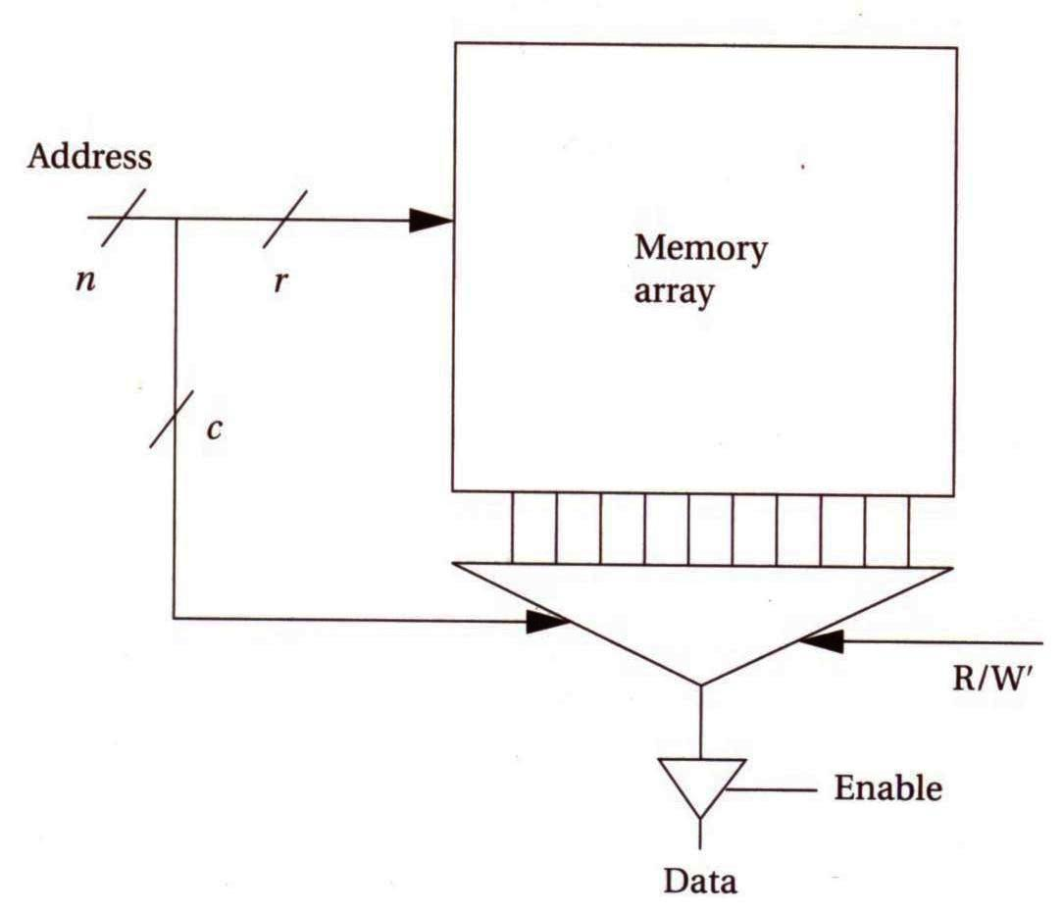
Internal organization of a memory device
© 2000 Morgan Kaufman
Overheads for Computers as Components

Slide 18
Random-access memory
Characteristics differences of static RAM (SRAM) and dynamic RAM (DRAM)
  SRAM is faster than DRAM
  SRAM consumes more power than DRAM
  More DRAM can be put on a single chip
  DRAM values must be periodic refreshed
© 2000 Morgan Kaufman
Overheads for Computers as Components

Slide 19
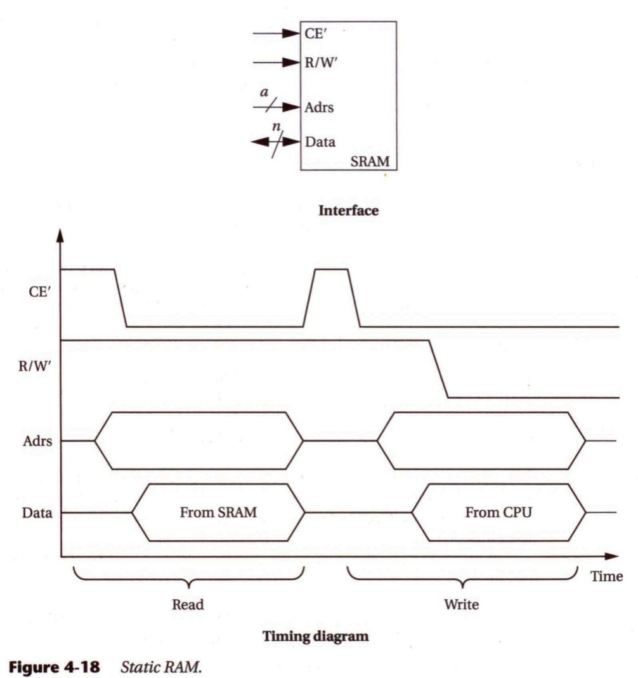
The operation of SRAM
CE’ is the chip enable input
R/W’ control read (=1) or write (=0) operation
Adrs specifies the address for the read or write
Data is a bidirectional bundle of singals for data transfer
© 2000 Morgan Kaufman
Overheads for Computers as Components

Slide 20
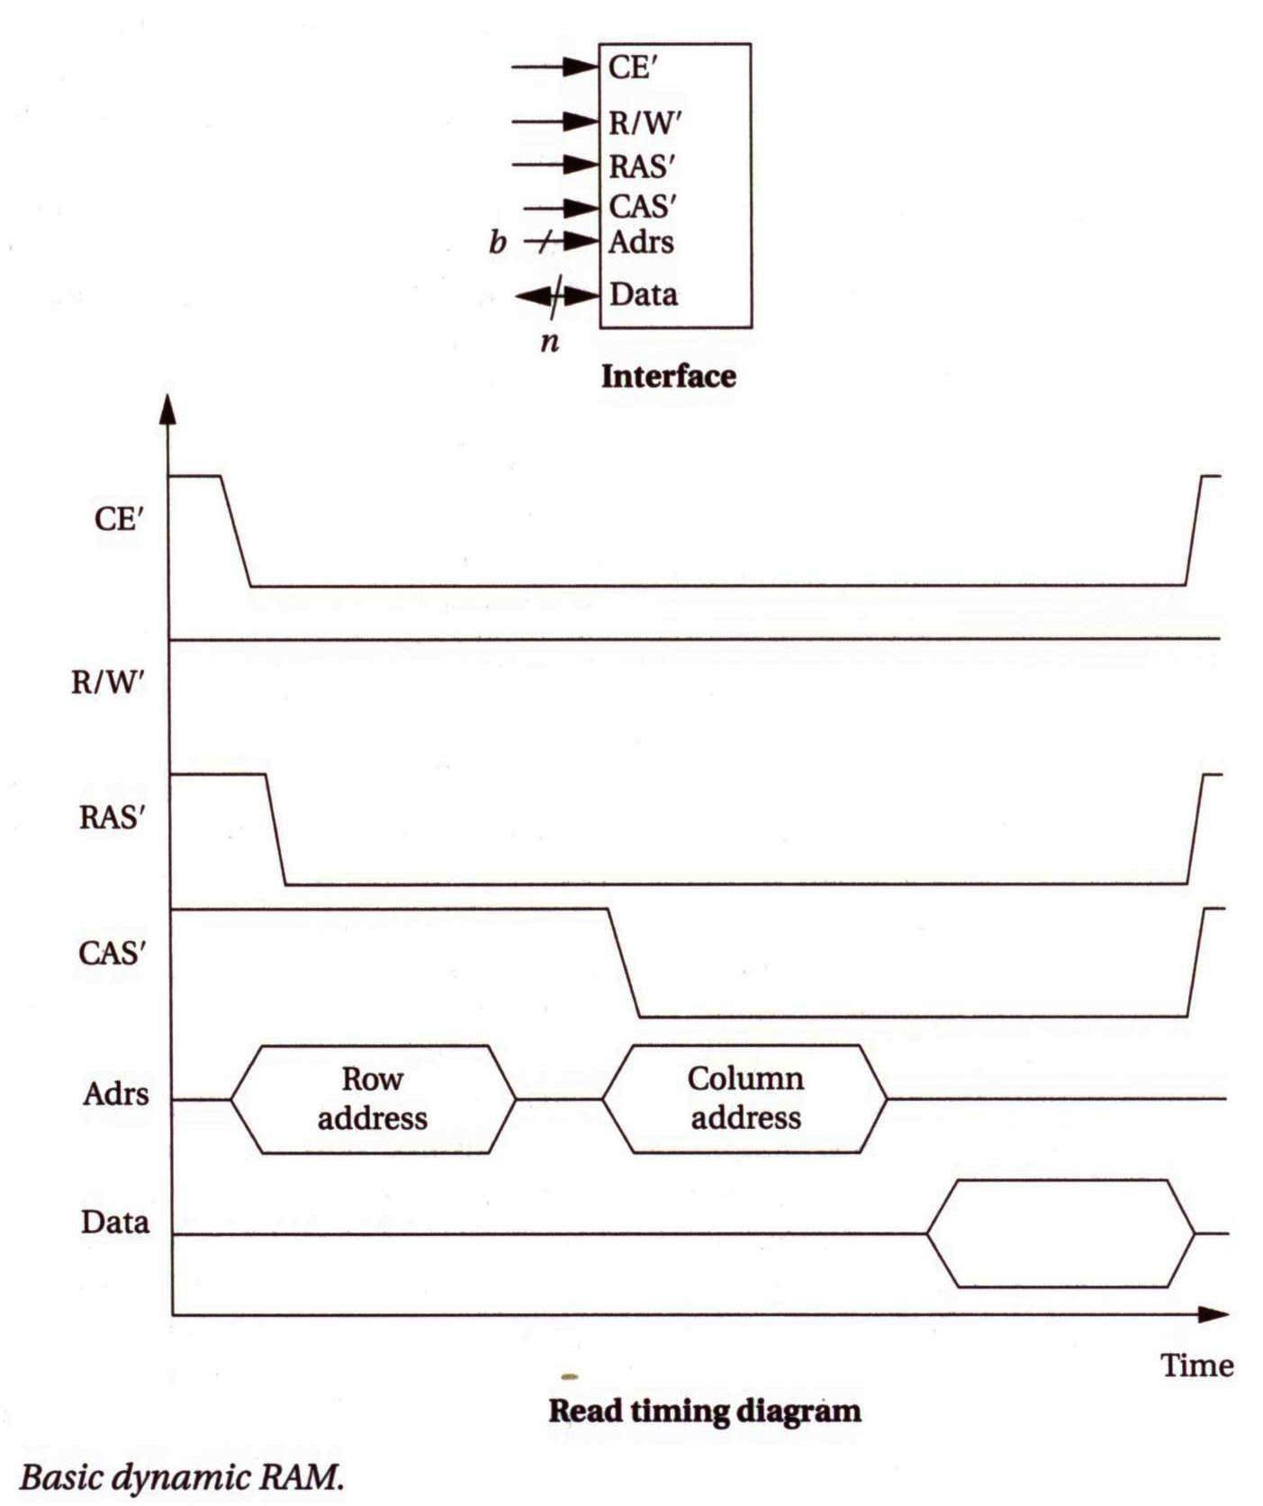
The operation of DRAM
CE’ is the chip enable input
R/W’ control read (=1) or write (=0) operation
RAS’ specifies the row address
CAS’ specifies the column address
Adrs specifies the address for the read or write
Data is a bidirectional bundle of singals for data transfer
© 2000 Morgan Kaufman
Overheads for Computers as Components

Slide 21
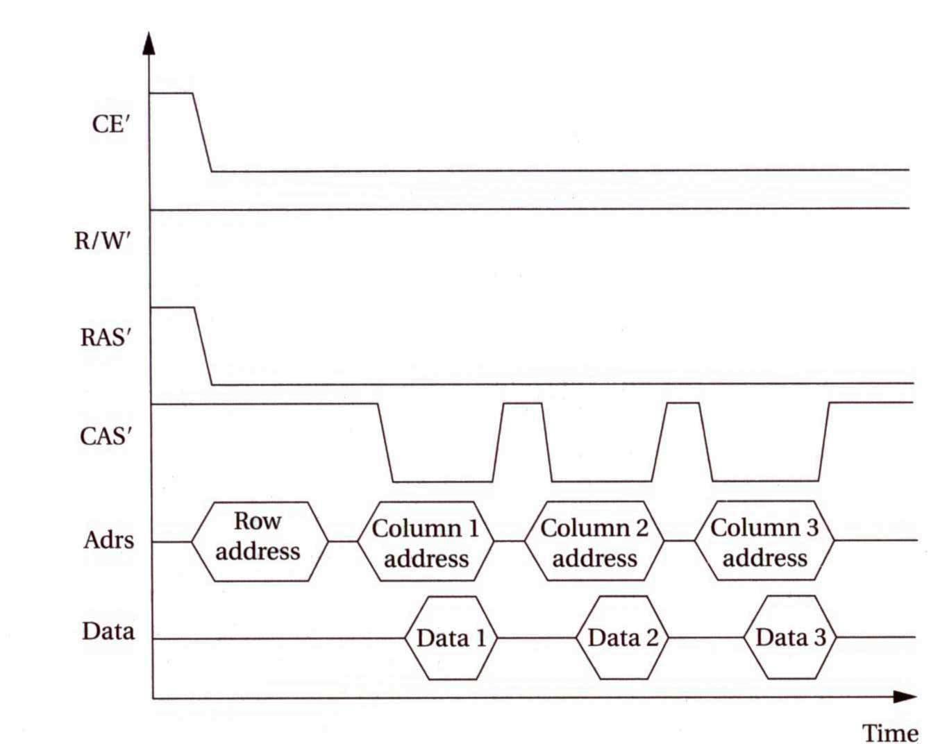
The operation of DRAM with page mode
© 2000 Morgan Kaufman
Overheads for Computers as Components

Slide 22
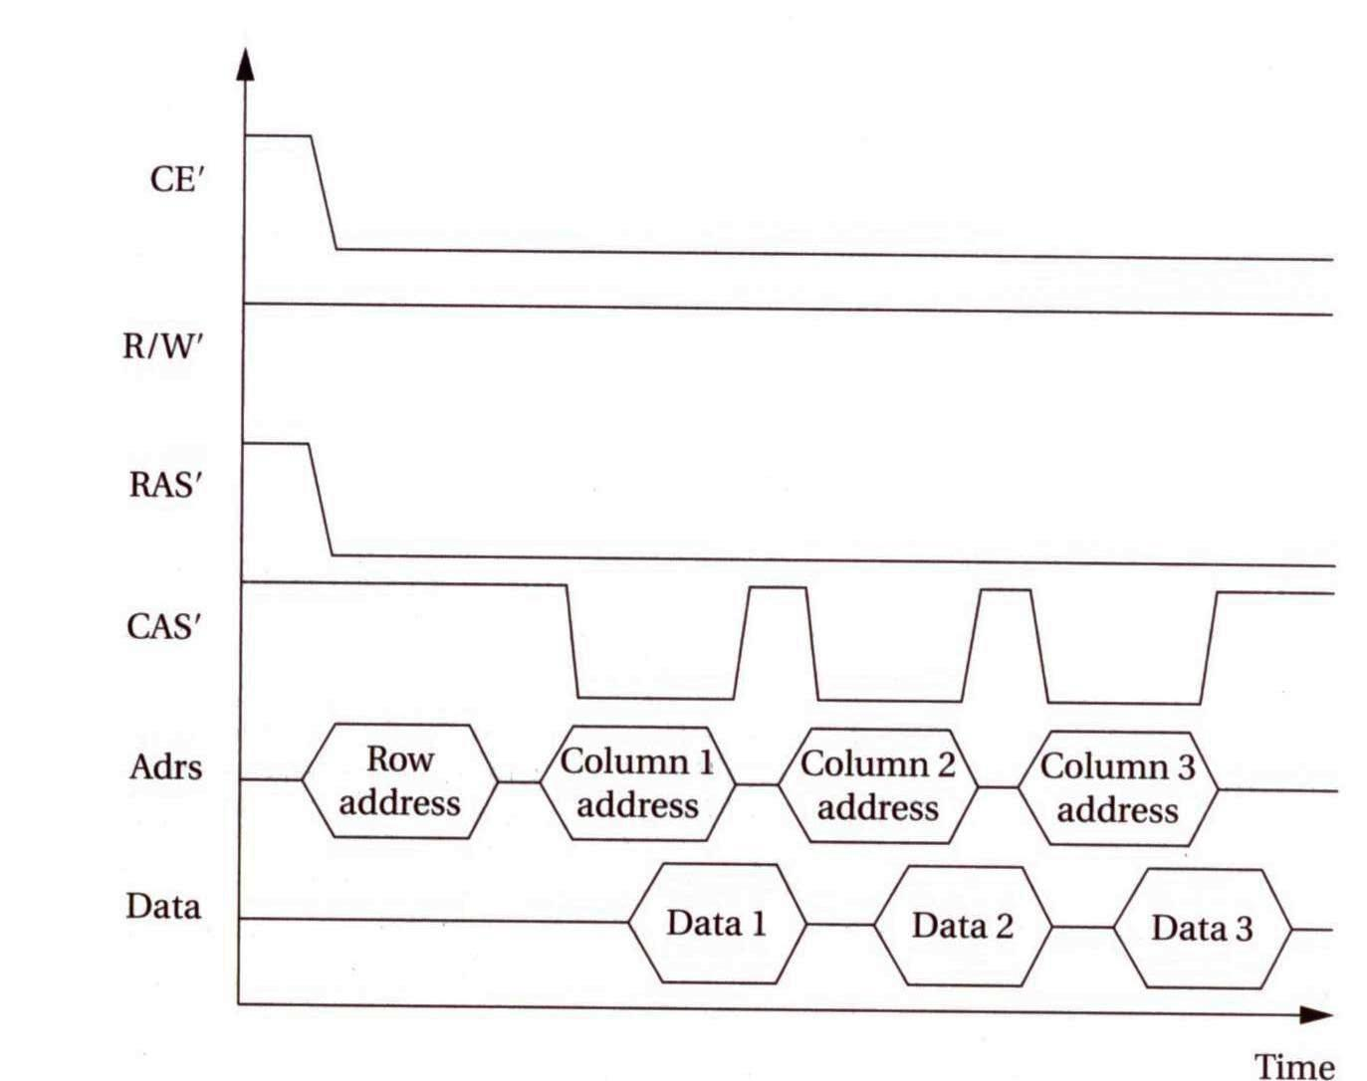
The operation of EDO DRAM
© 2000 Morgan Kaufman
Overheads for Computers as Components

Slide 23
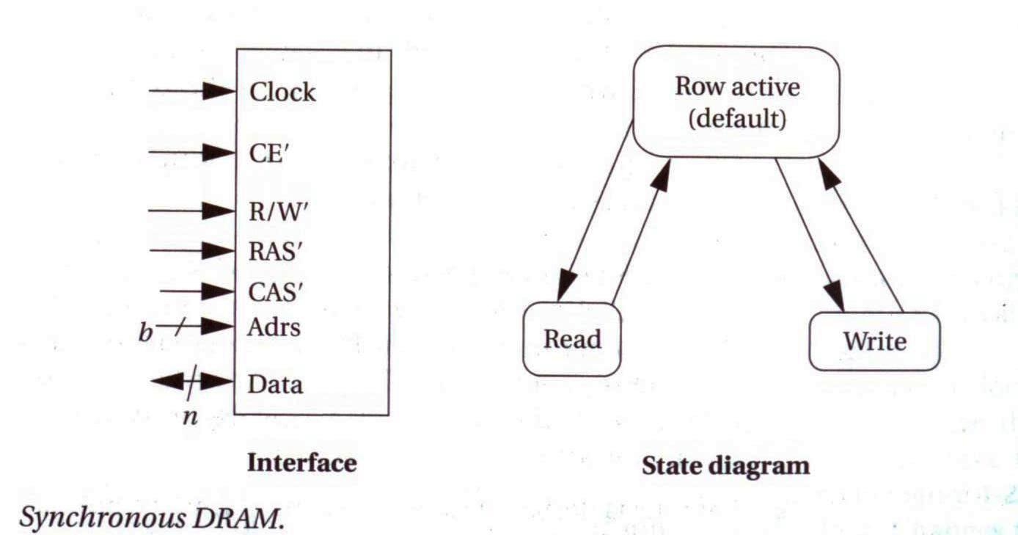
Synchronous DRAM
© 2000 Morgan Kaufman
Overheads for Computers as Components

Slide 24
Timers and counters
Very similar:
  a timer is incremented by a periodic signal;
  a counter is incremented by an asynchronous, occasional signal.
© 2000 Morgan Kaufman
Overheads for Computers as Components

Slide 25
Watchdog timer
Watchdog timer is periodically reset by system timer.
If watchdog is not reset, it generates an interrupt to reset the host.
host CPU
interrupt
watchdog
timer
reset
© 2000 Morgan Kaufman
Overheads for Computers as Components

Slide 26
Keyboard
An array of switches
A switch must be debounced to multiple contacts caused by eliminate mechanical bouncing
© 2000 Morgan Kaufman
Overheads for Computers as Components

Slide 27
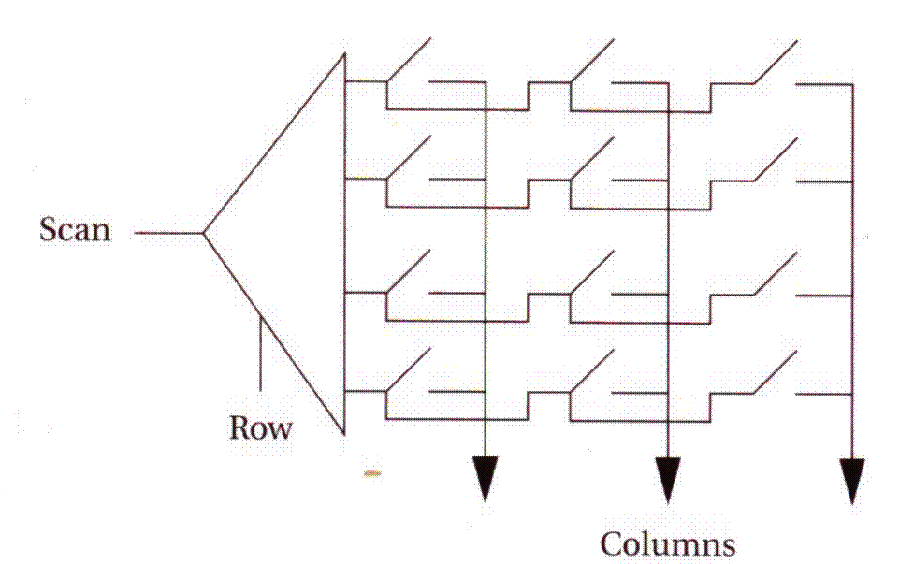
Encoded keyboard
An array of switches is read by an encoder.
N-key rollover remembers multiple key depressions.
© 2000 Morgan Kaufman
Overheads for Computers as Components

Slide 28
LED (Light-emitting diodes)
Must use resistor to limit current:
Digital logic
Current-limiting resistor
LED
© 2000 Morgan Kaufman
Overheads for Computers as Components

Slide 29
7-segment LCD display
May use parallel or multiplexed input.
© 2000 Morgan Kaufman
Overheads for Computers as Components

Slide 30
Types of high-resolution display
Cathode ray tube (CRT)
Liquid crystal display (LCD)
Plasma, etc.
© 2000 Morgan Kaufman
Overheads for Computers as Components

Slide 31
Touchscreen
Includes input and output device.
Input device is a two-dimensional voltmeter:
© 2000 Morgan Kaufman
Overheads for Computers as Components

Slide 32
Touchscreen position sensing
ADC
Conductive sheet
Space ball
voltage
© 2000 Morgan Kaufman
Overheads for Computers as Components

Slide 33
Designing with microprocessors
Architectures and components:
  software;
  hardware.
Debugging.
Manufacturing testing.
© 2000 Morgan Kaufman
Overheads for Computers as Components

Slide 34
Hardware platform architecture
Contains several elements:
CPU;
bus;
memory;
I/O devices: networking, sensors, actuators, etc.
How big/fast/much each one will be?
© 2000 Morgan Kaufman
Overheads for Computers as Components

Slide 35
Software architecture
Functional description must be broken into pieces:
division among people;
conceptual organization;
performance;
testability;
maintenance.
© 2000 Morgan Kaufman
Overheads for Computers as Components

Slide 36
Hardware and software architectures
Hardware and software are intimately related:
software doesn’t run without hardware;
how much hardware you need is determined by the software requirements:
  speed;
  memory.
© 2000 Morgan Kaufman
Overheads for Computers as Components

Slide 37
Software components
Need to break the design up into pieces to be able to write the code.
Some component designs come up often.
A design pattern is a generic description of a component that can be customized and used in different circumstances.
© 2000 Morgan Kaufman
Overheads for Computers as Components

Slide 38
Software state machine
State machine keeps internal state as a variable, changes state based on inputs.
Uses:
  control-dominated code;
  reactive systems.
© 2000 Morgan Kaufman
Overheads for Computers as Components

Slide 39
Software design techniques
Want to develop as much code as possible on a standard platform:
  friendlier programming environment;
  easier debugging.
May need to devise software stubs to allow testing of software elements without the full hardware/software platform.
© 2000 Morgan Kaufman
Overheads for Computers as Components

Slide 40
Host/target design
Use a host system to prepare software for target system:
target
system
serial line
host system
© 2000 Morgan Kaufman
Overheads for Computers as Components

Slide 41
Host-based tools
Cross compiler:
  compiles code on host for target system.
Cross debugger:
  displays target state, allows target system to be controlled.
© 2000 Morgan Kaufman
Overheads for Computers as Components

Slide 42
Evaluation boards
Designed by CPU manufacturer or others.
Includes CPU, memory, some I/O devices.
May include prototyping section.
CPU manufacturer often gives out evaluation board netlist---can be used as starting point for your custom board design.
© 2000 Morgan Kaufman
Overheads for Computers as Components

Slide 43
Adding logic to a board
Programmable logic devices (PLDs) provide low/medium density logic.
Field-programmable gate arrays (FPGAs) provide more logic and multi-level logic.
Application-specific integrated circuits (ASICs) are manufactured for a single purpose.
© 2000 Morgan Kaufman
Overheads for Computers as Components

Slide 44
The PC as a platform
Advantages:
  cheap and easy to get;
  rich and familiar software environment.
Disadvantages:
  requires a lot of hardware resources;
  not well-adapted to real-time.
© 2000 Morgan Kaufman
Overheads for Computers as Components

Slide 45
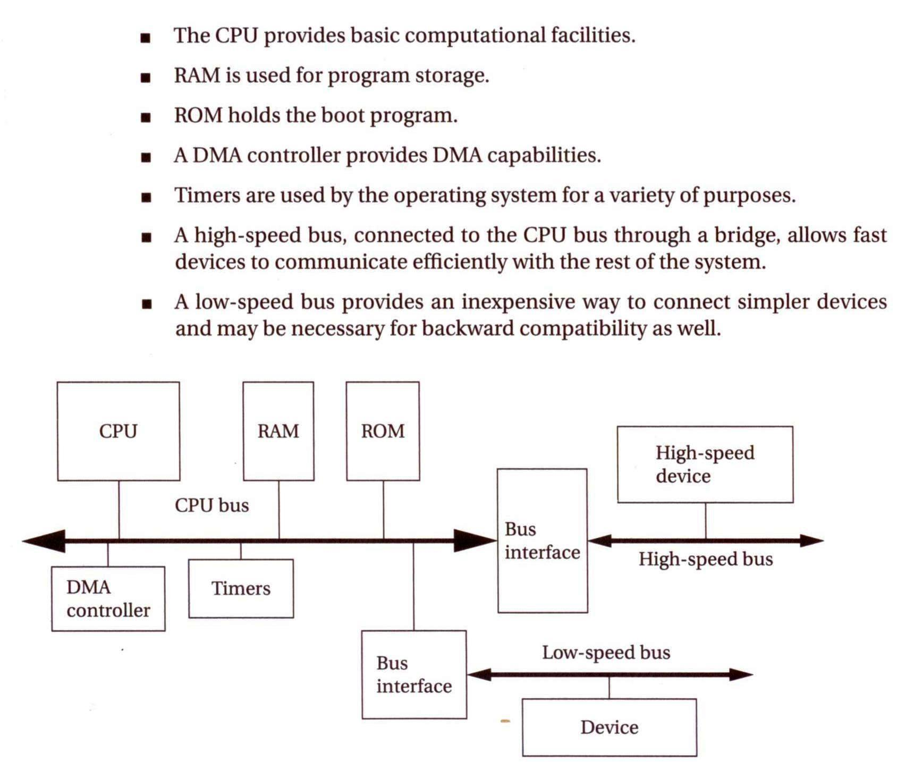
Typical PC hardware platform
© 2000 Morgan Kaufman
Overheads for Computers as Components

Slide 46
Typical busses
ISA (Industry Standard Architecture): original IBM PC bus, low-speed by today’s standard.
PCI: standard for high-speed interfacing
  33 or 66 MHz.
USB (Universal Serial Bus), Firewire: relatively low-cost serial interface with high speed.
© 2000 Morgan Kaufman
Overheads for Computers as Components

Slide 47
Software elements
IBM PC uses BIOS (Basic I/O System) to implement low-level functions:
  boot-up;
  minimal device drivers.
BIOS has become a generic term for the lowest-level system software.
© 2000 Morgan Kaufman
Overheads for Computers as Components

Slide 48
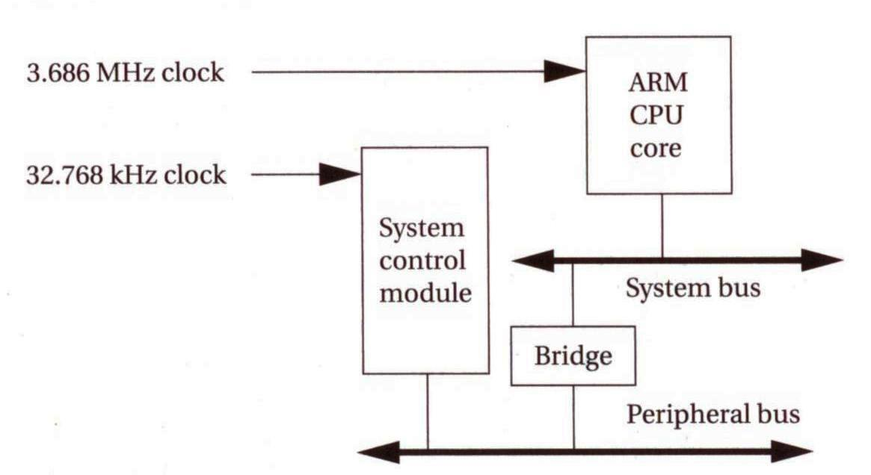
Example: StrongARM
StrongARM system includes:
  CPU chip (3.686 MHz clock)
  system control module
      a real-time clock;
      an operating system timer
      28 general-purpose I/O;
      an interrupt controller;
      a power manager controller;
      a reset controller.
© 2000 Morgan Kaufman
Overheads for Computers as Components

Slide 49
Debugging embedded systems
Challenges:
  target system may be hard to observe;
  target may be hard to control;
  may be hard to generate realistic inputs;
  setup sequence may be complex.
© 2000 Morgan Kaufman
Overheads for Computers as Components

Slide 50
Software debuggers
A monitor program residing on the target provides basic debugger functions.
Debugger should have a minimal footprint in memory.
User program must be careful not to destroy debugger program, but , should be able to recover from some damage caused by user code.
© 2000 Morgan Kaufman
Overheads for Computers as Components

Slide 51
Breakpoints
A breakpoint allows the user to stop execution, examine system state, and change state.
Replace the breakpointed instruction with a subroutine call to the monitor program.
© 2000 Morgan Kaufman
Overheads for Computers as Components

Slide 52
ARM breakpoints
0x400 MUL r4,r6,r6
0x404 ADD r2,r2,r4
0x408 ADD r0,r0,#1
0x40c B loop
uninstrumented code
0x400 MUL r4,r6,r6
0x404 ADD r2,r2,r4
0x408 ADD r0,r0,#1
0x40c BL bkpoint
code with breakpoint
© 2000 Morgan Kaufman
Overheads for Computers as Components

Slide 53
Breakpoint handler actions
Save registers.
Allow user to examine machine.
Before returning, restore system state.
  Safest way to execute the instruction is to replace it and execute in place.
  Put another breakpoint after the replaced breakpoint to allow restoring the original breakpoint.
© 2000 Morgan Kaufman
Overheads for Computers as Components

Slide 54
In-circuit emulators
A microprocessor in-circuit emulator is a specially-instrumented microprocessor.
Allows you to stop execution, examine CPU state, modify registers.
© 2000 Morgan Kaufman
Overheads for Computers as Components

Slide 55
Logic analyzers
A logic analyzer is an array of low-grade oscilloscopes:
© 2000 Morgan Kaufman
Overheads for Computers as Components

Slide 56
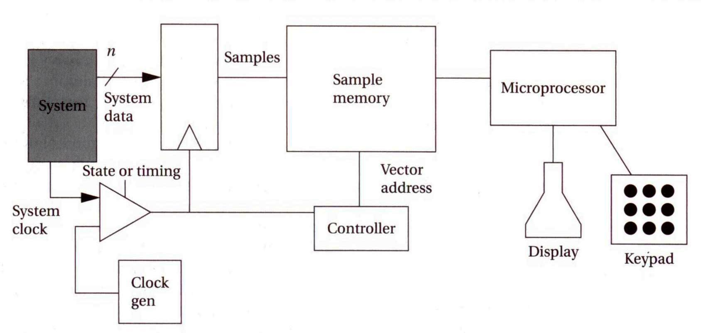
Logic analyzer architecture
© 2000 Morgan Kaufman
Overheads for Computers as Components

Slide 57
How to exercise code
Run on host system.
Run on target system.
Run in instruction-level simulator.
Run on cycle-accurate simulator.
Run in hardware/software co-simulation environment.
© 2000 Morgan Kaufman
Overheads for Computers as Components

Slide 58
Manufacturing testing
Goal: ensure that manufacturing produces defect-free copies of the design.
Can test by comparing unit being tested to the expected behavior.
  But running tests is expensive.
Maximize confidence while minimizing testing cost.
© 2000 Morgan Kaufman
Overheads for Computers as Components

Slide 59
Testing concepts
Yield: proportion of manufactured systems that work.
  Proper manufacturing maximizes yield.
  Proper testing accurately estimates yield.
Field return: defective unit that leaves the factory.
© 2000 Morgan Kaufman
Overheads for Computers as Components

Slide 60
Faults
Manufacturing problems can be caused by many thing.
Fault model: model that predicts effects of a particular type of fault.
Fault coverage: proportion of possible faults found by a set of test.
  Having a fault model allows us to determine fault coverage.
© 2000 Morgan Kaufman
Overheads for Computers as Components

Slide 61
Software vs. hardware testing
When testing code, we have no fault model.
  We verify the implementation, not the manufacturing.
  Simple tests (e.g., ECC) work well to verify software manufacturing.
Hardware requires manufacturing tests in addition to implementation verification.
© 2000 Morgan Kaufman
Overheads for Computers as Components

Slide 62
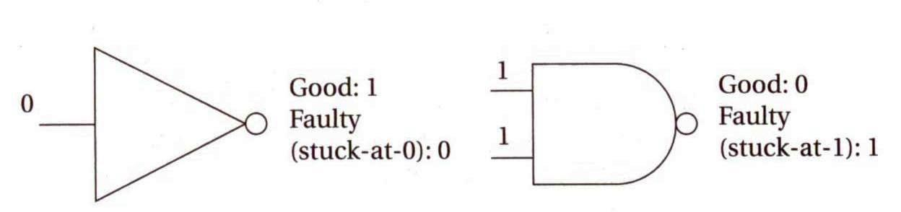
Hardware fault models
Stuck-at 0/1 fault model:
  output of gate is always 0/1.
© 2000 Morgan Kaufman
Overheads for Computers as Components

Slide 63
Combinational testing
Every gate can be stuck-at-0, stuck-at-1.
Usually test for single stuck-at-faults.
  One fault at a time.
  Multiple faults can mask each other.
We can generate a test for a gate by:
  controlling the gate’s input;
  observing the gate’s output through other gates.
© 2000 Morgan Kaufman
Overheads for Computers as Components

Slide 64
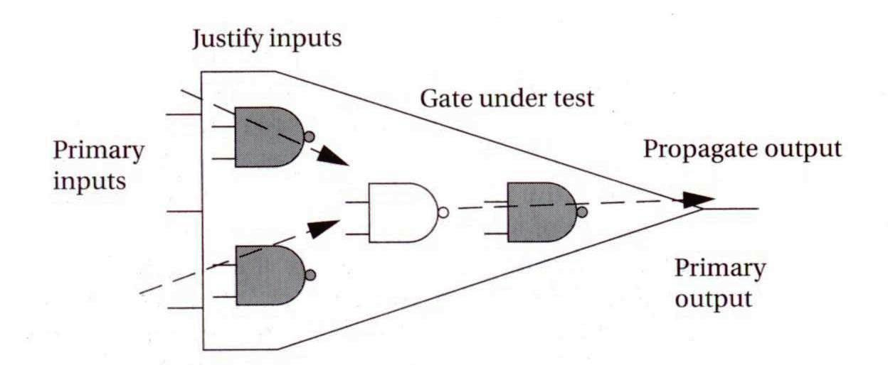
Combinational testing cont’d
© 2000 Morgan Kaufman
Overheads for Computers as Components

Slide 65
Sequential testing
A state machine is combinational logic + registers.
Sequential testing is considerably harder.
  A single stuck-at fault affects the machine on every cycle.
  Fault behavior on one cycle can be masked by same fault on other cycles.
© 2000 Morgan Kaufman
Overheads for Computers as Components

Slide 66
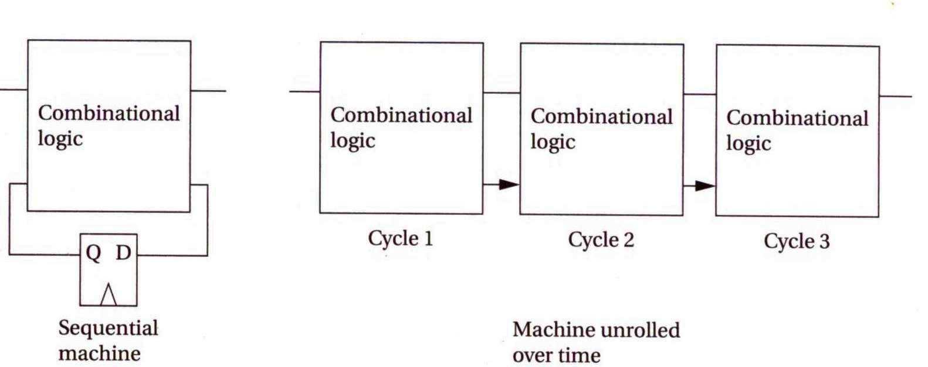
Unrolling a sequential machine in time
© 2000 Morgan Kaufman
Overheads for Computers as Components

Slide 67
Scan chains
A special type of register operates in two modes:
  normal
  scan---forms an element in a shift register.
Using scan chains reduces sequential testing to combinational testing.
  Uploading/unloading scan chain is slow.
  May use partial scan.
© 2000 Morgan Kaufman
Overheads for Computers as Components

Slide 68
Test generation
Automatic test pattern generation (ATPG) programs: produce a set of tests given the logic structure.
Some faults may not be testable---redundant.
  Timeout on a fault may mean hard-to-test or untestable.
© 2000 Morgan Kaufman
Overheads for Computers as Components

Slide 69
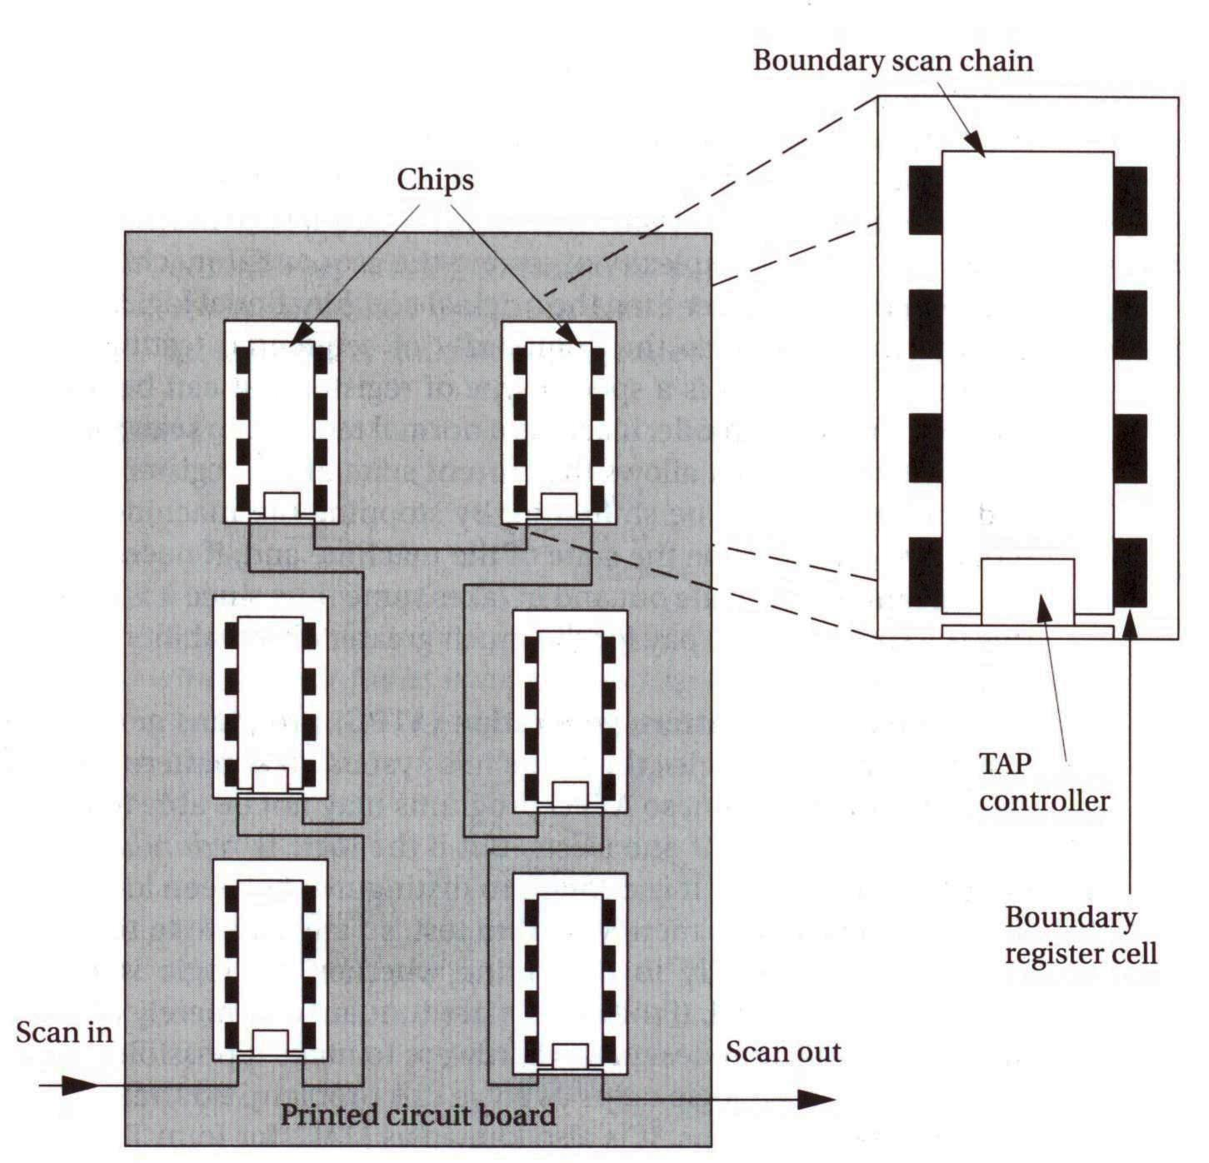
Boundary scan (JTAG)
Simplifies testing of multiple chips on a board
  Registers on pins can be configured as a scan chain
© 2000 Morgan Kaufman
Overheads for Computers as Components

Slide 70
The embedded systems platform
Example: alarm clock
© 2000 Morgan Kaufman
Overheads for Computers as Components

Slide 71
Alarm clock interface
Alarm on
Alarm off
buzzer
PM
Alarm
ready
light
set
time
set
alarm
hour
minute
button
© 2000 Morgan Kaufman
Overheads for Computers as Components

Slide 72
Operations
Set time: hold set time, depress hour, minute.
Set alarm time: hold set alarm, depress hour, minute.
Turn alarm on/off: depress alarm on/off.
© 2000 Morgan Kaufman
Overheads for Computers as Components

Slide 73
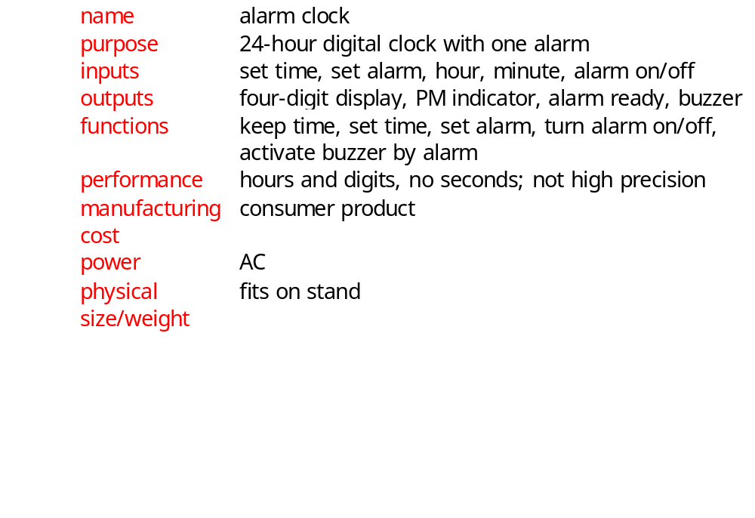
Alarm clock requirements
© 2000 Morgan Kaufman
Overheads for Computers as Components

Slide 74
Alarm clock class diagram
1
1
1
1
Lights*
Display
Mechanism
1
1
1
Buttons*
Speaker*
1
© 2000 Morgan Kaufman
Overheads for Computers as Components

Slide 75
Alarm clock physical classes
Lights*
Buttons*
Speaker*
digit-val()
digit-scan()
alarm-on-light()
PM-light()
set-time(): boolean
set-alarm(): boolean
alarm-on(): boolean
alarm-off(): boolean
minute(): boolean
hour(): boolean
buzz()
© 2000 Morgan Kaufman
Overheads for Computers as Components

Slide 76
Display class
Display
time[4]: integer
alarm-indicator: boolean
PM-indicator: boolean
set-time()
alarm-light-on()
alarm-light-off()
PM-light-on()
PM-light-off()
© 2000 Morgan Kaufman
Overheads for Computers as Components

Slide 77
Mechanism class
Mechanism
Seconds: integer
PM: boolean
tens-hours, ones-hours: boolean
tens-minutes, ones-minutes: boolean
alarm-ready: boolean
alarm-tens-hours, alarm-ones-hours:
boolean
alarm-tens-minutes, alarm-ones-minutes:
boolean
scan-keyboard()
update-time()
© 2000 Morgan Kaufman
Overheads for Computers as Components

Slide 78
Update-time behavior
update seconds
with rollover
display.set-time(current time)
F
Rollover?
Time >= alarm and alarm-on?
F
T
update hh:mm
with rollover
T
alarm.buzzer(true)
PM->AM
AM->PM
PM=true
PM=false
© 2000 Morgan Kaufman
Overheads for Computers as Components

Slide 79
Scan-keyboard behavior
Set-time and
not set-alarm
and hours
compute button activations
Alarm-on
Increment time
tens w. rollover
and AM/PM
alarm-ready=
true
Alarm-off
alarm-ready=
false
alarm.buzzer(false)
Increment time
ones w. rollover
and AM/PM
save button
states
Set-time and
not set-alarm
and minutes
© 2000 Morgan Kaufman
Overheads for Computers as Components

Slide 80
System architecture
Includes:
  periodic behavior (clock);
  aperiodic behavior (buttons, buzzer activation).
Two major software components:
  interrupt-driven routine updates time;
  foreground program deals with buttons, commands.
© 2000 Morgan Kaufman
Overheads for Computers as Components

Slide 81
Interrupt-driven routine
Timer probably can’t handle one-minute interrupt interval.
Use software variable to convert interrupt frequency to seconds.
© 2000 Morgan Kaufman
Overheads for Computers as Components

Slide 82
Foreground program
Operates as while loop:
while (TRUE) {
read_buttons(button_values);
process_command(button_values);
check_alarm();
}
© 2000 Morgan Kaufman
Overheads for Computers as Components

Slide 83
Testing
Component testing:
  test interrupt code on the platform;
  can test foreground program using a mock-up.
System testing:
  relatively few components to integrate;
  check clock accuracy;
  check recognition of buttons, buzzer, etc.
© 2000 Morgan Kaufman
Overheads for Computers as Components

