Slide 1
Program design and analysis
Design patterns
Representations of programs
Assembly and linking
© 2000 Morgan Kaufman
Overheads for Computers as Components

Slide 2
Design patterns
Design pattern: generalized description of the design of a certain type of program
Designer fills in details to customize the pattern to a particular programming problem
© 2000 Morgan Kaufman
Overheads for Computers as Components

Slide 3
List design pattern
1
*
List
List-element
create()
add-element()
delete-element()
find-element()
destroy()
© 2000 Morgan Kaufman
Overheads for Computers as Components

Slide 4
Design pattern elements
Class diagram
State diagrams
Sequence diagrams
etc.
© 2000 Morgan Kaufman
Overheads for Computers as Components

Slide 5
State machine
State machine is useful in many contexts:
  parsing user input
  responding to complex stimuli
  controlling sequential outputs
© 2000 Morgan Kaufman
Overheads for Computers as Components

Slide 6
State machine example
no seat/-
no seat/
buzzer off
idle
seat/timer on
no seat/-
no belt
and no
timer/-
buzzer
seated
Belt/buzzer on
belt/-
belt/
buzzer off
belted
no belt/timer on
© 2000 Morgan Kaufman
Overheads for Computers as Components

Slide 7
State machine pattern
State machine
state
output step(input)
© 2000 Morgan Kaufman
Overheads for Computers as Components

Slide 8
C implementation
#define IDLE 0
#define SEATED 1
#define BELTED 2
#define BUZZER 3
switch (state) {
case IDLE: if (seat) { state = SEATED; timer_on = TRUE; }
break;
case SEATED: if (belt) state = BELTED;
else if (timer) state = BUZZER;
break;
…
}
© 2000 Morgan Kaufman
Overheads for Computers as Components

Slide 9
Circular buffer
x1
x2
x3
x4
x5
x6
t₁
t₂
t₃
Data stream
x1
x5
x2
x6
x3
x7
x4
Circular buffer
© 2000 Morgan Kaufman
Overheads for Computers as Components

Slide 10
Circular buffer pattern
Circular buffer
init()
add(data)
data head()
data element(index)
© 2000 Morgan Kaufman
Overheads for Computers as Components

Slide 11
Circular buffer implementation: FIR filter
int circ_buffer[N], circ_buffer_head = 0;
int c[N]; /* coefficients */
…
int ibuf, ic;
for (f=0, ibuff=circ_buff_head, ic=0;
ic<N; ibuff=(ibuff==N-1?0:ibuff++), ic++)
f = f + c[ic]*circ_buffer[ibuf];
© 2000 Morgan Kaufman
Overheads for Computers as Components

Slide 12
Models of programs
Source code is not a good representation for programs:
  clumsy;
  leaves much information implicit.
Compilers derive intermediate representations to manipulate and optimize the program.
© 2000 Morgan Kaufman
Overheads for Computers as Components

Slide 13
Data flow graph
DFG: data flow graph.
Does not represent control.
Models basic block: code with one entry and exit.
Describes the minimal ordering requirements on operations.
© 2000 Morgan Kaufman
Overheads for Computers as Components

Slide 14
Single assignment form
x = a + b;
y = c - d;
z = x * y;
y = b + d;
original basic block
x = a + b;
y = c - d;
z = x * y;
y1 = b + d;
single assignment form
© 2000 Morgan Kaufman
Overheads for Computers as Components

Slide 15
Data flow graph
x = a + b;
y = c - d;
z = x * y;
y1 = b + d;
single assignment form
a
b
c
d
+
-
y
x
*
+
z
y1
DFG
© 2000 Morgan Kaufman
Overheads for Computers as Components

Slide 16
DFGs and partial orders
a
b
c
d
Partial order:
a+b, c-d; b+d, x*y
Can do pairs of operations in any order.
+
+
-
x
y
*
z
y1
© 2000 Morgan Kaufman
Overheads for Computers as Components

Slide 17
Control-data flow graph
CDFG: represents control and data.
Uses data flow graphs as components.
Two types of nodes:
  decision;
  data flow.
© 2000 Morgan Kaufman
Overheads for Computers as Components

Slide 18
Data flow node
Encapsulates a data flow graph:
Write operations in basic block form for simplicity.
x = a + b;
y = c + d
© 2000 Morgan Kaufman
Overheads for Computers as Components

Slide 19
Decision node (control)
cond
T
v1
v4
value
v2
v3
F
Equivalent forms
© 2000 Morgan Kaufman
Overheads for Computers as Components

Slide 20
CDFG example
T
if (cond1) bb1();
else bb2();
bb3();
switch (test1) {
case c1: bb4(); break;
case c2: bb5(); break;
case c3: bb6(); break;
}
cond1
bb1()
F
bb2()
bb3()
test1
c3
c1
c2
bb4()
bb5()
bb6()
© 2000 Morgan Kaufman
Overheads for Computers as Components

Slide 21
for loop
for (i=0; i<N; i++)
loop_body();
for loop
i=0;
while (i<N) {
loop_body(); i++; }
equivalent
i=0
i<N
F
T
loop_body()
© 2000 Morgan Kaufman
Overheads for Computers as Components

Slide 22
Assembly and linking
Last steps in compilation:
HLL
compile
assembly
HLL
assembly
assemble
HLL
assembly
load
executable
link
© 2000 Morgan Kaufman
Overheads for Computers as Components

Slide 23
Multiple-module programs
Programs may be composed from several files.
Addresses become more specific during processing:
  relative addresses are measured relative to the start of a module;
  absolute addresses are measured relative to the start of the CPU address space.
© 2000 Morgan Kaufman
Overheads for Computers as Components

Slide 24
Assemblers
Major tasks:
  generate binary for symbolic instructions;
  translate labels into addresses;
  handle pseudo-ops (data, etc.).
Generally one-to-one translation.
Assembly labels:
  ORG 100
  label1 ADR r4,c
© 2000 Morgan Kaufman
Overheads for Computers as Components

Slide 25
Symbol table
ADD r0,r1,r2
xx ADD r3,r4,r5
CMP r0,r3
yy SUB r5,r6,r7
assembly code
xx 0x8
yy 0x10
symbol table
© 2000 Morgan Kaufman
Overheads for Computers as Components

Slide 26
Symbol table generation
Use program location counter (PLC) to determine address of each location.
Scan program, keeping count of PLC.
Addresses are generated at assembly time, not execution time.
© 2000 Morgan Kaufman
Overheads for Computers as Components

Slide 27
Symbol table example
PLC=0x7
ADD r0,r1,r2
xx ADD r3,r4,r5
CMP r0,r3
yy SUB r5,r6,r7
xx 0x8
PLC=0x8
yy 0xa
PLC=0x9
PLC=0xa
© 2000 Morgan Kaufman
Overheads for Computers as Components

Slide 28
Two-pass assembly
Pass 1:
  generate symbol table
Pass 2:
  generate binary instructions
© 2000 Morgan Kaufman
Overheads for Computers as Components

Slide 29
Relative address generation
Some label values may not be known at assembly time.
Labels within the module may be kept in relative form.
Must keep track of external labels---can’t generate full binary for instructions that use external labels.
© 2000 Morgan Kaufman
Overheads for Computers as Components

Slide 30
Pseudo-operations
Pseudo-ops do not generate instructions:
  ORG sets program location.
  EQU generates symbol table entry without advancing PLC.
  Data statements define data blocks.
© 2000 Morgan Kaufman
Overheads for Computers as Components

Slide 31
Linking
Combines several object modules into a single executable module.
Jobs:
  put modules in order;
  resolve labels across modules.
© 2000 Morgan Kaufman
Overheads for Computers as Components

Slide 32
Externals and entry points
entry point
xxx ADD r1,r2,r3
B a
yyy %1
a ADR r4,yyy
ADD r3,r4,r5
external reference
© 2000 Morgan Kaufman
Overheads for Computers as Components

Slide 33
Module ordering
Code modules must be placed in absolute positions in the memory space.
Load map or linker flags control the order of modules.
module1
module2
module3
© 2000 Morgan Kaufman
Overheads for Computers as Components

Slide 34
Dynamic linking
Some operating systems link modules dynamically at run time:
  shares one copy of library among all executing programs;
  allows programs to be updated with new versions of libraries.
© 2000 Morgan Kaufman
Overheads for Computers as Components

Slide 35
Program design and analysis
Compilation flow.
Basic statement translation.
Basic optimizations.
Interpreters and just-in-time compilers.
© 2000 Morgan Kaufman
Overheads for Computers as Components

Slide 36
Compilation
Compilation strategy (Wirth):
  compilation = translation + optimization
Compiler determines quality of code:
  use of CPU resources;
  memory access scheduling;
  code size.
© 2000 Morgan Kaufman
Overheads for Computers as Components

Slide 37
Basic compilation phases
HLL
parsing, symbol table
machine-independent
optimizations
machine-dependent
optimizations
assembly
© 2000 Morgan Kaufman
Overheads for Computers as Components

Slide 38
Statement translation and optimization
Source code is translated into intermediate form such as CDFG.
CDFG is transformed/optimized.
CDFG is translated into instructions with optimization decisions.
Instructions are further optimized.
© 2000 Morgan Kaufman
Overheads for Computers as Components

Slide 39
Arithmetic expressions
a*b + 5*(c-d)
a
b
c
d
*
-
expression
5
*
+
DFG
© 2000 Morgan Kaufman
Overheads for Computers as Components

Slide 40
Arithmetic expressions, cont’d.
a
b
c
d
ADR r4,a
MOV r1,[r4]
ADR r4,b
MOV r2,[r4]
MUL r3,r1,r2
1
2
*
-
5
3
ADR r4,c
MOV r1,[r4]
ADR r4,d
MOV r5,[r4]
SUB r6,r4,r5
*
4
+
MUL r7,r6,#5
ADD r8,r7,r3
DFG
code
© 2000 Morgan Kaufman
Overheads for Computers as Components

Slide 41
Control code generation
if (a+b > 0)
x = 5;
else
x = 7;
a+b>0
x=5
x=7
© 2000 Morgan Kaufman
Overheads for Computers as Components

Slide 42
Control code generation, cont’d.
ADR r5,a
LDR r1,[r5]
ADR r5,b
LDR r2,b
ADD r3,r1,r2
BLE label3
1
2
a+b>0
x=5
3
x=7
LDR r3,#5
ADR r5,x
STR r3,[r5]
B stmtent
label3 LDR r3,#7
ADR r5,x
STR r3,[r5]
stmtent ...
© 2000 Morgan Kaufman
Overheads for Computers as Components

Slide 43
Procedure linkage
Need code to:
  call and return;
  pass parameters and results.
Parameters and returns are passed on stack.
  Procedures with few parameters may use registers.
© 2000 Morgan Kaufman
Overheads for Computers as Components

Slide 44
Procedure stacks
growth
proc1
proc1(int a) {
proc2(5);
}
FP
frame pointer
proc2
5
accessed relative to SP
SP
stack pointer
© 2000 Morgan Kaufman
Overheads for Computers as Components

Slide 45
ARM procedure linkage
APCS (ARM Procedure Call Standard):
  r0-r3 pass parameters into procedure. Extra parameters are put on stack frame.
  r0 holds return value.
  r4-r7 hold register values.
  r11 is frame pointer, r13 is stack pointer.
  r10 holds limiting address on stack size to check for stack overflows.
© 2000 Morgan Kaufman
Overheads for Computers as Components

Slide 46
Data structures
Different types of data structures use different data layouts.
Some offsets into data structure can be computed at compile time, others must be computed at run time.
© 2000 Morgan Kaufman
Overheads for Computers as Components

Slide 47
One-dimensional arrays
C array name points to 0th element:
a
a[0]
a[1]
= *(a + 1)
a[2]
© 2000 Morgan Kaufman
Overheads for Computers as Components

Slide 48
Two-dimensional arrays
Column-major layout:
a[0,0]
a[0,1]
M
...
N
...
a[1,0]
a[1,1]
= a[i*M+j]
© 2000 Morgan Kaufman
Overheads for Computers as Components

Slide 49
Structures
Fields within structures are static offsets:
aptr
field1
struct {
int field1;
char field2;
} mystruct;
struct mystruct a, *aptr = &a;
4 bytes
field2
*(aptr+4)
© 2000 Morgan Kaufman
Overheads for Computers as Components

Slide 50
Expression simplification
Constant folding:
  8+1 = 9
Algebraic:
  a*b + a*c = a*(b+c)
Strength reduction:
  a*2 = a<<1
© 2000 Morgan Kaufman
Overheads for Computers as Components

Slide 51
Dead code elimination
Dead code:
#define DEBUG 0
if (DEBUG) dbg(p1);
Can be eliminated by analysis of control flow, constant folding.
0
0
1
dbg(p1);
© 2000 Morgan Kaufman
Overheads for Computers as Components

Slide 52
Procedure inlining
Eliminates procedure linkage overhead:
int foo(a,b,c) { return a + b - c;}
z = foo(w,x,y);
⇨
z = w + x + y;
© 2000 Morgan Kaufman
Overheads for Computers as Components

Slide 53
Loop transformations
Goals:
  reduce loop overhead;
  increase opportunities for pipelining;
  improve memory system performance.
© 2000 Morgan Kaufman
Overheads for Computers as Components

Slide 54
Loop unrolling
Reduces loop overhead, enables some other optimizations.
for (i=0; i<4; i++)
a[i] = b[i] * c[i];
⇨
for (i=0; i<2; i++) {
a[i*2] = b[i*2] * c[i*2];
a[i*2+1] = b[i*2+1] * c[i*2+1];
}
© 2000 Morgan Kaufman
Overheads for Computers as Components

Slide 55
Loop fusion and distribution
Fusion combines two loops into 1:
for (i=0; i<N; i++) a[i] = b[i] * 5;
for (j=0; j<N; j++) w[j] = c[j] * d[j];
⇨ for (i=0; i<N; i++) {
a[i] = b[i] * 5; w[i] = c[i] * d[i];
}
Distribution breaks one loop into two.
Changes optimizations within loop body.
© 2000 Morgan Kaufman
Overheads for Computers as Components

Slide 56
Loop tiling
Breaks one loop into a nest of loops.
Changes order of accesses within array.
  Changes cache behavior.
© 2000 Morgan Kaufman
Overheads for Computers as Components

Slide 57
Loop tiling example
for (i=0; i<N; i++)
for (j=0; j<N; j++)
c[i] = a[i,j]*b[i];
for (i=0; i<N; i+=2)
for (j=0; j<N; j+=2)
for (ii=0; ii<min(i+2,N); ii++)
for (jj=0; jj<min(j+2,N); jj++)
c[ii] = a[ii,jj]*b[ii];
© 2000 Morgan Kaufman
Overheads for Computers as Components

Slide 58
Array padding
Add array elements to change mapping into cache:
a[0,0]
a[0,1]
a[0,2]
a[0,0]
a[0,1]
a[0,2]
a[0,2]
a[1,0]
a[1,1]
a[1,2]
a[1,0]
a[1,1]
a[1,2]
a[1,2]
before
after
© 2000 Morgan Kaufman
Overheads for Computers as Components

Slide 59
Register allocation
Goals:
  choose register to hold each variable;
  determine lifespan of variable in the register.
Basic case: within basic block.
© 2000 Morgan Kaufman
Overheads for Computers as Components

Slide 60
Register lifetime graph
w = a + b;
x = c + w;
y = c + d;
t=1
a
t=2
b
t=3
c
d
w
x
y
1
2
3
time
© 2000 Morgan Kaufman
Overheads for Computers as Components

Slide 61
Instruction scheduling
Non-pipelined machines do not need instruction scheduling: any order of instructions that satisfies data dependencies runs equally fast.
In pipelined machines, execution time of one instruction depends on the nearby instructions: opcode, operands.
© 2000 Morgan Kaufman
Overheads for Computers as Components

Slide 62
Reservation table
A reservation table relates instructions/time to CPU resources.
Time/instr A B
instr1 X
instr2 X X
instr3 X
instr4 X
© 2000 Morgan Kaufman
Overheads for Computers as Components

Slide 63
Software pipelining
Schedules instructions across loop iterations.
Reduces instruction latency in iteration i by inserting instructions from iteration i-1.
© 2000 Morgan Kaufman
Overheads for Computers as Components

Slide 64
Software pipelining example
ai = a[0]; bi = b[0];
p = ai*bi; ai = a[1]; bi = b[1];
for (i=2; i<N-2;i++) {
ai = a[i]; bi = b[i];
p = ai*bi;
sum += p ;
}
sum += p; p = ai*bi;
sum += p;
for (i=0; i<N;i++)
sum += a[i] * b[i];
© 2000 Morgan Kaufman
Overheads for Computers as Components

Slide 65
Software pipelining timing
ai=a[i]; bi=b[i];
p = ai*bi;
ai=a[i]; bi=b[i];
time
sum += p;
p = ai*bi;
ai=a[i]; bi=b[i];
pipe
sum += p;
p = ai*bi;
sum += p;
iteration i-2
iteration i-1
iteration i
© 2000 Morgan Kaufman
Overheads for Computers as Components

Slide 66
Instruction selection
May be several ways to implement an operation or sequence of operations.
Represent operations as graphs, match possible instruction sequences onto graph.
+
+
*
+
*
MUL
ADD
*
expression
templates
MADD
© 2000 Morgan Kaufman
Overheads for Computers as Components

Slide 67
Using your compiler
Understand various optimization levels (-O1, -O2, etc.)
Look at mixed compiler/assembler output.
Modifying compiler output requires care:
  correctness;
  loss of hand-tweaked code.
© 2000 Morgan Kaufman
Overheads for Computers as Components

Slide 68
Interpreters and JIT compilers
Interpreter: translates and executes program statements on-the-fly.
JIT compiler: compiles small sections of code into instructions during program execution.
  Eliminates some translation overhead.
  Often requires more memory.
© 2000 Morgan Kaufman
Overheads for Computers as Components

Slide 69
Program design and analysis
Optimizing for execution time.
Optimizing for energy/power.
Optimizing for program size.
© 2000 Morgan Kaufman
Overheads for Computers as Components

Slide 70
Motivation
Embedded systems must often meet deadlines.
  Faster may not be fast enough.
Need to be able to analyze execution time.
  Worst-case, not typical.
Need techniques for reliably improving execution time.
© 2000 Morgan Kaufman
Overheads for Computers as Components

Slide 71
Run times will vary
Program execution times depend on several factors:
  Input data values.
  State of the instruction, data caches.
  Pipelining effects.
© 2000 Morgan Kaufman
Overheads for Computers as Components

Slide 72
Measuring program speed
CPU simulator.
  I/O may be hard.
  May not be totally accurate.
Hardware timer.
  Requires board, instrumented program.
Logic analyzer.
  Limited logic analyzer memory depth.
© 2000 Morgan Kaufman
Overheads for Computers as Components

Slide 73
Program performance metrics
Average-case:
  For typical data values, whatever they are.
Worst-case:
  For any possible input set.
Best-case:
  For any possible input set.
Too-fast programs may cause critical races at system level.
© 2000 Morgan Kaufman
Overheads for Computers as Components

Slide 74
What data values?
What values create worst/average/best case behavior?
  analysis;
  experimentation.
Concerns:
  operations;
  program paths.
© 2000 Morgan Kaufman
Overheads for Computers as Components

Slide 75
Performance analysis
Elements of program performance (Shaw):
  execution time = program path + instruction timing
Path depends on data values. Choose which case you are interested in.
Instruction timing depends on pipelining, cache behavior.
© 2000 Morgan Kaufman
Overheads for Computers as Components

Slide 76
Programs and performance analysis
Best results come from analyzing optimized instructions, not high-level language code:
  non-obvious translations of HLL statements into instructions;
  code may move;
  cache effects are hard to predict.
© 2000 Morgan Kaufman
Overheads for Computers as Components

Slide 77
Program paths
Consider for loop:
for (i=0, f=0, i<N; i++)
f = f + c[i]*x[i];
Loop initiation block executed once.
Loop test executed N+1 times.
Loop body and variable update executed N times.
i=0; f=0;
i<N
N
Y
f = f + c[i]*x[i];
i = i+1;
© 2000 Morgan Kaufman
Overheads for Computers as Components

Slide 78
Instruction timing
Not all instructions take the same amount of time.
  Hard to get execution time data for instructions.
Instruction execution times are not independent.
Execution time may depend on operand values.
© 2000 Morgan Kaufman
Overheads for Computers as Components

Slide 79
Trace-driven performance analysis
Trace: a record of the execution path of a program.
Trace gives execution path for performance analysis.
A useful trace:
  requires proper input values;
  is large (gigabytes).
© 2000 Morgan Kaufman
Overheads for Computers as Components

Slide 80
Trace generation
Hardware capture:
  logic analyzer;
  hardware assist in CPU.
Software:
  PC sampling.
  Instrumentation instructions.
  Simulation.
© 2000 Morgan Kaufman
Overheads for Computers as Components

Slide 81
Loop optimizations
Loops are good targets for optimization.
Basic loop optimizations:
  code motion;
  induction-variable elimination;
  strength reduction (x*2 -> x<<1).
© 2000 Morgan Kaufman
Overheads for Computers as Components

Slide 82
Code motion
for (i=0; i<N*M; i++)
z[i] = a[i] + b[i];
i=0; X = N*M
i=0;
i<N*M
N
i<X
Y
z[i] = a[i] + b[i];
i = i+1;
© 2000 Morgan Kaufman
Overheads for Computers as Components

Slide 83
Induction variable elimination
Induction variable: loop index.
Consider loop:
  for (i=0; i<N; i++)
  for (j=0; j<M; j++)
  z[i][j] = b[i][j];
Rather than recompute i*M+j for each array in each iteration, share induction variable between arrays, increment at end of loop body.
© 2000 Morgan Kaufman
Overheads for Computers as Components

Slide 84
Cache analysis
Loop nest: set of loops, one inside other.
Perfect loop nest: no conditionals in nest.
Because loops use large quantities of data, cache conflicts are common.
© 2000 Morgan Kaufman
Overheads for Computers as Components

Slide 85
Array conflicts in cache
a[0][0]
1024
1024
4099
b[0][0]
...
4099
main memory
cache
© 2000 Morgan Kaufman
Overheads for Computers as Components

Slide 86
Array conflicts, cont’d.
Array elements conflict because they are in the same line, even if not mapped to same location.
Solutions:
  move one array;
  pad array.
© 2000 Morgan Kaufman
Overheads for Computers as Components

Slide 87
Performance optimization hints
Use registers efficiently.
Use page mode memory accesses.
Analyze cache behavior:
  instruction conflicts can be handled by rewriting code, rescheudling;
  conflicting scalar data can easily be moved;
  conflicting array data can be moved, padded.
© 2000 Morgan Kaufman
Overheads for Computers as Components

Slide 88
Energy/power optimization
Energy: ability to do work.
  Most important in battery-powered systems.
Power: energy per unit time.
  Important even in wall-plug systems---power becomes heat.
© 2000 Morgan Kaufman
Overheads for Computers as Components

Slide 89
Measuring energy consumption
Execute a small loop, measure current:
I
while (TRUE)
a();
© 2000 Morgan Kaufman
Overheads for Computers as Components

Slide 90
Sources of energy consumption
Relative energy per operation (Catthoor et al):
  memory transfer: 33
  external I/O: 10
  SRAM write: 9
  SRAM read: 4.4
  multiply: 3.6
  add: 1
© 2000 Morgan Kaufman
Overheads for Computers as Components

Slide 91
Cache behavior is important
Energy consumption has a sweet spot as cache size changes:
  cache too small: program thrashes, burning energy on external memory accesses;
  cache too large: cache itself burns too much power.
© 2000 Morgan Kaufman
Overheads for Computers as Components

Slide 92
Optimizing for energy
First-order optimization:
  high performance = low energy.
Not many instructions trade speed for energy.
© 2000 Morgan Kaufman
Overheads for Computers as Components

Slide 93
Optimizing for energy, cont’d.
Use registers efficiently.
Identify and eliminate cache conflicts.
Moderate loop unrolling eliminates some loop overhead instructions.
Eliminate pipeline stalls.
Inlining procedures may help: reduces linkage, but may increase cache thrashing.
© 2000 Morgan Kaufman
Overheads for Computers as Components

Slide 94
Optimizing for program size
Goal:
  reduce hardware cost of memory;
  reduce power consumption of memory units.
Two opportunities:
  data;
  instructions.
© 2000 Morgan Kaufman
Overheads for Computers as Components

Slide 95
Data size minimization
Reuse constants, variables, data buffers in different parts of code.
  Requires careful verification of correctness.
Generate data using instructions.
© 2000 Morgan Kaufman
Overheads for Computers as Components

Slide 96
Reducing code size
Avoid function inlining.
Choose CPU with compact instructions.
Use specialized instructions where possible.
© 2000 Morgan Kaufman
Overheads for Computers as Components

Slide 97
Code compression
Use statistical compression to reduce code size, decompress on-the-fly:
main
memory
table
0101101
0101101
decompressor
cache
LDR r0,[r4]
CPU
© 2000 Morgan Kaufman
Overheads for Computers as Components

Slide 98
Program design and analysis
Program validation and testing.
© 2000 Morgan Kaufman
Overheads for Computers as Components

Slide 99
Goals
Make sure software works as intended.
  We will concentrate on functional testing---performance testing is harder.
What tests are required to adequately test the program?
  What is “adequate”?
© 2000 Morgan Kaufman
Overheads for Computers as Components

Slide 100
Basic testing procedure
Provide the program with inputs.
Execute the program.
Compare the outputs to expected results.
© 2000 Morgan Kaufman
Overheads for Computers as Components

Slide 101
Types of software testing
Black-box: tests are generated without knowledge of program internals.
Clear-box (white-box): tests are generated from the program structure.
© 2000 Morgan Kaufman
Overheads for Computers as Components

Slide 102
Clear-box testing
Generate tests based on the structure of the program.
  Is a given block of code executed when we think it should be executed?
  Does a variable receive the value we think it should get?
© 2000 Morgan Kaufman
Overheads for Computers as Components

Slide 103
Controllability and observability
Controllability: must be able to cause a particular internal condition to occur.
Observability: must be able to see the effects of a state from the outside.
© 2000 Morgan Kaufman
Overheads for Computers as Components

Slide 104
Example: FIR filter
Code:
for (firout = 0.0, j =0; j < N; j++)
firout += buff[j] * c[j];
if (firout > 100.0) firout = 100.0;
if (firout < -100.0) firout = -100.0;
Controllability: to test range checks for firout, must first load circular buffer.
Observability: how do we observe values of buff, firout?
© 2000 Morgan Kaufman
Overheads for Computers as Components

Slide 105
Path-based testing
Clear-box testing generally tests selected program paths:
  control program to exercise a path;
  observe program to determine if path was properly executed.
May look at whether location on path was reached (control), whether variable on path was set (data).
© 2000 Morgan Kaufman
Overheads for Computers as Components

Slide 106
Points of view
Several ways to look at control coverage:
  statement coverage;
  basis sets;
  cyclomatic complexity;
  branch testing;
  domain testing.
© 2000 Morgan Kaufman
Overheads for Computers as Components

Slide 107
Example: choosing paths
Two possible criteria for selecting a set of paths:
  Execute every statement at least once.
  Execute every direction of a branch at least once.
Equivalent for structured programs, but not for programs with gotos.
© 2000 Morgan Kaufman
Overheads for Computers as Components

Slide 108
Path example
+/+ Covers all
branches
Covers all
statements
© 2000 Morgan Kaufman
Overheads for Computers as Components

Slide 109
Basis paths
How many distinct paths are in a program?
An undirected graph has a basis set of edges:
  a linear combination of basis edges (xor together sets of edges) gives any possible subset of edges in the graph.
CDFG is directed, but basis set is an approximation.
© 2000 Morgan Kaufman
Overheads for Computers as Components

Slide 110
Basis set example
a b c d e
a 0 0 1 0 0
b 0 0 1 0 1
c 1 1 0 1 0
d 0 0 1 0 1
e 0 1 0 1 0
a
b
c
incidence matrix
a 0 0 1 0 0
b 0 0 1 0 1
c 1 1 0 1 0
d 0 0 1 0 1
e 0 1 0 1 0
d
e
© 2000 Morgan Kaufman
Overheads for Computers as Components
basis set

Slide 111
Cyclomatic complexity (1)
Provides an upper bound on the control complexity of a program:
  e = # edges in control graph;
  n = # nodes in control graph;
  p = # graph components.
Cyclomatic complexity:
  M = e - n + 2p.
© 2000 Morgan Kaufman
Overheads for Computers as Components

Slide 112
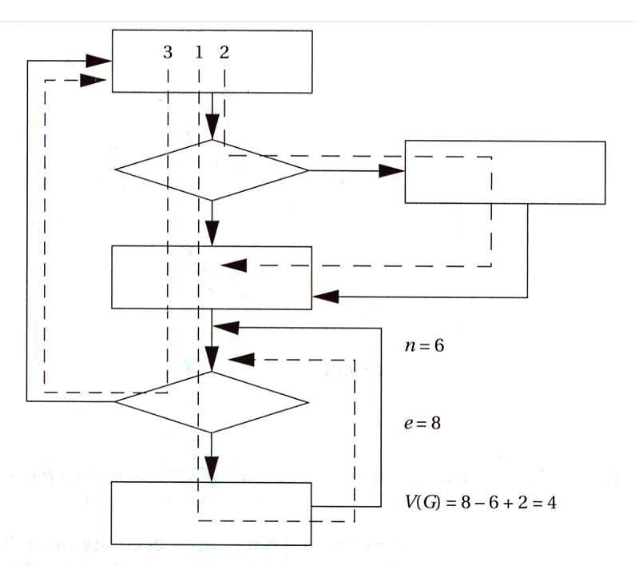
Cyclomatic complexity (2)
© 2000 Morgan Kaufman
Overheads for Computers as Components

Slide 113
Branch testing strategy
Exercise the elements of a conditional, not just one true and one false case.
Devise a test for every simple condition in a Boolean expression.
© 2000 Morgan Kaufman
Overheads for Computers as Components

Slide 114
Example: branch testing
Meant to write:
  if (a || (b >= c)) { printf(“OK\n”); }
Actually wrote:
  if (a && (b >= c)) { printf(“OK\n”); }
Branch testing strategy:
  One test is a=F, (b >= c) = T: a=0, b=3, c=2.
  Produces different answers.
© 2000 Morgan Kaufman
Overheads for Computers as Components

Slide 115
Another branch testing example
Meant to write:
  if ((x == good_pointer) && (x->field1 == 3))...
Actually wrote:
  if ((x = good_pointer) && (x->field1 == 3))...
Branch testing strategy:
  If we use only field1 value to exercise branch, we may miss pointer problem.
© 2000 Morgan Kaufman
Overheads for Computers as Components

Slide 116
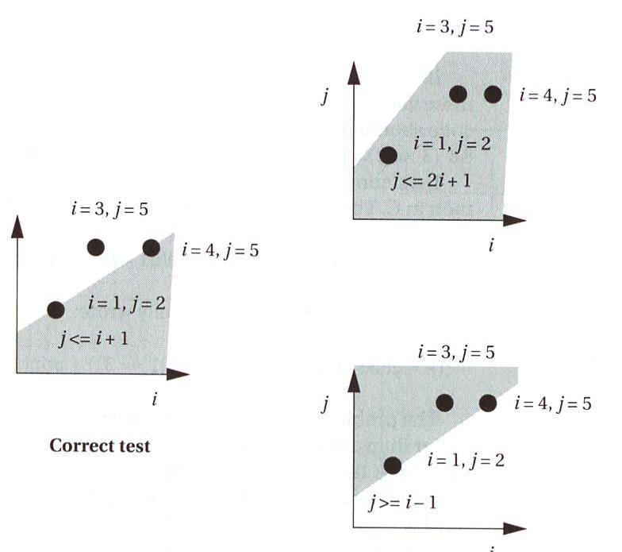
Domain testing
Concentrates on linear inequalities.
Example: j <= i + 1.
Test two cases on boundary, one outside boundary.
incorrect
© 2000 Morgan Kaufman
Overheads for Computers as Components

Slide 117
Data flow testing
Def-use analysis: match variable definitions (assignments) and uses.
Example:
x = 5;
…
if (x > 0) ...
Does assignment get to the use?
def
p-use
© 2000 Morgan Kaufman
Overheads for Computers as Components

Slide 118
Loop testing
Common, specialized structure---specialized tests can help.
Useful test cases:
  skip loop entirely;
  one iteration;
  two iterations;
  mid-range of iterations;
  n-1, n, n+1 iterations.
© 2000 Morgan Kaufman
Overheads for Computers as Components

Slide 119
Black-box testing
Black-box tests are made from the specifications, not the code.
Black-box testing complements clear-box.
  May test unusual cases better.
© 2000 Morgan Kaufman
Overheads for Computers as Components

Slide 120
Types of black-box tests
Specified inputs/outputs:
  select inputs from spec, determine requried outputs.
Random:
  generate random tests, determine appropriate output.
Regression:
  tests used in previous versions of system.
© 2000 Morgan Kaufman
Overheads for Computers as Components

Slide 121
Evaluating tests
How good are your tests?
  Keep track of bugs found, compare to historical trends.
Error injection: add bugs to copy of code, run tests on modified code.
© 2000 Morgan Kaufman
Overheads for Computers as Components

Slide 122
Program design and analysis
Software modem.
© 2000 Morgan Kaufman
Overheads for Computers as Components

Slide 123
Theory of operation
Frequency-shift keying:
  separate frequencies for 0 and 1.
0
1
time
© 2000 Morgan Kaufman
Overheads for Computers as Components

Slide 124
FSK encoding
Generate waveforms based on current bit:
bit-controlled
waveform
generator
0110101
© 2000 Morgan Kaufman
Overheads for Computers as Components

Slide 125
FSK decoding
zero filter
detector
0 bit
A/D converter
one filter
detector
1 bit
© 2000 Morgan Kaufman
Overheads for Computers as Components

Slide 126
Transmission scheme
Send data in 8-bit bytes. Arbitrary spacing between bytes.
Byte starts with 0 start bit.
Receiver measures length of start bit to synchronize itself to remaining 8 bits.
start (0)
bit 1
bit 2
bit 3
bit 8
...
© 2000 Morgan Kaufman
Overheads for Computers as Components

Slide 127
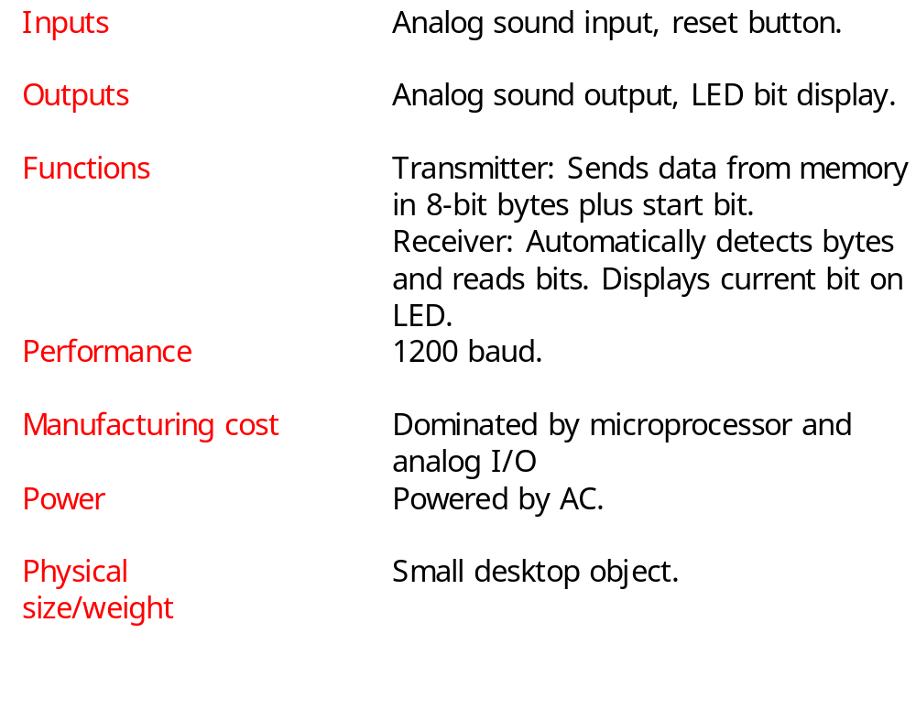
Requirements
© 2000 Morgan Kaufman
Overheads for Computers as Components

Slide 128
Specification
Line-in*
Receiver
1
1
input()
sample-in()
bit-out()
Transmitter
Line-out*
1
1
bit-in()
sample-out()
output()
© 2000 Morgan Kaufman
Overheads for Computers as Components

Slide 129
System architecture
Interrupt handlers for samples:
  input and output.
Transmitter.
Receiver.
© 2000 Morgan Kaufman
Overheads for Computers as Components

Slide 130
Transmitter
Waveform generation by table lookup.
  float sine_wave[N_SAMP] = { 0.0, 0.5, 0.866, 1, 0.866, 0.5, 0.0, -0.5, -0.866, -1.0, -0.866, -0.5, 0};
time
© 2000 Morgan Kaufman
Overheads for Computers as Components

Slide 131
Receiver
Filters (FIR for simplicity) use circular buffers to hold data.
Timer measures bit length.
State machine recognizes start bits, data bits.
© 2000 Morgan Kaufman
Overheads for Computers as Components

Slide 132
Hardware platform
CPU.
A/D converter.
D/A converter.
Timer.
© 2000 Morgan Kaufman
Overheads for Computers as Components

Slide 133
Component design and testing
Easy to test transmitter and receiver on host.
Transmitter can be verified with speaker outputs.
Receiver verification tasks:
  start bit recognition;
  data bit recognition.
© 2000 Morgan Kaufman
Overheads for Computers as Components

Slide 134
System integration and testing
Use loopback mode to test components against each other.
  Loopback in software or by connecting D/A and A/D converters.
© 2000 Morgan Kaufman
Overheads for Computers as Components

