Slide 1
Accelerators
Accelerated systems.
System design:
  performance analysis;
  scheduling and allocation.
© 2000 Morgan Kaufman
Overheads for Computers as Components

Slide 2
Accelerated systems
Use additional computational unit dedicated to some functions?
  Hardwired logic.
  Extra CPU.
Hardware/software co-design: joint design of hardware and software architectures.
© 2000 Morgan Kaufman
Overheads for Computers as Components

Slide 3
Accelerated system architecture
accelerator
request
CPU
result
data
data
memory
I/O
© 2000 Morgan Kaufman
Overheads for Computers as Components

Slide 4
Accelerator vs. co-processor
A co-processor executes instructions.
  Instructions are dispatched by the CPU.
An accelerator appears as a device on the bus.
  The accelerator is controlled by registers.
© 2000 Morgan Kaufman
Overheads for Computers as Components

Slide 5
Accelerator implementations
Application-specific integrated circuit.
Field-programmable gate array (FPGA).
Standard component.
  Example: graphics processor.
© 2000 Morgan Kaufman
Overheads for Computers as Components

Slide 6
System design tasks
Design a heterogeneous multiprocessor architecture.
  Processing element (PE): CPU, accelerator, etc.
Program the system.
© 2000 Morgan Kaufman
Overheads for Computers as Components

Slide 7
Why accelerators?
Better cost/performance.
  Custom logic may be able to perform operation faster than a CPU of equivalent cost.
  CPU cost is a non-linear function of performance.
cost
performance
© 2000 Morgan Kaufman
Overheads for Computers as Components

Slide 8
Why accelerators? cont’d.
Better real-time performance.
  Put time-critical functions on less-loaded processing elements.
  Remember RMS utilization---extra CPU cycles must be reserved to meet deadlines.
cost
deadline w.
RMS overhead
deadline
performance
© 2000 Morgan Kaufman
Overheads for Computers as Components

Slide 9
Why accelerators? cont’d.
Good for processing I/O in real-time.
May consume less energy.
May be better at streaming data.
May not be able to do all the work on even the largest single CPU.
© 2000 Morgan Kaufman
Overheads for Computers as Components

Slide 10
Accelerated system design
First, determine that the system really needs to be accelerated.
  How much faster is the accelerator on the core function?
  How much data transfer overhead?
Design the accelerator itself.
Design CPU interface to accelerator.
© 2000 Morgan Kaufman
Overheads for Computers as Components

Slide 11
Performance analysis
Critical parameter is speedup: how much faster is the system with the accelerator?
Must take into account:
  Accelerator execution time.
  Data transfer time.
  Synchronization with the master CPU.
© 2000 Morgan Kaufman
Overheads for Computers as Components

Slide 12
Accelerator execution time
Total accelerator execution time:
  t_{accel} = t_{in} + t_{x} + t_{out}
Data input
Data output
Accelerated
computation
© 2000 Morgan Kaufman
Overheads for Computers as Components

Slide 13
Data input/output times
Bus transactions include:
  flushing register/cache values to main memory;
  time required for CPU to set up transaction;
  overhead of data transfers by bus packets, handshaking, etc.
© 2000 Morgan Kaufman
Overheads for Computers as Components

Slide 14
Accelerator speedup
Assume loop is executed n times.
Compare accelerated system to non-accelerated system:
  S = n(t_{CPU} - t_{accel})
  = n[t_{CPU} - (t_{in} + t_{x} + t_{out})]
Execution time on CPU
© 2000 Morgan Kaufman
Overheads for Computers as Components

Slide 15
Single- vs. multi-threaded
One critical factor is available parallelism:
  single-threaded/blocking: CPU waits for accelerator;
  multithreaded/non-blocking: CPU continues to execute along with accelerator.
To multithread, CPU must have useful work to do.
  But software must also support multithreading.
© 2000 Morgan Kaufman
Overheads for Computers as Components

Slide 16
Total execution time
Single-threaded:
Multi-threaded:
P1
P1
P2
A1
P2
A1
P3
P3
P4
P4
© 2000 Morgan Kaufman
Overheads for Computers as Components

Slide 17
Execution time analysis
Single-threaded:
  Count execution time of all component processes.
Multi-threaded:
  Find longest path through execution.
© 2000 Morgan Kaufman
Overheads for Computers as Components

Slide 18
Sources of parallelism
Overlap I/O and accelerator computation.
  Perform operations in batches, read in second batch of data while computing on first batch.
Find other work to do on the CPU.
  May reschedule operations to move work after accelerator initiation.
© 2000 Morgan Kaufman
Overheads for Computers as Components

Slide 19
Accelerated systems
Several off-the-shelf boards are available for acceleration in PCs:
  FPGA-based core;
  PC bus interface.
© 2000 Morgan Kaufman
Overheads for Computers as Components

Slide 20
Accelerator/CPU interface
Accelerator registers provide control registers for CPU.
Data registers can be used for small data objects.
Accelerator may include special-purpose read/write logic.
  Especially valuable for large data transfers.
© 2000 Morgan Kaufman
Overheads for Computers as Components

Slide 21
Caching problems
Main memory provides the primary data transfer mechanism to the accelerator.
Programs must ensure that caching does not invalidate main memory data.
  CPU reads location S.
  Accelerator writes location S.
  CPU writes location S.
BAD
© 2000 Morgan Kaufman
Overheads for Computers as Components

Slide 22
Synchronization
As with cache, main memory writes to shared memory may cause invalidation:
  CPU reads S.
  Accelerator writes S.
  CPU reads S.
© 2000 Morgan Kaufman
Overheads for Computers as Components

Slide 23
Partitioning
Divide functional specification into units.
  Map units onto PEs.
  Units may become processes.
Determine proper level of parallelism:
f1()
f2()
f3(f1(),f2())
vs.
f3()
© 2000 Morgan Kaufman
Overheads for Computers as Components

Slide 24
Partitioning methodology
Divide CDFG into pieces, shuffle functions between pieces.
Hierarchically decompose CDFG to identify possible partitions.
© 2000 Morgan Kaufman
Overheads for Computers as Components

Slide 25
Partitioning example
cond 1
cond 2
Block 1
P1
Block 2
P2
Block 3
P4
P5
P3
© 2000 Morgan Kaufman
Overheads for Computers as Components

Slide 26
Scheduling and allocation
Must:
  schedule operations in time;
  allocate computations to processing elements.
Scheduling and allocation interact, but separating them helps.
  Alternatively allocate, then schedule.
© 2000 Morgan Kaufman
Overheads for Computers as Components

Slide 27
Example: scheduling and allocation
P1
P2
M1
M2
d1
d2
P3
Task graph
Hardware platform
© 2000 Morgan Kaufman
Overheads for Computers as Components

Slide 28
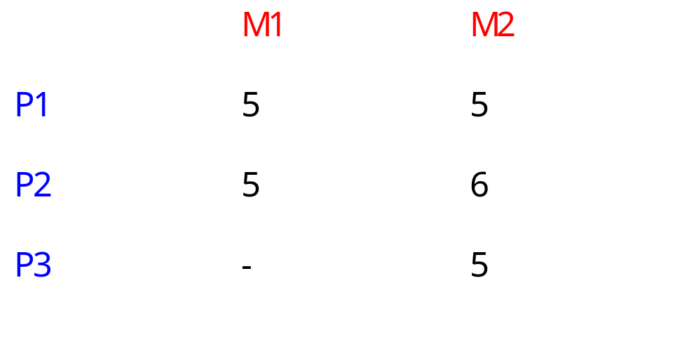
Example process execution times
© 2000 Morgan Kaufman
Overheads for Computers as Components

Slide 29
Example communication model
Assume communication within PE is free.
Cost of communication from P1 to P3 is d1 =2; cost of P2->P3 communication is d2 = 4.
© 2000 Morgan Kaufman
Overheads for Computers as Components

Slide 30
First design
Allocate P1, P2 -> M1; P3 -> M2.
M1
P1
P2
Time = 19
M2
P3
network
d2
5
10
15
20
© 2000 Morgan Kaufman
Overheads for Computers as Components
time

Slide 31
Second design
Allocate P1 -> M1; P2, P3 -> M2:
M1
P1
Time = 18
M2
P2
P3
network
d2
5
10
15
20
© 2000 Morgan Kaufman
Overheads for Computers as Components

Slide 32
System integration and debugging
Try to debug the CPU/accelerator interface separately from the accelerator core.
Build scaffolding to test the accelerator.
Hardware/software co-simulation can be useful.
© 2000 Morgan Kaufman
Overheads for Computers as Components

Slide 33
Accelerators
Example: video accelerator
© 2000 Morgan Kaufman
Overheads for Computers as Components

Slide 34
Concept
Build accelerator for block motion estimation, one step in video compression.
Perform two-dimensional correlation:
Frame 1
f2
f2
f2
f2
f2
f2
f2
f2
f2
f2
© 2000 Morgan Kaufman
Overheads for Computers as Components

Slide 35
Block motion estimation
MPEG divides frame into 16 x 16 macroblocks for motion estimation.
Search for best match within a search range.
Measure similarity with sum-of-absolute-differences (SAD):
  Σ | M(i,j) - S(i-o_{x}, j-o_{y}) |
© 2000 Morgan Kaufman
Overheads for Computers as Components

Slide 36
Best match
Best match produces motion vector for motion block:
© 2000 Morgan Kaufman
Overheads for Computers as Components

Slide 37
Full search algorithm
bestx = 0; besty = 0;
bestsad = MAXSAD;
for (ox = - SEARCHSIZE; ox < SEARCHSIZE; ox++) {
for (oy = -SEARCHSIZE; oy < SEARCHSIZE; oy++) {
int result = 0;
for (i=0; i<MBSIZE; i++) {
for (j=0; j<MBSIZE; j++) {
result += iabs(mb[i][j] - search[i-ox+XCENTER][j-oy-YCENTER]);
© 2000 Morgan Kaufman
Overheads for Computers as Components

Slide 38
Full search algorithm, cont’d.
}
}
if (result <= bestsad) { bestsad = result; bestx = ox; besty = oy; }
}
}
© 2000 Morgan Kaufman
Overheads for Computers as Components

Slide 39
Computational requirements
Let MBSIZE = 16, SEARCHSIZE = 8.
Search area is 8 + 8 + 1 in each dimension.
Must perform:
  n_{ops} = (16 x 16) x (17 x 17) = 73984 ops
CIF format has 352 x 288 pixels -> 22 x 18 macroblocks.
© 2000 Morgan Kaufman
Overheads for Computers as Components

Slide 40
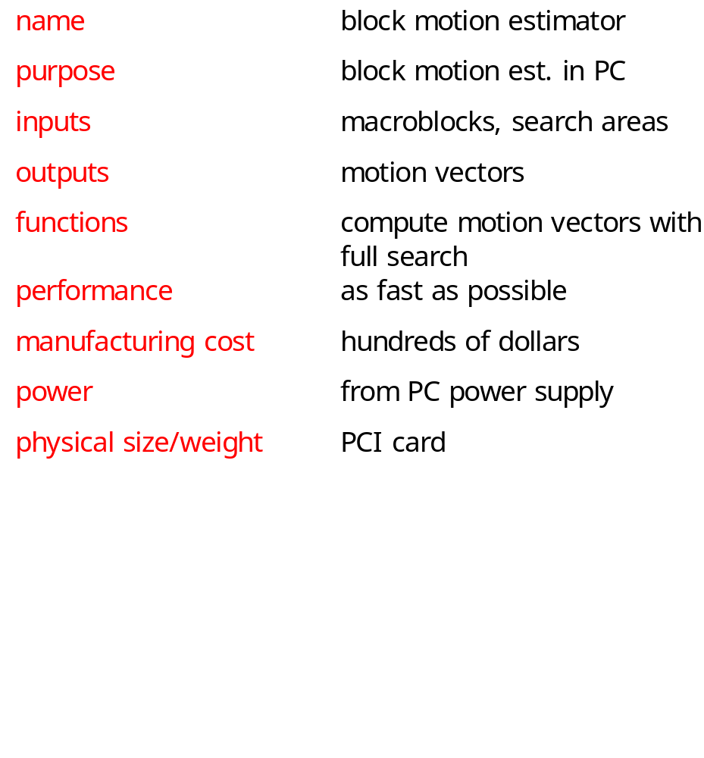
Accelerator requirements
© 2000 Morgan Kaufman
Overheads for Computers as Components

Slide 41
Accelerator data types, basic classes
Motion-vector
Macroblock
Search-area
x, y : pos
pixels[] : pixelval
pixels[] : pixelval
PC
Motion-estimator
memory[]
compute-mv()
© 2000 Morgan Kaufman
Overheads for Computers as Components

Slide 42
Sequence diagram
:PC
:Motion-estimator
compute-mv()
Search area
memory[]
memory[]
macroblocks
memory[]
© 2000 Morgan Kaufman
Overheads for Computers as Components

Slide 43
Architectural considerations
Requires large amount of memory:
  macroblock has 256 pixels;
  search area has 1,089 pixels.
May need external memory (especially if buffering multiple macroblocks/search areas).
© 2000 Morgan Kaufman
Overheads for Computers as Components

Slide 44
Motion estimator organization
PE 0
search area
network
PE 1
comparator
Address
generator
ctrl
...
Motion
vector
macroblock
network
PE 15
© 2000 Morgan Kaufman
Overheads for Computers as Components

Slide 45
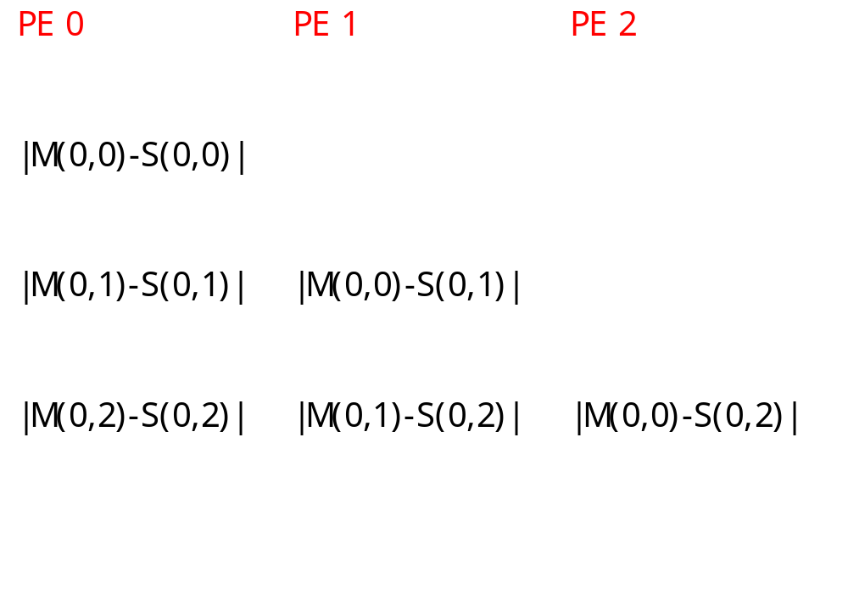
Pixel schedules
M(0,0)
S(0,2)
© 2000 Morgan Kaufman
Overheads for Computers as Components

Slide 46
System testing
Testing requires a large amount of data.
Use simple patterns with obvious answers for initial tests.
Extract sample data from JPEG pictures for more realistic tests.
© 2000 Morgan Kaufman
Overheads for Computers as Components

