Slide 1
Chapter 14
Disk Fundamentals

Slide 2
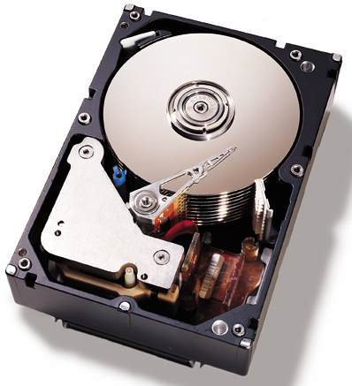
14.1 ~ 14.3
Disk Fundamentals
  Logical Sector Numbers
  File Systems
  Disk Directory (or Folder)

Slide 3



Slide 4
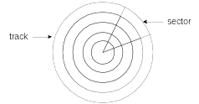
Tracks and Sectors
Physical disk geometry - a way of describing the disk’s structure to make it readable by the system BIOS
Track - concentric circle containing data
Sector - part of a track

Slide 5
Cylinders and Seeking
Cylinder - all tracks readable from one head position
Seek - move read/write heads between tracks

Slide 6
Translation
(from Physical to Logical Layout)
Translation - conversion of physical disk geometry to a sequence of logical sector numbers
Performed by a hard disk controller (firmware)
Logical sector numbers are numbered sequentially, have no direct mapping to hardware

Slide 7
Fragmentation
A fragmented file is one whose sectors are no longer located in contiguous areas of the disk.
  causes read/write heads to skip
  slower file access
  possible read/write errors

Slide 8
From now on, we will treat disk as a list of sectors…

Slide 9
…next, we will organize those sectors into files and folders

Slide 10
Keeping Track of Files
Topics:
MS-DOS Directory Structure
Long Filenames in MS-Windows
File Allocation Table (FAT)
Remember that Directories and FAT are also stored on disk (in reserved sectors)!

Slide 11
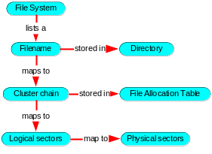
Directory, File, Cluster, Sector Relationships

Slide 12
File Allocation Table (1 of 2)
A map of all clusters on the disk, showing their ownership by specific files
Each entry corresponds to a cluster number
Each cluster contains one or more sectors
Each file is represented in the FAT as a linked list, called a cluster chain.
Three types of FAT's, named after the length of each FAT entry:
  FAT-12
  FAT-16
  FAT-32

Slide 13
File Allocation Table (2 of 2)
Each entry contains an n-bit integer that identifies the next entry. (n=12,16, or 32)
Two cluster chains are shown in the following diagram, one for File1, and another for File2:

Slide 14
Cluster (1 of 2)
Smallest unit of space used by a file
Consists of one or more adjacent sectors
Size depends on both the type of file system in use and the disk partition size
A file is a linked sequence of clusters. Example:

Slide 15
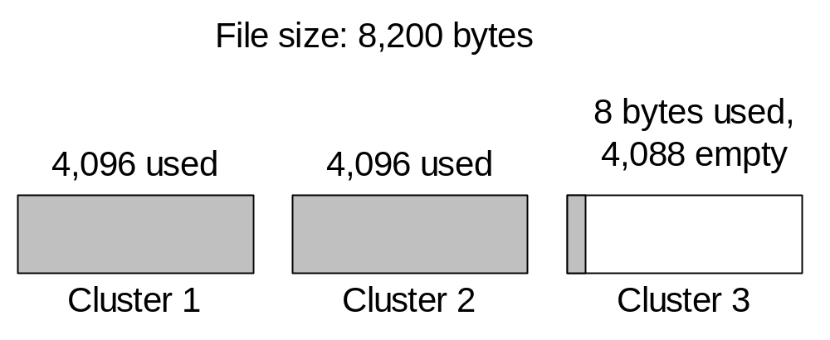
Cluster (2 of 2)
A file always uses at least one cluster
A high percentage of space may be wasted
Example: 8,200-byte file requires three 4K clusters:

Slide 16
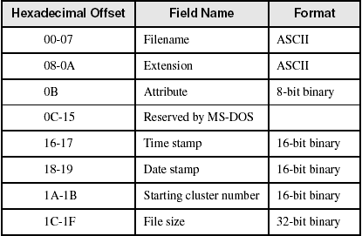
MS-DOS Directory Structure (1 of 2)

Slide 17

MS-DOS Directory Structure (2 of 2)
Time field equals 4DBDh (9:45:58), and the Date field equals 247Ah (March 26, 1998). Attribute is normal:

Slide 18
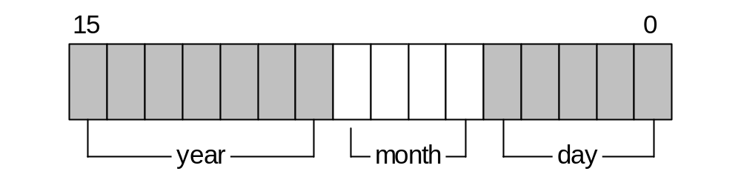
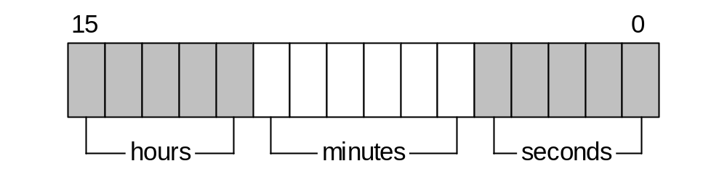
Date and Time Fields
Date stamp field:
Time stamp field:

Slide 19
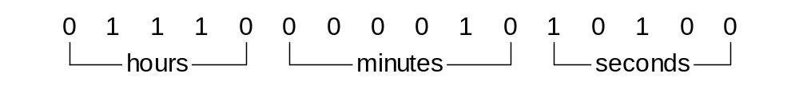
Your turn . . .
What time value is represented here?

Slide 20
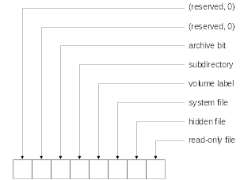
File Attribute Values
What type of file has attribute 00100111 . . . ?

Slide 21
Directory, File, Cluster, Sector Relationships (Review)

Slide 22
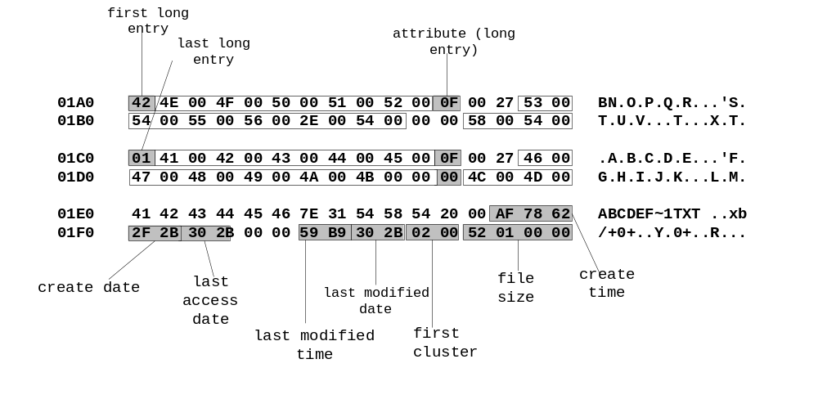
Long Filenames in MS-Windows
Filename: ABCDEFGHIJKLMNOPQRSTUV.TXT

Slide 23
FAT12
Designed for diskettes
Each FAT entry is 12 bits
Very little fault tolerance
  two copies of the FAT (cluster table)
Optimal storage for small files
  512-byte clusters

Slide 24
FAT16
MS-DOS format for hard disks
16-bit FAT entries
Large cluster size when disk > 1 GB
  inefficient for small files
Max 2 GB size under MS-DOS
Little or no recovery from read/write errors

Slide 25
FAT32
Supports long filenames
Supported by all version of MS-Windows from Windows 95 onward
  (except Windows NT)
32-bit FAT entries
32 GB maximum volume size
Improved recovery from read/write errors

Slide 26
NTFS
Supported by Windows NT, 2000, and XP
Handles large volumes
  can span multiple hard drives
Efficient cluster size (4K) on large volumes
Unicode filenames
Permissions on files & folders
Share folders across network
Built-in compression and encryption
Track changes in a change journal
Disk quotas for individuals or groups
Robust error recovery
Disk mirroring

