Slide 1
Chapter 2
IA-32 Processor Architecture

Slide 2
Chapter Overview
General Concepts
IA-32 Processor Architecture
IA-32 Memory Management
Components of an IA-32 Microcomputer
Input-Output System

Slide 3
General Concepts
Basic microcomputer design
Instruction execution cycle
Reading from memory
How programs run

Slide 4
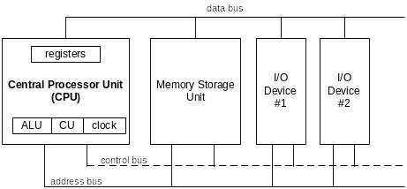
Basic Microcomputer Design
clock synchronizes CPU operations
control unit (CU) coordinates sequence of execution steps
ALU performs arithmetic and bitwise processing

Slide 5
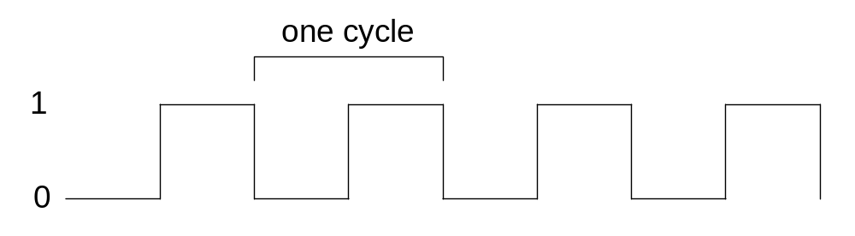
Clock
synchronizes all CPU and BUS operations
machine (clock) cycle measures time of a single operation
clock is used to trigger events

Slide 6
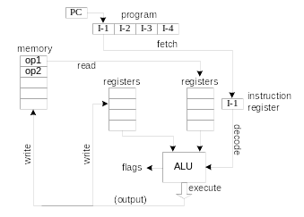
Instruction Execution Cycle
Fetch
Decode
Fetch operands
Execute
Store output

Slide 7
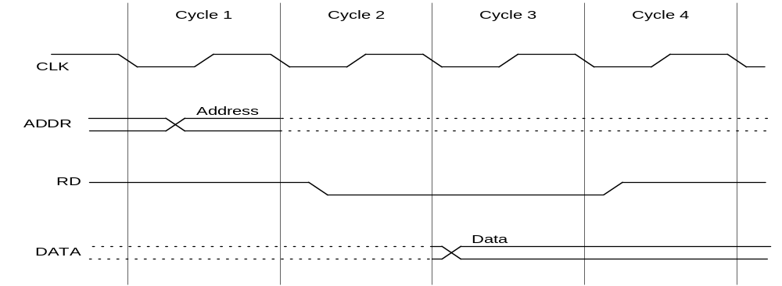
Reading from Memory
Multiple machine cycles are required when reading from memory, because it responds much more slowly than the CPU. The steps are:
  address placed on address bus
  Read Line (RD) set low
  CPU waits one cycle for memory to respond
  Read Line (RD) goes to 1, indicating that the data is on the data bus

Slide 8
Cache Memory
High-speed expensive static RAM both inside and outside the CPU.
  Level-1 cache: inside the CPU
  Level-2 cache: outside the CPU
Cache hit: when data to be read is already in cache memory
Cache miss: when data to be read is not in cache memory.

Slide 9
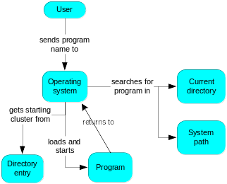
How a Program Runs

Slide 10
Multitasking
OS can run multiple programs at the same time.
Multiple threads of execution within the same program.
Scheduler utility assigns a given amount of CPU time to each running program.
Rapid switching of tasks
  gives illusion that all programs are running at once
  the processor must support task switching.

Slide 11
IA-32 Processor Architecture
Modes of operation
Basic execution environment
Floating-point unit
Intel Microprocessor history

Slide 12
Modes of Operation
Protected mode
  native mode (Windows, Linux)
Real-address mode
  native MS-DOS
System management mode
  power management, system security, diagnostics
Virtual-8086 mode
  hybrid of Protected
  each program has its own 8086 computer

Slide 13
Basic Execution Environment
Addressable memory
General-purpose registers
Index and base registers
Specialized register uses
Status flags
Floating-point, MMX, XMM registers

Slide 14
Addressable Memory
Protected mode
  4 GB
  32-bit address
Real-address and Virtual-8086 modes
  1 MB space
  20-bit address

Slide 15

General-Purpose Registers
Named storage locations inside the CPU, optimized for speed.

Slide 16


Accessing Parts of Registers
Use 8-bit name, 16-bit name, or 32-bit name
Applies to EAX, EBX, ECX, and EDX

Slide 17

Index and Base Registers
Some registers have only a 16-bit name for their lower half:

Slide 18
Some Specialized Register Uses (1/2)
General-Purpose
  EAX – accumulator
  ECX – loop counter
  ESP – stack pointer
  ESI, EDI – index registers
  EBP – extended frame pointer (stack)
Segment
  CS – code segment
  DS – data segment
  SS – stack segment
  ES, FS, GS - additional segments

Slide 19
Some Specialized Register Uses (2/2)
EIP – instruction pointer
EFLAGS
  status and control flags
  each flag is a single binary bit

Slide 20
Intel Microprocessor History
Intel 8086, 80286
IA-32 processor family
P6 processor family
CISC and RISC

Slide 21
Early Intel Microprocessors
Intel 8080
  64K addressable RAM
  8-bit registers
  CP/M operating system
  S-100 BUS architecture
  8-inch floppy disks!
Intel 8086/8088
  IBM-PC Used 8088
  1 MB addressable RAM
  16-bit registers
  16-bit data bus (8-bit for 8088)
  separate floating-point unit (8087)

Slide 22
The IBM-AT
Intel 80286
  16 MB addressable RAM
  Protected memory
  several times faster than 8086
  introduced IDE bus architecture
  80287 floating point unit

Slide 23
Intel IA-32 Family
Intel386
  4 GB addressable RAM, 32-bit registers, paging (virtual memory)
Intel486
  instruction pipelining
Pentium
  superscalar, 32-bit address bus, 64-bit internal data path

Slide 24
Intel P6 Family
Pentium Pro
  advanced optimization techniques in microcode
Pentium II
  MMX (multimedia) instruction set
Pentium III
  SIMD (streaming extensions) instructions
Pentium 4
  NetBurst micro-architecture, tuned for multimedia

Slide 25
CISC and RISC
CISC – complex instruction set
  large instruction set
  high-level operations
  requires microcode interpreter
  examples: Intel 80x86 family
RISC – reduced instruction set
  simple, atomic instructions
  small instruction set
  directly executed by hardware
  examples:
    ARM (Advanced RISC Machines)
    DEC Alpha (now Compaq)

Slide 26
IA-32 Memory Management
Real-address mode
Calculating linear addresses
Protected mode
Multi-segment model
Paging

Slide 27
Real-Address mode
1 MB RAM maximum addressable
Application programs can access any area of memory
Single tasking
Supported by MS-DOS operating system

Slide 28

Segmented Memory
Segmented memory addressing: absolute (linear) address is a combination of a 16-bit segment value added to a 16-bit offset
one segment
linear addresses

Slide 29
Calculating Linear Addresses
Given a segment address, multiply it by 16 (add a hexadecimal zero), and add it to the offset
Example: convert 08F1:0100 to a linear address
Adjusted Segment value: 0 8 F 1 0
Add the offset: 0 1 0 0
Linear address: 0 9 0 1 0

Slide 30
Your turn . . .
What linear address corresponds to the segment/offset address 028F:0030?
028F0 + 0030 = 02920
Always use hexadecimal notation for addresses.

Slide 31
Your turn . . .
What segment addresses correspond to the linear address 28F30h?
Many different segment-offset addresses can produce the linear address 28F30h. For example:
28F0:0030, 28F3:0000, 28B0:0430, . . .

Slide 32
Protected Mode (1/2)
4 GB addressable RAM
  (00000000 to FFFFFFFFh)
Each program assigned a memory partition which is protected from other programs
Designed for multitasking
Supported by Linux & MS-Windows

Slide 33
Protected mode (2/2)
Segment descriptor tables
Program structure
  code, data, and stack areas
  CS, DS, SS segment descriptors
  global descriptor table (GDT)
MASM Programs use the Microsoft flat memory model

Slide 34
Multi-Segment Model
Each program has a local descriptor table (LDT)
  holds descriptor for each segment used by the program

Slide 35
Paging
Supported directly by the CPU
Divides each segment into 4096-byte blocks called pages
Sum of all programs can be larger than physical memory
Part of running program is in memory, part is on disk
Virtual memory manager (VMM) – OS utility that manages the loading and unloading of pages
Page fault – issued by CPU when a page must be loaded from disk

