Slide 1
Chapter 3
Assembly Language Fundamentals

Slide 2
3.1 – Basic Elements
Program Formats

Slide 3
Example: Adding 3 Integers
TITLE Add and Sub
; This is a comment
INCLUDE Irvine32.inc
.code
Main proc
MOV EAX, 10000h
ADD EAX, 40000h
SUB EAX, 20000h
CALL DumpRegs
EXIT
Main endp
End Main

Slide 4
Format of Program
Identifiers are case insensitive.
Comments follow ‘;’ character.
Sections: Data, Code, and Stack.
Hexadecimal Numbers have ‘h’ suffix.

Slide 5
Directives vs. Instructions.
  Use Directives to tell assembler what to do.
  Use Instructions to tell CPU what to do.
Procedure defined by:
  [Name] PROC
  [Name] ENDP
Instruction Format:
  LABEL (optional), Mnemonic, Operands

Slide 6
I/O
Not as easy as you think, if you program it yourself.
We will use the library provided by the author of the textbook.
Two steps:
  Include the library (Irvine32.inc) in your code.
  Call the subroutines.

Slide 7
Assemble and Run!
The required software comes with the book:
  MASM: Microsoft Macro Assembler
  CodeView: A Debugger
  Irvine32.inc: I/O procedures

Slide 8
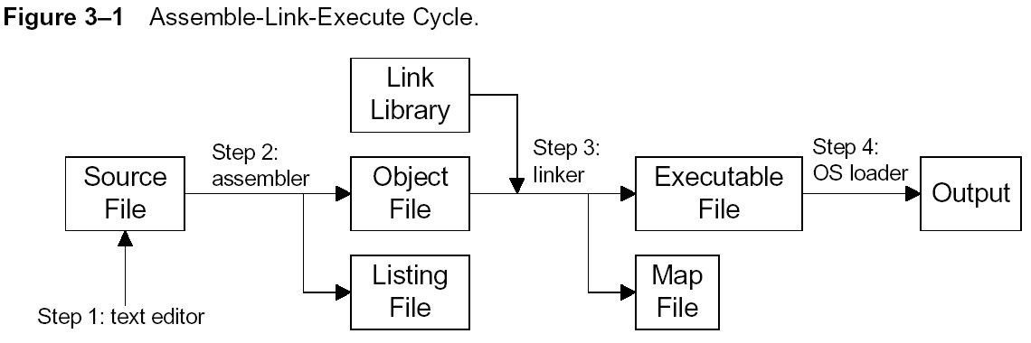
3.2 ~ 3.3

Slide 9
3.4 – Defining Data
Data Declaration
Signed vs. Unsigned
Characters and Strings
List and Array

Slide 10
Data Declaration
[Label], Type, Initialization (or just ?)
  Example: Var1 BYTE 7
Use ? if no initialization necessary.
  Example: Var1 BYTE ?
Other data types: (See Table 3-2 in p.80)
  WORD (or DW),
  DWORD (or DD), …etc.

Slide 11
Signed vs. Unsigned
Signed vs. Unsigned:
  SBYTE vs. BYTE
  SWORD vs. WORD
  …etc.
Example:
  Var1 BYTE 255
  Var1 SBYTE -1

Slide 12
Characters and Strings
How about characters?
A few examples:
  Var1 BYTE ‘A’
  Var1 BYTE 41h
  S1 BYTE ‘Hello, World!’
  Line BYTE ‘--------------------’

Slide 13
How About A List or Array?
Just list them! For example:
  List1 BYTE 10, 32, 41h
You may also mix them:
  List1 BYTE 10, 32, ?, ‘A’
  List2 BYTE “good”, ‘o’, ‘r’, ‘b’, ‘a’, ‘d’, 0
So, Is List2 an Array?
  Yes and No! (e.g., List2 actually means ‘g’.)

Slide 14
DUP
Good for allocating space for a string or array.
Examples:
  Var1 BYTE 20 DUP (0)
  Var2 BYTE 20 DUP (?)
  Var3 BYTE 4 DUP (“STACK”)

Slide 15
3.5 – Symbolic Constants
EQU
Irvine32.inc

Slide 16
EQU is for Constants
EQU for constants.
Also OK to use = for integers.
Examples:
  COUNT = 500
  COUNT EQU 500

Slide 17
Expression and Text in EQU
OK to use expressions in EQU:
  Matrix1 EQU 10 * 10
  Matrix1 EQU <10 * 10>
No expression evaluation if within < >.
EQU accepts texts too:
  Msg EQU <“Press any key…”, 0>

Slide 18
Why EQU? Why not storing the constants as variables (in memory)?
Exercise: Does it save memory? Isn’t the constant stored somewhere in memory anyway? (Hint: See Week02a slides.)

Slide 19
A few fine points
(that are skipped previously on pupose)…

Slide 20
If Irvine32.inc Is Not Used…
TITLE Add and Subtract
.386
.MODEL flat,stdcall
.STACK 4096
ExitProcess PROTO,dwExitCode:DWORD
DumpRegs PROTO
.code
main PROC
…

Slide 21
.code
main PROC
mov eax,10000h
add eax,40000h
sub eax,20000h
call DumpRegs
INVOKE ExitProcess,0
main ENDP
END main

