Slide 1
Chapter 6
Conditional Processing

Slide 2
6.2 – Boolean and Comparison Instruction
CMP Instruction

Slide 3
CMP and Jcond Instruction
The IF statement in C and PASCAL is converted into CMP and Jcond instructions in x86 Assembly:
If (X > op1)
Then
<…>
End If
CMP X, op1
JNG EndIf
<…>
EndIf:

Slide 4
CMP Instruction (1 of 4)
Compares the destination operand to the source operand
  Nondestructive subtraction of source from destination (destination operand is not changed)
Syntax: CMP destination, source
Example: destination == source
mov al,5
cmp al,5 ; Zero flag set

Slide 5
CMP Instruction (2 of 4)
Example: destination > source
(both the Zero and Carry flags are clear)
mov al,6
cmp al,5 ; ZF = 0, CF = 0
The comparisons shown so far were unsigned.

Slide 6
CMP Instruction (3 of 4)
The comparisons shown here are performed with signed integers.
Example: destination > source
mov al,5
cmp al,-2 ; Sign flag = Overflow flag
Example: destination < source
mov al,-1
cmp al,5 ; Sign flag != Overflow flag

Slide 7
CMP Instruction (4 of 4)
Unsigned
CMP Results | ZF | CF
Destination < Source | 0 | 1
Destination > Source | 0 | 0
Destination = Source | 1 | 0
Signed
CMP Result | Flags
Destination < Source | SF ≠ OF
Destination > Source | SF = OF
Destination = Source | ZF = 1

Slide 8
Boolean and Comparison Instructions
AND Instruction
OR Instruction
XOR Instruction
NOT Instruction
TEST Instruction
CMP Instruction

Slide 9


AND Instruction
Performs a Boolean AND operation between each pair of matching bits in two operands
Syntax:
    AND destination, source
  (same operand types as MOV)
AND

Slide 10


OR Instruction
Performs a Boolean OR operation between each pair of matching bits in two operands
Syntax:
    OR destination, source
OR

Slide 11

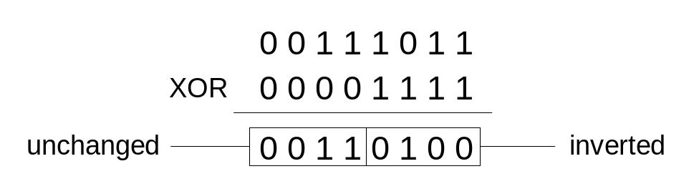
XOR Instruction
Performs a Boolean exclusive-OR operation between each pair of matching bits in two operands
Syntax:
    XOR destination, source
XOR
XOR is a useful way to toggle (invert) the bits in an operand.

Slide 12

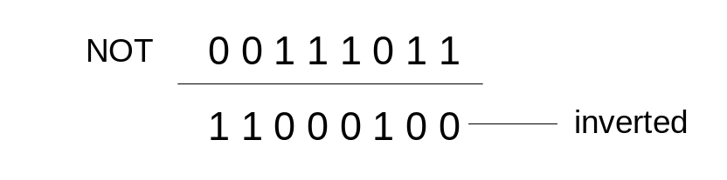
NOT Instruction
Performs a Boolean NOT operation on a single destination operand
Syntax:
    NOT destination
NOT

Slide 13
Application – An Example
Task: Convert the character in AL to upper case.
Solution: Use the AND instruction to clear bit 5.
mov al,'a‘ ; AL = 01100001b
and al,11011111b ; AL = 01000001b

Slide 14
TEST Instruction
Performs a nondestructive AND operation between each pair of matching bits in two operands
No operands are modified, but the Zero flag is affected.
Example: jump to a label if either bit 0 or bit 1 in AL is set.
test al,00000011b
jnz ValueFound

Slide 15
6.3 – Conditional Jumps
Jcond Instruction

Slide 16
Jcond Instruction
A conditional jump instruction branches to a label when specific register or flag conditions are met
Examples:
  JB, JC jump to a label if the Carry flag is set
  JE, JZ jump to a label if the Zero flag is set
  JS jumps to a label if the Sign flag is set
  JNE, JNZ jump to a label if the Zero flag is clear
  JECXZ jumps to a label if ECX equals 0

Slide 17
Flags and Jcond
How do Jcond instructions decide which way to go?
They check the flags!
Examples:
  JE/JNE checks Zero flag.
  JG/JL checks Sign flag.
CMP instruction sets the flags.

Slide 18
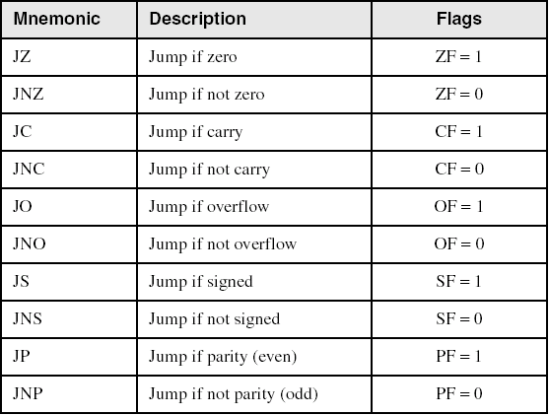
Jumps Based on Specific Flags

Slide 19
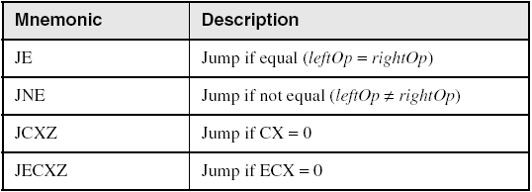
Jumps Based on Equality

Slide 20
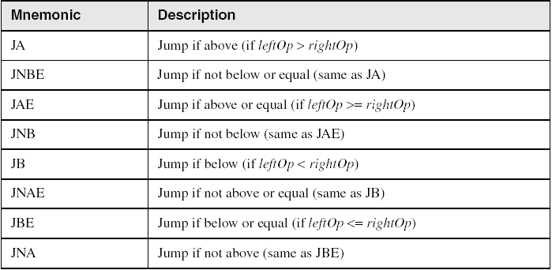
Jumps Based on Unsigned Comparisons

Slide 21
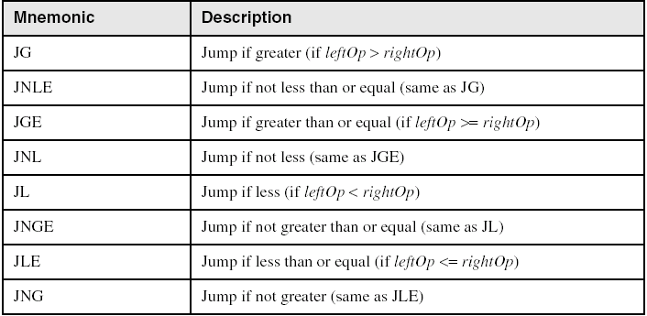
Jumps Based on Signed Comparisons

Slide 22
More Frequently Used Jcond Instructions
JE (Equal)
JNE (Not Equal)
JG or JGE (Greater Than or Equal)
JL or JLE (Less Than or Equal)
Note: JG=JNLE, JGE=JNL, …etc.

Slide 23
6.4 – Conditional Loop Instructions
LOOPZ and LOOPE
LOOPNZ and LOOPNE

Slide 24
LOOPZ and LOOPE
Syntax:
  LOOPE destination
  LOOPZ destination
Logic:
  ECX ← ECX – 1
  if ECX > 0 and ZF=1, jump to destination
Useful when scanning an array for the first element that does not match a given value.

Slide 25
LOOPNZ and LOOPNE
Syntax:
LOOPNZ destination
LOOPNE destination
Logic:
  ECX ← ECX – 1;
  if ECX > 0 and ZF=0, jump to destination
Useful when scanning an array for the first element that matches a given value.

Slide 26
LOOPNZ Example
The following code finds the first positive value in an array:
.data
array SWORD -3,-6,-1,-10,10,30,40,4
.code
  mov esi,OFFSET array
  mov ecx,LENGTHOF array
  sub esi,TYPE array
next:
  add esi, TYPE array
  test WORD PTR [esi],8000h ; test sign bit
  loopnz next ; continue loop
  jnz quit ; none found
  … ; ESI points to value
quit:

Slide 27
6.5 – Conditional Structures
If…then…else
While…do; Repeat…until

Slide 28
Simple IF
If (op1=op2) then <…> end if
Two different approaches:
CMP op1, op2
JE True
JMP EndIf
True:
<…>
EndIf
CMP op1, op2
JNE False
<…>
False:

Slide 29
IF … OR …
CMP X, op1
JG True
CMP Y, op2
JLE True
CMP …
…
…
JMP EndIf
True:
<…>
EndIf:
If (X > op1) or
(Y <=op2) or
…
Then
<…>
End If

Slide 30
Exercise
Can you rewrite the last slide and remove the “JMP EndIf”?
How about adding the “else” part?

Slide 31
IF … AND …
CMP X, op1
JNG EndIf
CMP Y, op2
JNLE EndIf
CMP …
…
…
<…>
EndIf:
If (X > op1)and
(Y <=op2)and
…
Then
<…>
End If

Slide 32
WHILE
While:
CMP op1, op2
JNL EndDo
<…>
JMP While
EndDo:
DO WHILE(op1<op2)
<…>
END DO

Slide 33
REPEAT UNTIL
repeat:
<…>
CMP X, op1
JE EndIf
CMP Y, op2
JNG repeat
EndIf:
REPEAT
<…>
UNTIL(X = op1) or
(Y > op2)

Slide 34
More Exercises
Write the code for the CASE statement.
AND conditions in REPEAT-UNTIL?
repeat:
<…>
CMP ?
?
?
EndIf:
REPEAT
<…>
UNTIL (X=op1) and
(Y>op2)

Slide 35
6.7 - Using the .IF Directive
.IF, .WHILE, .REPEAT Directives

Slide 36
Using the .IF Directive
Runtime Expressions
Relational and Logical Operators
MASM-Generated Code
.REPEAT Directive
.WHILE Directive

Slide 37
Runtime Expressions
.IF, .ELSE, .ELSEIF, and .ENDIF can be used to evaluate runtime expressions and create block-structured IF statements.
Examples:
.IF eax>ebx
mov edx,1
.ELSE
mov edx,2
.ENDIF
.IF eax>ebx && eax>ecx
mov edx,1
.ELSE
mov edx,2
.ENDIF
MASM generates "hidden" code for you, consisting of code labels, CMP and conditional jump instructions.

Slide 38
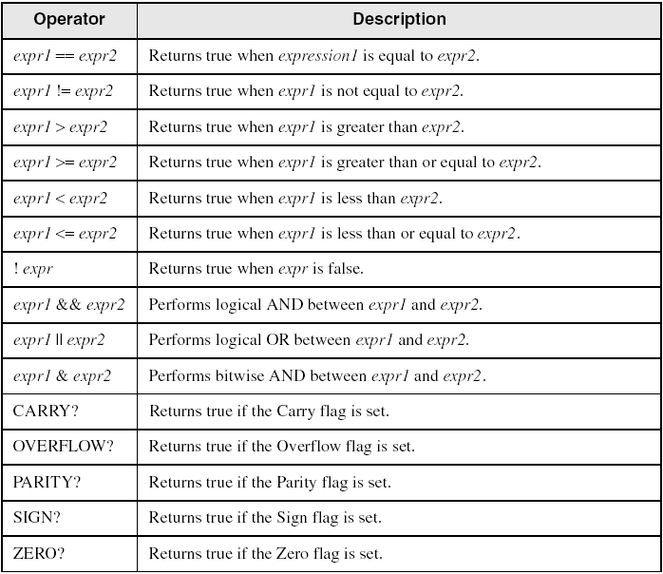
Relational and Logical Operators

Slide 39
MASM-Generated Code
.data
val1 DWORD 5
result DWORD ?
.code
mov eax,6
.IF eax > val1
mov result,1
.ENDIF
Generated code:
mov eax,6
cmp eax,val1
jbe @C0001
mov result,1
@C0001:
MASM automatically generates an unsigned jump (JBE).

Slide 40
MASM-Generated Code
.data
val1 SDWORD 5
result SDWORD ?
.code
mov eax,6
.IF eax > val1
mov result,1
.ENDIF
Generated code:
mov eax,6
cmp eax,val1
jle @C0001
mov result,1
@C0001:
MASM automatically generates a signed jump (JLE).

Slide 41
.REPEAT Directive
Executes the loop body before testing the loop condition associated with the .UNTIL directive.
Example:
; Display integers 1 – 10:
mov eax,0
.REPEAT
inc eax
call WriteDec
call Crlf
.UNTIL eax == 10

Slide 42
.WHILE Directive
Tests the loop condition before executing the loop body The .ENDW directive marks the end of the loop.
Example:
; Display integers 1 – 10:
mov eax,0
.WHILE eax < 10
inc eax
call WriteDec
call Crlf
.ENDW

Slide 43
When to Use or Not to Use Directives?
Directives make assembly language easier to write and to understand, by hiding tedious work. (Food for thought: Wouldn’t it be even better to use C language?)
Don’t use directives if you want to have total control.

