Slide 1
Chapter 8
Advanced Procedures

Slide 2
8.2 – Local Variables
Local Variables
Local Directive

Slide 3
Local Directive
A local variable is created, used, and destroyed within a single procedure
The LOCAL directive declares a list of local variables
  immediately follows the PROC directive
  each variable is assigned a type
Syntax:
    LOCAL varlist
Example:
MySub PROC
LOCAL var1:BYTE, var2:WORD, var3:SDWORD

Slide 4
Local Variables
Examples:
LOCAL flagVals[20]:BYTE ; array of bytes
LOCAL pArray:PTR WORD ; pointer to an array
myProc PROC, ; procedure
p1:PTR WORD ; parameter
LOCAL t1:BYTE, ; local variables
t2:WORD,
t3:DWORD,
t4:PTR DWORD

Slide 5
MASM-Generated Code (1 of 2)
BubbleSort PROC
LOCAL temp:DWORD, SwapFlag:BYTE
. . .
ret
BubbleSort ENDP
MASM generates the following code:
BubbleSort PROC
push ebp
mov ebp,esp
add esp,0FFFFFFF8h ; add -8 to ESP
. . .
mov esp,ebp
pop ebp
ret
BubbleSort ENDP

Slide 6
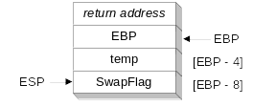
MASM-Generated Code (2 of 2)
Diagram of the stack frame for the BubbleSort procedure:

Slide 7
8.3 - Stack Parameters
INVOKE Directive
PROC Directive
PROTO Directive

Slide 8
Register vs. Stack Parameters
Register parameters require dedicating a register to each parameter. Stack parameters are more convenient
Imagine two possible ways of calling the DumpMem procedure. Clearly the second is easier:
pushad
mov esi,OFFSET array
mov ecx,LENGTHOF array
mov ebx,TYPE array
call DumpMem
popad
push OFFSET array
push LENGTHOF array
push TYPE array
call DumpMem

Slide 9
INVOKE Directive
The INVOKE directive is a powerful replacement for Intel’s CALL instruction that lets you pass multiple arguments
Syntax:
    INVOKE procedureName [, argumentList]
Arguments can be:
  immediate values and integer expressions
  variable names
  address and ADDR expressions
  register names

Slide 10
INVOKE Examples
.data
byteVal BYTE 10
wordVal WORD 1000h
.code
; direct operands:
INVOKE Sub1,byteVal,wordVal
; address of variable:
INVOKE Sub2,ADDR byteVal
; register name, integer expression:
INVOKE Sub3,eax,(10 * 20)
; address expression (indirect operand):
INVOKE Sub4,[ebx]

Slide 11
ADDR Operator
Returns a near or far pointer to a variable, depending on which memory model your program uses:
  Small model: returns 16-bit offset
  Large model: returns 32-bit segment/offset
  Flat model: returns 32-bit offset
Simple example:
.data
myWord WORD ?
.code
INVOKE mySub,ADDR myWord

Slide 12
PROC Directive
The PROC directive declares a procedure with an optional list of parameters.
Syntax:
  label PROC paramList
paramList is a list of parameters separated by commas. Each parameter has the following syntax:
  paramName:type
type must either be one of the standard ASM types (BYTE, SBYTE, WORD, etc.), or it can be a pointer to one of these types.

Slide 13
Sanity Check #1
Remember that PROC and INVOKE are directives, not instructions.
(i.e., CPU does not understand it.)

Slide 14
PROC Examples (1 of 2)
The AddTwo procedure receives two integers and returns their sum in EAX.
C++ programs typically return 32-bit integers from functions in EAX.
AddTwo PROC,
val1:DWORD, val2:DWORD
mov eax,val1
add eax,val2
ret
AddTwo ENDP

Slide 15
PROC Examples (2 of 2)
FillArray receives a pointer to an array of bytes, a single byte fill value that will be copied to each element of the array, and the size of the array.
FillArray PROC,
pArray:PTR BYTE, fillVal:BYTE
arraySize:DWORD
mov ecx,arraySize
mov esi,pArray
mov al,fillVal
L1: mov [esi],al
inc esi
loop L1
ret
FillArray ENDP

Slide 16
PROTO Directive
Creates a procedure prototype
Syntax:
  label PROTO paramList
Every procedure called by the INVOKE directive must have a prototype
A complete procedure definition can also serve as its own prototype

Slide 17
PROTO Directive
Standard configuration: PROTO appears at top of the program listing, INVOKE appears in the code segment, and the procedure implementation occurs later in the program:
MySub PROTO ; procedure prototype
.code
INVOKE MySub ; procedure call
MySub PROC ; procedure implementation
.
.
MySub ENDP

Slide 18
PROTO Example
Prototype for the ArraySum procedure, showing its parameter list:
ArraySum PROTO,
ptrArray:PTR DWORD,
szArray:DWORD

Slide 19
Sanity Check #2
So, PROC and INVOKE are directives, not instruction.
How does MASM handle the parameters?

Slide 20
Passing by Value
When a procedure argument is passed by value, a copy of a 16-bit or 32-bit integer is pushed on the stack. Example:
.data
myData WORD 1000h
.code
main PROC
INVOKE Sub1, myData
MASM generates the following code:
push myData
call Sub1

Slide 21
Passing by Reference
When an argument is passed by reference, its address is pushed on the stack. Example:
.data
myData WORD 1000h
.code
main PROC
INVOKE Sub1, ADDR myData
MASM generates the following code:
push OFFSET myData
call Sub1

Slide 22
Example: Exchanging Two Integers
The Swap procedure exchanges the values of two 32-bit integers. pValX and pValY do not change values, but the integers they point to are modified.
Swap PROC USES eax esi edi,
  pValX:PTR DWORD, ; pointer to first integer
  pValY:PTR DWORD ; pointer to second integer
  mov esi,pValX ; get pointers
  mov edi,pValY
  mov eax,[esi] ; get first integer
  xchg eax,[edi] ; exchange with second
  mov [esi],eax ; replace first integer
  ret
Swap ENDP

Slide 23
Memory Address of Parameter
Where are the parameters stored in memory?
Hint: INVOKE is translated into PUSH and CALL.
Answer: They are stored in stack!

Slide 24
8.4 – Stack Frames
Stack Frame

Slide 25
Stack Frame
Also known as an activation record
Area of the stack set aside for a procedure's return address, passed parameters, saved registers, and local variables
Created by the following steps:
  Calling program pushes arguments on the stack and calls the procedure.
  The called procedure pushes EBP on the stack, and sets EBP to ESP.
  If local variables are needed, a constant is subtracted from ESP to make room on the stack.

Slide 26
Explicit Access to Stack Parameters
A procedure can explicitly access stack parameters using constant offsets from EBP.
  Example: [EBP + 8]
EBP is often called the base pointer or frame pointer because it holds the base address of the stack frame.
EBP does not change value during the procedure.
EBP must be restored to its original value when a procedure returns.

Slide 27
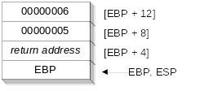
Stack Frame Example (1 of 2)
.data
sum DWORD ?
.code
push 6 ; second argument
push 5 ; first argument
call AddTwo ; EAX = sum
mov sum,eax ; save the sum
AddTwo PROC
push ebp
mov ebp,esp
.
.

Slide 28
Stack Frame Example (2 of 2)
AddTwo PROC
  push ebp
  mov ebp,esp ; base of stack frame
  mov eax,[ebp + 12]; second argument (6)
  add eax,[ebp + 8] ; first argument (5)
  pop ebp
  ret 8 ; clean up the stack
AddTwo ENDP ; EAX contains the sum

Slide 29
8.5 - Recursion
Recursion

Slide 30
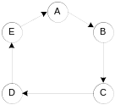
What is Recursion?
The process created when . . .
  A procedure calls itself
  Procedure A calls procedure B, which in turn calls procedure A
Using a graph in which each node is a procedure and each edge is a procedure call, recursion forms a cycle:

Slide 31
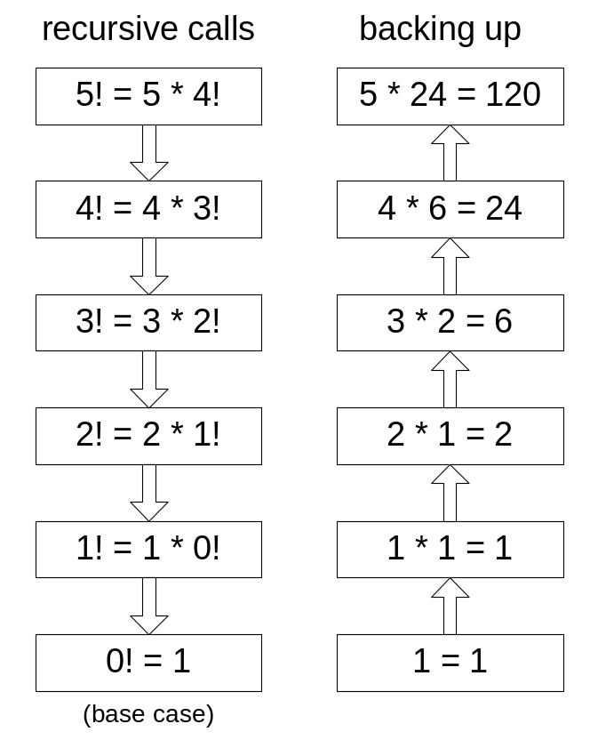
Calculating a Factorial (1 of 3)
This function calculates the factorial of integer n. A new value of n is saved in each stack frame:
int factorial(int n) {
if(n == 0)
return 1;
else
return n*factorial(n-1);
}
As each call instance returns, the product it returns is multiplied by the previous value of n.

Slide 32
Calculating a Factorial (2 of 3)
Factorial PROC
push ebp
mov ebp,esp
mov eax,[ebp+8] ; get n
cmp eax,0 ; n < 0?
ja L1 ; yes: continue
mov eax,1 ; no: return 1
jmp L2
L1: dec eax
push eax ; Factorial(n-1)
call Factorial
; Instructions from this point on execute when
; each recursive call returns.
ReturnFact:
mov ebx,[ebp+8] ; get n
mul ebx ; ax = ax * bx
L2: pop ebp ; return EAX
ret 4 ; clean up stack
Factorial ENDP
See the program listing (Fact.asm)

Slide 33
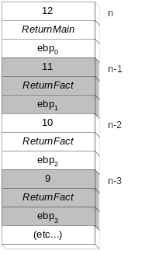
Calculating a Factorial (3 of 3)
Suppose we want to calculate 12!
This diagram shows the first few stack frames created by recursive calls to Factorial
Each recursive call uses 12 bytes of stack space.

