Slide 1
CS2422 Assembly Language & System Programming
September 9, 2003

Slide 2
Announcement
Two sessions for this course:
  CS2422-01 (張鈞法教授)
  CS2422-02 (鍾葉青教授)

Slide 3
Textbooks
Kip Irvine, “Assembly Language for Intel-Based Computers” 4th ed.
Leland Beck, “System Software”
  Using the first 4 chapters.
Other good books:
  Patterson & Hennesey, “Computer Organization and Design” (not Intel-based)
  The Art of Assembly (freely available online)

Slide 4
Honor Code
University code will be followed strictly to handle the cheating in assignments and exams.
You are allowed (and in fact encouraged) to discuss the assignments, but the work must be your own.

Slide 5
Early Bonus & Late Penalty
Early bonus: +2% for each day early, up to two days.
Late penalty: -20% for each day (or partial day) late.

Slide 6
Why Learning Assembly?
A great way to learn how a computer really works:
  To talk in the languages of the processors.
  To see how a computer talks to the other devices.
To build solid background for other courses:
  Computer Architecture, Compilers, Operating Systems…etc.

Slide 7
What Exactly Is a PC?
A machine to…
“…use email and surf the web” (Grandma)
“…run MS-Office” (said Mom & Dad)
“…play games and watch movies” (Kids)
“…to write programs for Linux or Bill Gates’ DOS/Windows” (CS Students)
“…to show you the BIOS Screen” (EE Students)
Notes:
Concepts of abstract layers: APIs, Java virtual machines…etc.
Specialized PCs: Web TV, DVD players, game console (XBox).

Slide 8
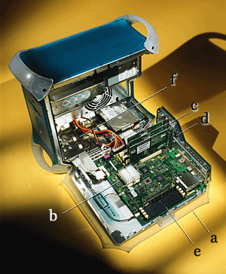
Inside the case
b. Processor
c. PCI slots (for I/O)
e. Memory slots

Slide 9
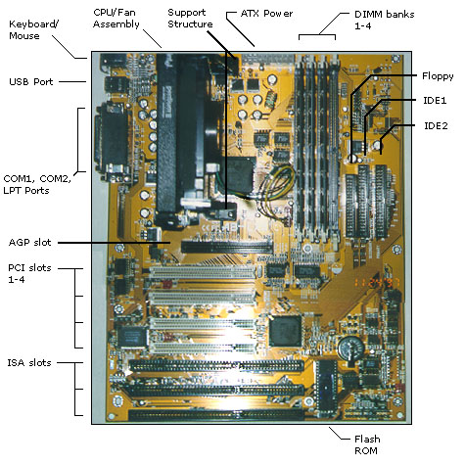
Motherboard

Slide 10

Memory
RAM
DRAM
SRAM
ROM
Volatile / Non-Volatile
Magnetic

Slide 11
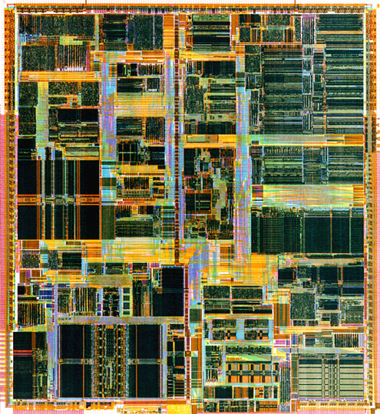
Processor
Pentium III Xeon

Slide 12
You only need switches and wires!
In
Relays
Vacuum tubes
Transistors
Integrated Circuits
VLSI
Nanotubes?
Quantum Effect Devices?
Control
Out

Slide 13
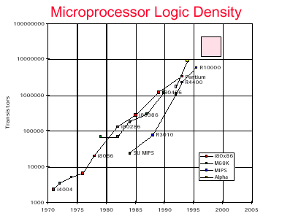
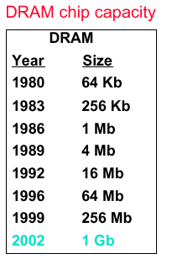
Improving Technology

Slide 14
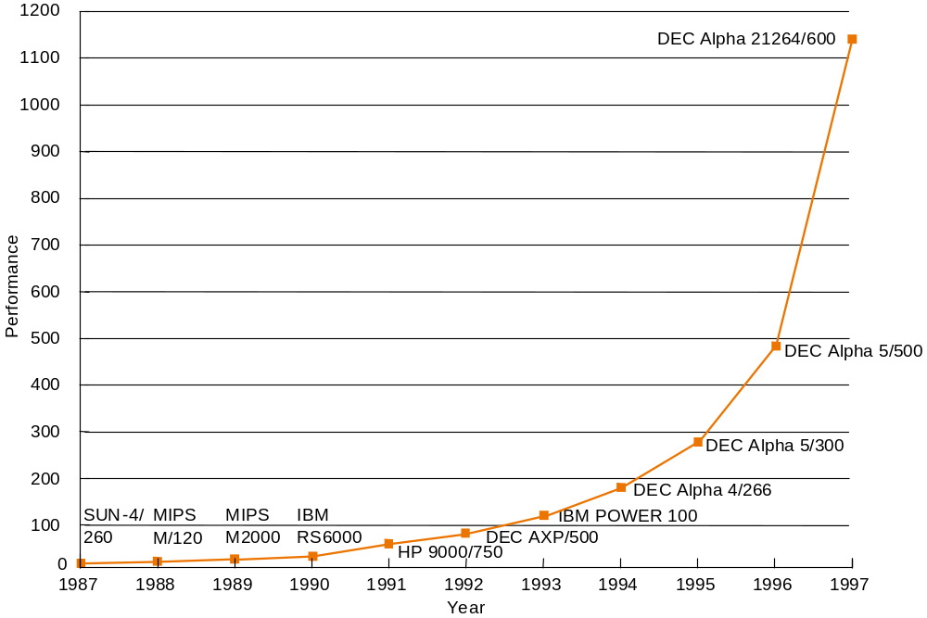
Performance Increase

Slide 15
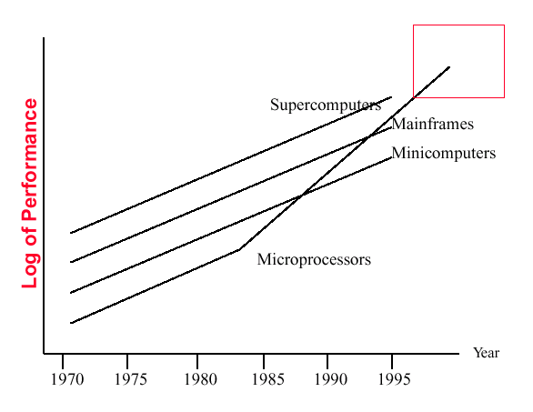
Performance Trends

Slide 16
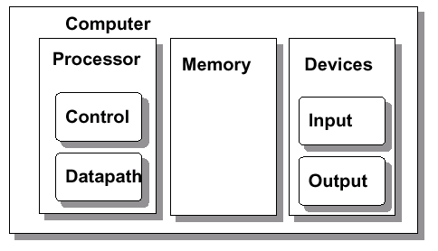
5 Classic Computer Components
Notes:
Even though the speed increases dramatically, the fundamental organization of PCs and the basic underlying commands remain pretty much the same.

Slide 17
Instruction and Operands
Example:
    MOV CX, 25
    ADD AX, CX
Data are in registers or memory.
For now, we will focus on CPU, Registers, and Memory only.
I/O will be discussed later.
Notes:
So, how are those simple commands turned into a fancy web browser?
Consider how a surgeon sees a dancer or movie star (不食人間煙火?). Now you have seen the “guts” and “gory detail” of a PC.

Slide 18
Abstraction: C to ASM
x = (a+b) * b
Assembly
C compiler
MOV AX, a
ADD AX, b
MUL c
MOV x, AX

Slide 19
Abstraction: ASM to Binary
Assembly
Assembler
MOV AX, a
ADD AX, b
MUL c
MOV x, AX
00000000101000010000000000011000
00000000100011100001100000100001
10001100011000100000000000000000
10001100111100100000000000000100
10101100111100100000000000000000
10101100011000100000000000000100 00000011111000000000000000001000
Binary

Slide 20
Acknowledgement
Many slides in this lecture are borrowed from Prof. Gary Bishop’s COMP120 courses.

