Slide 1
CS2422 Assembly Language & System Programming
September 16, 2003

Slide 2
Today’s Topics (1/2)
Data representation – What are stored in the main memory?
  Binary, Decimal, Hexadecimal…etc.
  Units: Byte, Word, Double-word…etc.
  Memory Addresses.
  Characters Strings.
  Big or Little Endian.

Slide 3
Today’s Topics (2/2)
How the CPU executes a program.
Where we can store the data.
  Registers
  Memory
  Constants

Slide 4
Study Guide
Textbook: Sections 1.3, 2.1 (except 2.1.2.2), 2.2, 2.3.
Read (in depth):
  2.1.1 and 2.1.2.1
  2.2.1 and 2.2.2
  2.3.1 and 2.3.2.1
Browse the rest (like reading news stories).

Slide 5
Data Representations
Consider this simple view: The whole program is stored in main memory.
  Including program instructions (code) and data.
  CPU loads the instructions and data from memory for execution.
  Don’t worry about the disk for now.

Slide 6
Number Systems
I assume that you all know:
  Binary & hexadecimal numbers.
  Conversion between them and decimal.
  How to represent negative numbers (in 2’s compliment).

Slide 7
Byte? Word?
The number has limited range.
1 Byte = 8 Bits:
  Binary: 0000 0000 to 1111 1111
  Hexadecimal: 00 to FF
  Decimal: 0 to 255
Word = 2 or 4 bytes, depending on the machine. In 80x86, it means 2 bytes.

Slide 8
Memory Size
Organized like mailboxes, numbered 0, 1, 2, 3,…, 2^{n}-1.
  Each box can hold 8 bits (1 byte)
  So it is called byte-addressing.
…

Slide 9
Memory Addresses
Byte Addressing: each memory location has 8 bits, i.e., one byte.
If we have only 16 bytes…
  Then 4 bits are enough for addresses
What if we have 64K?
1M? 1G?

Slide 10
Memory Address
16-bit address is enough for up to 64K
20-bit for 1M
32-bit for 4G
Most servers need more than 4G!! That’s why we need 64-bit CPUs like Alpha (DEC/Compaq/HP) or Merced (Intel).

Slide 11
Confused Now?
So, is the memory 8-bit or 32-bit?
It depends on what you ask:
  Content or Address?
  Remember addresses can be stored in memory as well. (They are called pointers in PASCAL and C.)

Slide 12
Character String
So how are strings like “Hello, World!” are stored in memory?
ASCII Code!
Each character is stored as a byte.
Review: how is “1234” stored in memory?

Slide 13
Integer
A byte can hold an integer number:
  between 0 and 255 (unsigned) or
  between –128 and 127 (2’s compliment)
How to store a bigger number?
Review: how is 1234 stored in memory?

Slide 14
Big or Little Endian?
Example: 1234 is stored in 2 bytes.
= 100-1101-0010 in binary
= 04 D2 in hexadecimal
Do you store 04 or D2 first?
Big Endian: 04 first.
Little Endian: D2 first.← Intel’s choice

Slide 15
Ancient History -- Segment
IBM PC XT (Intel 8088/8086) is a so-called 16-bit machine.
Each register has 16 bits.
2^16 = 65536 = 64K
But we want to use more memory (640K, 1M)…

Slide 16
Break

Slide 17
…Continued from Last Lecture
Reason for Little-Endian?
  More consistent for variable length (e.g., 2 bytes, 4 bytes, 8 bytes…etc.)

Slide 18
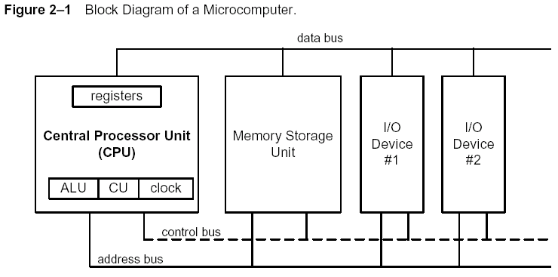
Program Loading & Execution
A simpler view:

Slide 19
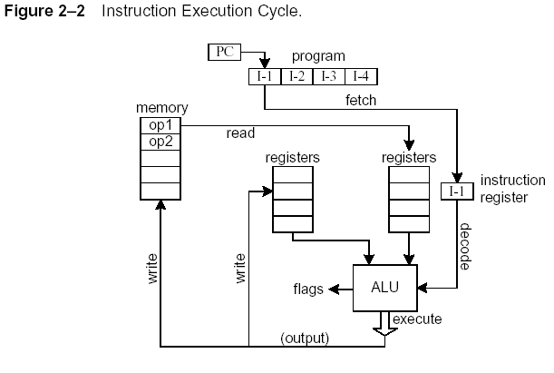
A slightly scarier view:

Slide 20
Clock
Not the wall clock.
Ever wondering what the CPU clock rate (like 2.0GHz) means?
Next slide: using the memory read as an example

Slide 21
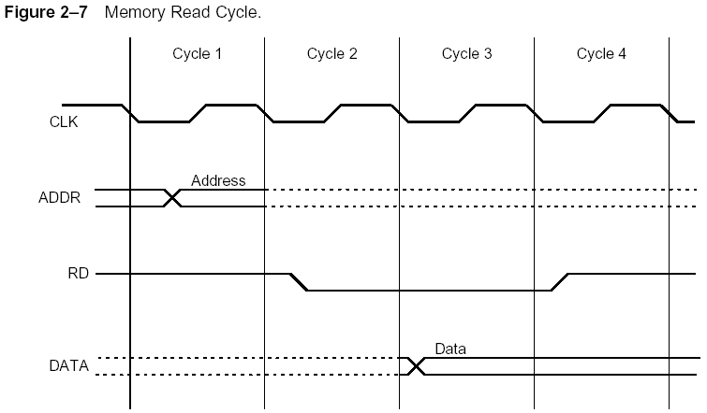
Figure 2.7 (from Textbook)

Slide 22
Where are the Data?
Registers (inside the CPU)
Memory
Constant

Slide 23
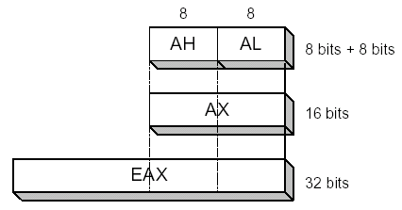
Registers
General-Purpose:
  AX, BX, CX, DX: 16 bits
  Splitted into H and L parts, 8 bits each.
  Extended into E?X to become 32-bit register (i.e., EAX, EBX,…etc.).

Slide 24
Convention
AX: accumulator
BX: base register
CX: count register
DX: data register
Some instructions use them implicitly. (e.g., LOOP uses CX with no mentioning.)

Slide 25
Other Registers
We will explain their meaning when we encounter them later this semester:
Segment (CS, DS, SS, ES)
Pointer (IP, SP, BP)
Index (SI, DI)
Flags

Slide 26
Memory
Byte Addressing: each memory location has 8 bits.
If we have only 16 bytes…
  4 bits are enough for an address
What if we have 64K?
1M? 1G?

Slide 27
Memory Address
A Quick Review:
16-bit address is enough for up to 64K
20-bit for 1M
32-bit for 4G

Slide 28
Segment?
IBM PC XT (Intel 8088/8086) is a so-called 16-bit machine.
Each register has 16 bits.
2^16 = 65536 = 64K
But we want to use more memory (640K, 1M)…

Slide 29
Segment
Segment : Offset
Segment: one of CS, DS, SS, ES
Real address = Segment * 16 + Offset
Overlapping segments. For example:
0000:01F0 = 0001:01E0 = 0010:00F0

Slide 30
Writing the First Program…
MOV AX, var1
MOV BX, 1
ADD AX, BX
MOV var1, AX

Slide 31
Constant (or Immediate) Data
Compare:
  MOV AX, 25
  MOV AX, var1 ; assume var1 at address 25
The constant 25 in the first case is called immediate data.
The second case may be considered as:
  MOV AX, [25]

Slide 32
Food for Thought
Example: MOV AX, 25
But, where is the number stored? In memory?
A related question: where is the instruction (MOV AX, 25) stored?
What do we do if we want to move the data in memory address 25 to AX?

Slide 33
Instruction Set Architecture
... the attributes of a [computing] system as seen by the programmer, i.e. the conceptual structure and functional behavior, as distinct from the organization of the data flows and controls, the logic design, and the physical implementation.
– Amdahl, Blaaw, and Brooks, 1964
interface between hardware and low-level software
standardizes instructions, machine language bit patterns, etc.
advantage: different implementations of the same architecture
disadvantage: sometimes prevents using new innovations

Slide 34
RISC vs. CISC
RISC: PowerPC, MIPS, DEC Alpha
CISC: x86/Pentium, AMD, VAX
Example:
x86 (CISC):
MOV AX, a
ADD AX, b
RISC:
Load R1, a
Load R2, b
Add R2, R1

