Slide 1
CS2422 Assembly Language & System Programming
October 7, 2003

Slide 2
Questions?
Any problem in submitting assignments online?
How to debug in 32-bit mode?
  You may set up Visual Studio to assemble, run, and debug your program!
  http://www.nuvisionmiami.com/books/asm/ide/vs6/index.htm

Slide 3
Today’s Topics
Conditional Processing
  If…then…else
  While…do; Repeat…until

Slide 4
Study Guide
Suggested Order:
  Section 6.1: Introduction
  Section 6.3.1-6.3.4: Conditional Jumps
  Section 6.5: Conditional Structures
  Section 6.2: Boolean Operations
  (Optional): Sections 6.3.5, 6.4, 6.6, 6.7

Slide 5
CMP and Jcond Instruction
The IF statement in C and PASCAL is converted into CMP and Jcond instructions in x86 Assembly:
If (X > op1)
Then
<…>
End If
CMP X, op1
JNG EndIf
<…>
EndIf:

Slide 6
CMP Instruction (1 of 4)
Compares the destination operand to the source operand
  Nondestructive subtraction of source from destination (destination operand is not changed)
Syntax: CMP destination, source
Example: destination == source
mov al,5
cmp al,5 ; Zero flag set

Slide 7
CMP Instruction (2 of 4)
Example: destination > source
(both the Zero and Carry flags are clear)
mov al,6
cmp al,5 ; ZF = 0, CF = 0
The comparisons shown so far were unsigned.

Slide 8
CMP Instruction (3 of 4)
The comparisons shown here are performed with signed integers.
Example: destination > source
mov al,5
cmp al,-2 ; Sign flag = Overflow flag
Example: destination < source
mov al,-1
cmp al,5 ; Sign flag != Overflow flag

Slide 9
CMP Instruction (4 of 4)
Unsigned
CMP Results | ZF | CF
Destination < Source | 0 | 1
Destination > Source | 0 | 0
Destination = Source | 1 | 0
Signed
CMP Result | Flags
Destination < Source | SF ≠ OF
Destination > Source | SF = OF
Destination = Source | ZF = 1

Slide 10
Jcond Instruction
A conditional jump instruction branches to a label when specific register or flag conditions are met
Examples:
  JB, JC jump to a label if the Carry flag is set
  JE, JZ jump to a label if the Zero flag is set
  JS jumps to a label if the Sign flag is set
  JNE, JNZ jump to a label if the Zero flag is clear
  JECXZ jumps to a label if ECX equals 0

Slide 11
Flags and Jcond
How do Jcond instructions decide which way to go?
They check the flags!
Examples:
  JE/JNE checks Zero flag.
  JG/JL checks Sign flag.
CMP instruction sets the flags.

Slide 12
Boolean and Comparison Instructions
AND Instruction
OR Instruction
XOR Instruction
NOT Instruction
TEST Instruction
CMP Instruction

Slide 13


AND Instruction
Performs a Boolean AND operation between each pair of matching bits in two operands
Syntax:
    AND destination, source
  (same operand types as MOV)
AND

Slide 14


OR Instruction
Performs a Boolean OR operation between each pair of matching bits in two operands
Syntax:
    OR destination, source
OR

Slide 15

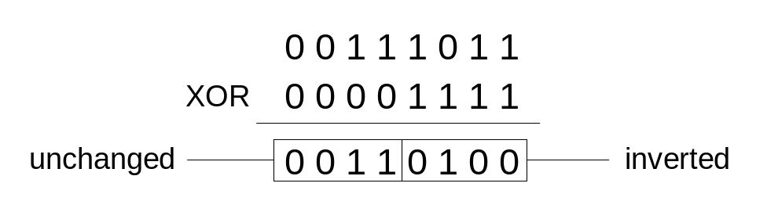
XOR Instruction
Performs a Boolean exclusive-OR operation between each pair of matching bits in two operands
Syntax:
    XOR destination, source
XOR
XOR is a useful way to toggle (invert) the bits in an operand.

Slide 16

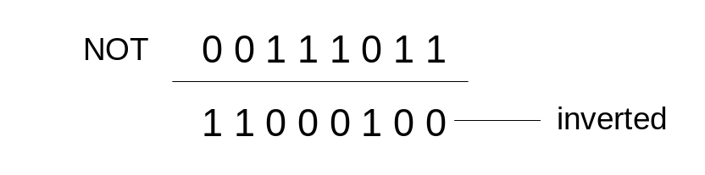
NOT Instruction
Performs a Boolean NOT operation on a single destination operand
Syntax:
    NOT destination
NOT

Slide 17
Application – An Example
Task: Convert the character in AL to upper case.
Solution: Use the AND instruction to clear bit 5.
mov al,'a‘ ; AL = 01100001b
and al,11011111b ; AL = 01000001b

Slide 18
TEST Instruction
Performs a nondestructive AND operation between each pair of matching bits in two operands
No operands are modified, but the Zero flag is affected.
Example: jump to a label if either bit 0 or bit 1 in AL is set.
test al,00000011b
jnz ValueFound

Slide 19
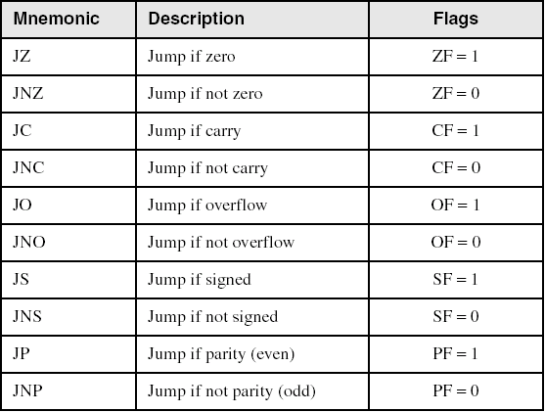
Jumps Based on Specific Flags

Slide 20
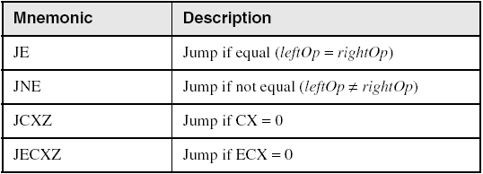
Jumps Based on Equality

Slide 21
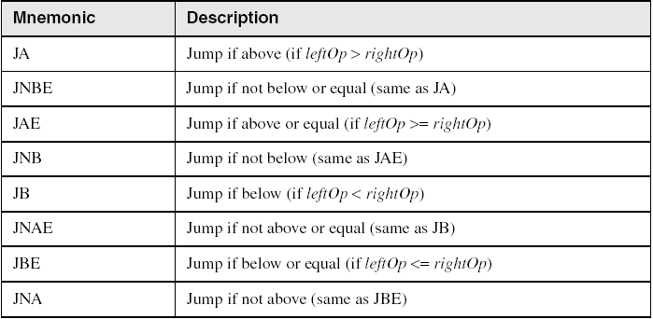
Jumps Based on Unsigned Comparisons

Slide 22
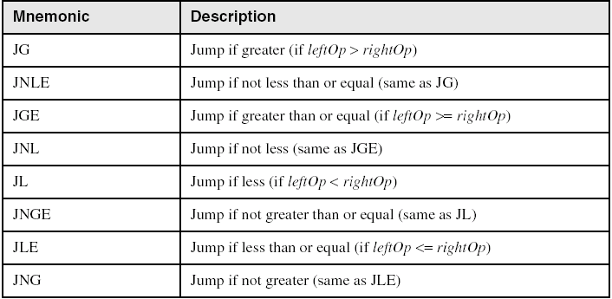
Jumps Based on Signed Comparisons

Slide 23
More Frequently Used Jcond Instructions
JE (Equal)
JNE (Not Equal)
JG or JGE (Greater Than or Equal)
JL or JLE (Less Than or Equal)
Note: JG=JNLE, JGE=JNL, …etc.

Slide 24
Simple IF
If (op1=op2) then <…> end if
Two different approaches:
CMP op1, op2
JE True
JMP EndIf
True:
<…>
EndIf
CMP op1, op2
JNE False
<…>
False:

Slide 25
IF … OR …
CMP X, op1
JG True
CMP Y, op2
JLE True
CMP …
…
…
JMP EndIf
True:
<…>
EndIf:
If (X > op1) or
(Y <=op2) or
…
Then
<…>
End If

Slide 26
Exercise
Can you rewrite the last slide and remove the “JMP EndIf”?
How about adding the “else” part?

Slide 27
IF … AND …
CMP X, op1
JNG EndIf
CMP Y, op2
JNLE EndIf
CMP …
…
…
<…>
EndIf:
If (X > op1)and
(Y <=op2)and
…
Then
<…>
End If

Slide 28
WHILE
While:
CMP op1, op2
JNL EndDo
<…>
JMP While
EndDo:
DO WHILE(op1<op2)
<…>
END DO

Slide 29
REPEAT UNTIL
repeat:
<…>
CMP X, op1
JE EndIf
CMP Y, op2
JNG repeat
EndIf:
REPEAT
<…>
UNTIL(X = op1) or
(Y > op2)

Slide 30
More Exercises
Write the code for the CASE statement.
AND conditions in REPEAT-UNTIL?
repeat:
<…>
CMP ?
?
?
EndIf:
REPEAT
<…>
UNTIL (X=op1) and
(Y>op2)

