Slide 1
CS2422 Assembly Language & System Programming
October 9, 2003

Slide 2
Today’s Topics
Conditional Processing (The rest of Chapter 6)
  Conditional Loop
  .IF, .WHILE, .REPEAT Directives

Slide 3
Study Guide
Sections 6.4 and 6.7

Slide 4
A Quick Review –
CMP and Jcond Instruction
The IF statement in C and PASCAL is converted into CMP and Jcond instructions in x86 Assembly:
If (X > op1)
Then
<…>
End If
CMP X, op1
JNG EndIf
<…>
EndIf:

Slide 5
Rest of Chapter 6
Conditional Loop Instructions.
Finite State Machine (not covered today)
.IF, .WHILE, and .REPEAT Directives (note: not Instructions)

Slide 6
Conditional Loop Instructions
LOOPZ and LOOPE
LOOPNZ and LOOPNE

Slide 7
LOOPZ and LOOPE
Syntax:
  LOOPE destination
  LOOPZ destination
Logic:
  ECX ← ECX – 1
  if ECX > 0 and ZF=1, jump to destination
Useful when scanning an array for the first element that does not match a given value.

Slide 8
LOOPNZ and LOOPNE
Syntax:
LOOPNZ destination
LOOPNE destination
Logic:
  ECX ← ECX – 1;
  if ECX > 0 and ZF=0, jump to destination
Useful when scanning an array for the first element that matches a given value.

Slide 9
LOOPNZ Example
The following code finds the first positive value in an array:
.data
array SWORD -3,-6,-1,-10,10,30,40,4
.code
  mov esi,OFFSET array
  mov ecx,LENGTHOF array
  sub esi,TYPE array
next:
  add esi, TYPE array
  test WORD PTR [esi],8000h ; test sign bit
  loopnz next ; continue loop
  jnz quit ; none found
  … ; ESI points to value
quit:

Slide 10
Using the .IF Directive
Runtime Expressions
Relational and Logical Operators
MASM-Generated Code
.REPEAT Directive
.WHILE Directive

Slide 11
Runtime Expressions
.IF, .ELSE, .ELSEIF, and .ENDIF can be used to evaluate runtime expressions and create block-structured IF statements.
Examples:
.IF eax>ebx
mov edx,1
.ELSE
mov edx,2
.ENDIF
.IF eax>ebx && eax>ecx
mov edx,1
.ELSE
mov edx,2
.ENDIF
MASM generates "hidden" code for you, consisting of code labels, CMP and conditional jump instructions.

Slide 12
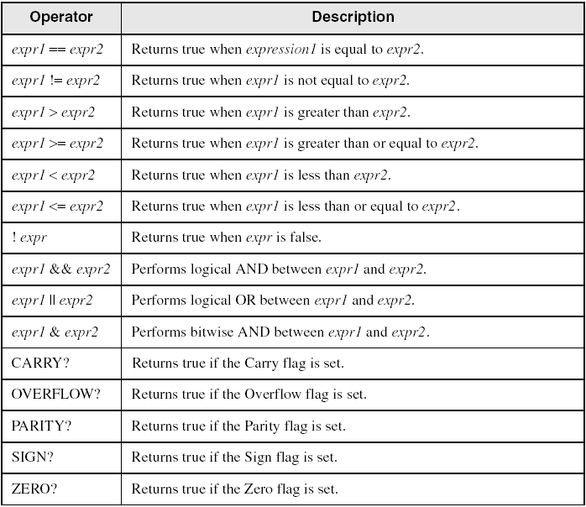
Relational and Logical Operators

Slide 13
MASM-Generated Code
.data
val1 DWORD 5
result DWORD ?
.code
mov eax,6
.IF eax > val1
mov result,1
.ENDIF
Generated code:
mov eax,6
cmp eax,val1
jbe @C0001
mov result,1
@C0001:
MASM automatically generates an unsigned jump (JBE).

Slide 14
MASM-Generated Code
.data
val1 SDWORD 5
result SDWORD ?
.code
mov eax,6
.IF eax > val1
mov result,1
.ENDIF
Generated code:
mov eax,6
cmp eax,val1
jle @C0001
mov result,1
@C0001:
MASM automatically generates a signed jump (JLE).

Slide 15
.REPEAT Directive
Executes the loop body before testing the loop condition associated with the .UNTIL directive.
Example:
; Display integers 1 – 10:
mov eax,0
.REPEAT
inc eax
call WriteDec
call Crlf
.UNTIL eax == 10

Slide 16
.WHILE Directive
Tests the loop condition before executing the loop body The .ENDW directive marks the end of the loop.
Example:
; Display integers 1 – 10:
mov eax,0
.WHILE eax < 10
inc eax
call WriteDec
call Crlf
.ENDW

Slide 17
When to Use or Not to Use Directives?
Directives make assembly language easier to write and to understand, by hiding tedious work. (Food for thought: Wouldn’t it be even better to use C language?)
Don’t use directives if you want to have total control.

