Slide 1
CS2422 Assembly Language & System Programming
October 16, 2003

Slide 2
Today’s Topics
IA-32 Memory
Have some fun with emulators (Apple II and MAME).

Slide 3
Study Guide
Section 2.2: IA-32 Processor
Section 2.3: IA-32 Memory Management

Slide 4
Modes of Operation
Protected mode
  native mode (Windows, Linux)
Real-address mode
  native MS-DOS
System management mode
  power management, system security, diagnostics
Virtual-8086 mode
  hybrid of Protected
  each program has its own 8086 computer

Slide 5
Addressable Memory
Protected mode
  4 GB
  32-bit address
Real-address and Virtual-8086 modes
  1 MB space
  20-bit address

Slide 6
Early Intel Microprocessors
Intel 8080
  64K addressable RAM
  8-bit registers
  CP/M operating system
  S-100 BUS architecture
  8-inch floppy disks!
Intel 8086/8088
  IBM-PC Used 8088
  1 MB addressable RAM
  16-bit registers
  16-bit data bus (8-bit for 8088)
  separate floating-point unit (8087)

Slide 7
The IBM-AT
Intel 80286
  16 MB addressable RAM
  Protected memory
  several times faster than 8086
  introduced IDE bus architecture
  80287 floating point unit

Slide 8
Intel IA-32 Family
Intel386
  4 GB addressable RAM, 32-bit registers, paging (virtual memory)
Intel486
  instruction pipelining
Pentium
  superscalar, 32-bit address bus, 64-bit internal data path

Slide 9
IA-32 Memory Management
Real-address mode
Calculating linear addresses
Protected mode
Multi-segment model
Paging

Slide 10
Real-Address mode
1 MB RAM maximum addressable
Application programs can access any area of memory
Single tasking
Supported by MS-DOS operating system

Slide 11

Segmented Memory
Segmented memory addressing: absolute (linear) address is a combination of a 16-bit segment value added to a 16-bit offset
one segment
linear addresses

Slide 12
Calculating Linear Addresses
Given a segment address, multiply it by 16 (add a hexadecimal zero), and add it to the offset
Example: convert 08F1:0100 to a linear address
Adjusted Segment value: 0 8 F 1 0
Add the offset: 0 1 0 0
Linear address: 0 9 0 1 0

Slide 13
Protected Mode (1 of 2)
4 GB addressable RAM
  (00000000 to FFFFFFFFh)
Each program assigned a memory partition which is protected from other programs
Designed for multitasking
Supported by Linux & MS-Windows

Slide 14
Protected mode (2 of 2)
Segment descriptor tables
Program structure
  code, data, and stack areas
  CS, DS, SS segment descriptors
  global descriptor table (GDT)
MASM Programs use the Microsoft flat memory model

Slide 15
Multi-Segment Model
Each program has a local descriptor table (LDT)
  holds descriptor for each segment used by the program

Slide 16
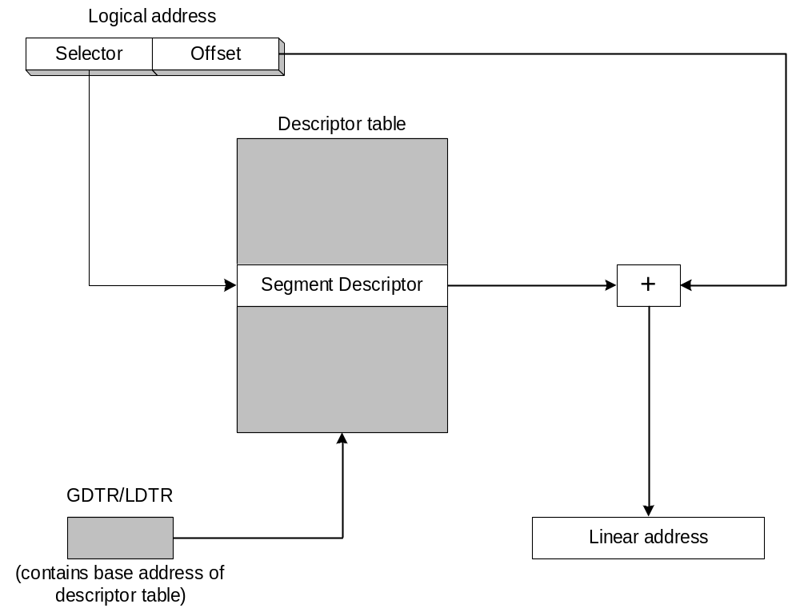
Converting Logical to Linear Address
The segment selector points to a segment descriptor, which contains the base address of a memory segment. The 32-bit offset from the logical address is added to the segment’s base address, generating a 32-bit linear address.

Slide 17
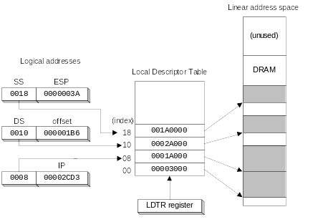
Indexing into a Descriptor Table
Each segment descriptor indexes into the program's local descriptor table (LDT). Each table entry is mapped to a linear address:

Slide 18
Paging
Supported directly by the CPU
Divides each segment into 4096-byte blocks called pages
Sum of all programs can be larger than physical memory
Part of running program is in memory, part is on disk
Virtual memory manager (VMM) – OS utility that manages the loading and unloading of pages
Page fault – issued by CPU when a page must be loaded from disk

Slide 19
For More Information
See Section 11.3

