Slide 1
CS2422 Assembly Language & System Programming
November 6, 2003

Slide 2
Today’s Topics
Integer Arithmetic
  Shift and Rotate
  Multiplication and Division
  Extended Addition and Subtraction

Slide 3
Study Guide
Sections 7.2 and 7.3: Shift and Rotate (except 7.2.8)
Section 7.4: Multiplication and Division
Section 7.5: Extended Addition and Subtraction

Slide 4
Shift and Rotate Instructions
SHL
SHR
SAL and SAR
ROL
ROR
RCL and RCR
SHLD/SHRD

Slide 5


Logical vs Arithmetic Shifts
A logical shift fills the newly created bit position with zero:
An arithmetic shift fills the newly created bit position with a copy of the number’s sign bit:

Slide 6

SHL Instruction
The SHL (shift left) instruction performs a logical left shift on the destination operand, filling the lowest bit with 0.
Operand types:
SHL reg,imm8
SHL mem,imm8
SHL reg,CL
SHL mem,CL

Slide 7

Fast Multiplication
Shifting left 1 bit multiplies a number by 2
mov dl,5
shl dl,1
Shifting left n bits multiplies the operand by 2^{n}
For example, 5 * 2² = 20
mov dl,5
shl dl,2 ; DL = 20

Slide 8
Binary Multiplication
We already know that SHL performs unsigned multiplication efficiently when the multiplier is a power of 2.
You can factor a binary number into powers of 2.
  For example, to multiply EAX * 36, factor 36 into 32 + 4 and use the distributive property of multiplication to carry out the operation:
EAX * 36
= EAX * (32 + 4)
= (EAX * 32)+(EAX * 4)
mov eax,123
mov ebx,eax
shl eax,5 ; mult by 2⁵
shl ebx,2 ; mult by 2²
add eax,ebx

Slide 9
SHR Instruction
The SHR (shift right) instruction performs a logical right shift on the destination operand. The highest bit position is filled with a zero.
Shifting right n bits divides the operand by 2^{n}
mov dl,80
shr dl,1 ; DL = 40
shr dl,2 ; DL = 10

Slide 10
SAL and SAR Instructions
SAL (shift arithmetic left) is identical to SHL.
SAR (shift arithmetic right) performs a right arithmetic shift on the destination operand.
An arithmetic shift preserves the number's sign.
mov dl,-80
sar dl,1 ; DL = -40
sar dl,2 ; DL = -10

Slide 11

ROL Instruction
ROL (rotate) shifts each bit to the left
The highest bit is copied into both the Carry flag and into the lowest bit
No bits are lost
mov al,11110000b
rol al,1 ; AL = 11100001b
mov dl,3Fh
rol dl,4 ; DL = F3h

Slide 12

ROR Instruction
ROR (rotate right) shifts each bit to the right
The lowest bit is copied into both the Carry flag and into the highest bit
No bits are lost
mov al,11110000b
ror al,1 ; AL = 01111000b
mov dl,3Fh
ror dl,4 ; DL = F3h

Slide 13
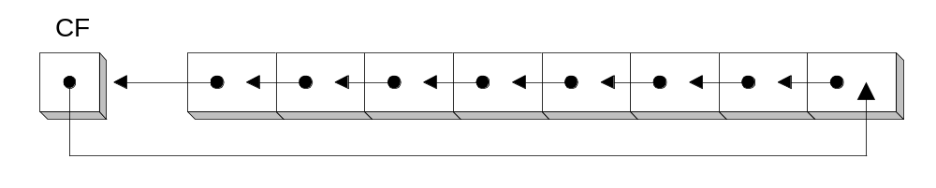
RCL Instruction
RCL (rotate carry left) shifts each bit to the left
Copies the Carry flag to the least significant bit
Copies the most significant bit to the Carry flag
clc ; CF = 0
mov bl,88h ; CF,BL = 0 10001000b
rcl bl,1 ; CF,BL = 1 00010000b
rcl bl,1 ; CF,BL = 0 00100001b

Slide 14
RCR Instruction
RCR (rotate carry right) shifts each bit to the right
Copies the Carry flag to the most significant bit
Copies the least significant bit to the Carry flag
stc ; CF = 1
mov ah,10h ; CF,AH = 00010000 1
rcr ah,1 ; CF,AH = 10001000 0

Slide 15
SHLD Instruction
Shifts a destination operand a given number of bits to the left
The bit positions opened up by the shift are filled by the most significant bits of the source operand
The source operand is not affected
Syntax:
  SHLD destination, source, count

Slide 16
SHLD Example
Shift wval 4 bits to the left and replace its lowest 4 bits with the high 4 bits of AX:
.data
wval WORD 9BA6h
.code
mov ax,0AC36h
shld wval,ax,4
Before:
After:

Slide 17
SHRD Instruction
Shifts a destination operand a given number of bits to the right
The bit positions opened up by the shift are filled by the least significant bits of the source operand
The source operand is not affected
Syntax:
  SHRD destination, source, count

Slide 18
SHRD Example
Shift AX 4 bits to the right and replace its highest 4 bits with the low 4 bits of DX:
mov ax,234Bh
mov dx,7654h
shrd ax,dx,4
Before:
After:

Slide 19
Shift and Rotate Applications
Shifting Multiple Doublewords
Binary Multiplication
Displaying Binary Bits
Isolating a Bit String

Slide 20
Binary Multiplication
We already know that SHL performs unsigned multiplication efficiently when the multiplier is a power of 2.
You can factor a binary number into powers of 2.
  For example, to multiply EAX * 36, factor 36 into 32 + 4 and use the distributive property of multiplication to carry out the operation:
EAX * 36
= EAX * (32 + 4)
= (EAX * 32)+(EAX * 4)
mov eax,123
mov ebx,eax
shl eax,5 ; mult by 2⁵
shl ebx,2 ; mult by 2²
add eax,ebx

Slide 21
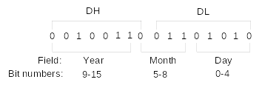
Isolating a Bit String
The MS-DOS file date field packs the year, month, and day into 16 bits:
Isolate the Month field:
mov ax,dx ; make a copy of DX
shr ax,5 ; shift right 5 bits
and al,00001111b ; clear bits 4-7
mov month,al ; save in month variable

Slide 22
Multiplication and Division Instructions
MUL Instruction
IMUL Instruction
DIV Instruction
Signed Integer Division

Slide 23
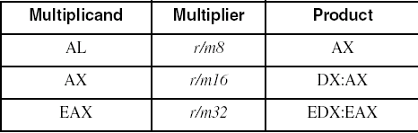
MUL Instruction
The MUL (unsigned multiply) instruction multiplies an 8-, 16-, or 32-bit operand by either AL, AX, or EAX.
The instruction formats are:
    MUL r/m8
    MUL r/m16
    MUL r/m32
Implied operands:

Slide 24
MUL Examples
100h * 2000h, using 16-bit operands:
.data
val1 WORD 2000h
val2 WORD 100h
.code
mov ax,val1
mul val2 ; DX:AX = 00200000h, CF=1
The Carry flag indicates whether or not the upper half of the product contains significant digits.
12345h * 1000h, using 32-bit operands:
mov eax,12345h
mov ebx,1000h
mul ebx ; EDX:EAX = 0000000012345000h, CF=0

Slide 25
IMUL Instruction
IMUL (signed integer multiply ) multiplies an 8-, 16-, or 32-bit signed operand by either AL, AX, or EAX
Preserves the sign of the product by sign-extending it into the upper half of the destination register
Example: multiply 48 * 4, using 8-bit operands:
mov al,48
mov bl,4
imul bl ; AX = 00C0h, OF=1
OF=1 because AH is not a sign extension of AL.

Slide 26
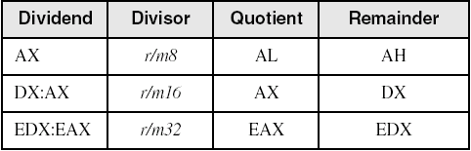
DIV Instruction
The DIV (unsigned divide) instruction performs 8-bit, 16-bit, and 32-bit division on unsigned integers
A single operand is supplied (register or memory operand), which is assumed to be the divisor
Instruction formats:
    DIV r/m8
    DIV r/m16
    DIV r/m32
Default Operands:

Slide 27
DIV Examples
Divide 8003h by 100h, using 16-bit operands:
mov dx,0 ; clear dividend, high
mov ax,8003h ; dividend, low
mov cx,100h ; divisor
div cx ; AX = 0080h, DX = 3
Same division, using 32-bit operands:
mov edx,0 ; clear dividend, high
mov eax,8003h ; dividend, low
mov ecx,100h ; divisor
div ecx ; EAX = 00000080h, DX = 3

Slide 28
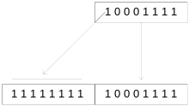
Signed Integer Division
Signed integers must be sign-extended before division takes place
  fill high byte/word/doubleword with a copy of the low byte/word/doubleword's sign bit
For example, the high byte contains a copy of the sign bit from the low byte:

Slide 29
CBW, CWD, CDQ Instructions
The CBW, CWD, and CDQ instructions provide important sign-extension operations:
  CBW (convert byte to word) extends AL into AH
  CWD (convert word to doubleword) extends AX into DX
  CDQ (convert doubleword to quadword) extends EAX into EDX
For example:
    mov eax,0FFFFFF9Bh
    cdq ; EDX:EAX = FFFFFFFF FFFFFF9Bh

Slide 30
IDIV Instruction
IDIV (signed divide) performs signed integer division
Uses same operands as DIV
Example: 8-bit division of –48 by 5
mov al,-48
cbw ; extend AL into AH
mov bl,5
idiv bl ; AL = -9, AH = -3

Slide 31
IDIV Examples
Example: 16-bit division of –48 by 5
mov ax,-48
cwd ; extend AX into DX
mov bx,5
idiv bx ; AX = -9, DX = -3
Example: 32-bit division of –48 by 5
mov eax,-48
cdq ; extend EAX into EDX
mov ebx,5
idiv ebx ; EAX= -9, EDX= -3

Slide 32
Extended Addition and Subtraction
ADC Instruction
Extended Addition Example
SBB Instruction

Slide 33
ADC Instruction
ADC (add with carry) instruction adds both a source operand and the contents of the Carry flag to a destination operand.
Example: Add two 32-bit integers (FFFFFFFFh + FFFFFFFFh), producing a 64-bit sum:
    mov edx,0
    mov eax,0FFFFFFFFh
    add eax,0FFFFFFFFh
    adc edx,0
    ;EDX:EAX = 00000001 FFFFFFFEh

Slide 34
Extended Addition Example
Add two integers of any size
Pass pointers to the addends and sum
ECX indicates the number of words
L1: mov eax,[esi] ; get the first integer
adc eax,[edi] ; add the second integer
pushfd ; save the Carry flag
mov [ebx],eax ; store partial sum
add esi,4 ; advance all 3 pointers
add edi,4
add ebx,4
popfd ; restore the Carry flag
loop L1 ; repeat the loop
adc word ptr [ebx],0 ; add any leftover carry

Slide 35
SBB Instruction
The SBB (subtract with borrow) instruction subtracts both a source operand and the value of the Carry flag from a destination operand.
The following example code performs 64-bit subtraction. It sets EDX:EAX to 0000000100000000h and subtracts 1 from this value. The lower 32 bits are subtracted first, setting the Carry flag. Then the upper 32 bits are subtracted, including the Carry flag:
    mov edx,1 ; upper half
    mov eax,0 ; lower half
    sub eax,1 ; subtract 1
    sbb edx,0 ; subtract upper half

