Slide 1
CS2422 Assembly Language & System Programming
November 13, 2003

Slide 2
Today’s Topics
Hardware Control using I/O Ports

Slide 3
Study Guide
Section 17.1 (on the CD-ROM)

Slide 4
Last week, we learn how the files are built from disk sectors.
But…, how do we control the I/O devices? For example, how do we control the disk to read or write the sectors?
We will use the PC internal speaker as an example.

Slide 5
I/O Ports for PC Speakers
I/O Port 61h (bits 1 and 0) controls its on and off.
Port 42h (count) sets the frequency.
How do I know which ports?
How do I know what to send to the port?

Slide 6
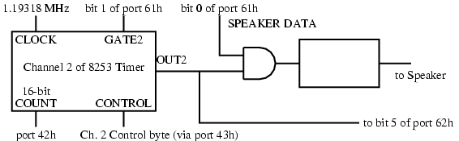

Slide 7
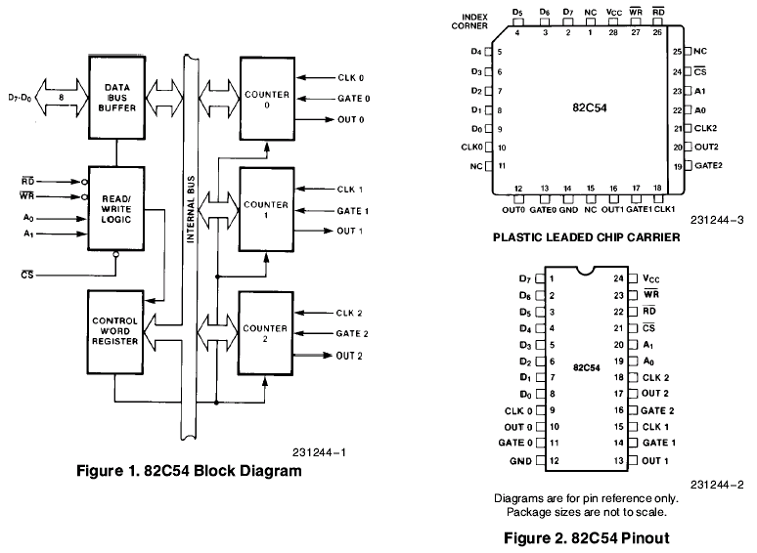

Slide 8
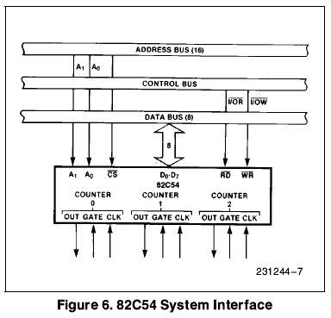

Slide 9
INCLUDE Irvine16.inc
speaker = 61h ; address of speaker port
timer = 42h ; address of timer port
startPitch = 60
.code
main PROC
in al,speaker ; get speaker status
push ax ; save status
or al,00000011b ; set lowest 2 bits
out speaker,al ; turn speaker on
mov al,startPitch ; starting pitch
L2:
out timer,al ; timer port: pulses speaker

Slide 10
Preview of Thursday Class
These slides are related to Chapter 11 of Irvine’s book. It’s an overview of Win32 programming in assembly. However, in this course, we will teach the windows programming in C, not in assembly.

Slide 11
MessageBox Function
Displays text in a box that pops up and waits for the user to click on a button:
MessageBox PROTO,
hWnd:DWORD,
pText:PTR BYTE,
pCaption:PTR BYTE,
style:DWORD
hWnd is a handle to the current window. pText points to a null-terminated string that will appear inside the box. pCaption points to a null-terminated string that will appear in the box’s caption bar. style is an integer that describes both the dialog box’s icon (optional) and the buttons (required).

Slide 12
MessageBox Example
Displays a message box that shows a question, including an OK button and a question-mark icon:
.data
hMainWnd DWORD ?
QuestionText BYTE "Register this program now?"
QuestionTitle BYTE "Trial Period Has Expired"
.code
INVOKE MessageBox,
hMainWnd,
ADDR QuestionText,
ADDR QuestionTitle,
MB_OK + MB_ICONQUESTION

Slide 13
WinMain Procedure
Every Windows application needs a startup procedure, usually named WinMain, which is responsible for the following tasks:
Get a handle to the current program
Load the program’s icon and mouse cursor
Register the program’s main window class and identify the procedure that will process event messages for the window
Create the main window
Show and update the main window
Begin a loop that receives and dispatches messages

Slide 14
WinProc Procedure
WinProc receives and processes all event messages relating to a window
  Some events are initiated by clicking and dragging the mouse, pressing keyboard keys, and so on
WinProc decodes each message, carries out application-oriented tasks related to the message
WinProc PROC,
hWnd:DWORD, ; handle to the window
localMsg:DWORD, ; message ID
wParam:DWORD, ; parameter 1 (varies)
lParam:DWORD ; parameter 2 (varies)
(Contents of wParam and lParam vary, depending on the message.)

Slide 15
Sample WinProc Messages
In the example program from this chapter, the WinProc procedure handles three specific messages:
  WM_LBUTTONDOWN, generated when the user presses the left mouse button
  WM_CREATE, indicates that the main window was just created
  WM_CLOSE, indicates that the application’s main window is about to close
(many other messages are possible)

Slide 16
Message Loop
In WinMain, the message loop receives and dispatches (relays) messages:
Message_Loop:
; Get next message from the queue.
INVOKE GetMessage, ADDR msg, NULL,NULL,NULL
; Quit if no more messages.
.IF eax == 0
jmp Exit_Program
.ENDIF
; Relay the message to the program's WinProc.
INVOKE DispatchMessage, ADDR msg
jmp Message_Loop

Slide 17
Processing Messages
WinProc receives each message and decides what to do with it:
WinProc PROC, hWnd:DWORD, localMsg:DWORD,
wParam:DWORD, lParam:DWORD
mov eax, localMsg
.IF eax == WM_LBUTTONDOWN ; mouse button?
INVOKE MessageBox, hWnd, ADDR PopupText,
ADDR PopupTitle, MB_OK
jmp WinProcExit
.ELSEIF eax == WM_CREATE ; create window?
INVOKE MessageBox, hWnd, ADDR AppLoadMsgText,
ADDR AppLoadMsgTitle, MB_OK
jmp WinProcExit
(etc.)

Slide 18
Program Listing
View the program listing (WinApp.asm)
Run the program
When linking the program, remember to replace
/SUBSYSTEM:CONSOLE
with: /SUBSYSTEM:WINDOWS

Slide 19
Backup Slides…
These slides are from Kip Irvine’s CD-ROM. I feel that they are more confusing than useful, so they are moved to here as backup slides.

Slide 20
Writing a Graphical Windows Application
Required Files
POINT, RECT Structures
MSGStruct, WNDCLASS Structures
MessageBox Function
WinMain, WinProc Procedures
ErrorHandler Procedure
Message Loop & Processing Messages
Program Listing

Slide 21
POINT and RECT Structures
POINT - X, Y screen coordinates
RECT - Holds the graphical coordinates of two opposing corners of a rectangle
POINT STRUCT
ptX DWORD ?
ptY DWORD ?
POINT ENDS
RECT STRUCT
left DWORD ?
top DWORD ?
right DWORD ?
bottom DWORD ?
RECT ENDS

Slide 22
MSGStruct Structure
MSGStruct - holds data for MS-Windows messages (usually passed by the system and received by your application):
MSGStruct STRUCT
msgWnd DWORD ?
msgMessage DWORD ?
msgWparam DWORD ?
msgLparam DWORD ?
msgTime DWORD ?
msgPt POINT <>
MSGStruct ENDS

Slide 23
WNDCLASS Structure (1 of 2)
Each window in a program belongs to a class, and each program defines a window class for its main window:
WNDCLASS STRUC
style DWORD ? ; window style options
lpfnWndProc DWORD ? ; WinProc function pointer
cbClsExtra DWORD ? ; shared memory
cbWndExtra DWORD ? ; number of extra bytes
hInstance DWORD ? ; handle to current program
hIcon DWORD ? ; handle to icon
hCursor DWORD ? ; handle to cursor
hbrBackground DWORD ? ; handle to background brush
lpszMenuName DWORD ? ; pointer to menu name
lpszClassName DWORD ? ; pointer to WinClass name
WNDCLASS ENDS

Slide 24
WNDCLASS Structure (2 of 2)
style is a conglomerate of different style options, such as WS_CAPTION and WS_BORDER, that control the window’s appearance and behavior.
lpfnWndProc is a pointer to a function (in our program) that receives and processes event messages triggered by the user.
cbClsExtra refers to shared memory used by all windows belonging to the class. Can be null.
cbWndExtra specifies the number of extra bytes to allocate following the window instance.
hInstance holds a handle to the current program instance.
hIcon and hCursor hold handles to icon and cursor resources for the current program.
hbrBackground holds a background (color) brush.
lpszMenuName points to a menu string.
lpszClassName points to a null-terminated string containing the window’s class name.

