Slide 1
CS2422 Assembly Language & System Programming
November 18, 2003

Slide 2
Today’s Topic
Chapter 1 of Beck’s “System Software” book.

Slide 3
Study Guide
1.1 Introduction
1.2 System Software and Machine Architecture
1.3 The Simplified Instructional Computer (SIC)
  SIC Machine Architecture
  SIC/XE Machine Architecture
  SIC Programming Examples

Slide 4
Introduction
Definition of System software
  System software consists of a variety of programs that support the operation of a computer
E.g. of system software
  Text editor, compiler, loader or linker, debugger, macro processors, operating system, database management systems, software engineering tools, ….

Slide 5
System Software and Machine Architecture (1/2)
One characteristic in which most system software differs from application software is machine dependency
System programs are intended to support the operation and use of the computer itself, rather than any particular application.

Slide 6
System Software and Machine Architecture (2/2)
Because most system software is machine-dependent, we must include real machines and real pieces of software in our study.
Simplified Instructional Computer (SIC)
  SIC is a hypothetical computer that has been carefully designed to include the hardware features most often found on real machines, while avoiding unusual or irrelevant complexities

Slide 7
The Simplified Instructional Computer (SIC)
Like many other products, SIC comes in two versions
  The standard model
  An XE version
    “extra equipments”, “extra expensive”
The two versions has been designed to be upward compatible

Slide 8
SIC Machine Architecture (1/7)
Memory
  Memory consists of 8-bit bytes
  Any 3 consecutive bytes form a word (24 bits)
  Total of 32768 (2¹⁵) bytes in the computer memory

Slide 9
SIC Machine Architecture (2/7)
Registers
  Five registers
  Each register is 24 bits in length
Mnemonic | Number | Special use
A | 0 | Accumulator
X | 1 | Index register
L | 2 | Linkage register
PC | 8 | Program counter
SW | 9 | Status word

Slide 10
SIC Machine Architecture (3/7)
Data Formats
  Integers are stored as 24-bit binary number
  2’s complement representation for negative values
  Characters are stored using 8-bit ASCII codes
  No floating-point hardware on the standard version of SIC

Slide 11
SIC Machine Architecture (4/7)
Instruction Formats
  Standard version of SIC
8 | 1 | 15
opcode | x | address
The flag bit x is used to indicate indexed-addressing mode

Slide 12
SIC Machine Architecture (5/7)
Addressing Modes
  There are two addressing modes available
    Indicated by x bit in the instruction
Mode | Indication | Target address calculation
Direct | x=0 | TA=address
Indexed | x=1 | TA=address+(X)
(X): the contents of register X

Slide 13
SIC Machine Architecture (6/7)
Instruction Set
  Load and store registers
    LDA, LDX, STA, STX, etc.
    Integer arithmetic operations
      ADD, SUB, MUL, DIV
      All arithmetic operations involve register A and a word in memory, with the result being left in A
    COMP
    Conditional jump instructions
      JLT, JEQ, JGT
    Subroutine linkage
      JSUB, RSUB
    See appendix A, Page 495

Slide 14
SIC Machine Architecture (7/7)
Input and Output
  Input and output are performed by transferring 1 byte at a time to or from the rightmost 8 bits of register A
    Test Device TD instruction
    Read Data (RD)
    Write Data (WD)

Slide 15
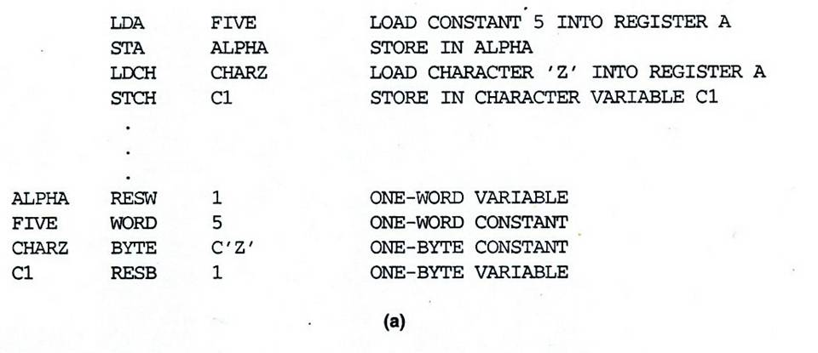
SIC Programming Examples (Fig 1.2a)

Slide 16
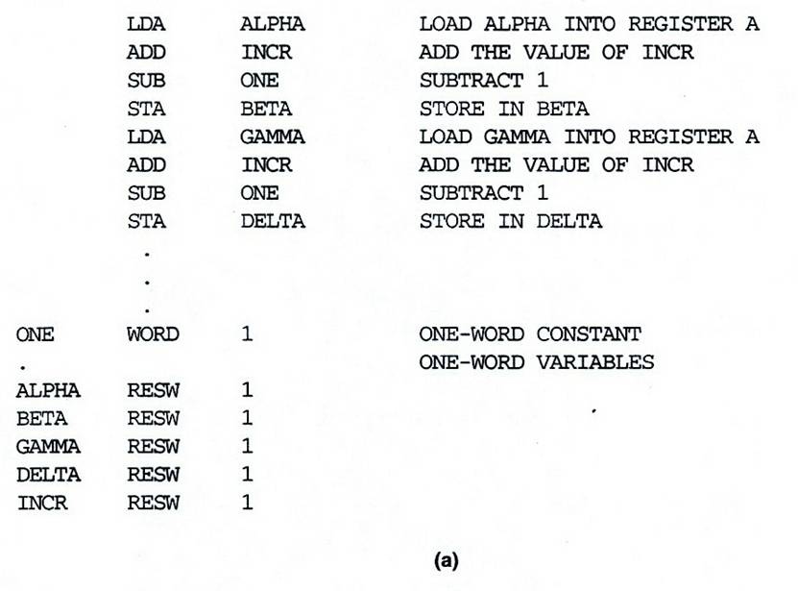
SIC Programming Example (Fig 1.3a)

Slide 17
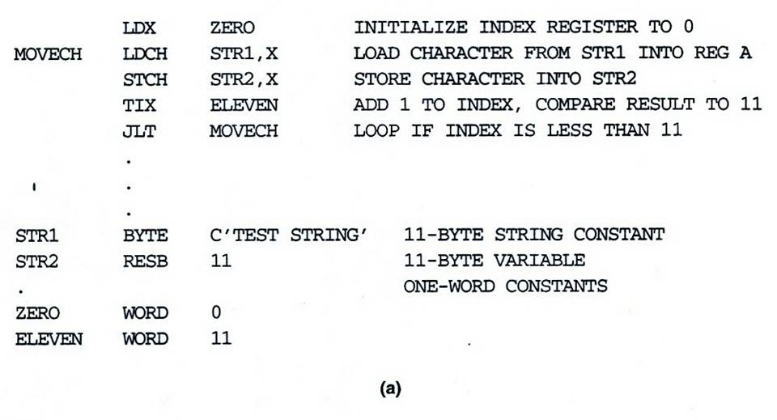
SIC Programming Example (Fig 1.4a)

Slide 18
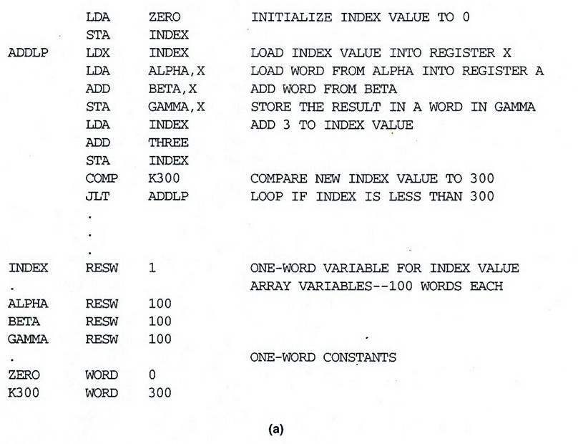
SIC Programming Example (Fig 1.5a)

Slide 19
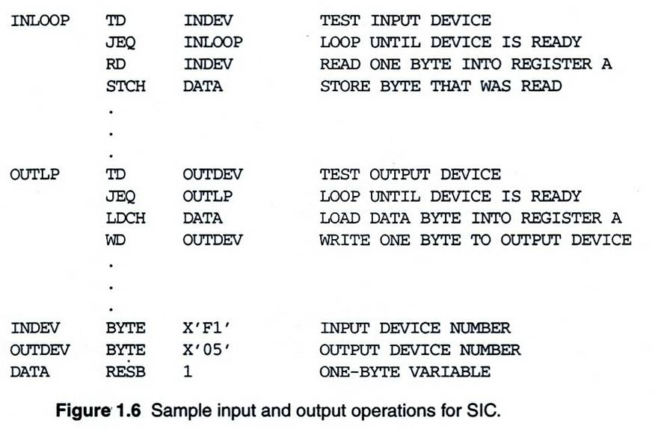
SIC Programming Example (Fig 1.6)

Slide 20
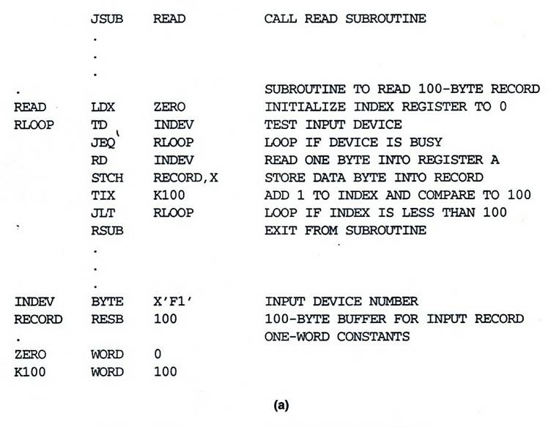
SIC Programming Example (Fig 1.7a)

Slide 21
SIC/XE Machine Architecture (1/13)
Memory
  Maximum memory available on a SIC/XE system is 1 megabyte (2²⁰ bytes)

Slide 22
SIC/XE Machine Architecture (2/13)
Registers
  Additional registers are provided by SIC/XE
Mnemonic | Number | Special use
B | 3 | Base register
S | 4 | General working register
T | 5 | General working register
F | 6 | Floating-point accumulator (48 bits)

Slide 23
SIC/XE Machine Architecture (3/13)
There is a 48-bit floating-point data type
1 | 11 | 36
s | exponent | fraction
F*2^{(e-1024)}

Slide 24
SIC/XE Machine Architecture (4/13)
Instruction Formats
8
op
Format 1 (1 byte)
8 | 4 | 4
op | r1 | r2
Format 2 (2 bytes)
6 | 1 | 1 | 1 | 1 | 1 | 1 | 12
op | n | i | x | b | p | e | disp
Format 3 (3 bytes)
6 | 1 | 1 | 1 | 1 | 1 | 1 | 20
op | n | i | x | b | p | e | address
Format 4 (4 bytes)
Formats 1 and 2 are instructions that do not reference memory at all

Slide 25
SIC/XE Machine Architecture (5/13)
Addressing modes
  Base relative (n=1, i=1, b=1, p=0)
  Program-counter relative (n=1, i=1, b=0, p=1)
  Direct (n=1, i=1, b=0, p=0)
  Immediate (n=0, i=1, x=0)
  Indirect (n=1, i=0, x=0)
  Indexing (both n & i = 0 or 1, x=1)
  Extended (e=1)

Slide 26
SIC/XE Machine Architecture (6/13)
Base Relative Addressing Mode
 | n | i | x | b | p | e
opcode | 1 | 1 |  | 1 | 0 |  | disp
n=1, i=1, b=1, p=0, TA=(B)+disp (0≤disp ≤4095)
Program-Counter Relative Addressing Mode
 | n | i | x | b | p | e
opcode | 1 | 1 |  | 0 | 1 |  | disp
n=1, i=1, b=0, p=1, TA=(PC)+disp (-2048≤disp ≤2047)

Slide 27
SIC/XE Machine Architecture (7/13)
Direct Addressing Mode
 | n | i | x | b | p | e
opcode | 1 | 1 |  | 0 | 0 |  | disp
n=1, i=1, b=0, p=0, TA=disp (0≤disp ≤4095)
 | n | i | x | b | p | e
opcode | 1 | 1 | 1 | 0 | 0 |  | disp
n=1, i=1, b=0, p=0, TA=(X)+disp
(with index addressing mode)

Slide 28
SIC/XE Machine Architecture (8/13)
Immediate Addressing Mode
 | n | i | x | b | p | e
opcode | 0 | 1 | 0 |  |  |  | disp
n=0, i=1, x=0, operand=disp
Indirect Addressing Mode
 | n | i | x | b | p | e
opcode | 1 | 0 | 0 |  |  |  | disp
n=1, i=0, x=0, TA=(disp)

Slide 29
SIC/XE Machine Architecture (9/13)
Simple Addressing Mode
 | n | i | x | b | p | e
opcode | 0 | 0 |  |  |  |  | disp
i=0, n=0, TA=bpe+disp (SIC standard)
 | n | i | x | b | p | e
opcode | 1 | 1 |  |  |  |  | disp
i=1, n=1, TA=disp (SIC/XE standard)

Slide 30
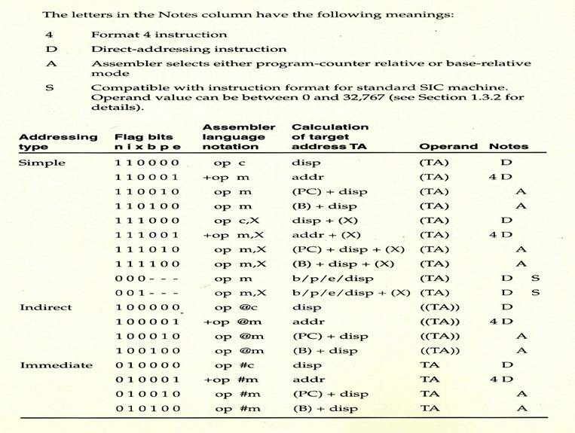
SIC/XE Machine Architecture (10/13)
Addressing Modes Summary

Slide 31
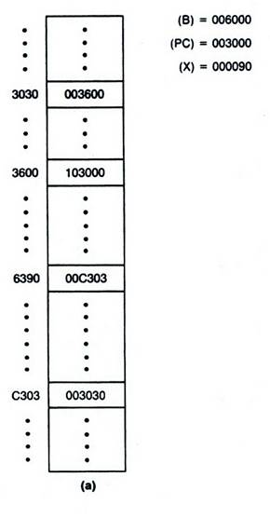
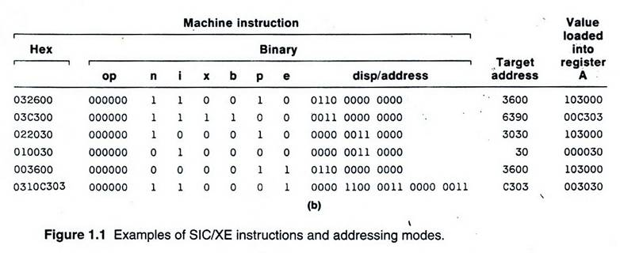
SIC/XE Machine Architecture (11/13)
Instruction Format

Slide 32
SIC/XE Machine Architecture (12/13)
Instruction Set
  Instructions to load and store the new registers
    LDB, STB, etc.
  Floating-point arithmetic operations
    ADDF, SUBF, MULF, DIVF
  Register move instruction
    RMO
  Register-to-register arithmetic operations
    ADDR, SUBR, MULR, DIVR
  Supervisor call instruction
    SVC

Slide 33
SIC/XE Machine Architecture (13/13)
Input and Output
  There are I/O channels that can be used to perform input and output while the CPU is executing other instructions

Slide 34
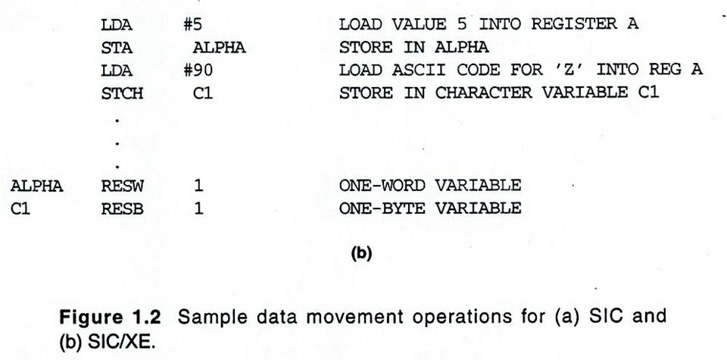
SIC/XE Programming Examples (Fig 1.2b)

Slide 35
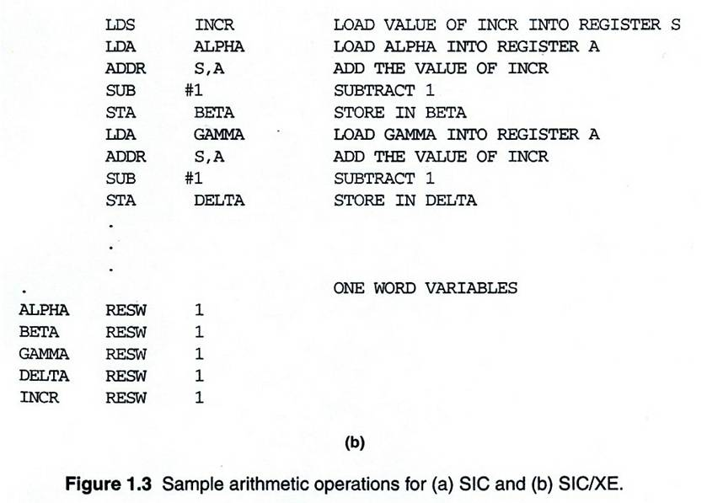
SIC/XE Programming Example (Fig 1.3b)

Slide 36
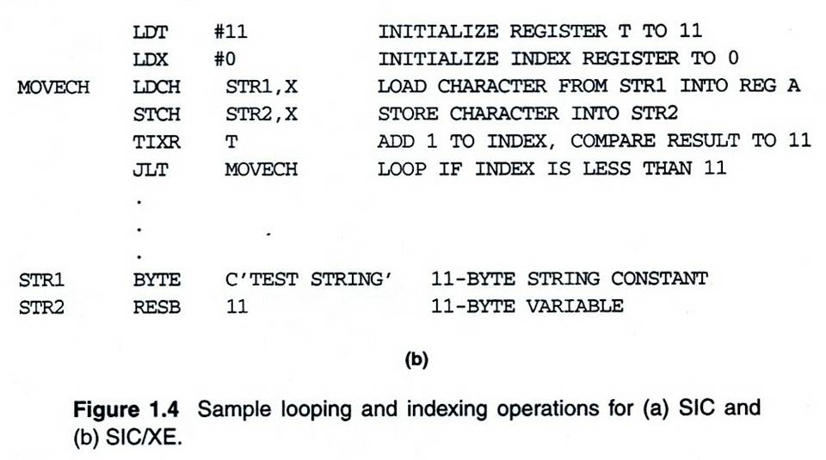
SIC/XE Programming Example (Fig 1.4b)

Slide 37
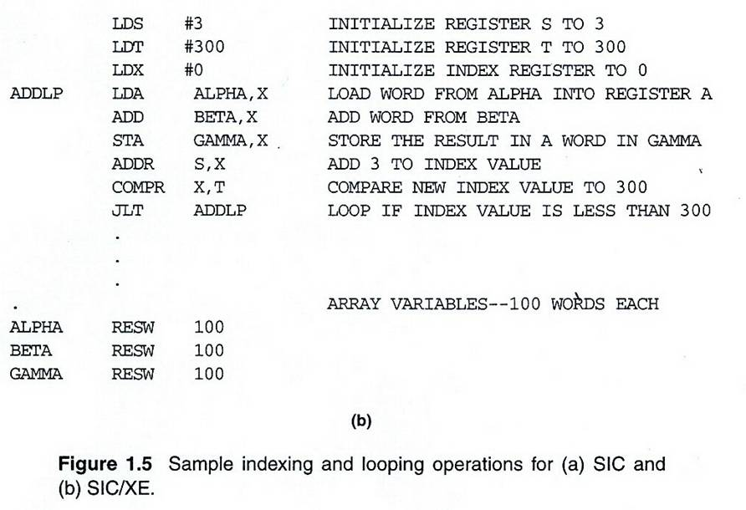
SIC/XE Programming Example (Fig 1.5b)

Slide 38
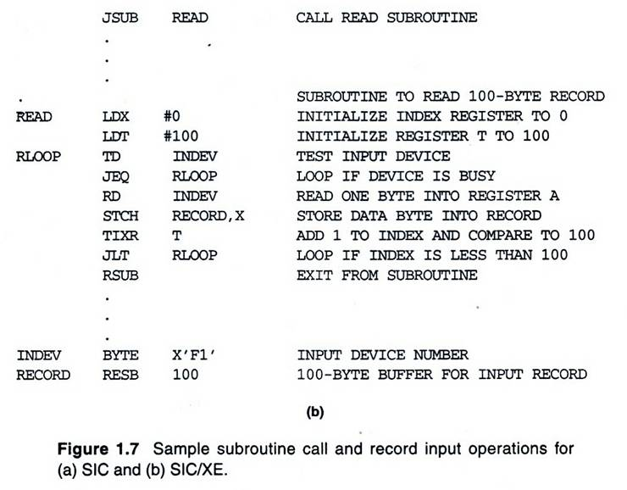
SIC/XE Programming Example (Fig 1.7b)

