Slide 1
CS2422 Assembly Language & System Programming
Chapter 2 : Assemblers

Slide 2
2.1’s Topic
Assembler: Basic Functions
Reading Assignment: pages 43-52.

Slide 3
Role of Assembler
Assembler
Object
Code
Linker
Source
Program
Executable
Code
Loader

Slide 4
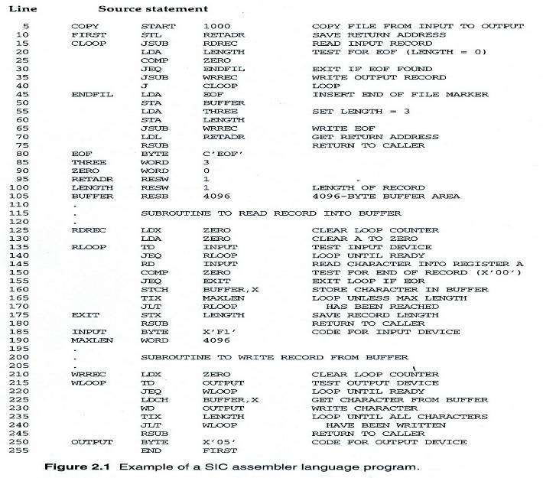
Example Program Fig. 2.1 (1/3)

Slide 5
Example Program Fig. 2.1 (2/3)
Purpose
  Reads records from input device (code F1)
  Copies them to output device (code 05)
  At the end of the file, writes EOF on the output device, then RSUB to the operating system

Slide 6
Example Program Fig. 2.1 (3/3)
Data transfer (RD, WD)
  A buffer is used to store record
  Buffering is necessary for different I/O rates
  The end of each record is marked with a null character (00₁₆)
  The end of the file is indicated by a zero-length record
Subroutines (JSUB, RSUB)
  RDREC, WRREC
  Save link register first before nested jump

Slide 7
Assembler Directives
Pseudo-Instructions
  Not translated into machine instructions
  Providing information to the assembler
Basic assembler directives
  START
  END
  BYTE
  WORD
  RESB
  RESW

Slide 8
Functions of a Basic Assembler
Mnemonic code (or instruction name) → opcode.
Symbolic operands (e.g., variable names) → addresses.
Choose the proper instruction format and addressing mode.
Constants → Numbers.
Output to object files and listing files.

Slide 9
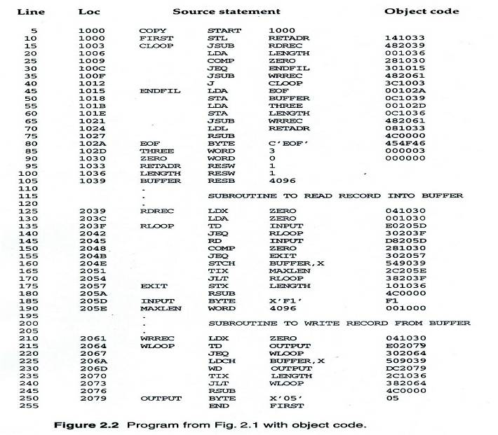
Example Program with Object Code

Slide 10
SIC Instruction Set (Review)
Load/Store: LDA/STA, LDX/STX…etc.
Arithmetic: ADD, SUB, MUL, DIV
Compare: COMP
Jump: J
Conditional Jump: JLT, JEQ, JGT
See Appendix A for the complete list.

Slide 11
SIC Instruction Format (again)
Opcode: 8 bits
Address: one bit flag (x) and 15 bits of address
8
1
15
OPCODE
X
Address

Slide 12
Examples
Mnemonic code (or instruction name) → opcode.
Examples:
  STL 1033 → opcode 14 10 33
  LDA 1036 → opcode 00 10 36
0001 0100
0
001 0000 0011 0011
0000 0000
0
001 0000 0011 0110

Slide 13
Symbolic Operands
We’re not likely to write memory addresses directly in our code.
  Instead, we will define variable names.
Other examples of symbolic operands:
  Labels (for jump instructions)
  Subroutines
  Constants

Slide 14
Converting Symbols to Numbers
Isn’t it straightforward?
  Isn’t it simply the sequential processing of the source program, one line at a time?
  Not so, if we have forward references.
COPY START 1000
  …
LDA LEN
…
…
LEN RESW 1

Slide 15
Two Pass Assembler
Pass 1
  Assign addresses to all statements in the program
  Save the values assigned to all labels for use in Pass 2
  Perform some processing of assembler directives
Pass 2
  Assemble instructions
  Generate data values defined by BYTE, WORD
  Perform processing of assembler directives not done in Pass 1
  Write the object program and the assembly listing

Slide 16
Two Pass Assembler
Read from input line
  LABEL, OPCODE, OPERAND
Source
program
Intermediate
file
Object
codes
Pass 1
Pass 2
OPTAB
SYMTAB
SYMTAB

Slide 17
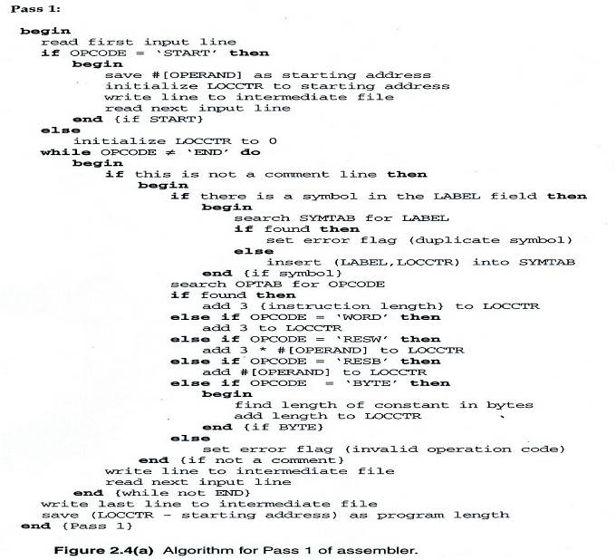
Two Pass Assembler – Pass 1

Slide 18
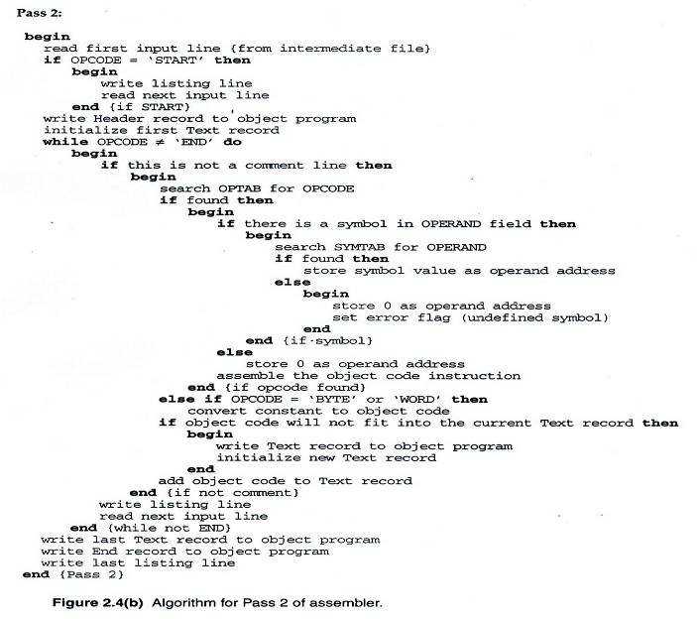
Two Pass Assembler – Pass 2

Slide 19
Data Structures
Operation Code Table (OPTAB)
Symbol Table (SYMTAB)
Location Counter(LOCCTR)

Slide 20
OPTAB (operation code table)
Content
  Menmonic, machine code (instruction format, length) etc.
Characteristic
  Static table
Implementation
  Array or hash table, easy for search

Slide 21
SYMTAB (symbol table)
Content
  Label name, value, flag, (type, length) etc.
Characteristic
  Dynamic table (insert, delete, search)
Implementation
  Hash table, non-random keys, hashing function
COPY 1000
FIRST 1000
CLOOP 1003
ENDFIL 1015
EOF 1024
THREE 102D
ZERO 1030
RETADR 1033
LENGTH 1036
BUFFER 1039
RDREC 2039

Slide 22
One-Pass Assemblers
Forward references can be resolved in One-Pass Assemblers too!
Add a linked list to the Symbol Table to keep track of unresolved references.

Slide 23
Object Program
Header
  Col. 1 H
  Col. 2~7 Program name
  Col. 8~13 Starting address (hex)
  Col. 14-19 Length of object program in bytes (hex)
Text
  Col.1 T
  Col.2~7 Starting address in this record (hex)
  Col. 8~9 Length of object code in this record in bytes (hex)
  Col. 10~69 Object code (69-10+1)/6=10 instructions
End
  Col.1 E
  Col.2~7 Address of first executable instruction (hex)
  (END program_name)

Slide 24
Fig. 2.3
H COPY 001000 00107A
T 001000 1E 141033 482039 001036 281030 301015 482061 ...
T 00101E 15 0C1036 482061 081044 4C0000 454F46 000003 000000
T 002039 1E 041030 001030 E0205D 30203F D8205D 281030 …
T 002057 1C 101036 4C0000 F1 001000 041030 E02079 302064 …
T 002073 07 382064 4C0000 05
E 001000 ←starting address

Slide 25
2.2’s Topic
Assembler: Machine Dependent Features
  SIC/XE
  Program Relocation
  Modification Records in an Object File.

Slide 26
SIC/XE Assembler
We have learned the 2-pass assembler for SIC.
What’s new for SIC/XE?
  More addressing modes.
  Program Relocation.

Slide 27
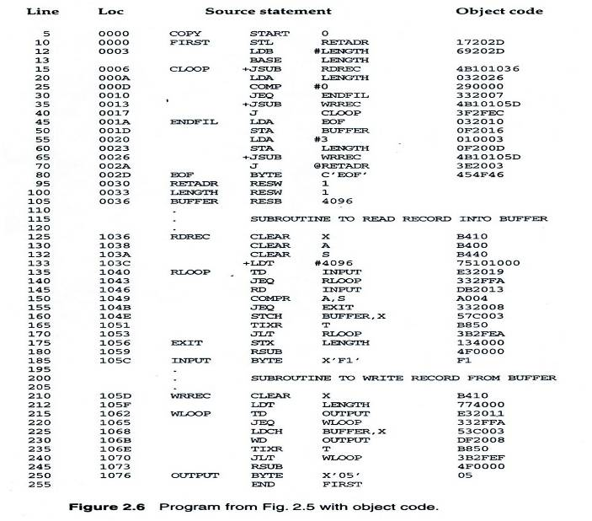
An SIC/XE Example Fig. 2.6

Slide 28
A Case of Object Code Generation
Figure 2.6, Line 10
    STL RETADR → 17 20 2D
The mode bit p=1, meaning PC relative addressing mode.
6 bits
12 bits
OPCODE
n
i
x
b
p
e
Address
0001 01
1
1
0
0
1
0
0000 0010 1101
17
20
2D

Slide 29
Instruction Format and Addressing Mode
SIC/XE
  PC-relative or Base-relative addressing: op m
  Indirect addressing: op @m
  Immediate addressing: op #c
  Extended format: +op m
  Index addressing: op m,x
  register-to-register instructions
  larger memory -> multi-programming (program allocation)

Slide 30
Translation
Register translation
  Register name (A, X, L, B, S, T, F, PC, SW) and their values (0,1, 2, 3, 4, 5, 6, 8, 9)
  Preloaded in SYMTAB
Address translation
  Most register-memory instructions use program counter relative or base relative addressing
  Format 3: 12-bit address field
    Base-relative: 0~4095
    PC-relative: -2048~2047
  Format 4: 20-bit address field

Slide 31
PC-Relative Addressing Mode
PC-relative
  10 0000 FIRST STL RETADR 17202D
    Displacement= RETADR - PC = 30-3 = 2D
  40 0017 J CLOOP 3F2FEC
    Displacement= CLOOP-PC= 6 - 1A= -14= FEC
OPCODE
n
i
x
b
p
e
Address
0001 01
1
1
0
0
1
0
(02D)₁₆
OPCODE
n
i
x
b
p
e
Address
0011 11
1
1
0
0
1
0
(FEC)₁₆

Slide 32
Base-Relative Addressing Modes
Base-relative
  Base register is under the control of the programmer
  12 LDB #LENGTH
  13 BASE LENGTH
  160 104E STCH BUFFER, X 57C003
    Displacement= BUFFER - B = 0036 - 0033 = 3
  NOBASE is used to inform the assembler that the contents of the base register no longer be relied upon for addressing
OPCODE
n
i
x
b
p
e
Address
0101 01
1
1
1
1
0
0
(003)₁₆

Slide 33
Immediate Address Translation (1/2)
Immediate addressing
  55 0020 LDA #3 010003
  133 103C +LDT #4096 75101000
OPCODE
n
i
x
b
p
e
Address
0000 00
0
1
0
0
0
0
(003)₁₆
OPCODE
n
i
x
b
p
e
Address
0111 01
0
1
0
0
0
1
(01000)₁₆

Slide 34
Immediate Address Translation (2/2)
Immediate addressing
  12 0003 LDB #LENGTH 69202D
  12 0003 LDB #LENGTH 690033
    The immediate operand is the symbol LENGTH
    The address of this symbol LENGTH is loaded into register B
    LENGTH=0033=PC+displacement=0006+02D
    If immediate mode is specified, the target address becomes the operand
OPCODE
n
i
x
b
p
e
Address
0110 10
0
1
0
0
1
0
(02D)₁₆
OPCODE
n
i
x
b
p
e
Address
0110 10
0
1
0
0
0
0
(033)₁₆

Slide 35
Indirect Address Translation
Indirect addressing
  Target addressing is computed as usual (PC-relative or BASE-relative)
  Only the n bit is set to 1
  70 002A J @RETADR 3E2003
    TA=RETADR=0030
    TA=(PC)+disp=002D+0003
OPCODE
n
i
x
b
p
e
Address
0011 11
1
0
0
0
1
0
(003)₁₆

Slide 36
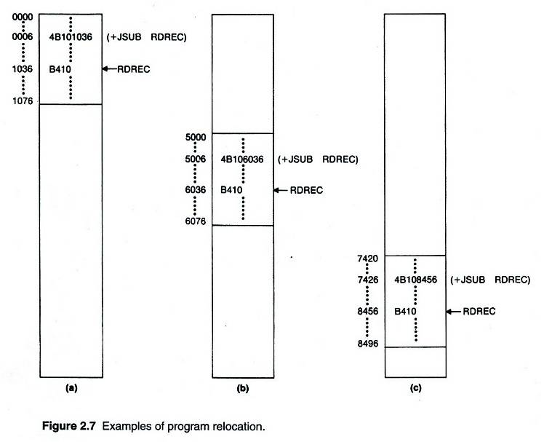
Program Relocation

Slide 37
Examples of Program Relocation (1/2)
Example Fig. 2.2
  Absolute program, starting address 1000
==== → 2000
5 2000 1000 COPY START 1000
10 2000 1000 FIRST STL RETADR 141033 142033
15 2003 1003 CLOOP JSUB RDREC 482039 483039
20 2006 1006 LDA LENGTH 001036 002036
25 2009 1009 COMP ZERO 281030 282030
30 200C 100C JEQ ENDFIL 301015 302015
35 200F 100F JSUB WREC 482061 483061
40 2012 1012 J CLOOP 3C1003 3C2003
45 2015 1015 ENDFIL LDA EOF 00102A 00202A
50 2018 1018 STA BUFFER 0C1039 0C2039
55 201B 101B LDA THREE 00102D 00202D
60 201E 101E STA LENGTH 0C1036 0C2036
65 2021 1021 JSUB WREC 482061 483061
70 2024 1024 LDL RETADR 081033 082033
75 2027 1027 RSUB 4C0000 4C0000
80 202A 102A EOF BYTE C'EOF' 454E46 454E46
85 202D 102D THREE WORD 3 000003 000003
90 2030 1030 ZERO WORD 0 000000 000000
95 2033 1033 RETADR RESW 1
100 2036 1036 LENGTH RESW 1
105 2039 1039 BUFFER RESB 4096
==== → 2000

Slide 38
Examples of Program Relocation (2/2)
Example Fig. 2.6:
  Except for absolute address, the rest of the instructions need not be modified
    not a memory address (immediate addressing)
    PC-relative, Base-relative
  The only parts of the program that require modification at load time are those that specify direct addresses
5 1000 0000 COPY START 0
10 1000 0000 FIRST STL RETADR 17202D 17202D
12 1003 0003 LDB #LENGTH 69202D 69202D
13 BASE LENGTH
15 1006 0006 CLOOP +JSUB RDREC 4B101036 4B102036
20 100A 000A LDA LENGTH 032026 032026
25 100D 000D COMP #0 290000 290000
30 1010 0010 JEQ ENDFIL 332007 332007
35 1013 0013 +JSUB WRREC 4B10105D 4B10205D
40 1017 0017 J CLOOP 3F2FEC 3F2FEC
45 101A 001A ENDFIL LDA EOF 032010 032010
50 101D 001D STA BUFFER 0F2016 0F2016
55 1020 0020 LDA #3 010003 010003
60 1023 0023 STA LENGTH 0F200D 0F200D
65 1026 0026 +JSUB WRREC 4B10105D 4B10205D
70 102A 002A J @RETADR 3E2003 3E2003
80 102D 002D EOF BYTE C'EOF' 454F46 454F46
95 1030 0030 RETADR RESW 1
100 1036 0036 BUFFER RESB 4096
== → 1000

Slide 39
How to Make Program Relocation Easier
Use program-counter (PC) relative addresses
  Did you notice that we didn’t modify the addresses for JEQ, JLT and J instructions?
  We didn’t modify the addresses for RETADR, LENGTH, and BUFFER in Figure 2.6 either.
Virtual memory! (Not covered in this course)

Slide 40
Relocatable Program
Modification record
  Col 1 M
  Col 2-7 Starting location of the address field to be
  modified, relative to the beginning of the program
  Col 8-9 length of the address field to be modified, in half-
  bytes

Slide 41
Object File with M-Records
Modification records are added to the object files. (See pp.64-65 and Figure 2.8.)
Example:
    HCOPY 001000 001077
    T000000 1D 17202D…4B101036…
    T00001D ……
    …
    M000007 05 ← Modification Record
    ……
    E000000

Slide 42
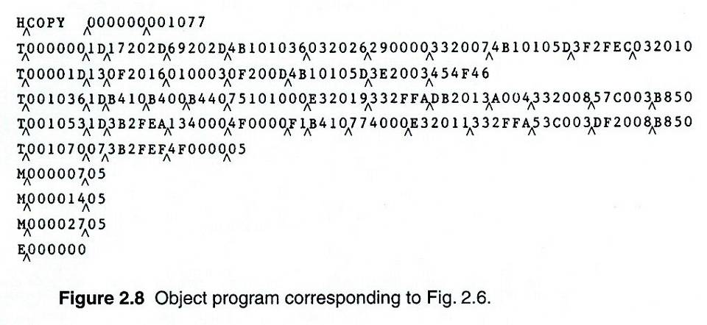
Object Code

Slide 43
2.3’s Topic
Machine Independent Assembler Features
  Literals
  Symbol Defining Statements
  Expressions
  Program Blocks
  Control Sections and Program Linking

Slide 44
Literals
Design idea
  Let programmers to be able to write the value of a constant operand as a part of the instruction that uses it.
  This avoids having to define the constant elsewhere in the program and make up a label for it.
Example (Fig. 2.10)
  45 001A ENDFIL LDA =C’EOF’ 032010
  93 LTORG
  002D * =C’EOF’ 454F46
  215 1062 WLOOP TD =X’05’ E32011

Slide 45
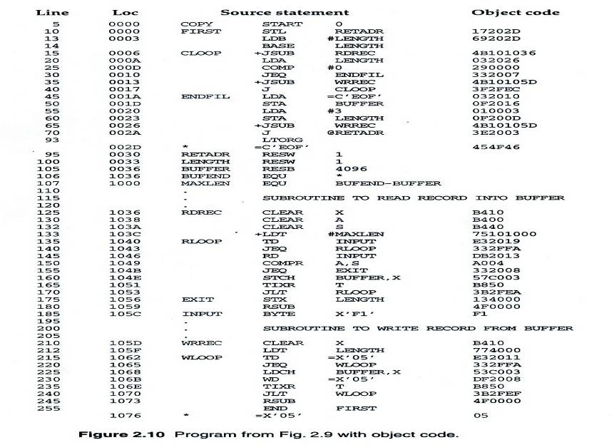
Fig. 2.10

Slide 46
Literals vs. Immediate Operands
Immediate Operands
  The operand value is assembled as part of the machine instruction
  e.g. 55 0020 LDA #3 010003
Literals
  The assembler generates the specified value as a constant at some other memory location
  e.g. 45 001A ENDFIL LDA =C’EOF’ 032010
Compare (Fig. 2.6)
  e.g. 45 001A ENDFIL LDA EOF 032010
  80 002D EOF BYTE C’EOF’ 454F46

Slide 47
Literal - Implementation (1/3)
Literal pools
  Normally literals are placed into a pool at the end of the program
    See Fig. 2.10 (END statement)
    255 END FIRST
    1076 * =X’05’ 05
  In some cases, it is desirable to place literals into a pool at some other location in the object program
    Assembler directive LTORG
    Reason: keep the literal operand close to the instruction

Slide 48
Literal - Implementation (2/3)
Duplicate literals
  e.g. 215 1062 WLOOP TD =X’05’
  e.g. 230 106B WD =X’05’
  The assemblers should recognize duplicate literals and store only one copy of the specified data value
    Comparison of the defining expression
      Same literal name with different value, e.g. LOCCTR=*
    Comparison of the generated data value
      The benefits of using generate data value are usually not great enough to justify the additional complexity in the assembler

Slide 49
Literal - Implementation (3/3)
LITTAB
  Literal name, the operand value and length, the address assigned to the operand
Pass 1
  Build LITTAB with literal name, operand value and length, leaving the address unassigned
  When LTORG statement is encountered, assign an address to each literal not yet assigned an address
Pass 2
  Search LITTAB for each literal operand encountered
  Generate data values using BYTE or WORD statements
  Generate modification record for literals that represent an address in the program

Slide 50
Symbol-Defining Statements (1/2)
Labels on instructions or data areas
  The value of such a label is the address assigned to the statement
Defining symbols
  Symbol EQU Value
  Value can be: constant, other symbol, expression
  Making the source program easier to understand
  No forward reference

Slide 51
Symbol-Defining Statements (2/2)
Example 1
  MAXLEN EQU 4096
  +LDT #MAXLEN
Example 2
  BASE EQU R1
  COUNT EQU R2
  INDEX EQU R3
Example 3
  MAXLEN EQU BUFEND-BUFFER
  +LDT #4096

Slide 52
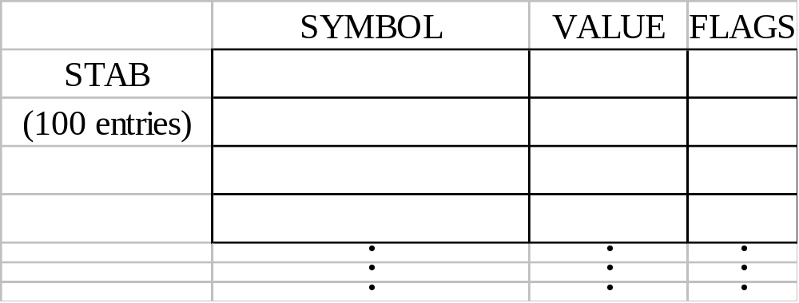
ORG (origin)
Indirectly assign values to symbols
Reset the location counter to the specified value
    ORG value
Value can be: constant, other symbol, expression
No forward reference
Example
  SYMBOL: 6bytes
  VALUE: 1word
  FLAGS: 2bytes
  LDA VALUE, X

Slide 53
ORG Example
Using EQU statements
  STAB RESB 1100
  SYMBOL EQU STAB
  VALUE EQU STAB+6
  FLAG EQU STAB+9
Using ORG statements
  STAB RESB 1100
  ORG STAB
  SYMBOL RESB 6
  VALUE RESW 1
  FLAGS RESB 2
  ORG STAB+1100

Slide 54
Expressions
Expressions can be classified as absolute expressions or relative expressions
  MAXLEN EQU BUFEND-BUFFER
  BUFEND and BUFFER both are relative terms, representing addresses within the program
  However the expression BUFEND-BUFFER represents an absolute value
When relative terms are paired with opposite signs, the dependency on the program starting address is canceled out; the result is an absolute value

Slide 55
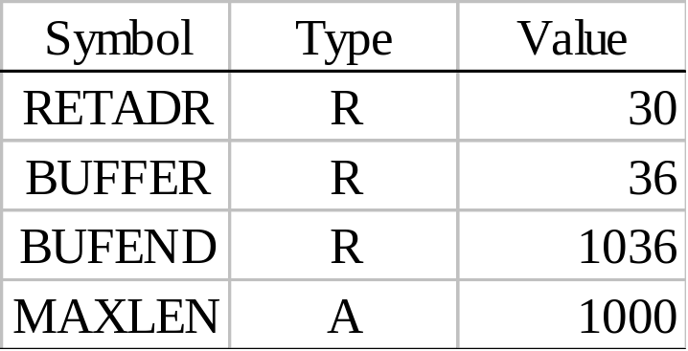
SYMTAB
None of the relative terms may enter into a multiplication or division operation
Errors:
  BUFEND+BUFFER
  100-BUFFER
  3*BUFFER
The type of an expression
  keep track of the types of all symbols defined in the program

Slide 56
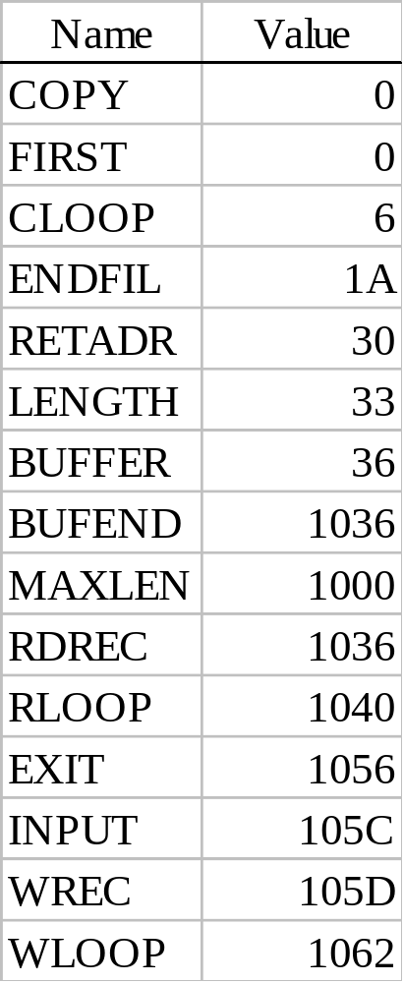
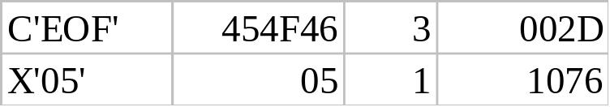
Example 2.9
SYMTAB LITTAB

Slide 57
Program Blocks
Program blocks
  Refer to segments of code that are rearranged within a single object program unit
  USE [blockname]
  At the beginning, statements are assumed to be part of the unnamed (default) block
  If no USE statements are included, the entire program belongs to this single block
  Example: Figure 2.11
  Each program block may actually contain several separate segments of the source program

Slide 58
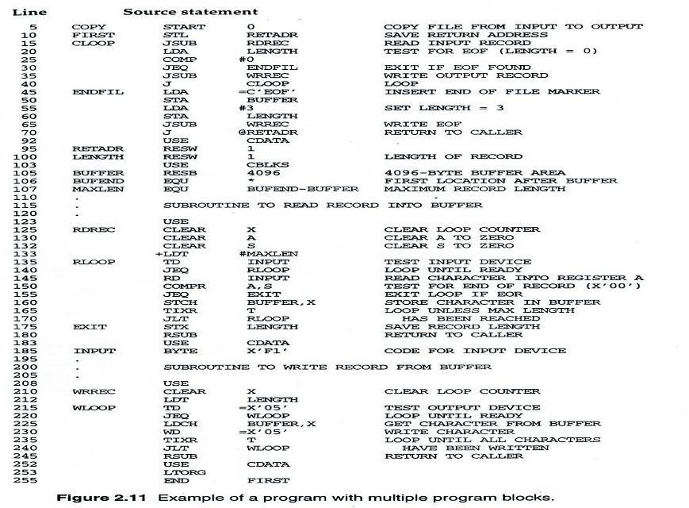
Figure 2.11

Slide 59
Program Blocks - Implementation
Pass 1
  Each program block has a separate location counter
  Each label is assigned an address that is relative to the start of the block that contains it
  At the end of Pass 1, the latest value of the location counter for each block indicates the length of that block
  The assembler can then assign to each block a starting address in the object program
Pass 2
  The address of each symbol can be computed by adding the assigned block starting address and the relative address of the symbol to that block

Slide 60
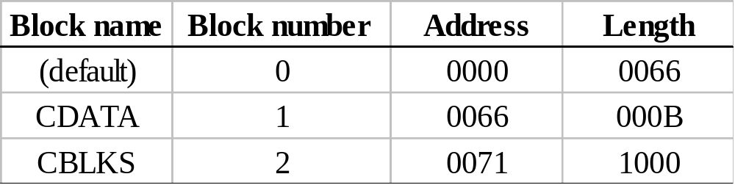
Figure 2.12
Each source line is given a relative address assigned and a block number
For absolute symbol, there is no block number
  line 107
Example
  20 0006 0 LDA LENGTH 032060
  LENGTH = (Block 1) + 0003 = 0066 + 0003 = 0069
  LOCCTR = (Block 0) + 0009 = 0009

Slide 61
Program Readability
Program readability
  No extended format instructions on lines 15, 35, 65
  No needs for base relative addressing (line 13, 14)
  LTORG is used to make sure the literals are placed ahead of any large data areas (line 253)
Object code
  It is not necessary to physically rearrange the generated code in the object program
  See Fig. 2.13, Fig. 2.14

Slide 62
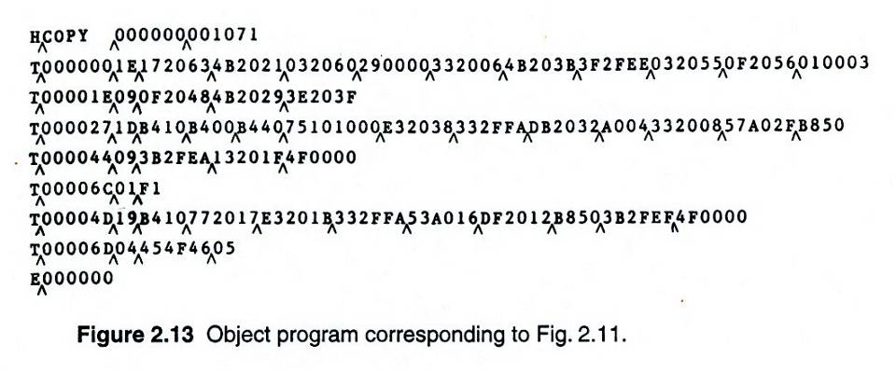
Figure 2.13

Slide 63
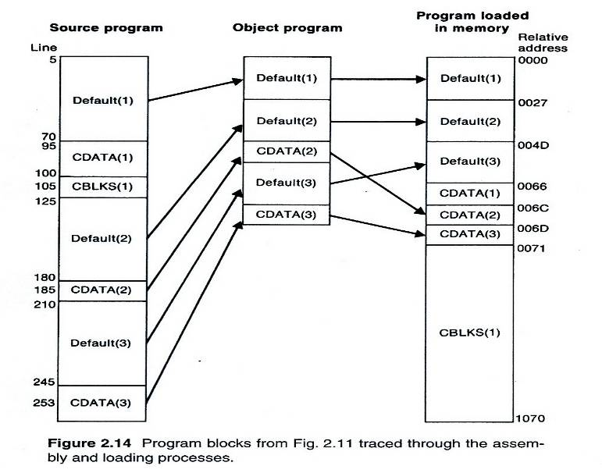
Figure 2.14

Slide 64
Control Sections and Program Linking
Control Sections
  Are most often used for subroutines or other logical subdivisions of a program
  The programmer can assemble, load, and manipulate each of these control sections separately
  Instruction in one control section may need to refer to instructions or data located in another section
  Because of this, there should be some means for linking control sections together
  Fig. 2.15, 2.16

Slide 65
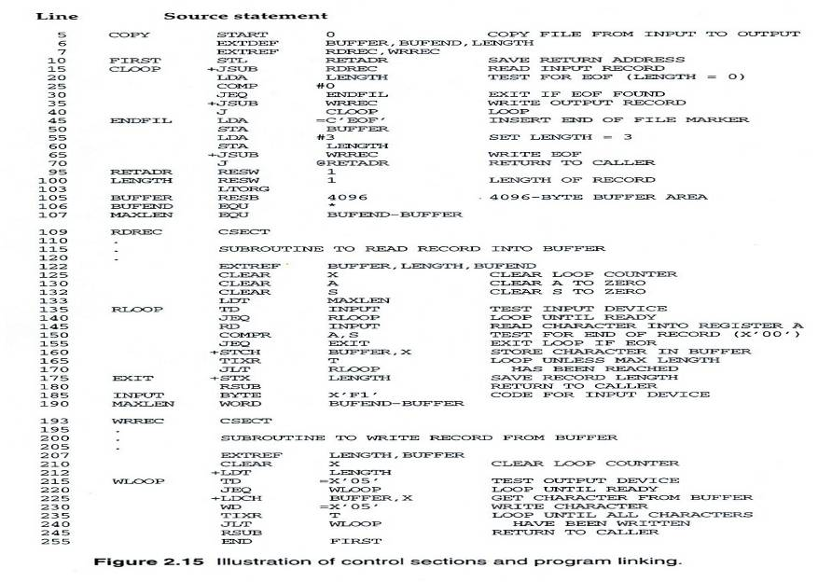
Figure 2.15

Slide 66
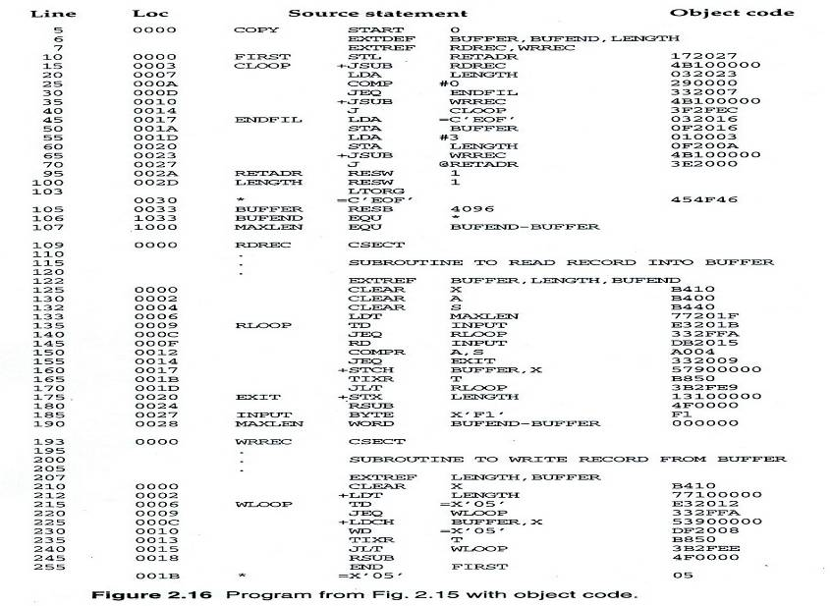
Figure 2.16

Slide 67
External Definition and References
External definition
  EXTDEF name [, name]
  EXTDEF names symbols that are defined in this control section and may be used by other sections
External reference
  EXTREF name [,name]
  EXTREF names symbols that are used in this control section and are defined elsewhere
Example
  15 0003 CLOOP +JSUB RDREC 4B100000
  160 0017 +STCH BUFFER,X 57900000
  190 0028 MAXLEN WORD BUFEND-BUFFER 000000

Slide 68
Implementation
The assembler must include information in the object program that will cause the loader to insert proper values where they are required
Define record
  Col. 1 D
  Col. 2-7 Name of external symbol defined in this control section
  Col. 8-13 Relative address within this control section (hexadeccimal)
  Col.14-73 Repeat information in Col. 2-13 for other external symbols
Refer record
  Col. 1 D
  Col. 2-7 Name of external symbol referred to in this control section
  Col. 8-73 Name of other external reference symbols

Slide 69
Modification Record
Modification record
  Col. 1 M
  Col. 2-7 Starting address of the field to be modified (hexiadecimal)
  Col. 8-9 Length of the field to be modified, in half-bytes (hexadeccimal)
  Col.11-16 External symbol whose value is to be added to or subtracted from the indicated field
  Note: control section name is automatically an external symbol, i.e. it is available for use in Modification records.
Example
  Figure 2.17
  M00000405+RDREC
  M00000705+COPY

Slide 70
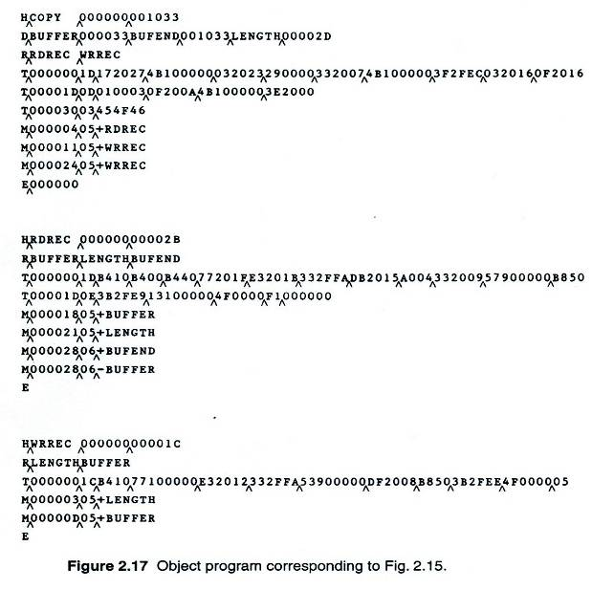
Figure 2.17

Slide 71
External References in Expression
Earlier definitions
  Required all of the relative terms be paired in an expression (an absolute expression), or that all except one be paired (a relative expression)
New restriction
  Both terms in each pair must be relative within the same control section
  Ex: BUFEND-BUFFER
  Ex: RDREC-COPY
In general, the assembler cannot determine whether or not the expression is legal at assembly time. This work will be handled by a linking loader.

Slide 72
2.4’s Topic
Assembler Design Options
  One-pass assemblers
  Multi-pass assemblers
  Two-pass assembler with overlay structure

Slide 73
Two-Pass Assembler with Overlay Structure (1/3)
For small memory
  Pass 1 and pass 2 are never required at the same time
  Three segments
    Root: driver program and shared tables and subroutines
    Pass 1
    Pass 2
  Tree structure
  Overlay program

Slide 74
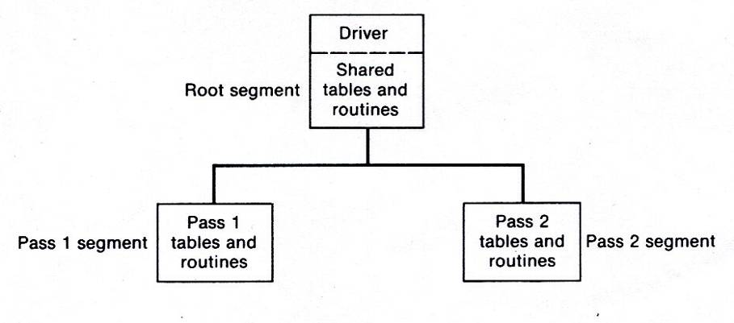
Two-Pass Assembler with Overlay Structure (2/3)
Tree structure

Slide 75
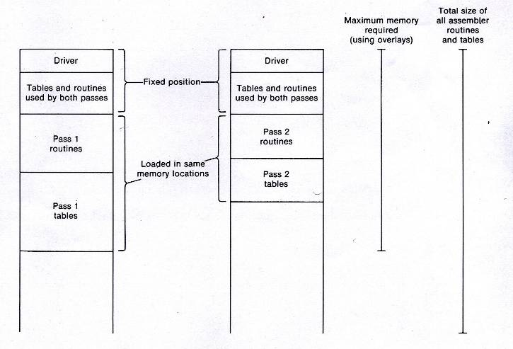
Two-Pass Assembler with Overlay Structure (3/3)
Overlay programs

Slide 76
One-Pass Assemblers (1/2)
Main problem
  Forward references
    Data items
    Labels on instructions
Solution
  Data items: require all such areas be defined before they are referenced
  Labels on instructions: no good solution

Slide 77
One-Pass Assemblers (2/2)
Two types of one-pass assembler
  Load-and-go
    Produces object code directly in memory for immediate execution
  The other
    Produces usual kind of object code for later execution

Slide 78
Load-and-go Assembler (1/3)
Characteristics
  Useful for program development and testing
  Avoids the overhead of writing the object program out and reading it back
  Both one-pass and two-pass assemblers can be designed as load-and-go.
  However one-pass also avoids the over head of an additional pass over the source program
  For a load-and-go assembler, the actual address must be known at assembly time, we can use an absolute program

Slide 79
Load-and-go Assembler (2/3)
For ward references handling
  1. Omit the address translation
  2. Insert the symbol into SYMTAB, and mark this symbol undefined
  3. The address that refers to the undefined symbol is added to a list of forward references associated with the symbol table entry
  4. When the definition for a symbol is encountered, the proper address for the symbol is then inserted into any instructions previous generated according to the forward reference list

Slide 80
Load-and-go Assembler (3/3)
At the end of the program
  Any SYMTAB entries that are still marked with * indicate undefined symbols
  Search SYMTAB for the symbol named in the END statement and jump to this location to begin execution
The actual starting address must be specified at assembly time
Example
  Figure 2.18, 2.19

Slide 81
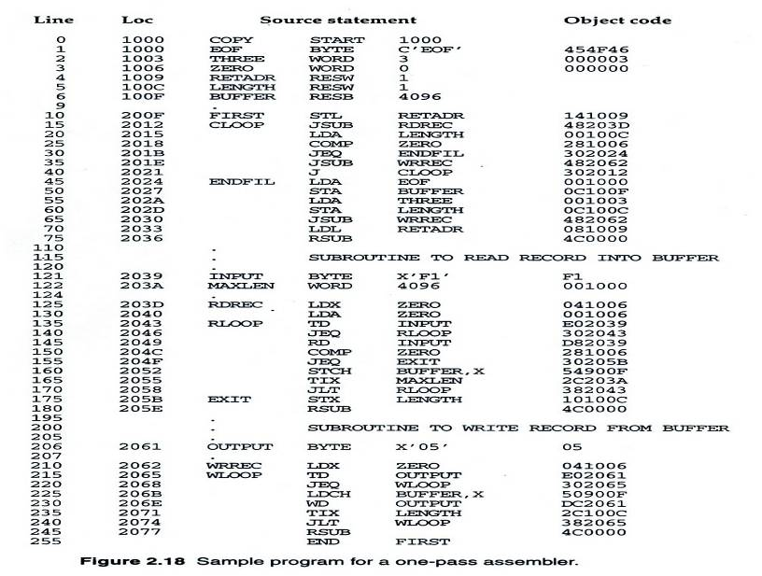
Figure 2.18

Slide 82
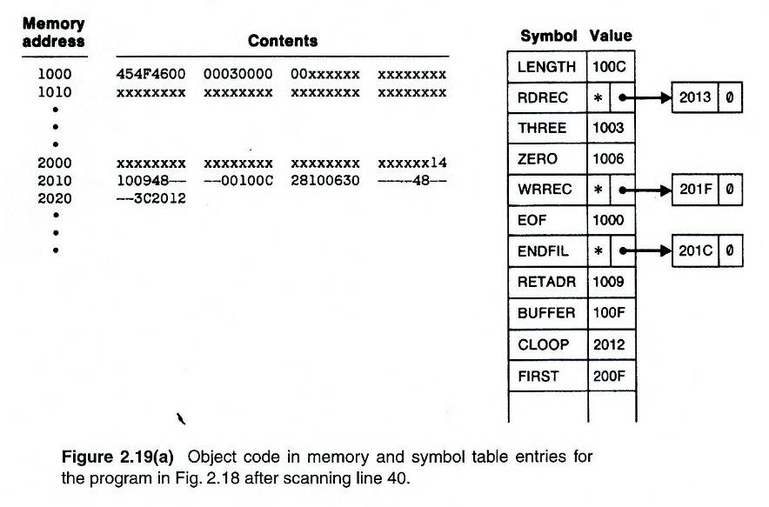
Figure 2.19(a)

Slide 83
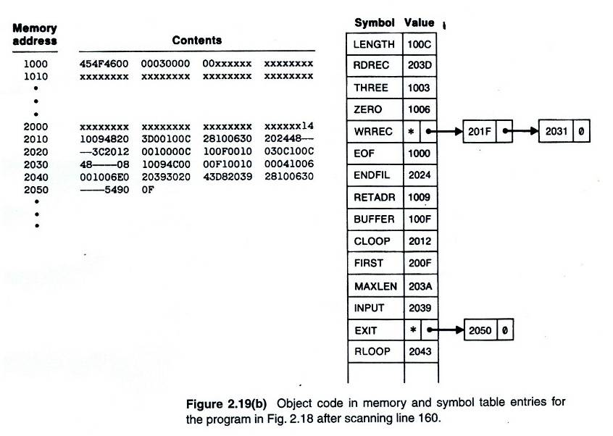
Figure 2.19(b)

Slide 84
Producing Object Code
When external working-storage devices are not available or too slow (for the intermediate file between the two passes
Solution:
  When definition of a symbol is encountered, the assembler must generate another Tex record with the correct operand address
  The loader is used to complete forward references that could not be handled by the assembler
  The object program records must be kept in their original order when they are presented to the loader
Example: Figure 2.20

Slide 85
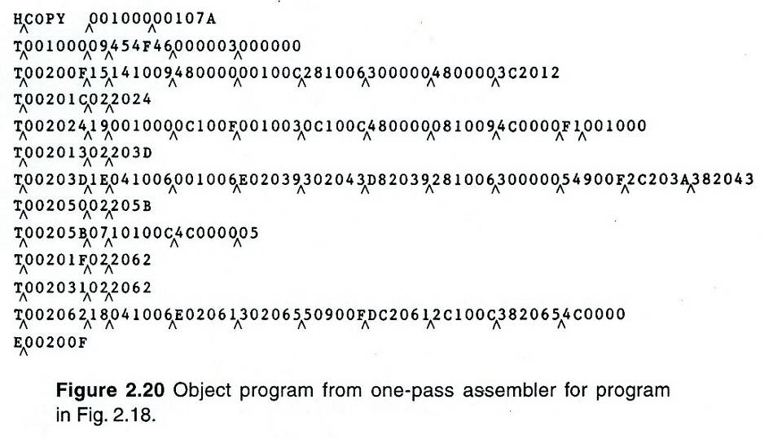
Figure 2.20

Slide 86
Multi-Pass Assemblers
Restriction on EQU and ORG
  No forward reference, since symbols’ value can’t be defined during the first pass
Example
  Use link list to keep track of whose value depend on an undefined symbol
Figure 2.21

Slide 87
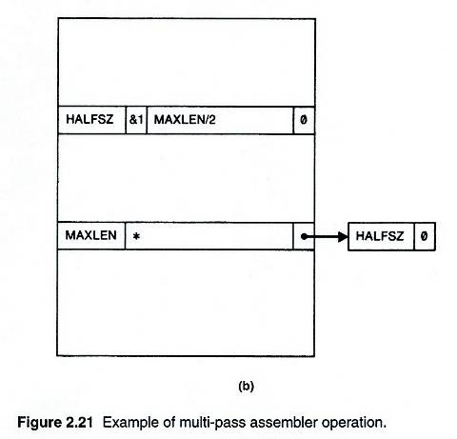
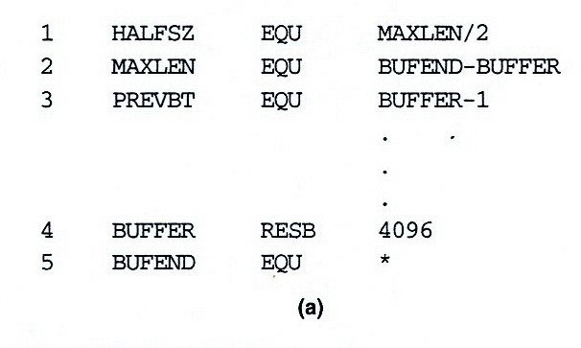
Figure 2.21 (1/5)

Slide 88
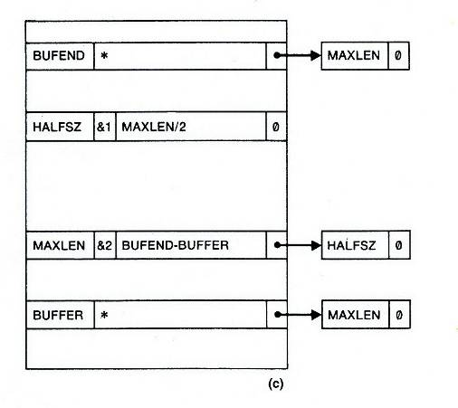
Figure 2.21 (2/5)

Slide 89
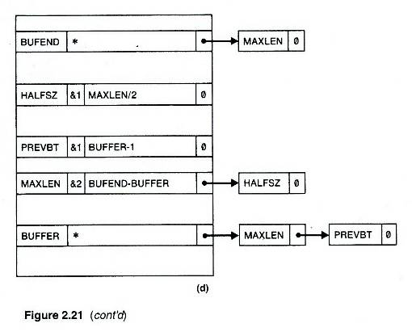
Figure 2.21 (3/5)

Slide 90
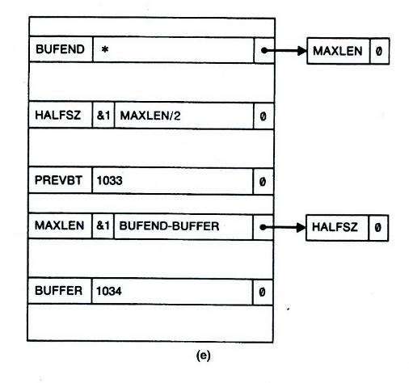
Figure 2.21 (4/5)

Slide 91
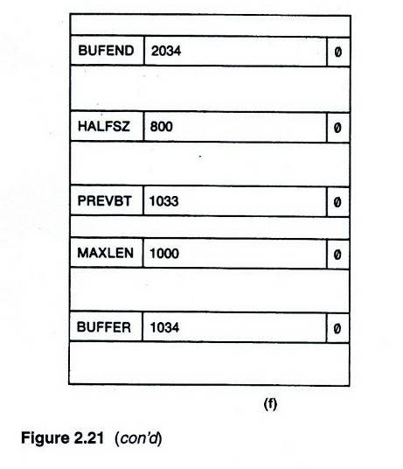
Figure 2.21 (5/5)

