Slide 1
CS2422 Assembly Language & System Programming
Chapter 3 : Loaders and Linkers

Slide 2
3.1 – 3.2’s Topics
Basic Loader Functions
  Design of an Absolute Loader
  A Simple Bootstrap Loader
Machine-Dependent Loader Features
  Relocation
  Program Linking
Algorithm and Data Structure for a Linking Loader

Slide 3
Introduction
To execute an object program, we needs
  Relocation, which modifies the object program so that it can be loaded at an address different from the location originally specified
  Linking, which combines two or more separate object programs and supplies the information needed to allow references between them
  Loading and Allocation, which allocates memory location and brings the object program into memory for execution

Slide 4
Overview of Chapter 3
Type of loaders
  Assemble-and-go loader
  Absolute loader (bootstrap loader)
  Relocating loader (relative loader)
  Direct linking loader
Design options
  Linkage editors
  Dynamic linking
  Bootstrap loaders

Slide 5
Assemble-and-go Loader
Characteristic
  The object code is stored in memory after assembly
  Single JUMP instruction
Advantage
  Simple, developing environment
Disadvantage
  Whenever the assembly program is to be executed, it has to be assembled again
  Programs have to be coded in the same language

Slide 6
Design of an Absolute Loader
Absolute Program
  Advantage
    Simple and efficient
  Disadvantage
    The need for programmer to specify the actual address
    Difficult to use subroutine libraries
Program Logic

Slide 7
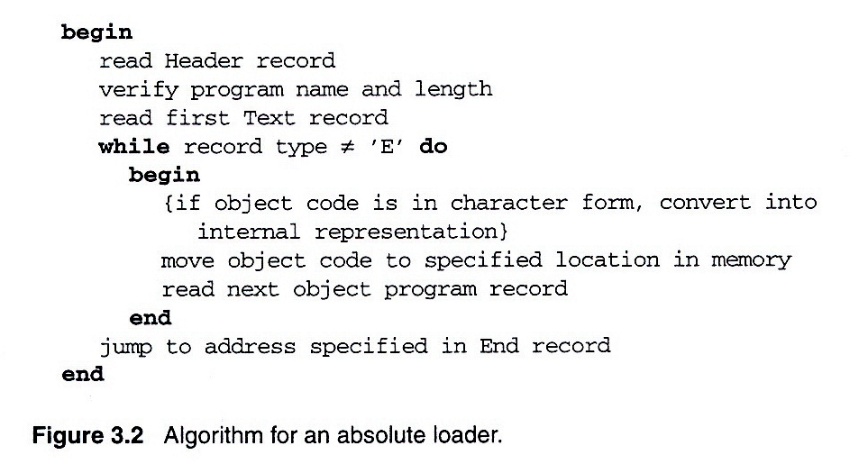
Fig. 3.2 Algorithm for an absolute loader

Slide 8
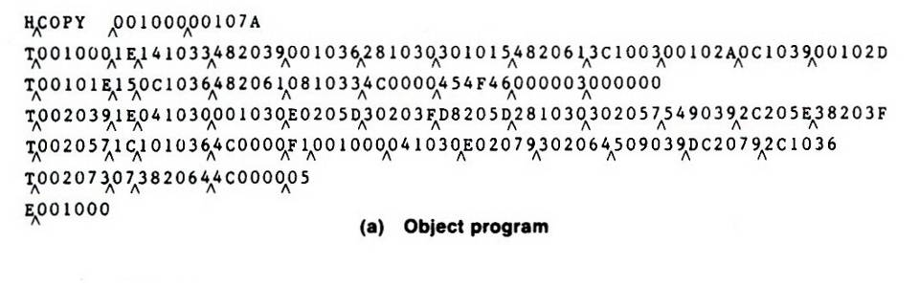
Loading of an absolute program (1/2)
Fig. 3.1(a)

Slide 9
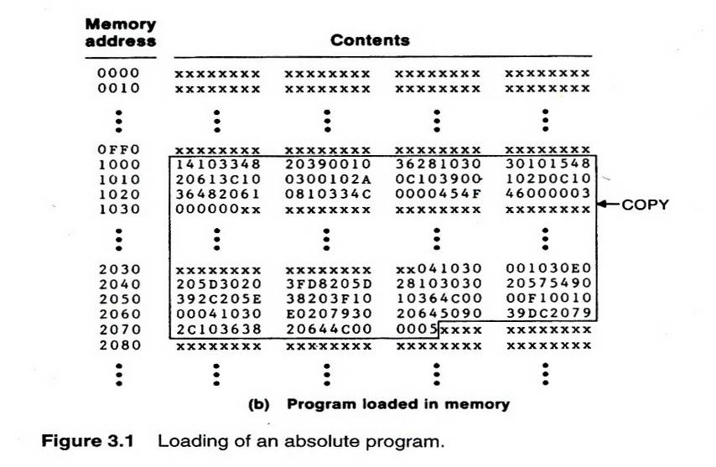
Loading of an absolute program (2/2)
Fig. 3.1(b)

Slide 10
Object Code Representation
Fig. 3.1(a)
  Each byte of assembled code is given using its hexadecimal representation in character form
  Easy to read by human beings
In general
  Each byte of object code is stored as a single byte
  Most machine store object programs in a binary form
  We must be sure that our file and device conventions do not cause some of the program bytes to be interpreted as control characters

Slide 11
A Simple Bootstrap Loader
Bootstrap Loader
  When a computer is first tuned on or restarted, a special type of absolute loader, called bootstrap loader is executed
  This bootstrap loads the first program to be run by the computer -- usually an operating system
Example (SIC bootstrap loader)
  The bootstrap itself begins at address 0
  It loads the OS starting address 0x80
  No header record or control information, the object code is consecutive bytes of memory

Slide 12
Bootstrap loader for SIC/XE
Begin
X=0x80 (the address of the next memory location to be loaded)
Loop
A←GETC (and convert it from the ASCII character code to the value of the hexadecimal digit)
save the value in the high-order 4 bits of S
A←GETC
combine the value to form one byte A← (A+S)
store the value (in A) to the address in register X
X←X+1
End
GETC A←read one character
if A=0x04 then jump to 0x80
if A<48 then GETC
A ← A-48 (0x30)
if A<10 then return
A ← A-7
return

Slide 13
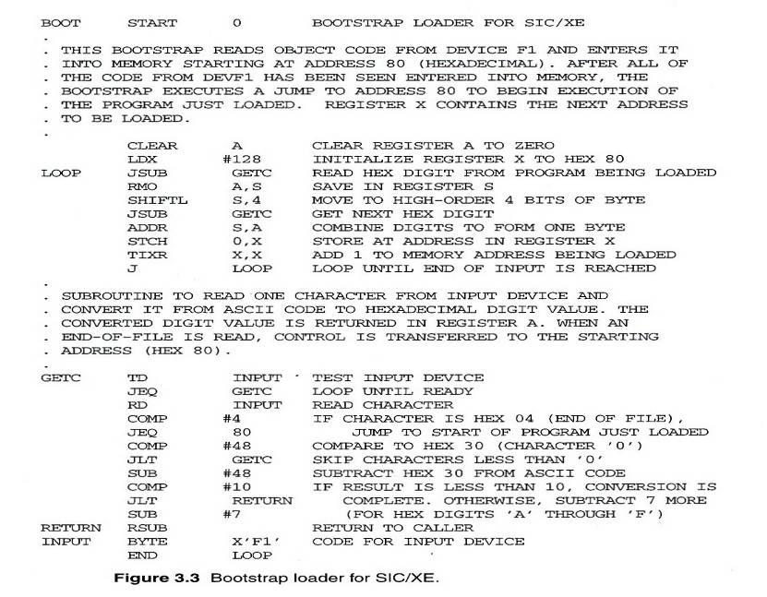
Fig. 3.3 Bootstrap loader for SIC/XE

Slide 14
Relocating Loaders
Motivation
  Efficient sharing of the machine with larger memory and when several independent programs are to be run together
  Support the use of subroutine libraries efficiently
Two methods for specifying relocation
  Modification record (Fig. 3.4, 3.5)
  Relocation bit (Fig. 3.6, 3.7)
    Each instruction is associated with one relocation bit
    These relocation bits in a Text record is gathered into bit masks

Slide 15
Modification Record
For complex machines
Also called RLD specification
  Relocation and Linkage Directory
Modification record
  col 1: M
  col 2-7: relocation address
  col 8-9: length (halfbyte)
  col 10: flag (+/-)
  col 11-17: segment name

Slide 16
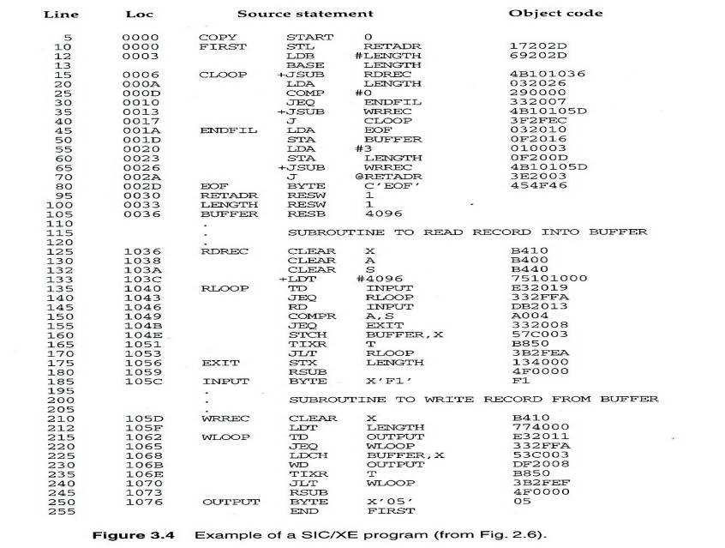
Fig. 3.4

Slide 17
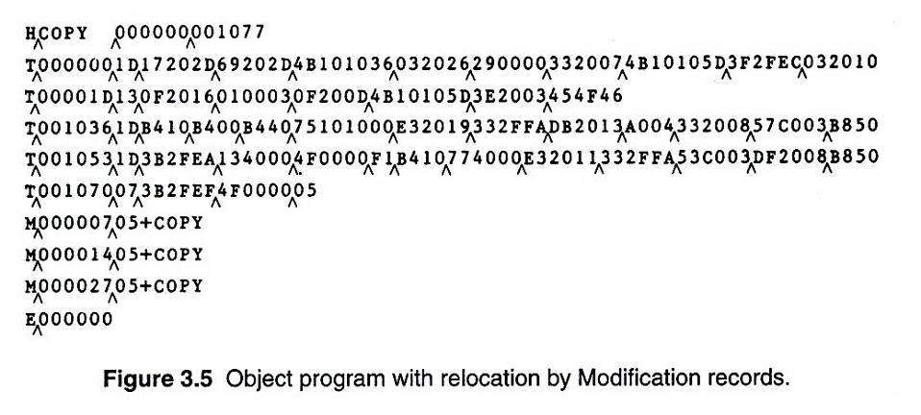
Fig. 3.5

Slide 18
Relocation Bit
For simple machines
Relocation bit
  0: No modification is necessary
  1: Modification is needed
Twelve-bit mask is used in each Text record
  Since each text record contains less than 12 words
  Unused words are set to 0
  Any value that is to be modified during relocation must coincide with one of these 3-byte segments
    e.g. line 210
Text record
  col 1: T
  col 2-7: starting address
  col 8-9: length (byte)
  col 10-12: relocation bits
  col 13-72: object code

Slide 19
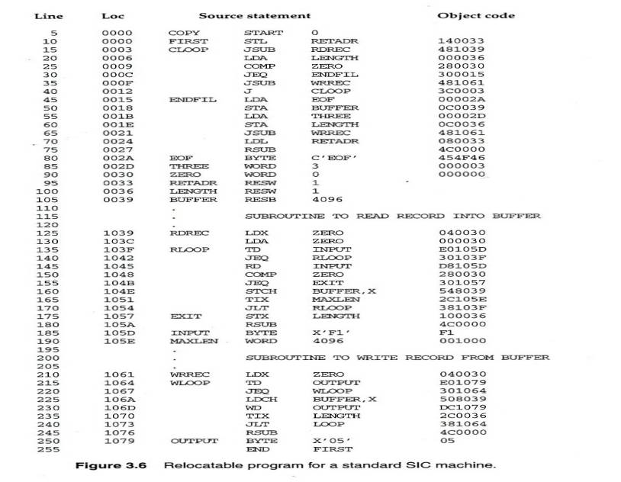
Fig. 3.6

Slide 20
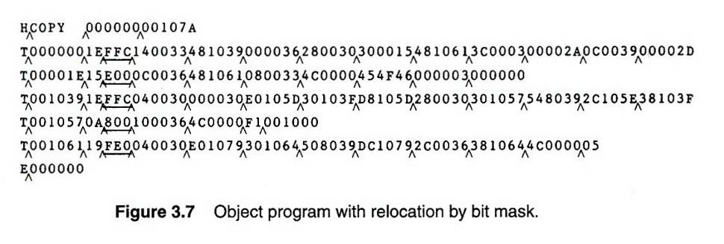
Fig. 3.7

Slide 21
Program Linking
Goal
  Resolve the problems with EXTREF and EXTDEF from different control sections (sec 2.3.5)
Example
  Program in Fig. 3.8 and object code in Fig. 3.9
  Use modification records for both relocation and linking
    Address constant
    External reference

Slide 22
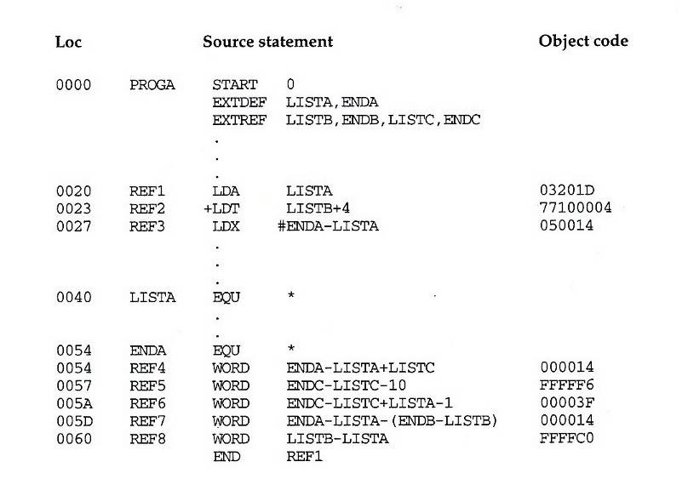
Fig. 3.8-1

Slide 23
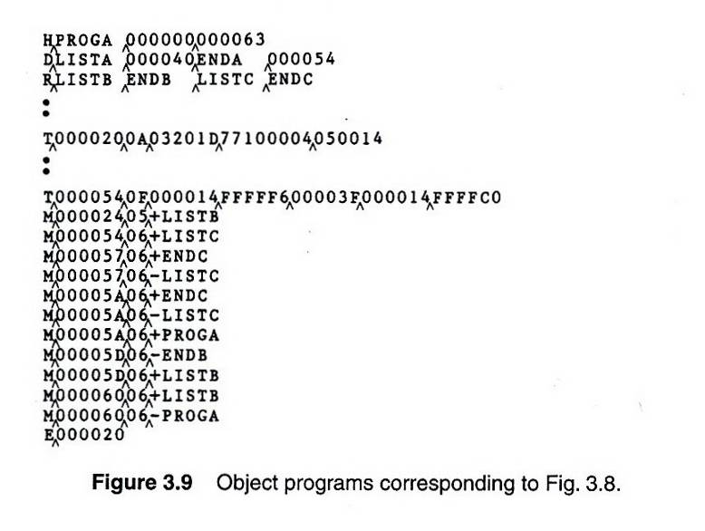
Fig. 3.9-1

Slide 24
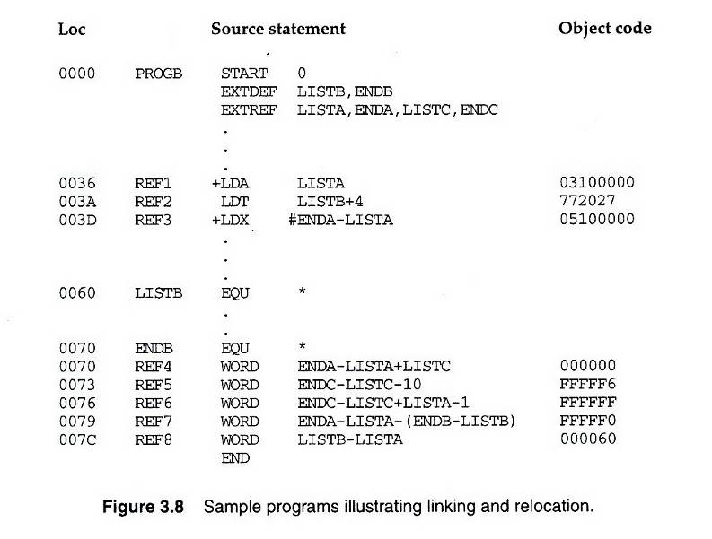
Fig. 3.8-2

Slide 25
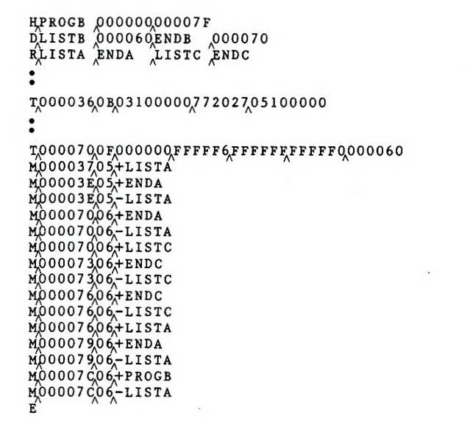
Fig. 3.9-2

Slide 26
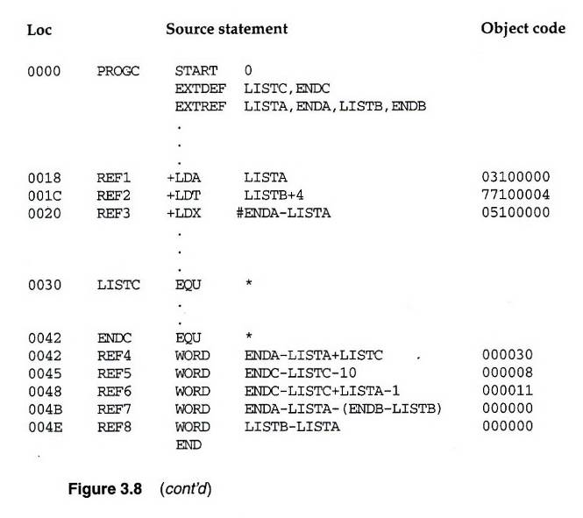
Fig. 3.8-3

Slide 27
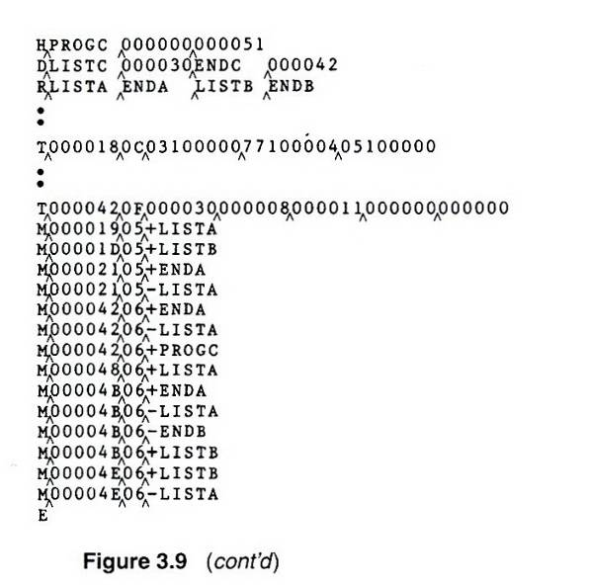
Fig. 3.9-3

Slide 28
Program Linking Example
Fig. 3.10
Load address for control sections
  PROGA 004000 63
  PROGB 004063 7F
  PROGC 0040E2 51
Load address for symbols
  LISTA: PROGA+0040=4040
  LISTB: PROGB+0060=40C3
  LISTC: PROGC+0030=4112
REF4 in PROGA
  ENDA-LISTA+LISTC=14+4112=4126
  T0000540F000014FFFFF600003F000014FFFFC0
  M00005406+LISTC

Slide 29
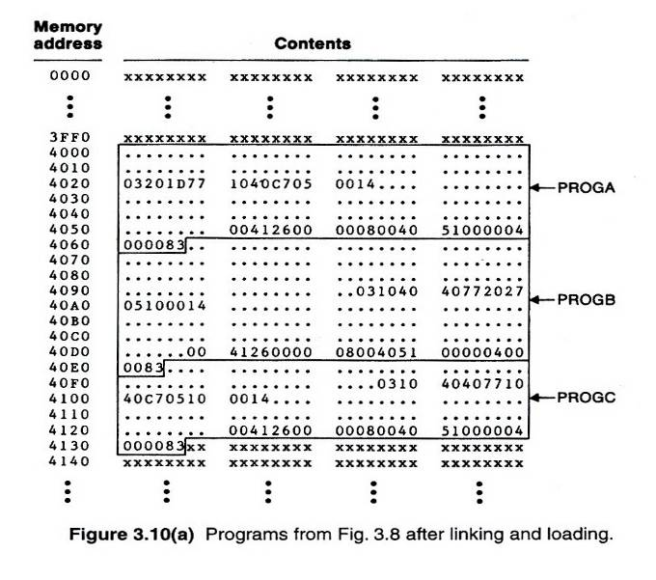
Fig. 3.10(a)

Slide 30
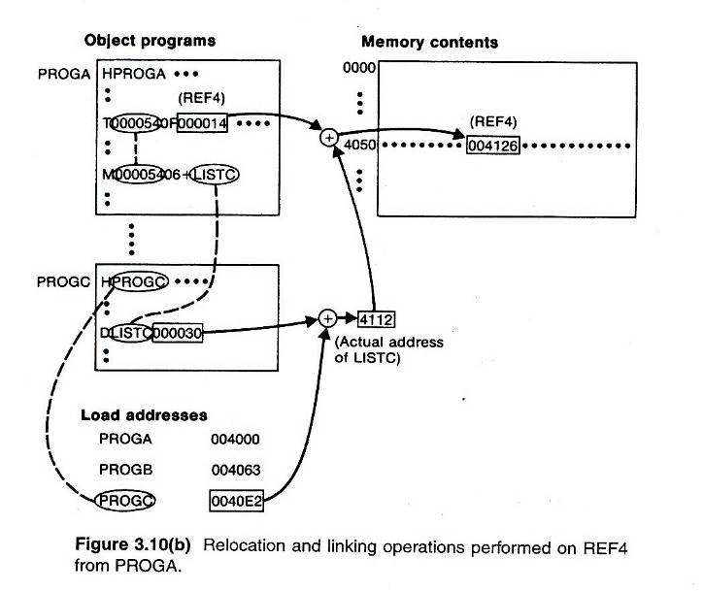
Fig. 3.10(b)

Slide 31
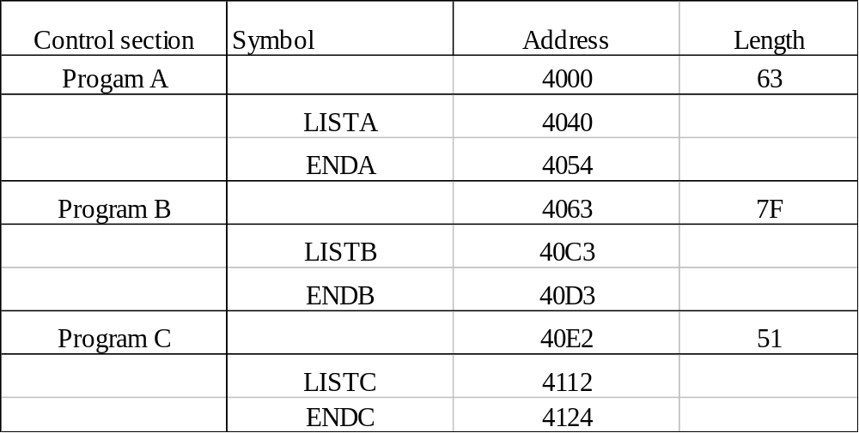
Algorithm and Data Structure
Two Passes Logic
  Pass 1: Assign addresses to all external symbols
  Pass 2: Perform the actual loading, relocation, and linking
ESTAB (external symbol table)
+
+

Slide 32
Pass 1 Program Logic
Pass 1:
  Assign addresses to all external symbols
Variables & Data structures
  PROGADDR (program load address) from OS
  CSADDR (control section address)
  CSLTH (control section length)
  ESTAB
Fig. 3.11(a)
  Process Define Record

Slide 33
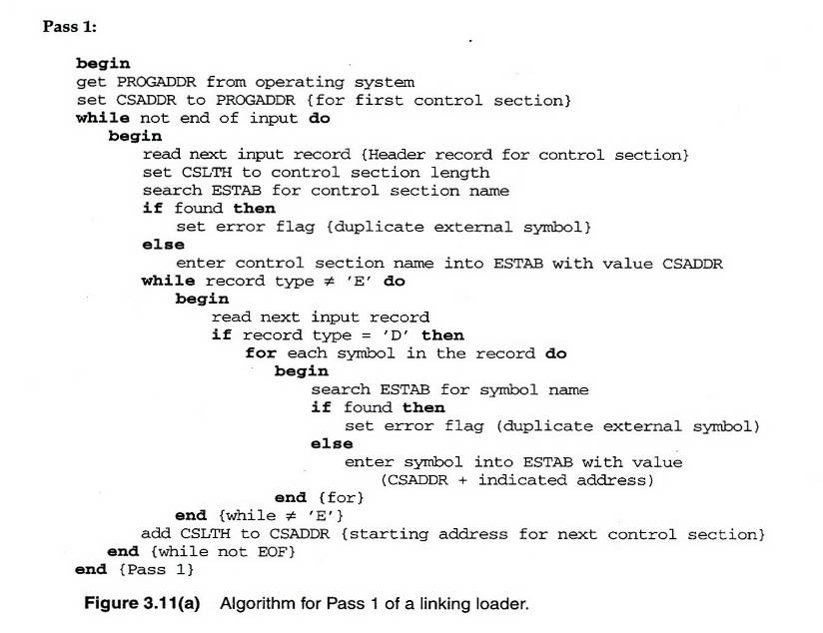
Fig. 3.11(a)

Slide 34
Pass 2 Program Logic
Pass 2:
  Perform the actual loading, relocation, and linking
Modification record
  Lookup the symbol in ESTAB
End record for a main program
  Transfer address
Fig. 3.11(b)
  Process Text record and Modification record

Slide 35
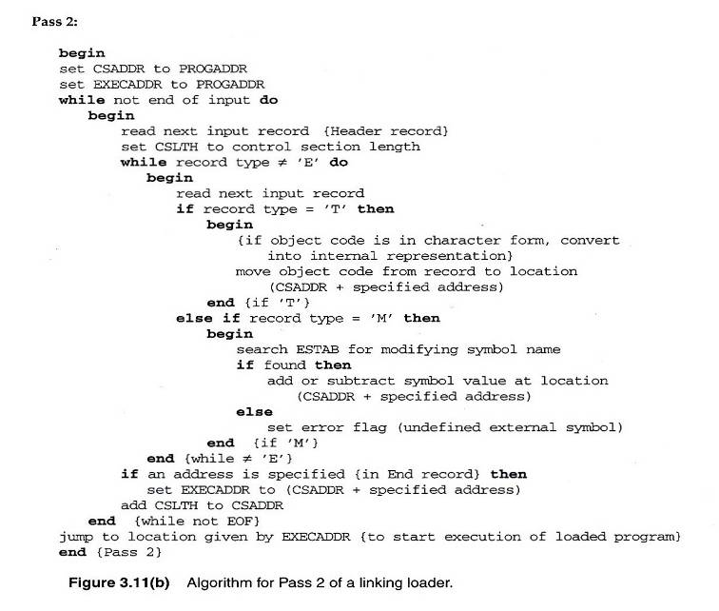
Fig. 3.11(b)

Slide 36
Improve Efficiency
Use local searching instead of multiple searches of ESTAB for the same symbol
  Assign a reference number to each external symbol
  The reference number is used in Modification records
Implementation
  01: Control section name
  Other: External reference symbols
Example
  Fig. 3.12

Slide 37
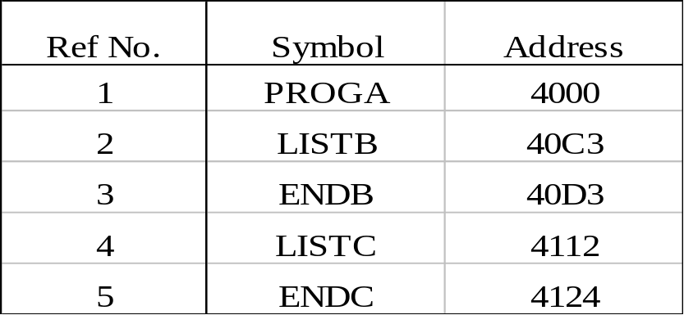
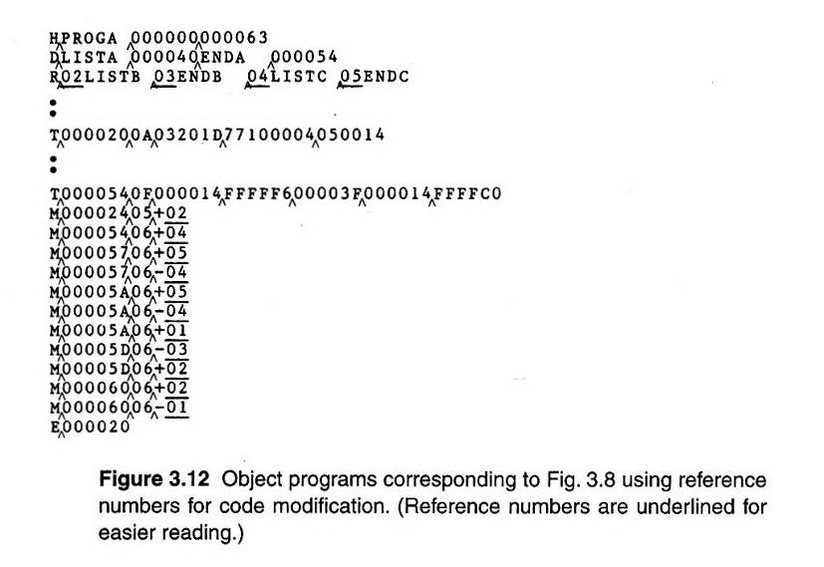
Fig. 3.12 (1/3)

Slide 38
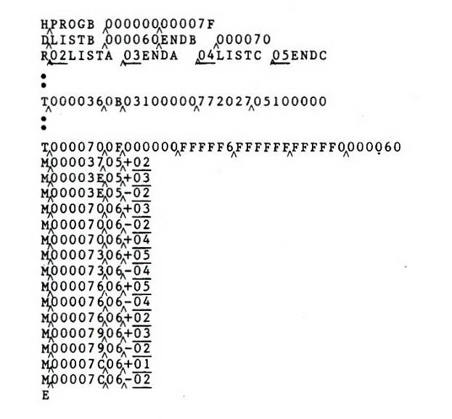
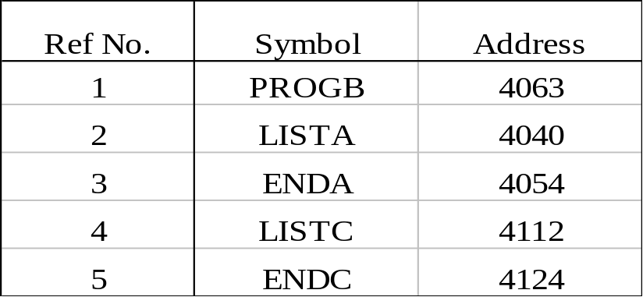
Fig. 3.12 (2/3)

Slide 39
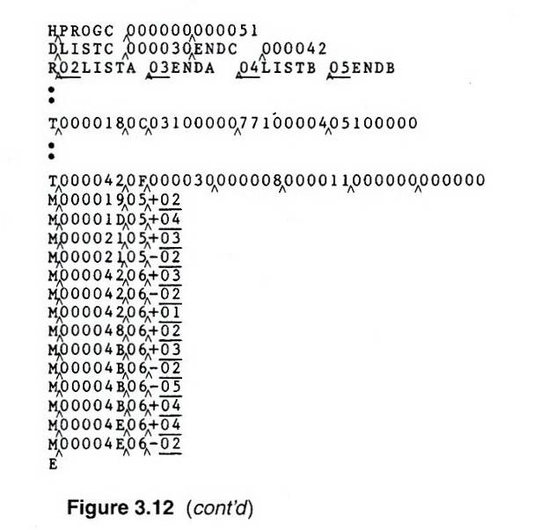
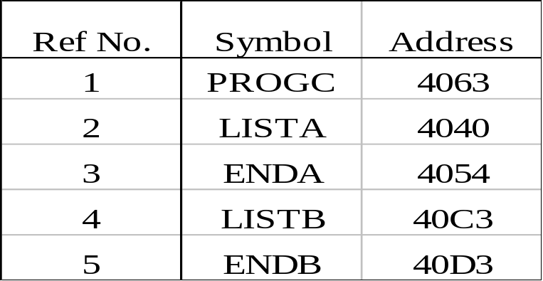
Fig. 3.12 (3/3)

Slide 40
3.4 – 3.5’s Topics
Machine-Independent Loader Features
  Automatic Library Search
  Loader Options
Loader Design Options
  Linking Editors
  Dynamic Linking
  Bootstrap Loader
Implementation Examples
  MS-DOS Linker
  SunOS Linkers
  Cray MPP Linker

Slide 41
Automatic Library Search (1/2)
Automatic library call
  The programmer does not need to take any action beyond mentioning the subroutine names as external references
Solution
  Enter the symbols from each Refer record into ESTAB
  When the definition is encountered (Define record), the address is assigned
  At the end of Pass 1, the symbols in ESTAB that remain undefined represent unresolved external references
  The loader searches the libraries specified (or standard) for undefined symbols or subroutines

Slide 42
Automatic Library Search (2/2)
The library search process may be repeated
  Since the subroutines fetched from a library may themselves contain external references
Programmer defined subroutines have higher priority
  The programmer can override the standard subroutines in the library by supplying their own routines
Library structures
  Assembled or compiled versions of the subroutines in a library can be structured using a directory that gives the name of each routine and a pointer to its address within the library

Slide 43
Loader Options (1/2)
Many loaders have a special command language that is used to specify options
  A separate input file
  Source program
  Embedded in the primary input stream between programs
Command Language
  Specifying alternative sources of input
    INCLUDE program-name(library-name)
  Changing or deleting external reference
    DELETE name
    CHANGE symbol1, symbol2
  Controlling the automatic library search
    LIBRARY MYLIB

Slide 44
Loader Options (2/2)
  Specify that some references not be resolved
    NOCALL name
  Specify the location at which execution is to begin
Example
  If we would like to evaluate the use of READ and WRITE instead of RDREC and WRREC, for a temporary measure, we use the following loader commands
    INCLUDE READ(UTLIB)
    INCLUDE WRITE(UTILB)
    DELETE RDREC, WRREC
    CHANGE RDREC, READ
    CHANGE WRREC, WRITE
  If it is know that the statistical analysis is not to be performed in an execution
    NOCALL STDDEV, PLOT, CORREL

Slide 45
Loader Design Options
Linkage Editors
Dynamic Linking
Bootstrap Loaders

Slide 46
Linkage Editors (1/3)
Definition
  A linkage editor produces a linked version of the program (often called a load module or an executable image) which is written to a file or a library for later execution
Procedure
  A linkage editor performs relocation of all control sections relative to the start of the linked program, resolves all external reference, and output a relocatable module for later execution
A simple relocating loader can be used to load the program into memory (one-pass without external symbol table)

Slide 47
Linkage Editors (2/3)
Other functions
  Produce core image if actual address is known in advance
  Improve a subroutine (PROJECT) of a program (PLANNER) without going back to the original versions of all of the other subroutines
      INCLUDE PLANNER(PROGLIB)
      DELETE PROJECT {delete from existing PLANNER}
      INCLUDE PROJECT(NEWLIB) {include new version}
      REPLACE PLANNER(PROGLIB)
    External references are retained in the linked program

Slide 48
Linkage Editors (3/3)
  Build packages of subroutines or other control sections THAT ARE GENERALLY USED TOGETHER
    Example
      INCLUDE READR(FTNLIB)
      INCLUDE WRITER(FTNLIB)
      INCLUDE BLOCK(FTNLIB)
      INCLUDE DEBLOCK(FTNLIB)
      INCLUDE ENCODE(FTNLIB)
      INCLUDE DECODE(FTNLIB)
      …
      SAVE FTNIO(SUBLIB)
  Specify that external references are not to be resolved by automatic library search

Slide 49
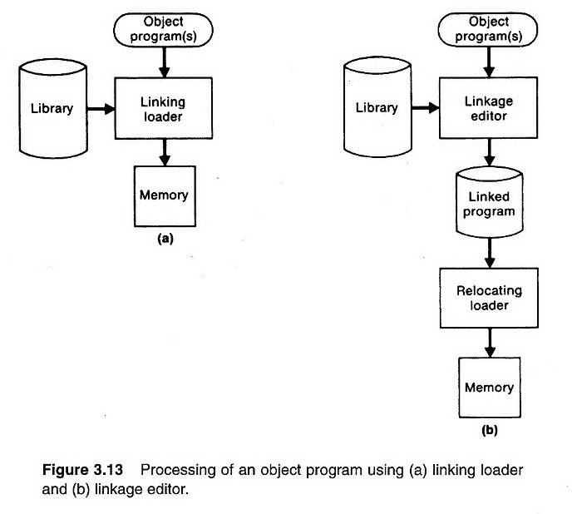
Linking Loader vs. Linkage Editor (1/2) (Fig. 3.13)

Slide 50
Linking Loader vs. Linkage Editors (2/2)
Comparison
  Linking Loader: performs all linking and relocation operations, including library search if specified, and loads the linked program directly into memory for execution
  Linkage Editors: produces a linked version of the program (often called a load module or an executable image), which is written onto a file or library for later execution
  Resolution of external reference and library searching are only performed once for linkage editor
    If a program is to be executed many times without being reassembled, the use of a linkage editor substantially reduces the overhead required.
    If a program is under development or is used infrequently, the use of a linking loader outperforms a linkage editor

Slide 51
Dynamic Linking (1/2)
Comparison
  Linkage editors perform linking operations before the program is loaded for execution
  Linking loaders perform linking operations at load time
  Dynamic linking (dynamic loading, load on call) perform linking at execution time
Delayed Binding
  Avoid the necessity of loading the entire library for each execution, i.e. load the routines only when they are needed
  Allow several executing programs to share one copy of a subroutine or library (Dynamic Link Library, DLL)

Slide 52
Dynamic Linking (2/2)
Via an OS
  Dynamic loader is one part of the OS
  Instead of executing a JSUB instruction that refers to an external symbol, the program makes a load-and-call service request to the OS
  Pass of control
    User program → OS
    OS: load the subroutine
    OS → Subroutine
    Subroutine → OS
    OS → User program

Slide 53
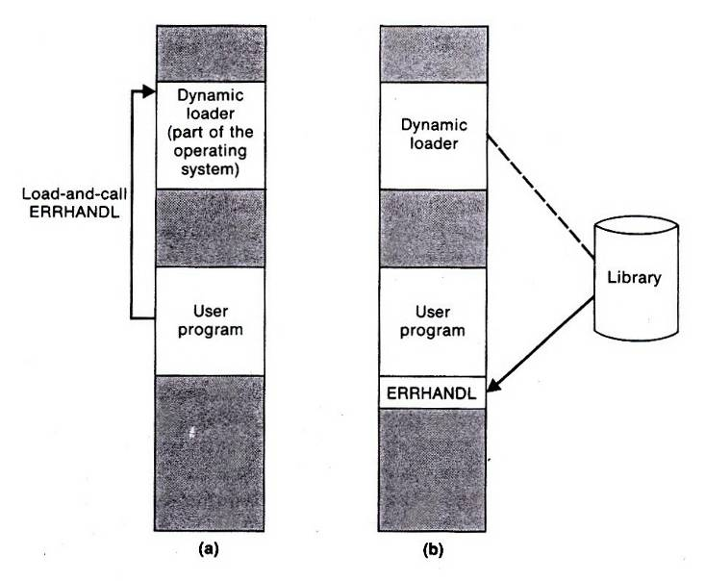
Fig. 3.14 (1/2)

Slide 54
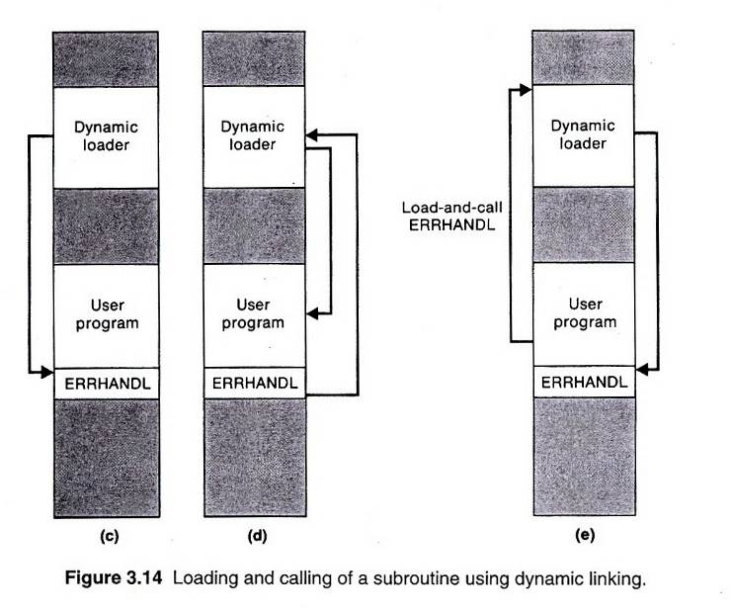
Fig. 3.14 (2/2)

Slide 55
Bootstrap Loaders
Absolute loader
  One some computers, an absolute loader program is permanently resident in a read-only memory ROM
  One some computers, there’s a built-in hardware which read a fixed-length record from some device into memory at a fixed location. After the read operation, control is automatically transferred to the address in memory

Slide 56
Implementation Example -- MS-DOS
MS-DOS assembler (MASM) produce object modules (.OBJ)
MS-DOS LINK is a linkage editor that combines one or more modules to produce a complete executable program (.EXE)
MS-DOS object module
  THEADER similar to Header record in SIC/XE
  MODEND similar to End record in SIC/XE

Slide 57
MS-DOS object module
  TYPDEF data type
  PUBDEF similar to Define record in SIC/XE
  EXTDEF similar to Reference record in SIC/XE
  LNAMES contain a list of segments and class names
  SEGDEF segment define
  GRPDEF specify how segments are grouped
  LEDATA similar to Text Record in SIC/XE
  LIDATA specify repeated instructions
  FIXUPP similar to Modification record in SIC/XE

Slide 58
Repeated Instruction
Suppose that the SIC assembler language is changed to include a new form of the RESB statement, such as
  RESB n‘c’
which reserves n bytes of memory and initializes all of these bytes to the character ‘c’. For example
BUFFER RESB 4096‘ ’
This feature could be implemented by simply generating the required number of bytes in Text records. However, this could lead to a large increase in the size of the object program.

Slide 59
LINK
Pass 1
  Compute a starting address for each segment in the program
    Segment from different object modules that have the same segment name and class are combined
    Segments with the same class, but different names are concatenated
    A segment’s starting address is updated as these combinations and concatenations are performed
Pass 2
  Extract the translated instructions from the object modules
  Build an image of the executable program in memory
  Write it to the executable (.EXE) file

Slide 60
SunOS Linkers
Link-editor
  Relocatable object module, for further link-editing
  Static executable, ready to run
  Dynamic executable, some symbolic references need to be bound at run time
  Shared object, services that can be bound at run time to dynamic executables
Run-time linker

Slide 61
Run-Time Linker
Locate and include necessary shared objects
Lazy binding
  Binding of procedure calls is normally deferred until the program is in execution
Reduce the amount of overhead required for starting a program

