Slide 1
CS2422 Assembly Language & System Programming
Chapter 4 : Macro Processors

Slide 2
4.1’s Topics
Basic Macro Processor Functions
  Macro definition and expansion
  Macro processor tables and logic

Slide 3
Introduction
Concept
  A macro instruction is a notational convenience for the programmer
  It allows the programmer to write shorthand version of a program (module programming)
  The macro processor replaces each macro invocation with the corresponding sequence of statements (expanding)

Slide 4
Macro Processor
Recognize macro definitions
Save the macro definition
Recognize macro calls
Expand macro calls
Source Code
(with macro)
Macro Processor
Expanded Code
Compiler or Assembler
obj

Slide 5
Macro Definition
Two new assembler directives
  MACRO
  MEND
A pattern or prototype for the macro instruction
  Macro name and parameters

Slide 6
Macro Invocation and Expansion
Often referred to as a macro call
  Need the name of the macro instruction begin invoked and the arguments to be used in expanding the macro
Expanded program
  No macro instruction definitions
  Each macro invocation statement has been expanded into the statements that form the body of the macro, with the arguments from the macro invocation substituted for the parameters in the prototype
Fig. 4.1, Fig. 4.2

Slide 7
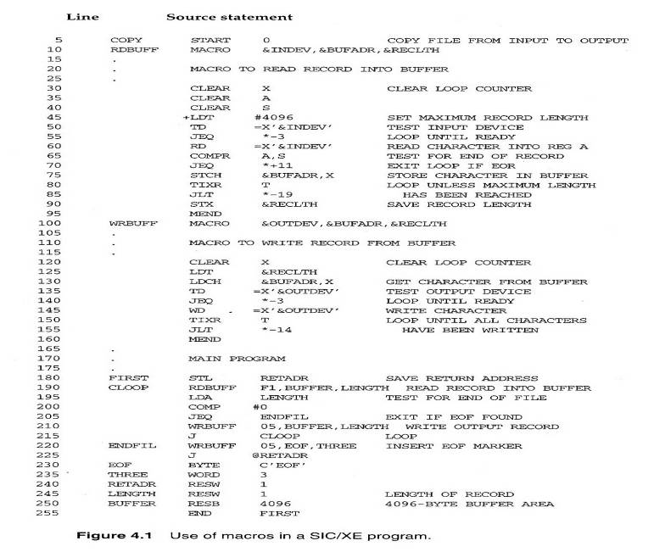
Fig. 4.1

Slide 8
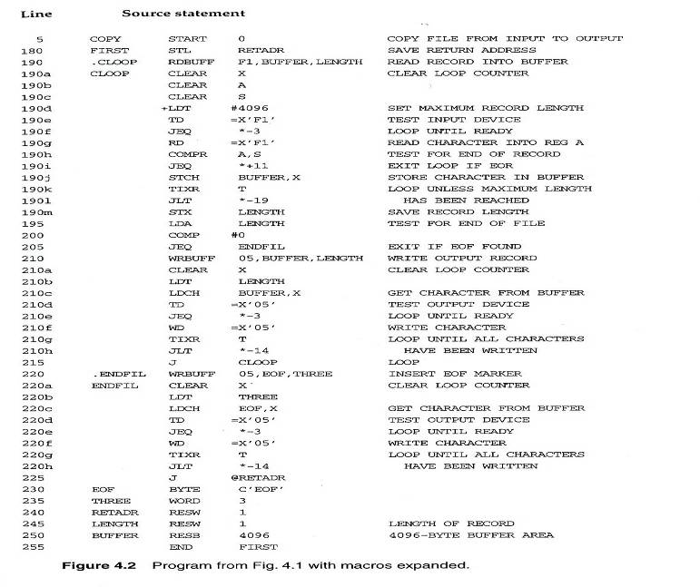
Fig. 4.2

Slide 9
Macro vs. Subroutine
Macro
  The statement of expansion are generated each time the macro are invoked
Subroutine
  The statement in a subroutine appears only once

Slide 10
Macro Processor Algorithm and Data Structures (1/3)
It is easy to design a two-pass macro processor
  Pass 1:
    All macro definitions are processed
  Pass 2:
    All macro invocation statements are expanded
However, a two-pass macro processor would not arrow the body of one macro instruction to contain definitions of other macros
  See Figure 4.3

Slide 11
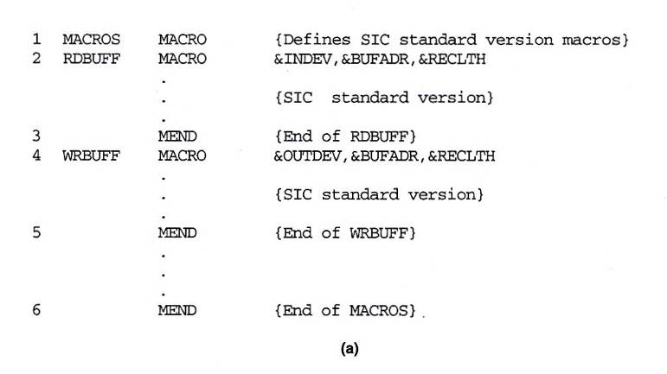
Fig. 4.3(a)

Slide 12
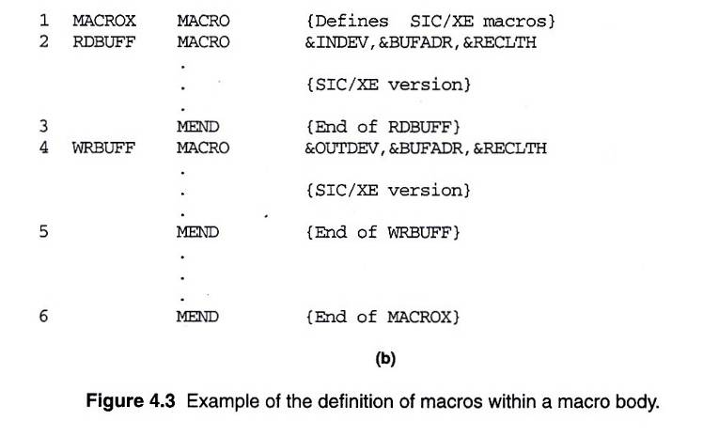
Fig. 4.3(b)

Slide 13
Macro Processor Algorithm and Data Structures (2/3)
Sub-Macro definitions are only processed when an invocation of their Super-Macros are expanded
  See Fig. 4.3: RDBUFF
A one-pass macro processor that can alternate between macro definition and macro expansions able to handle macros like those in Fig. 4.3

Slide 14
Macro Processor Algorithm and Data Structures (3/3)
Because of the one-pass structure, the definition of a macro must appear in the source program before any statements that invoke that macro
Three main data structures involved in an one-pass macro processor (Global variable)
  DEFTAB, NAMTAB, ARGTAB
  Fig. 4.4

Slide 15
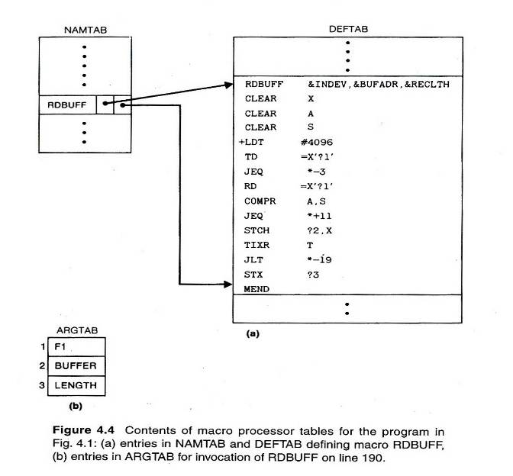
Fig. 4.4

Slide 16
One-Pass Macro Processor
Prerequisite
  Every macro must be defined before it is called
Sub-procedures
  Macro definition: DEFINE
  Macro invocation: EXPAND
MACRO
DEFINE
PROCESSLINE
CALL
EXPAND

Slide 17
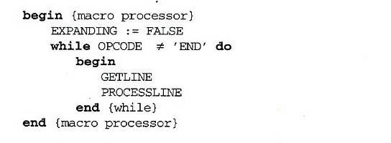
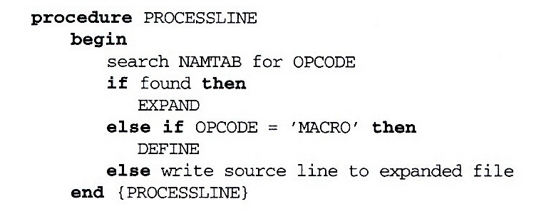
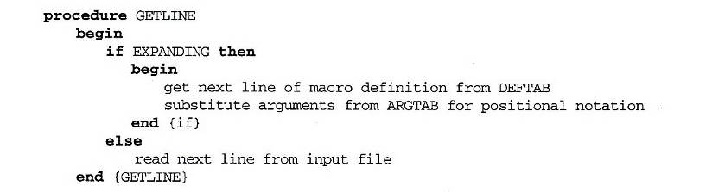
Fig. 4.5 (1/2)

Slide 18
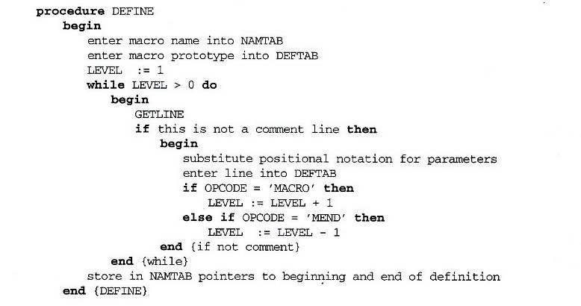
Fig. 4.5 (2/2)

Slide 19
One-Pass Macro Processor That Allows Nested Macro Definition
Sub-procedures
  Macro definition: DEFINE
  Macro invocation: EXPAND
EXPAND may invoke DEFINE when encounter macro definition
NAMTAB
DEFINE
MACRO
DEFTAB
PROCESSLINE
CALL
EXPAND
ARGTAB
Expanding
MACRO Definition

Slide 20
Comparison of Macro Processors Design
Single pass
  Every macro must be defined before it is called
  One-pass processor can alternate between macro definition and macro expansion
  Nested macro definitions may be allowed but nested calls are not
Two pass algorithm
  Pass1: Recognize macro definitions
  Pass2: Recognize macro calls
  Nested macro definitions are not allowed

Slide 21
4.2 – 4.3’s Topics
Machine-Independent Macro Processor Features
  Concatenation of macro parameters
  Generation of unique labels
  Conditional macro expansion
  Keyword macro parameters
Macro Processor Design Options
  Recursive macro expansion
  Macro processing within language translators

Slide 22
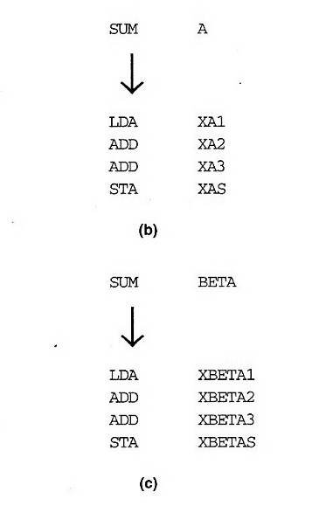
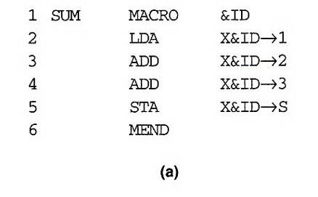
Concatenation of Macro Parameters
Pre-concatenation
  LDA X&ID1
Post-concatenation
  LDA X&ID→1
Example: Fig. 4.6

Slide 23
Generation of Unique Labels
Example
  JEQ *-3
  inconvenient, error-prone, difficult to read
Example Fig. 4.7
    $LOOP TD =X’&INDEV’
  1st call:
    $AALOOP TD =X’F1’
  2nd call:
    $ABLOOP TD =X’F1’

Slide 24
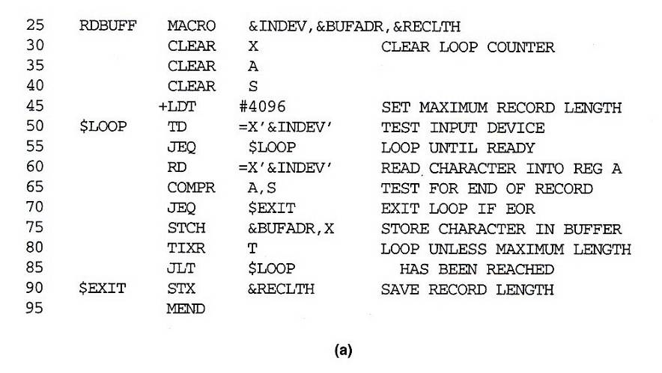
Fig. 4.7(a)

Slide 25
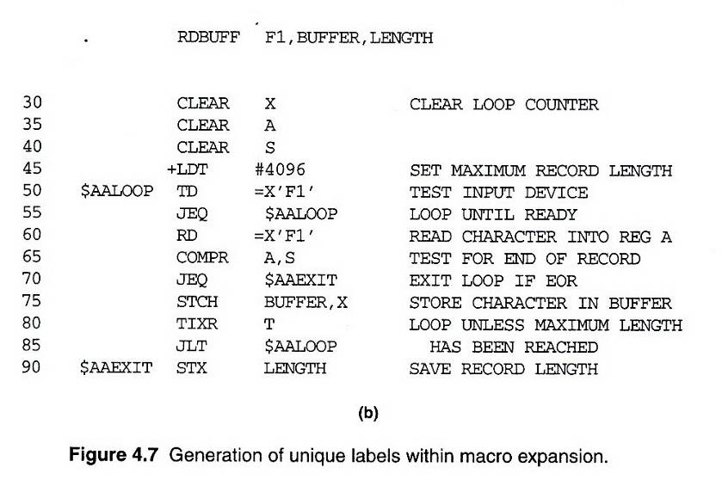
Fig. 4.7(b)

Slide 26
Conditional Macro Expansion (1/2)
Macro-time conditional statements
  Example: Fig. 4.8
  IF-ELSE-ENDIF
Macro-time variables
  Any symbol that begins with the character & and that is not a macro parameter
  Macro-time variables are initialized to 0
  Macro-time variables can be changed with their values using SET
    &EORCK SET 1

Slide 27
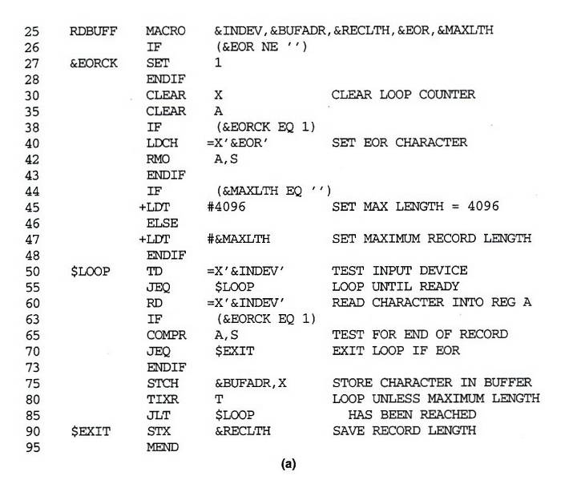
Fig. 4.8(a)

Slide 28
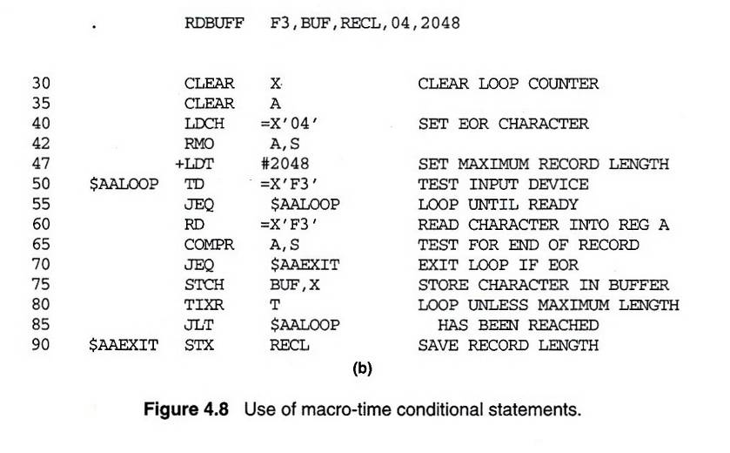
Fig. 4.8(b)

Slide 29
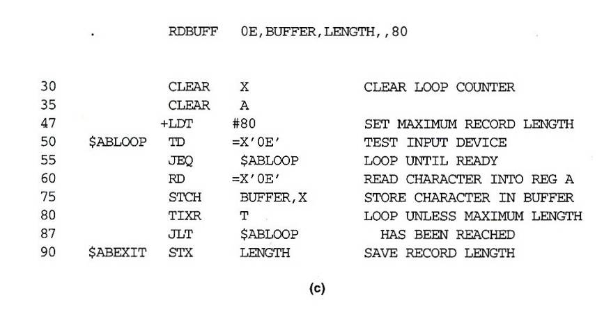
Fig. 4.8(c)

Slide 30
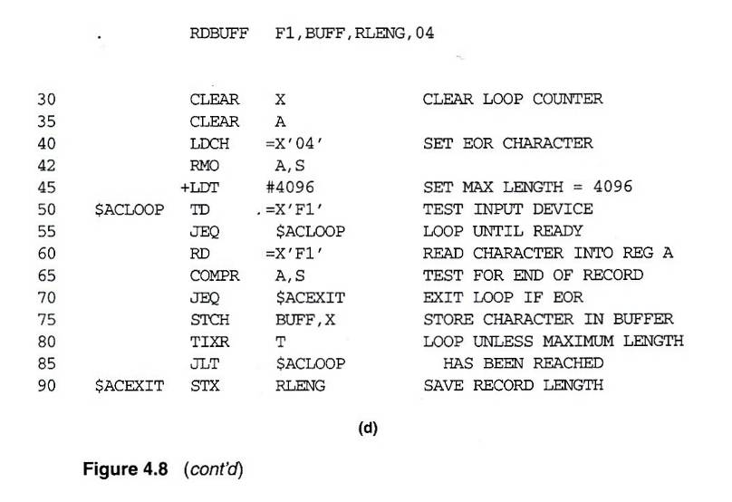
Fig. 4.8(d)

Slide 31
Conditional Macro Expansion (2/2)
Macro-time looping statement
  Example: Fig. 4.9
  WHILE-ENDW
Macro processor function
  %NITEMS: The number of members in an argument list

Slide 32
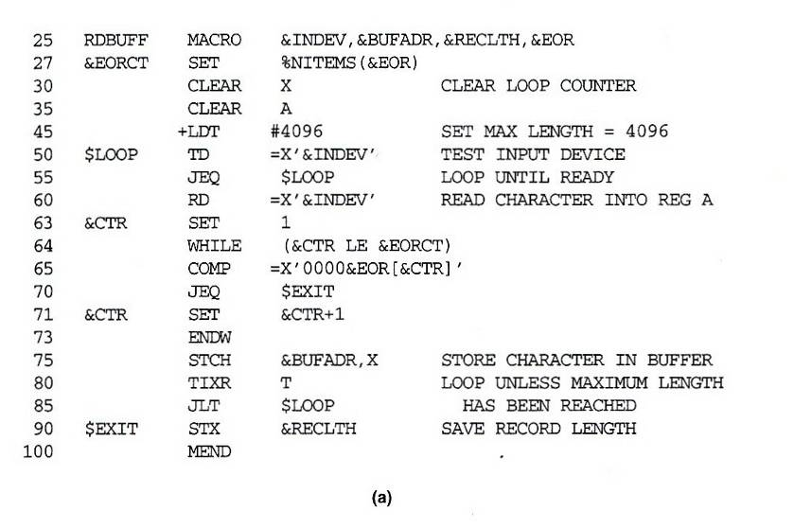
Fig. 4.9(a)

Slide 33
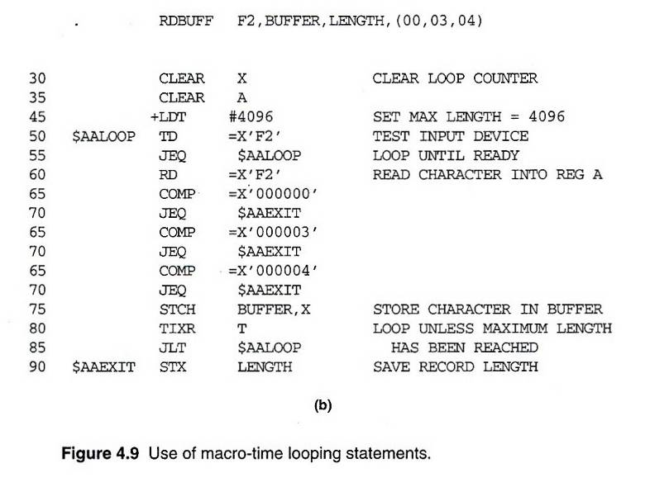
Fig. 4.9(b)

Slide 34
Keyword Macro Parameters (1/2)
Positional parameters
  Parameters and arguments were associated with each other according to their positions in the macro prototype and the macro invocation statement
  Consecutive commas is necessary for a null argument
    GENER ,,DIRECT,,,,,,3

Slide 35
Keyword Macro Parameters (2/2)
Keyword parameters
  Each argument value is written with a keyword that names the corresponding parameter
  A macro may have a large number of parameters , and only a few of these are given values in a typical invocation
    GENER TYPE=DIRECT, CHANNEL=3
  See Fig. 4.10

Slide 36
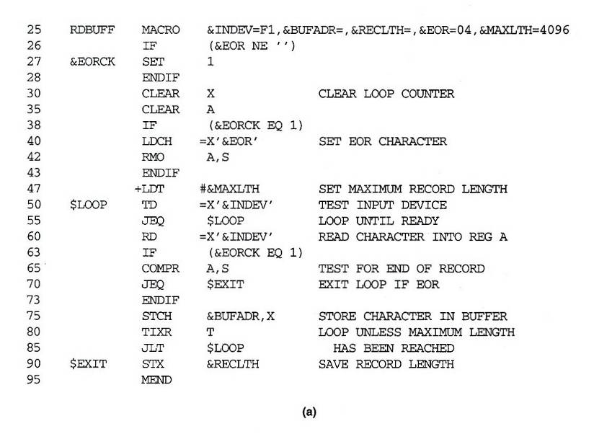
Fig. 10(a)

Slide 37
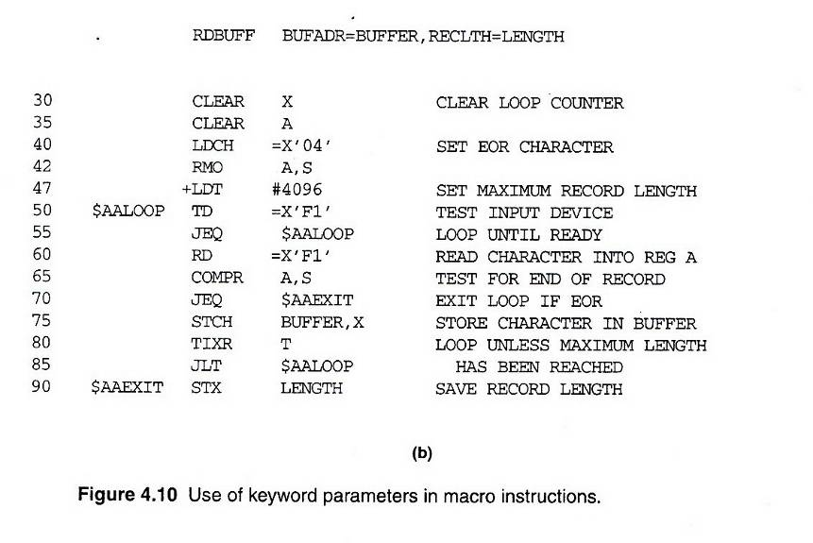
Fig. 10(b)

Slide 38
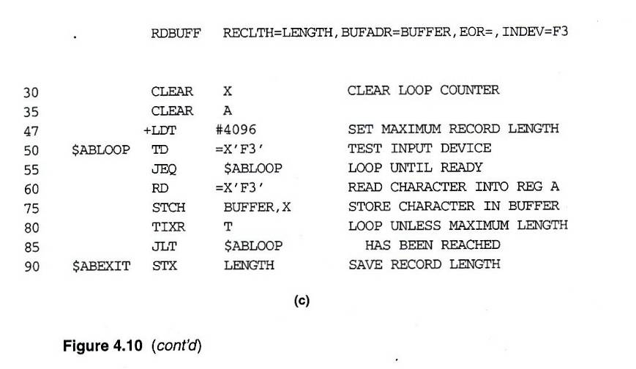
Fig. 10(c)

Slide 39
Nested Macro Invocations
Macro invocations within macros
  Process macro invocation during expansion time
Recursive macro expansion
  Example: Fig. 4.11
  Problems:
    ARGTAB
    EXPANDING
  Solution
    Recursive call (programming language supports)
    While loop with stack

Slide 40
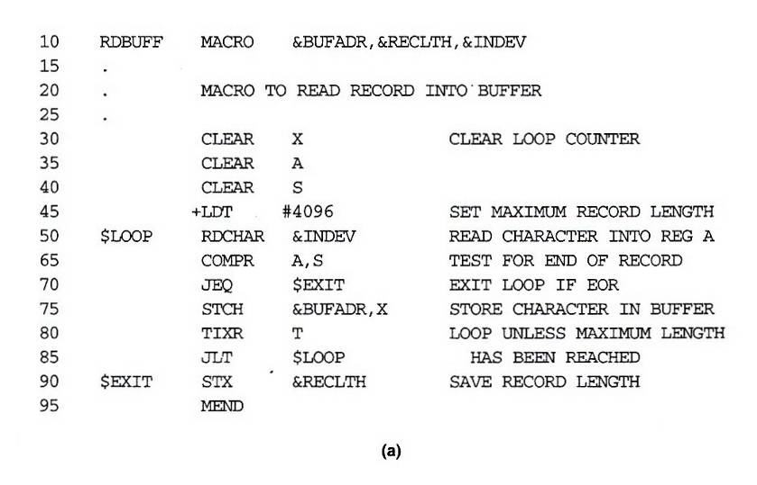
Fig. 4.11(a)

Slide 41
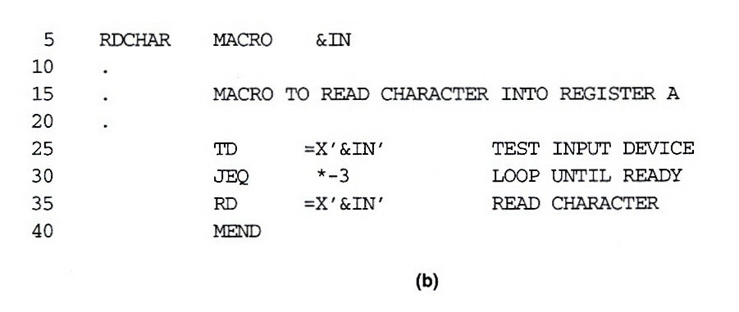
Fig. 4.11(b)

Slide 42
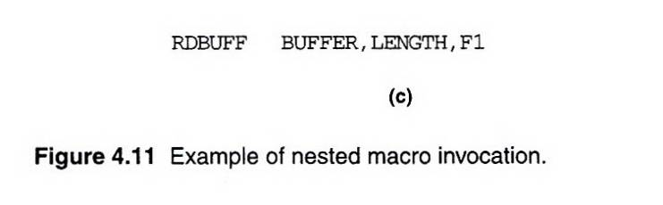
Fig. 4.11(c)
Parameter Value
---------------------------------
1 BUFFER
2 LENGTH
3 F1
4 (unused)
. .
---------------------------------
Parameter Value
---------------------------------
1 F1
2 (unused)
. .
---------------------------------

Slide 43
General-Purpose Macro Processors (1/6)
Macro processors have been developed for some high-level programming languages
These special-purpose macro processors are similar in general function and approach; however, the details differ from language to language

Slide 44
General-Purpose Macro Processors (2/6)
The advantages of such a general-purpose approach to macro processing are obvious
  The programmer does not need to learn about a different macro facility for each compiler or assembler language, so much of the time and expense involved in training are eliminated
  A substantial overall saving in software development cost

Slide 45
General-Purpose Macro Processors (3/6)
In spite of the advantages noted, there are still relatively few general-purpose macro processors. Why?
  In a typical programming language, there are several situations in which normal macro parameter substitution should no occur
    E.g. comments should usually be ignored by a macro processor

Slide 46
General-Purpose Macro Processors (4/6)
  Another difference between programming languages is related to their facilities for grouping together terms, expressions, or statements
    E.g. Some languages use keywords such as begin and end for grouping statements. Others use special characters such as { and }.

Slide 47
General-Purpose Macro Processors (5/6)
  A more general problem involves the okens of the programming language
    E.g. identifiers, constants, operators, and keywords
    E.g. blanks

Slide 48
General-Purpose Macro Processors (6/6)
  Another potential problem with general-purpose macro processors involves the syntax used for macro definitions and macro invocation statements. With most special-purpose macro processors, macro invocations are very similar in form to statements in the source programming language

Slide 49
4.4’s Topics
Implementation Examples
  MASM Macro Processor
  ANSI C Macro Language
  The ELENA Macro Processor

Slide 50
Macro-Assembler
Advantage
  Reduce 1 pass
  Share same data structure
Disadvantage
  More complex

Slide 51
Pass 1
READ
Search
(Pseudo-Op Table)
Pass 2
R
Type?
Search NAMTAB
(Macro Name Table)
MACRO
Define
Process
pseudo-ops
Search
(Machine Op Table)
R
R
MACRO
Expand
Process machine instruction
R
R

Slide 52
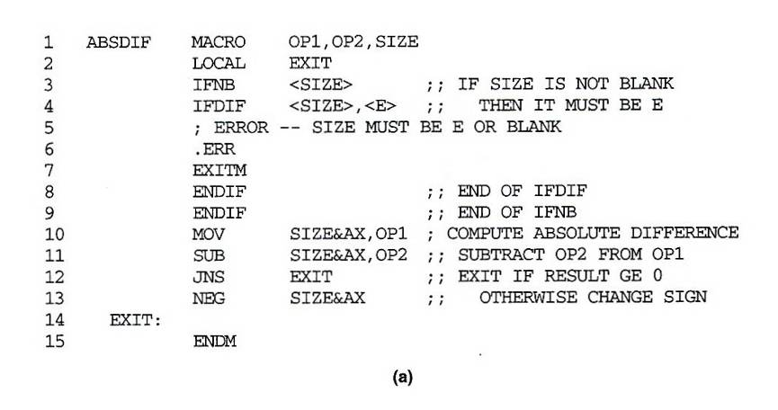
MASM Macro Processor (1/3)
Examples of MASM macro and conditional statements

Slide 53
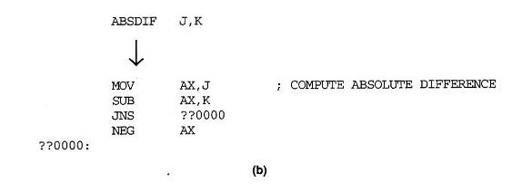
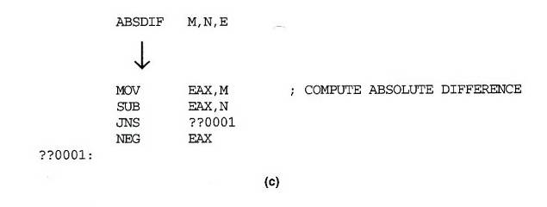
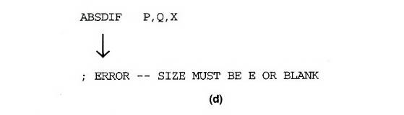
MASM Macro Processor (2/3)

Slide 54
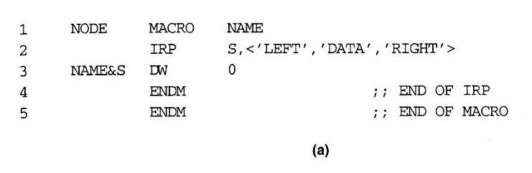
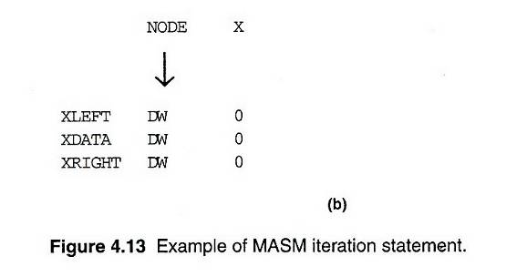
MASM Macro Processor (3/3)
Example of MASM iteration statement

Slide 55
ANSI C Macro Language (1/3)
Simple examples:
  #define NULL 0
  #define EOF (-1)
  #define EQ ==
Macro defined with parameters
  #define ABSDIFF( X, Y ) ( (X) > (Y) ? (X) – (Y) : (Y) – (X) )
  ABSDIFF( I+1, J–5 ) ➔
  ( ( I+1) > (J-5) ? (I+1) : (J-5) : (J-5) – (I+1) )
  #define ABSDIFF( X, Y ) X > Y ? X – Y : Y – X
  ABSDIFF( 3+1, 10-8 ) ➔
  3 + 1 > 10 – 8 ? 3 + 1 – 10 – 8 : 10 – 8 – 3 + 1

Slide 56
ANSI C Macro Language (2/3)
Parameter substitutions are not performed within quoted strings
  #define DISPLAY(EXPR) printf( “EXPR = %d\n”, EXPR )
  DISPLAY( I*J+1 )
  printf( “EXPR = %d\n”, I*J+1 )
Special “stringizing” operator #
  #define DISPLAY(EXPR) printf( #EXPR “= %d\n”, EXPR )
  DISPLAY( I*J+1 )
  printf( “I*J+1” “ = %d\n”, I*J+1 )

Slide 57
ANSI C Macro Language (3/3)
Macro within macro
  DISPLAY( ABSDIFF( 3, 8 ) )
  → printf( “ABSDIFF( 3, 8 ) )” “= %d\n”, ABSDIFF( 3, 8 ) )
  → printf( “ABSDIFF( 3, 8 ) )” “= %d\n”,
  ( (3) > (8) ? (3) – (8) : (8) – (3) ) )
Conditional macro
  #ifnedf BUFFER_SIZE
  #define BUFFER_SIZE 1024
  #endif
  #define DEBUG 1
  …
  #if DEBUG == 1
  printf( … ); // debugging output
  #endif

Slide 58
General Purpose Macro Processor (1/2)
ELENA
  Software: Practice and Experience, Vol. 14, pp. 519-531, Jun. 1984
Macro definition
  Header:
    A sequence of keywords and parameter markers (%)
    At least one of the first two tokens in a macro header must be a keyword, not a parameter marker
  Body:
    The character & identifies a local label
    Macro time instruction (.SET, .IF .JUMP, .E)
    Macro time variables or labels (.)

Slide 59
General Purpose Macro Processor (2/2)
Macro invocation
  There is no single token that constitutes the macro “name”
  Constructing an index of all macro headers according to the keywords in the first two tokens of the header
  Example
    DEFINITION:
      %1 = %2 + %3
      ALPHA = BETA + GAMMA
      ADD %1 TO THE FIRST ELEMENT OF %2
      ADD 10 TO THE VALUE OF INDEX
    INVOCATION:
      DISPLAY TABLE
DISPLAY %1
%1 TABLE

Slide 60
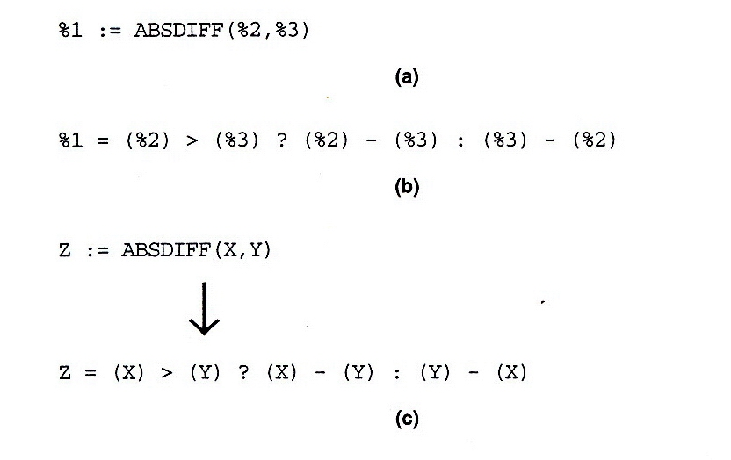
Fig. 4.14 (1/2)

Slide 61
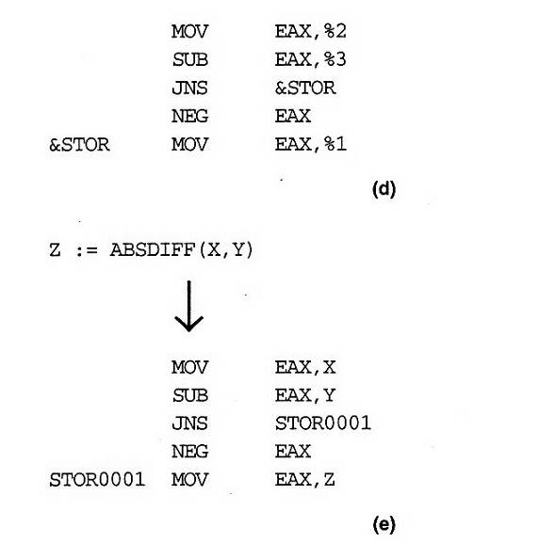
Fig. 4.14 (2/2)

Slide 62
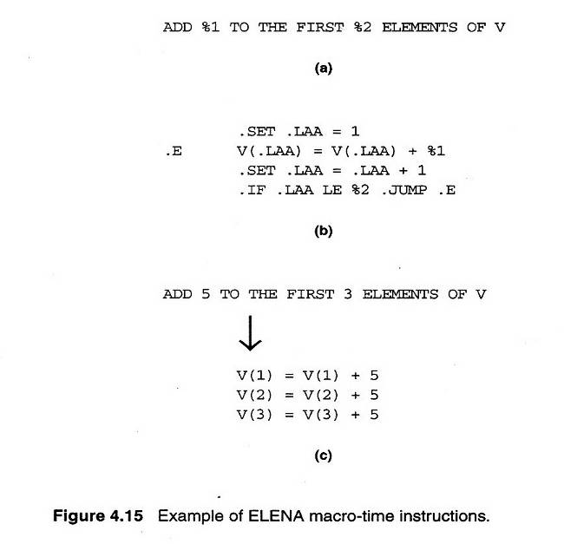
Fig. 4.15

